Slide 1

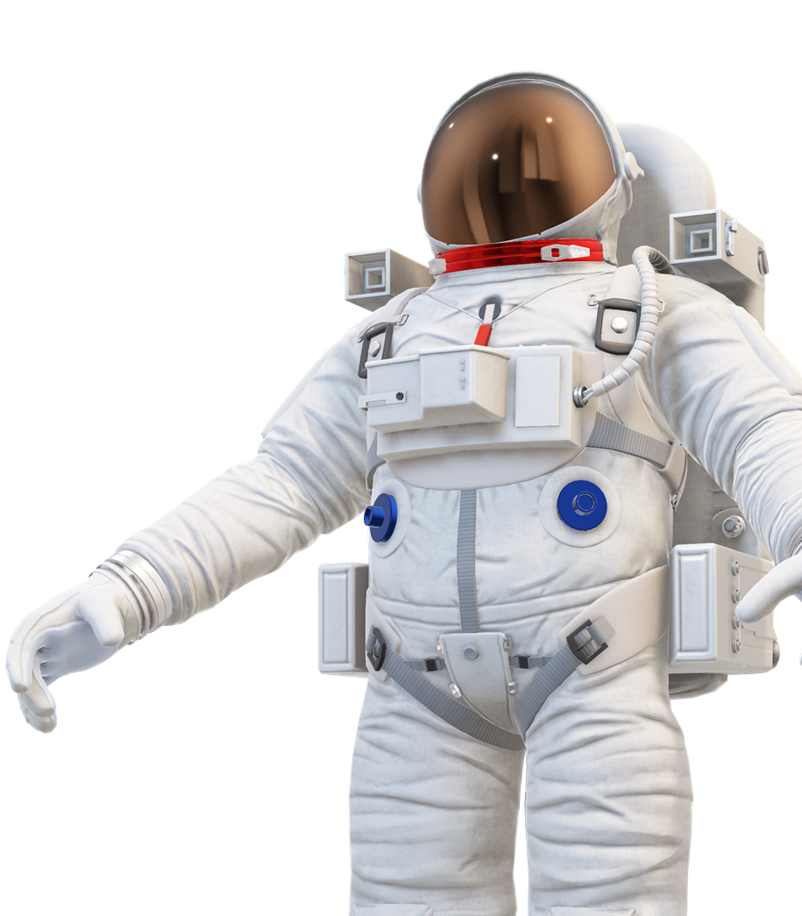
Radiography for in-flight health assessment during space missions: a new field for medical physics?
Laura Antonia Cerbone
lauraantonia.cerbone-ssm@unina.it
IEEE NPSS Prague EduCom International Summer School (PEISS) 2025

Slide 2





5 Hazards of human spaceflight
Space Radiation
Gravity
(or lack thereof)
Isolation and Confinement
Hostile/Closed Environments
Distance from Earth

Slide 3
5 Hazards of human spaceflight
Gravity (or lack thereof)
Space Radiation
Cephalad fluid shift
Increased intracranial and intraocular pressure
Space anemia (reduction of blood volume)
Cardiac atrophy
Orthostatic syndrome
Muscle atrophy
Bone loss
Space Motion Sickness
Isolation and Confinement
Hostile/Closed Environments
Distance from Earth

Slide 4
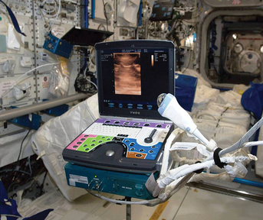
Medical imaging in space: Ultrasounds
ISS medical imaging capability is limited to ultrasonography.
US has been utilized in space since 1982
(Salyut 6 space station)
Today onboard the ISS: Ultrasound II system
(Vivid q, General Electric, USA), launched in 2012.
Diagnostic relevance for several conditions
Bone (surface) and muscle imaging
Venous thrombosis
Cardiovascular health assessment
Abdominal and genitourinary conditions
Ocular examination
Decompression sickness.
Ultrasound II system (Vivid q, General Electric, USA) onboard the ISS

Slide 5
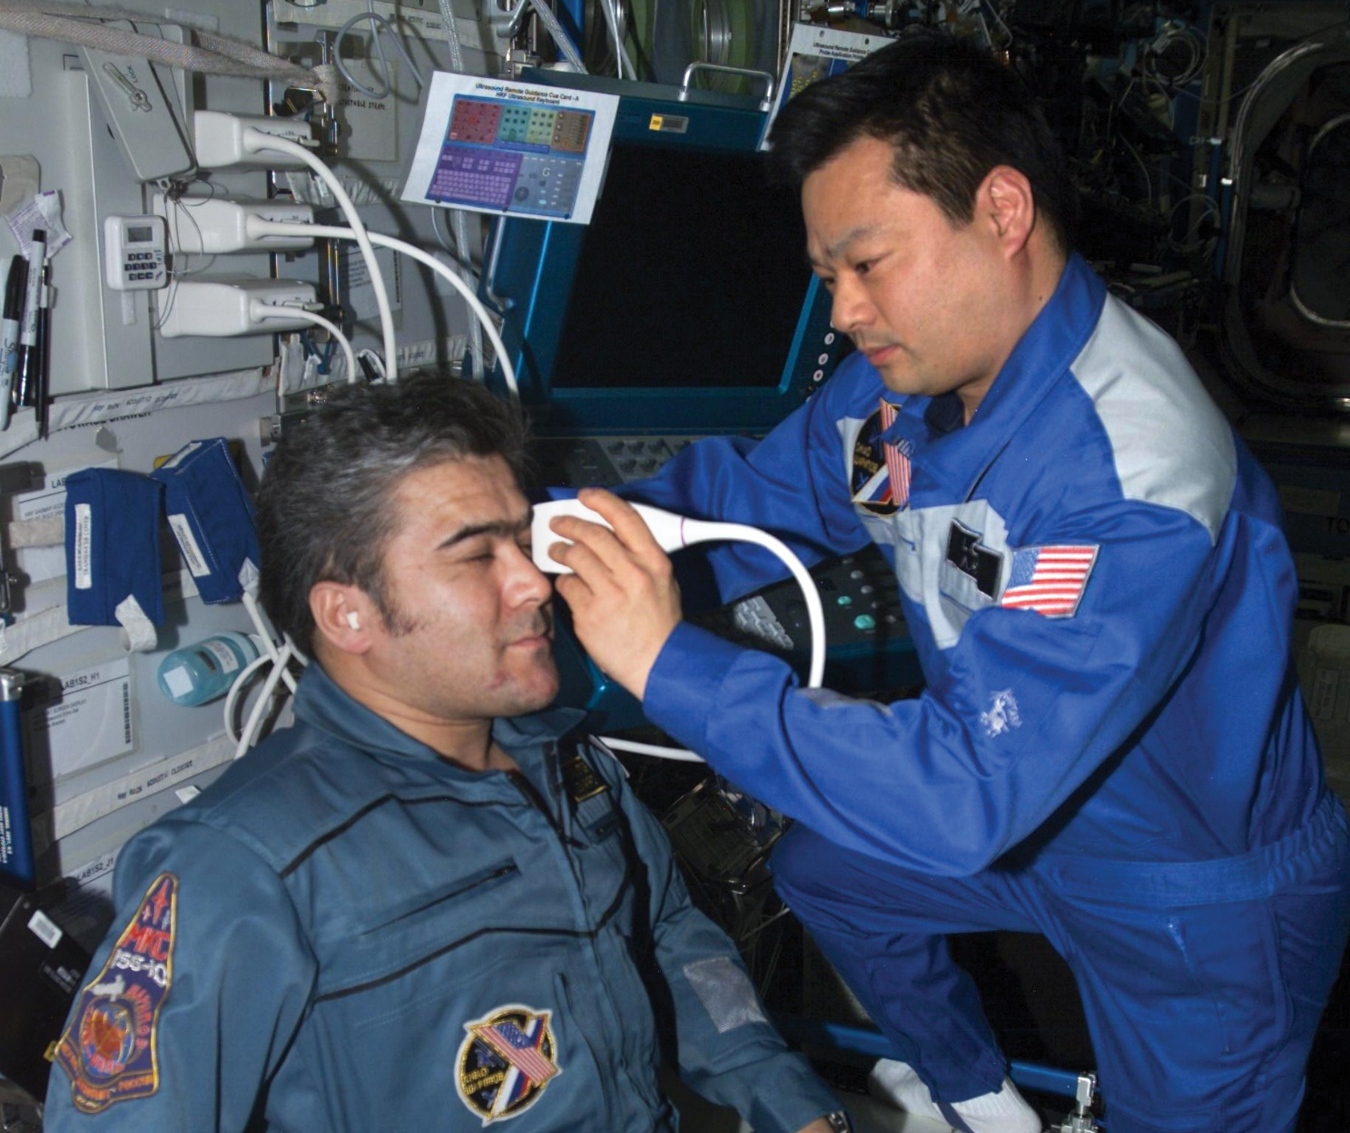
Medical imaging in space: Ultrasounds
ISS medical imaging capability is limited to ultrasonography.
US has been utilized in space since 1982
(Salyut 6 space station)
Today onboard the ISS: Ultrasound II system
(Vivid q, General Electric, USA), launched in 2012.
Diagnostic relevance for several conditions
Bone (surface) and muscle imaging
Venous thrombosis
Cardiovascular health assessment
Abdominal and genitourinary conditions
Ocular examination
Decompression sickness.
Astronauts performing an ocular ultrasonography.

Slide 6

Medical imaging in space: Ultrasounds
ISS medical imaging capability is limited to ultrasonography.
US has been utilized in space since 1982
(Salyut 6 space station)
Today onboard the ISS: Ultrasound II system
(Vivid q, General Electric, USA), launched in 2012.
Diagnostic relevance for several conditions
Bone (surface) and muscle imaging
Venous thrombosis
Cardiovascular health assessment
Abdominal and genitourinary conditions
Ocular examination
Decompression sickness.
Ultrasonography has some limitations
It is highly operator-dependent
Guidance from Earth is needed
Image interpretation can be challenging

Slide 7
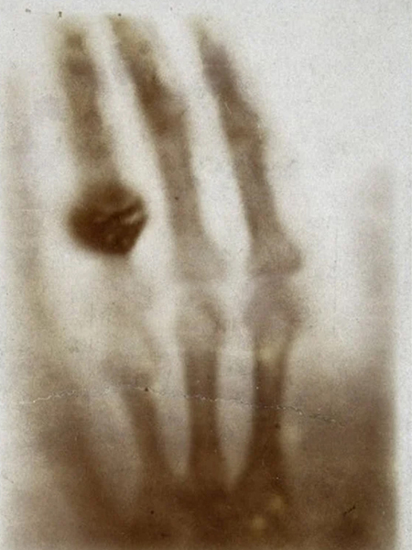
Medical imaging in space: Radiography
Radiography is the most used diagnostic imaging technique on Earth.
NASA Human Research Program scientists are exploring the feasibility of performing X-ray imaging in space.
Diagnostic relevance for several conditions in the space environment
Bone imaging (fractures, dislocations, traumas, etc…)
Dental imaging (abscess, crown loss, fraction, loss)
Acute abdominal conditions
EVA-related injuries
Decompression sickness
Kidney stones
1895 - First medical X-ray image
by Wilhelm Röntgen of his wife’s hand

Slide 8
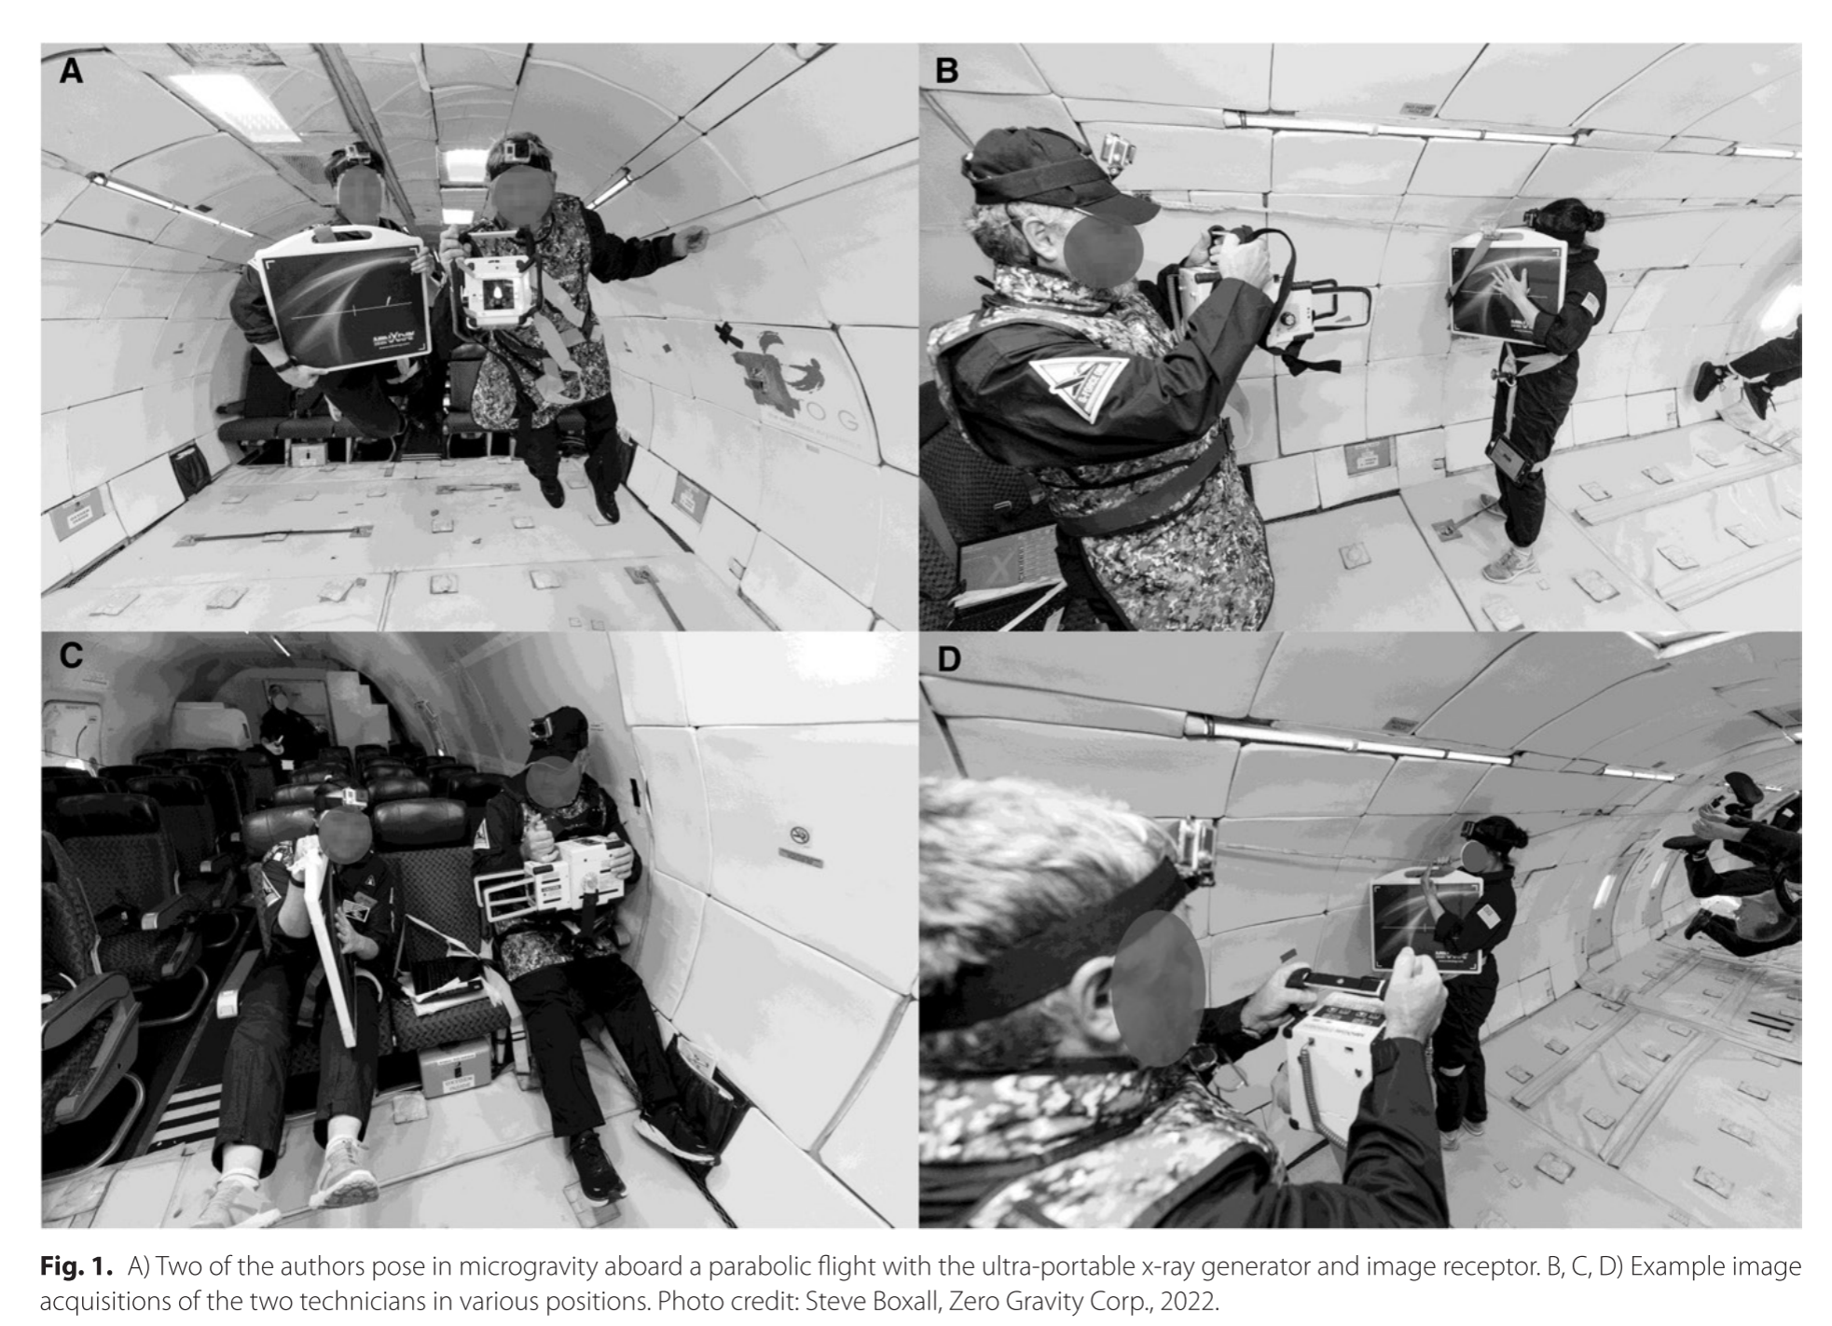
Radiography in microgravity
First tests of radiography in microgravity were performed in 2022 during a parabolic flight.

Slide 9
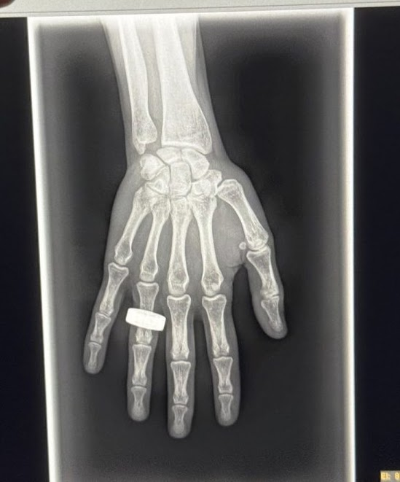
Radiography in Low Earth Orbit
On the 2nd of April 2025, the first radiography in space was acquired by the Fram2 crew during a low Earth orbit flight around the poles, as part of the scientific research program of the mission
This event opens the path for using X-ray imaging devices during space missions.
2025 - First medical X-ray image in space
by Fram2 crew of an astronaut’s hand.
Credits: https://www.spacexray.org/

Slide 10
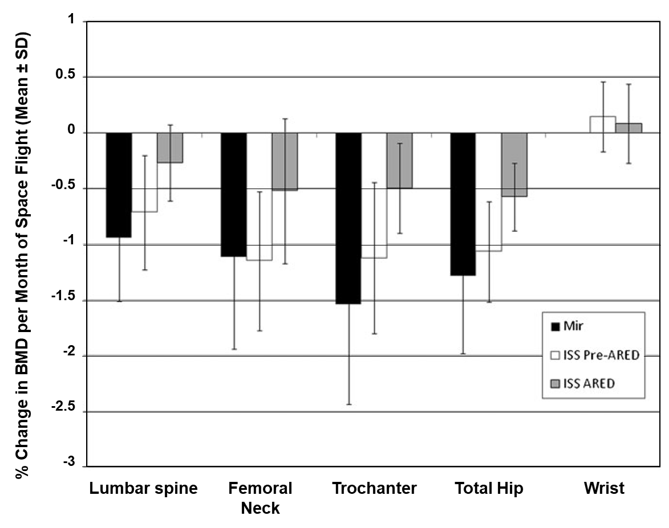
Bone loss in space
Bone loss due to microgravity is a relevant issue for astronaut in space and upon return.
Mineral density in astronaut is monitored before and after the flight.
We propose to design a compact DXA scanner with Timepix4 and a compact X-Ray generator.
Periodic scans to distal tibia to monitor bone density on-mission.
Timepix4 → Spectral imaging
K-edge filtration → Double-energy spectrum
Three CdTe-Timepix4 assemblies
Sensitive area: 21 cm²
FOV: 7 cm x 1.6 cm

Slide 11
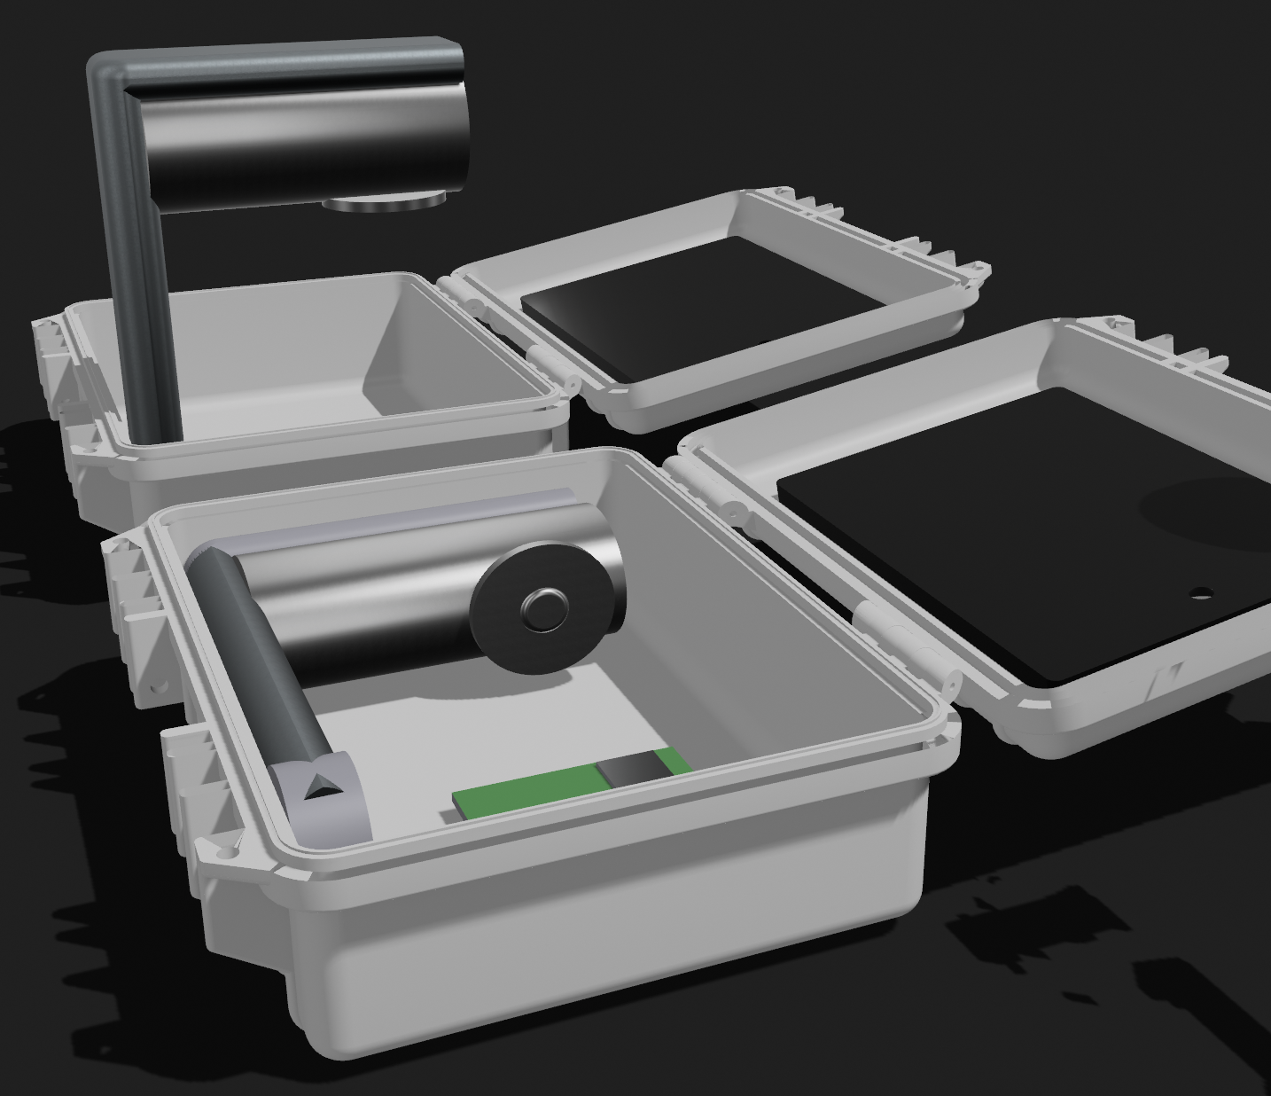
11
X-ray for bone health in space: Dual X-ray Absorptiometry
Bone loss due to microgravity is a relevant issue for astronaut in space and upon return.
Mineral density in astronaut is monitored before and after the flight.
We propose to design a compact DXA scanner with Timepix4 and a compact X-Ray generator.
Periodic scans to distal tibia to monitor bone density on-mission.
Timepix4 → Spectral imaging
K-edge filtration → Double-energy spectrum
Three CdTe-Timepix4 assemblies
Sensitive area: 21 cm²
FOV: 7 cm x 1.6 cm

Slide 12

Thank you!
IEEE NPSS Prague EduCom International Summer School (PEISS) 2025
Laura Antonia Cerbone
lauraantonia.cerbone-ssm@unina.it

Slide 13
DXA4A: a DXA scanner for astronauts
DXA is the golden standard for bone densitometry
Compact device weight < 20 kg, volume < 12 L
Power 240 W (power consumption 10 Wh)
No moving parts
Fast scan (one frame needed only)
No need for recontruction
Results are easy to read and store (aBMD and T-score)
No need for guidance from Earth
Extremely low dose (0.1 μSv, 10 s of exposure to cosmic radiation)
A compact densitometer for rodents flew in space already (Redwire).
(15 x 20 x 40 cm³)

Slide 14
DXA4A: a DXA scanner for astronauts
Other possible uses:
Dental X-ray
Small field of view X-ray imaging
Small object spectral X-ray analysis for research
Timepix4 as an onboard real-time dosimeter
More…?
(15 x 20 x 40 cm³)

Slide 15
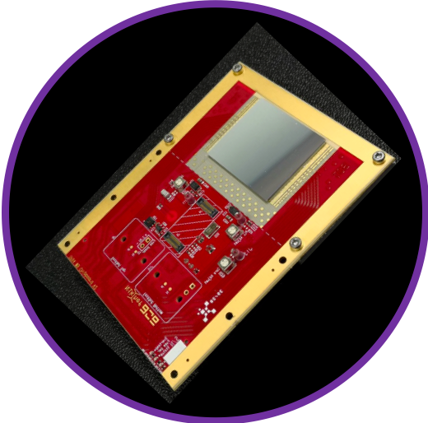



Timepix4 ASIC Hybrid pixel detector readout ASIC
Timepix4 ASIC (448 x 512 square pixels, 0.055 mm pitch).
1 mm or 2 mm thick CdTe sensor (sensitive area of 6.93 cm² ).
4 side buttable (TSV connections)
Spectral imaging and particle tracking
Time Resolution ≈ 200 ps
Energy resolution < 1 keV

