Slide 1
Constant Fraction Discriminator (CFD)
IEEE NPSS Summer School
Jan Jamnik Srpčič, 10. 7. 2025

Slide 2
Averaging across subjects’ responses and ratings from a total of 30,767 trials, 2,420 single-photon events passed post-selection and we found the averaged probability of correct response to be 0.516±0.010 (P=0.0545; Fig. 2a), suggesting that subjects could detect a single photon with a probability above chance. To our knowledge, these experiments provide the first evidence for the direct perception of a single photon by humans.
Tinsley, J., Molodtsov, M., Prevedel, R. et al. Direct detection of a single photon by humans. Nat Commun 7, 12172 (2016). https://doi.org/10.1038/ncomms12172
We could still detect light here!

Slide 3
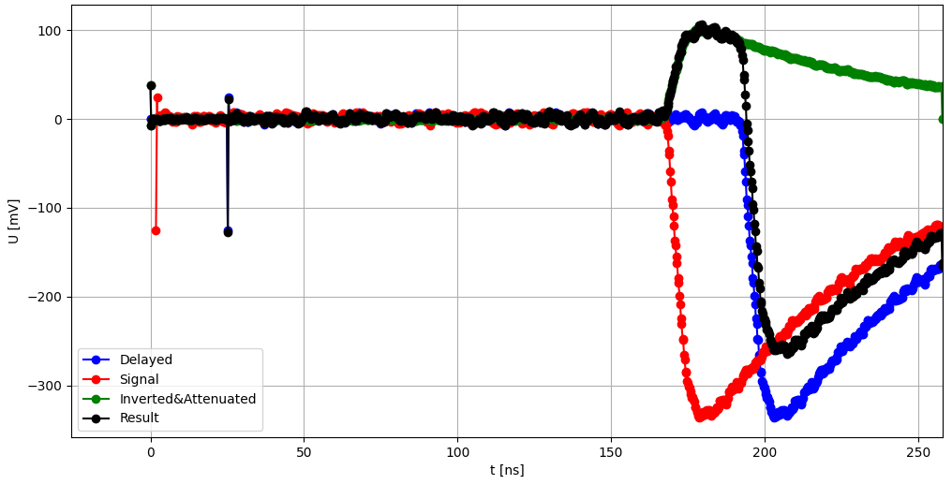
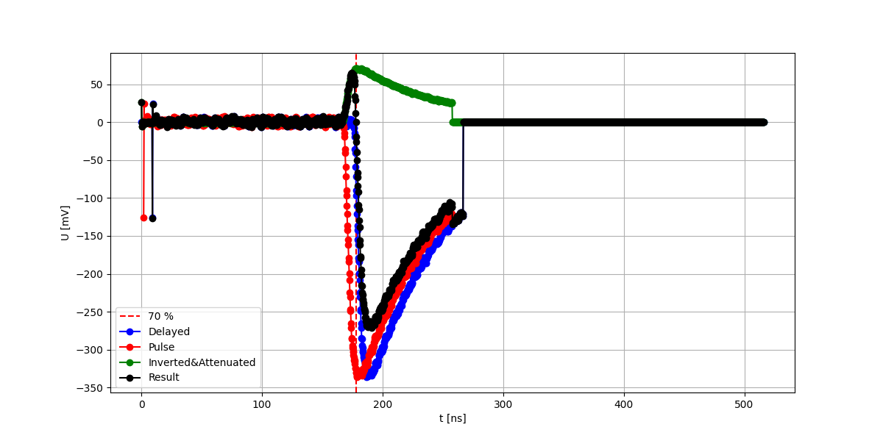
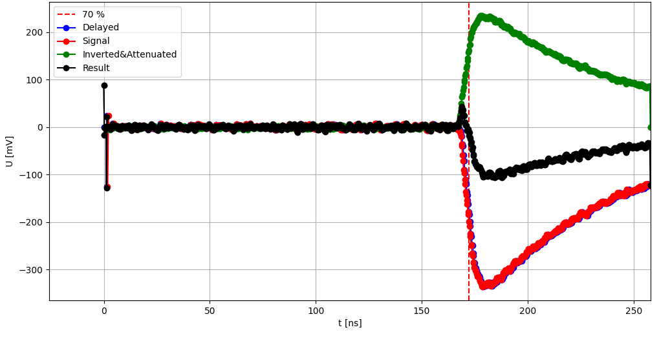
Constant Fraction Discriminator (CFD)
First attempt
Delay = 5 ns, Inverted pulse 70% of the signal

Slide 4
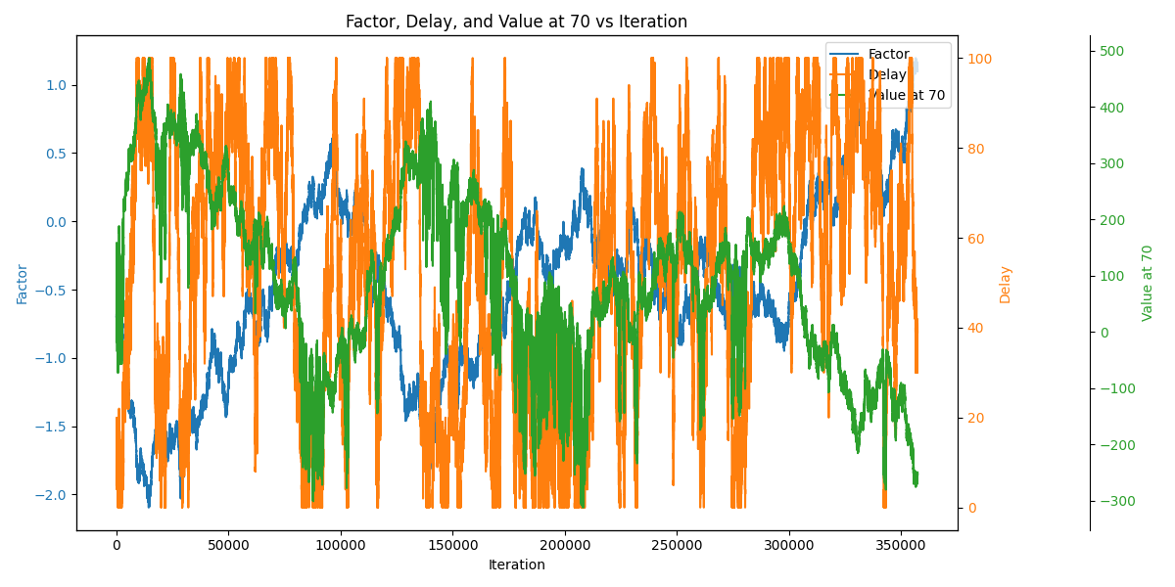
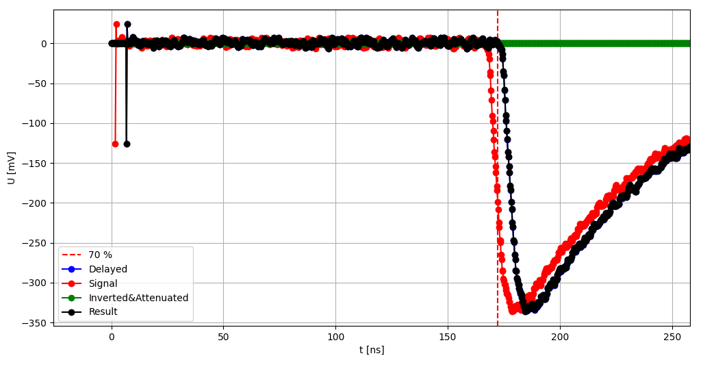
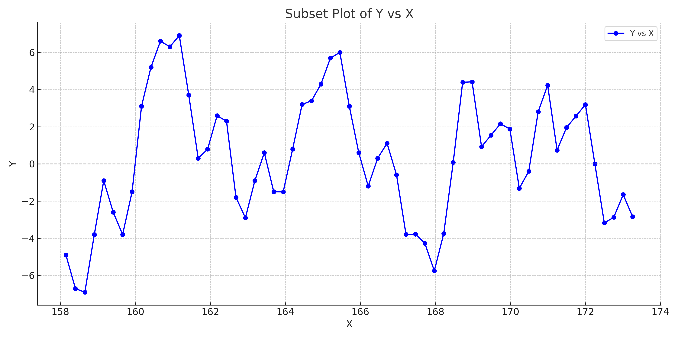
Restriction: Delay > 0 and < 100.
factor | 1.31E-3
delay | 6.8 ns
abs(valueat70%) | 1.20E-3 mV
Factor is to low, lost in the noise!
U [mV]
t [ns]

Slide 5
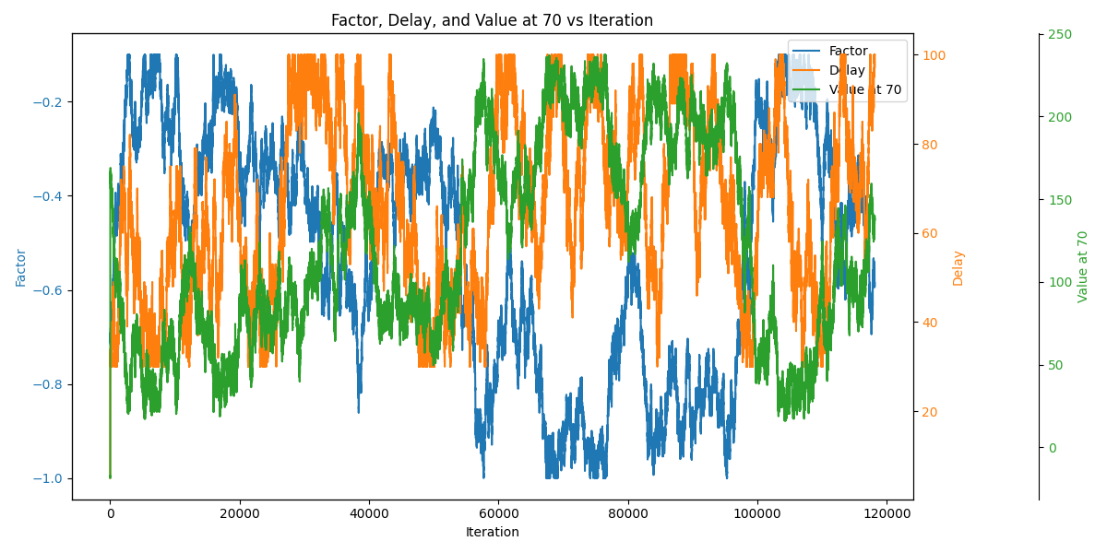
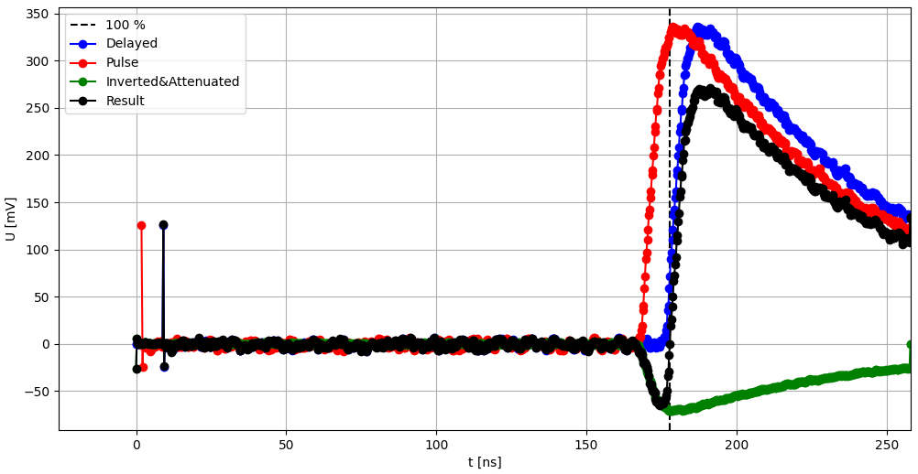
factor | -0.21
delay | 9 ns
abs(valueat100%) | 4.12E-3 mV
Constraints
30 < delay < 100
-1 < factor < 0.1

Slide 6
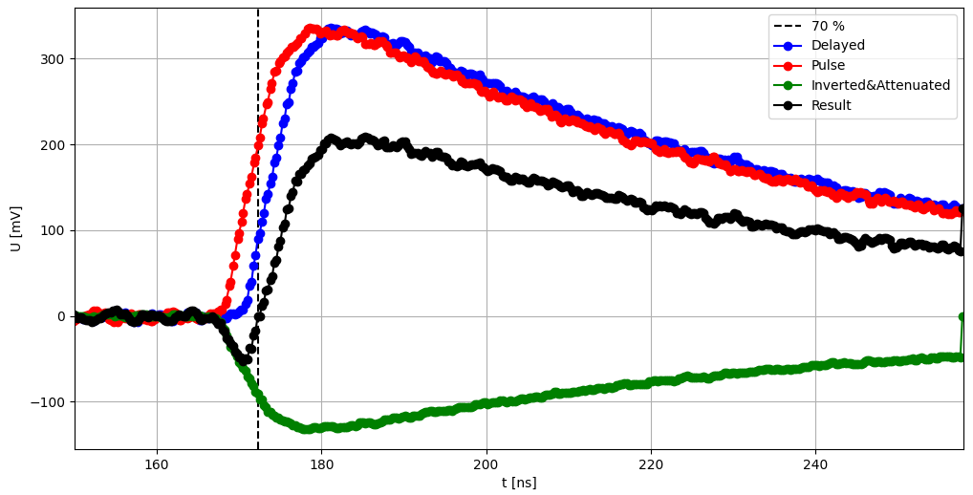
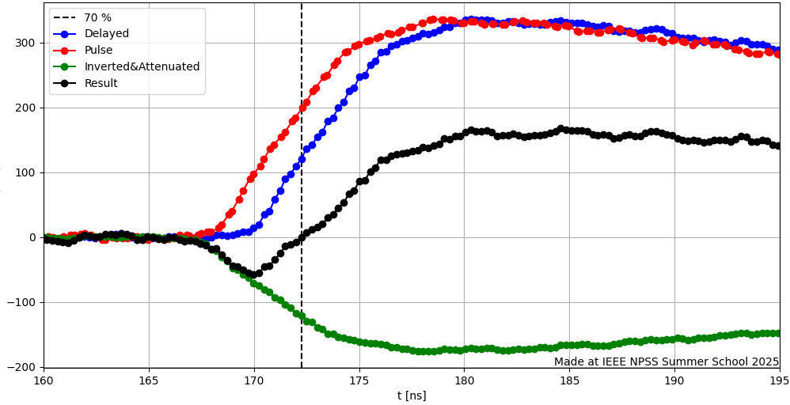
Thank you for your attention!
factor | -0.39
delay | 13 steps = 3.2 ns
abs(valueat70) | 2.92E-3 mV
factor | -0.52
delay | 10 = 2.52 ns
abs(valueat70) | 7.6E-5 mV

