Slide 1
X-ray imaging
Jakub Kubica

Slide 2
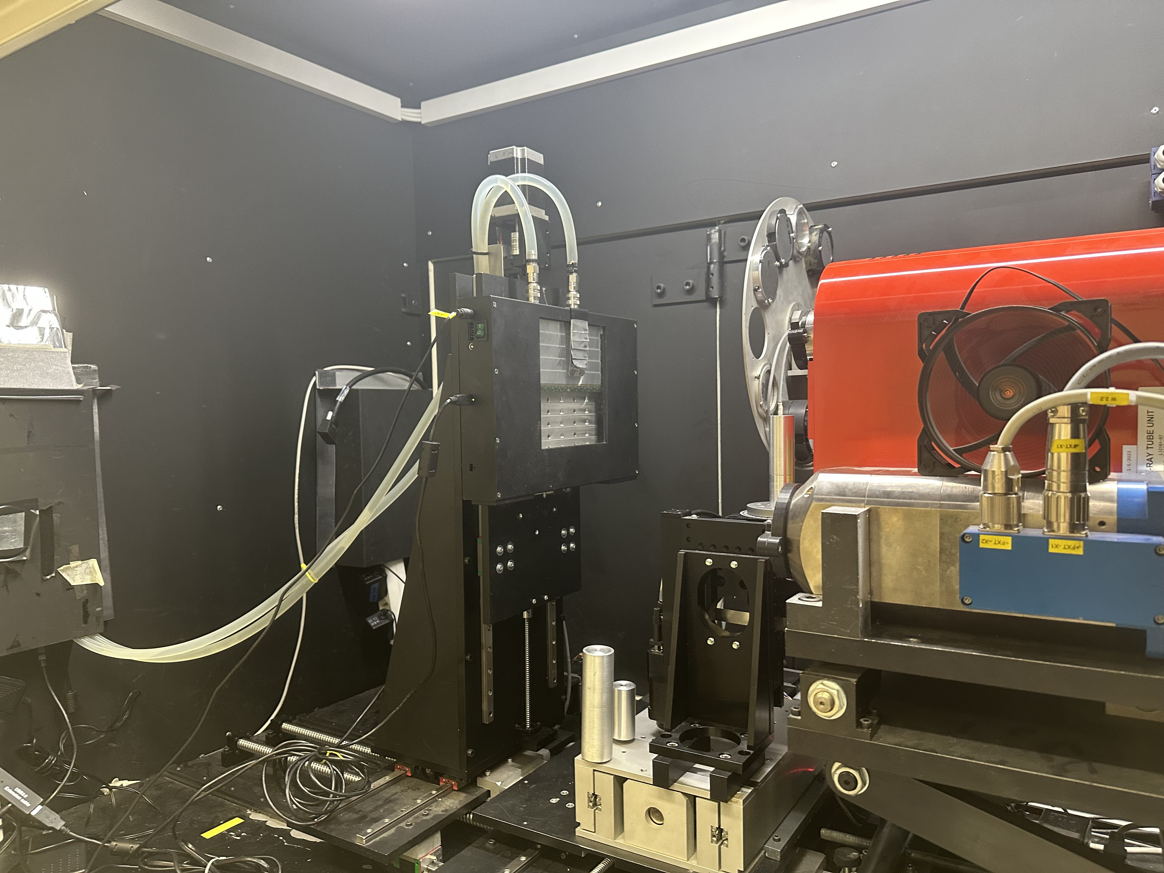
Introduction
Hamamatsu L12161-07 X-ray source
  tube voltage
  tube current
  focus mode
WidePIX_{10x5}
  Medipix Mode
  Time-over-Threshold Mode
  Timepix Mode

Slide 3

Signal to noise ratio
$SNR=\frac{λ}{σ}$ Poisson distribution: $σ=\sqrt{λ}→SNR=\sqrt{λ}$

Slide 4




Beer-Lambert law
$$dI=−μ\left(f\right)Idz→I=I_{0}e^{−μ\left(f\right) z}$$
$$μ_{40}=28\left(2\right){ cm}^{−1}$$
$$μ_{60}=24\left(2\right) {cm}^{−1}$$
$$μ_{120}=18\left(2\right){ cm}^{−1}$$

Slide 5
Thank you for your attention

