Slide 1

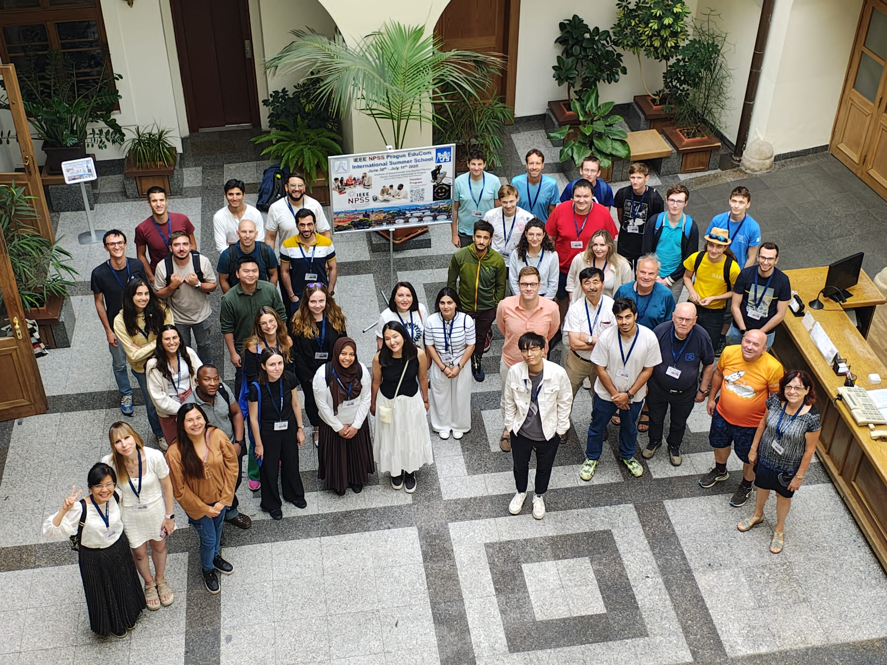
INSIDE A PEN
WITH CT IMAGINING
Giulia Tosetti
tosetti@lpccaen.in2p3.fr

Slide 2
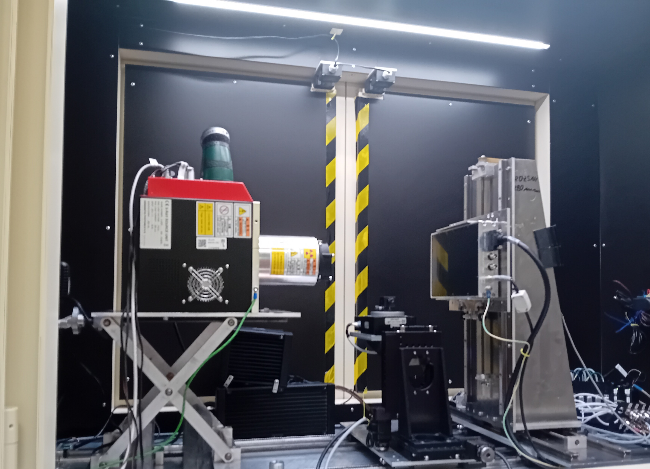
INTRODUCTION
What is a CT imaging?
It is a X-ray imaging technique used to obtain high-resolution 3D representations of an object's internal geometry.
It is a diagnostic tool, used in Treatment Planning Systems (TPS) to simulate and optimize radiation therapy treatment.

Slide 3
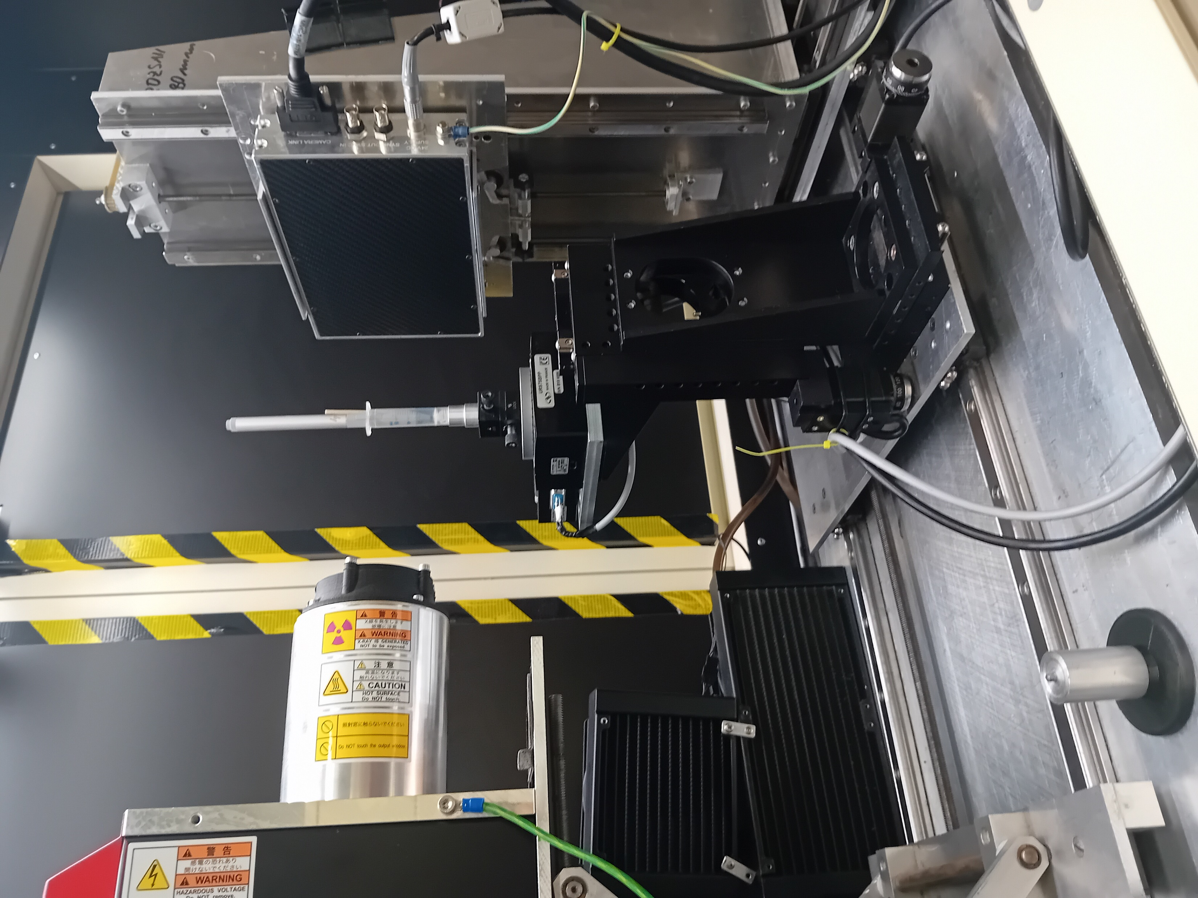
THE EXPERIMENT
The pen is positioned between the source and the detector
It was placed inside a syringe to keep it stable and avoid positional shifts
Only a segment is selected

Slide 4

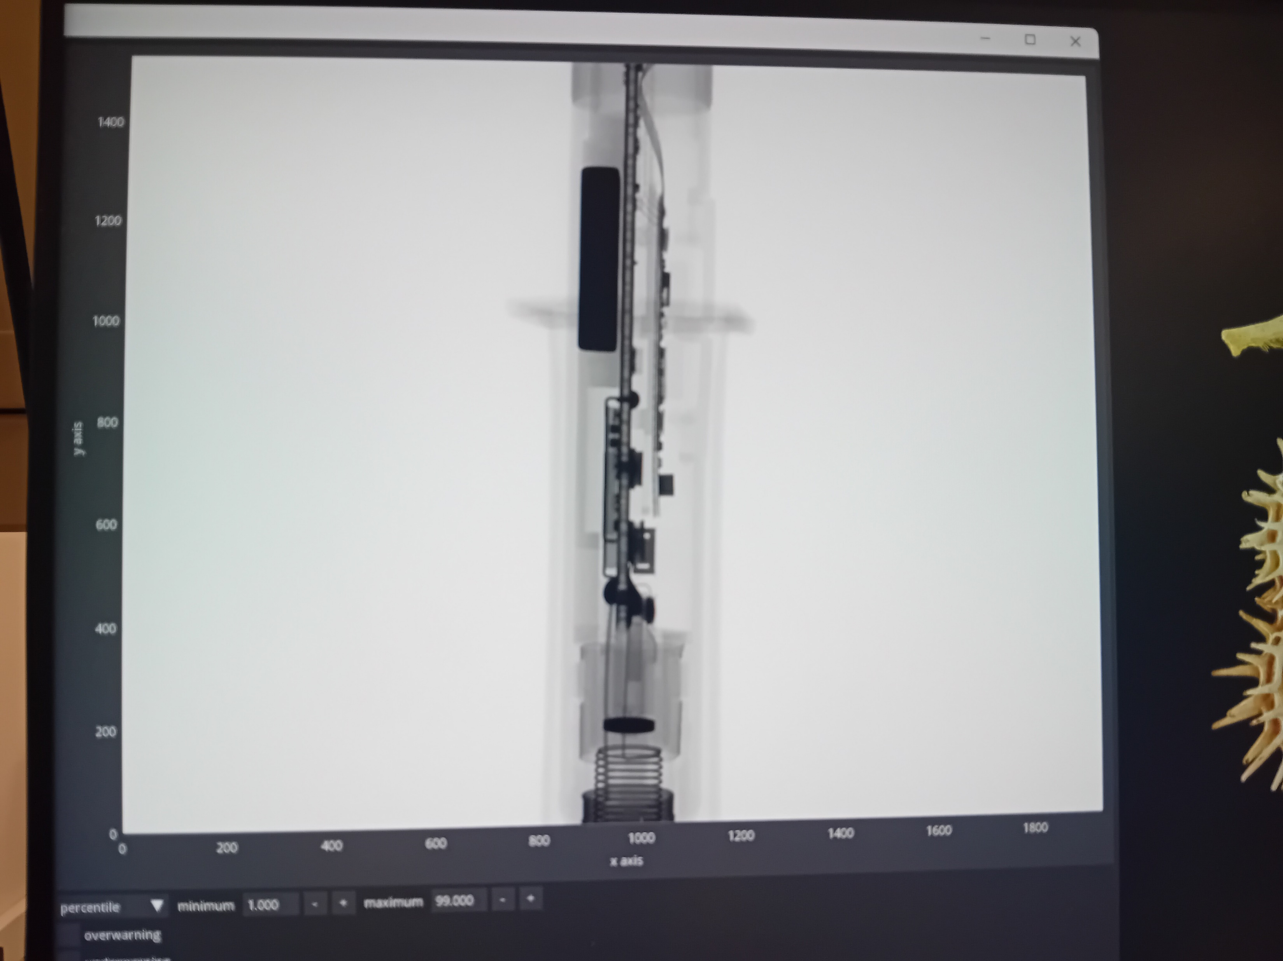
THE EXPERIMENT
IEEE NPSS Prague Summer school

Slide 5




THE EXPERIMENT
The CT scanner rotates around the object
The image is reconstructed using X-ray projections acquired from multiple angles.

Slide 6

AND LIKE MAGIC…
… AND THANKS TO VERONIKA

Slide 7
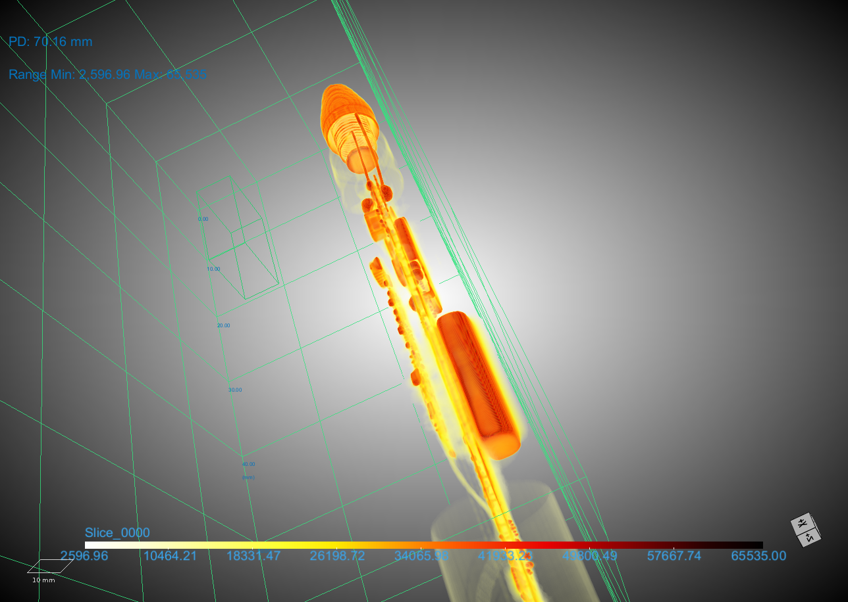
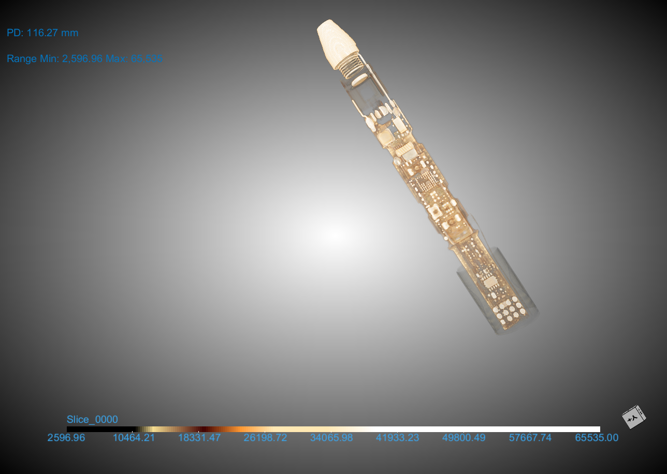
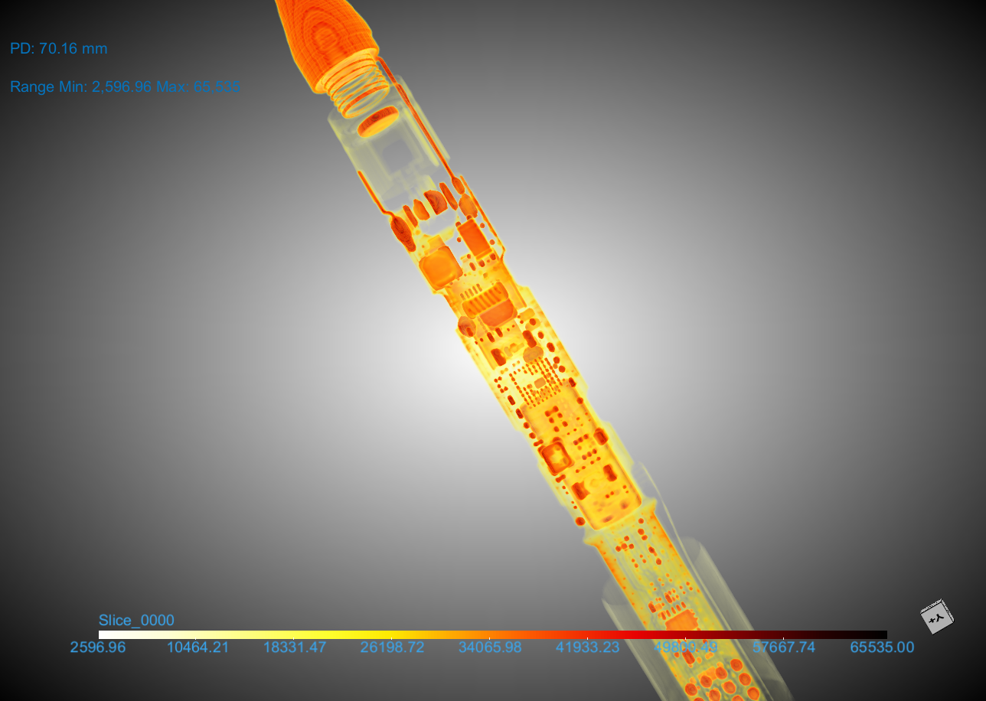
THE EXPERIMENT
The slices are combined by computer processing
Time to play!!!

Slide 8
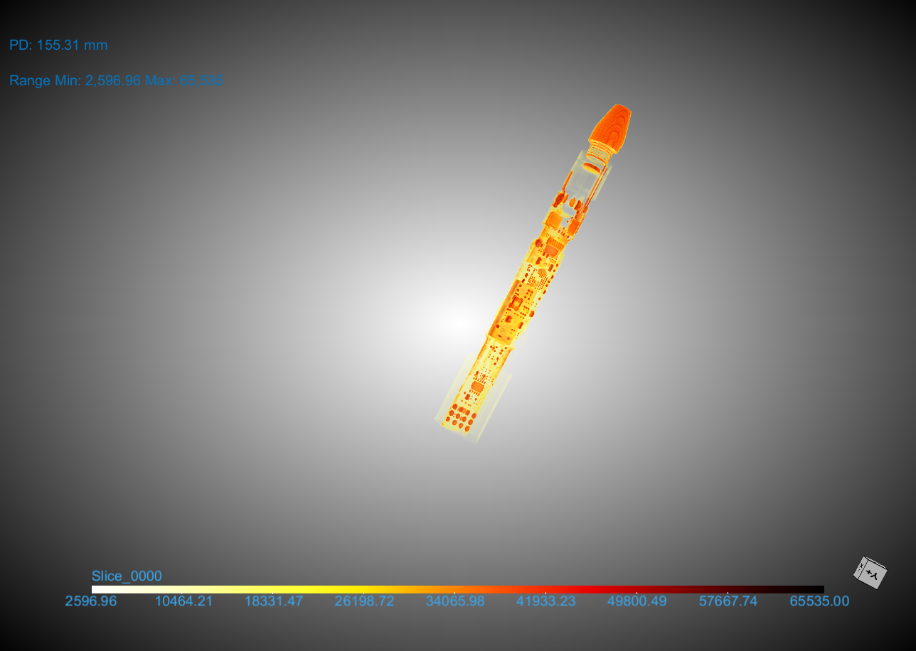
CONCLUSION
The CT provides high resolution 3D imaging
It takes a lot of time ~ 40 min for 5 cm
Movements introduces artifacts but they are not the only cause

Slide 9
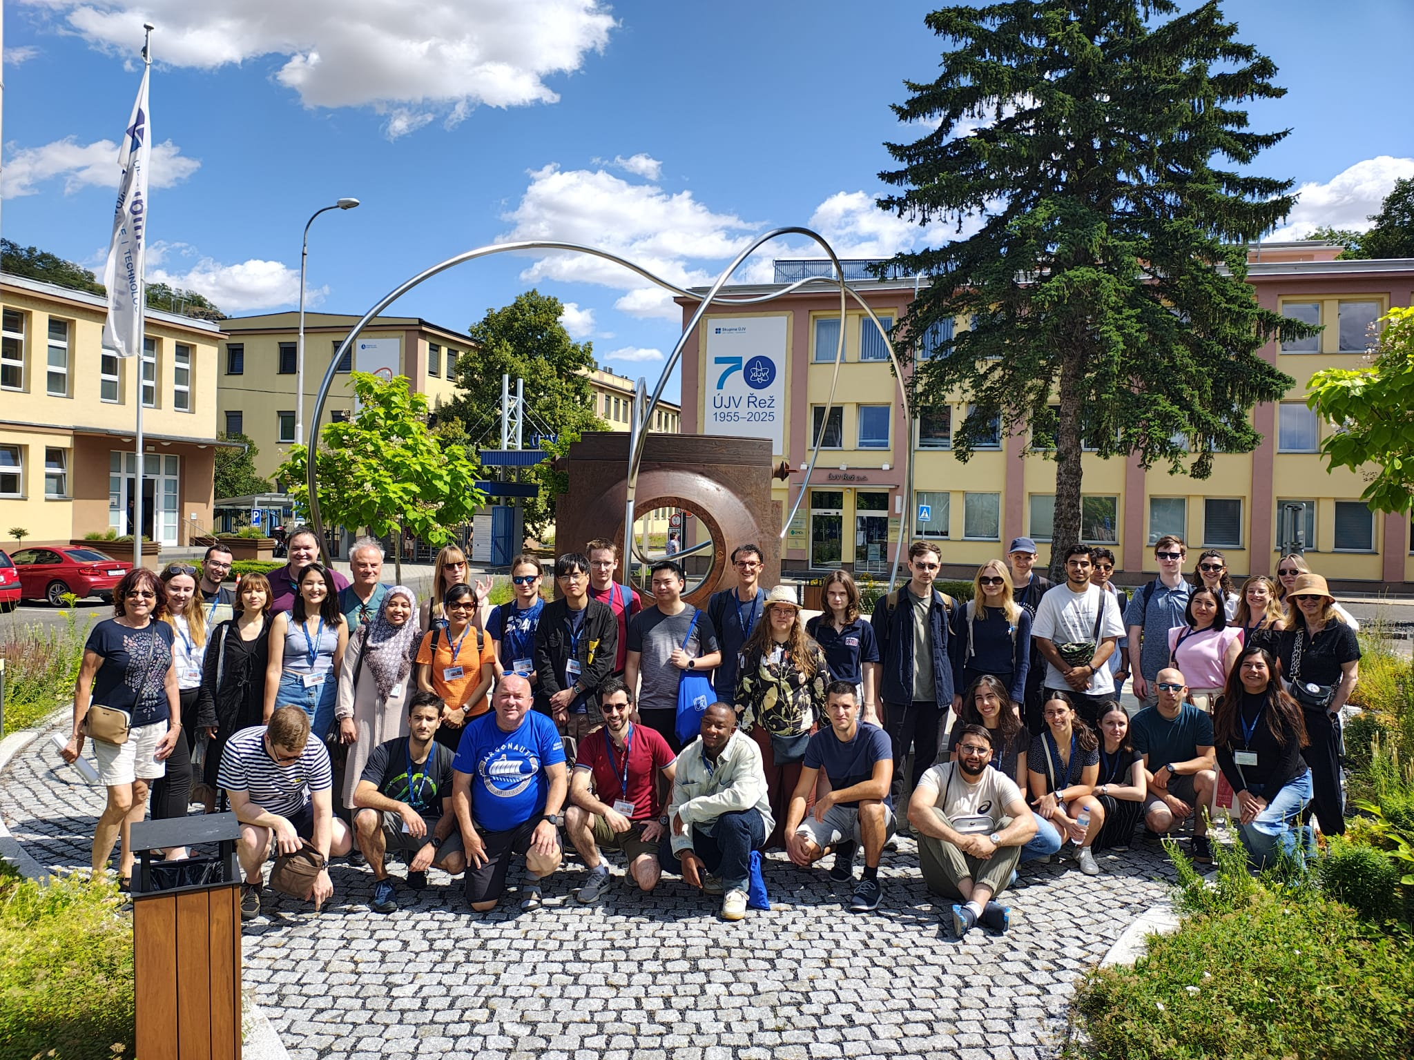



THANK YOU!
Giulia Tosetti
tosetti@lpccaen.in2p3.fr

Slide 10


BACKUP
How did I made the video?
CHAT GPT

