Slide 1

EasyPET
Gabriela Jazvac¹
¹Institute for Medical Reasearch and Occupational Health, Ksaverska cesta 2, Zagreb, Croatia

Slide 2
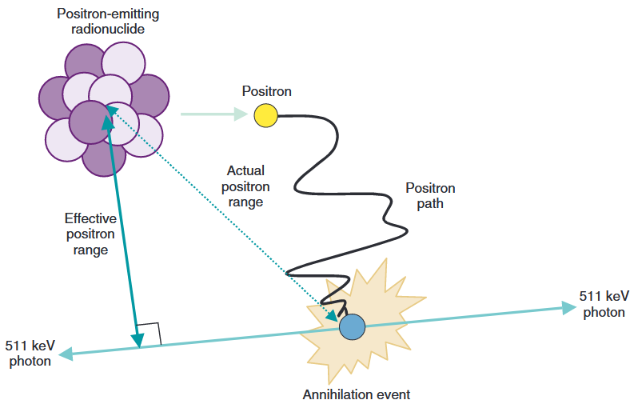
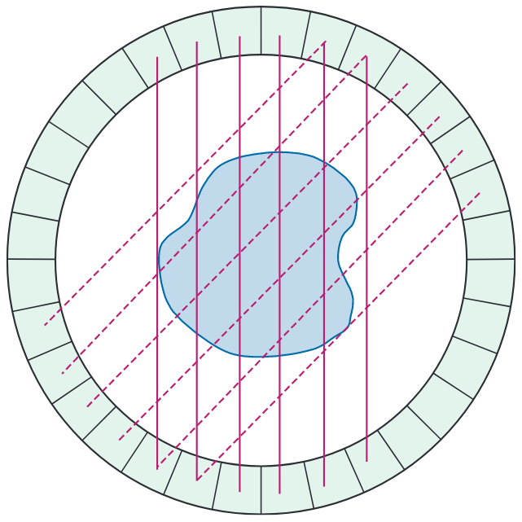
PET Imaging
β+ decay → annihilation
  two 511 keV photons
~180° angle + time coincidence
  lines of response (LoR)
    image reconstruction
S. R. Cherry, J. A. Sorenson, M. E. Phelps, Physics in Nuclear Medicine, 2012

Slide 3
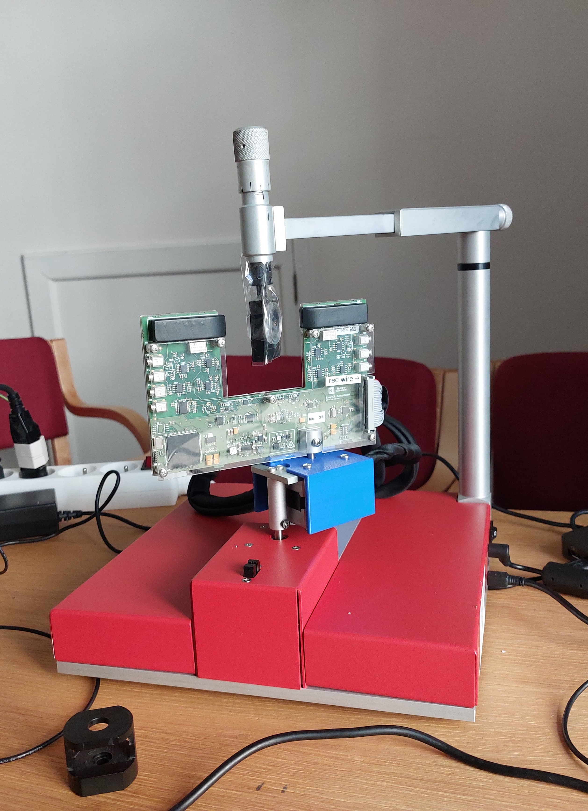
Experiment Setup
CAEN EasyPET, MCA
2 x (scintillator (CsI) + SiPM)
2 motors
  360°
  adjustable range
source in the middle (²²Na, 12 µCi)
  single point source
  two point sources

Slide 4
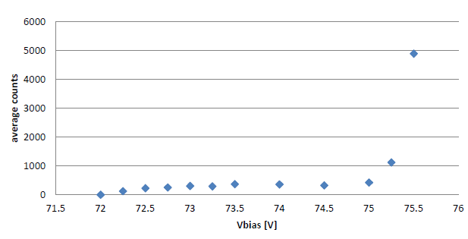
Initial measurements and calibration
dark count measurement
  bias voltage (linear gain)
multi photon spectrum
²²Na spectrum
alignment calibration counts

Slide 5
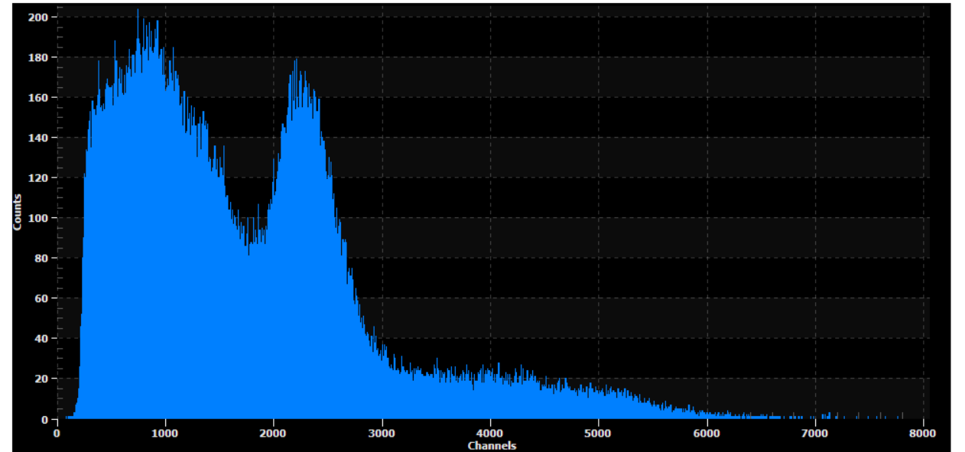
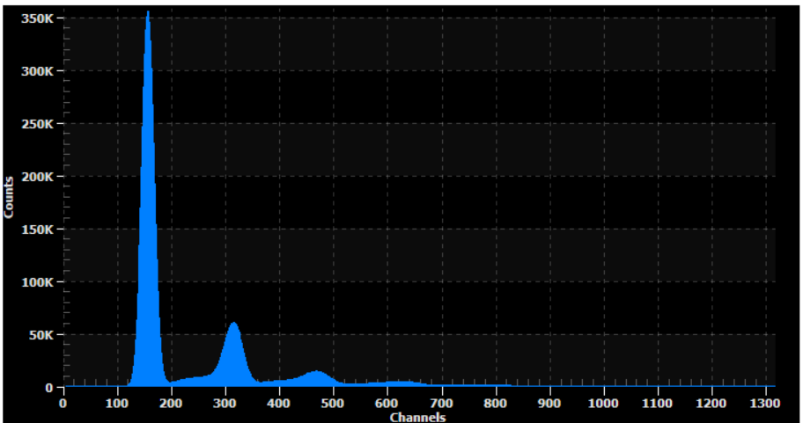
Measured Spectra
²²Na spectrum
Multi photon spectrum

Slide 6
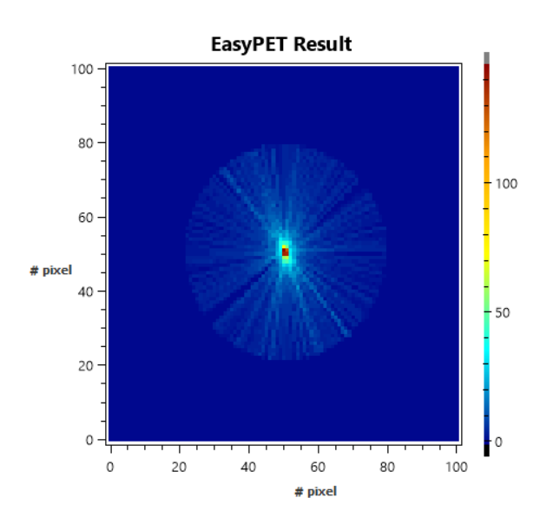
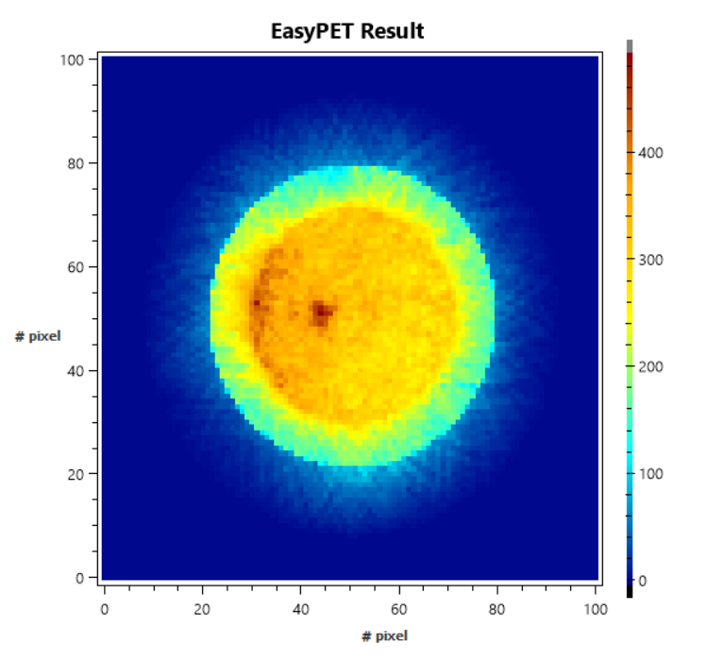
Results: Overlap of LoR
Single point source
Two point sources

Slide 7
Conclusion
Proper alignment is important
Working equipment is important
  If these conditions are met, PET can resolve multiple sources

Slide 8
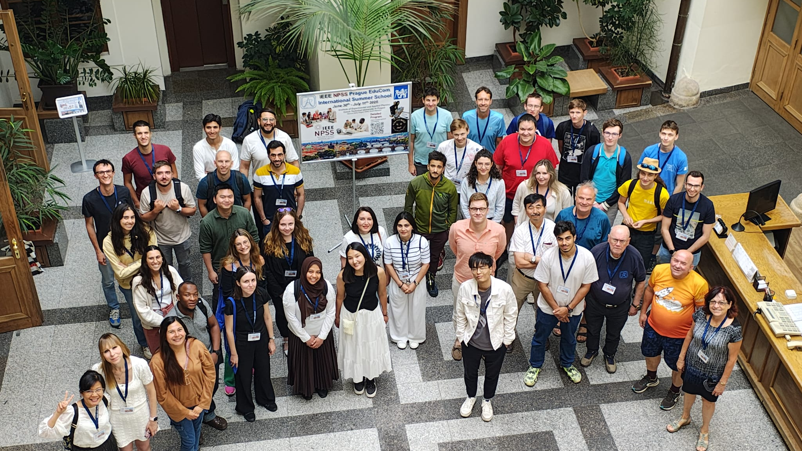
Thank you for your attention!

