Slide 1
Radiation Detection at International Borders
Richard Kouzes, Ph.D.
Laboratory Fellow Emeritus
Pacific Northwest National Laboratory
IEEE Nuclear and Plasma Sciences Society School
Rabat, Morocco
July 2024
PNNL-SA-135051
Notes:
Abstract:
Radiation Detection at International Borders
The detection of ionizing radiation is a little over 100 years old, dating from the first observation of natural radioactivity. Today, radiation detection plays a key role in diverse fields from medicine to defense to basic science. For homeland security, countries around the world are deploying passive radiation detection instrumentation to interdict the illegal shipment of radioactive material crossing international borders at ports of entry. These efforts include deployments in the United States and several European and Asian countries by governments and international agencies. This talk discusses our experience with radiation detection interdiction at international borders and other applications to national security.

Slide 2

IEEE is …
The Institute of Electrical and Electronics Engineers
  Largest technical/scientific organization – 38 Technical Societies.
  International with activities in all regions of the world.
  Organizes the most technical meetings with highest aggregate attendance.
Nuclear and Plasma Sciences Society
  Computer Applications in Nuclear and Plasma Sciences
  Fusion Technology
  Nuclear Medical and Imaging Sciences
  Particle Accelerator Science and Technology
  Plasma Sciences and Applications
  Pulsed Power Systems
  Radiation Effects
  Radiation Instrumentation

Slide 3
Pacific Northwest National Laboratory
U.S. DOE National Laboratory
Office of Science Lab
> 4500 staff
> $1B
Physical Sciences Facility
  Ultra-trace Laboratory
  Radiation Detection Laboratory
  Materials Science & Technology Laboratory
  Underground Laboratory
  Large Detector Laboratory

Slide 4
Talk Outline
The Threat at International Borders
Radiation Detection
Border Security
Challenges and Solutions

Slide 5
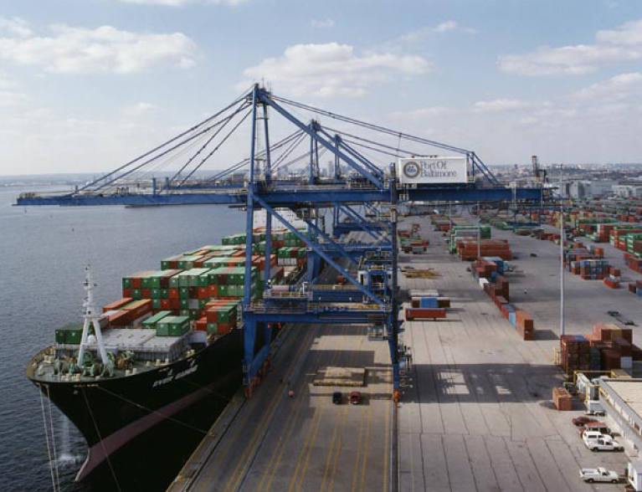
The Threat

Slide 6
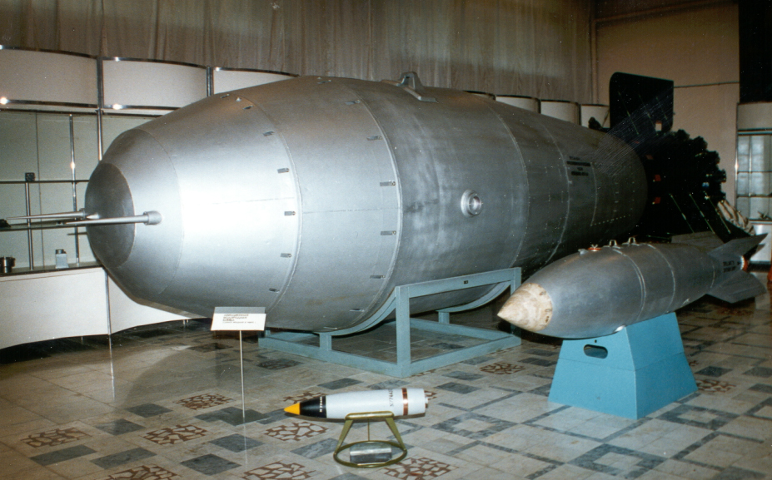
The Problem And The Threat
Weapons of Mass Destruction (WMD)
Improvised Nuclear Devices (IND)
Special Nuclear Material (SNM)
Radiation Dispersal Devices (RDD)
US DOE: 4 kg ²³⁹Pu or 25 kg highly enriched uranium (HEU) are sufficient for a nuclear explosive device
IAEA Significant Quantity: 8 kg ²³⁹Pu or 25 kg HEU

Slide 7
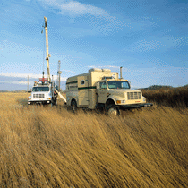
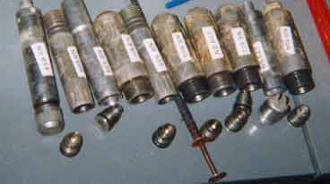
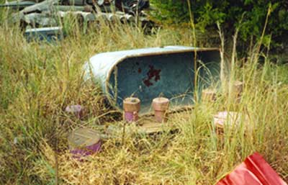
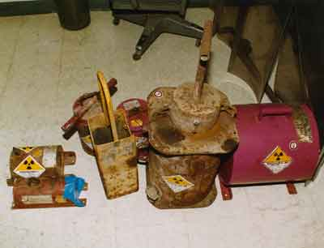
Orphaned Sources
Notes:
Gamma backscatter and neutron induced gamma emission are both used to look for hydrogenous material.

Slide 8
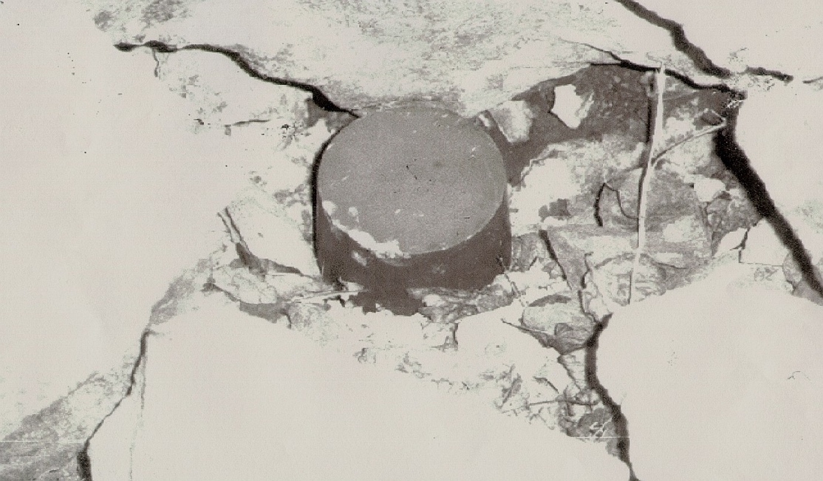
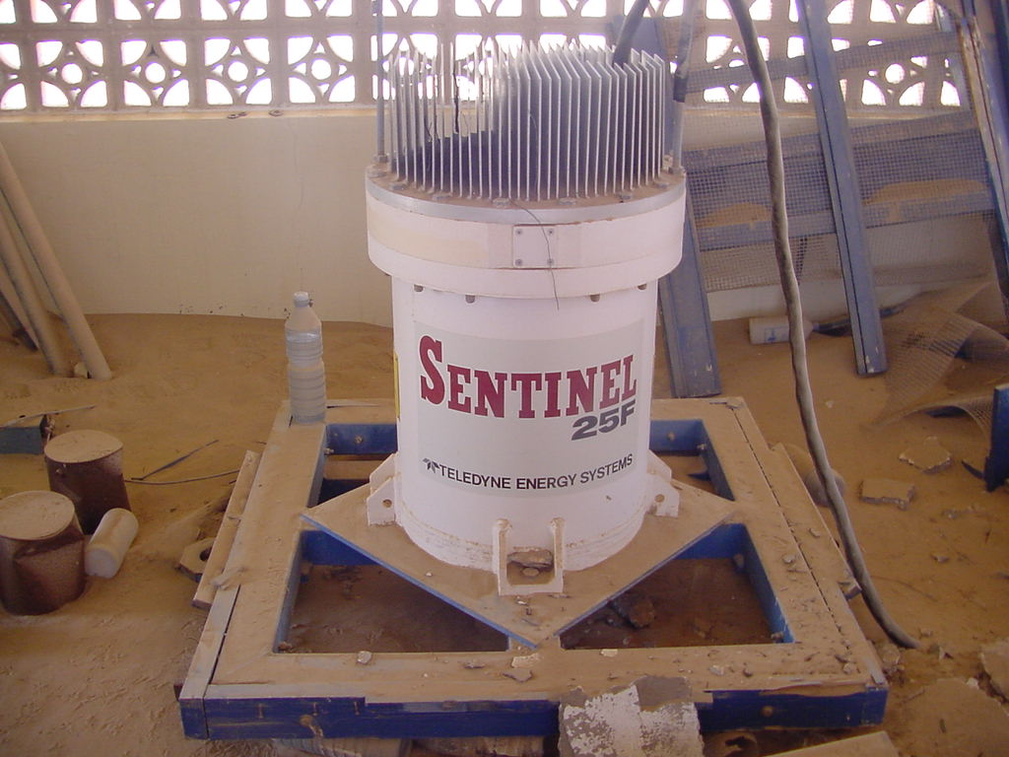
Soviet Sr-90 (~40 kCi) RTG
Recovered in Georgia
Radioisotope thermoelectric generator (RTG)
December 2001: three woodsmen in former Soviet republic of Georgia suffered severe radiation burns after handling the strontium-90 core from an abandoned radiothermal generator.
Notes:
RTGs exist in the thousands

Slide 9
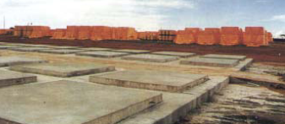
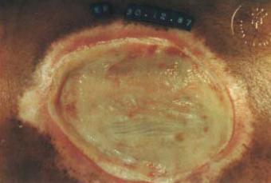
1987 Incident in Goiania, Brazil
Container of ¹³⁷Cs scavenged from defunct medical clinic
Children played with the glowing powder (1400 Ci)
11 days before discovered (up to 100 miles away)
Four people died (450-600 rem)
28 suffered radiation burns, 249 contaminated
More than 112,000 requested medical monitoring!
Clean-up effort cost ~$20M (275 truckloads of waste).
Notes:
5000 m^3 of stored waste
3800 200 liter drums
1400 1.2 m^3 boxes
10 32 m^3 ship containers
6 waste containers
7 houses demolished
Cheap labor
50% drop in agriculture, housing prices fell, cars were stoned, tourism dropped
Goiania ~800,000 people
CsCl in 2” x 2” source 1375 Ci, 456 rad/hr @ 1m
Sept 13 - salvagers took home and opened source
Sept 15 - 1 sought medical help - sent home as allergic reaction to bad food
Sept 14-15 - disassembled, punctured source, scooped out material, sold to salvage yard
Sept 28 - wife of junk yard dealer sought medical care - carried source to clinic; diagnosed as tropical disease
Doctor got 100 rad dose
Suspected radiation
4 deaths at 1 month: wife, 2 junk yard employees, 6 yr old niece
Oct 3 - situation fully appreciated

Slide 10
Radiation Detection Basics
r

Slide 11
History of Nuclear Physics
1895 – Roentgen discovers x-rays
1896 – Becquerel finds U salts fog film
1897 – Thompson discovers the electron
1903 – Curies get radiation burns
1903 – Rutherford & Soddy “radioactive change”
1905 – Einstein publishes E = mc²
1907 – Rutherford notes “scattering of α rays”
1911 – Rutherford announces nuclear atom from measuring α scattering
1914 – HG Wells publishes “A World Set Free”
1942 – Nuclear reactor

Slide 12
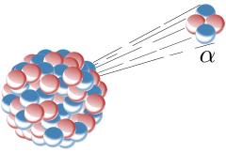
Radioactivity – α, β, and γ Decay
neutrons/protons
γ decay
Excitation increase PE (E_{i} to E_{f})
α decay
De-excitation photon hf = E_{f} - E_{i}
_
β⁻ decay
ν
β⁺ decay
ν
n
p
p
n
e⁻
e⁺

Slide 13
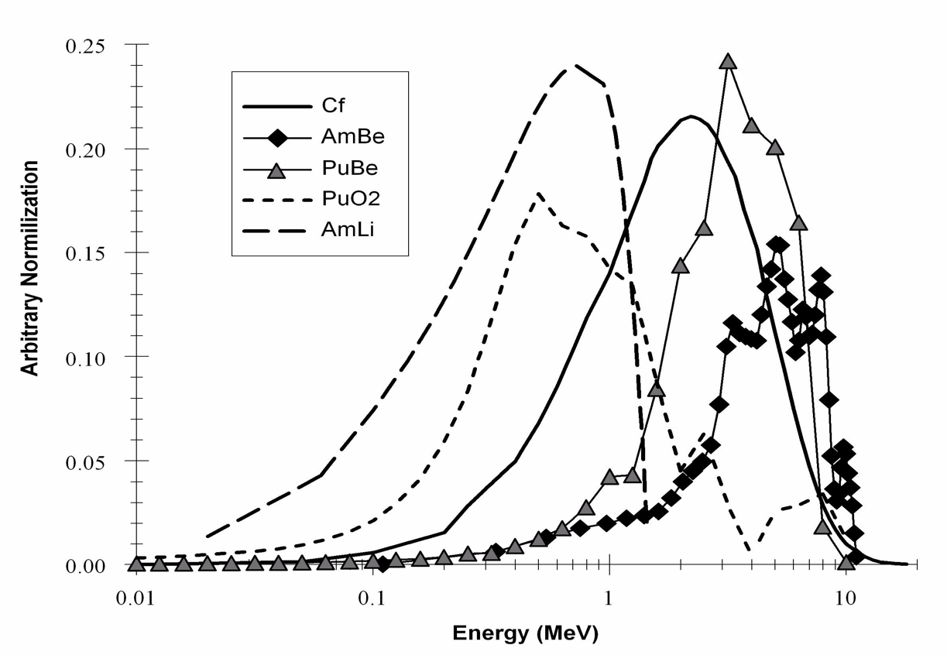
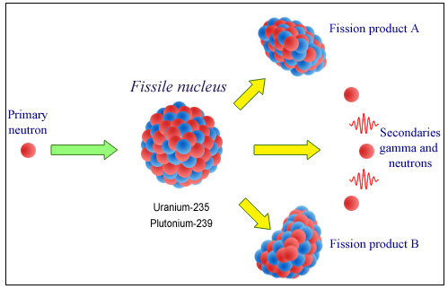
Radioactivity – Fission
Fission of a heavy nucleus such as plutonium and uranium can be spontaneous or induced
Fission produces two daughter nuclei and one to several neutrons
For example: ²³⁵U ➔ ⁹⁰Rb + ¹⁴³Cs + 2n
Neutron
Spectra
Kouzes, NIM 584 (2008)

Slide 14
Detection of Radiation
Since there is radiation, how do you detect these gamma rays, beta rays, alpha particles and neutrons?
130 years since discovery of x-rays and natural radioactivity
Charged particles and photons interact with matter through the electromagnetic force, depositing energy
Neutral particles (neutrons) must scatter off protons that then deposit energy, or are absorbed, causing fission

Slide 15
Radiation Interaction With Matter
Summary of α, β, γ, x-ray, muon radiation interaction with matter:
  All radiation releases energy in matter in the form of electrons and ionized atoms
  Biological effects come from chemical changes produced by freed electrons, destroyed molecules, and chemical radicals that attack cell components
Range Table in Tissue
Energy | α | β | γ | n
1 MeV | 0.0006 cm | 0.5 cm | ~10 cm | ~10 cm
10 MeV | 0.01 cm | 5 cm | ~36 cm | ~50 cm

Slide 16
Radiation Detection Effectiveness
Source activity (A)
  Strength, type, and energy
Detection geometric efficiency (e_{g} ~ 1/r²)
  Source and detector size and distance
Detector intrinsic efficiency (ε_{i})
  Material, geometry, collection
Shielding (S ~ e^{-μx})
  Amount, type, and geometry
Background (B)
  Type, energy distribution, and intensity
  Naturally occurring radioactive material (NORM)
Time for detection (t)
  Statistics for signal to noise
  Operational limitation
Expert/Automated analysis of information
r
Time
Distance
Shielding

Slide 17
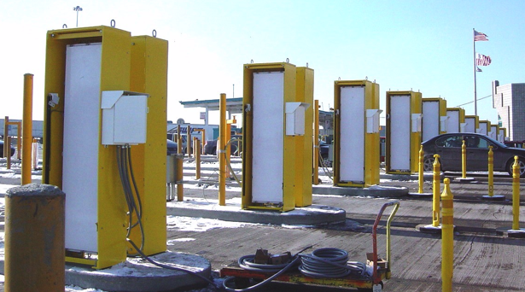
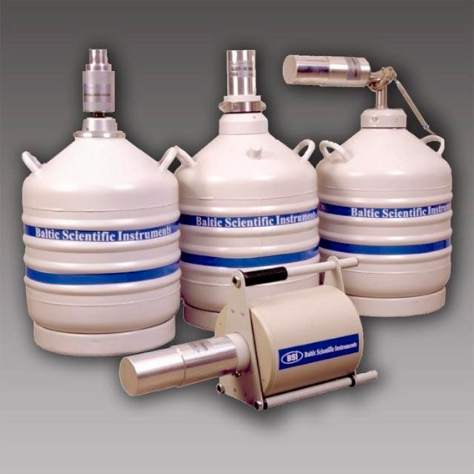
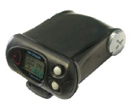
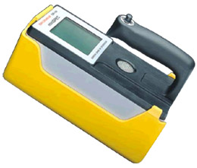
Gamma Ray Detectors
Gas counters
  Ionization chambers
  Proportional counters
  Geiger counters
Scintillators
  NaI(Tl)
  Plastic: polyvinyl toluene (PVT)
Solid state detectors
  Si
  High purity Ge (HPGe)
PVT
HPGe
NaI(Tl)
CsI
Notes:
Gamma and neutron detection are complementary.

Slide 18
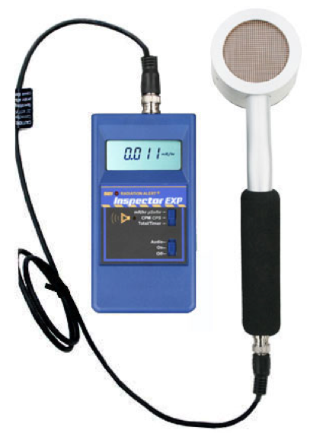
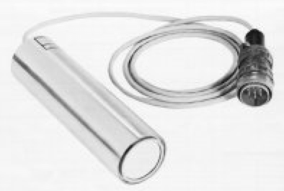
Alpha and Beta Detectors
Gas detectors or scintillators
Ionization chambers, proportional counters and Geiger counters for alphas
Plastic scintillators for betas
Thin windows
Notes:
Gamma and neutron detection are complementary.

Slide 19

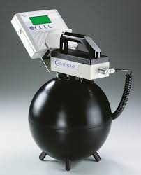
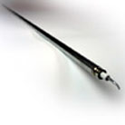
Neutron Detectors
Neutrons observed from fission sources
Energy not unique to special nuclear material (SNM) – Pu and U
Background
  From cosmic rays
  ~1/1000 of gamma-ray background
  Few commercial sources
Many scatterings prior to capture
Difficult to shield
Detectors: ³He, ⁶Li, ¹⁰B
Bonner Sphere
³He Tube
Moderator
Notes:
Gamma and neutron detection are complementary.

Slide 20
Border Security

Slide 21
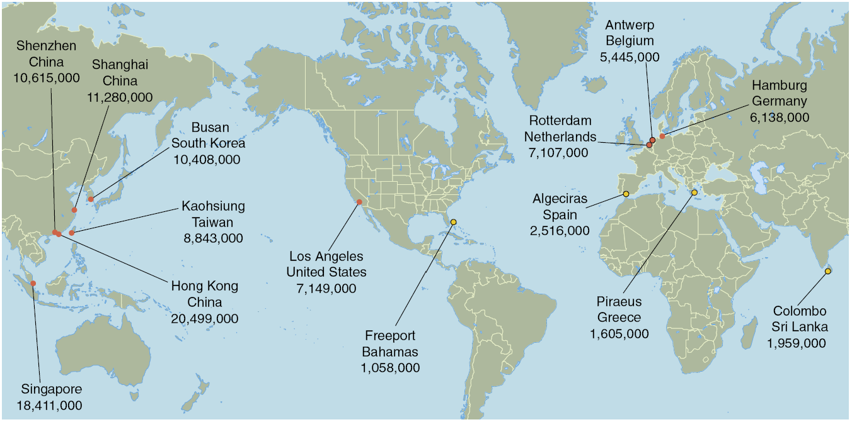
The Global View of Commerce
20 foot Shipping Container Traffic Per Year

Slide 22
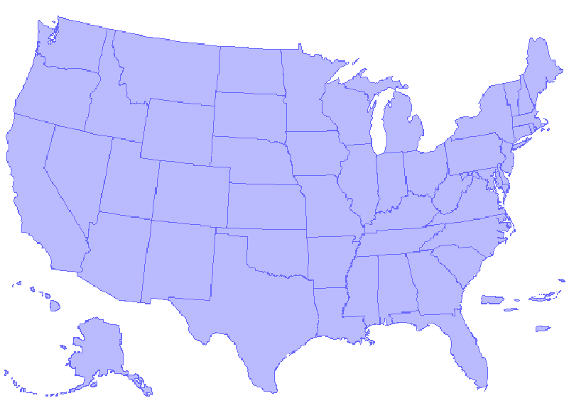
The Challenge: U.S. Ports of Entry
100% of containerized cargo is screened for radiation
Mail/ECCF
Land Border
Maritime
Air Cargo
307 Ports of Entry representing:
621 border sites to protect
332,622 vehicles per day
57,006 trucks/containers per day
2,459 aircraft per day
580 vessels per day
Notes:
The dots represent each of the ports of entry. Each has unique challenges to be addressed: quantity of traffic, natural radiation background, seasonal variation in cargo, environmental/weather

Slide 23
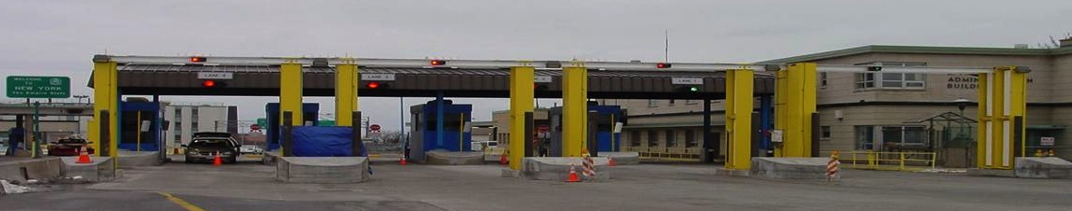
Radiation Portal Monitors
Used for decades in the scrap steel industry.
Sensitive to small quantities of SNM & RDD materials.
Large area, high-efficiency gamma-ray detectors & ³He neutron detectors.
Best cost/performance ratio of any detection technology.
Provide the capability to rapidly screen cargo.

Slide 24
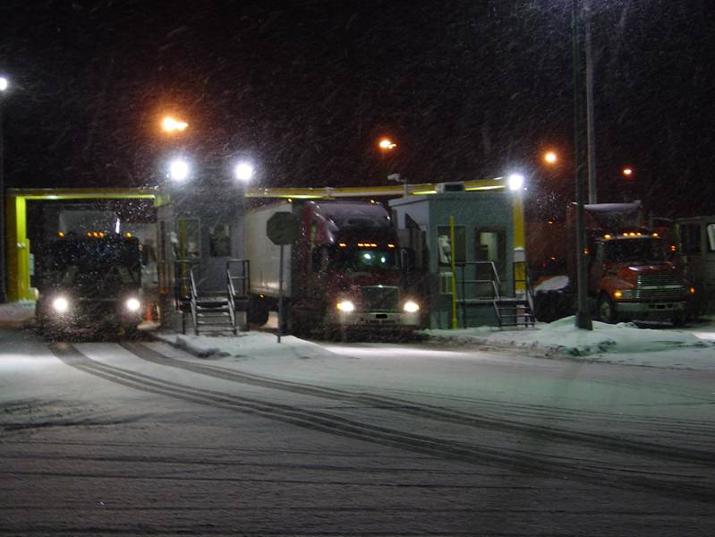
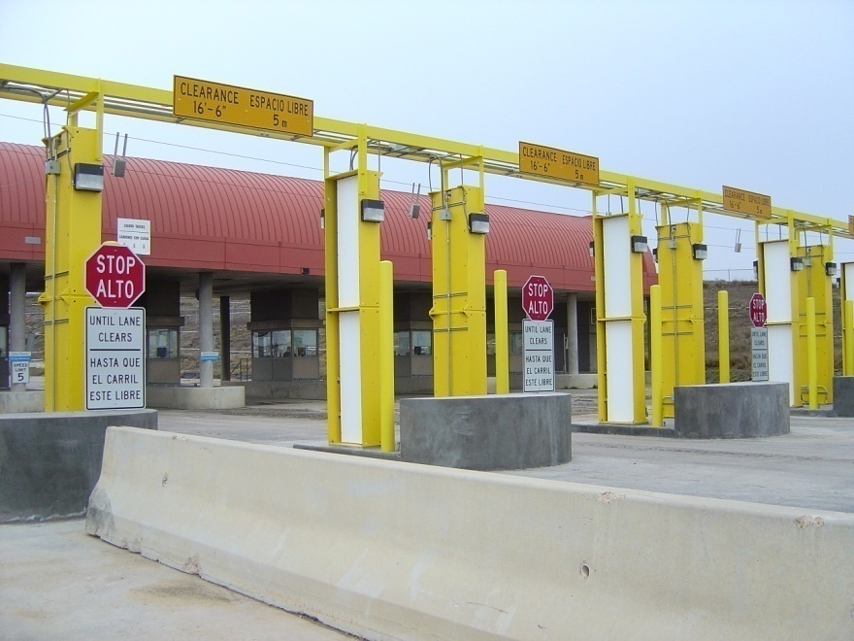
Homeland Security Systems
Second Line of Defense / Megaports (1997)
  RPMs deployed overseas
Radiation Portal Monitor Project (2002)
  Over 1600 systems deployed in US
Guardian Program (2003)
  Screening at DoD bases

Slide 25
Traffic Monitoring Example
Traffic flow over 7 hours - each dip or rise is a passing vehicle
Cars and trucks moving through a portal block background radiation
Notes:
Example of RPM traffic monitoring.

Slide 26
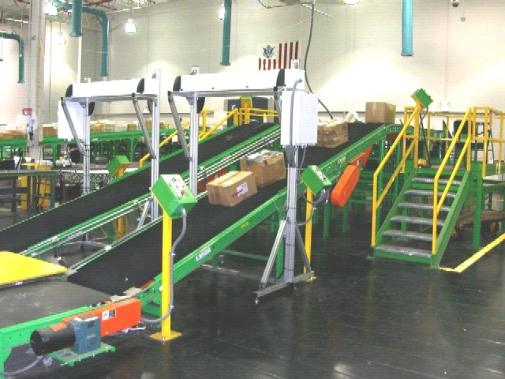
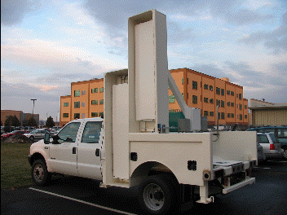
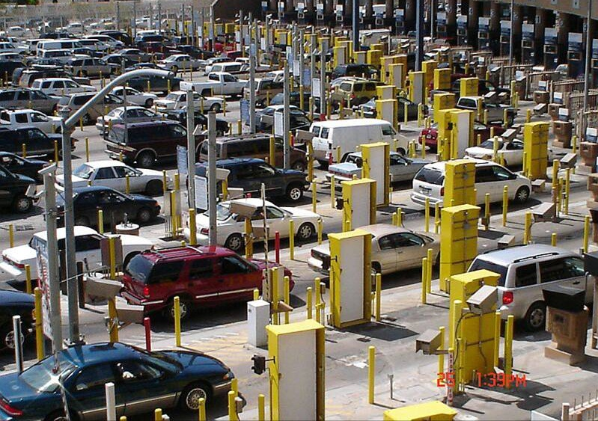
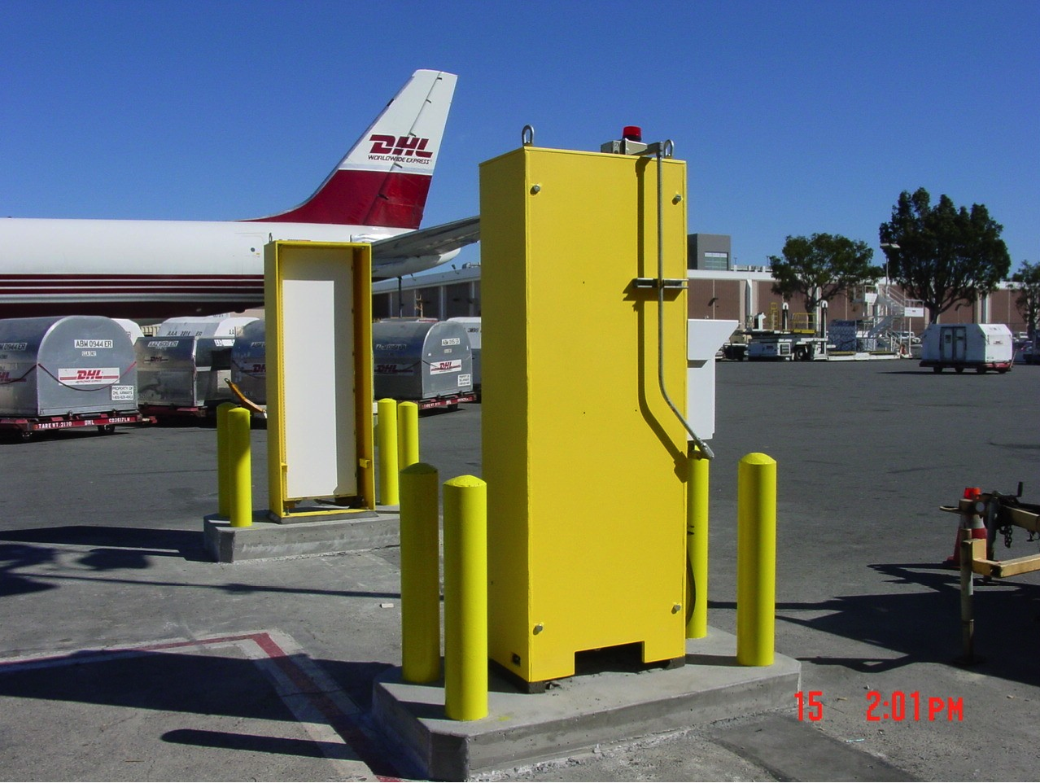
Border Security Examples
Notes:
US Customs (CBP) is deploying COTS at POEs

Slide 27
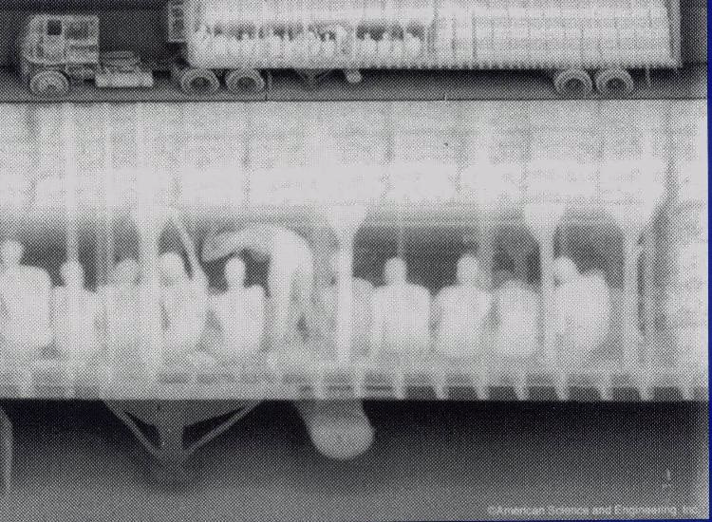
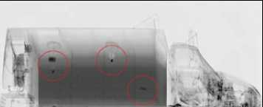
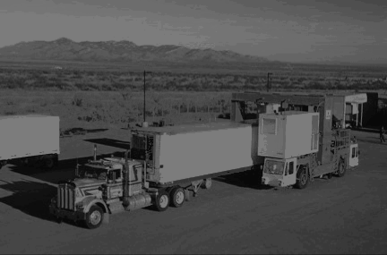
Layered Approach: Imaging
X-ray and gamma-ray transmission or backscatter imaging
Aracor Eagle
AS&E

Slide 28
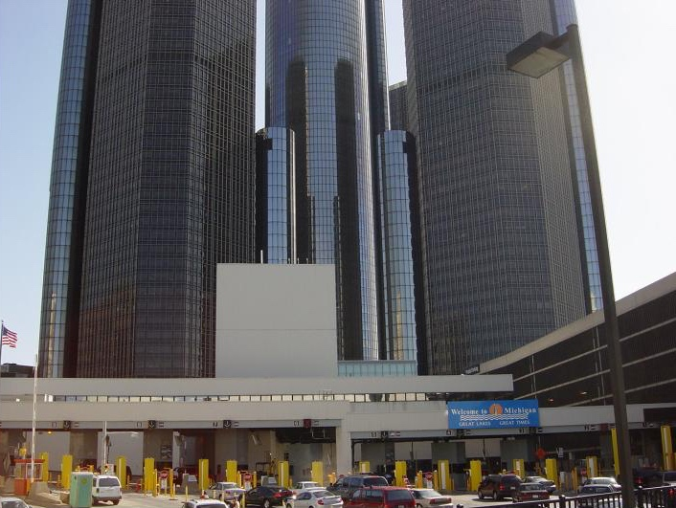
Challenges & Solutions

Slide 29
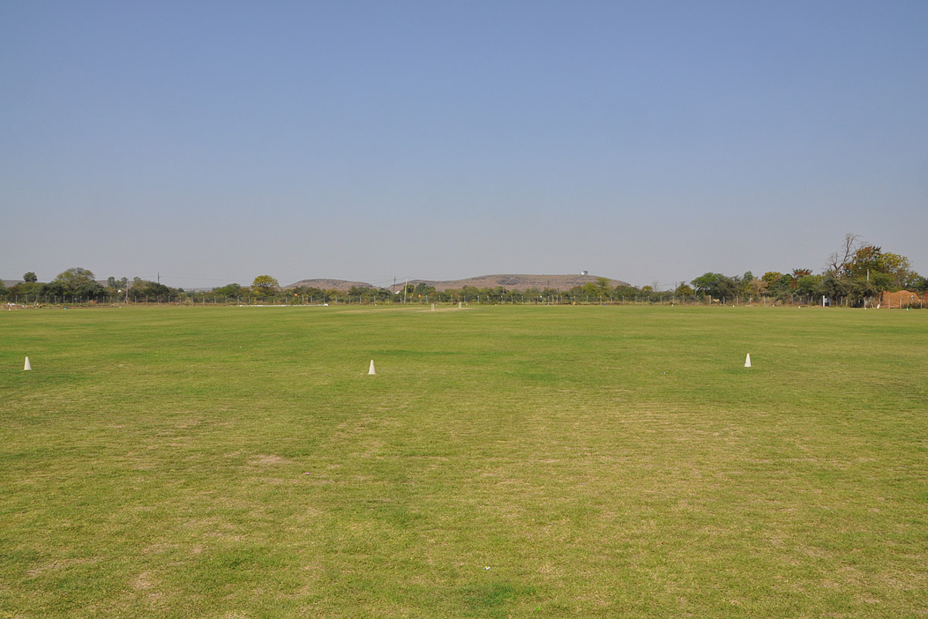


Background Radioactivity Sources
Radiation comes from cosmic rays, the ground, the air we breath, surrounding buildings, medicine and the food we eat
Exposure to people depends on where you live (e.g., altitude, local geology) and how you live (e.g., medical exposure, work exposure, flying)
Medical Exposure
ν
Cosmic
Rays
μ
n
Radon
Food
U, Th, K

Slide 30
Naturally Occurring Radioactive Material and Man-Made Sources
NORM is the dominant source of alarms for cargo, but not passenger cars
NORM, and technologically enhanced NORM, contain:
  uranium series (²³⁸U; 4.5 billion years)
  thorium series (²³²Th; 14 billion years)
  potassium (⁴⁰K; 1.3 billion years)
Commercial isotope examples
  ²⁴¹Am, ¹³³Ba, ¹³⁷Cs, ⁵⁷Co, ⁶⁰Co, ¹⁹²Ir, ²²⁶Ra, ²⁵²Cf, nuclear fuel, depleted uranium
Medical radioisotopes
  92% of procedures are ^{99m}Tc for stress tests
  ¹⁸F, ¹⁴C, ¹¹¹In, ⁵⁷Co, ²⁰¹Tl, ¹⁵³Sm, ⁸⁹Sr, ¹³¹I, ⁶⁷Ga, ⁵¹Cr
  One in 2600 Americans carries a radioactive burden large enough to be seen in an RPM
Skyshine from radiography

Slide 31
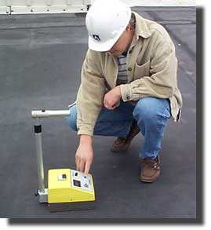
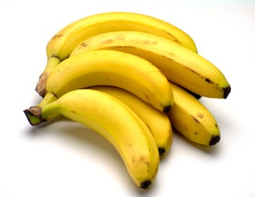
“Nuisance” or “Innocent” Alarms
Neutron Alarms - Few sources
  Troxler gauges, nuclear fuel, yellowcake, well logging sources
  Ship effect
Gamma Ray Nuisance Alarms
  Naturally Occurring Radioactive Material
  agricultural products like fertilizer
  kitty litter
  ceramic glazed materials
  aircraft parts and counter-weights
  polishing compounds and abrasives
  propane tanks
  road salt
  welding rods
  ore and rock
  smoke detectors
  medical radioisotopes
  skyshine
Troxler Gauge

Slide 32
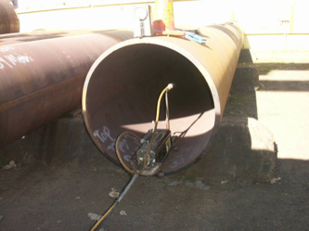
Skyshine
Radiation scattered from the air above a source
Radiography (¹⁹²Ir, ⁶⁰Co) or “x-ray” imaging sources
Very large sources (~100 Ci)
Can produce interference with radiation detection systems at very large distances (1% strength at 200 m)
Impacts all detector types (gross-counting or spectral)
Requires mitigation through distance, shielding, and operations
¹⁹²Ir Radiography Skyshine Source

Slide 33
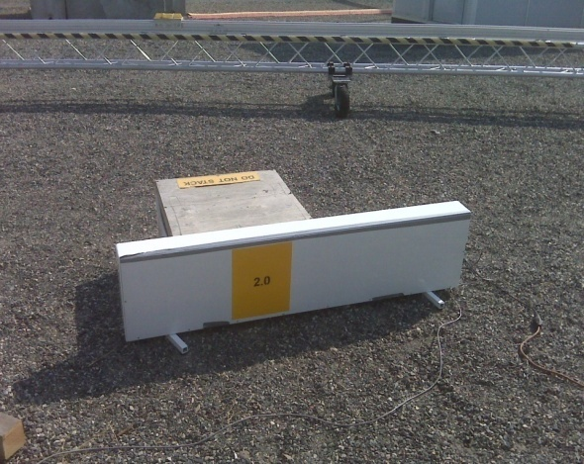
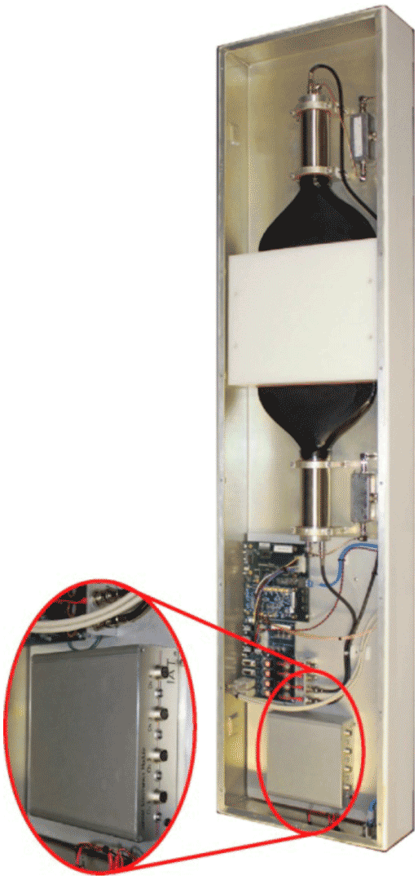
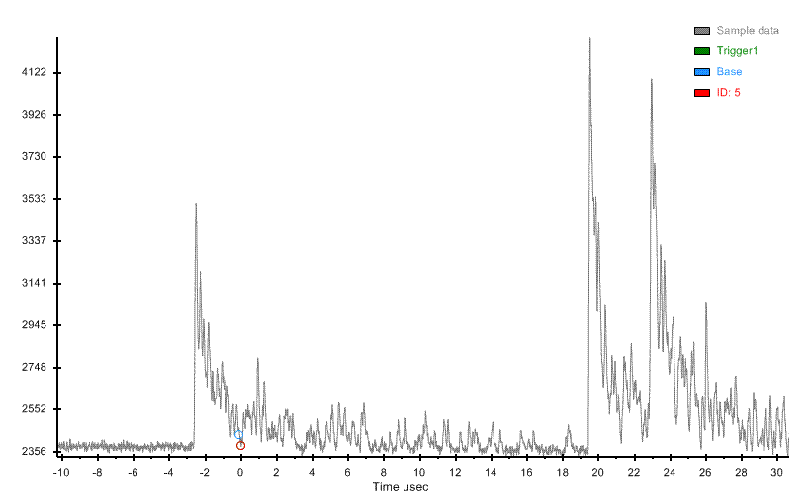
Neutron Ship Effect Event Example
3 neutrons in 30 microseconds in an IAT detector
33

Slide 34
Energy-Based Algorithms for Enhanced Portal Sensitivity
Energy-based algorithms can preferentially alarm on low-energy gamma-ray signals
  HEU, WGPu & Medical Radionuclides
Energy discrimination avoids many NORM alarms
  NORM spectra contain a significant high-energy component from thorium and potassium
Energy ratio modeling also handles baseline depression
  Background spectral ratios nearly constant with and without a vehicle in the portal

Slide 35
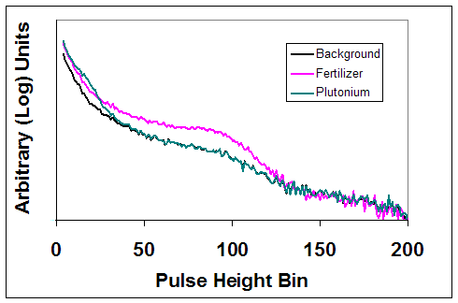
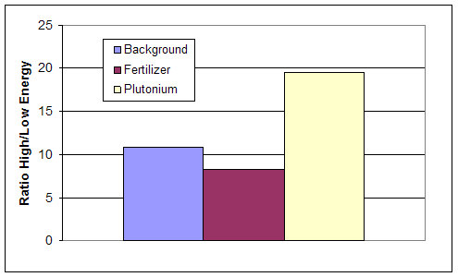
Energy-Window Ratio Algorithm
Use PVT spectral shape for discrimination
Low
Window
High
Window
Create the ratio:
Using ratios of energy regions enhances discrimination significantly and minimizes effect of intensity variations
Notional
Threshold

Slide 36
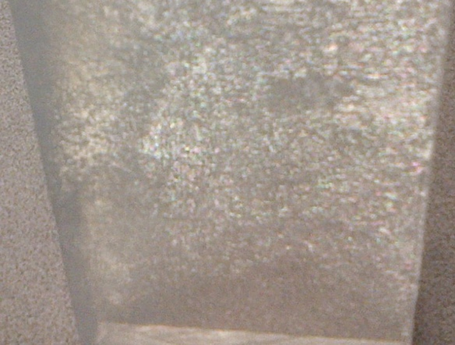
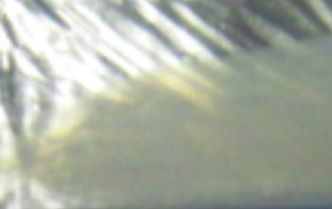





Observations of Plastic Aging
Polyvinyl toluene (PVT) and polystyrene (PS) are widely used plastic scintillators
Most new and old PVT & PS shows no significant change in response to gamma radiation with temperature
Various forms of damage are observed in PVT and PS
Internal temporary and permanent fogging are two forms of damage that may be seen even at room temperature
Severe fogging sometimes observed at low temperature
The effect, first observed in 2009, was not reproduced in the lab for new PVT samples until 2013
Surface Crazing
Surface Clouding
Internal Fogging
36

Slide 37
PVT Degradation Mitigation
Keep the plastic in an environmentally controlled space
Heat the plastic so it never gets cold
Dehumidify so water is not available to permeate the plastic
Encapsulate the plastic in a water impermeable membrane
  Requires material with MVTR ~ 10⁻⁵ g·m⁻²·d⁻¹
  Requires sealants for edges
  Might require electrical feedthroughs
New formulations of plastic scintillator
37

Slide 38
Conclusions
Radiation detection is important for a wide range of applications
Radiation detection at borders is challenging
NORM and medical alarms can be operational limiting factors for border interdiction
Computer simulation is widely applied to development of radiation detector systems
Gamma ray and neutron detection are very active fields of research for developing new technologies
38

Slide 39
Acknowledgements
Thanks to IEEE NPSS for supporting this lecture.
Support for this work came from:
  US Department of Energy
  The US Department of Defense
  The US Department of Homeland Security
  PNNL
39

Slide 40
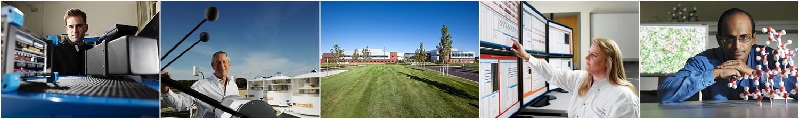
Pacific Northwest National Laboratory
Questions

Slide 41
Backup Slides

Slide 42
International Incidents
IAEA reported 18 incidents involving the smuggling of weapons grade nuclear materials between 1993 and 2004.
1994: police at the Munich airport intercepted a suitcase from Moscow with half a kilogram of nuclear-reactor fuel (363 grams weapons grade Pu).
1994: Prague police seized 2.7 kilograms of HEU from a former worker at a Russian nuclear institute.
1995: Chechen rebels buried a small amount of ¹³⁷Cs in a Moscow park and notified Russian television crew.
2004: Russian Customs uncovered some 200 attempts to smuggle nuclear or radiological materials.
42
42

Slide 43
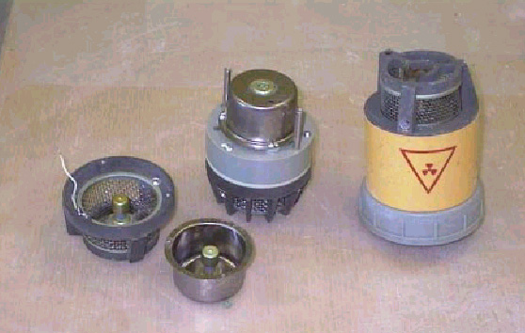
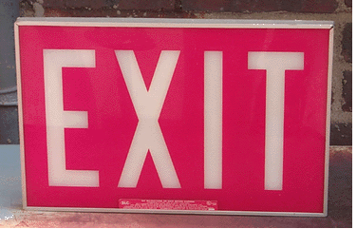
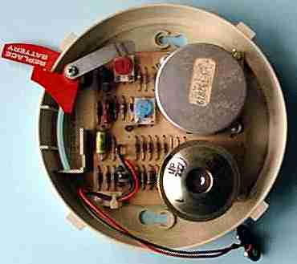
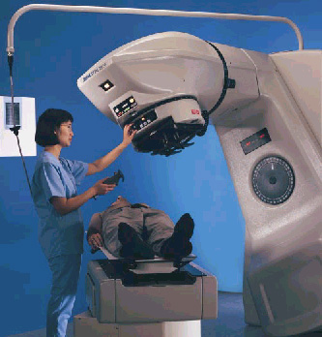



Consumer & Therapy Sources
Radiation Therapy
Brachytherapy
43
Notes:
Tritium and 241Am sources

Slide 44




Industrial Radiography, Irradiators, DU
747 Airplane Counterweights
Photo Courtesy Boeing
Notes:
192Ir or 60Co, 25-200 Ci (new)

Slide 45





Non-Traditional Vectors
Transportation Modes
Unpredictable Delivery
45

Slide 46

Photon Interactions With Matter
X-rays and gamma rays – three interactions
  Photoelectric effect – low energy (~ 1 eV - 100 keV)
  Compton effect (scattering) – medium energy (~100 – 2000 keV)
  Pair production - higher energy (> 2000 keV)
Photons have an attenuation length, not a range
  For 1 MeV gamma rays in tissue, 66% are gone after 10 cm, and 98% are gone after 40 cm
e⁺
e⁻
e⁻
e⁻
e⁻
Photoelectric Effect
Compton Scattering
Pair Production

Slide 47

Charged Particle Interactions With Matter
Alphas, betas, and other charged particles
  Interact with electrons through their electric charge
  Energy lost through multiple scattering events
  Relativity is important for betas
  Positrons annihilate with electrons after slowing down
  Protons/heavy ions lose most energy at end of range
α, β, p …
α, β, p …
e⁻
e⁻

Slide 48
Neutron Interactions With Matter
Neutrons
  Uncharged, so no electromagnetic interaction
  Scattering and absorption through the strong force
  Attenuation length similar to photons
  Hard to shield
1 MeV neutrons penetrate 10 cm in tissue
10 MeV neutrons penetrate 50 cm in tissue
n
n
n
Elastic Scattering
Absorption

Slide 49

Gamma Ray Spectra (HPGe)

Slide 50

Alarms From 3 Border Crossings

Slide 51





RPM Concept of Operations
Detect
Confirm
Isolate
Identify
Respond
Primary Detection
Secondary Detection
Isolation
Identification of Isotope
Seize/Arrest
or Release
Gamma Detectors – Poly-Vinyl Toluene (PVT) Plastic Scintillators
Neutron Detectors – Moderated Helium-3 Gas Tubes
Neutron Scan

Slide 52
Baseline Depression
Potential
Threshold
Above NORM
Potential
SNM Source
in NORM
Potential
Medical
Signal
Normal
“No-Vehicle”
Background
Potential NORM Profile
Potential
SNM Source
w/o NORM
Depressed Baseline
SNM Calibration
Source Signal
w/o Vehicle
Fraction of
Normal
Background
Extra Baseline Dip
52

Slide 53
Background Radiation
Background radiation: 360 mrem/y (3.6 mSv/y)
Source | Dose (mrem)
Medical x-rays | 103
Chicago | 80
Miami | 65
Denver | 125
Airline crew, 720 hours | 160
Airline passenger, 10 flights | 3
Tobacco, 1.5 pack/day | 8000
Bricks and masonry | 7
Smoke detectors | 1
Clocks | 9
Global fallout | 4
Gas ranges | 8
TV, males | 1
TV, females | 0.3
Nuclear power | 0.3

Slide 54
Medical Radiation
Medical x-rays have become the dominant background radiation for many Americans
Chest x-ray ~20 mrem
Dental - full set of 16 films ~3 rem to head
Frequent x-rays should be avoided
A dose of 500 rem to the whole body is lethal 50% of the time in 60 days
  If a person lives 100 years, and there were no repair, 5 rem/y would be fatal in 100 years (50% of time)
  5 rem/y is the legal limit for radiation workers
  0.5 rem/y is the legal limit for general population

Slide 55

Biological Effects
Radiation dose correlated with cancer rate, cell death, cancer deaths, cataracts, leukemia deaths
Is the linear or thresholds hypothesis true?
Cannot be experimentally tested since so small
Demonstrated Effect
Linear
Thresholds
Normal level of incidence

Slide 56
Acute Whole Body Radiation
Much of what is known is from Hiroshima and Nagasaki
If you survive the blast effects:
  1 kton bomb gives 1000 rem at 0.3 mile
  1 Mton bomb gives 1000 rem at 1.5 mile
Prompt whole body dose effects
  25-100 rem: no illness
  100-200 rem: slight illness
  200-1000 rem: survival is possible
  >1000 rem: survival is improbable

Slide 57
Medical Radiation Therapy
Diagnostics and therapeutics
  X-rays, CAT and PET
  Stress tests with ^{99m}Tc
Basis: killing cells through damage and repair
Susceptibility to damage depends on cell cycle
Rapidly dividing cells more subject to damage
Treatments over several weeks like chemotherapy
Cancer may be localized or dispersed
  External radiation, injected or implanted
  Shape beam and rotate to reduce damage to good tissue
  Oxygen enhancement

Slide 58
Units, Exposure and Dose
Unit of radioactive decay
  Curie (Ci): 1 Ci = 3.7x10¹⁰ decay/s
  Becquerel (Bq): 1 Bq = 1 decay/s
Exposure – exposed to amount of radiation
  Roentgen (R): 1 R = 2.58x10⁻⁴ coulombs/kg
Absorbed energy deposited per unit mass
  Rad: 1 rad = 0.01 J/kg
  For x-rays and gamma rays: 1 R ≈ 1 rad
  Gray: 1 Gy = 1 J/kg = 100 rad
Biological effect of radiation depends on type
  Radiation equivalent man: 1 rem = 1 rad QF
  Sievert: 1 Sv = 100 rem
  500 rem (5 Sv) whole body is fatal 50% in 60 days

Slide 59
Decay Chain Example
²³⁸U 4.5 Gy
α
²³⁴Th 24 d
β
²³⁴Pa 1.2 m
β
²³⁴U 250 ky
α
²³⁰Th 7.5x10⁴ y
α
²²⁶Ra 1502 y
α
²²²Rn 3.8 d
α
²¹⁸Po 27 m
β
²¹⁸At 1.8x10⁻⁴ s
…
²⁰⁶Pb

Slide 60




Benefits of Energy-Window Ratio
Truck with NORM cargo
Truck with dense cargo
Gross Counts
Gross Counts
Notional
Thresholds
Simple EWR
Simple EWR
Reduce NORM alarms
Reduce effects of
background suppression

Slide 61
Standards
ANSI N42.41: Minimum Performance Criteria for Active Interrogation Systems used for Homeland Security
  Non-intrusive inspection of closed containers, vehicles, and packages, but not imaging
  Inspection times of 90-900 s depending on size
  Test masses: explosives (200 kg), chemicals (200 kg), fissionable material (25 kg), weapon shells (16 kg)
Standards establish test methods based on threat-informed unclassified source materials and configurations
Standards establish performance requirements for automated active systems that detect shielded SNM
20 cm
20 cm
61
61
20 cm

Slide 62

Active Interrogation
From Morse

Slide 63



Active Interrogation (AI)
AI initiated by energetic photons, neutrons or muons
Detected signal is photons, neutrons or muons
Large source required giving large dose
Our study includes only:
  High-Z: presence of high atomic number (Z) material
  Photofission: presence of fissionable material
  Differential die-away: presence of fissile material
  Nuclear resonance fluorescence: presence of HEU or Pu
63
Notes:
CAARS: SAIC – L3 – AS&E
Raytheon - Passport

Slide 64


Modeling With MCNP & GEANT4
Analytical calculations performed to establish order of magnitude requirements
MCNP models of differential die-away (DDA): comparison made to published information provided model validation
MCNP models of PF for SNM and surrogates
9 MeV Bremsstrahlung beam GEANT4 simulation
Neutron die-away times observed for bare tungsten, DU, HEU and Pu.
64

Slide 65



Muon Scattering Detection
Cosmic ray muons used
Muon scattering is highly dependent on density
Measure the muon path through a vehicle
Demonstrated to show presence of high density material like HEU and Pu
Takes minutes to make a measurement because of small muon flux of ~160 m⁻¹s⁻¹
Decision Sciences

Slide 66


Is Active Interrogation Feasible?
Can we do 100% imaging?
Is active interrogation operationally possible?
  AI cannot be used in primary screening, so limited to targeted containers
  Large dose
  Large footprint (on private land)
  Large cost
  If looking for a weapon, it is too late!
Passport
Rapiscan

Slide 67
High-Z & Photofission Detection
Interrogate with x-rays and look for gamma-rays or neutrons
DU is a good surrogate material for High-Z detection and Photofission
Surrogate for high-Z detection can be 2 kg DU
Surrogate for Photofission detection can be 2 kg
  Consider prompt neutrons, delayed neutrons and delayed gamma rays
  Too many combinations of possible surrogate masses: Pb attenuators used to reduce signal to correct value
67

Slide 68
Differential Die-Away
Interrogate with neutron pulse
LEU is a usable surrogate for DDA
Surrogate mass for DDA is 2 kg LEU
Surrogate provides similar response as HEU & Pu
Comparison of PNNL validation model results with measured data (Jordan et al. 2007)
68

Slide 69

Nuclear Resonance Fluorescence
Interrogate with gamma-rays and observe gamma-ray signal
DU is good surrogate material for NRF
NRF signal size depends on mode (transmission or scattering) and HEU or Pu
Surrogate for NRF is 2 kg DU
  2 kg DU provides more signal than SNM
  Pb attenuators used to reduce signal to correct value and depends on transmission or scattering modes
69

