Slide 1

Nuclear Energy
Some Basics & Statistics
Abdallah Lyoussi
CEA/IRESNE, France
Senior Fellow
(IEEE DL)
abdallah.lyoussi@cea.fr
Abdallah Lyoussi

Slide 2
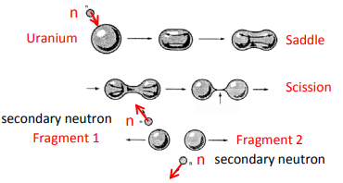
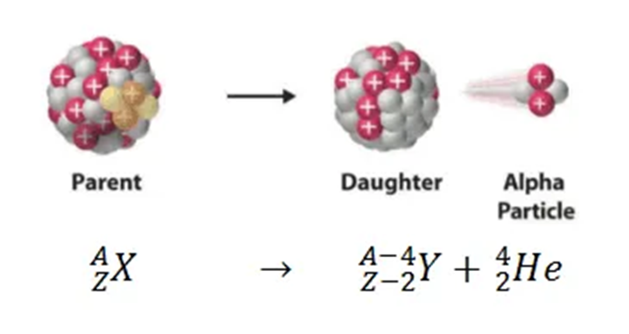
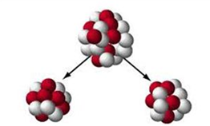
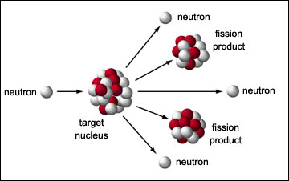
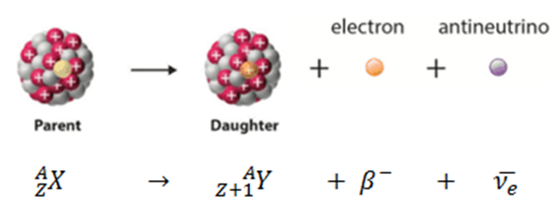
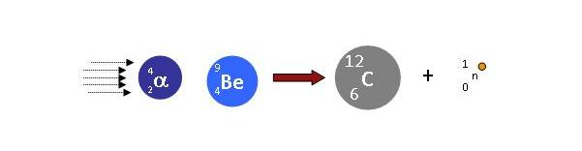
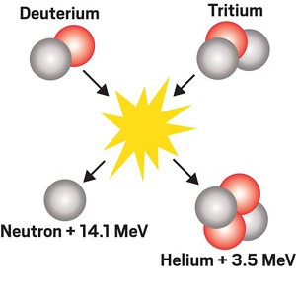
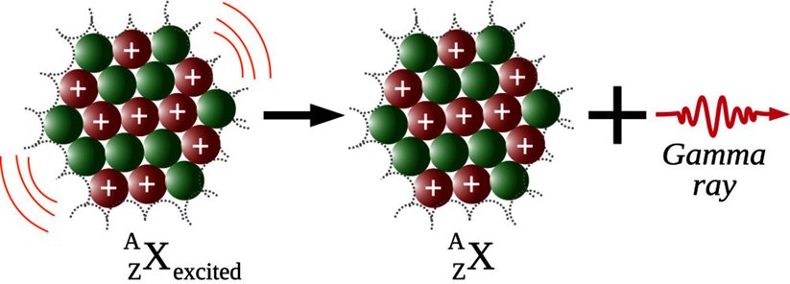
Nuclear reactions
Spontaneous and induced reactions
Induced fission
Spontaneous fission :
- Occurs with a very heavy nucleus (Z>90)
- The electromagnetic repellent force overcomes the strong nuclear force
- The nucleus splits
- Will eject 2-4 neutrons per reaction
≈ 200 MeV
Induced fusion
a + A ⇒ B + b
Incident particle
Ejected particle
Nucleus target
Residual nucleus
2

Slide 3
Nuclear reactions
a + A ⇒ B + b
Incident particle
Ejected particle
Nucleus target
Residual nucleus
Some nuclear reactions release energy while other reactions require input energy to occur
The amount of energy released or absorbed in a nuclear reaction (in the center of mass reference frame) is called the Q value or Reaction Energy
Q = [(M_{a} + M_{A} – (M_{b}+M_{B})] c ²
If Q > 0 ⇔ Exoergic reaction
If Q<O ⇔ Endoergic reaction
An endoergic reaction could not proceed unless the incoming particle provides the reaction energy Q (in CM).
3

Slide 4
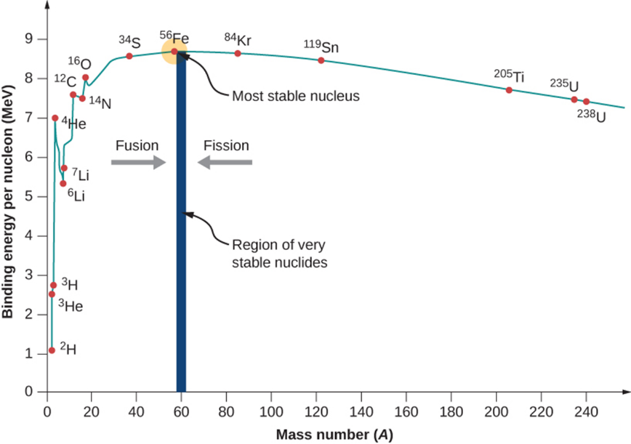
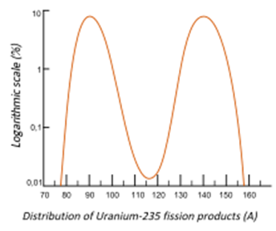
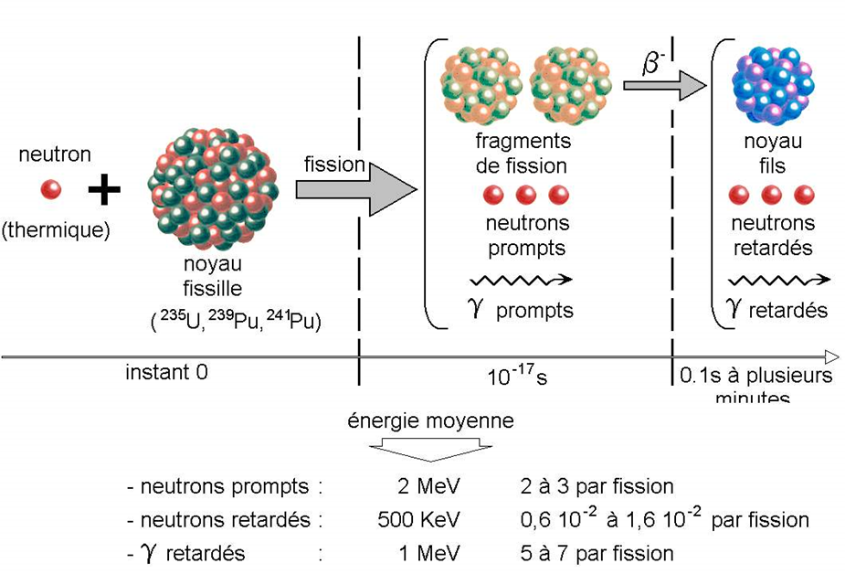
Exoenergetic Nuclear Reactions
17,6 MeV generated
(3.5 MeV/nucl.)
200 MeV generated
(0.8 MeV/nucl.)
4

Slide 5
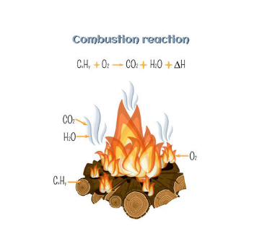
Exoenergetic Chemical Reactions
Conventional combustion
Chemical reaction of H or C with O :
  H₂ + 0,5 O₂ ⇒ H₂O with
  E = 1,4 eV/atom of H
  C + O₂ ⇒ CO₂
  E = 4 eV/atom
Energy balance 10⁷ à 10⁸ lower than nuclear reactions :
  Fission (200 MeV/reaction, 0,8 MeV/nucleon)
  Fusion (17,6 MeV/reaction, 3,5 MeV/nucleon)
5

Slide 6
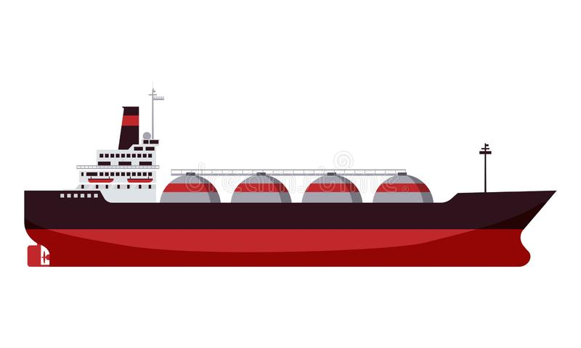
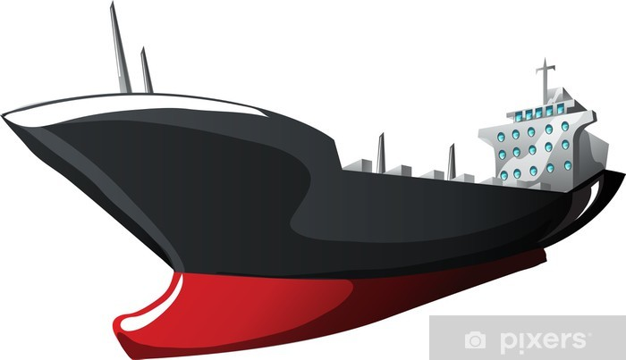
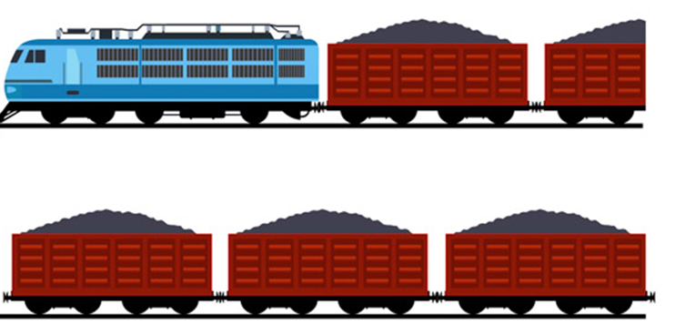
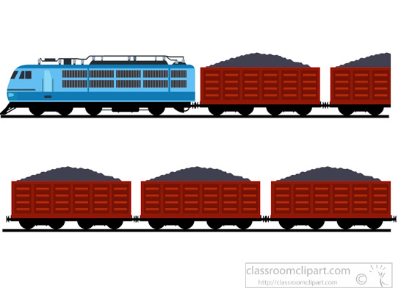

To produce 1 GWE ≡ 1.25 % of the French electricity consumption (523 TWh in 2021)
1 year of production with availability rate of 75%
Gas ⇒ 1.8 billions m³
30 LNG* Tankers
Oil ⇒ 1 300 000 tons
15 to 45 Oil Tankers
Coal ⇒ 2 000 000 tons
600 Trains
Uranium ⇒ 150 t of Nat. U
(25 t of 4% enriched Uranium
6 Semi-Trailer Trucks
(*)Liquid Natural Gas
6

Slide 7
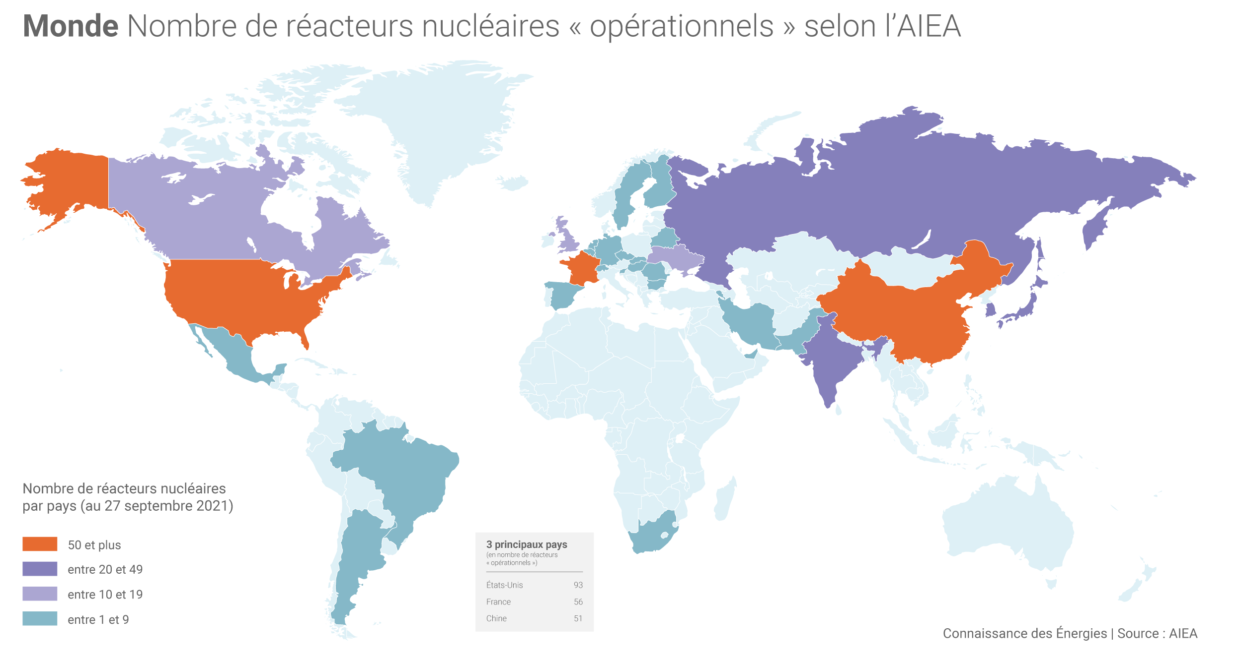
Worldwide electronuclear landscape: 442 reactors in the world
7
7

Slide 8
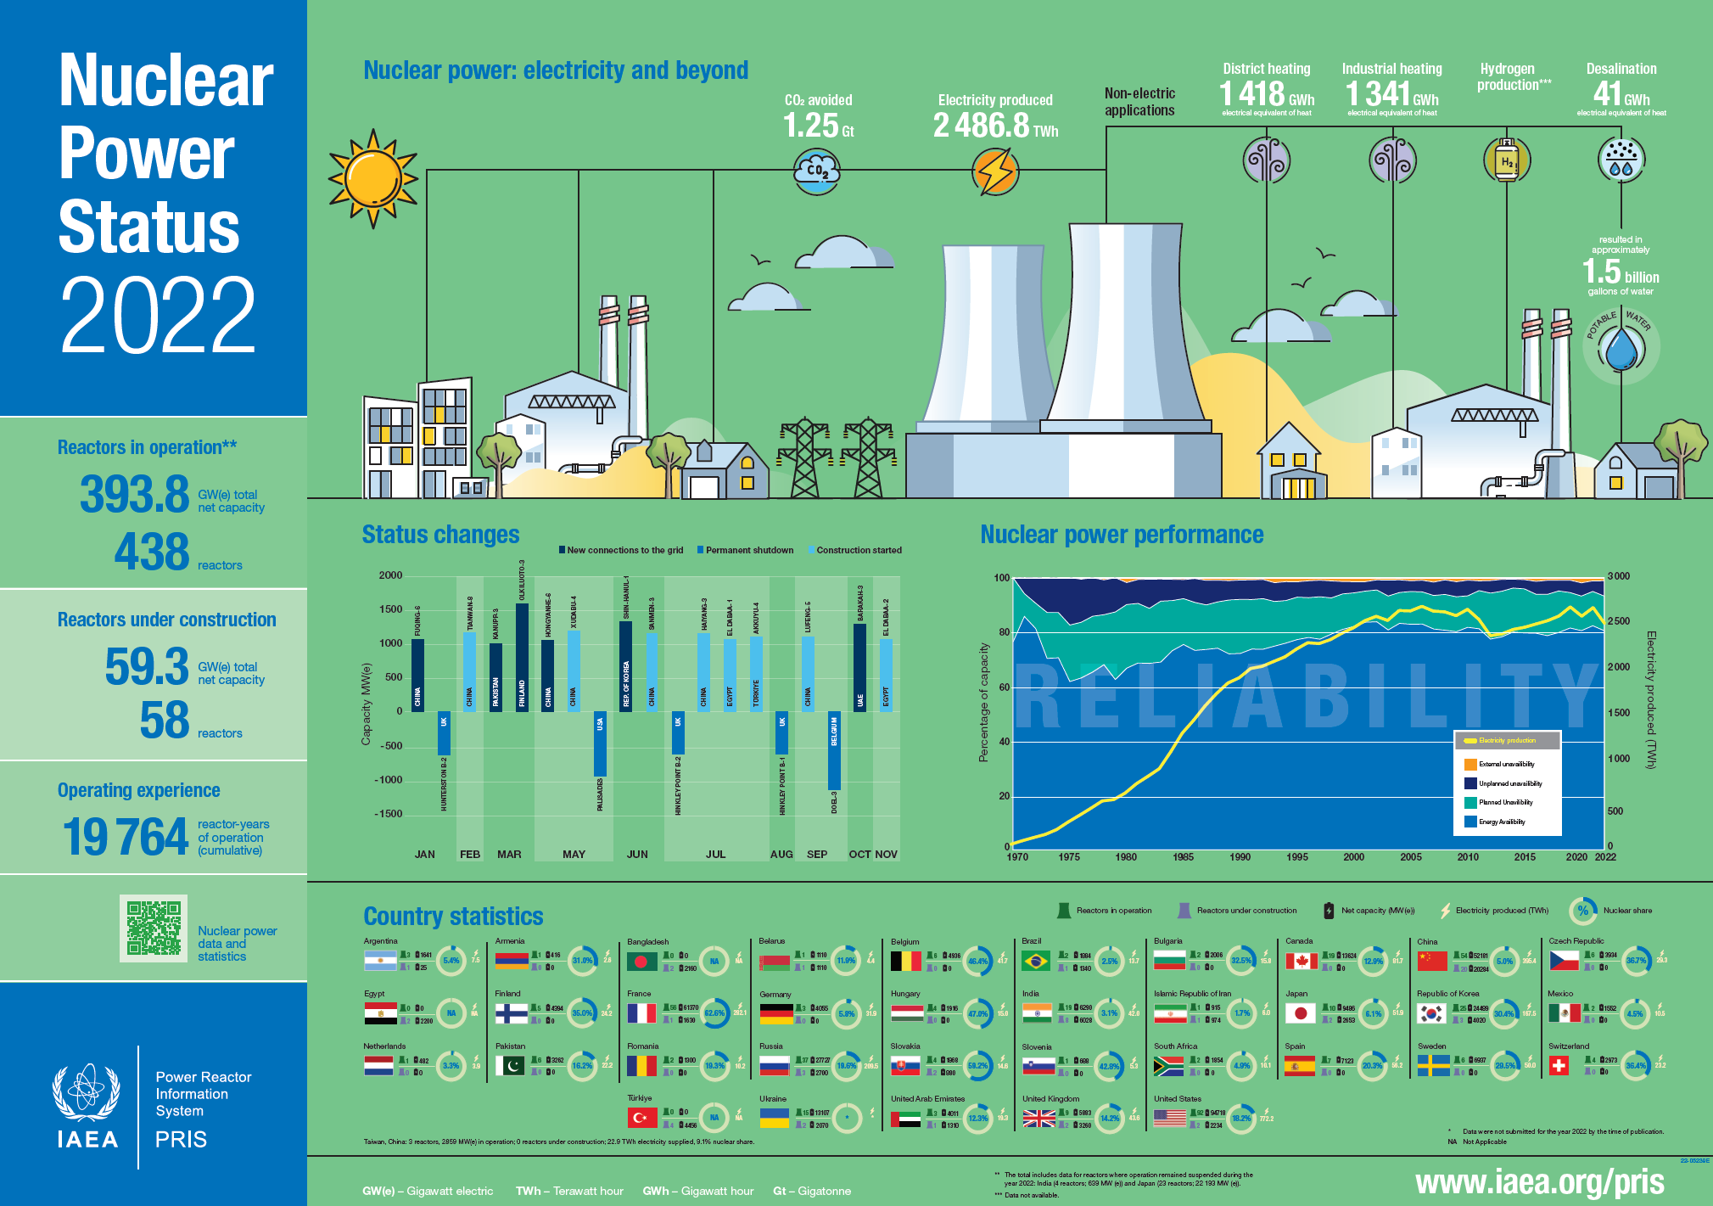

Slide 9
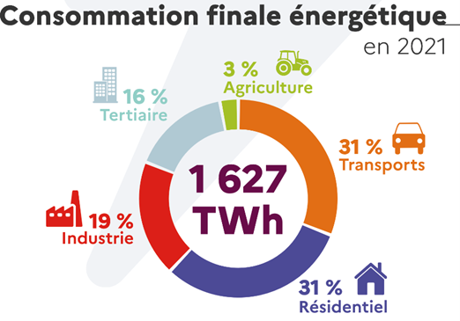
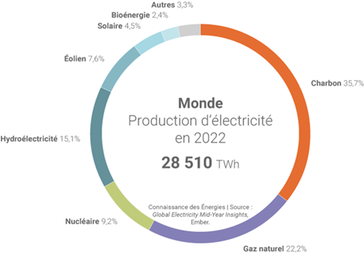
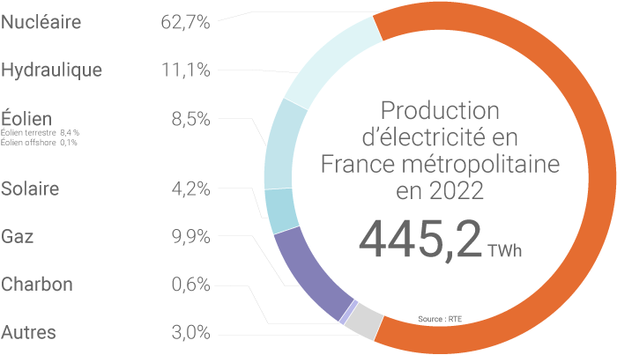

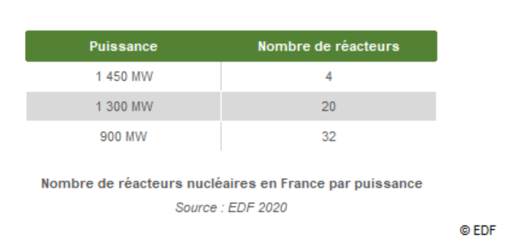
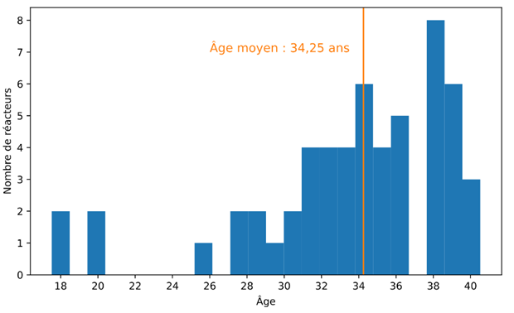
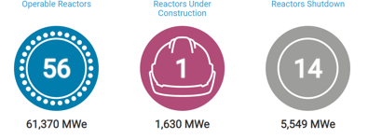
442 in the world and 56 in France so far…
< 20 % de la consommation totale d’énergie
< 4 % de la consommation totale d’énergie
9

Slide 10
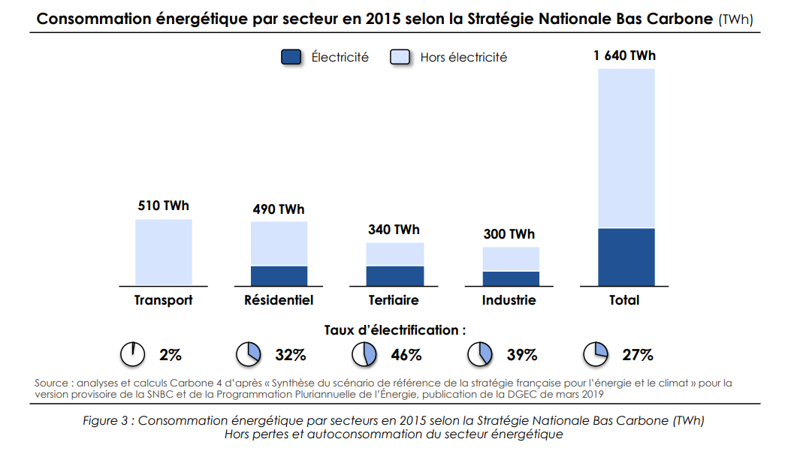
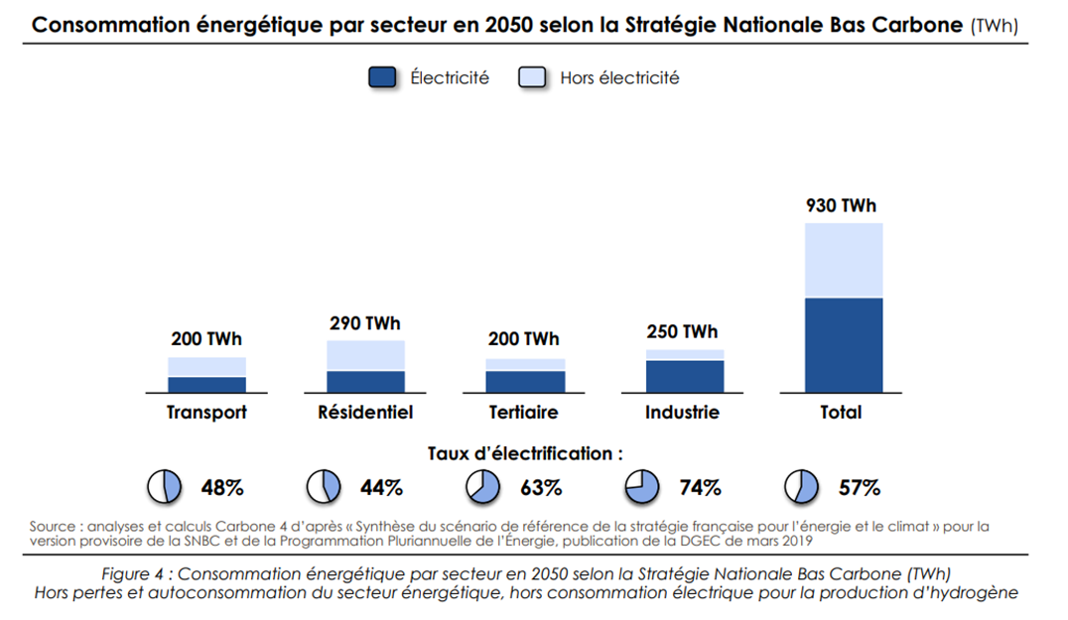


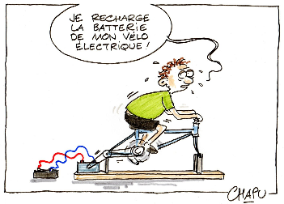

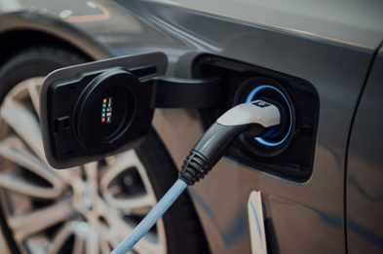
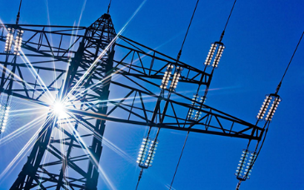
The future will be Electrical…or it will not be
- 40% Tot
+20% Elec
Carbon Neutrality
The world will need more than 15 GW of new nuclear every year until 2070 according to IEA
10

Slide 11
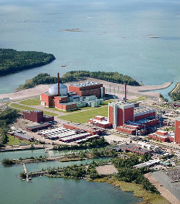
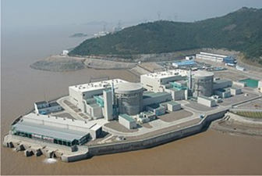
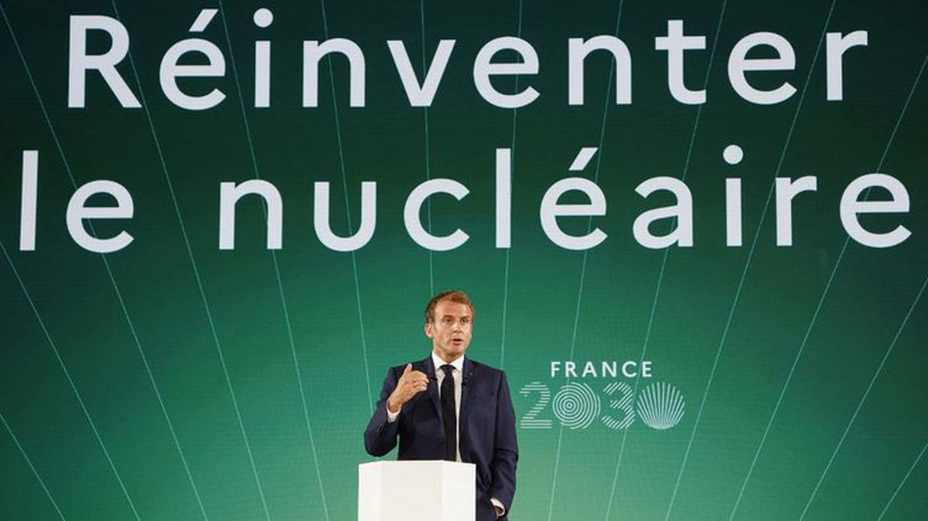

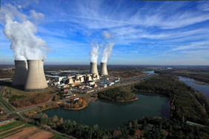
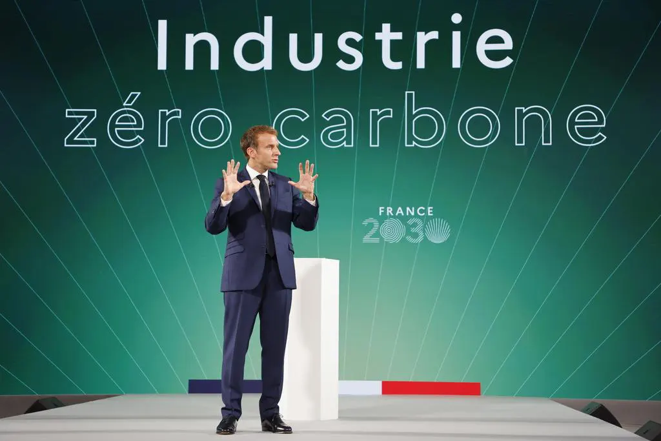
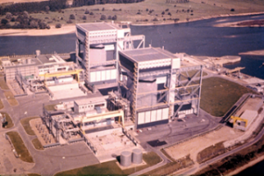
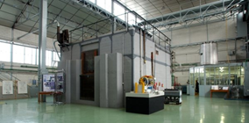



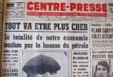
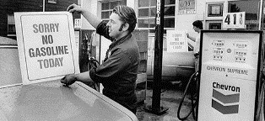
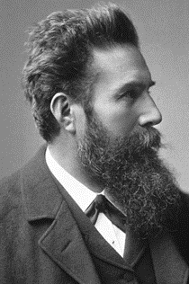
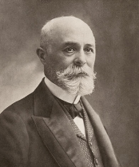
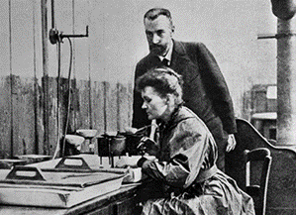
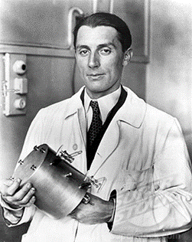
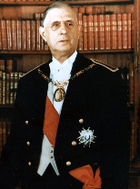
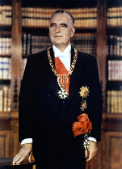
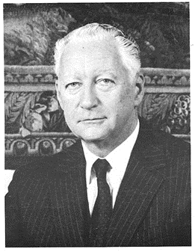
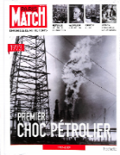
The French Nuclear Energy Epopee
Numb. of reactors #56
# 56 PWRs;
360,9 TWh
~ 69,% of Electricity
~ 92% Low Carbone Emission
Total power* (Gwe)
Advanced LWRs
-Enhanced Safety
-Highly Economical
-Reducing wastes
-Proliferation resistant
Generation I
Generation II
Generation III & III+
SMR/AMR
61.3 (2020)
Commercial reactors
Generation IV
54.2 (1990)
AP600
System 80+
CANDU6
ABWR
ACR1000
AP1000
EPR
ESBWR
Early prototypes
13.6 (1980)
PWR
REP900
REP1300
N4
AGR
BWR
CANDU
RBMK
UNGG
ChoozA
Magnox
Zoé, the 1st French nuclear reactor
0
F. Perrin & M. Curie
(*)https://cnpp.iaea.org/countryprofiles/France/France.htm
W. Röntgen
H. Becquerel
P. and M. Curie
F. Joliot
Ch. De Gaulle
G. Pompidou
Pierre Messmer
1900
1910
1920
1930
1940
1950
1960
1970
1980
1990
2000
2010
2020
2030
2040
2050
11
Notes:
France’s relationship with nuclear power and research spans over 100 years.
From the very first discovery of natural radioactivity by scientist Antoine Henri Becquerel to the Curie family legacy of nuclear research, the creation of the Commissariat à l’Energie Atomique CEA (energies alternatives) to the 58 active nuclear reactors in the country today, it is fair to say that the French have a longstanding fascination with nuclear energy.
In 1945, the interim government of France led by Charles de Gaulle created the Commissariat à l’Energie Atomique (CEA) government agency and Nobel Prize laureate Frederic Joliot-Curie was appointed as its first high-commissioner.
The purpose of the CEA was/still is to conduct fundamental and applied research within the fields of nuclear reactor design, manufacturing of integrated circuits and use of radionuclides for medical treatments as well as several others.
In 1964, the first nuclear power reactor EDF1 in France was operational at Chinon on the Loire river.
The international 1973 oil crisis spurred France’s race to find a domestic source of energy. France’s Prime Minister, Pierre Messmer then decided to launch the Messmer Plan that called for dozens of nuclear reactors to be opened by 1985 and for 170 to be opened by 2000. As a result of the Plan, France constructed a total of 56 new reactors between the years of 1974 and 1989.

Slide 12
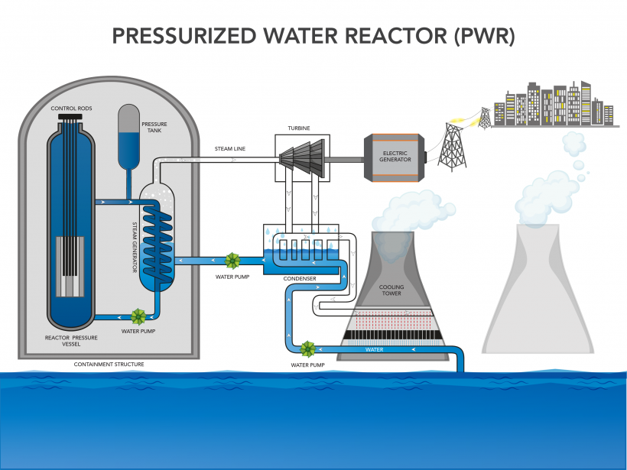
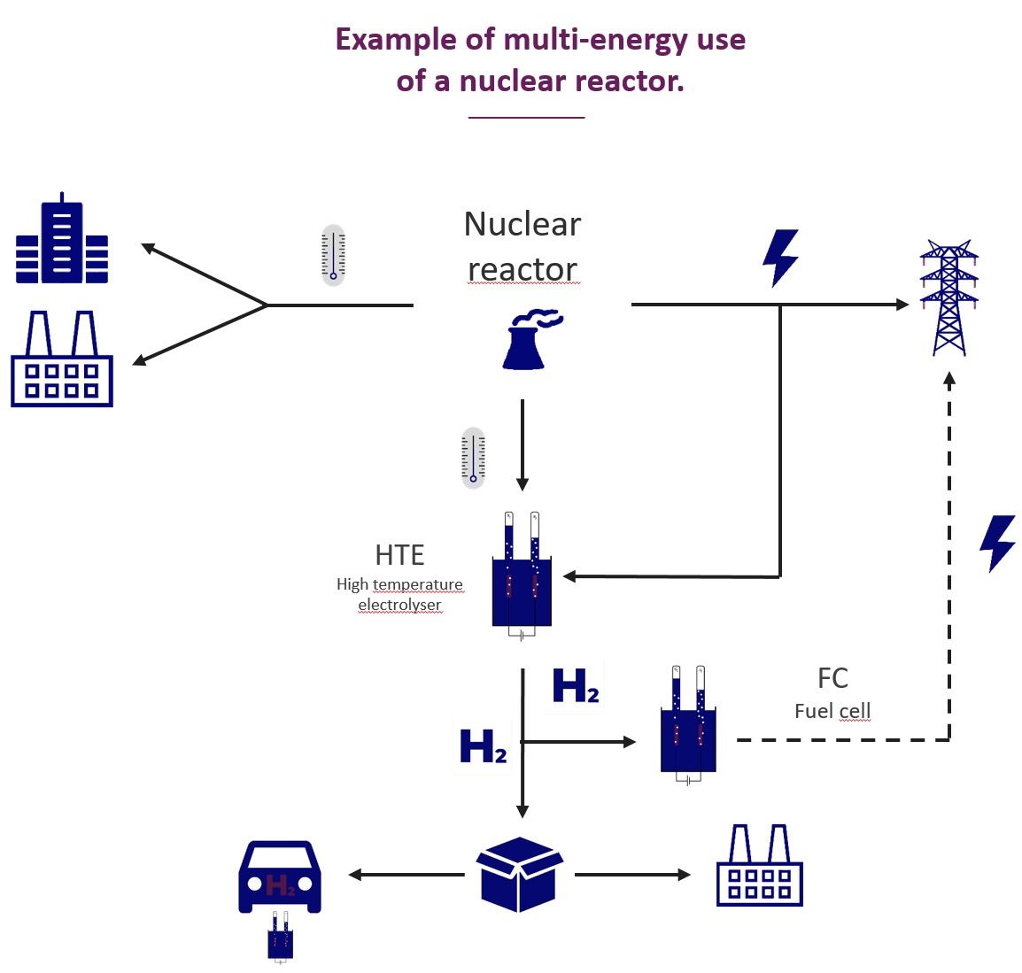
France Equiped only with PWRs
Induced fission
12

Slide 13



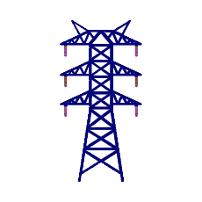


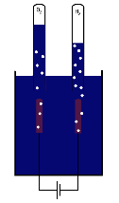





IRESNE | Towards an integrated energy system
Example of multi-energy use
of a nuclear reactor.
Reactor flexibility and load following.
    Development of more flexible fuels (IPG risk)
    Reactor and power grid studies
    Thermal storage for flexibility
Nuclear reactor
HTE
High temperature electrolyser
Other energy vectors, storage.
FC
Fuel cell
    Non-electric uses of reactors: heat sources, H2, ...
    SMR / HTE coupling, dedicated heat generator SMR ...
    Cogeneration, thermal storage
13

Slide 14




AND….The Fusion Nuclear Energy
WEST
2029
2060
14

Slide 15





The Fusion : From Tore Supra to DEMO
10⁴
G=10
10³
G=1
10²
See Mike Walsh Presentation
P
(MWth)
10
1
ITER
DEMO
JET
80 m³
800 m³
1000-3500 m³
10⁻¹
10⁻²
Tore
Supra
10⁻³
25 m³
1
10
10²
10³
10⁴
10⁵
10⁶
time (s)
15

