Slide 1
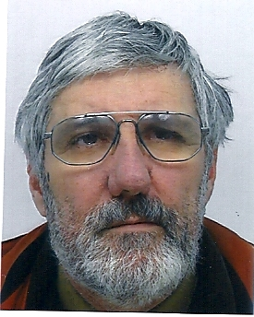

Highlighting your work
Some simple suggestions & hints!
Patrick Le Dû
patrickledu@me.com
REISS school – July 2024 2023

Slide 2
Goals of this presentation
Communicate your work is very important
  Paper writing →Simon Cherry
  Oral Presentation
  Poster
Some simple ‘personal’ suggestions & guidelines extracted from my own experiences illustrated with some typical exemples (Some extracted on web site)
Notes:
This overview interdisciplinary talk has the main purpose to present how HEP developments and evolution of front end deadtimeless low noise electronics, parallel read-out , real time selection of events (trigger), terabit data networking (DAQ) and on-line processing farms can be use to improve drastically the performances and efficiency of medical imaging devices like the Positron Emission Tomograph (PET) of next genration. The first part of the presentation will introduce the generic architectural model of future large colliding experiments like the future Colliders (ILC/CLIC) and its main features like the software trigger concept. An example of possible implementation will be shown using the new Advance Telecom Computing Architecture (ATCA) standard. Then, it will be discussed how these innovative ideas, tools and techniques of modern architectural concept in data acquisition can be applied in two particular applications of the future: the whole body Time Of Flight Positron Emission Tomography (TOF-TEP) for tumour diagnostic and the Hadrontherapy In-Beam PET for cancer treatment.

Slide 3

Oral Presentation
Extracted from UCSB McNair Scholars 2011 Summer Program

Slide 4
Purpose of an Oral presentation
In the academic community a well done oral research presentation should:
Communicate the importance of your research
Clearly state your finding and the analysis of those findings
Prompt others in the academic community to ask questions and give you valuable feedback that could further, and strengthen, your research

Slide 5
Goal of the presentation (General)
Today, it is very easy to prepare a presention with PPT BUT its depends of:
  The context (school, conference, workshop …)
  The audience (students, engineers, scientists, mixed )
  The level of the majority of the audience .
  Depends of what message you want to give (results, overview, lessons)
  Be carefull with animation
  Style of presentation and content → example later
Looks at the time you have
  Number of slides
    1 per min in average
  Quantity of information in a slide
    Depends on type of information to explain
    Isolate clearly what is important
    Graphics, tables, text, images
…

Slide 6
Title slide
Each presentation will have a title slide
The title slide must contain the title of your project, which must be the same title you used for your abstract submission
People will decide whether they want to attend your presentation based only on your title and abstract
It must include your name, your faculty mentor’s name and department, and the name and location of your institution

Slide 7
Composition of an Oral research presentation
Each research presentation, regardless of your field of study, should contain some common sections
Introduction
Background/Literature Review
Research Question(s)
Research Methods
Findings/Data
Discussion/Conclusion(s)
Future Research
References
AcknowledgementsQuestions
Be aware that your particular research project will dictate the exact sections you will have

Slide 8
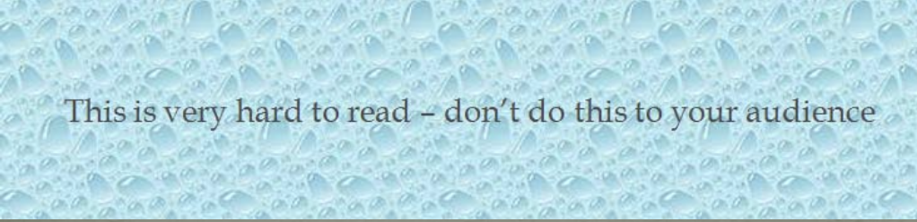


Technical aspect
Background
Use simple backgrounds that provide some visual interest
Always use the same background throughout the presentation
Try not to use backgrounds that are distracting or make it difficult to read the words
Color
Use a text color that contrasts with the background
Keep color simple:less is more
Use color for emphasis
Use colors sparingly
Use colors to tie points together
Fonts
Fonts should be standard and easy to read
Times New Roman, Arial, Calibri
The title of the slide should be about 44-point
The body of the slide should be about 22-point
You do not want your font too small so that your audience has to strain to read it
CAPITALIZE ONLY TO MAKE A POINT – NOT ALL THE TIME
Stay away from complicated and exotic fonts - Use one font style throughout

Slide 9
Technical aspects on slide layout
Avoid text heavy slides
Avoid full paragraphs unless quoting
Create a slide for each main point because it
Keeps presentation focused
Helps the audience concentrate on each point
Prevents audience from reading ahead
Think that there are visually impaired people

Slide 10
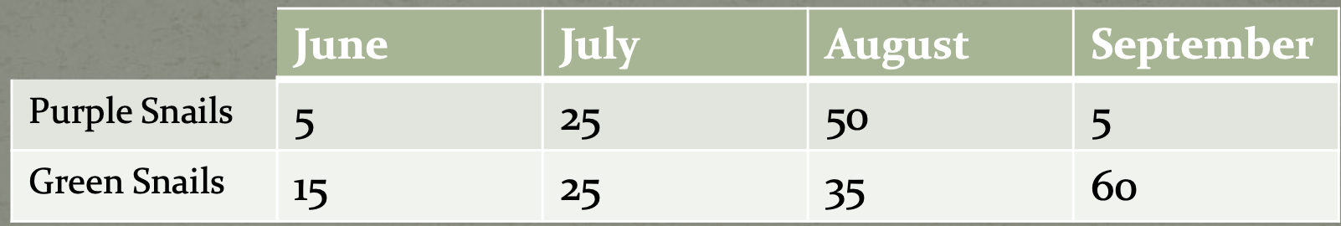
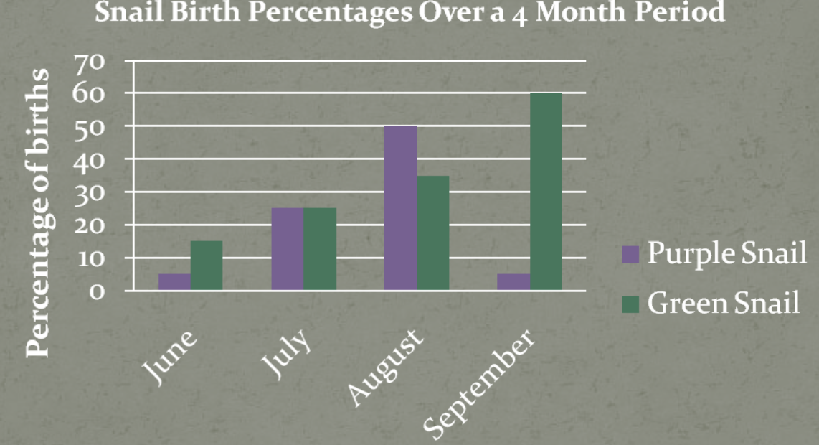
Table vs Graph
Not every table and graph is good
Do your best to display your data in the most clear, concisway possible
Remember that your audience will only have a minute or less to view your table/graph example Snail birth percentage over 4 months
Do you think this is a good table?
The following is a much better way to display the data on the previous table :
What makes this graph so much better than the table on the previous slide?

Slide 11
Technical problems to look at
(my own experience )
Your own computer vs the central one
Mac vs Windows PPT (versions)
PPT vs PDF does not look identical
Fonts
Animation
Small vs large screens
Small & large room
More about this subject as ‘back-up slides’

Slide 12
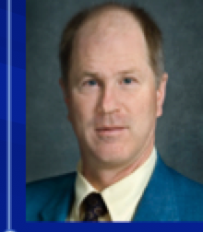
Fast Timing and TOF in PET Medical Imaging
William W. Moses
Lawrence Berkeley National Laboratory
October 15, 2008
Outline:
Time-of-Flight PET
History
Present Status
Future
This work was supported in part by the U.S. DOE (contract No. DE-AC02-05CH11231) and in part by the NIH (NIBIB grant No. R01-EB006085).
Thanks to M. Ullisch and W.-S. Choong of LBNL, M. Casey, J. Young, and B. Bendriem of Siemens Medical Solutions, and Y. Hämisch of Philips.

Slide 13

Time-of-Flight in PET
c = 30 cm/ns
500 ps timing resolution
⇒ 7.5 cm localization
Can localize source along line of flight.
Time of flight information reduces noise in images.
Variance reduction given by 2D/cΔt.
500 ps timing resolution
⇒ 5x reduction in variance!
D
Time of Flight Provides a Huge Performance Increase!
Largest Improvement in Large Patients
Notes:
One normal variation in PET cameras is the “time-of-flight” or TOF design. By measuring the difference in arrival time at the two detectors, the positron source can be localized along the line of flight. Doing this does not improve the spatial resolution, but improves the signal to noise ratio (the mechanism will be described in more detail in the next slide) — the variance improves by a factor of 2D/cΔt, where D is the diameter of the radionuclide distribution, c is the speed of light, and Δt is the TOF resolution. Several TOF PET systems were built in the 1980’s with barium fluoride or cesium fluoride scintillators. They achieved ~500 ps timing resolution, which results in 8 cm localization. For objects the size of the human head (which was what most PET cameras imaged in the 1980’s) the net result is a tomograph with a factor of ~2 lower variance than a non-TOF BGO tomograph.
Problems arose from the use of barium fluoride as a scintillator. It is less dense than BGO, and so the spatial resolution is degraded. In addition, the wavelength of its fast emission is in the hard UV, which made it difficult to work with (i.e. expensive) because it does not penetrate glass-windowed photomultiplier tubes or any known glue (to couple the crystal to the photomultiplier tube). Finally, it was difficult to keep these cameras in tune. Thus, TOF PET largely died at the end of the 80’s. However, the advent of LSO and other new PET scintillators (that can provide excellent timing resolution without the material drawbacks of barium fluoride) makes TOF a promising direction for modern PET.

Slide 14
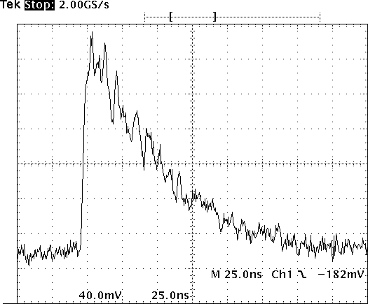
Raw Signal
From Photomultiplier Tube
Important Region for Timing
Oscilloscope
Trace from
One Event
Small Signal Level — 0.000000511 TeV
Small Fraction of Scintillation Light in Leading Edge
Fundamental Limit Due to Statistical Fluctuations

Slide 15
POSTER

Slide 16
POSTER presentation shoul contain
Logo, Photo
Title
Name, collaboration, Institution ….
Context
Details
Results
Conclusions
References

Slide 17
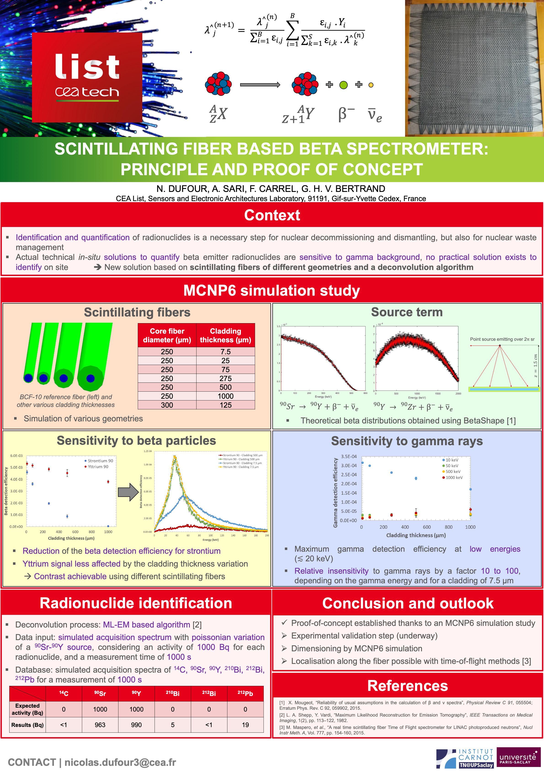
POSTER winner
Photo
Manchester 2019 NSS
Awarded “Student’
Do not load too much
No ‘small text’
Should be attractive for the eye
Should be seen from at least one meter

Slide 18
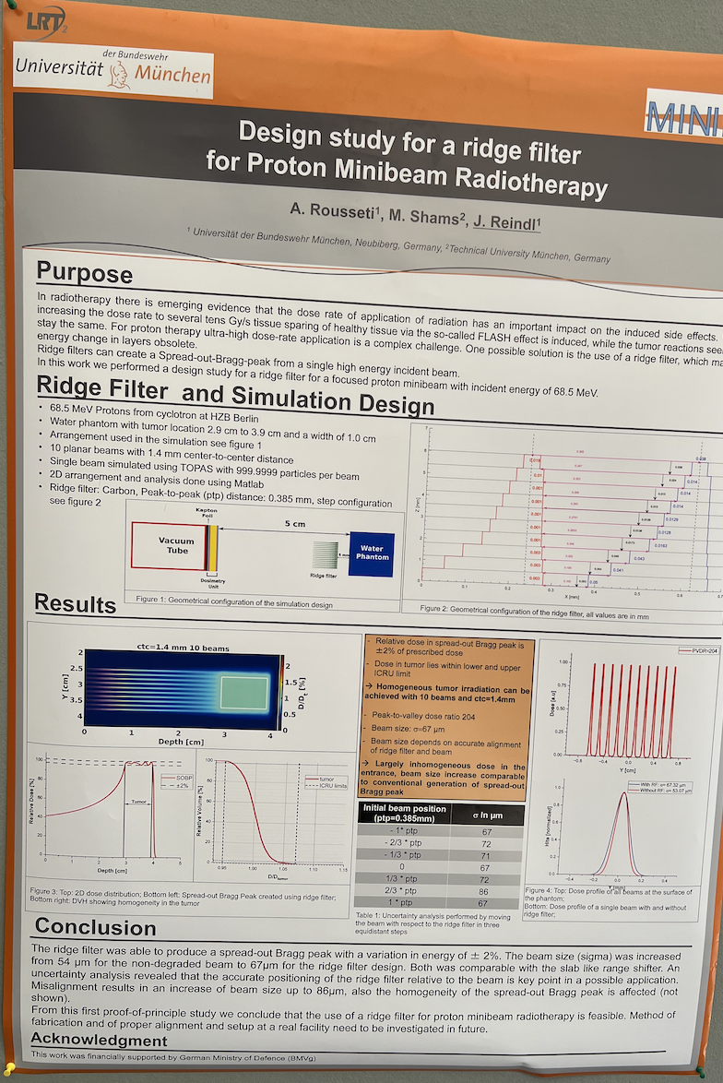
Poster Presentation recent presentation from a Munich University student

Slide 19
Thank you for your attention
Questions?
Or send me an email
patrickledu@me.com

Slide 20
More on Oral Research Presentation
Extracted from UCSB McNair Scholars 2011 Summer Program

Slide 21
Discussion/Conclusion(s)
This section is a concise summary of your main findings
Ideally you should be able to state the answer to your research question that you initially posed in the beginning
If you have only begun to answer your research question tell the audience what you know thus far and what you plan to do next to fully answer that question
This is also where you will analyze and discuss the answers you obtained from the data you showed on the previous slides
Do not make this slide too overwhelming, but rather keep it to the main findings

Slide 22
Futur research
Not all presentations will have this section, but at your stage of research you will most likely have future research goals.
State your goals in a bulleted format
Add a sentence about why you believe the research should go in this direction
You may want to brief ly mention how you plan to implement these research goals

Slide 23
References
In this section you do not want to include your entire reference list that is in your research paper
It’s best to include 3-5 key references
Be sure your references are in the proper format for your field of study

Slide 24
Acknowledgements
This section is used to thank the people, programs and funding agencies that allowed you to perform your research.
Be sure to thank:
Your faculty mentor
Any post-docs or graduate students that may have helped you  The UCSB McNair Scholars Program
And anyone else you may want to add

Slide 25
Questions ?
It’s great to include a final slide that simply says “Questions?” or “Any Questions?” in the center of the slide
If you DO NOT know the answer to a question:
It is always a bad idea to “fake” an answer to a question Just say something like:
“I actually don’t know the answer to that, but it’s a great question and I will look into it.”
Follow-up with this person after your presentation so you can send them information on what you discover
It’s often a good idea to have some extra slides prepared at the end of your presentation to answer anticipated questions

