Slide 1
Statistics and Measurements
Christian Bohm
University of Stockholm
My aim is to introduce and discuss some key statistical concepts related to measurements

Slide 2
Classical measurements
The determination of the size or magnitude of some physical entity
or
Comparison of an unknown quantity with some known quantity of the same kind

Slide 3
Assume you are measuring a fixed parameter.
The measurements are affected by fluctuating parameters that obscure the exact value, but their variations can be described by a probability distribution function (pdf) (the frequentalist view). The distribution can not be determined by one measurement
you need several measurements,
infinitely many for a exact determination, but
a smaller number, a sample, can be sufficient for an approximate determination
Sometimes the distribution can be deduced from physics

Slide 4
Thus in a measurement, it is important to identify the pdf of the result
If this is not possible - one can at least characterize the pdf
The most important parameters are position, width, skewness, etc.
(these parameters can be determined with good precision from a smaller amount of data)
Another way is to specify a distribution is to calculate its moments.

Slide 5
The position of the distribution
The expectation value of x
f’s 1:st moment
(center of gravity)
Population mean
Mode
Median
Choice of optimum position parameter depend on the type of measurement
Mean most common

Slide 6
The width of the distribution
Population variance
Expectation value
f’s 2:nd central moment
f’s 2:nd moment
σ = standard deviation
100%
FWHM
50%
FWTM
10%
f_{25%}
f_{50%}
f_{75%}
Quartile distance
Range
Choice of width parameters depends on the type of measurement
Standard deviation and Full Width Half Maximum (FWHM) most common

Slide 7
The Normal Distribution
Variable
x, real number
Parameters
σ, μ standard deviation, mean
Probability distribution
N(μ,σ²) denotes a normal distributed parameter with mean μ and standard deviation σ
FWHM=2.354σ
A 100x100 image with Gaussian data will contain about 500 2σ points and 50 3σ points.
Here finding a 5σ point is not so spectacular
μ−σ
μ+σ
68%
μ−2σ
μ+2σ
95%
μ−3σ
99.5%
μ+3σ
Also called the Gaussian distribution

Slide 8
Central limit theorem
If the independent events X_{i} have the mean μ and the variance σ²
then
has the mean Nμ and the variance Nσ²
→ i.e. the sample mean, has the mean μ and the variance σ²/N
i.e. has the mean 0 and the variance 1
The central limit theorem claims that for large Ns is normally distributed
i.e. it has the limit distribution N(0,1)
This is why the normal distribution is so important
Quadrupling the number of measurements -> halves the statistical error

Slide 9
The Binomial Distribution
Repeating independent elementary binary events (succeed – fail) each with the probability p
E.g.
Tossing coins elementary event – coin toss
Drawing tickets with replacement elementary event – draw
Radioactive decay elementary event – decay of a nucleus
Monte Carlo simulations elementary event – one case
0.25
0.2
N=20
p=0.2
0.15
Parameters
N>0 number of trails
Variable
Probability distribution
Mean
Variance
0.1
probability
0.05
0
0
2
4
6
8
10
12
14
16
18
20
0.18
0.16
N=20
p=0.5
0.14
0.12
0.1
0.08
0.06
0.04
0.02
0
0
2
4
6
8
10
12
14
16
18
20
N=50 close to normal

Slide 10
The uniform distribution
E.g.
Pseudo random number in a computer, truncation errors and digitization
errors are uniformly distributed
Variable x, real number
Parameters a, b, a < b
Probability distribution function
Mean
Variance
;

Slide 11

The Poisson distribution
If the probability per time unit for an event is constant (λ) and independent on history,
the probability for a certain number of events during a time period is Poisson distributed.
One can say that the process has no memory
Parameter
0<
λ
, events/time unit
Variabel
r≥0, the number of events
Probability distribution
Mean
Variance
Binomial distribution --> Poisson distribution with if and while
Np=const
Radioactive decays (approx. Poisson)
Histograms with many events (approx. Poisson)
0.18
0.06
Assuming Poisson instead of Binomial when p is large leads to over estimation of variance.
In semiconductor detectors this is compensated by using the Fano factor
0.16
λ=5
0.05
λ=50
0.14
0.12
0.04
0.1
0.03
0.08
0.06
0.02
0.04
0.01
0.02
0
0
2
4
6
8
10
12
14
16
18
20
0
0
10
20
30
40
50
60
70
80
90
100
Poisson distribution with n>50 looks like a normal distribution

Slide 12
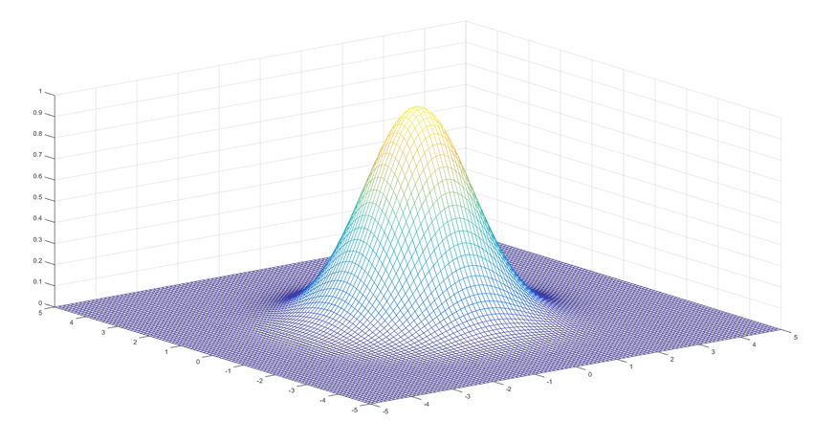
Two random variables
If you consider two random variables simultaneously, you need the combined probability distribution p(x,y),
which may or may not be separable, i.e. p(x,y)=p(x)p(y)
Separable means that the random variables are independent,
That the value of one does not affect the value of the other
If we have two random variables
then as x varies around μ_{x} y will vary around μ_{y}
The covariance will tell us if their variations are connected:
or for continuous variables:
cov(x,x)=var (x)
The covariance matrix is defined as:
cov(x,y)=cov(y,x) → V is symmetric

Slide 13
Two random variables
If the independent variables x and y have the distributions f(x) and g(y) then
z=x+y will have the distribution:
Here we have assumed that x, y and z are discrete
With continuous variables this becomes:
This operation is called a convolution

Slide 14
Correlations
The magnitude of the normalized correlation coefficient is defined as:
is always between -1 or 1:
y
y
y
x
x
x
0
Close to 1
1
Diagonal
Non-diagonal
Non-diagonal

Slide 15
Correlation and independency
x
i
x
i
x
j
x
j
corr(x_{i},x_{j})
0
0
Whether the pattern is “circular” or “elliptic” along the coordinate axes,
does not affect the correlation
Since the ellipticity can be removed by re-scaling
But it is important to remember that:
Independent
Uncorrelated
corr(x,y) = -1
for sample 1
corr(x,y) = +1
For sample 2
thus:
Here corr (x,y)= 0
for the combined sample 1 + 2
But x and y are definitely not independent

Slide 16


Multidimensional probability distributions
The multivariate distribution
If x₁ and x₂ are independent and normally distributed, the compound 2-d distribution is given by:
y marginal distribution, integrate over x
Marginal
distributions
x marginal distribution, integrate over y

Slide 17

Multivariate distributions
If x and y are correlated we get
Marginal
distributions
The marginal distributions do not tell the whole story
When reporting a result the entire covariance matrix provide valuable information

Slide 18
Error propagation
Independent errors will propagate through the formula:
y=f(x₁,x₂,x₃,,,x_{n})
according to:
n
dy = Σ{(dg/dx_{j})dx_{j}}
j=1
A corresponding formula for the propagation of variances is:
σ_{f}² = Σ{(dg/dx_{j})²σ²_{xj}}
n
j=1

Slide 19
Statistical or Systematic errors
Practical measurements are affected by both statistical and systematic errors.
The size of statistical or random errors are related to the precision.
Identify the fluctuating parameters.
Repeat and form averages ->reduced statistical errors and increased precision
Systematic error are related to accuracy
Precision and accuracy are sometimes connected
Measurements with both statistical and systematic eerors can be reported such as: x = value ± σ_{stat} (stat.) ± σ_{syst} (syst.)

Slide 20
Systematic errors
Systematic (offset) errors often require a careful analysis to determine. There are no general methods to take care of all of them.
If there are other methods to measure the parameter, comparison of the results can be used for calibration.
Monte Carlo methods can be used to estimate the sensitivity of the parameters involved
Error propagation can be used estimate the errors of the result, provided the errors are small enough to use linear approximations
Blinding
nuisance parameter
Non-linear

Slide 21
Stochastic variables
a variable x which can assume different values with the probability density function f_{x}
x is therefore completely defined by f. This is a concept that characterizes a measurement.
You can multiply sv:s with coefficients, add or subtract them
y=2x has a probability density and is thus also a stochastic variable. Here the distribution just expanded with a factor 2.
If y is a stochastic variable then so is x+y with the probability distribution f_{x} * f_{y}

Slide 22
Linear transforms of stochastic variables
The stochastic variable y=2x has the probability density f_{x}(y/2)/2
y
f_{y}
y=2x
The areas correspond
to the same event
f_{x}
Probabilities for the selected event:
f_{y}(y) dy = f_{x}(x) dx
but since: dy = y´dx = 2dx
f_{y}(y) = f_{x}(x) /2 = f_{x}(y/2) /2
Twice as wide and half as high

Slide 23
Non-linear transform of stochastic variables
The stochastic variable y=g(x) has the probability density f_{x}(x) /|g’(x)|
y
f_{y}
y=g(x)
The areas correspond
to the same event
f_{x}
Probabilities for the selected event:
f_{y}(y) dy = f_{x}(x) dx
but since: dy = g’(x) dx
f_{y}(y) = f_{x}(x) /|g’(x)| provided g(x) is one-one
If g(x) is non-linear the pdf will be deformed
But if g(x) is approximatively linear in the main range of x
then g(x) will, apart from a coefficient, have the similar pdf as x

Slide 24
Monte Carlo simulations
are consists of many choices of sv:s with different distribution functions
A uniformly distributed sv is easily generated in a computer.
You start with a seed number to initialize the random number generator which then generate a sequence of numbers, one for each function call, a sequence of approximately uniformly distributed values.
This is called pseudo random variable. If you start with the same seed you get the same sequence (very useful if you are developing a program).
The pseudo random variable can then be transformed into any desired distribution
Uniform
x = uniformRand(0, 1)
Range
x = log(1-uniformRand(0, 1))/(-λ)
Normal
x = 0;
For i=1,12
x=x+ uniformRand(0, 1)/sqrt(12)
end
Columb or Absorption

Slide 25
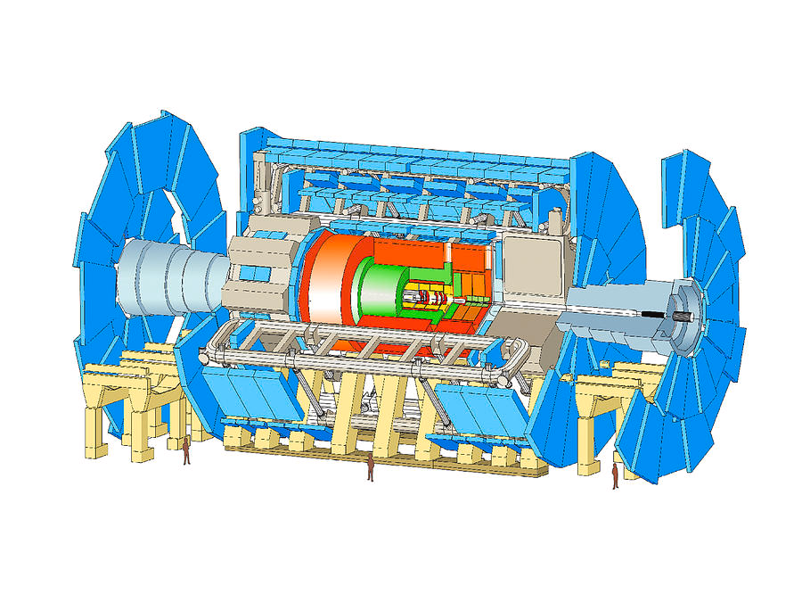
A simple simulation
A simulation of gamma-rays impinging om a cubic crystal
rotated in different angels.
The gamma-rays are scanning over a range covering the crystal in x and y (depth) direction. Gammas out of range are discarded. Inside the crystal they are tracked until escape or absorption
Compton
y
Outside range
x
γ-source
Absorption
x
Penetration
New γ, direction 0,0
Generate x,y
Compton
y
Outside crystal?
A complicated simulation
Find hit point
Generate range, absorption or Compton
n
Inside crystal, new start point
y
Absorption
Get New (Compton) direction and energy
The Atlas Detector
Geant4 framework
Gate another framework
Below energy cut-off
n
Record Energy

Slide 26
Statistics
A statistic is a function of stochastic variables
T_{N} = f(X₁,X₂, ,X_{N}) is a statistic ;where X is a measurement
The calculation {X} --> T_{N} implies a data reduction
The task is to perform data reduction without loosing information

Slide 27
Estimators
Let us use the statistics T
parameter θ
N
to estimate the physical
T
N
is the called an estimator
An infinitely large sample should give the true value
If then T
N
is consistent
The mean of a large number of small sample estimators should give the true value
If for all N then T is
unbiased
N
unbiased
biased
consistent
inconsistent

Slide 28
Estimators
If T uses the information well it is
effective
N
If T
is not sensitive to small variations in the distribution then T
N
is robust
N
A lack of consistency correspond to the presence of systematical errors

Slide 29
Samples
If you have a sample with N measured values x_{i} then
It is a consistent estimator of the population mean μ
One also easily show that it is unbiased,
since the mean of many small samples is the same as the mean
of one large sample
and
are both consistent estimators of σ² but
only the right one is unbiased
Why N-1?
is more central in the sample than μ thus
N-1 compensates for the under estimation

Slide 30
We need many measurements to claim a discovery
To determine if N observed events include a new type of events that would constitute a discovery we must determine if the data could be produced by combinations of well-understood events.
The probability for such events is the background B and its standard deviation σ(B)=sqrt(B) (Poisson statistics)
For N to contain a discovery, N must be significantly larger than B
For example if N is 80 and B is 64 then σ(B) is 8
N is 2σ above B i.e. 2% probability that N is just random noise
If we measure 4 times as long N´ will be at 320 and B´ 256 making σ(B´) 16, i.e. the difference is then about 4σ corresponding to 0.004% that the measurement is just random noise. This is a much smaller probability but it is not enough to claim a discovery.
5σ (0.00002% it is gaussian noise) is often required for discovery.
However, this argument assumes no systematic errors. Increasing the number of events means that the relative influence of the systematic errors increase.
Normal distribution
Almost the same
as Poisson if N>50
68.3
95.5
99.7
μ−σ
μ
μ+σ

Slide 31
Tests of hypotheses
H0 the null-hypothesis the hypothesis you want to test - e.g. there is a pulse
H1 an alternative hypothesis – there was no pulse, just noise
Error of the first kind (E1): Erroneous rejection of the null-hypothesis – loosing the pulse, inefficiency
Error of the second kind (E2): Erroneous rejection of the alternate hypothesis – reading noise as a pulse
Choose a limit so that P(E2) becomes sufficiently small – below a significance level 5% is common.
If P(E2) becomes too large improve the data (more measurements)
Difficult to optimize choice of two conflicting parameters
Find a cost function which includes the probabilities and the cost caused by the different errors
Choose a limit that minimizes the cost function
Reject H0
Accept H0
P(X|H1)
P(X|H0)
P(E1)
P(E2)

Slide 32
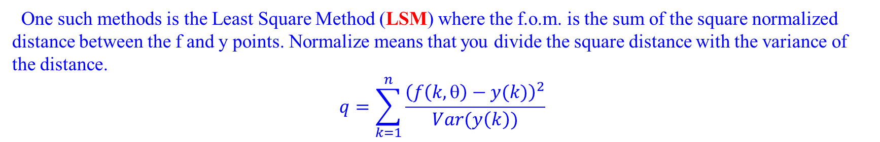
Fitting parametrized expressions to data sequences
To fit a theoretical expression f(k,θ) that depends on the parameter θ to a set of data y(k) where k=1 to n, you need a figure of merit to optimize. The f.o.m. expresses how close f and y are.
One such methods is the Least Square Method (LSM) where the f.o.m. is the sum of the square normalized distance between the f and y points. Normalize means that you divide the square distance with the variance of the distance.
$$q=\sum_{k=1}^{n}{\frac{{\left(f\left(k,\text{q}\right)−y(k)\right)}^{2}}{Var(y\left(k\right))}}$$
The sum of the squares q are χ²-distributed, where the degrees of freedom is the number of data points minus the number of parameters fitted.
Another method is to calculate the probability (Likelihood) for getting the measurement results y if θ is the parameter value, P(y| θ). The parameter values are chosen that maximizes the Likelihood (ML-method) or which is the same - maximizes logarithm.

Slide 33
The χ²-distribution
If x_{i} are N different N(0,1) normal distributed variables then the sum
is χ²-distributed with N degrees of freedom
Variable
q, positive real number
Parameter
N degrees of freedom
Probability distribution
Mean
Variance
The Γ-function is defined as:
0
2
4
6
8
10
12
14
16
18
20

Slide 34
Bayes’ theorem
P(A) is the probability that A will occur
P(A|B) is the conditional probability that A will occur if B has occured
A
B
AB
P(B|A) = P(AB)/P(A) →
P(AB) = P(A)P(B|A) = P(A|B)P(B) Bayes’ theorem
Bayesian methods
P(A) Prior distribution
P(A|B) Experiment result
P(AB) Posterior distribution

Slide 35
The Bayesian approach
. C
In the Bayesian approach p is interpreted as the degree of belief and
the Bayes’ theorem is used to combine results from different experiments.
The a priori (initial) knowledge can be expressed with a probability distribution p(μ,σ),
which has a mean, μ, and a standard deviation, σ.
The result of an experiment can be expressed with the probability distribution p´(μ´,σ´).
In Bayesian statistics, these results are combined into an a posteriori result p”(μ”,σ”).
c is a normalization coefficient
. C
Here the arbitrariness of the selection of the a priori knowledge is a problem

Slide 36
This process can then be repeated with more experiments.
p(μ_{r},σ_{r})= p(μ₂,σ₂) . p(μ₁,σ₁) . p(μ_{a},σ_{a}) . c
If p is normal then n combined identical experiments will result in:
p(μ_{n},σ_{n})= p(μ,σ) . . p(μ,σ) . c
N times
(2πσ²/N)^{-1/2.}e^{-N(x-μ)2/(2σ2)}=(2πσ²)^{-1/2.}e^{-(x-μ)2/(2σ2).} . . (2πσ²)^{-1/2.}e^{-(x-μ)2/(2σ2)} . c
N times
N(μ,σ/sqrt(Ν))= N(μ,σ) . . N(μ,σ) . c
N times
The same result as the Central Limit Theorem

Slide 37
If the probability distributions are normal, the relationship between the means and the variances will be:
This, in turn, can be restated as
where
is a reduction factor expressing how much the variance reduces when incorporating the information
from the second experiment.

Slide 38
Stochastic Processes
Random variable
ensemble
A stochastic process is a family (ensemble) of functions
depends on time t and the outcome of the experiment ζ (family member)
It is thus a time dependent stochastic variable whose values can be described by a multiordered PDF:

Slide 39
Stochastic Processes
The mean function η(t) and the autocorrelation function R(t₁,t₂) are defined as:
and
A process is stationary in a strict sense (SSS) when none of its statistics are influenced by a displacement in time.
A process is stationary in a weak sense (WSS) if this is true for the mean and the correlation function.
SSS implies WSS, but a normal WSS is also SSS.

Slide 40
  Signals
Signals are information carrying variations in a medium.
The information is encoded in the pattern and the medium is a space that provides a path between different points in space and time, the information channel.
There are different types of signals depending of media such as:
Electrical signals in wires
Electro magnetic signals in air and in fibers
Mechanical signals in different media
Neutrino signals (communication with submarines)
Chemical signals (transmitter substances between nerve cells)
DNA segments (Genes)
Signals can be of long duration or limited in time. In the latter case we talk about pulses.

Slide 41
  Noise
Noise are statistical fluctuations in the media that do not carry information.
The noise pattern is only determined with respect to its statistic properties (auto correlation) and is in many practical situation usually stationary
Mathematically described by stochastic processes.
Interference – influence from other sources or media in the environment such as via electromagnetic fields or via electric connections (electric interference) or via vibrations (microphonics)
There are also different types of noise such as:
Electrical signals in wires - Thermal noise (Brownian motion, Einstein), quantization
Electro magnetic signals in air and in fibers Microwave background, Brownian motion
Mechanical signals in different media Brownian motion
Neutrino signals (communication with submarines)
Chemical signals (transmitter substances between nerve cells)
DNA segments (Genes) Mutations
We usually assume that the noise has a zero mean
The noise auto correlation function is a measure of how fast a noise instant is forgotten.

Slide 42
Noise spectra and correlations
One can show that the power spectrum S, i.e. the squared magnitude of the Fourier transform and the auto correlation form a Fourier transform pair (Weiner-Khinchins theorem).
Some noise sources produce noise that can be approximated as a series of impulses. Such an idealized ”white noise” (all the frequency components have the same amplitude) corresponds to infinite energy.
The autocorrelation for white noise is an impulse function. The ”noise impulse" has an infinitesimal extension in time and can thus not affect later noise contributions.
The ideal white noise spectrum (the FT of the autocorrelation) is constant in frequency.
In reality the noise is always limited in frequency due to physics reasons. There are no modules or media that can propagate infinite frequencies and infinite velocities.
Additional frequency limitations reduce the total noise energy.
t
ω
Fourier Transform
Square
Fourier Transform
ω
τ

Slide 43
1/f noise
The 1/f noise reduces with increased frequency and is therefore called ”pink noise”.
One example is the flicker noise, which is produced when charge carriers recombine in transistors.
Many 1/f sources, mainly from active components, contributing to 1/f noise have not been satisfactory explained. Some types are caused by surface effects on semiconductor materials.
The noise spectra are 1/f^{n} where 0.8<n<1.5
Square+
Fourier Transform
In this case the auto correlation will not be impulsive.

Slide 44

Bit Error Rates (BER)
1
0
When transmitting digital signals the Bit Error Rate is an important figure of merit. The BER depends on the distance between 0 and 1 related to the noise level and the sample time. One usually assumes normally distributed noise.
If the noiseless 1 and 0 are separated by one σ away we will get a bit error i.e. an error of the first kind every third measurement (32%)
If the transition level is two σ away we will get a bit error every 20th measurement (5%)
Usually one is interested in BERs around 10⁻¹⁵ or so

Slide 45
Thank you for your attention

