Slide 1

Data Analysis with Jupyter Notebook and Python, supported with AI from ChatGPT
Aziza Zendour, Stefan Riit
Paul Scherrer Institute (PSI), Switzerland
Laboratory of Particle Physics (LTP), Muon Group
IEEE NPSS Rabat Educom Instrumentation Summer School
July 1-10,2024

Slide 2
Outline
Introduction to ChatGPT and Some Practical Applications
Data Analysis with Jupyter Notebook and Python, supported with AI from ChatGPT

Slide 3
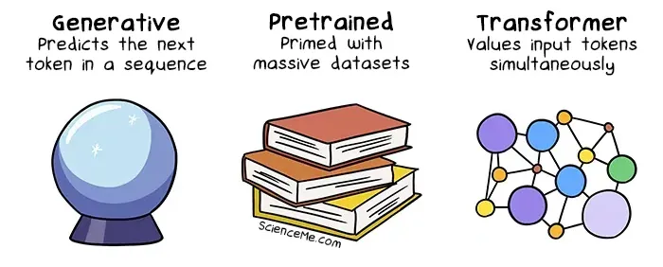



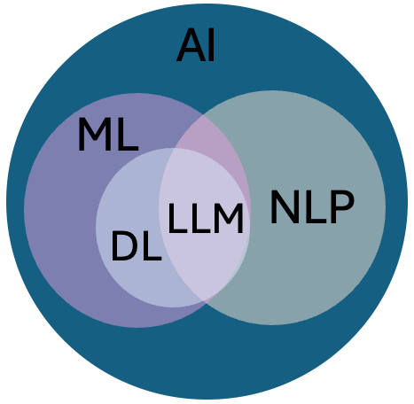
How does ChatGPT work ?
Note:
ChatGPT is available for free with certain limitations.
Important :
AI has risks and opportunities
Try to learn some details and make the best use of it
The class called
the Large Language Model (LLM)

Slide 4

Large Language Model
The more parameters a model has, the better it can understand and generate complex language.

Slide 5
How LLM Work
Next word prediction paradigm
Quickly think : What comes next?
In the absence of
an external force ...
Notes:
ChatGPT is capable of performing a wide range of tasks, from answering questions and providing explanations to generating creative writing, coding, and even engaging in casual conversation.
How does it do this? ChatGPT constructs sentences based on the probability of certain words and phrases frequently used together. It analyzes patterns in the data it’s been trained on to predict what comes next in a sentence.
For example, let’s consider this sentence: 'In the absence of an external force...' What do you think comes next? What is the next word ?

Slide 6
How LLM Work
95%
conserved
92%
is
Next word prediction paradigm
60%
constant
8%
momentum
5%
be
98%
will
not
2%
90%
is
85%
20%
momentum
the
will
15%
10%
will
58%
inertia
In the absence of
an external force ...
of
42%
80%
body
48%
15%
a
on
system
52%
20%
object
63%
the
particles
37%
continues
40%
5%
100%
an
object
will
38%
does
12%
doesn’t
10%

Slide 7
Token Probability in Language Models
In language models, the concept of "temperature" (T) dictates how tokens are selected:
  T=0: always choose the most likely next token
very predictable, but may run into “local nonsense minimum”
  T>0: the higher the temperature, the more likely less likely tokens are chosen
For ChatGPT, the default is T=0.7, which is why you get different answers every time
often (not always), when being asked something, it takes the prompt, generates the start of a reply, and then keeps going.

Slide 8
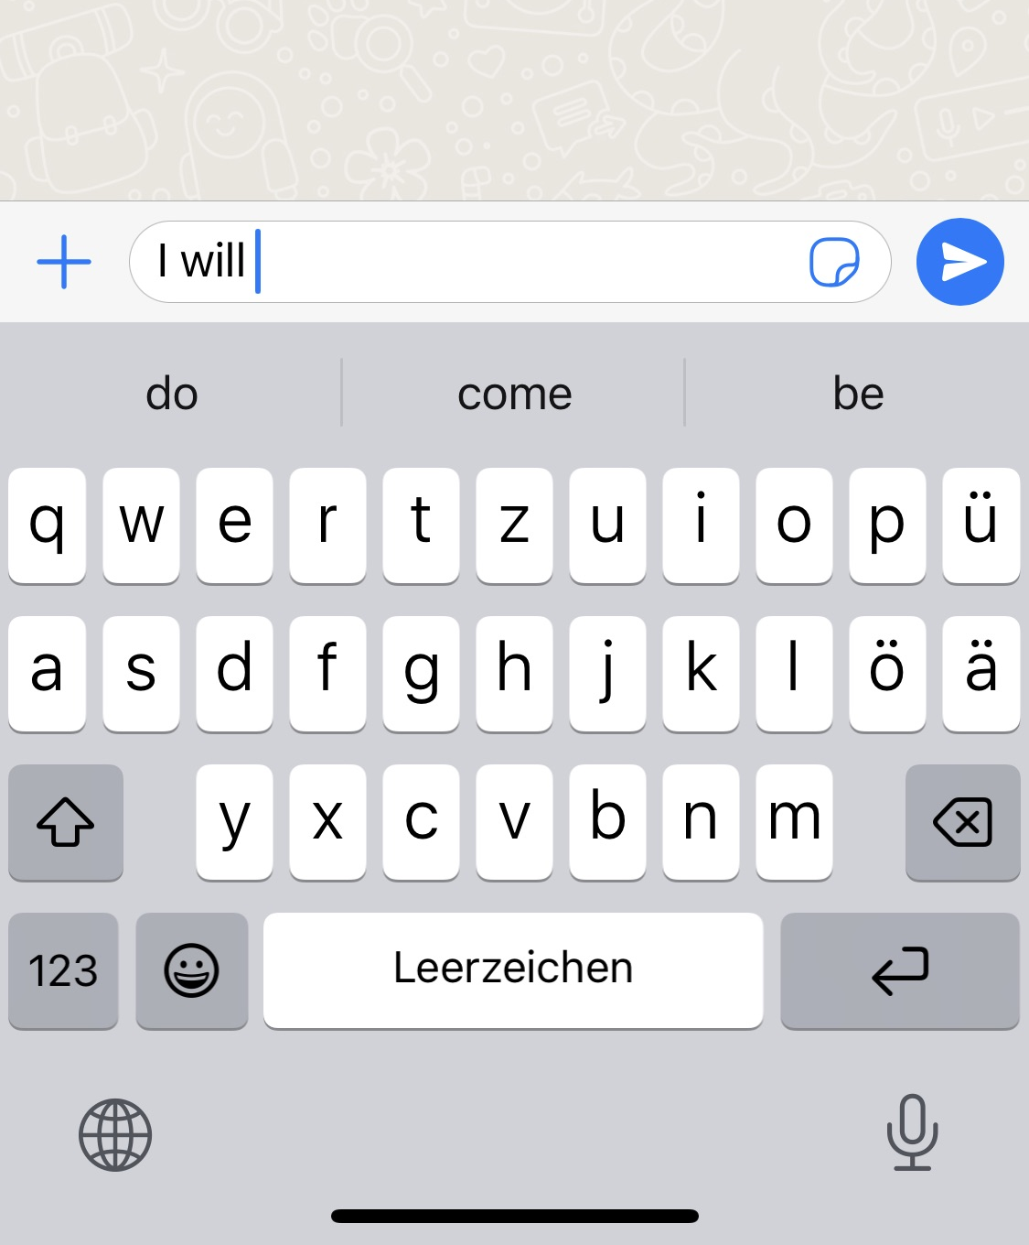
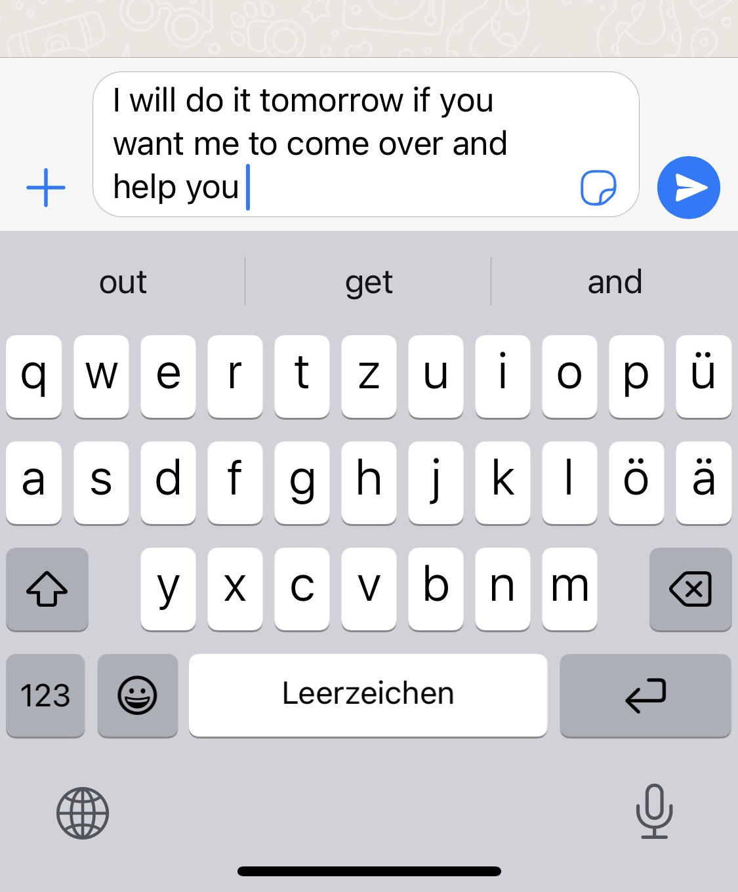
Text generation
Text can be predicted using probabilities, see your smartphones autocomplete function:
do
come
be
13.4 %
11.2 %
8.1 %
I will

Slide 9
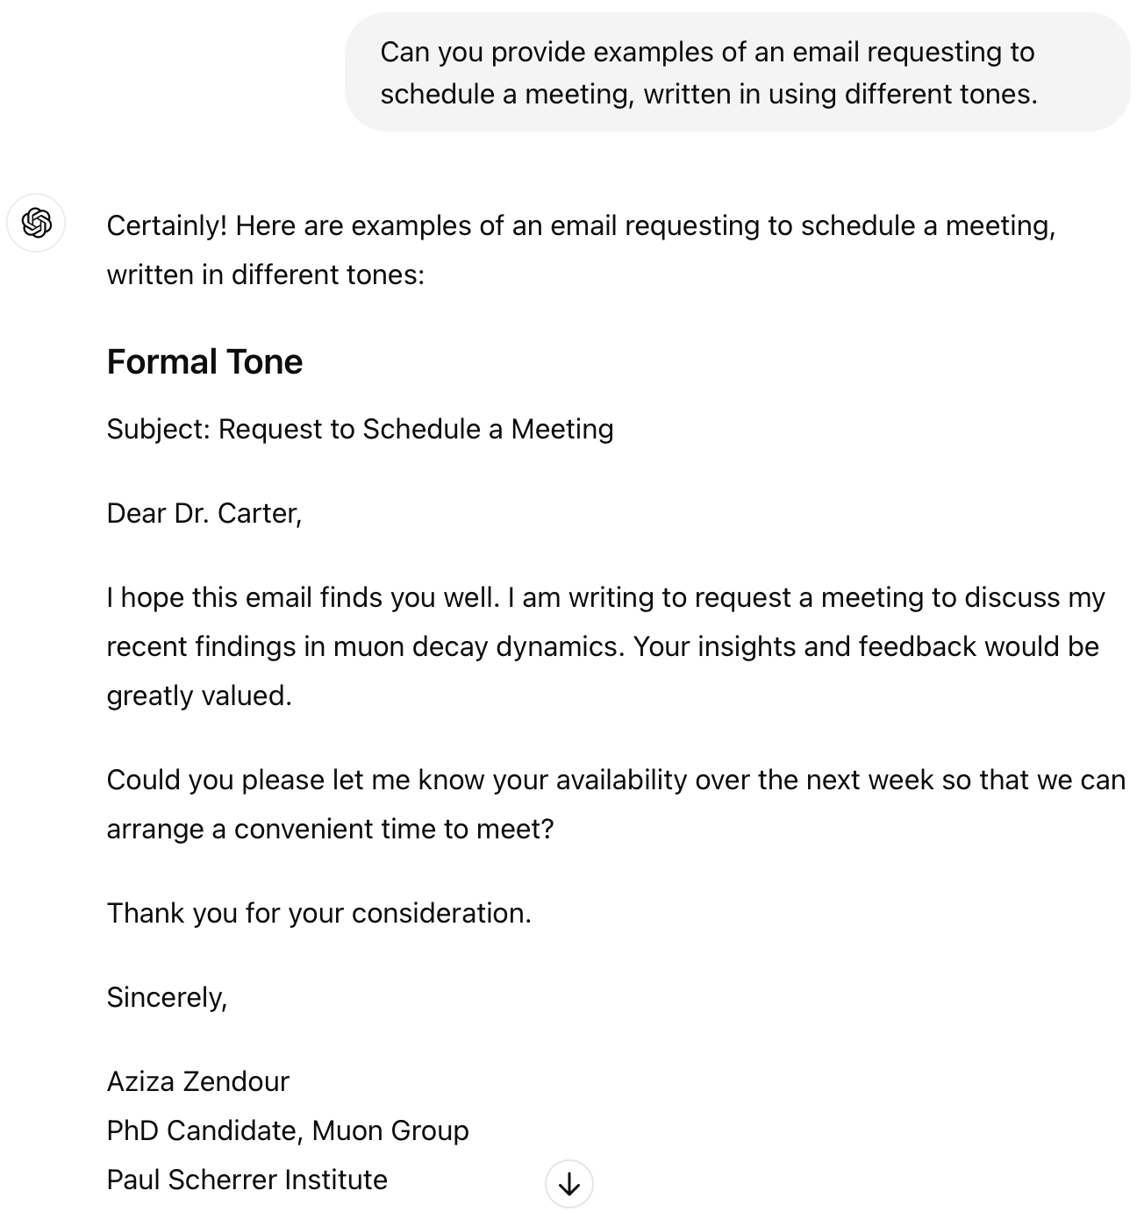

Write some text
Write an email
Write in different styles and tones

Slide 10

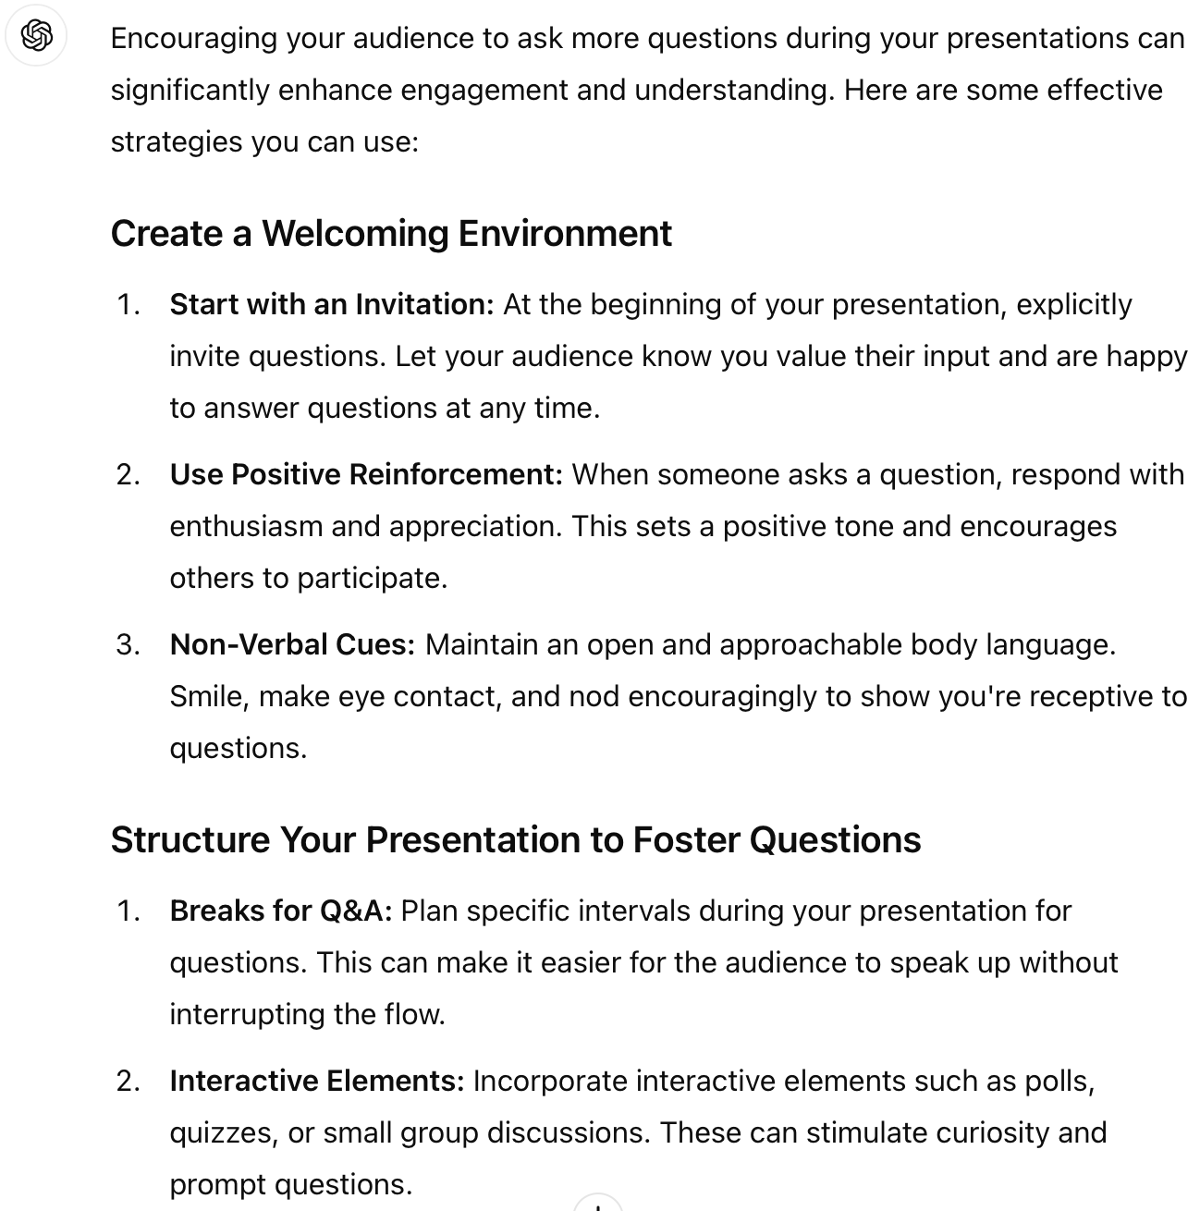
Brainstorming

Slide 11
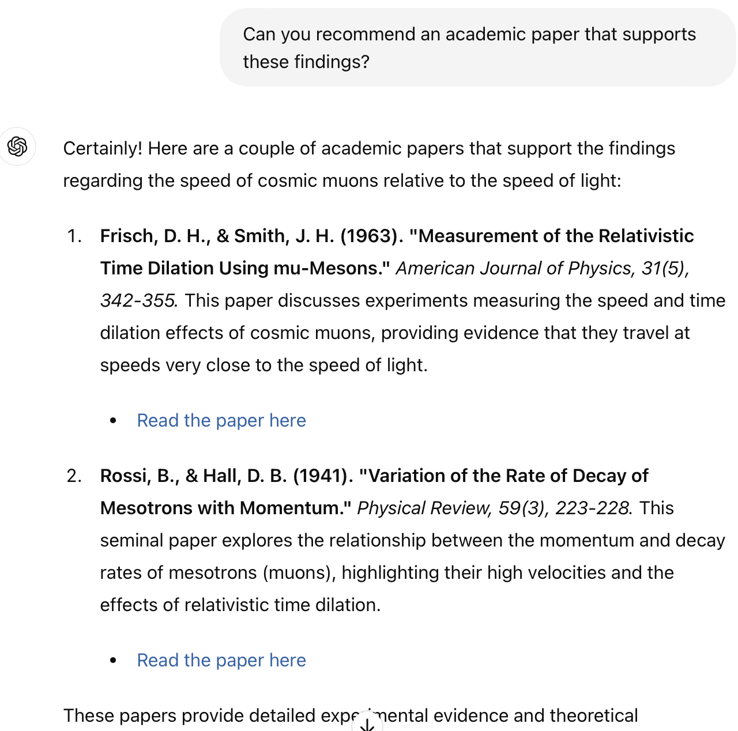
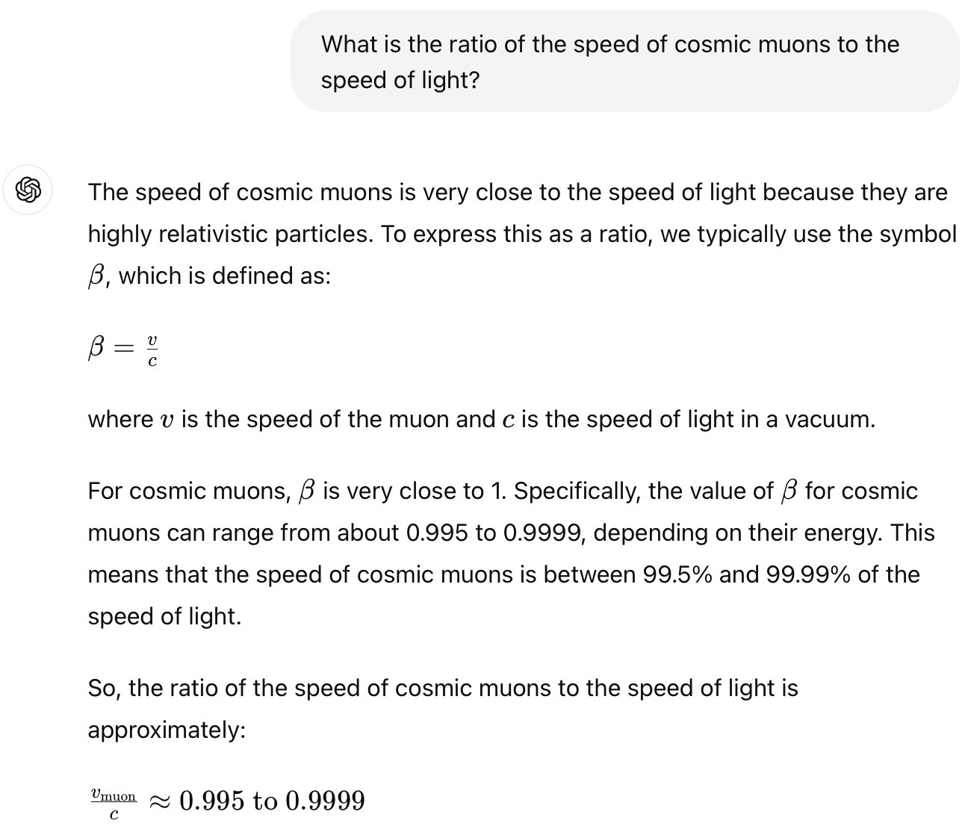
Ask some questions, but double check

Slide 12
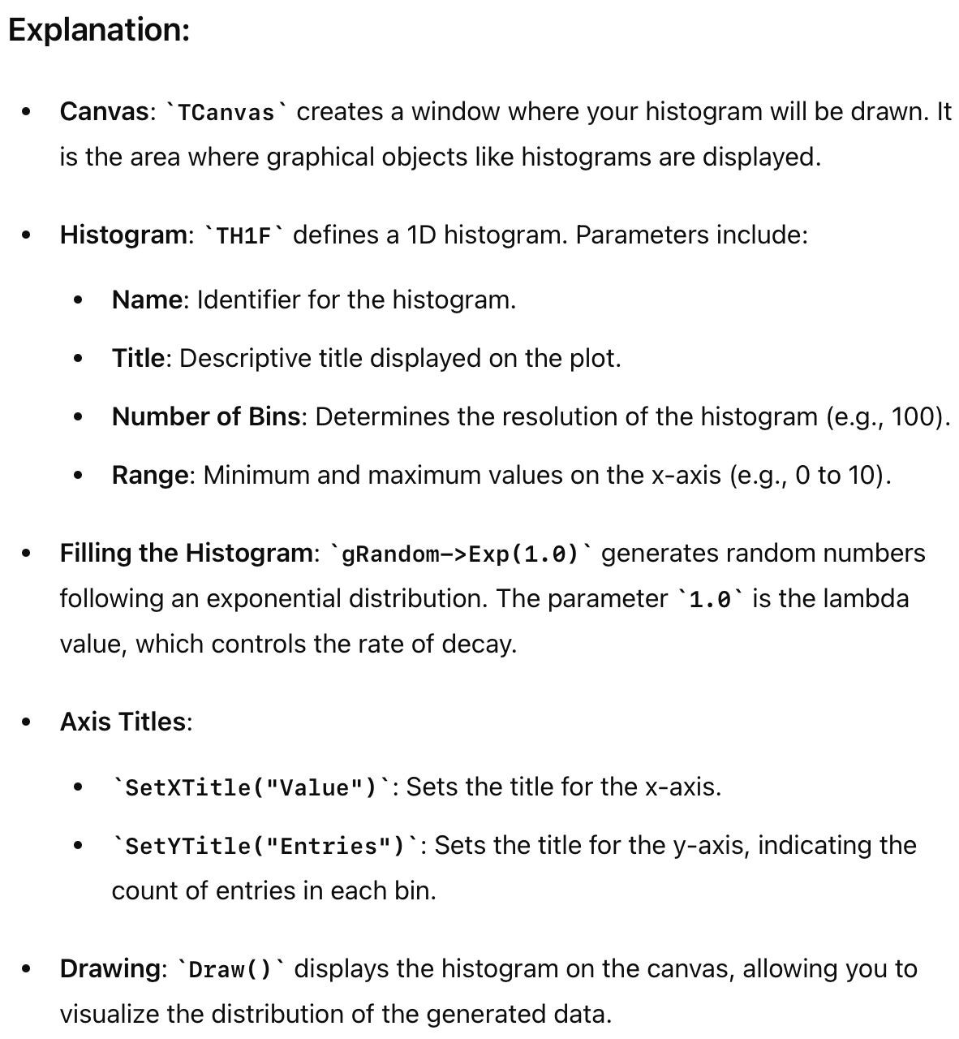
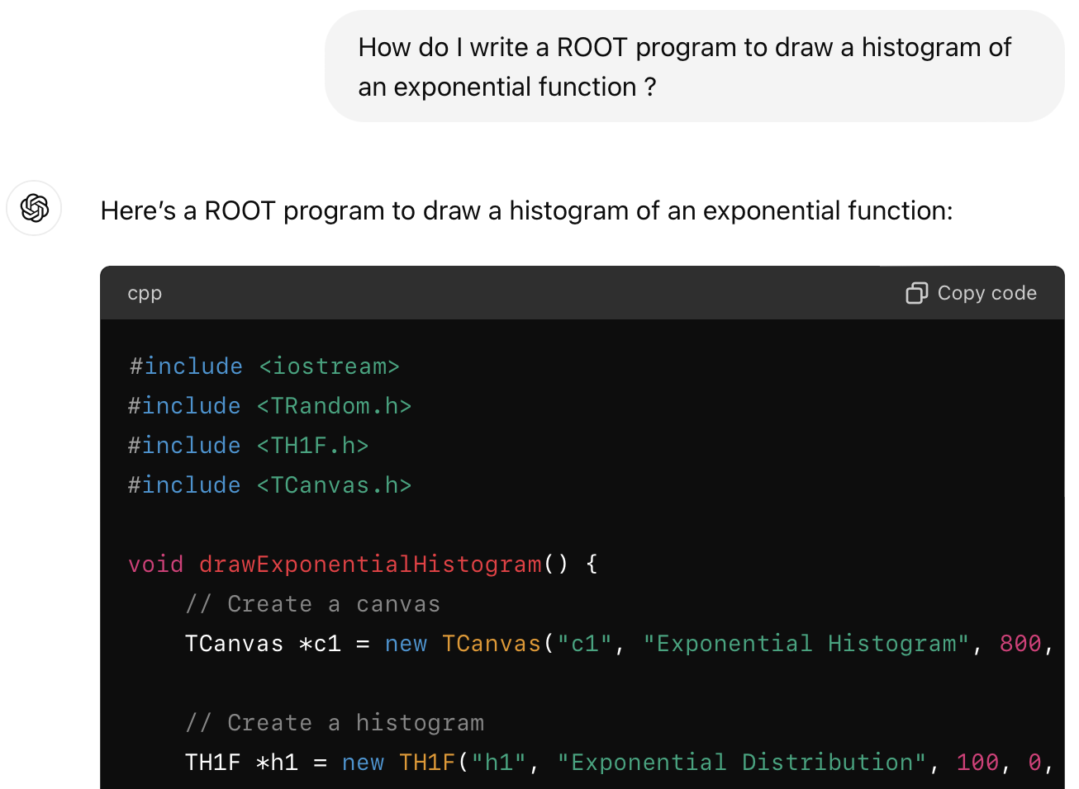
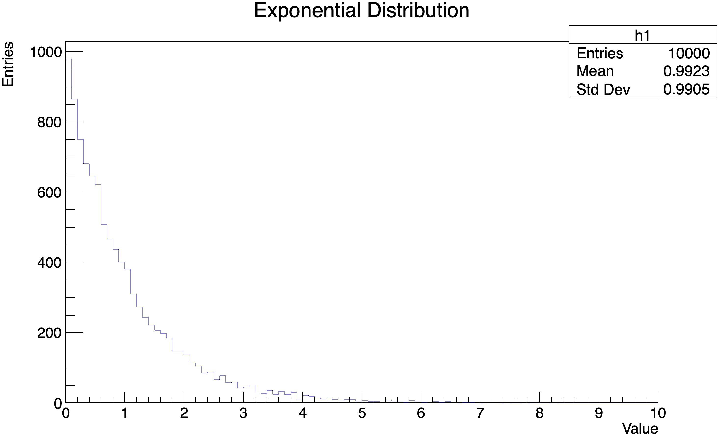
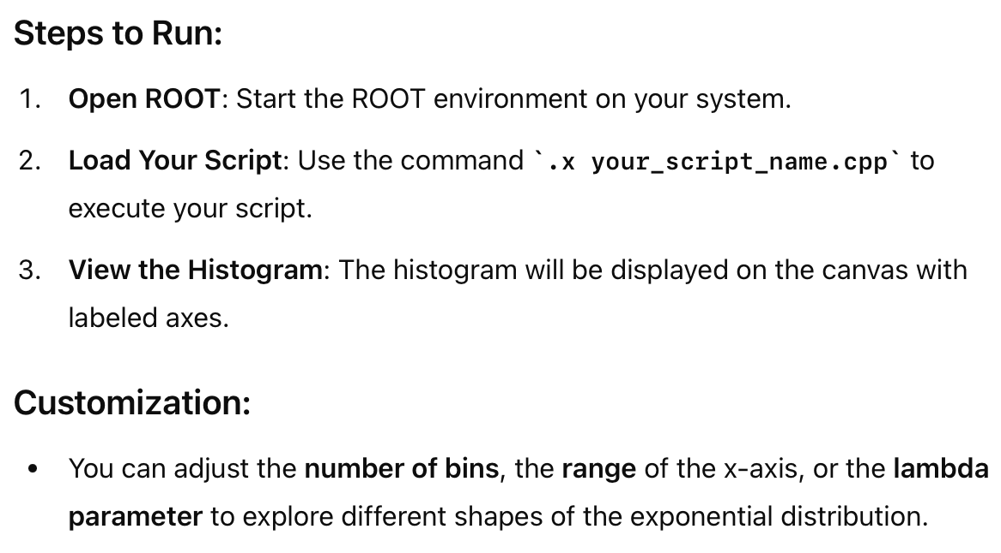
Write code

Slide 13

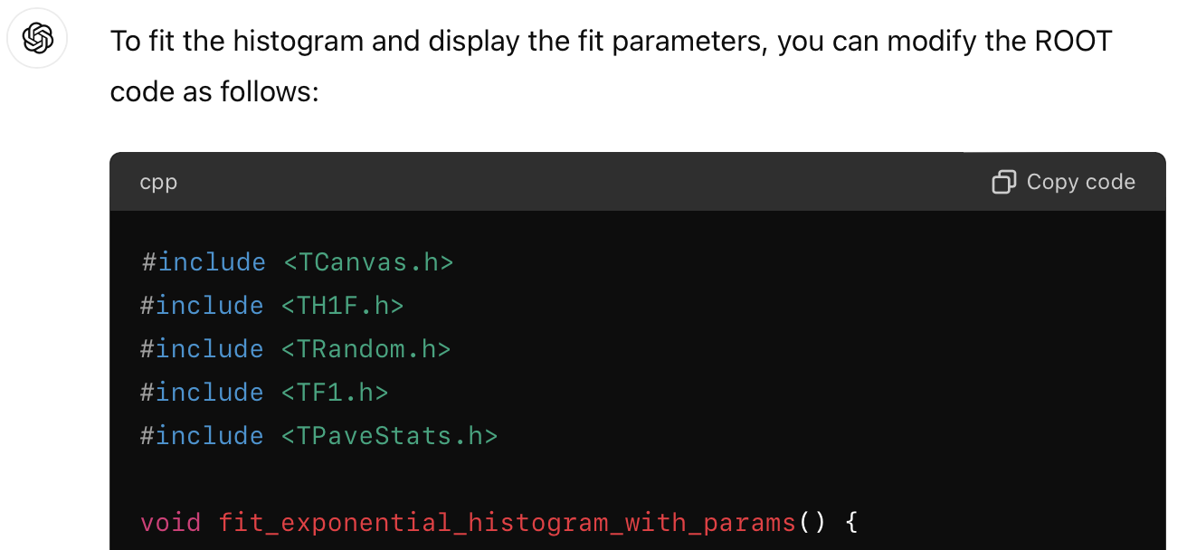
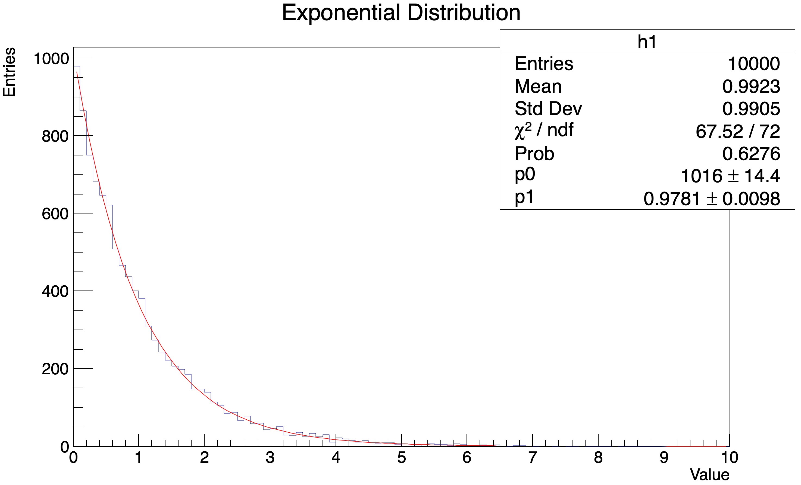
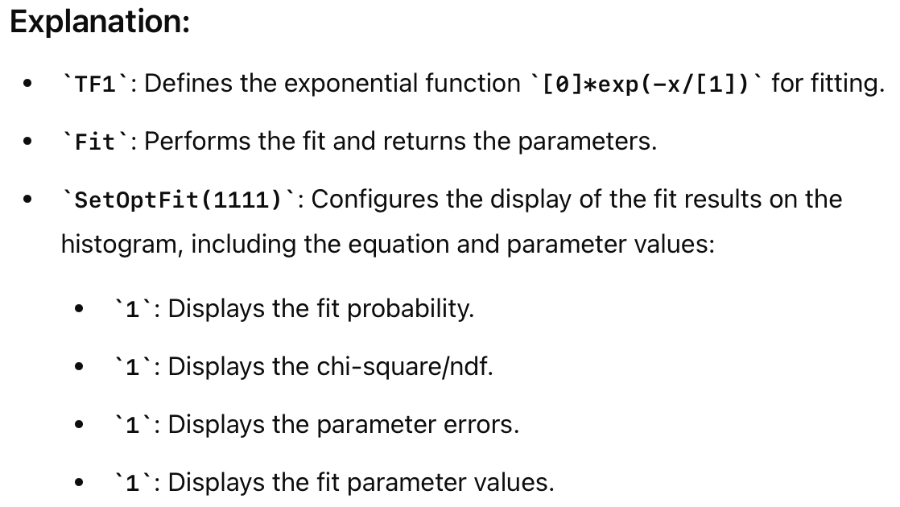
Write code

Slide 14

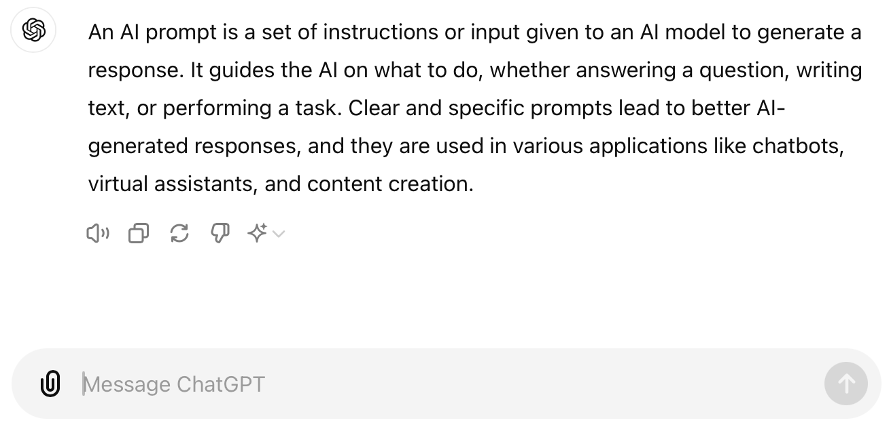
Strategy to get better AI prompt results
The better the input, the higher the quality the output
This is a ChatGPT
Prompt

Slide 15
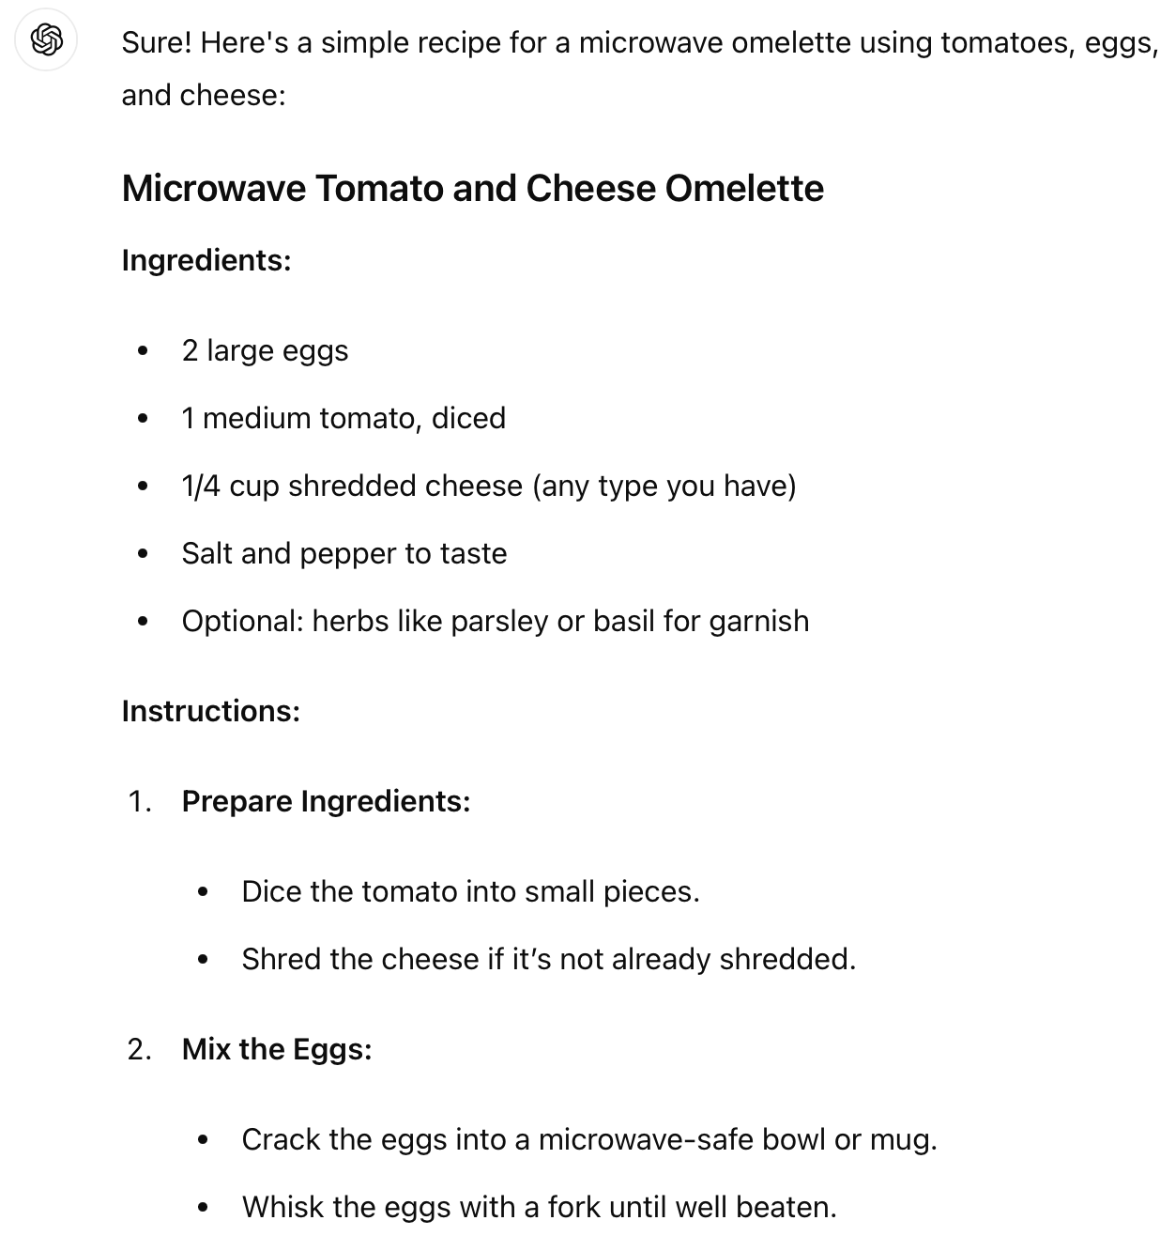
Be Specific with Your Task
🚫 Unspecific Prompt: Hey ChatGPT, I want to make a recipe for tonight dinner, help me create a dish.
✅ Specific Prompt: Hey ChatGPT, I want a recipe for dinner in my refrigerator I've been left with tomatoes, eggs and cheese.
Create a recipe using only these items and make sure the dish does not use a stove as I have a microwave oven.

Slide 16


Few-Shot Prompting Technique

Slide 17
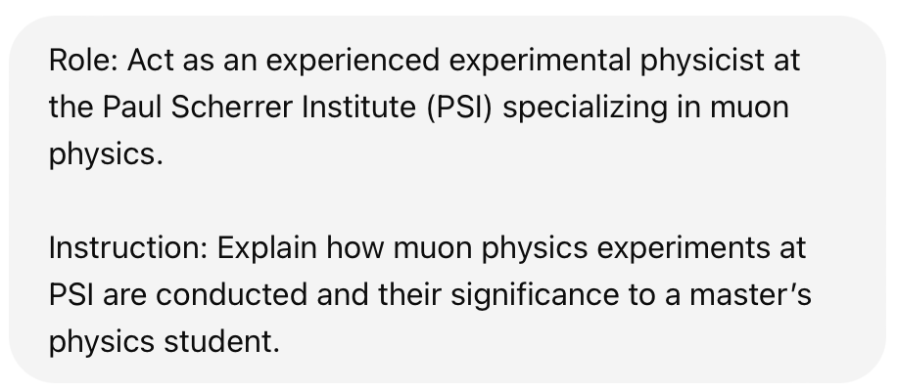
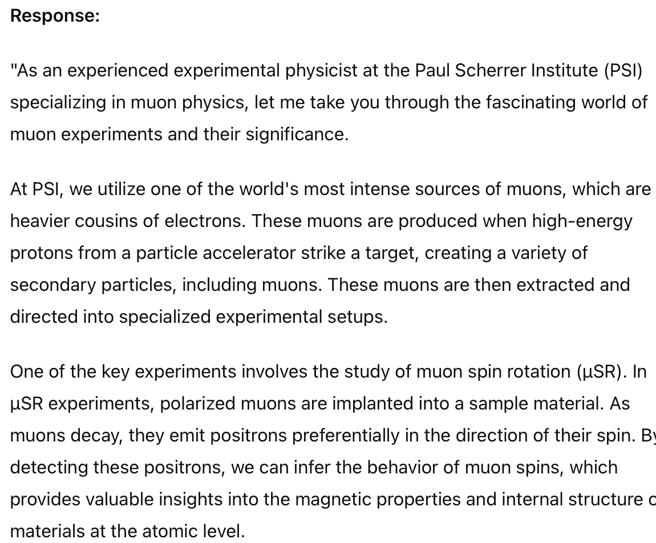
Using “Roles” and “Act As” Prompting

Slide 18


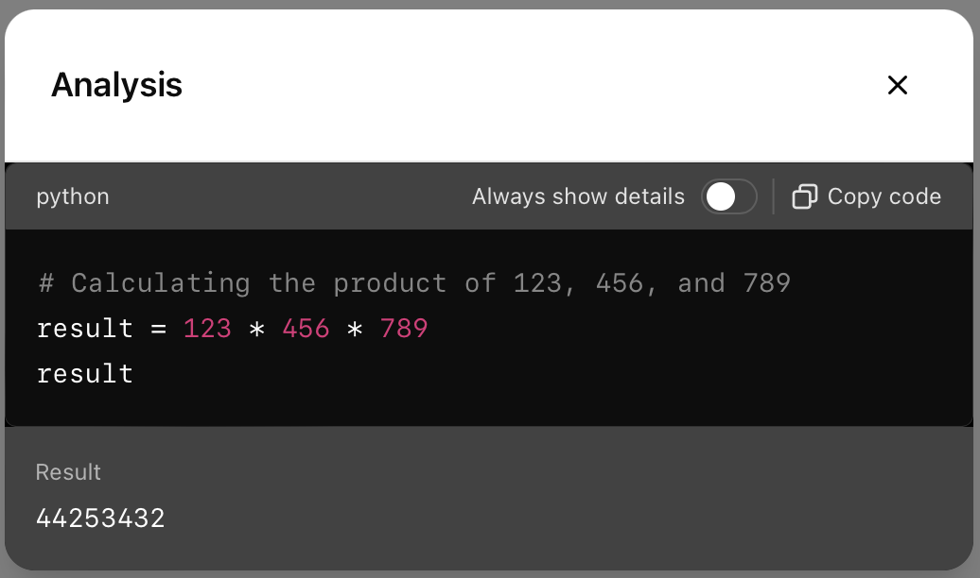
GPT-3.5 lost most points on calculations and symbolic-
math manipulations
GPT-4 also cannot count, calculate, or do most other math, but it can write itself a Python program to do it

Slide 19

Important Lesson to be learned
Learn to use ChatGPT to your advantage, but don't rely on it entirely. It's a powerful tool, yet not perfect.
The output of a Large Language Model
is “mostly” correct
Use it for cases where you can double-check or
do not rely on the correctness of the output

Slide 20


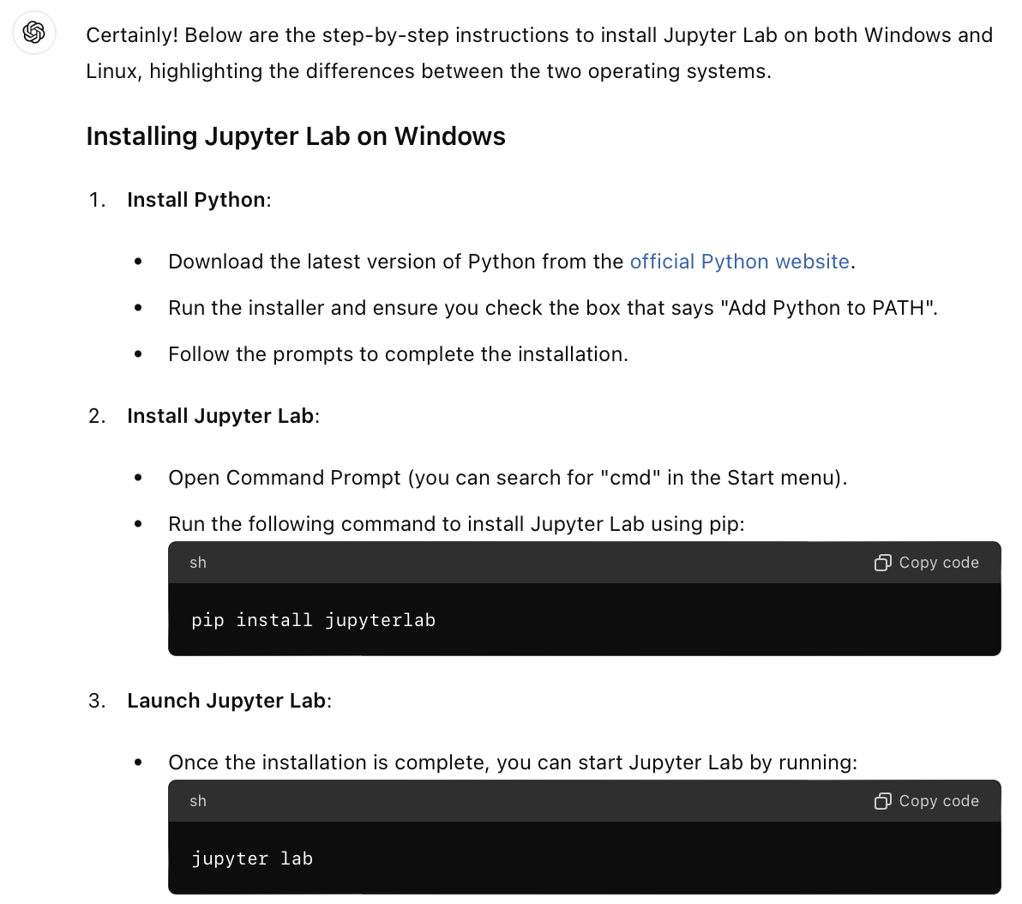
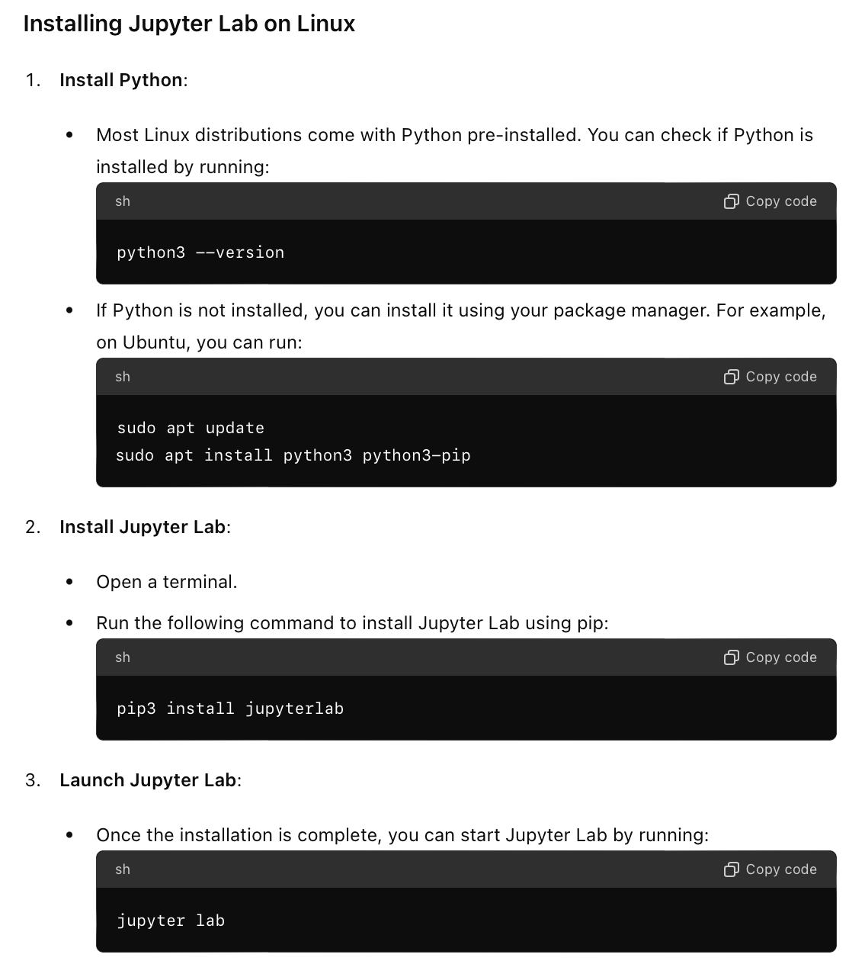

Jupyter Lab
How to install ?
$→$ Ask ChatGPT

Slide 21
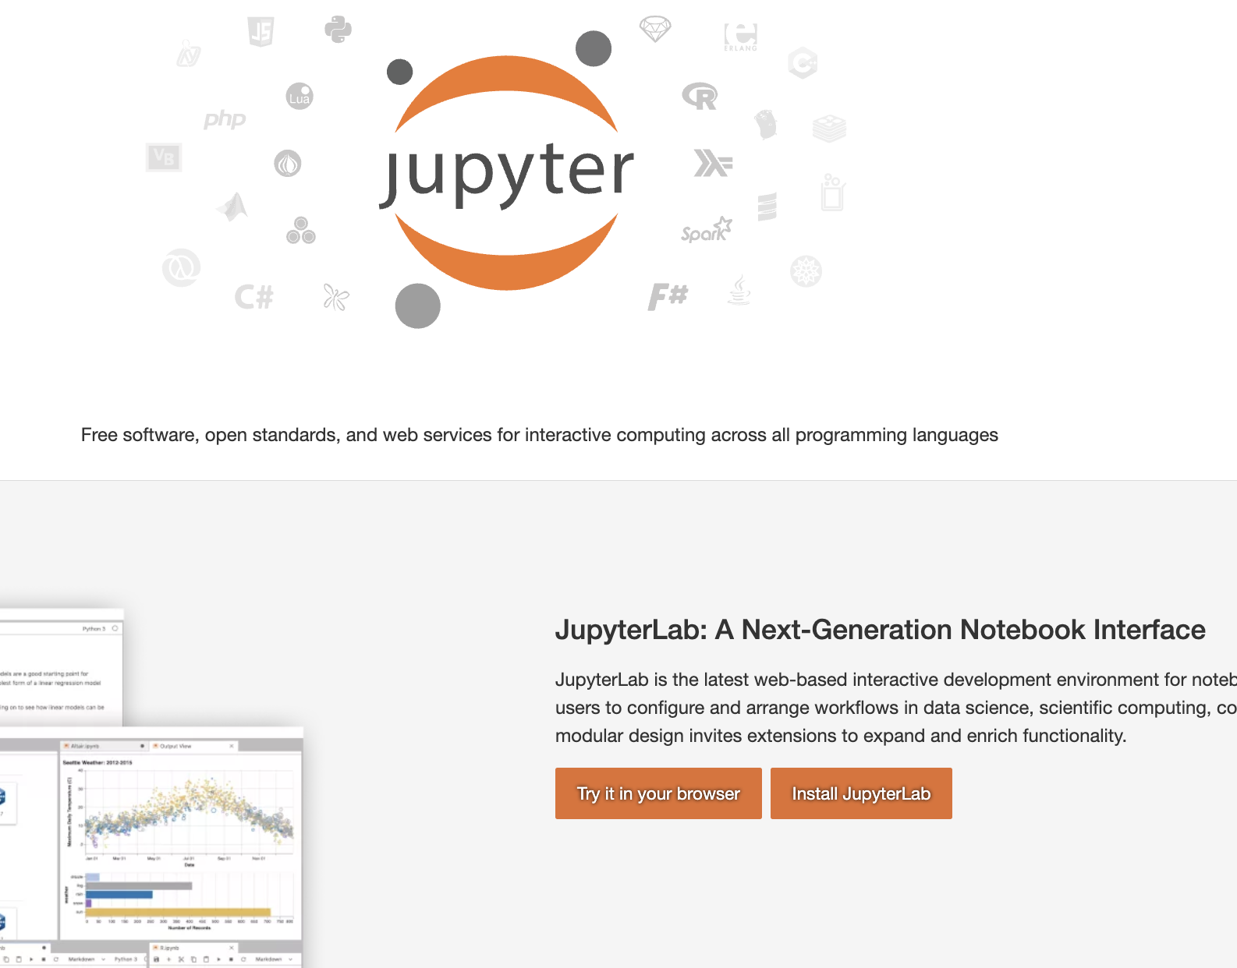
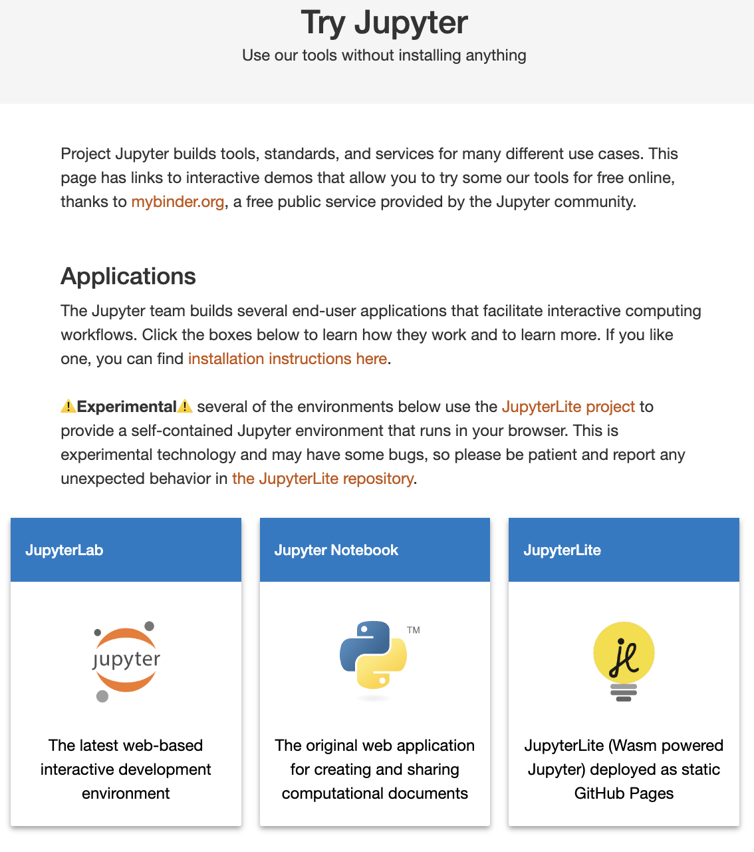
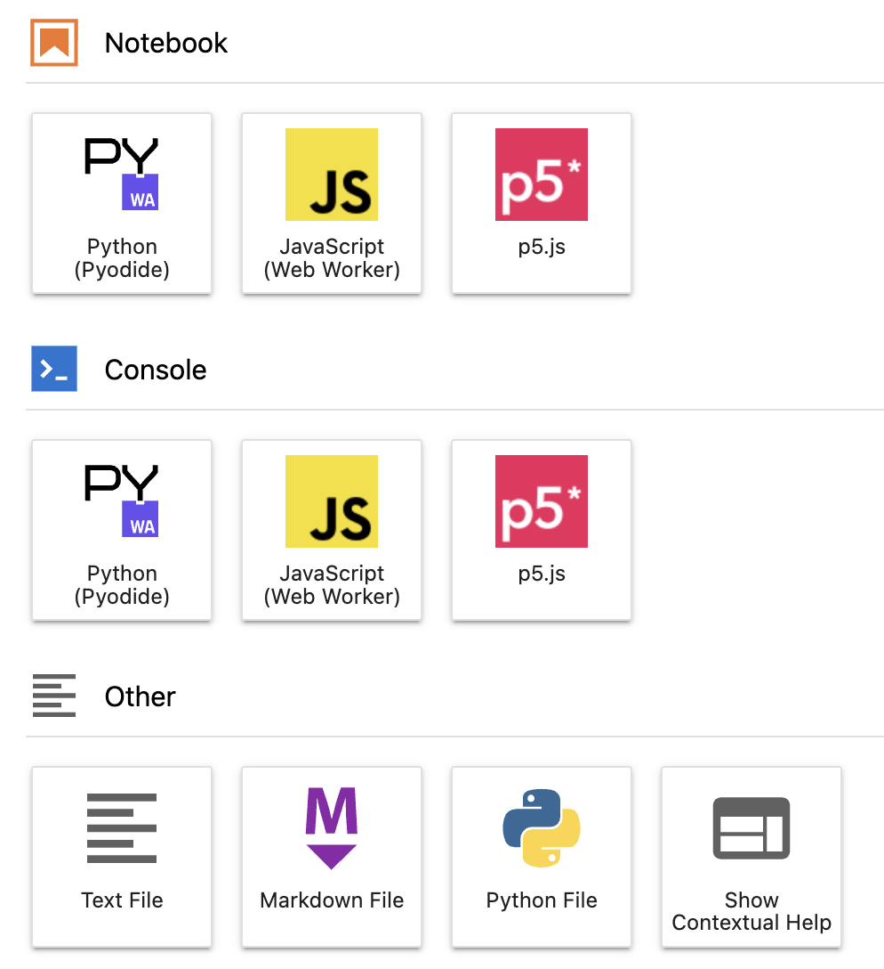
Jupyter Lab
To create a new notebook, go to https://jupyter.org
click on “Try in your browser”, then on JupyterLite, then on Notebook - Python

Slide 22
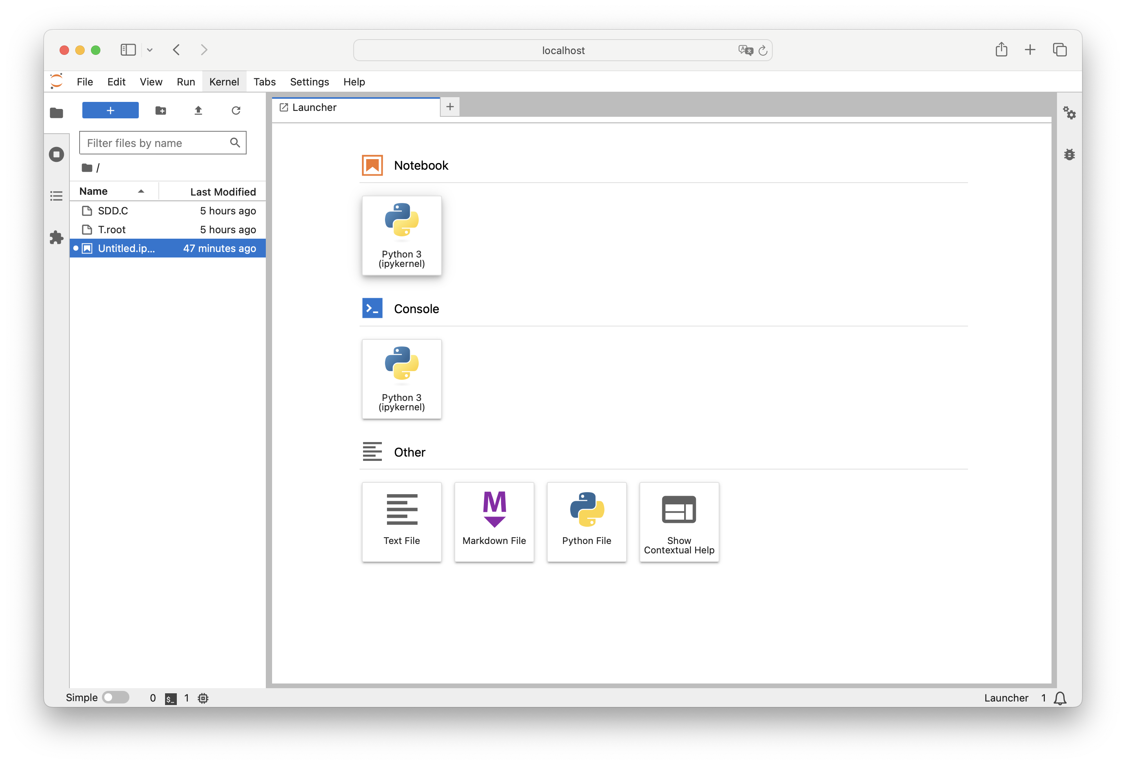
The Interface
The Launcher screen that allows you to select one of the available options:
Menu bar
Open new notebook
Open new console
Folders / notebook files
Open new terminal, txt file, etc.
Notes:
Jupyter lab are essential tool for any data scientist coding in Python
So today we're going to talk about how to use Jupyter Notebook on your local machine also some cloud environments that provide JupyterNotebook.
Depending on the purpose and objective of your JupyterLab analysis, you can select an environment setup that you find most suitable for the given analysis. The following table shows the available JupyterLab environment setups and some details about available tools and libraries in each of them:
When you open JupyterLab, you see this
Console :
Use Case: Quick testing, debugging, or running small code snippets.

Slide 23
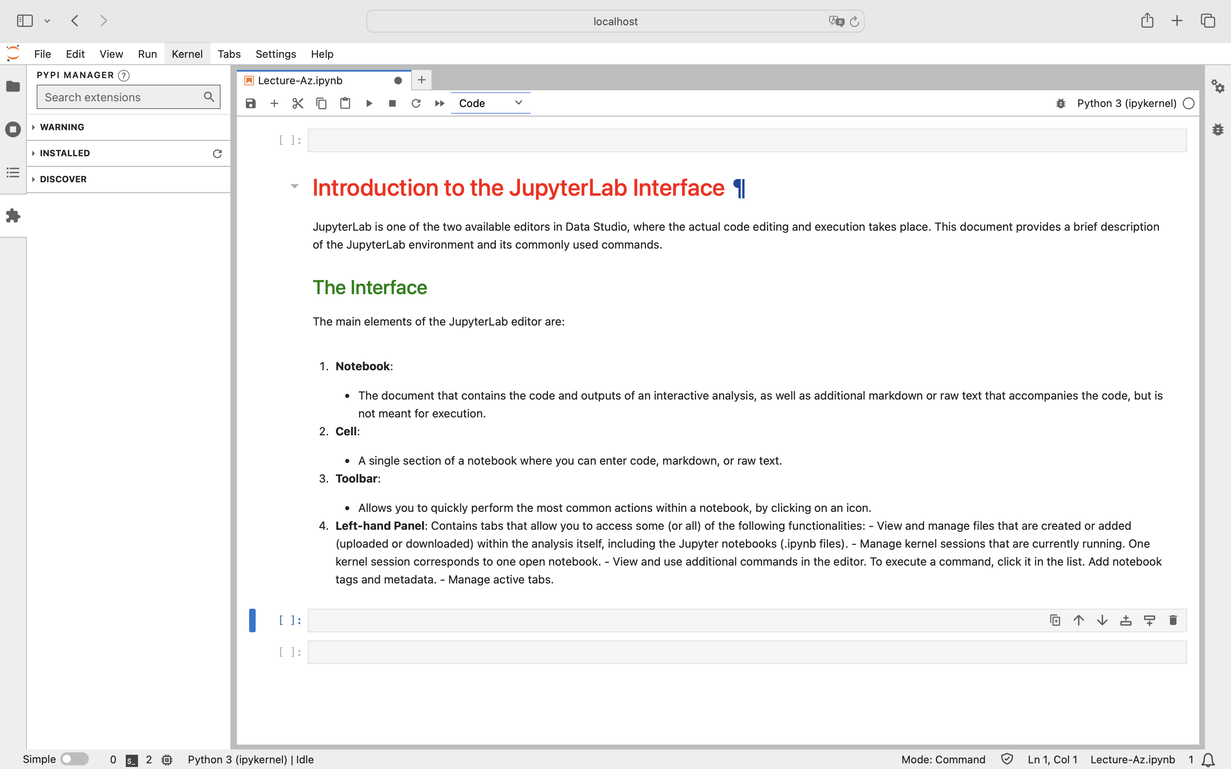

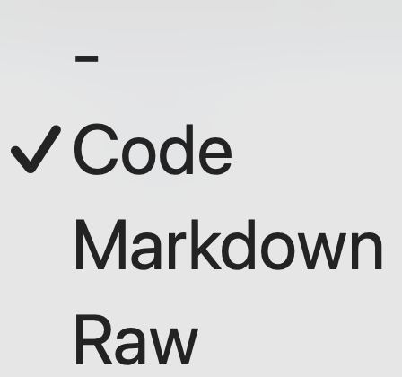
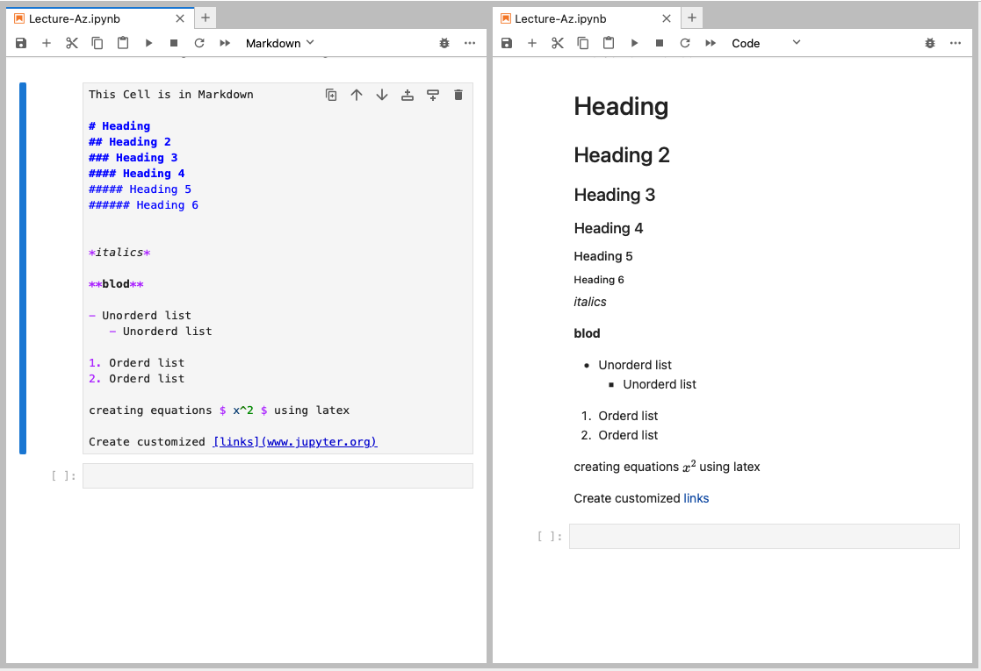




Slide 24
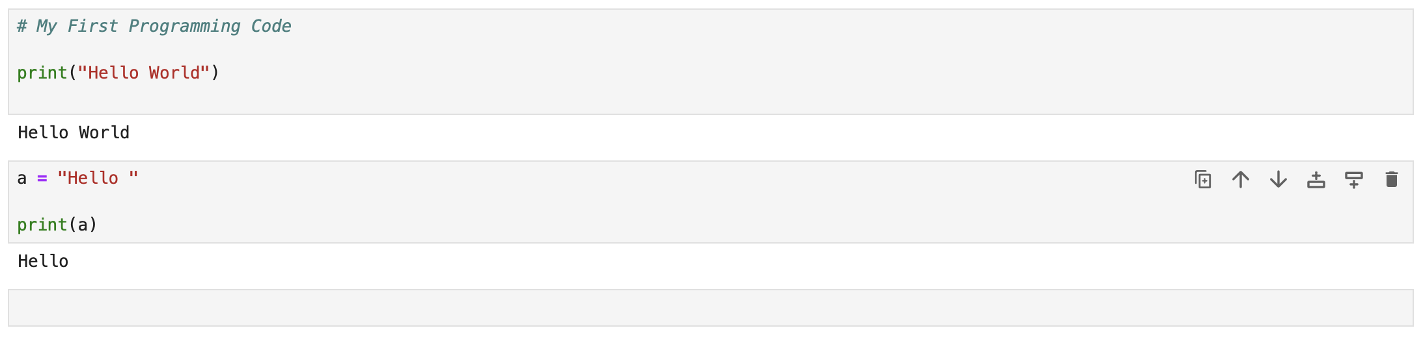
Basic Python Concepts:
[Shift+Enter]
(or [Ctrl+Enter]
to stay in the cell)
Starting with a simple print statement
Notes:
At first sight the notebook looks like a text editor. Below the toolbar you can see a cell. The default purpose of a cell is to write code:
You can write one or more lines of code in a cell. You can run this code by clicking on the “Play” button from the toolbar. However it is much faster to use the keybord shortcut: [Shift+Enter] (or [Ctrl+Enter] to stay in the cell). Once you have executed a cell, a new cell should appear below. You can also insert cells with the “Insert” menu. Again, it is much faster to learn the keybord shortcut for this: [Ctrl+m] to enter in command mode then press [a] for “above” or [b] for “below”.

Slide 25
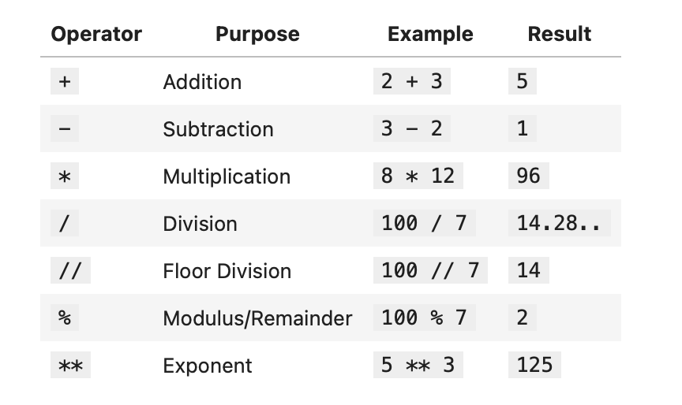
Basic Python Concepts:
Performing arithmetic operations

Slide 26
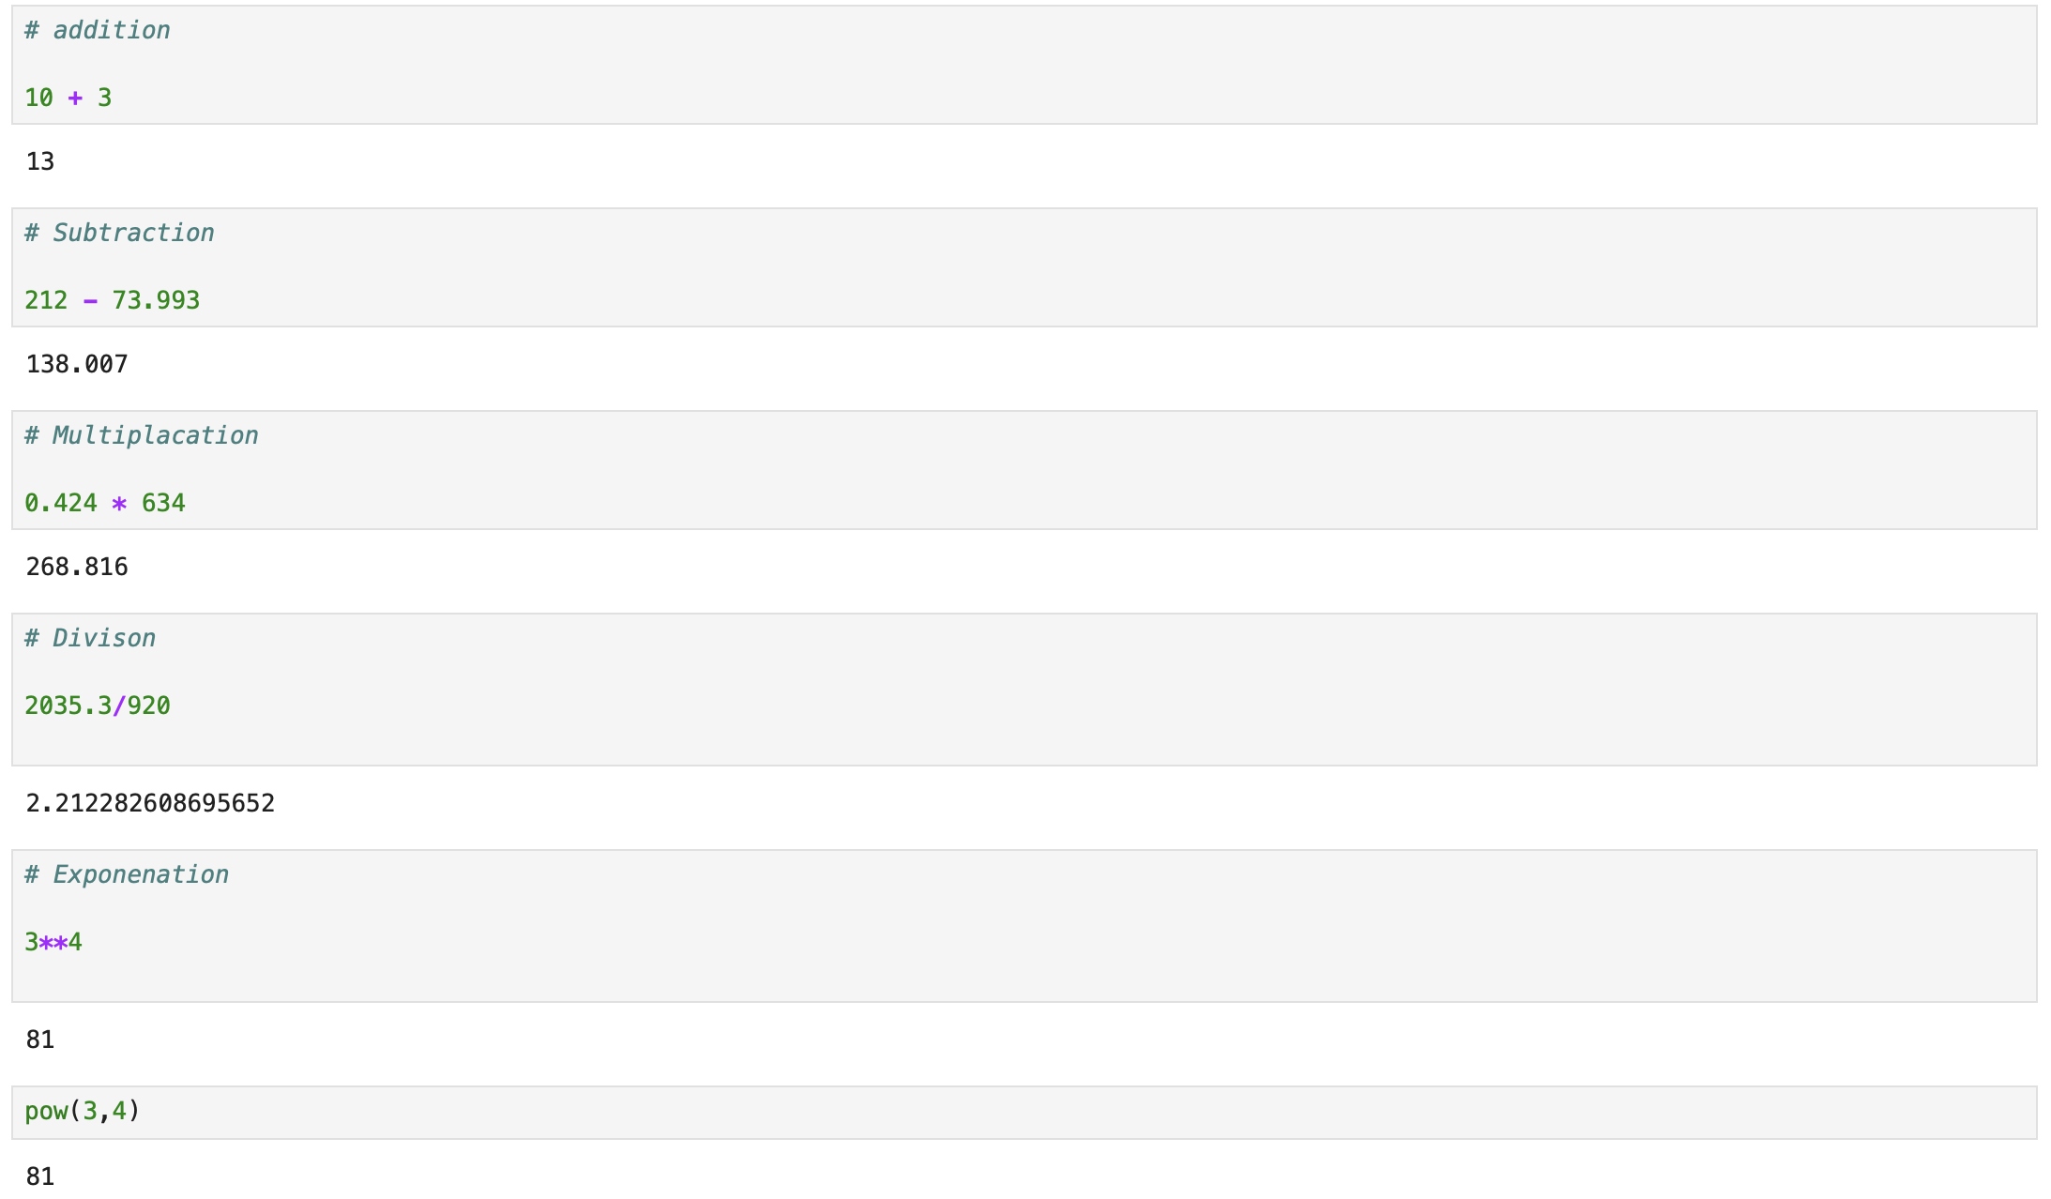
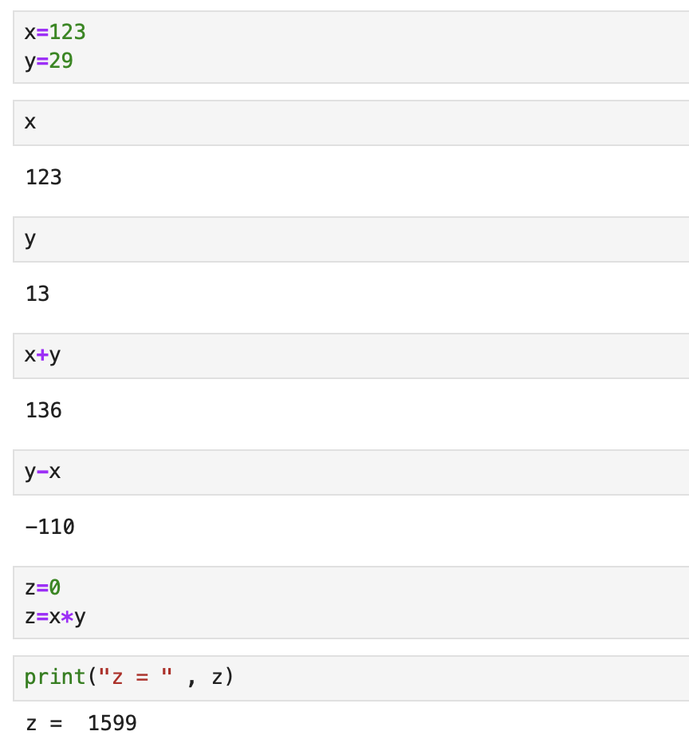
Basic Python Concepts:
Exploring arithmetic operations
Using Variables

Slide 27
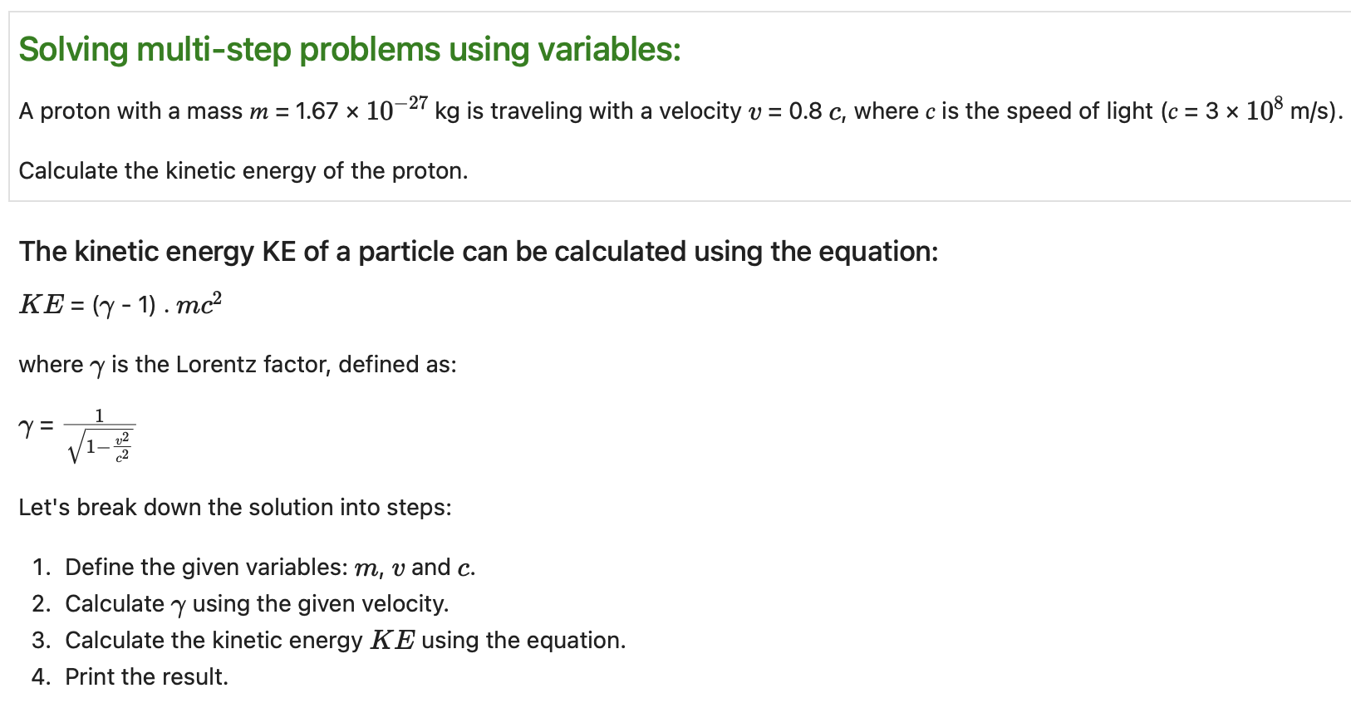
Exercise: Get Help from ChatGPT
Notes:
A proton with a mass 𝑚 = 1.67 × $10^{-27}$ kg is traveling with a velocity $ v $ = 0.8 $ c $,
where 𝑐 is the speed of light (𝑐 = 3 × $10^{8}$ m/s).
Calculate the kinetic energy of the proton.
A proton with a mass m=1.67×10−27m=1.67×10−27 kg is traveling with a velocity v=0.8cv=0.8c, where c is the speed of light (c=3×108c=3×108 m/s). Can you provide a step-by-step explanation and Python code to calculate the kinetic energy of the proton, and convert the result from joules to MeV?

Slide 28
Exercise
Use ChatGPT
Ensure that your prompt is clear and detailed for the best output
Calculate and compare the classical and relativistic velocities of alpha and beta particles, given kinetic energies of KE=3.325 MeV for alpha and KE=1.145 MeV for beta, and express these velocities as a fraction of the speed of light (v/c)?
Notes:
I got these results “Classical velocity of alpha particle: 0.042241 c Relativistic velocity of alpha particle: 0.042212 c Classical velocity of beta particle: 2.116934 c Relativistic velocity of beta particle: 0.951200 c” How can I interpret it?

Slide 29
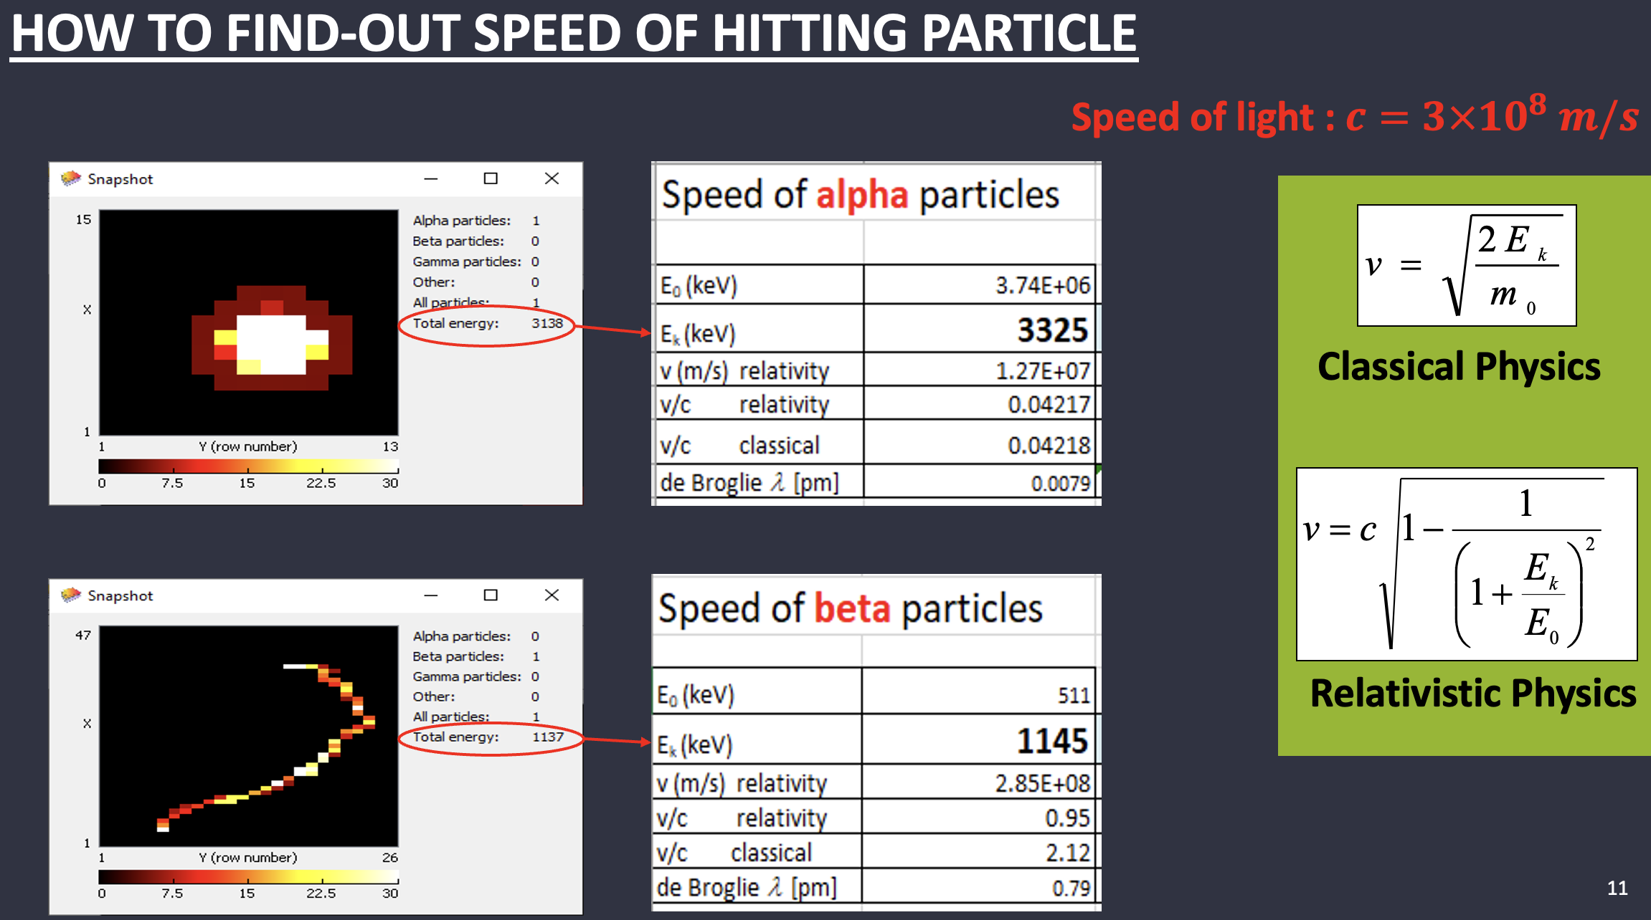
Timepix Exercise

Slide 30
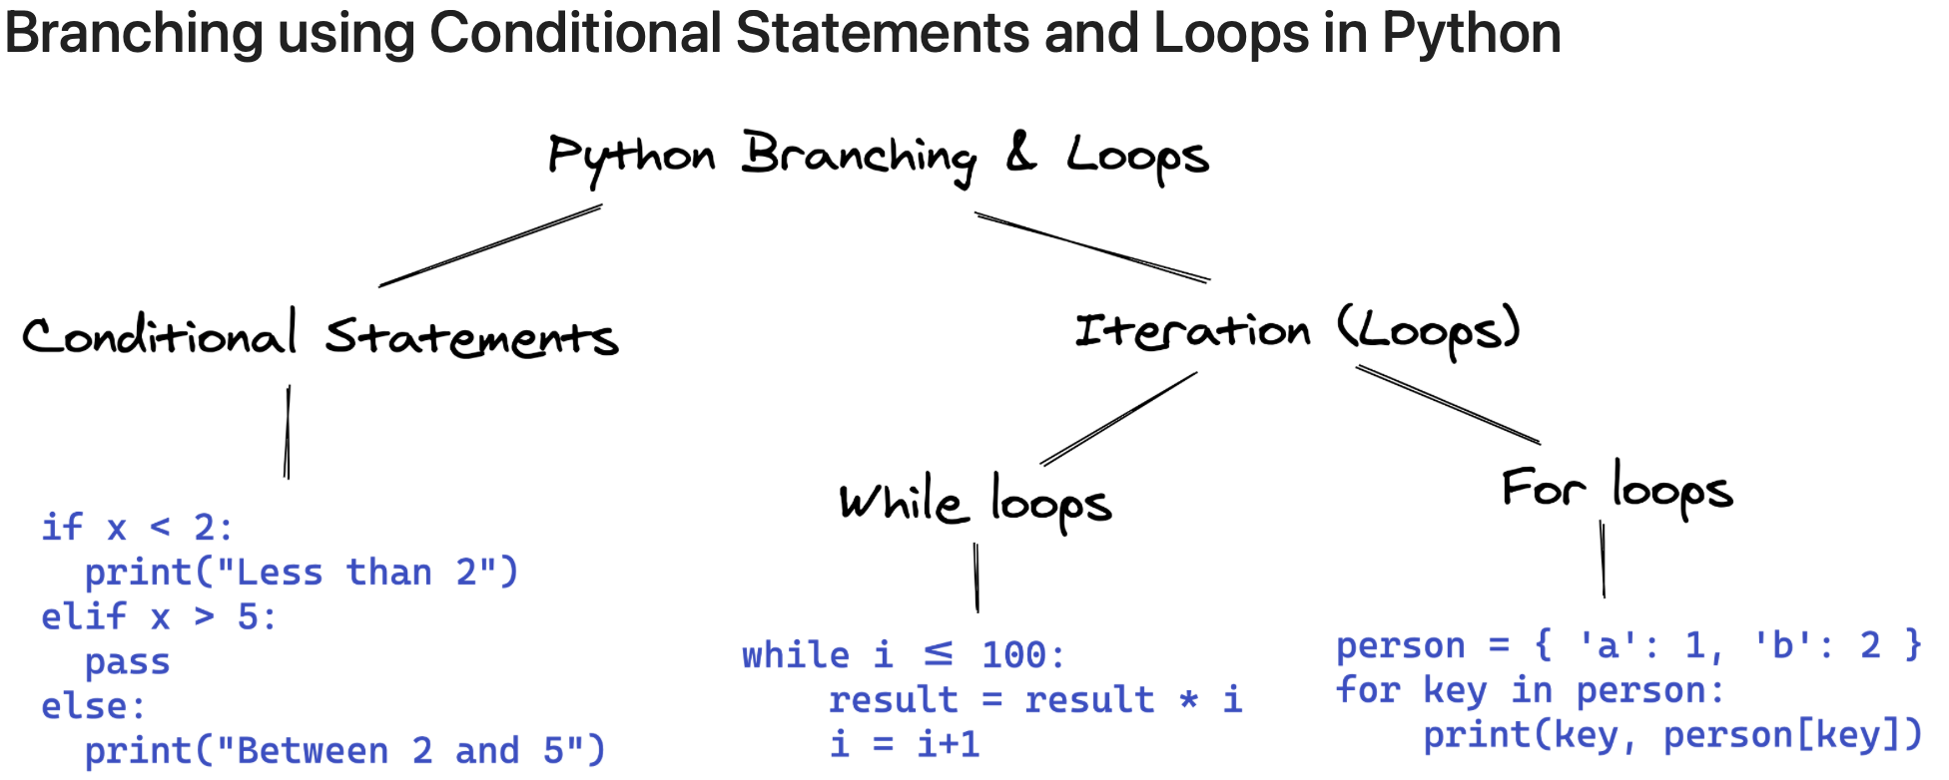
Conditional Statement and Loop in Python

Slide 31
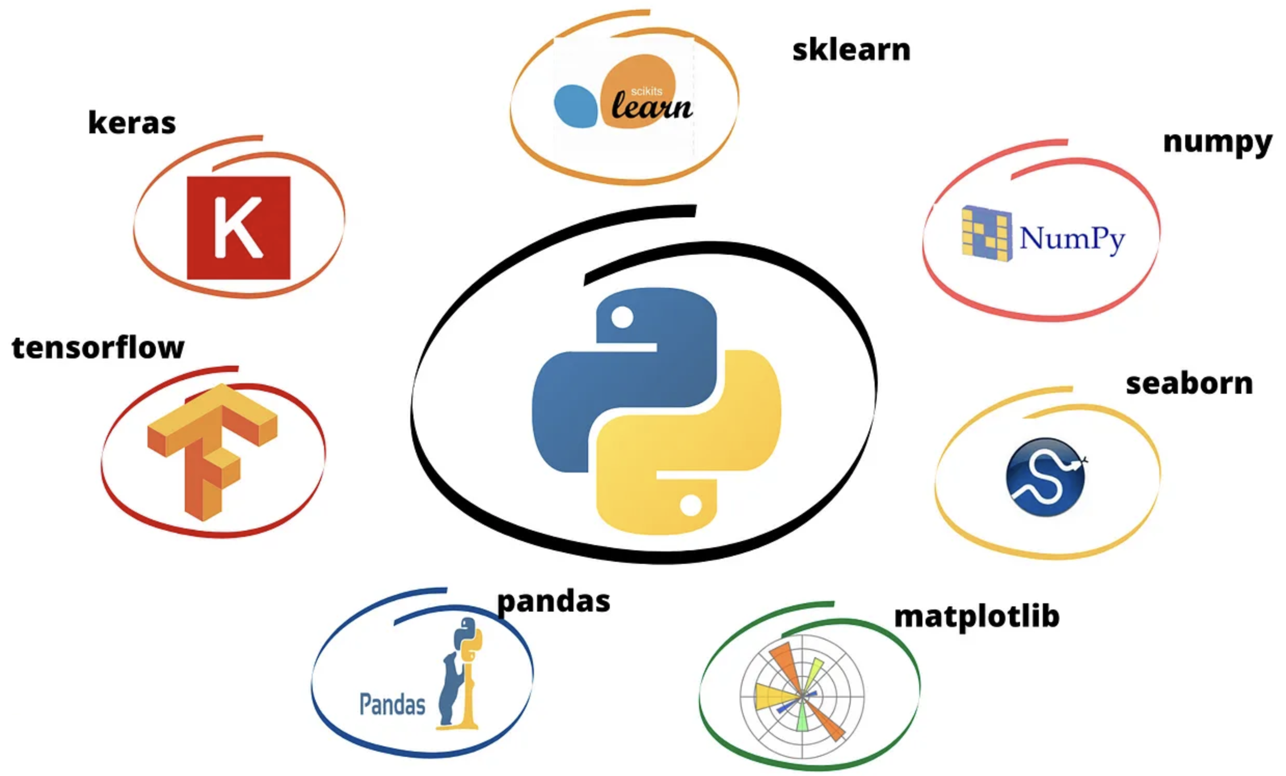
Data Analysis
Data analysis is a process of inspecting, cleansing, transforming and modeling data with the goal of discovering useful information, informing conclusions and supporting decision making.
Notes:
The "data" in Data Analysis typically refers to numerical data, e.g., stock prices, sales figures, sensor measurements, sports scores, database tables, etc. The Numpy library provides specialized data structures, functions, and other tools for numerical computing in Python. Let's work through an example to see why & how to use Numpy for working with numerical data.

Slide 32

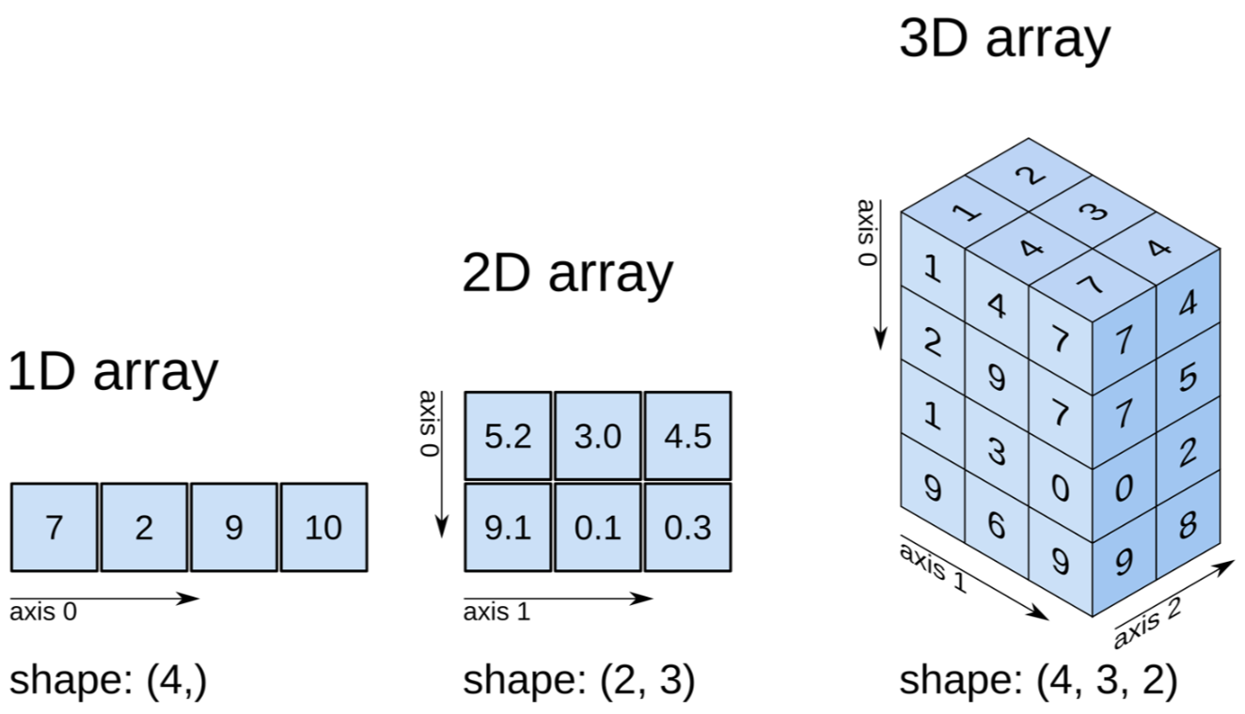
NumPy in Python
NumPy is a Python library for numerical computation, providing tools for handling large datasets with multi-dimensional arrays and a wide range of mathematical functions.

Slide 33
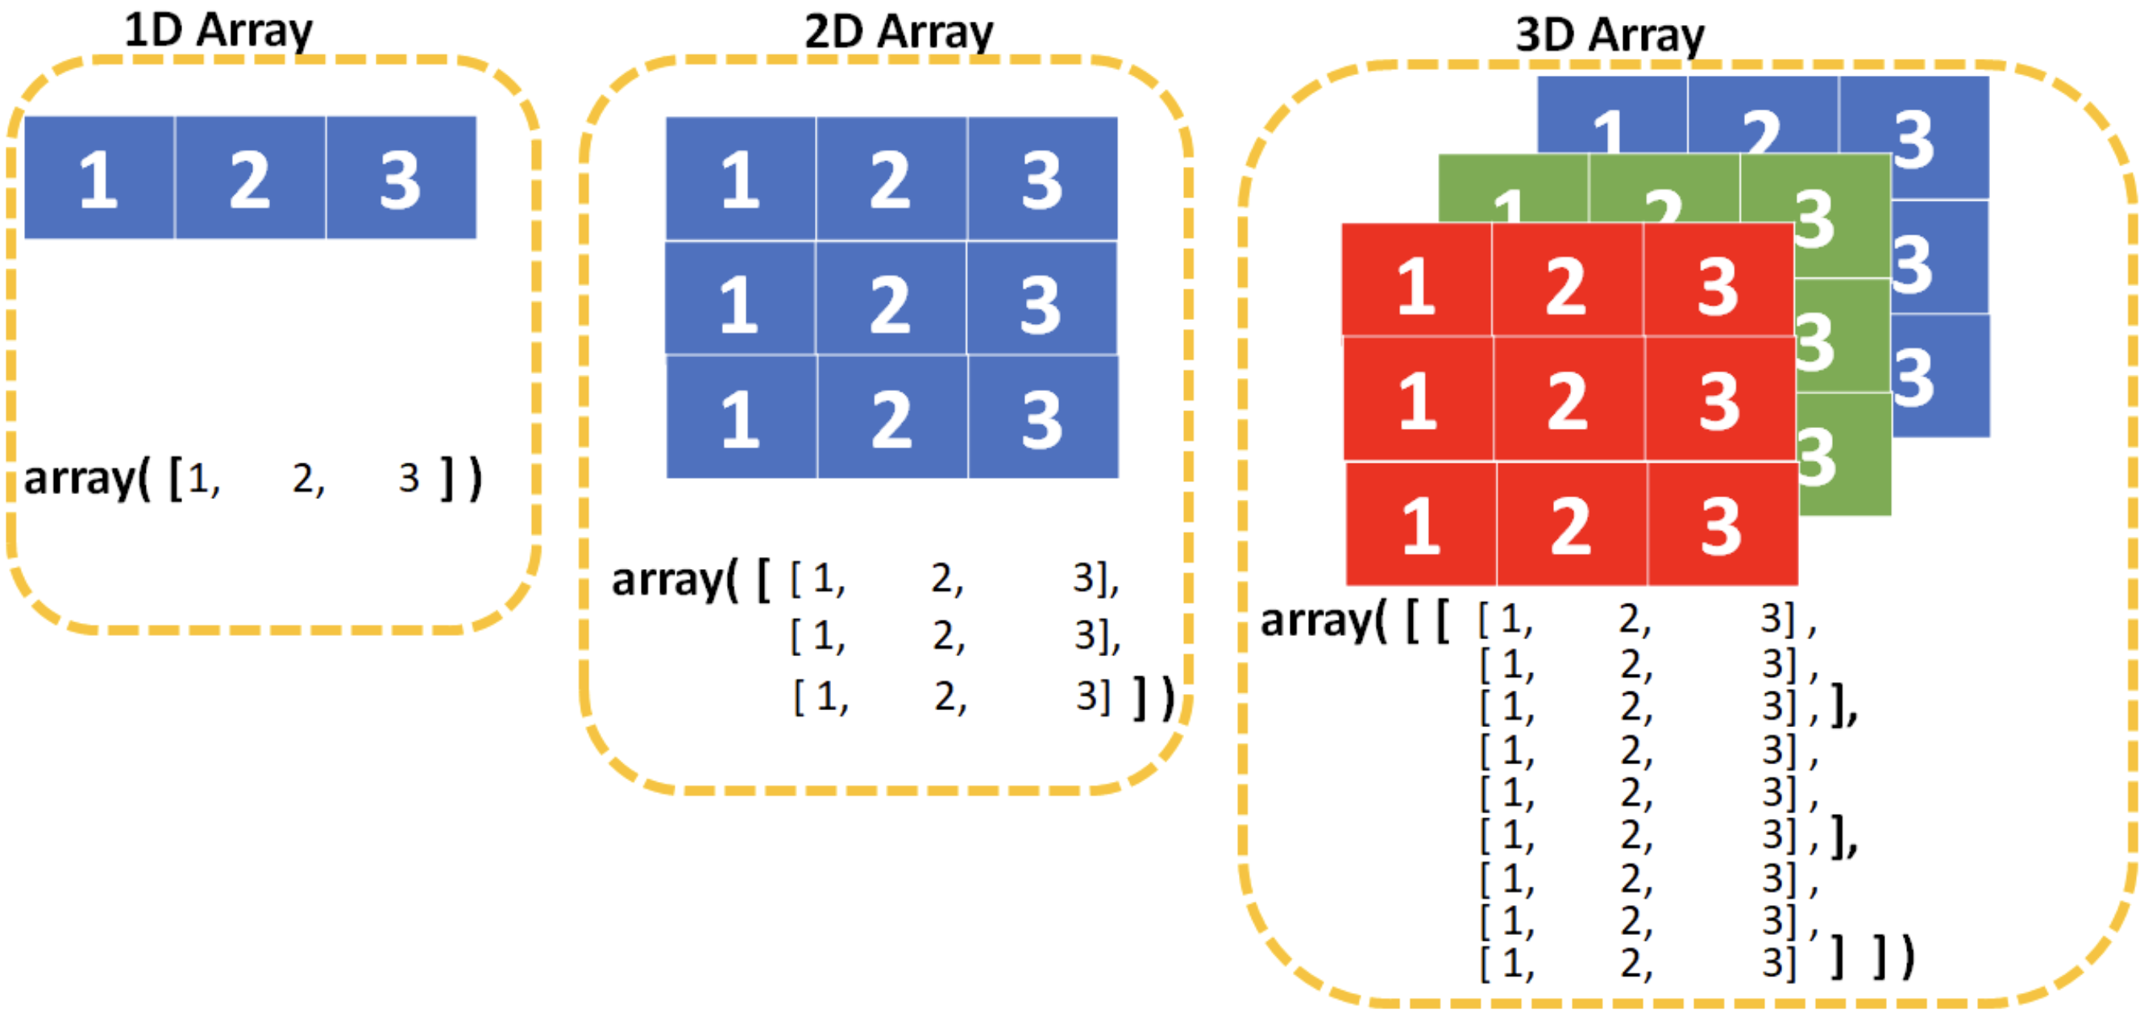
Installation & Import NumPy
Installation NumPy
Pip install numpy
Import NumPy
Import numpy as np
Creating NumPy Arrays
x=np.array([1,2,3])

Slide 34

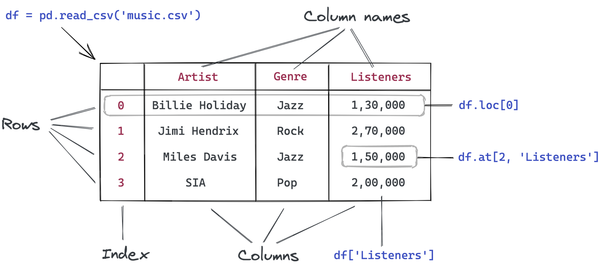
Pandas
The name “pandas” has a reference to both “panel data”, and python data analysis” .
Pandas is a python library used for working with data sets. It has functions for analyzing, cleaning, exploring, and manipulating data. Read and write data structures and different formats .csv, .html, .doc, .text, .json files.
Notes:
2 Data manipulation and analysis:
pandas:
It provides to access the n dimensions dataset with .csv, .html, .doc, .text, .json files. It offers to work with labeled and relational datasets.
It contains the two most important features that are
It works with data structures like series and lists.
It allows us to work with a big dataset like data frames with n-dimensions and in table format.
It offers to convert the data structures into the data frame and to provide some data analysis tasks to find out the missing values, plot the data with histogram, drop the null values columns, and more. It has all the data manipulation, optimization, visualization, and data wrangling features.

Slide 35

To Be continue …
Thank you

