Slide 1
Nuclear Energy
Fusion Reactor Instrumentation and Approach
By Michael Walsh
ITER Organization, Provence, France
The views and opinions expressed herein do not necessarily reflect those of the ITER Organization.

Slide 2
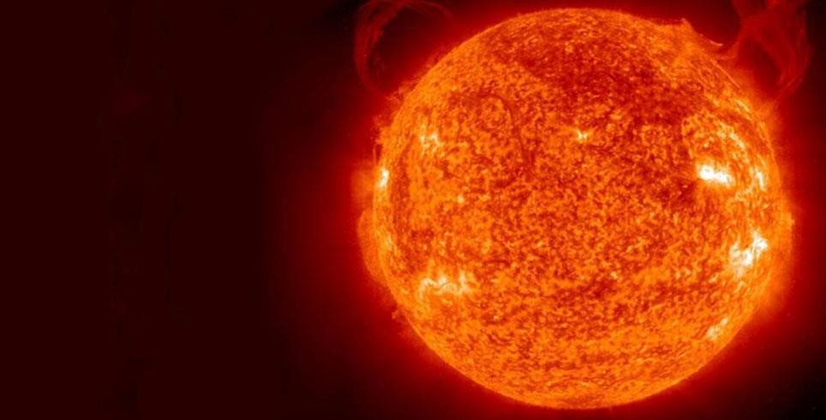
https://euro-fusion.org/fusion/fusion-on-the-sun/
Nuclear Energy – Fusion

Slide 3
What fuel is used in the sun?
Hydrogen

Slide 4
What fuel is practical on earth?
Deuterium
Tritium
In reality a mix of D/T us used as the practical way forward

Slide 5
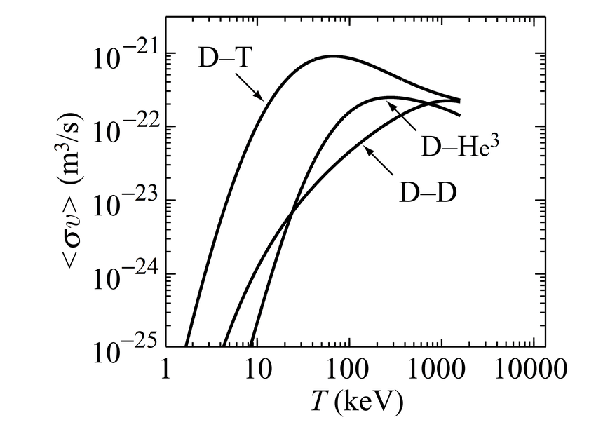
Deuterium-Tritium Fusion
>100 Million degrees Kelvin needed, 1eV is 11605 K
D+T => n (14 MeV) + α (3.5 MeV)
https://www.researchgate.net/figure/Reaction-rate-averaged-over-a-Maxwellian-energy-distribution-as-function-of-the_fig1_338596522

Slide 6
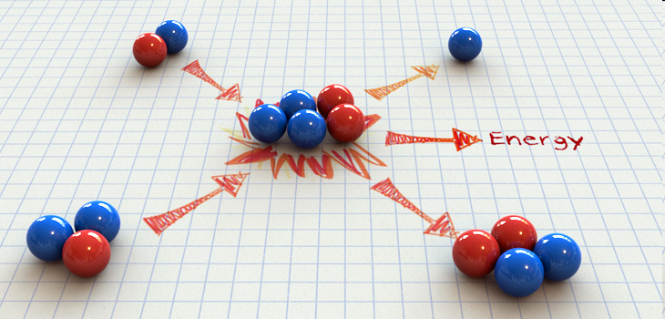
What happens?
Deuterium
High energy
Neutron
Tritium
Helium
nucleus
Need high speed of D and T ions to force collisions
Results in Helium-nucleus and n and something else too……………..

Slide 7
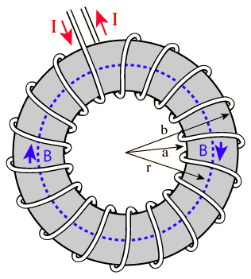
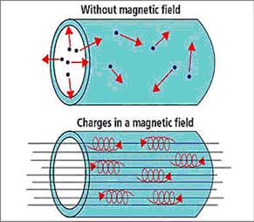
Magnetic Field
Circular Road leads to a clever scheme known as a Tokamak- other options also exist

Slide 8
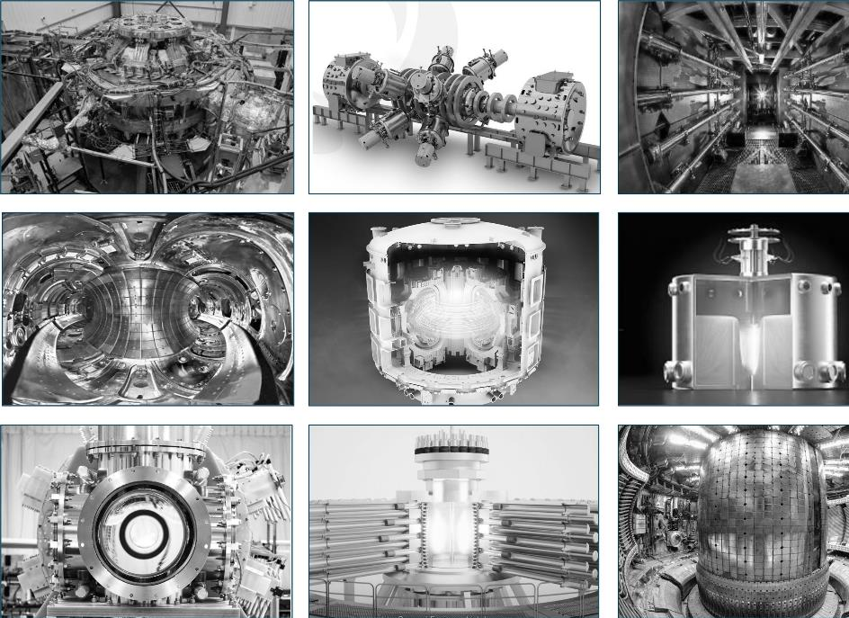
text
Many Different Options
text
text
I will explore the Tokamak now
text

Slide 9
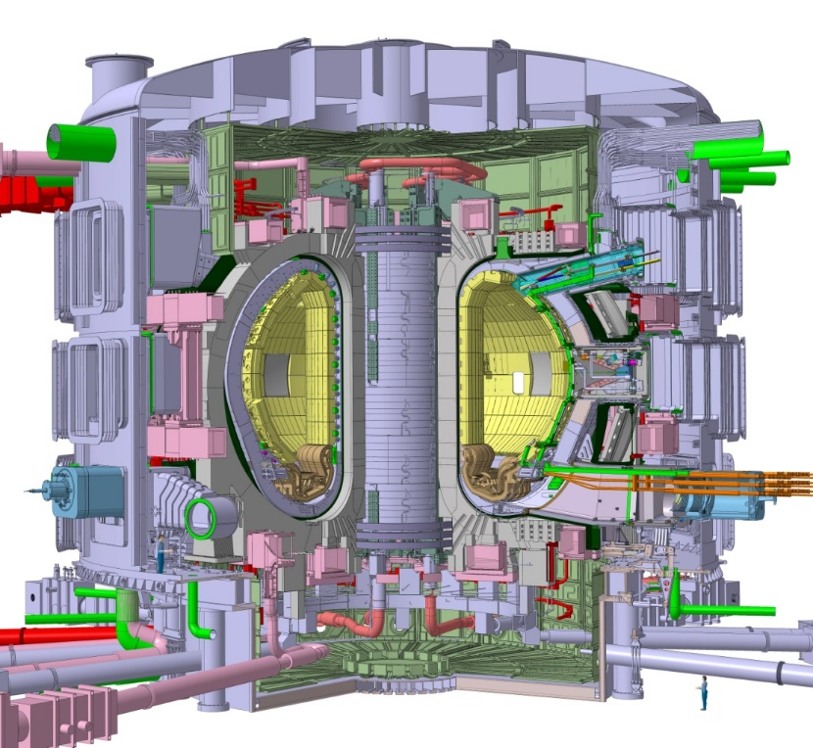
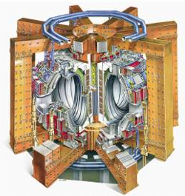
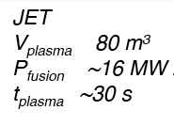
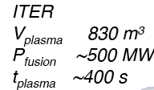
Example Magnetic Fusion Power Generators- TFTR, JET proved- ITER coming

Slide 10
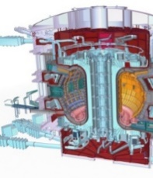
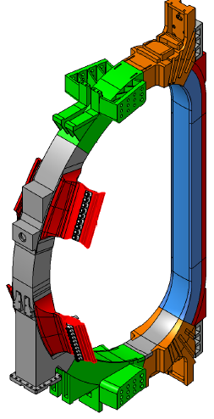
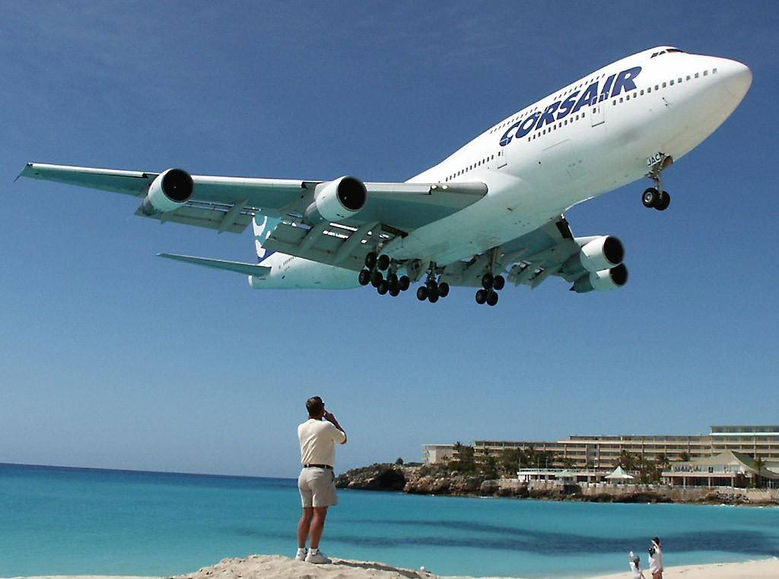
TF Coil – To contextualise
Mass of (1) TF Coil:
16 m Tall x 9 m Wide, ~360 t
Boeing 747-300
(Maximum Takeoff Weight) ~377 t

Slide 11
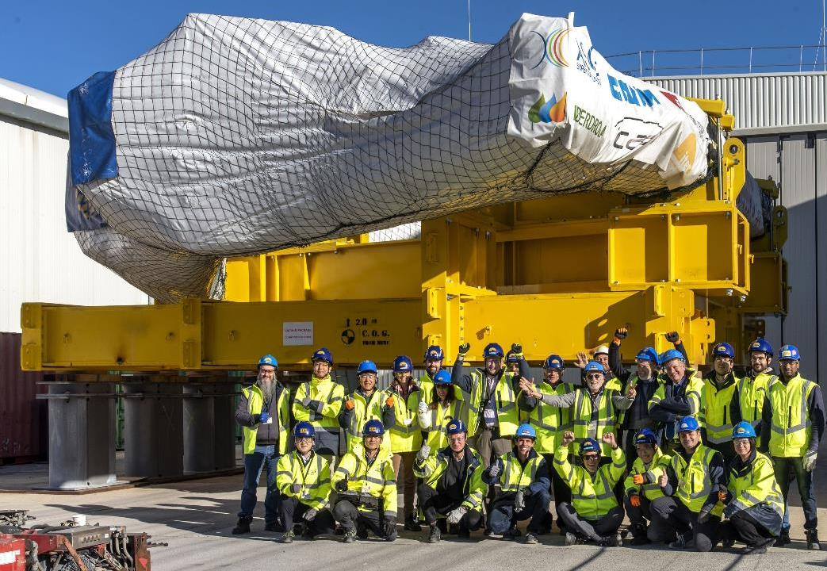

text
TOROIDAL FIELD COILS
18 coils
41 gigajoules
11.8 Tesla
Each coil:
360 tonnes
9 x 17 metres
Status:
Manufacturing of all 19 coils completed. All coils have been delivered to the ITER site.
text
text
11
text

Slide 12
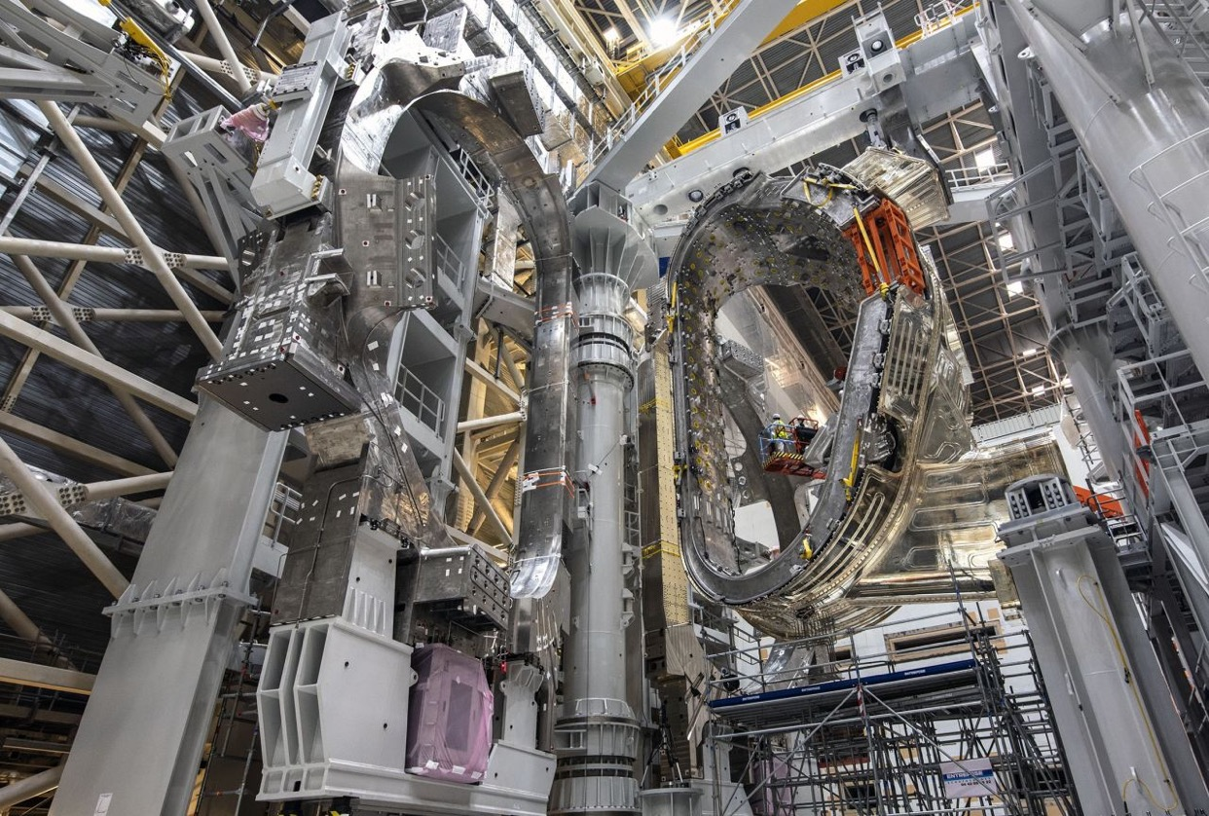

Slide 13
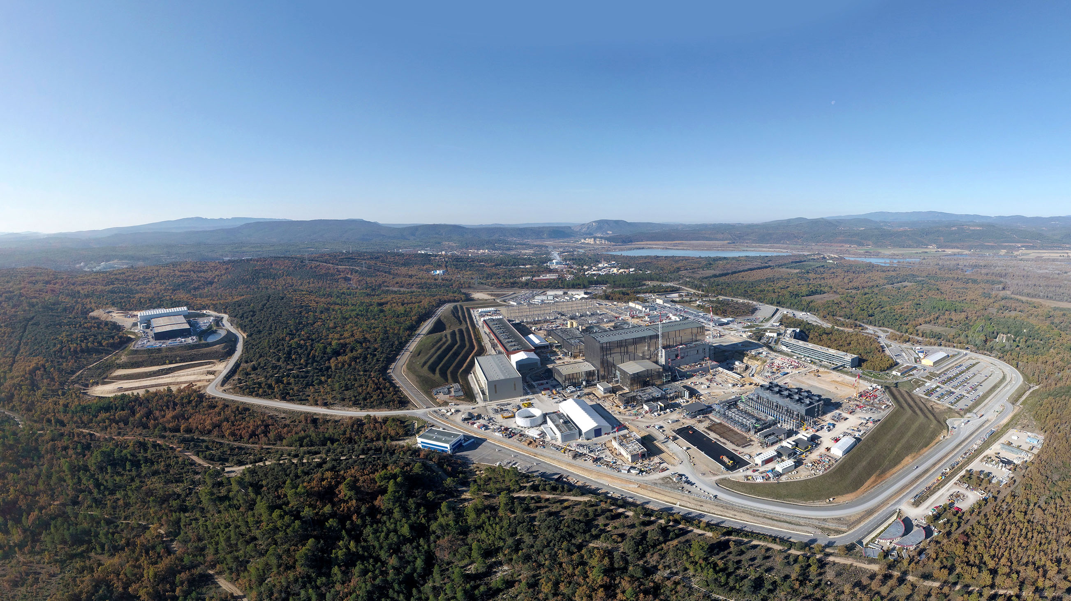
The Site Recently [Provence, France]

Slide 14
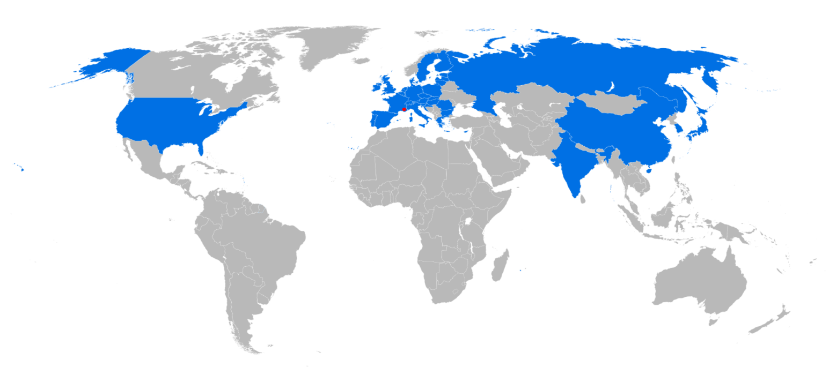





Who is working on this Project?
We are here

Slide 15






An International, Integrated Team
T
I
E
I
T
E
R
T
R
T
E
A
M
Eoin Walsh
E
M
A

Slide 16
Diagnostics/instrumentation is to provide the measurements necessary to control the plasma

Slide 17
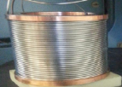
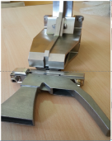
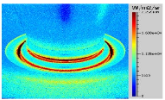
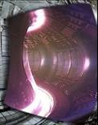
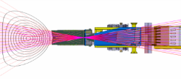
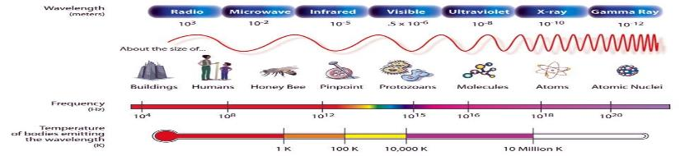
Spectral Areas Covered by the Diagnostics
IOCT
IOCT - CEA
Radial Neutron Camera Schematic
RFDA
JET
250 Million K
In ITER- the plasma emits in all regions and diagnostics make good use of this

Slide 18
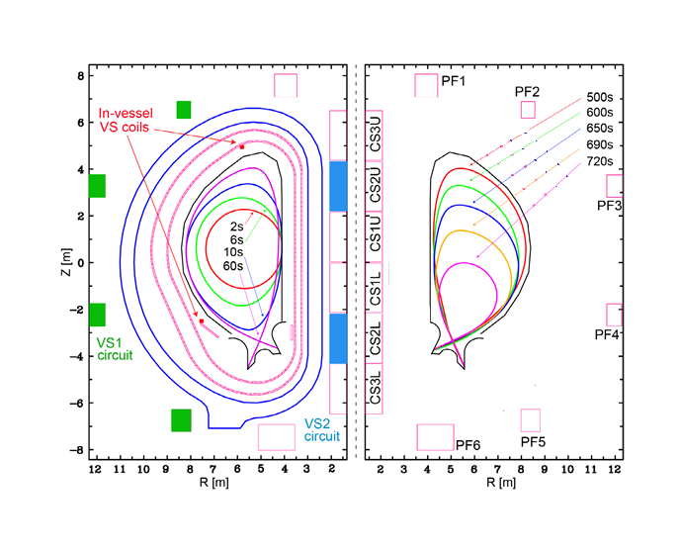
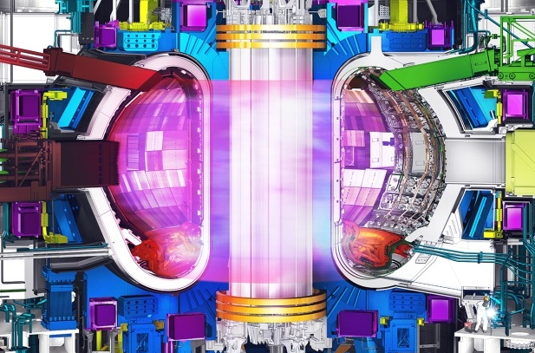
Some example uses of real-time measurements?
Q=10 scenario with (ELMy H-mode ):
I_{p}= 15MA, P_{aux}= 50MW, H_{98(y,2)} = 1
This allows us to control what is happening?

Slide 19
Things to Control
Plasma shape and size
Neutrons
Light emitted
Hot surfaces
Gases
Safe operation
Around 50 diagnostics and >100 projects needed to realize the measurement systems

Slide 20
To Observe – Systems are either
Passive
or
Active

Slide 21
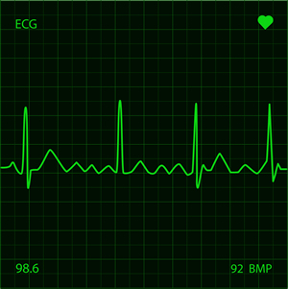
Passive Systems
Measure what is happening
Example- Heart monitor
In ITER- place detectors around the machine and measure what is happening

Slide 22
Passive Systems Examples

Slide 23
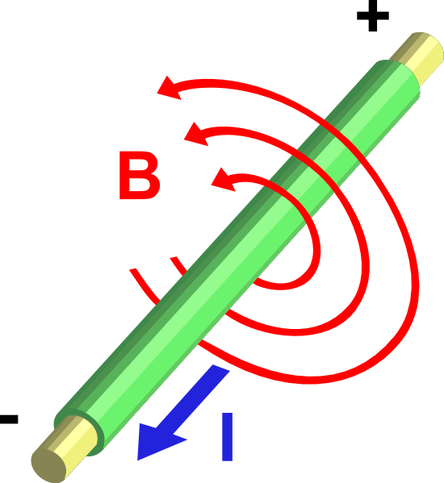
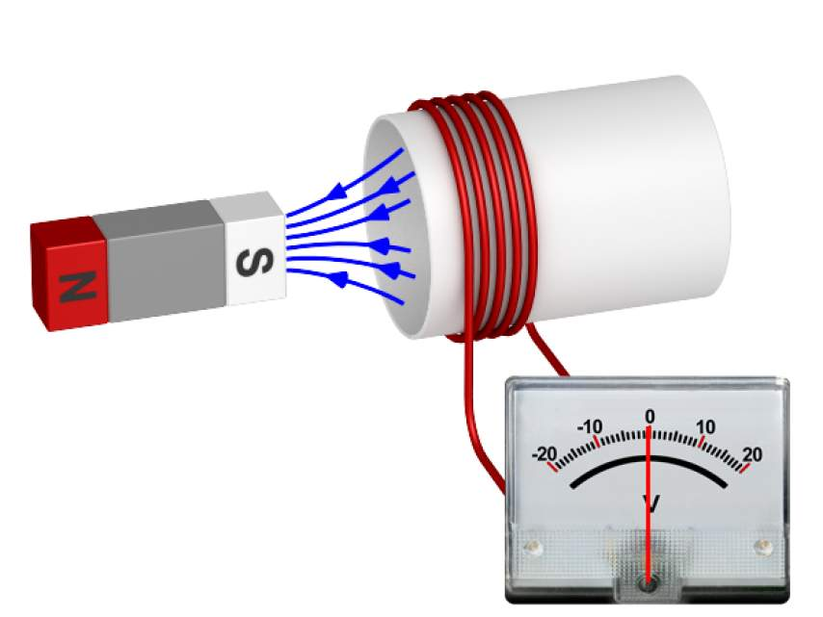
Plasma Current and magnetic Field?
Magnetic fields created by putting current in coil
MagLab
ITER will have 15MA flowing in the “jelly” like plasma?

Slide 24
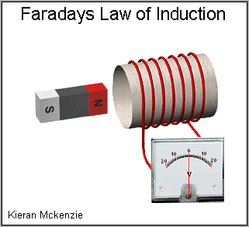
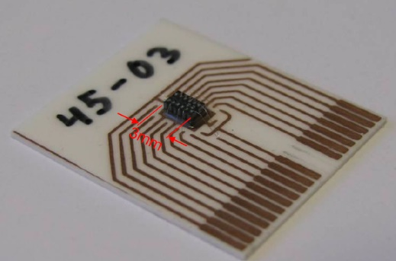
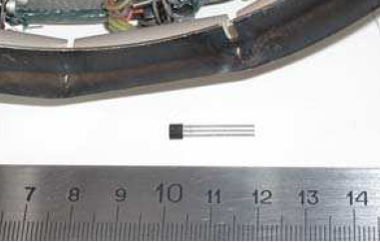
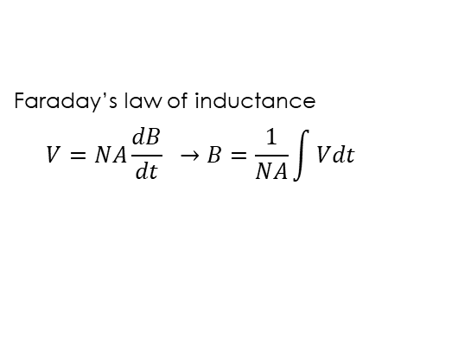
how to measure local magnetic field?
Inductive coil
Faraday’s law of inductance
$$V=NA\frac{dB}{dt} →B=\frac{1}{NA}\int{Vdt}$$
2. Micro Electro-Mechanical System (MEMS)
3. Hall-effect sensor
VTT
I.Duran for WEST

Slide 25
design procedures
Integration
Functional
REQs.
Distribution
Assembly
& Installation
Blanket
VV
Engineering Analysis
(Loading, structural, welding…)
Spatial allocation
design
components
specification,
prototyping,
lab testing…

Slide 26
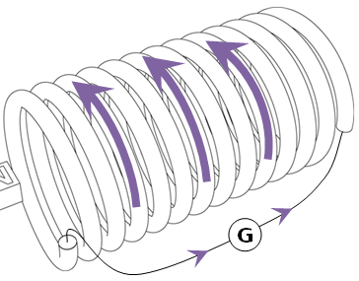
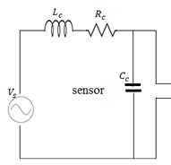






inductive coil design
N
A
equivalent circuit
A
dB/dt
$A_{eff}=NA$: effective area
$$V=NA\frac{dB}{dt}$$
$$L_{coil} \sim \frac{N^{2}A}{l}$$
$L :$ inductance
f-response
$R :$ resistance
$$R_{DC}=ρ_{u}λ/S_{w}$$

Slide 27
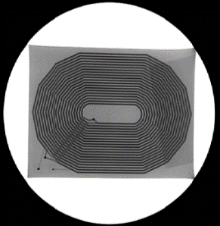
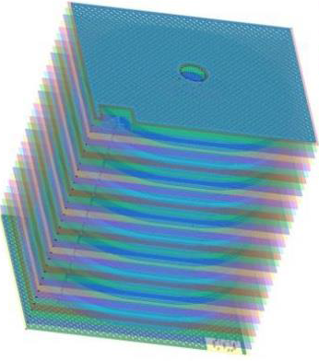
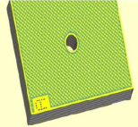
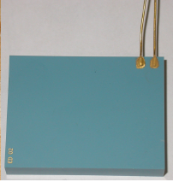
step forward: sensor development
LTCC Sensor
(Low-Temperature Co-fired Ceramic)
metallic ink via filling on ceramic substrate
Substrates stacking, vias connected
sintering
small and thin (~few mm thickness)
easy to integrate and cool, excellent thermal performance
suitable for long-pulse, ideal for equilibrium sensors
Courtesy Consorzio RFX
ceramic brittle, need to keep temperature uniform
structural integrity after neutron radiation (initial test promising)

Slide 28
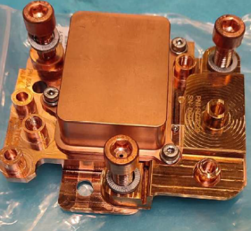
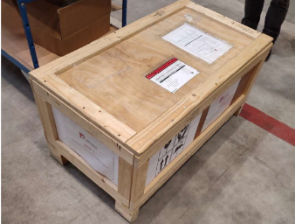
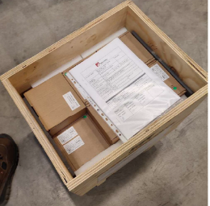
Delivery of Integrated Sensor Housing [size for each is 15cmX15cmX10cm]
Site delivery of integrated Sensor Housing (just over 150 sensors out of 400 in total)
Items packaged in zip plastic bags and carton boxes
Carton boxes stacked and loaded into wooden crates

Slide 29
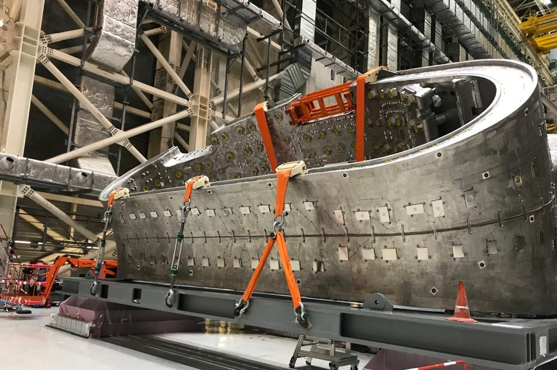
Outer Vessel Diagnostic Coils fully installed on the Vacuum vessel Sector 6
OVC Diagnostic coils(EUDA)

Slide 30
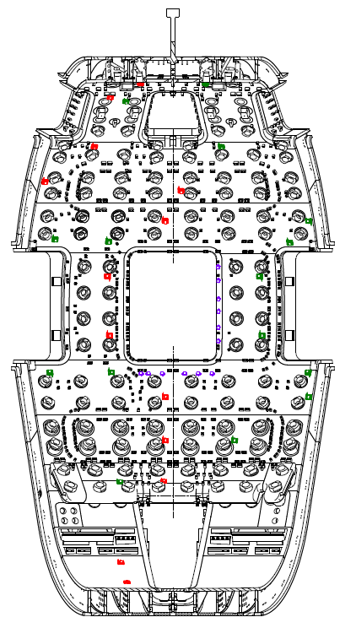
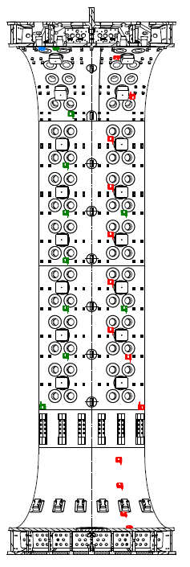
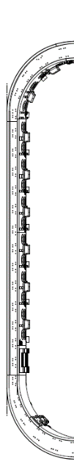
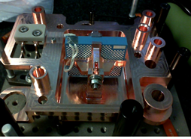

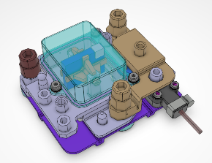

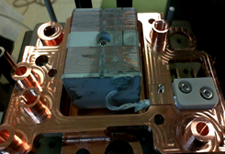
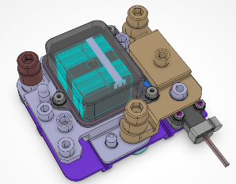

Distribution of Sensors on the Vessel and Divertor
Real Magnetic Coil Example
Outboard
Inboard
High Frequency (MHD)
Components delivered

Slide 31
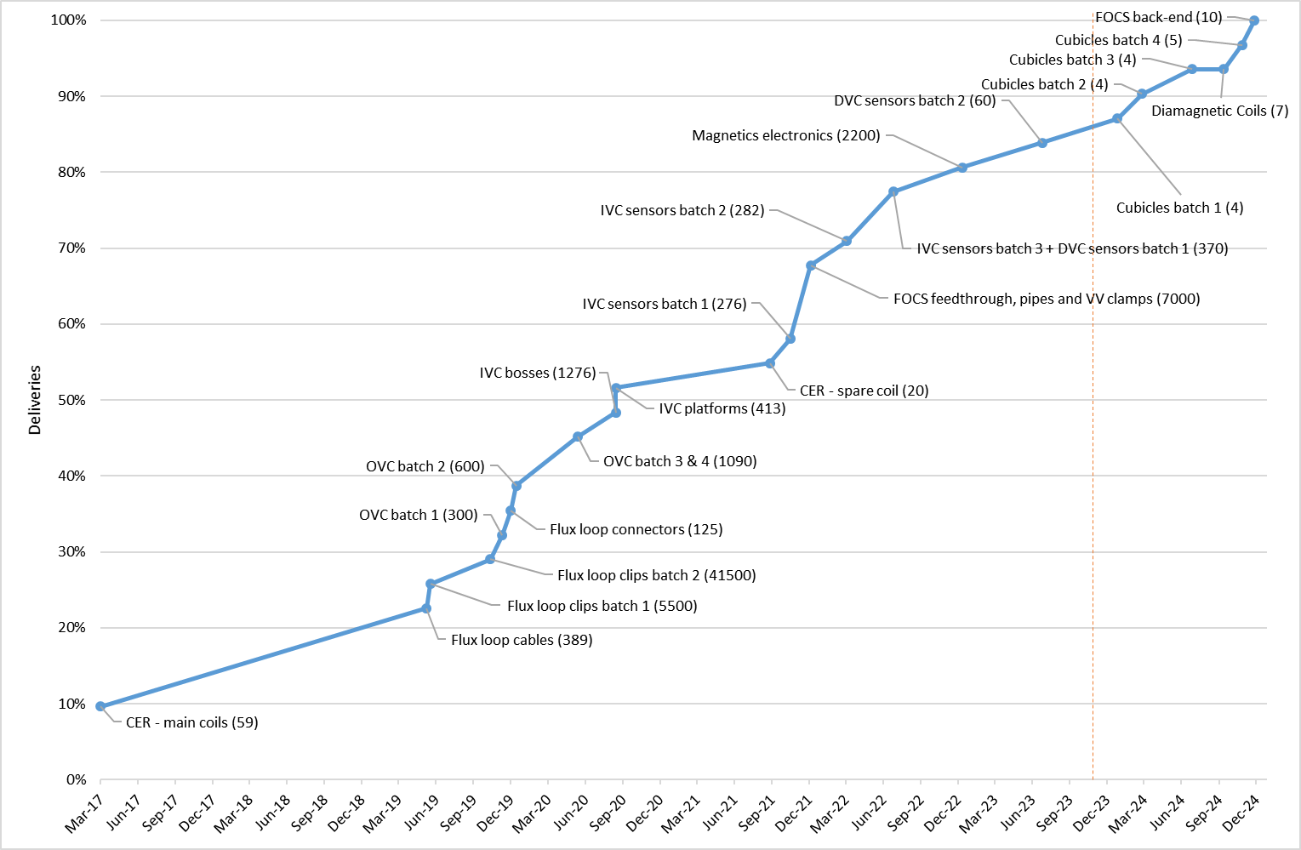
Status of 55.Ax FP magnetics by delivery milestone fraction (parts quantity in brackets)

Slide 32
Plasma Shape measurements and Control

Slide 33


What do we do with all the magnetic signals?
Magnetic Flux Topology (reconstructed)
Reconstruction
Numerical Code
(EFIT)
Magnetics densely distributed on VV surface inside and outside the vessel wall
Very importantly- these measurements can be used to grow the plasma and maintain it in real-time within centimeters of the walls of ITER and keep it there for very long periods
A very serious undertaking given the hostile environment!

Slide 34

ITER Plasma using Magnetics
The magnetic field is also measured using an array of coils
With these - the plasma shape, position and many other parameters can be determined
Plasma Start up

Slide 35
How about getting samples of dust from inside ITER

Slide 36

Dust Collection Head design and prototype
Dust tube guidance spring
CAD – Design
Latching tailpiece
HV contact
electrode
Direction of container removal
Ceramic insulators
Biased grid assembly
Dust Collection Container
First version of dust collection head prototype has been manufactured and tested
Dust collection efficiency has been tested
Opening for the dust container
Prototype
110 mm

Slide 37
Dust sample before collection | Dust sample after collection
Prototype demonstrated its ability to mobilize dust particles of different sizes and collect them with approximately 84% efficiency.
Tungsten Dust 1-100 µm
Aluminium Chips up to 1500 µm

Slide 38
Infrared Viewing systems

Slide 39
Let’s take an example measurement
Infrared or also known as IR measurement
Can’t see with naked eye but we have detectors

Slide 40


Infrared Viewing?
an infrared image of a cup holding a hot drink (degrees F)
infrared map of sea surface temperatures

Slide 41
How about the walls of the machine?
What happens if they get hot?
When they get hot - they emit a characteristic signal
This is well measured using infrared

Slide 42

Key areas are monitored – like Divertor
If this gets too hot –we have a big problem
The IR system will monitor this
And allow us to stop the operation if needed

Slide 43
Now to Active Diagnostic Systems

Slide 44

Active Systems
Externally influence to see effect
Example- Magnetic Resonance Imaging (or NMR)-
In ITER- launch laser, microwave or Particle beam and look at various physics effects

Slide 45
Electron Density measurement

Slide 46


TIP [Toroidal Interferometer/Polarimeter]
Principle
  IR interferometer
  2nd interferometer for vibration compensation
  Polarimeter for fringe skips
Design Features
  CO2 laser, 10.6μm;
  2nd laser - Quantum Cascade ~5μm
  Corner cube retroreflector (CCR) in blankets
Particular Challenges
  Retroreflector design
  Long beam path (>50m round trip)
  Alignment issues
  Large vibrations
interferometry
overview of TIP in vessel
USDA /PPPL/General Atomics/IO

Slide 47

TIP System Overview

Slide 48
I&C is a Critically important system for ITER

Slide 49
Electronics and Cameras
  Need to be able to face up to some neutrons and gammas
  Need also to be able to take local magnetic fields (not DC-DC transformers!!))
  Radiation effects Data for components is important

Slide 50

Electronic Components and Radiation
577 in the port-cells, 540 in galleries, 726 in the shielded corners and 1646 in Diag Building

Slide 51
I&C Infrastructure
Use configurable code modules provided
Still works with CCS out of the box, all interfaces handled by infrastructure
Signal exchange fully transparent
Interface management drastically simplified
Highly flexible, easy to maintain, scalable
Synergy possible between diagnostics for similar functions (binning, averaging, calibrating, 2-out-of-3 voting, etc.)
Diagnostic under resp. of DA 1
IO resp.
Diagnostic under resp. of DA 2
Common use of the ITER
Real-time framework
Diagnostic under resp. of DA 3
Real-time signal exchange

Slide 52


I&C for the Power distribution for the Diagnostics
The I&C subsystem of 55.NE.X0 controls and monitors the power supply to every diagnostic
A prototype has been installed in Corbières to verify operation and HMI

Slide 53
The big Picture

Slide 54


text
text
text
Who works for ITER?
The ITER Organization employs ~1250 staff from 35 countries, plus about 500 experts and subcontractors.
ITER Domestic Agencies (mostly Fusion for Energy, the EU-DA) has about 350 employees in France.
On the construction site, we also have about 2500 additional workers.
Globally, ITER partners also employ more than 3000 scientists, engineers, technicians, and support staff.
text

Slide 55












Work to be done roughly?
Funding (getting enough!)
Managing budgets and projects and Administration
System Engineering (essential for big projects!)
Hiring (the right people!)
Safety & Training (takes time in new industries!)
Managing people (everyone is different!)
You must work out what your strengths are, and what are your areas where you could develop
Leading and Team Building (developing a positive culture)
Conflict management
Overall Design and Ideas and Modelling (collaborative!)
Mechanical and Electrical Engineering and Physics
Computer Aided Design (CAD) and Diagrams
Instrumentation & Control (I&C) and real-time programming
Notes:
Check animation order for the new stuff

Slide 56
See Video [on disk]
https://youtu.be/iHZjgPSfZNs?si=DnKo3JwsR7dr2DWb

Slide 57
Conclusion – I issue a challenge to you all
  Work to high quality, making sure to balance time and cost
  Look for opportunities to innovate and simplify using modern methods, keep up with the times
  Integrate systems to simplify where possible
  Work hard and always believe in yourself

Slide 58


Thank you!
ITER Open Doors Day
June 2023

Slide 59


text
ASSEMBLING THE MACHINE: ITER Assembly Hall
September 2023
text
text
59
text

Slide 60




text
CRYOGENIC PLANT
75kW @ 4 Kelvin
Equipment installation is complete, and has entered pre-commissioning phase.
a
text
text
60
text

Slide 61


text
CHALLENGES OF
FIRST-OF-A-KIND COMPONENTS
… but the sector-to-sector welding of Vacuum Vessel sectors was reassessed to be too challenging to perform in situ, based on the previously identified geometric non-conformities in the field joints.
text
text
61
text

Slide 62


text
CHALLENGES OF FIRST-OF-A-KIND COMPONENTS
Leakage was also identified in thermal shield cooling piping due to chloride stress corrosion.
a
text
text
62
text

Slide 63



Power Creation
Sun→Fusion
Our Approach to Fusion on earth
START Machine-CCFE
Picture courtesy of the SOHO/EIT collaboration
Magnetic Confinement Fusion- Tokamak
This leads to ITER

Slide 64

55B4 D0 Neutron Flux Monitor EQ#7 – NFM-7
Lower cryostat cylinder LCC
NFM7

Slide 65

Fusion Product - Fusion Power
Fusion power limit of 500 MW – for archiving for nuclear licensing
Redundancy through large number.
Neutron Flux Monitors NFM (fission chambers)
Front end electronics in port-cell
Radiation hard preamplifiers?
Calorimetry for diversity
Electronics in diagnostics building
Details to be developed

