Slide 1
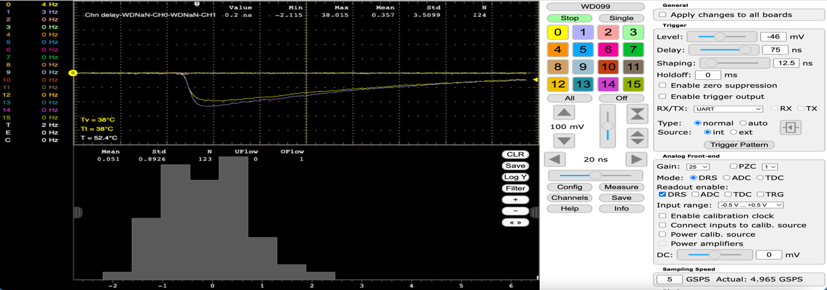
Waveform Digitizing
Stefan Ritt, Paul Scherrer Institute, Switzerland
IEEE NPSS Workshop on Applicatioins of Radiation Instrumentation
Nov. 25th, 2022, Dakar, Senegal

Slide 2
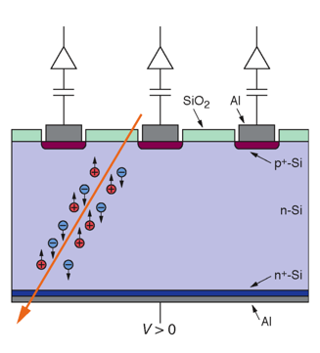
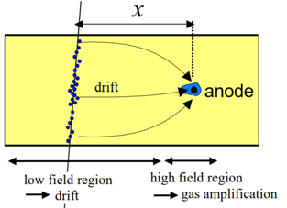
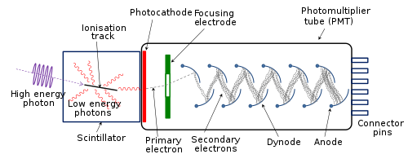
2 Principles of Detection of Ionizing Radiation
Detectors convert property to be measured directly into electrical signal → position, time
Indirect via light generation in scintillator → energy, time
Silicon detector
Wire chamber
Photomultiplier

Slide 3
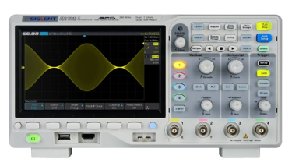
Modern Digital Oscilloscopes
Oscilloscope
01101
Detector
Amplifier
Digitization
Computer
Display
time

Slide 4
Analog-to-Digital Conversion
ADCs & More

Slide 5
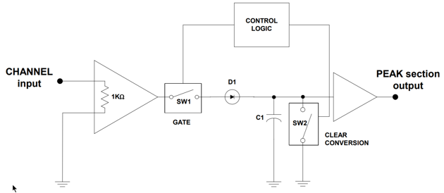
Digitization: Peak-sensing ADC
Reset
Technique to digitize fast signals with slow ADCs
Needs reset after each signal
Mainly historical
Amplitude
constant
-
+
D
Vout
Vin
C

Slide 6
Digitization: Charge integration
Charge
Many detectors have a proportionality between charge and particle energy
Noise immunity
V_{out}
Amplitude
V_{in}
-
+
V_{out}
time
Gate

Slide 7
Digitization: Waveform sampling
Sample waveform at discrete points (sampling rate) and extract features in digital world
time
ADC Type | Resolution (bits) | Conversion rate
Dual Slope | 12-20 | 100 sample/s
Successive approximation | 8-18 | 10 Msample/s
Flash | 4-12 | 10 Gsample/s
Pipeline | 8-16 | 1 Gsample/s
Delta-sigma | 8-32 | 1 Msample/s
Amplitude
time
Q_{int}
V_{th}
Amplitude
V_{pk}
T_{interp.}

Slide 8
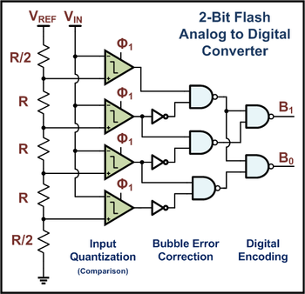
Digitization: Flash ADC 1-bit and 2-bit
V_{REF}
1-Bit Flash
Analog to Digital
Converter
R
V_{IN}
B
Threshold
R

Slide 9
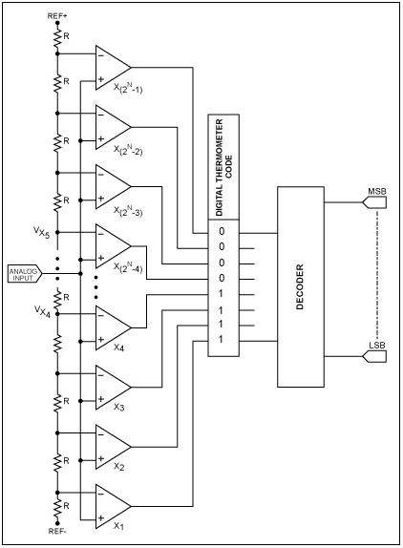
Digitization: Flash ADC n-bit
Flash ADC very fast
Requires 2^{n} comparators
Typically <=8 bit resolution

Slide 10
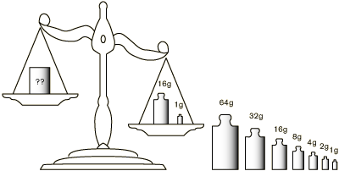
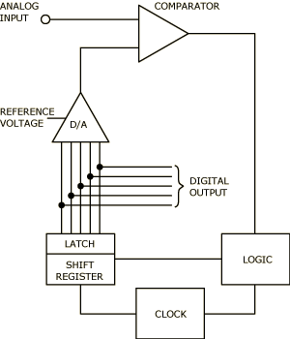
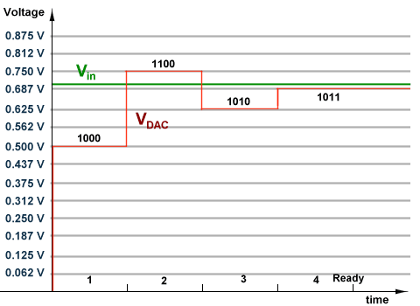
Digitization: Successive approximation ADC

Slide 11
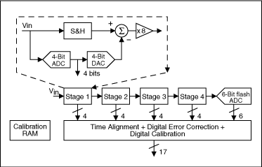
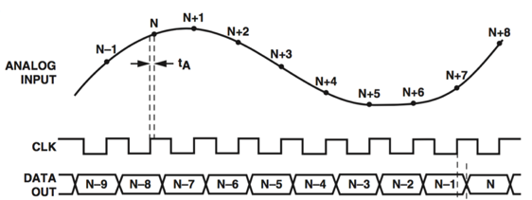
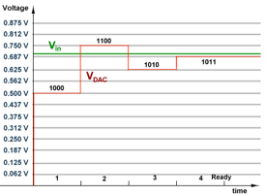
Digitization: Pipeline ADC
Combine several flash ADCs with successive approximation logic
Only requires 4-Bit flash ADC
Can convert one sample in each clock cycle
Has a latency depending on the number of pipeline stages
Most common technology for fast ADCs b)
11
10
Residual voltage
quantized by 2nd ADC
01
00
→ 101110

Slide 12
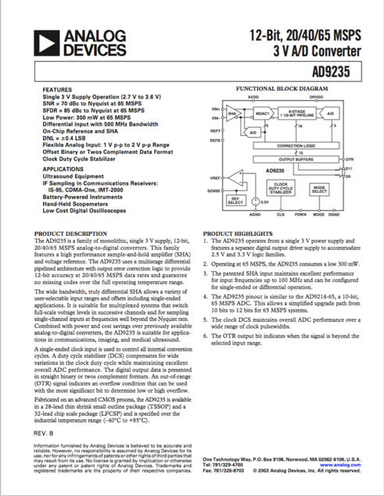
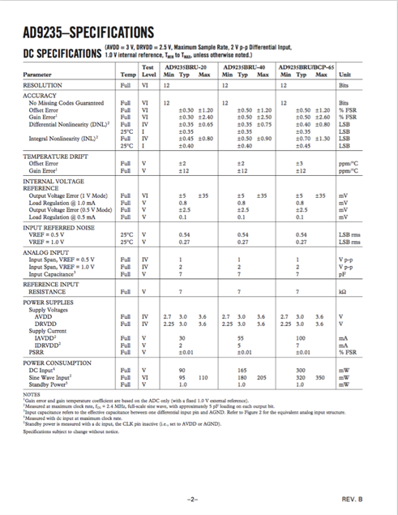
ADC Datasheets

Slide 13
Nyquist-Shannon Sampling Theorem
f_{signal} < f_{sampling} /2
Only signals with frequencies below half the sampling frequency can be perfectly sampled.
Then the original signal can be recovered from the discrete sampling points.
f_{signal} > f_{sampling} /2

Slide 15
Limits of waveform digitizing
Aliasing occurs if f_{signal} > 0.5 * f_{sampling}
Features of the signal can be lost (“pile-up”)
Precise time measurement and good energy resolution need very fast high resolution ADCs

Slide 16
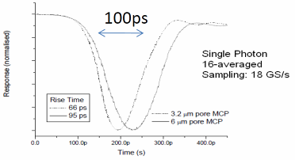
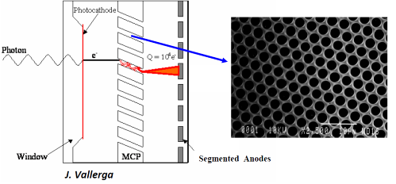
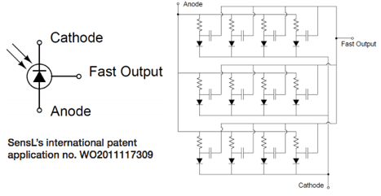
What are the fastest detectors?
Micro-Channel-Plates (MCP)
  Photomultipliers with thousands of tiny channels (3-10 μm)
  Typical gain of 10,000 per plate
  Very fast rise time down to 70 ps
70 ps rise time → 4-5 GHz BW → 10 GSPS
SiPMs (Silicon PMTs) are also getting < 100 ps
J. Milnes, J. Howoth, Photek

Slide 17

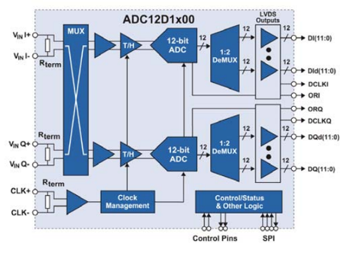
Can it be done with FADCs?
8 bits – 3 GS/s – 1.9 W → 24 Gbits/s
10 bits – 3 GS/s – 3.6 W → 30 Gbits/s
12 bits – 3.6 GS/s – 3.9 W → 43.2 Gbits/s
14 bits – 0.4 GS/s – 2.5 W → 5.6 Gbits/s
V1761: 2 Channels, 4 GS/s, 10 bits
24x1.8 Gbits/s
1.8 GHz!
Costs: 1-10 k$ / channel
What about 1000+ channels?
Requires high-end FPGA
Complex board design
High FPGA power

Slide 18
Digitization: Application Specific Integrated Circuit (ASIC) for Waveform Sampling: Switched Capacity Arrays (SCA)
0.2-2 ns
10-100 mW
Inverter “Domino” ring chain
IN
Waveform
stored
Out
FADC
33 MHz
Clock
Shift Register

Slide 19
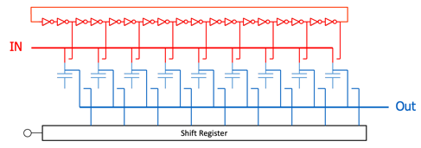
Time Stretch Ratio (TSR)
δt_{s}
Typical values:
δ t_{s} = 0.5 ns (2 GSPS)
δ t_{d} = 30 ns (33 MHz)
→ TSR = 60
δt_{d}

Slide 20
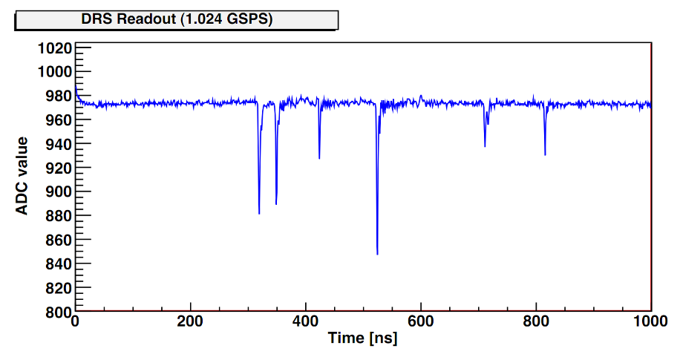
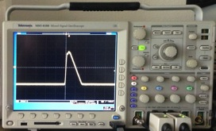
Triggered Operation
sampling
digitization
sampling
digitization
Sampling Windows * TSR
lost events
Dead time =
Sampling Window ∙ TSR
(e.g. 100 ns ∙ 60 = 6 μs)
Chips usually cannot sample during readout ⇒ “Dead Time”
Technique only works for “events” and “triggers”

Slide 21
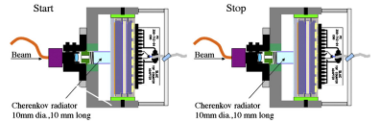
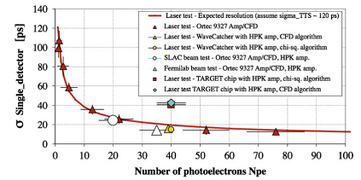
How to measure timing best?
J.-F. Genat et al., arXiv:0810.5590 (2008)
D. Breton et al., NIM A629, 123 (2011)

Slide 22
How is timing resolution affected
voltage noise Δu
signal height U
timing uncertainty Δt
rise time t_{r}
number of samples on slope

Slide 23
How is timing resolution affected?
U | Δu | f_{s} | f_{3db} | Δt
100 mV | 1 mV | 2 GSPS | 300 MHz | ∼10 ps
1 V | 1 mV | 2 GSPS | 300 MHz | 1 ps
1 V | 1 mV | 10 GSPS | 3 GHz | 0.1 ps
today:
optimized SNR:
next generation:
- high frequency noise
- quantization noise

Slide 24
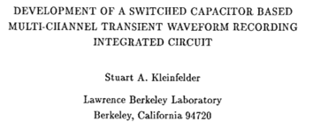
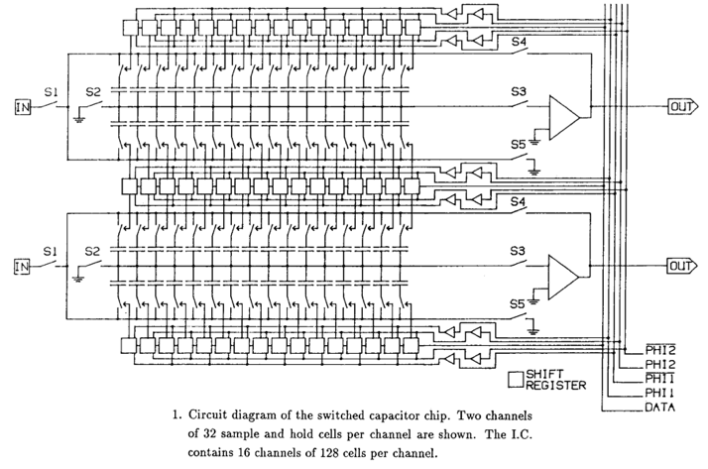
First Switched Capacitor Arrays
IEEE Transactions on Nuclear Science,
Vol. 35, No. 1, Feb. 1988
50 MSPS in
3.5 μm CMOS process

Slide 25
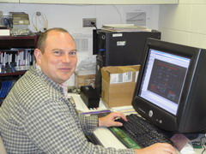
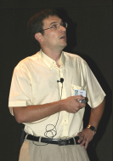

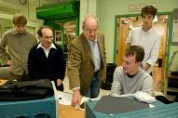






Switched Capacitor Arrays for Particle Physics
E. Delagnes
D. Breton
CEA Saclay
G. Varner, Univ. of Hawaii
H. Frisch et al., Univ. Chicago
STRAW3
LABRADOR3
TARGET
AFTER
SAM
NECTAR0
PSEC1 - PSEC4
0.13 μm IBM
Large Area Picosecond Photo-Detectors Project (LAPPD)
0.25 μm TSMC
Many chips for different projects
(Belle, Anita, IceCube …)
0.35 μm AMS
T2K TPC, Antares, Hess2, CTA
www.phys.hawaii.edu/~idlab/
matacq.free.fr
psec.uchicago.edu

Slide 26
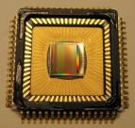
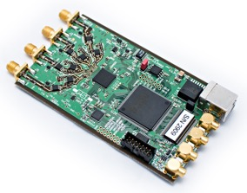
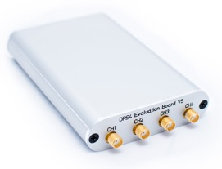
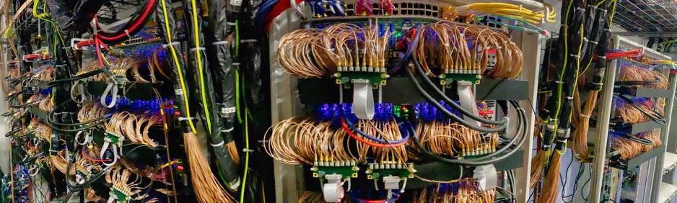
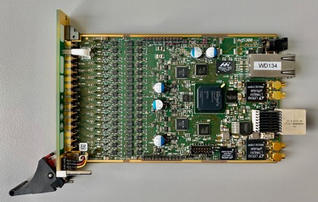
DRS4 Chip
DRS4 Chip
Developed at PSI in 2008 together
with R. Dinapoli
5 Gsamples/s, 12 bits resolution,
8+1 channels, 17.5 mW/channel
Time measurements down to 10 ps
Evaluation Board
WaveDREAM Board
9000+ channels of MEG II, PSI

Slide 27
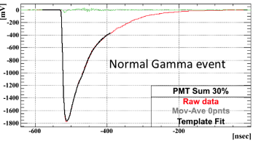
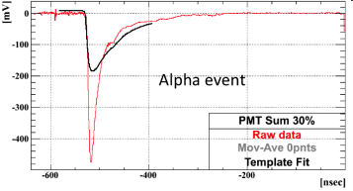
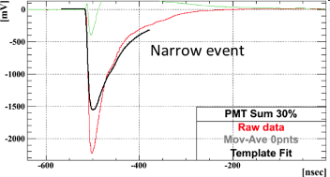
Pulse shape discrimination
μ
γ
γ
α
α
μ
Events found and correctly processed
2 years (!) after the data has been taken

Slide 28
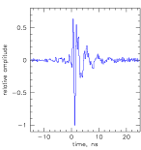
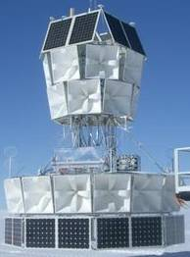
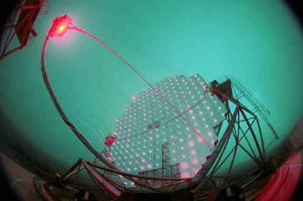
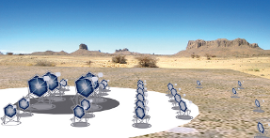
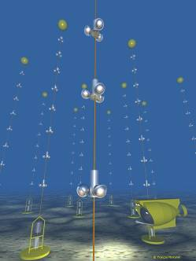
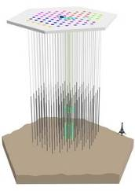
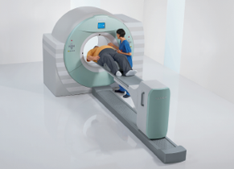
Applications of SCA
Gamma-ray astronomy
CTA
320 ps
Magic
Antarctic Impulsive
Transient Antenna
(ANITA)
Antares
(Mediterranian)
IceCube
(Antarctica)
ToF PET (Siemens)

Slide 29
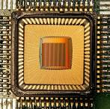
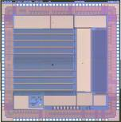
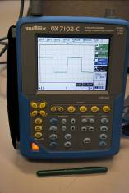
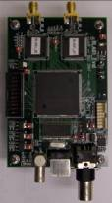
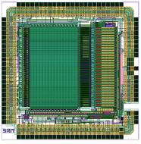



Conclusions
SCA technology offers tremendous opportunities
Several chips and boards are on the market for evaluation
New series of chips on the horizon might change front-end electronics significantly

