Slide 1




Particle Camera
Experiment guidelines
Michael Holik, Vladimir Vicha, Stanislav Pospisil, et al.
Institute of Experimental and Applied Physics
Czech Technical University in Prague
2022/11/02

Slide 2
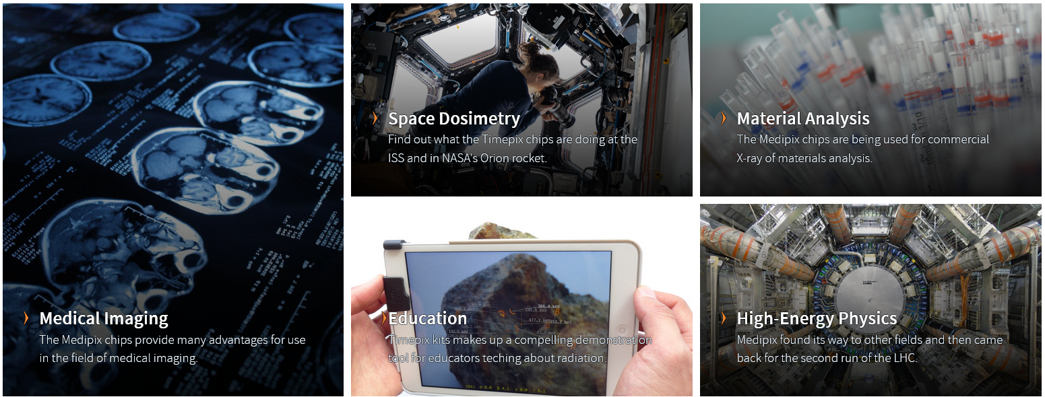
CERN Medipix
Collaboration
Development of pixel detectors
Technology transfer initiative
Application of pixel detectors in the field of education

Slide 3
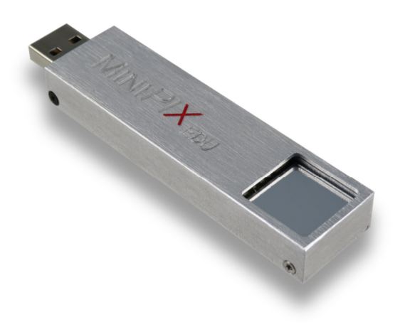
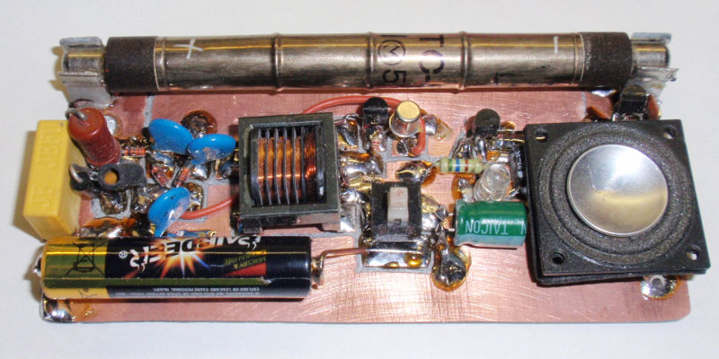
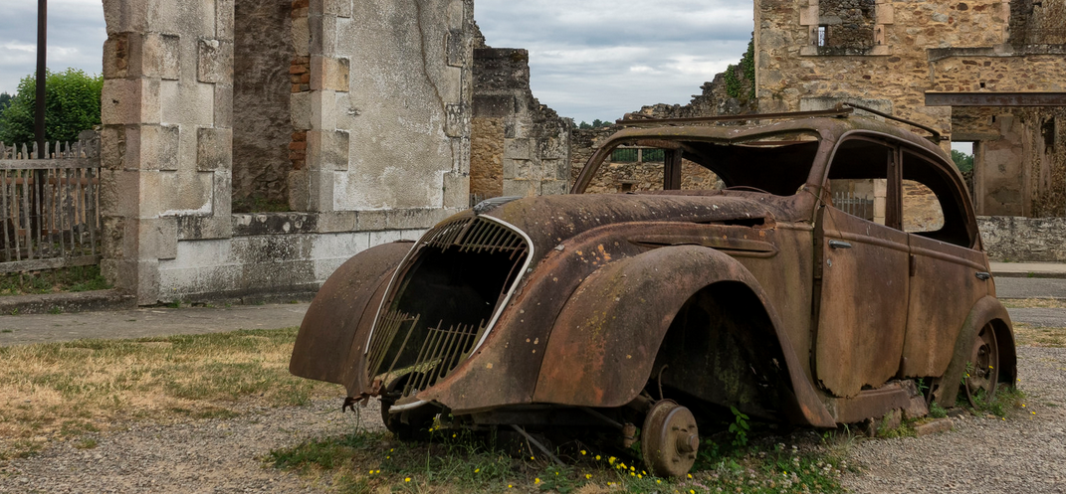
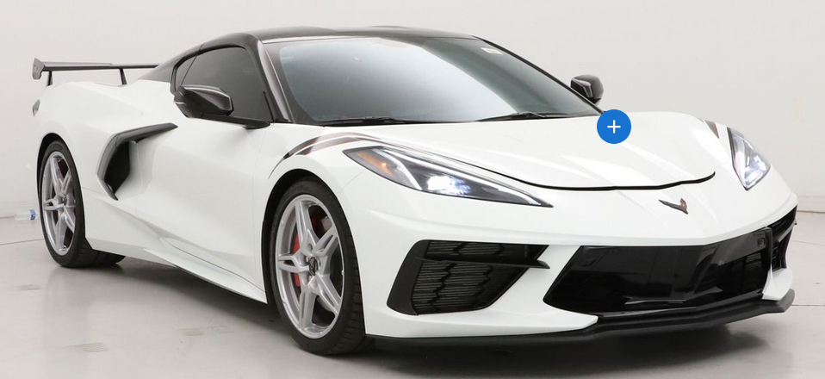
Particle Camera = Modern Instrument
for Teaching of Physics
Geiger-Muller counter vs Timepix based Particle camera
Notes:
2022 Corvette Stingray 3LT - Chevrolet

Slide 4
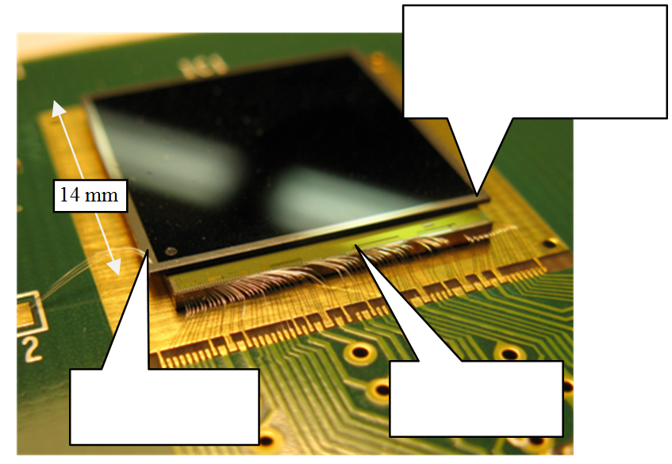
Timepix
Timepix - Hybrid Pixel Detector with Single Particle Detecting Capability
Single photon counting readout provides low noise, high contrast images with very high dynamic range
55 x 55 um pixel pitch Matrix 256 by 256
Si, CdTe, GaAs sensors
Different sensor thickness 300um, 500um, 1mm,
2mm, 5mm

Slide 5
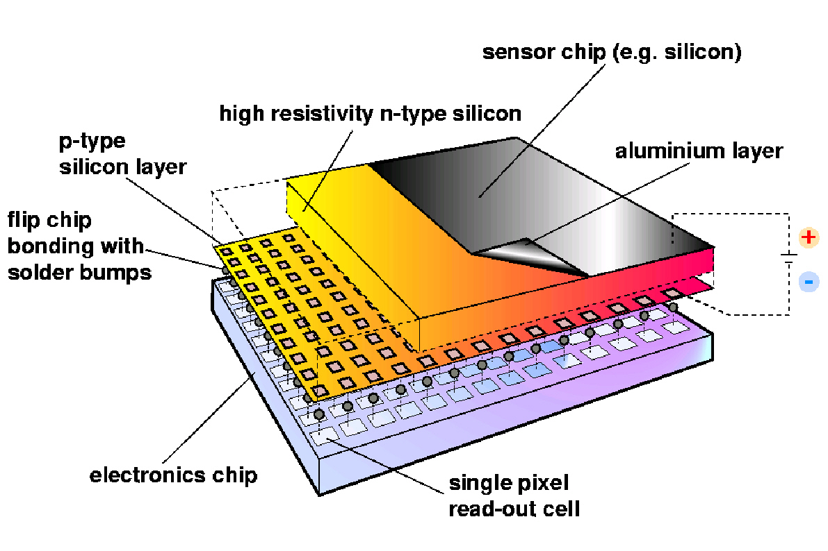
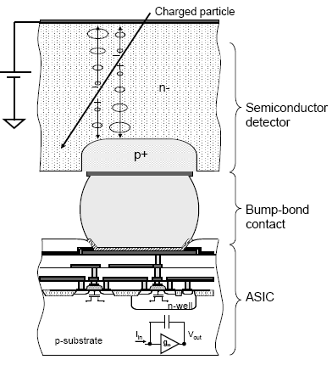
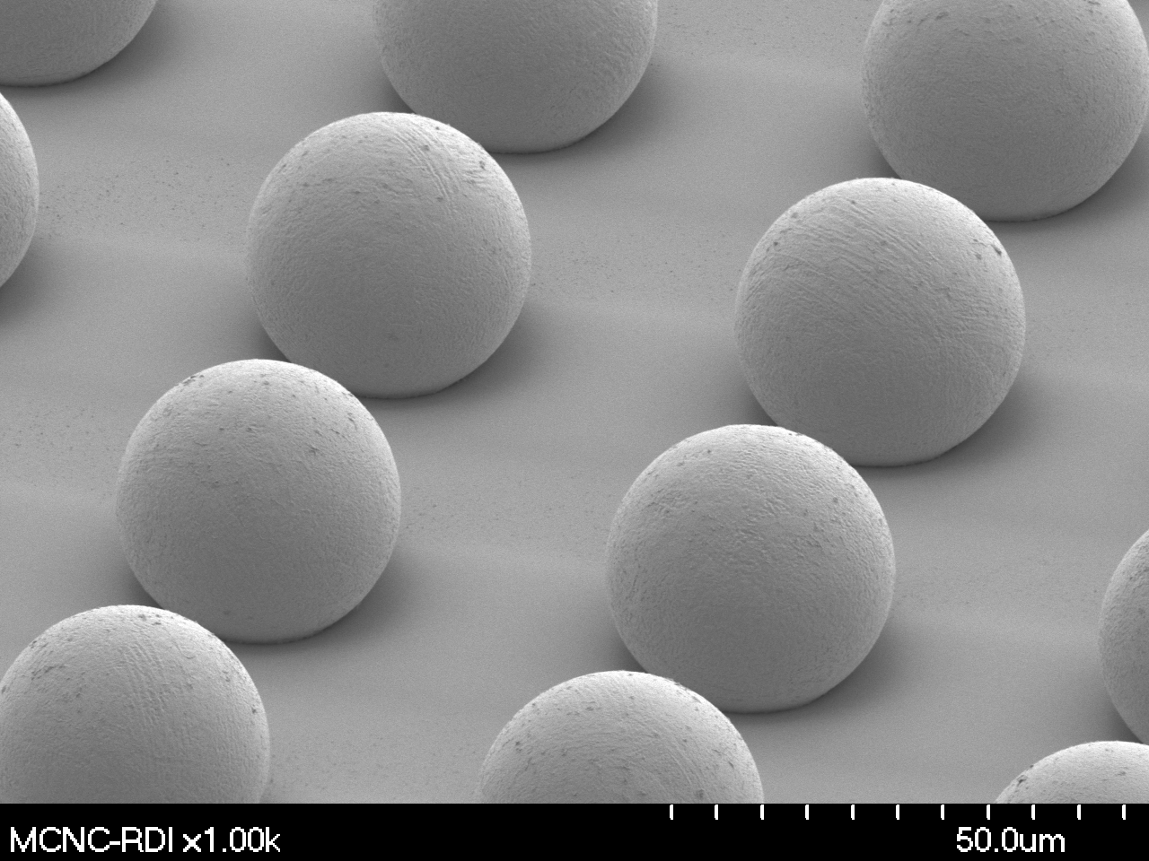
Timepix - Hybrid Pixel Detector with Single Particle Detection Capability
Sensor part and readout electronics part are optimized separately
(sensor materials – Si, CdTe, GaAS)

Slide 6
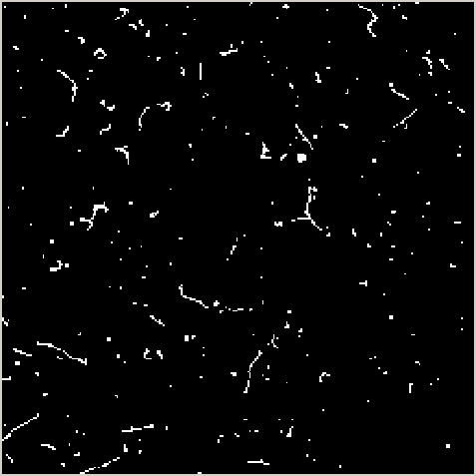
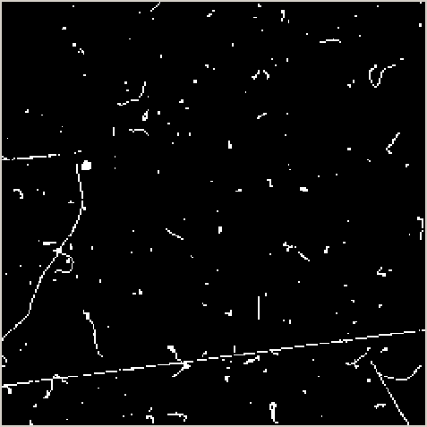
Pixel detector as
“Active emulsion”
Some particles can be identified from shape of their tracks as in formerly used nuclear emulsions.
Example: Cosmic rays and natural background
Are particles photogenic?
Yes of course, they are when observing them with Timepix detector.

Slide 7
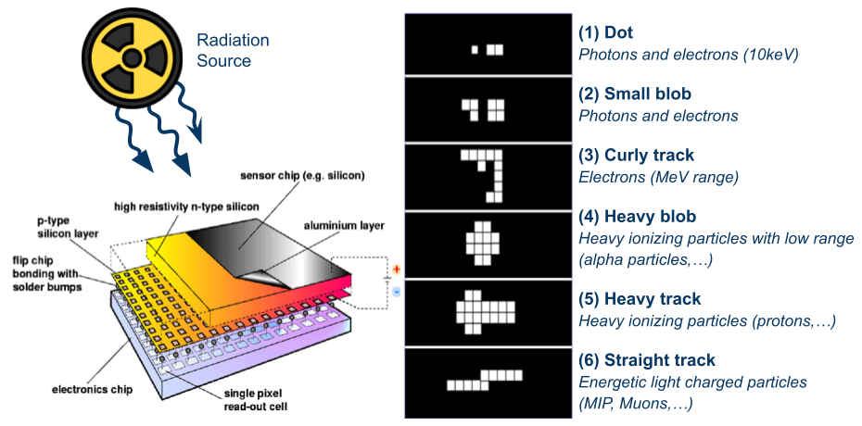
Particle Camera Working Principle
….Different kind of radiation produces tracks of different shape

Slide 8
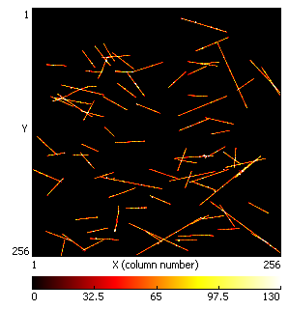
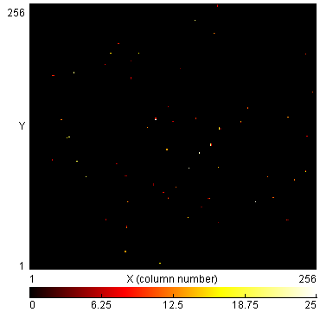
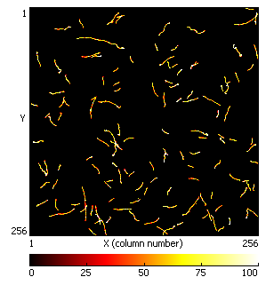
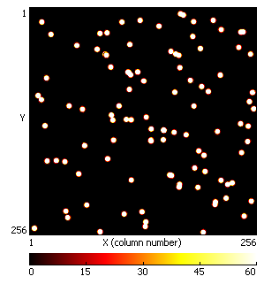
Particle Tracking
and Recognition
Muons
Type of interacting particle can be recognized by its specific track left in the pixel matrix
Track shape depends on interacting particle energy, mass, sensor material, bias voltage, angle,…
Gammas/X-Rays
Alphas
Electrons

Slide 9
Principle of semiconductor single particle counting pixel detector
Threshold level above
electronic noise
No false counting.
Digital integration (counting)
No dark current.
Unlimited dynamic range and exposure time.
Detected count obeys poissonian distribution
N⁺
P⁺
Si
+
Bias Voltage
Amplifier
Common
back-side
electrode
Pixelated
front-side
electrode
Compa
rator
Counter: Particle count
Threshold
level
000
001
Pixel electronics
Notes:
9

Slide 10
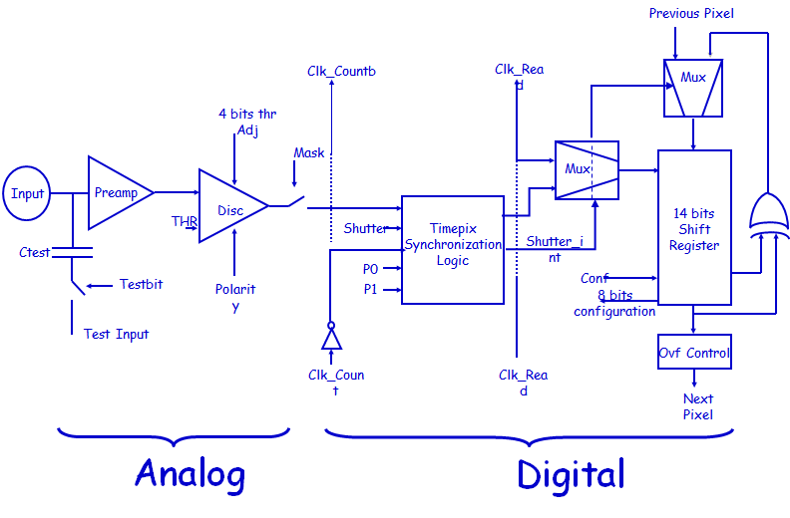
Timepix read-out chip
Single pixel schematics
Independent signal processing is performed in each individual pixel
Very high level of miniaturization and functionality implementation
All 65 536 detector channels (pixels) are running in parallel

Slide 11
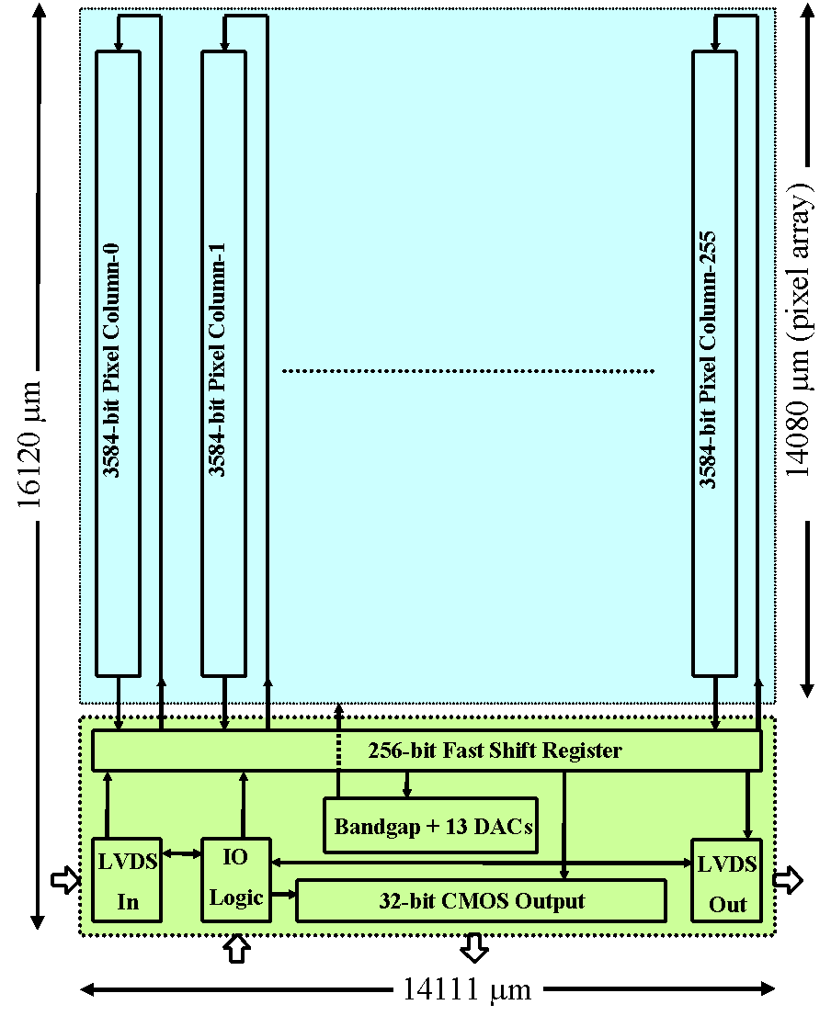
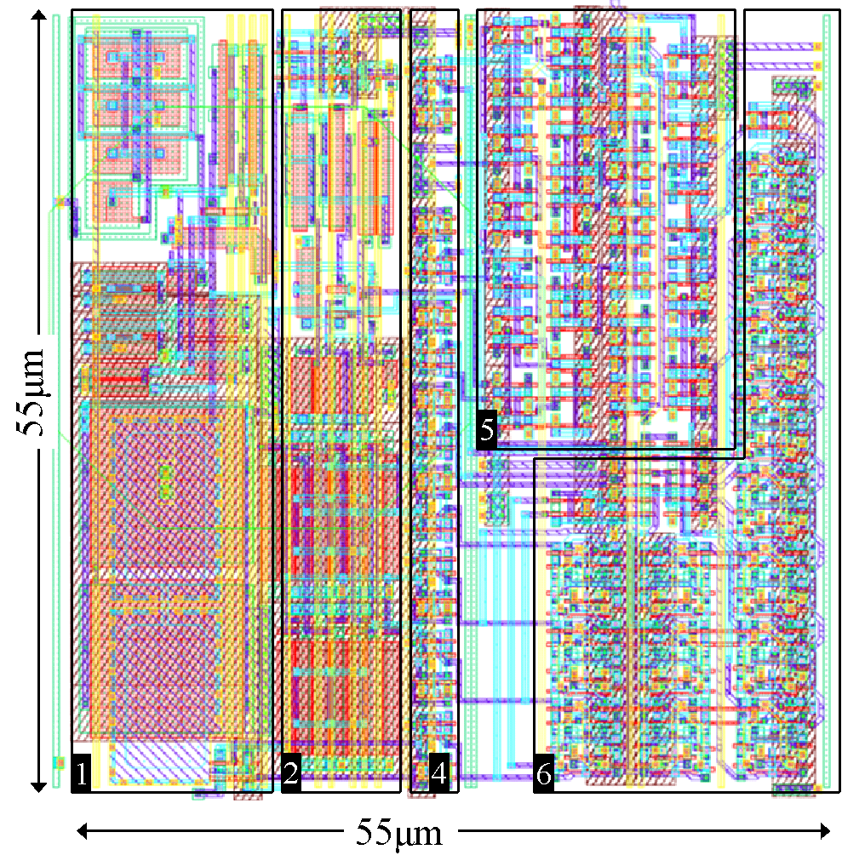
Timepix readout chip layout
256x256 55µm square pixels
36M Transistors
Serial readout (@100MHz) -> 9.17 ms
(~100 frames per second)
Parallel readout (@100MHz) -> 287 µs
(~3000 frames per second)
Single pixel floor plan

Slide 12
Pixel Operation Modes
Each pixel can be configured to operate in different mode independently to other pixels
Medipix mode
Counter is incremented if incoming particle is registered
Time of Arival mode
Counter is continuously incremented from the time when first particle is registered
Time Over Threshold mode
Counter is incremented as long as a signal is over threshold
Masked mode
pixel is disabled

Slide 13
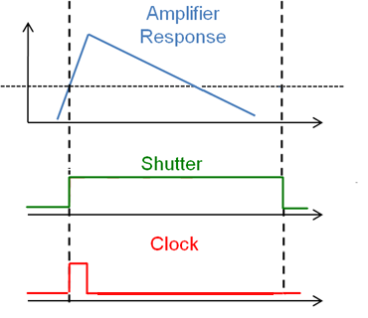
Medipix / Event Counting Mode
Each event registered is counted as 1
Counter value equals to a number of interacted particles
Event rate is limited by run up time and time of integration
Threshold
Pixel Counter

Slide 14
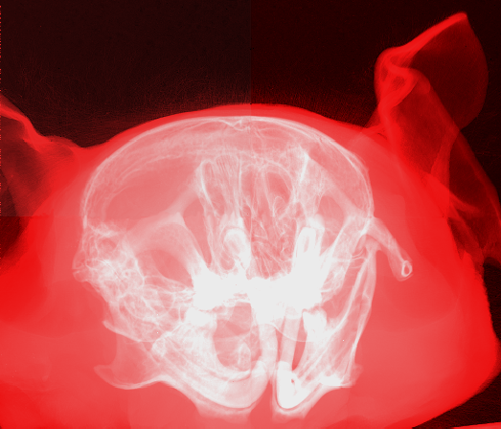
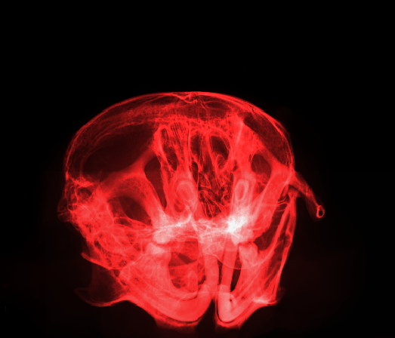
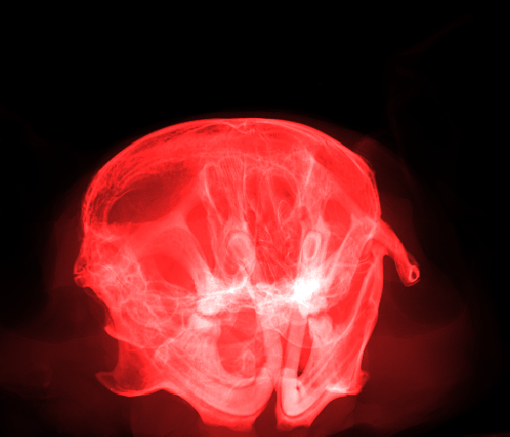
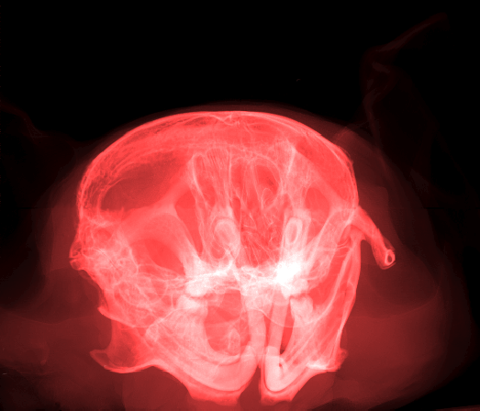
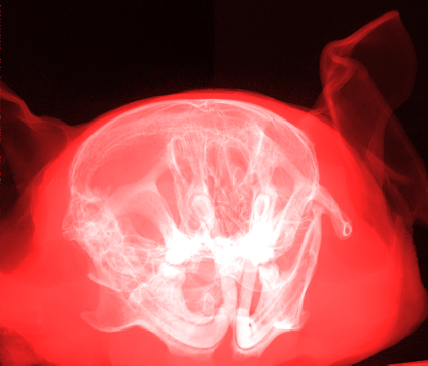
High contrast imaging:
Unlimited dynamic range
Example 1:
X-ray transmission
Image of mouse head
(dose 0.9 mGy)
Single photon counting device can count unlimited number of photons, noise in images is given just by poissonian statistics:
  => Unlimited number of gray levels in images depending just on the beam intensity and exposure time.
  => Almost unlimited contrast
Surrounding soft tissue
Very light parts: hairs
Hard structures: skull
Softer structures: muscles
Even softer structures
Mouse head – different scaling of same data

Slide 15
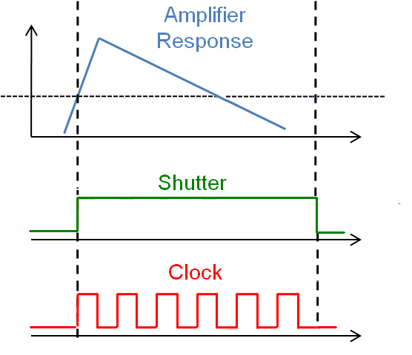
Timepix / Time Of Arrival Mode
Counts from passing threshold to closing shutter
Allows accurate timing of hits in individual pixels
Threshold
Pixel Counter

Slide 16
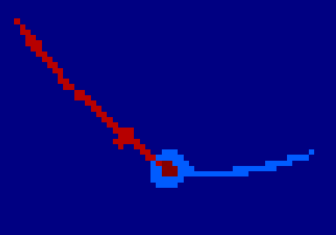
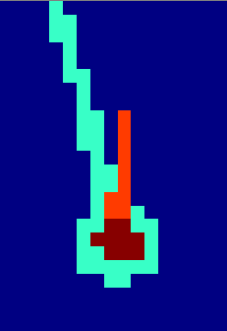
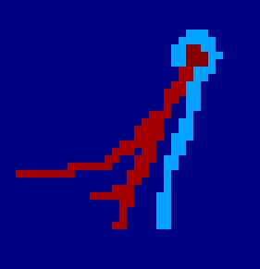
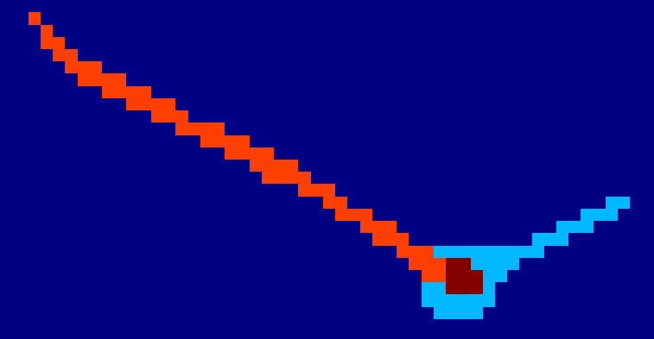
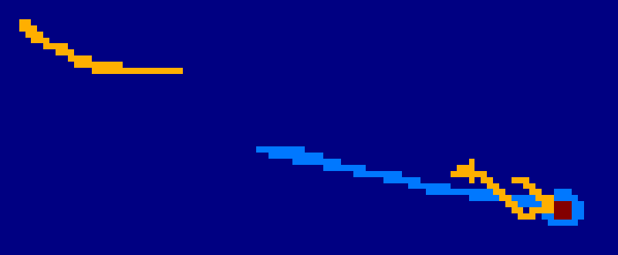
Measured events: ⁸He decays (TOA Mode)
Primary ion
2ndbeta decay
1st beta decay
Alpha decay
⁸He
β
n
120 ms
β
810 ms
α
< ns

Slide 17
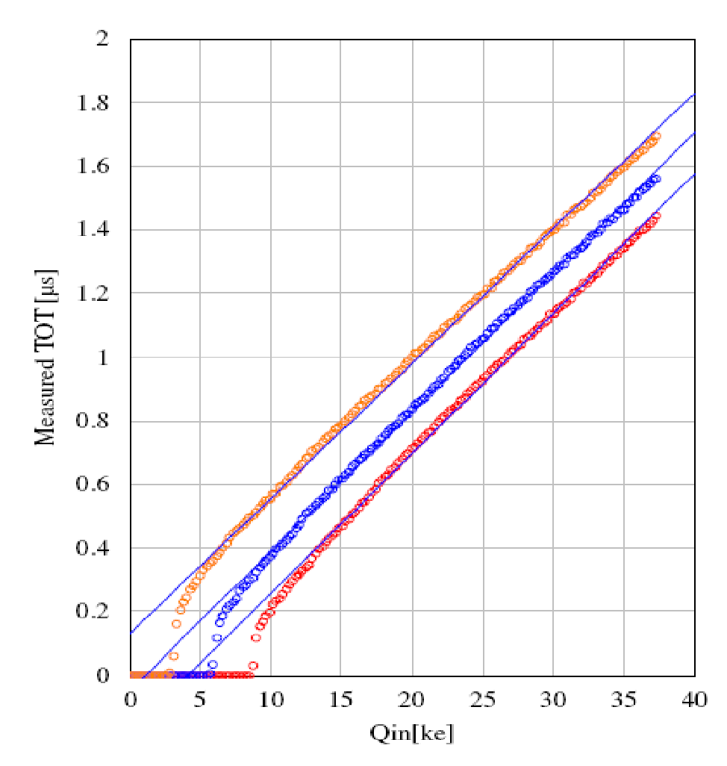
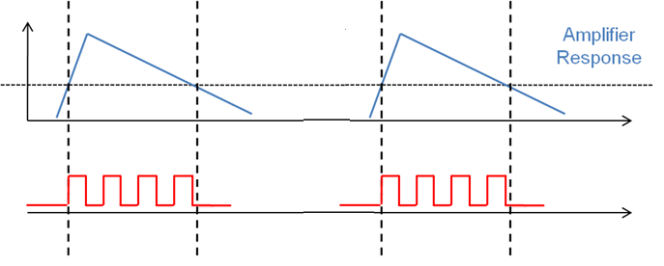
Time Over Threshold Mode
Energy measurement
Counter is incremented as long as a signal is over threshold
Threshold
Counter
Clock
E.g. 20ke- ~1us = 40 x 25ns (i.e. base clock 40 MHz)
Residual errors come from non linearity with small charge signals and a slow return to baseline
Preamp has fast rise (90ns) but slow (500ns -2500ns) constant current return to zero
Linearity of one pixel measured at three different threshold values

Slide 18
per pixel energy measurement:
Time Over Threshold mode
Counter in each pixel can be used as
Wilkinson type ADC to measure energy of each particle detected.
TOT
Calibration
curve
If the pulse shape is triangular then Time over Threshold is proportional to collected charge i.e. to energy.
Due to limited bandwidth the pulse can be NEVER perfectly triangular.
Non-linear TOT to energy dependence
Energy
Energy
Threshold
Time

Slide 19
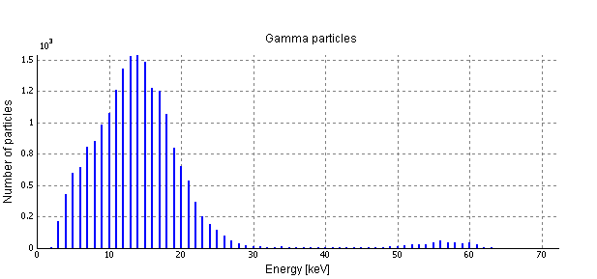
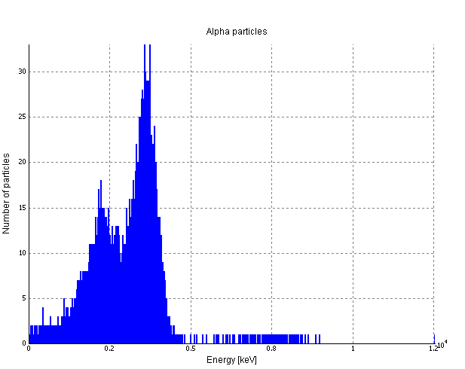
And when per-pixel calibration is applied on measured TOT values…
Exemplar ²⁴¹Am spectra
distance
+1 cm
distance
0 cm
Exemplar ²⁴¹Am alpha spectrum measured in air at two different distances between the radiation source and the Timepix detector

Slide 20
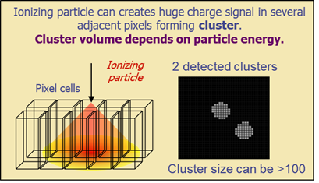
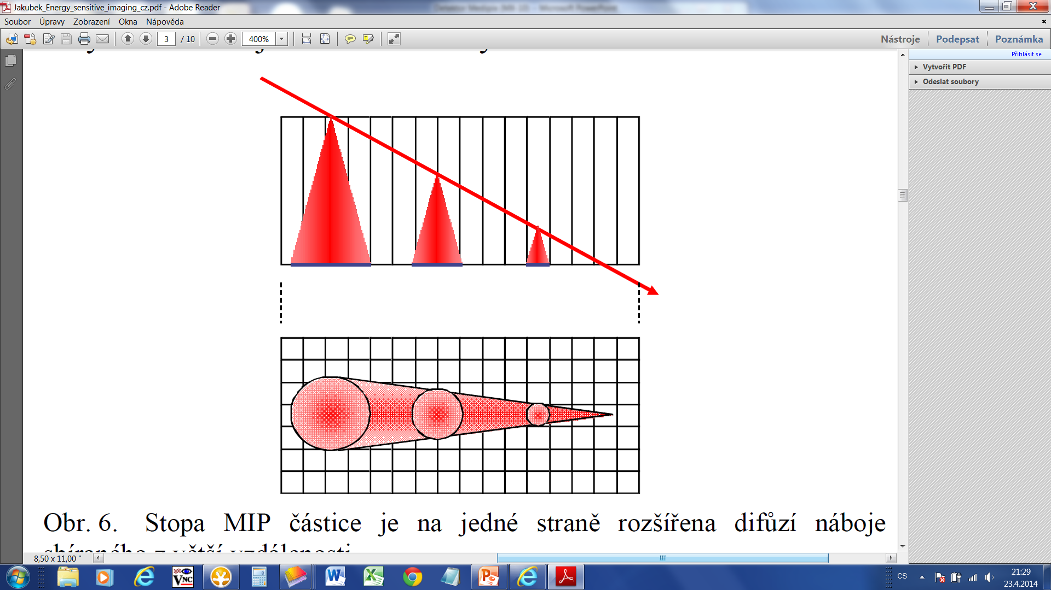
Charge Sharing Effect
creation of clusters
Ionizing particle creates a charge in the sensor.
The charge is collected by external electric field => the process takes some time
Due to charge diffusion the charge cloud expands
The charge cloud can overlap several adjacent pixels => CLUSTER
Pixels in a cluster will detect the charge if it is higher than certain threshold
The Cluster size depends on:
Particle energy and range
Depth of interaction
Detector Bias Voltage
Local CCE (e.g. due to a material inhomogeneities and radiation damage)
TimePix can measure charge in each pixel
Energy threshold

Slide 21
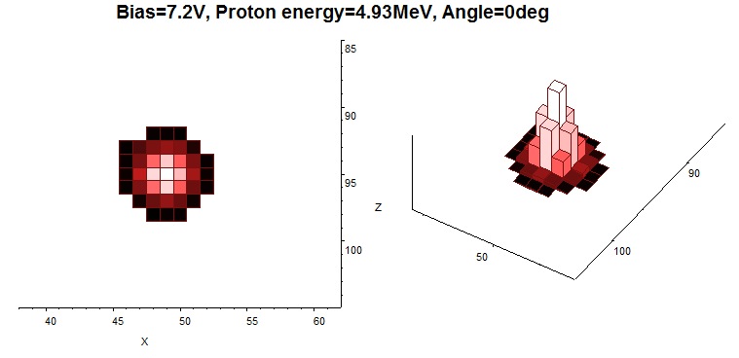
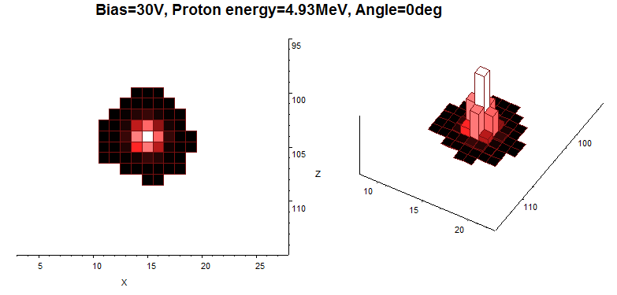
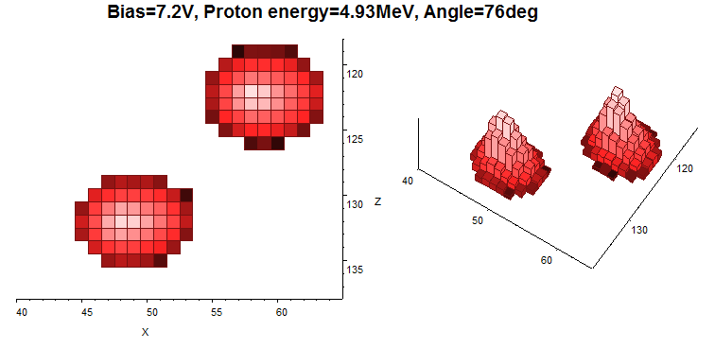
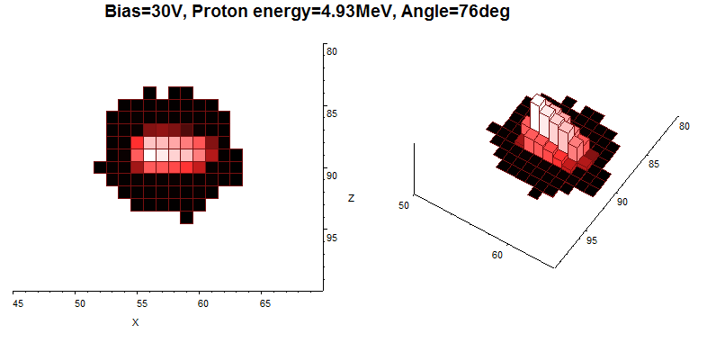
4.93 MeV proton tracks in silicon pixel detector recorded by Timepix device. Exposition under different angles and different applied detector biases.
What is the spatial resolution? X- and Y-coordinates are determined with a precision of about 500nm. Determination of angle is with a precision of about 1º. It needs additional experiments.

Slide 22
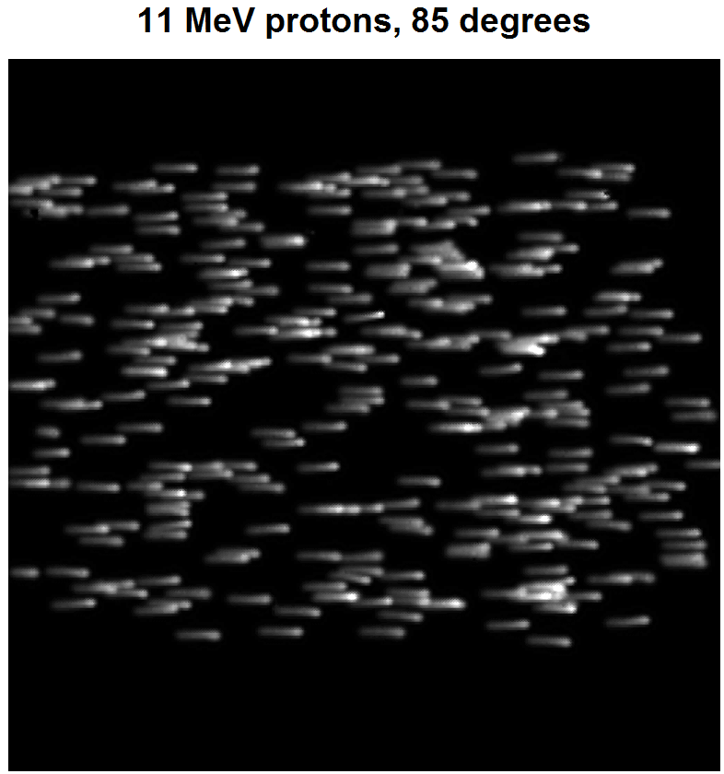
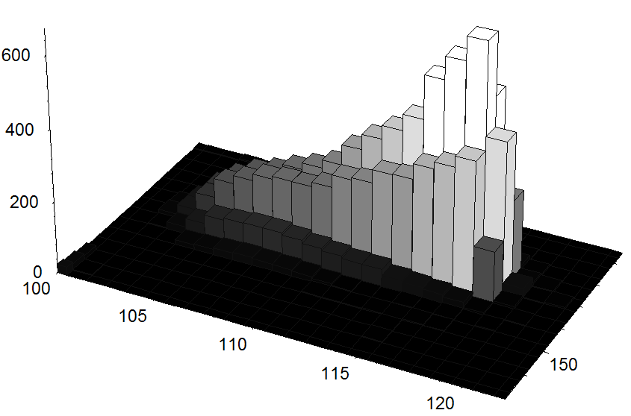
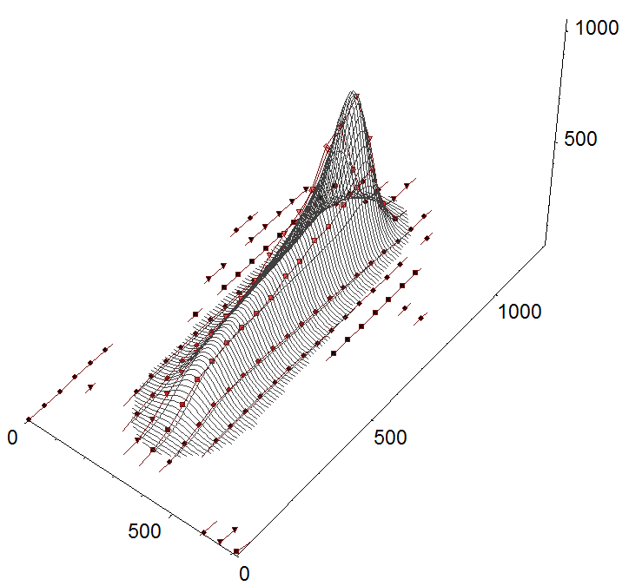
Flock of 11 MeV protons entering the silicon sensor under 85º
ΔE/Δx Bragg profile nicely pronounced, proton range about 960 μm
Fit by model

Slide 23
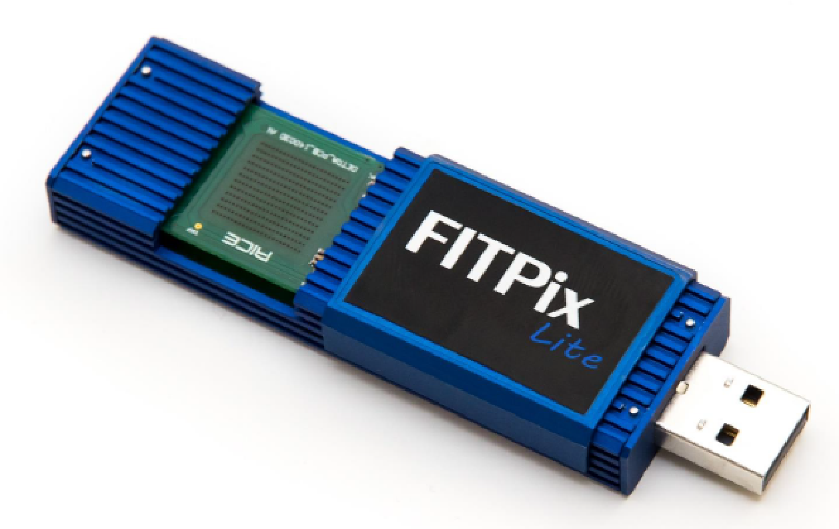
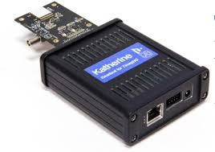
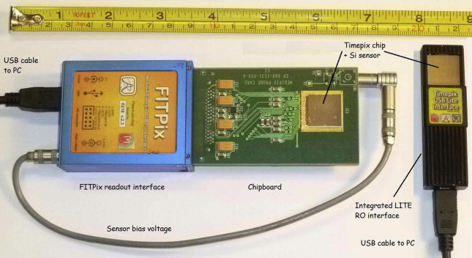
Readout interface and its role in data the acquisition process
Detector supporting electronics
Acquisition control
Detector powering
Data transfer (USB, Ethernet, …)
Never ending need for a development of application specific variants of readout interfaces (vacuum operation, space environment, multi-detector arrays,…)

Slide 24
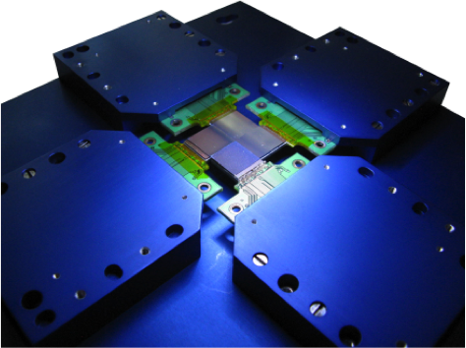
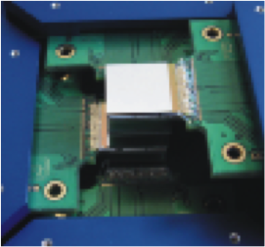
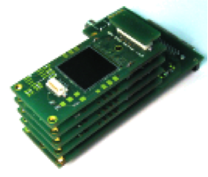


Timepix based devices developed and tested in IEAP CTU

Slide 25

Data Acquisition Control Software
Finally, it makes Timepix detector a powerful tool.
Otherwise it is useful as a car without the steering wheel.
PIXELMAN – IEAP CTU
Acquisition and control tool for
Medipix & Timepix Detectors

Slide 26

SESTRA - School Education Set with Timepix for Radiation Analysis

Slide 27

SESTRA Kit Components
Particle Camera MiniPixEDU
(Timepix detector, calibrated)
Control Software
Pixelman Simple preview & Pixet basic
(acquisition, online visualisation, etc.,)
SZZ Alfa
(241Am, 𝛼 and 𝛾 source, 9.5 kBq)
DZZ Gamma
(241Am, 𝛾 source, 300 kBq, optional)
Potassium Salt
(𝛽 and 𝛾 source)
Thoriated Tungsten Electrode
(𝛼, 𝛽 and 𝛾 source)
Uranium Glass
(𝛼, 𝛽 and 𝛾 source)
Mounting Rails
Source Holder
Camera Holder
Aluminium, Stainless, Copper, Brass
and Lead Shielding Plates
Radiography Adapter Head
+Samples with Hidden Patterns
Vacuum Cleaner Grate Adapter
USB Cable
Book of detailed guidelines
“Experiments Using Pixel Detector in
Teaching Nuclear and Particle Physics”
Set of kit accessories was designed according to practical experiences gained while using the Timepix for teaching of students...

Slide 28

Detailed guidelines to experiments practicable with Timepix based particle camera
Wide set of 50 experiments
...involving detection and recognition of different kinds of ionising radiation in pixel detector, observation of natural background radiation, space originating radiation, basics of radiography….
Focused on high school students and university students by means of practical exercises to help them to understand physics and motivate them in further learning

Slide 29

Mechanics of the SESTRA
educational kit
Fast (re)arrangement of various experimental set-up(s)
Prepared for performing of real time demonstrations within a time span of the standard classes

Slide 30

Set of Radiation Sources
in the SESTRA kit
Thoriated Tungsten Electrode
(𝛼, 𝛽 and 𝛾 source)
Uranium Glass
(𝛼, 𝛽 and 𝛾 source)
Potassium Salt
(𝛽 and 𝛾 source)
241Am 𝛼 and 𝛾 source 9.5 kBq (optional)
241Am 𝛾 source
300 kBq (optional)

Slide 31




URANIUM Glass Radioactivity
Sample included in the kit
Uranium serving as a yellowish-green glass colorant
Freely available on the market in the form of various decorative items
Uranium
²³⁵U, 0.72%, T_{1/2} = 7,0.10⁸ years
²³⁸U, 99.274%, T_{1/2} = 4,5.10⁹ years

Slide 32

Pixelman - Simple Preview
Measurement control, data acquisition and visualisation software
The main control window appears after starting application “Pixelman.exe”
One window instance for the real Particle camera and one instance for a virtual (file reader) device will appear on the screen.

Slide 33

Uranium Glass
preparation of measurement
Experiment set-up:
Particle camera and computer, mounting rails, uranium glass sample placed in the source holder close to the detector
Settings:
Exp. count: 60 Continuous measurement: No
Mode: Spectrometer Exp. time: 1 s
Analysis type: Basic Min. level: 0
Bias voltage: 20V Max. level: 20
Integral mode: No Colormap: Hot

Slide 34


URANIUM Glass Radioactivity Observation
Uranium glass as a weak source of mixed radiation field
Evidence of alpha, beta, gamma particle detection

Slide 35





Review of the characteristic patterns
1) Dot
2) Small blob
3) Curly track
4) Heavy blob
5) Heavy track
6) Straight track
Photons and electrons (10keV)
Photons and electrons
Electrons (MeV range)
Heavy ionizing particles with low range (alpha particles,…)
Heavy ionizing particles (protons,…)
Energetic light charged particles (MIP, Muons,…)

Slide 36


Radiation Origin Overview
Alpha Particles
Exemplar alpha decay
https://en.wikipedia.org/wiki/Alpha_particle

Slide 37


Radiation Origin Overview
Beta Particles
Exemplar beta- decay
https://en.wikipedia.org/wiki/Beta_particle

Slide 38


Radiation Origin Overview
Gamma Photons
Exemplar gamma photon emission
*The nucleus in an excited state returns to the ground state by emitting a photon.
https://en.wikipedia.org/wiki/Gamma_ray

Slide 39

Uranium Glass Radioactivity Close Look Observation
Evidence of alpha, beta, gamma
particle detection

Slide 40

Uranium Glass Radioactivity
Close look on a single particle
When zoomed-in, properties of single particle track can be obtained (deposited energy in keV, cluster area, track type classification)

Slide 41

Uranium Glass Radioactivity as seen by the Timepix pixel detector
Several useful hints on software functionality
Getting a snapshot (Menu: Tools -> Snapshot)
Displaying of integral frame composed of separate frames (Menu: Tools -> Integral frame)

Slide 42

Kinetic Energy Absorbed in the Sensor,
How to find-out speed of hitting particle
The Einstein relation
E = E₀ + E_{k}
Speed of alphas?
Speed of betas?
Rest mass energy:
Alpha: E₀ =3,735,000 keV ,
Beta: E₀ = 511 keV
Hint:
Use the excel table “Speeds of particles i lambda.xlsx” to compute speed of observed particles

Slide 43
Kinetic Energy Absorbed in the Sensor,
How to find-out speed of hitting particle
What are the highest energies of detected alphas, bettas and gammas?
Speed of alphas
VS
speed of bettas?
Can speeds of alphas or betas be comparable to speed of light?
E_{max} ?

Slide 44


Tungsten Welding Electrode with THORIUM
WTh-40
WTh-20
Thorium ²³²Th, T_{1/2} = 1,4.10¹⁰ years
Age of the Earth: 4,5.10⁹ years

Slide 45

Thoriated Welding Rod
preparation of measurement
WTh-40
WTh-20
Experiment set-up:
Particle camera, computer, mounting rails, thorium welding rod in a holder.
Settings:
Exp. count: 60 Continuous measurement: No
Mode: Spectrometer Exposition time: 1 s
Analysis type: Basic Min. level: 0
Bias voltage: 20V Max. level: 20
Integral mode: No Colormap: Hot

Slide 46

Thoriated Welding Rod Radioactivity Observation
Thoriated electrode as a weak source of mixed radiation field
again, evidence of alpha, beta, gamma detection
Higher portion of alpha radiation is apparent

Slide 47


Thorium Radioactivity as seen by Timepix pixel detector
Are there more energetic alpha and beta tracks in comparison to uranium glass observation?

Slide 48




POTASSIUM Chloride Salt
KCl - Potassium Chloride
Natural abundance 0.0117% of radioactive isotope ⁴⁰K with half life 1.277*10⁹ years
Decay modes
89.28 %, emission of β⁻ with energy 1.311 MeV
20.72 %, emission of gamma with energy 1.5049 MeV

Slide 49

Potassium Chloride Salt
preparation of measurement
Experiment set-up:
Particle camera and computer, container with potassium salt inserted into the holder at close position to the detecto.
Settings:
Exp. count: 60 Continuous measurement: No
Mode: Spectrometer Exp. time: 1 s
Analysis type: Basic Min. level: 0
Bias voltage: 20V Max. level: 20
Integral mode: No Colormap: Hot

Slide 50

…Few facts about potassium
How much potassium does a human body contain?
A human body of 70 kg weigh contains about 140 g of potassium while just (0.0117%) a small portion of 0.0164 g is the radioactive isotope ⁴⁰K
Aren’t we living radiation sources???
Corresponding activity of such amount is 4300 Bq (decays/sec)
Are bananas save to eat???
1kg of banana contains 0.390 g of potassium
…where 0.00004563 g is a portion of the radioactive isotope ⁴⁰K
…with activity of 12 Bq (decays/sec)

Slide 51



Potassium radioactivity
observation
Container filled with the potassium chloride (KCl) salt
Weak source of gamma and beta radiation

Slide 52

Potassium Radioactivity as seen by Timepix pixel detector
Obvious difference to Uranium glass and Thoriated electrode experiment
- no alpha particle tracks present

Slide 53


SZZ Alfa
²⁴¹Am isotope radiation source
Activity 9.5 kBq
Adapted for educational purposes
Source of alpha and gamma radiation
E(α) = 5 500 keV
E(γ) = 59.5keV
Half-life of ²⁴¹Am is 432 years.

Slide 54




SZZ Alfa Radiation Source
4 selectable output configurations
1 - Closed
3 –“Short collimated“
4 –“Long Collimated“
2 - „Sieve“
(multihole)
Note: Radiation in other directions is shielded out by a brass body

Slide 55


9. ENERGY OF ALPHA PARTICLES EMITTED FROM SZZ Alfa 241Am radiation source
Experiment set-up:
Particle camera, computer, mounting rails, SZZ Alfa placed in a holder.
Settings:
Exp. count: 60 Integral mode: No
Mode: Spectrometer Exposition time: 0.05 s
Analysis type: Basic Min. level: 0
Bias voltage: 20V Max. level: 20
Continuous measurement: Yes Colormap: Hot
Visual Tools: Histograms of particle properties - Energy all frames (tab Alpha)

Slide 56


SZZ Alpha Radiation Source
Americium 241 source observation
Source of alpha and gamma radiation
low activity, 9.6 kBq
Suitable for demonstration of properties of heavy charged particles
Collimated vs Non-collimated Beam

Slide 57




Beam Collimation
Short collimated output Long collimated output
²⁴¹Am
²⁴¹Am
Brass body
shielding

Slide 58
Loss of Alpha Particle Energy in the air
distance
0 cm
LET=1590 keV/cm
for 3.5 MeV alpha
a~10¹⁵ m/s²
distance
1 cm
Experiment set-up:
Particle camera and computer, SZZ alfa placed in the holder, distance in between the detector and radiation source is changed
Settings:
Exp. count: 60 Continuous measurement: YES
Mode: Spectrometer Exp. time: 0.05 s
Analysis type: Basic Min. level: 0
Bias voltage: 20V Max. level: 20
Integral mode: No Colormap: Hot
Visual Tools: Histograms of particle properties - Energy all frames (tab Alpha)

Slide 59


What happens if frame exposition time is significantly prolonged???
Americium 241 represents a source of monoenergetic alpha particles but there are displayed several peaks in the spectrum
Energy of higher peaks exceeds energy of americium alphas
Effect of particle track overlapping

Slide 60


Loss of Alpha Particle Energy in other materials
Experiment set-up:
Particle camera and computer, SZZ alfa placed in the holder, various materials are placed in between the detector and radiation source
Visual Tools:
Histograms of particle properties - Energy all frames (tab Alpha)
Histograms of particle properties - Histogram of rate (tab Alpha and Gamma)
What happens if some material is placed in between the alpha source and the detector???
…Sheet of paper, aluminium wrapping foil, thin plastic foil, …..
The entire chip area is covered
the edge of paper
Is the covered area really empty without any tracks?

Slide 61




Statistical Nature of Radioactivity
Decay n - Random Variable
Alpha particle flux in time
Flux histogram
Experiment set-up:
Particle camera and computer, SZZ alfa placed in the holder, multihole output is selected, radiation source close to the detector
Settings:
Exp. count: 200 Continuous m.: YES
Mode: Spectrometer Exp. time: 0.05 s
Analysis type: Basic Min. level: 0
Bias voltage: 20V Max. level: 20
Integral mode: No Colormap: Hot
Visual Tools: Histograms of particle properties - Energy all frames (tab Alpha or tab Gamma)
Gama particle flux in time
Flux histogram
Poisson Distribution

Slide 62



Background Radiation with Origin in Space
Detection of cosmic muons and their contribution to background radiation on the ground.
Exemplar frames measured at different conditions:
one frame represents response acquired at the vertically oriented sensor at the airport. The next one was acquired on board of the airplane on the standard flight level at the vertical sensor orientation and the last one at the horizontal sensor orientation.

Slide 63


Linear Tracks of Interacting Particles at the Polar Angle
Significantly different results of muon observation are obtained in dependence on the detector orientation
Note the typical dimensions of Timepix sensor 14 x 14 x 0.3 mm (w x l x h)

Slide 64



WHY MUONS OF LOW INCLINATION
DO NOT REACH TO GROUND?
Half-life of muons is: 2,2 μs.
How long distance can be reached until it decays?
Presumption, muon was created at altitude of 10 km, its velocity is 0,999c.
Can it reach the ground?
Classical physics: It can not reach the ground
STR: It can reach the ground
(in dependence inclination on angle)

Slide 65

Working with Pre-measured Data Using the Virtual (filedevice 3000) Paraticle Camera
Select Folder:
Location of the measured data
The virtual particle camera allows to replay experimental data measured in the past
same visualisation and processing functionalities are available as if a real particle camera would be connected to a computer

Slide 66



Radiation field observation on board of the airplane as seen by the particle camera
Recording from the flight from London to Prague
Significant difference in field composition and intensity when flying or when landed…

Slide 67


Close look on airplane flight observation recorded by the
particle camera
Typical composition of radiation field at flight level
(high count of muons)
Occasional detection of heavy energetic ions

Slide 68

Radiation intensity observed on Earth vs on board of the airplane
On Earth 1
On Earth 2
On board
of the airplane
Particle flux Φ in dependence on time (with 10 s step)

Slide 69




Dosimetry in space:
SATRAM – ESA Proba-V satellite
Characterization of mixed radiation field on low orbit of PROBA-V satellite
Altitude ~ 800 km
Timepix for the first time outside in the space
Launched in May 2013

Slide 70



SATRAM
(Space Application of Timepix Radiation Monitor)
on board of Proba-V ESA satellite
The same kind of pixel detector Timepix as one embedded in the particle camera MiniPixEDU of the SESTRA educational kit
mission on LEO - altitude 820 km
Timepix for the first time outside in the space
Launched in May 2013
Radiation field recordings available for research and also for educational purposes

Slide 71



SATRAM Radiation Observation
on the Earth Orbit
Variation of radiation field composition in depence on the earth orbit position
Notable difference in field composition when compared to observations performed with natural radiation sources in the SESTRA educational kit
Radiation field as seen
by Timepix detector
Mission data available online at the web portal:
https://satram.utef.cvut.cz/

Slide 72



Timepix/ESA Proba-V:
LEO space radiation @ 820 km
HETPs: Highly energetic heavy charged particles (ions) 🡪 HZE’s

Slide 73

Timepix/ESA Proba-V:
LEO space radiation @ 820 km
LETPs: Energetic light charged particles (I) + nuclear interactions

Slide 74

Measured radiation map by Satram device in orbit around the Earth at an altitude of 820 km from the earth's surface obtained within 36 days from January 1, 2014 to February 7, 2014 logarithmic scale in μG/hr.

Slide 75


Radon as a common source of background radioactivity
Noble gas originating from decay of radium
It further decay through the serie of daughter products

Slide 76

Radon as a common source of background radioactivity
The histogram of alpha particles emitted from a paper tissue right after the air filtering was stopped.
Energy peaks correspond to the values presented in the scheme of the decay chain.

Slide 77



Radon - Easy way how to prepare own radiation source
Preparation requires just usage of a vacuum cleaner + grate adapter + paper tissue (or head mask)
(ideal location - non-ventilated basement of an old building)
After several minutes letting air pass through the filter, radon daughter products get captured in the filter
Then the paper tissue is placed on the top of the particle camera and radiation measurement is started

Slide 78


Comparison of Radioactivity observed in the
Non-ventilated (left) and ventilated (right) room
Demonstration of the radioactivity of the paper tissue that was used as an air filter in one house in Pardubice – Czech Republic
The filtering took 5 minutes and exposure time was 10 minutes in both cases

Slide 79



(Alpha) Radiography
Samples with hidden patterns
What is
Hidden
Inside?
Settings of Particle camera: Radiation source other, analysis type OFF, continuous YES, integral YES, exposure count 60, exposure time 1 s, max. level 1, colormap GRAY.
Settings of Filedevice: Radiation source other, analysis type OFF, continuous YES, integral YES, exposure count 60, exposure time 0.01 s, max. level 1, colormap GRAY.

Slide 80




(Alfa) Radiography Demonstration
Impact of
Sample
position
(magnification)
Impact of
Beam
collimation
even µm material thickness matter

Slide 81


ABSORPTION of gamma particles in metals
Metallic
plate
Settings of Simple preview: Radiation source americium, bias voltage 50 V, continuous NO, integral NO, exposure count 300, exposure time 0.5 s, max. level 1, colormap GRAY.

Slide 82

Absorption of Gamma/X-Ray
in shielding plates of various materials
Aluminum vs Brass vs Lead
vs OTHER materials vs Background?
DZZ Gamma
Americium 241 source
300 kBq activity
Settings of Filedevice: Radiation source other, analysis type OFF, continuous YES, integral YES, exposure count 60, exposure time 0.1 s, max. level 1, colormap GRAY.
SZZ Alpha
Americium 241 source
9.5 kBq activity
Settings of Filedevice: Radiation source other, analysis type OFF, continuous YES, integral YES, exposure count 60, exposure time 1 s, max. level 1, colormap GRAY.

Slide 83


Radiography (Gamma)
Samples with hidden patterns
What is hidden
inside?
Settings of Particle camera: Radiation source other, analysis type OFF, continuous YES, integral YES, exposure count 60, exposure time 1 s, max. level 1, colormap GRAY.
Settings of Filedevice: Radiation source other, analysis type OFF, continuous YES, integral YES, exposure count 60, exposure time 0.01 s, max. level 1, colormap GRAY.

Slide 84



(Xray) Radiography
Demonstration
In contrary to more advanced imaging
Prove of basic working principle

Slide 85




Hidden pattern examples….
Paper clip
Airgun pellet

Slide 86


Thank you for your participation
Any initiative in a way to further cooperation is welcome!!!
outreach.and.education@utef.cvut.cz

Slide 87
Course Outline
Part 1
Introduction into Timepix detector, particle camera working principle, content of SESTRA kit, Pixelman simple preview software and its functionality
Part 2
Uranium glass experiment, Potassium experiment, Thoriated electrode experiment, Study of particle properties, Using of online visualisation tools, americium isotope radiation source, beam collimation, study of alpha radiation properties, start of long term background measurement
Part 3
Evaluation of long term background measurement, Radiation at on Earth ground vs orbit, observation of radon decay, Cosmic radiation, utilization of virtual particle camera, utilization of advanced particle type analysis
Part 4
alpha radiography, absorption of gammas in metals, gamma radiography, Own radiation sample study
Discussion

