Slide 1
Preparing a Presentation
Dakar IEEE NPSS School, 2022

Slide 2
What to present?
Motivation
Description
Measurement
Result
Discussion

Slide 3
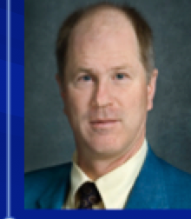
Fast Timing and TOF in PET Medical Imaging
William W. Moses
Lawrence Berkeley National Laboratory
October 15, 2008
Outline:
Time-of-Flight PET
History
Present Status
Future
This work was supported in part by the U.S. DOE (contract No. DE-AC02-05CH11231) and in part by the NIH (NIBIB grant No. R01-EB006085).
Thanks to M. Ullisch and W.-S. Choong of LBNL, M. Casey, J. Young, and B. Bendriem of Siemens Medical Solutions, and Y. Hämisch of Philips.

Slide 4
Number of slides
Rough guideline: 1 slide per minute
Longer talks: -10-20%
Don’t put too much on too few slides
Concentrate on main message
For tomorrow: Aim at 5 mins / 5 slides

Slide 5
What is your message?
It is not the “what”
It is the “so what”
Putting the “so what” on your slide is very important
Slide can also be understood offline
Message can even be in the title
Concentrate on your message

Slide 6
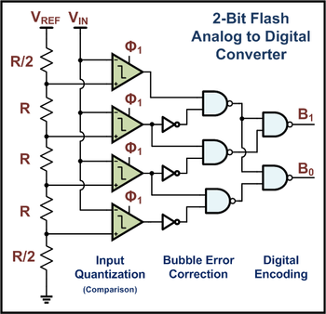
Digitization: Flash ADC 1-bit and 2-bit
V_{REF}
1-Bit Flash
Analog to Digital
Converter
R
V_{IN}
B
Threshold
R

Slide 7
Digitization: Flash ADC 1-bit and 2-bit
V_{REF}
1-Bit Flash
Analog to Digital
Converter
R
V_{IN}
B
Threshold
R
A Flash ADC can digitize a signal very fast without a clock

Slide 8
A Flash ADC can digitize very quickly without clock
V_{REF}
1-Bit Flash
Analog to Digital
Converter
R
V_{IN}
B
Threshold
R

Slide 9
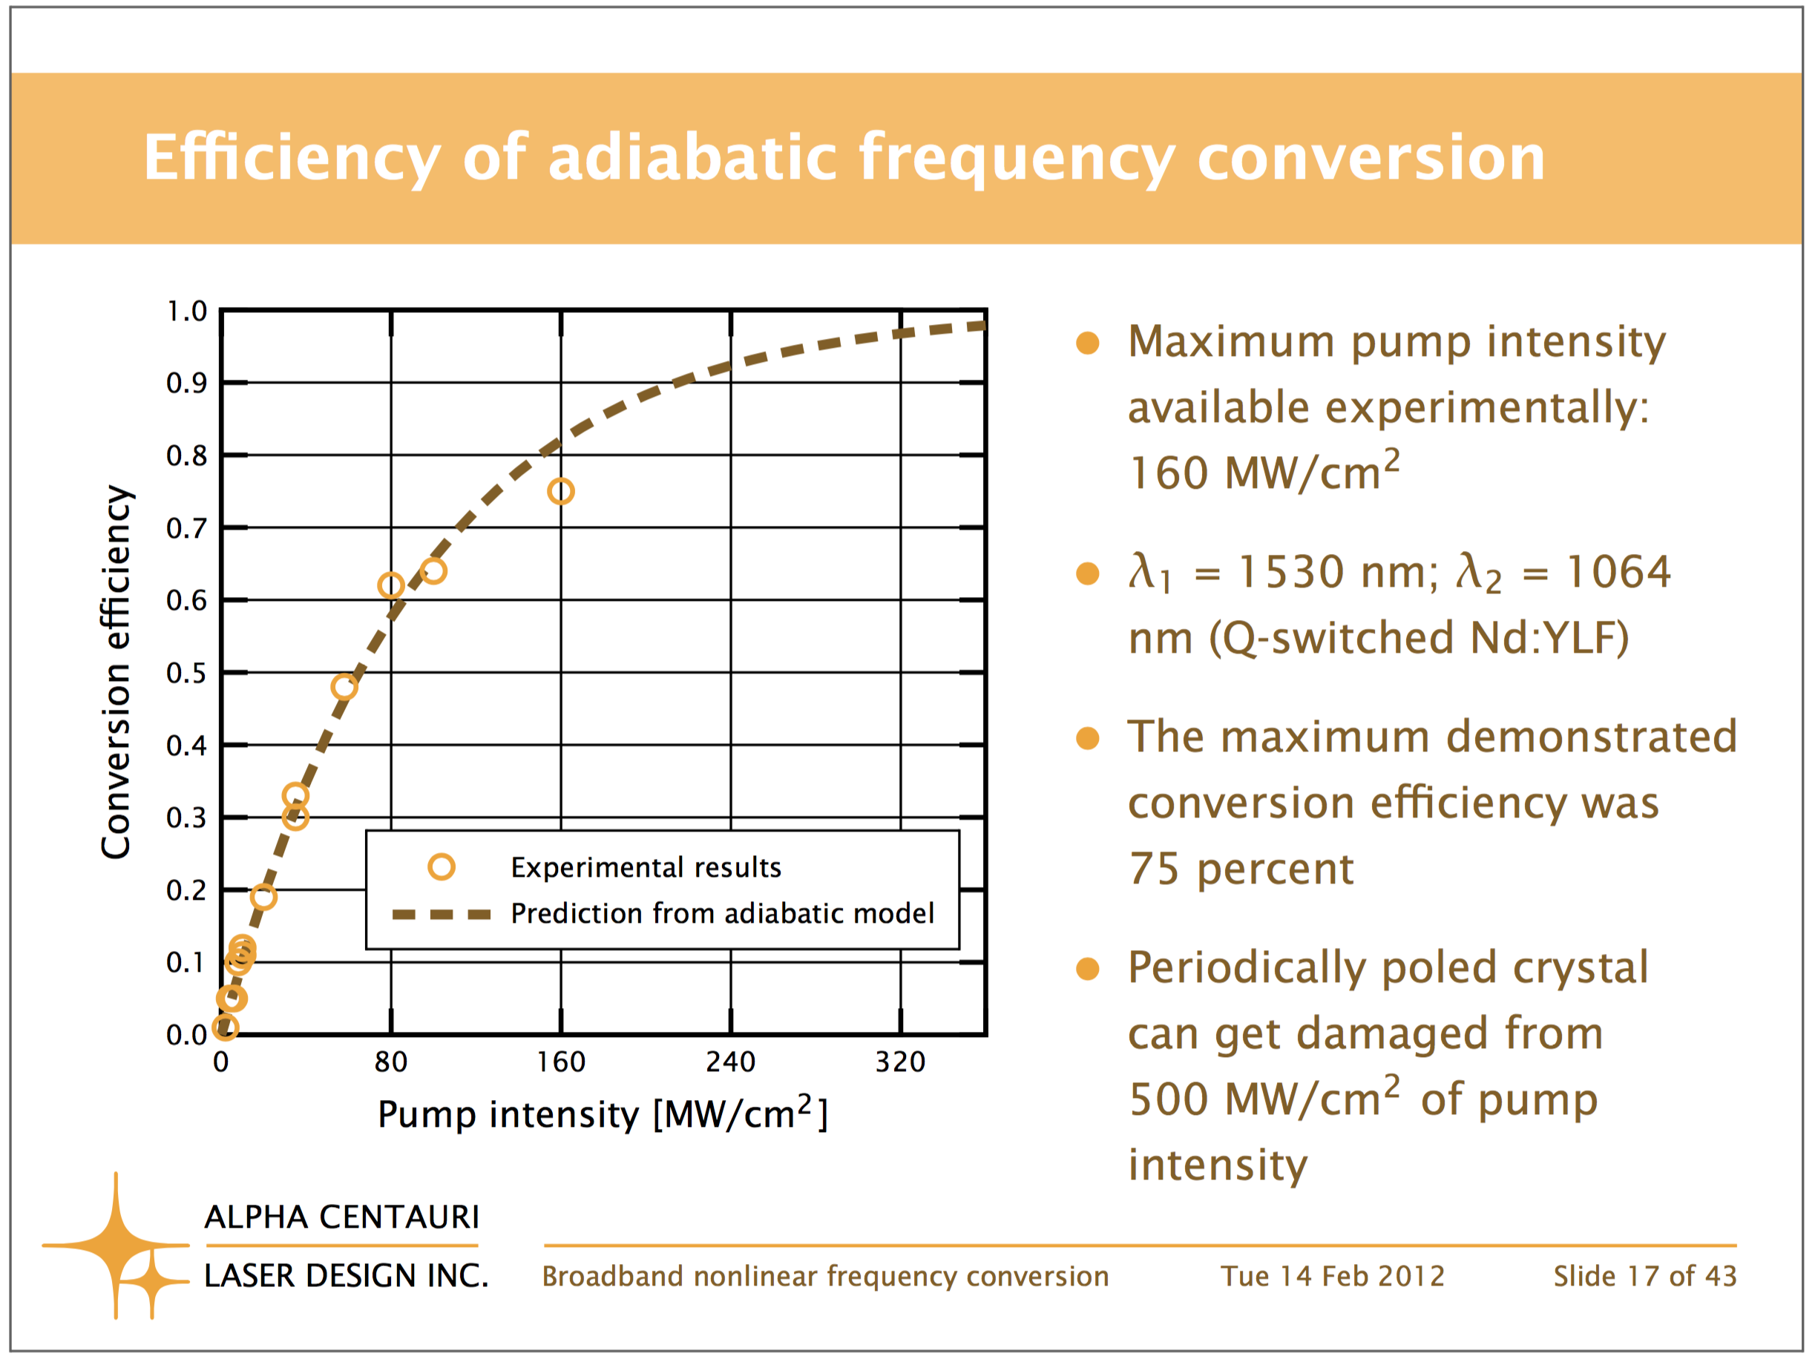
Presenting Plots
Labels need to be readable
Axis titles
Lines and points large enough
Legend
Message

