Slide 1


Tips for presenting a scientific work
Some simple suggestions & hints!
Patrick Le Dû
patrickledu@me.com
Dakar school – November 15th, 2022

Slide 2
Goals of this presentation
Communicate your work is very important
  Paper writing
  Presentation
Some simple ‘personal’ suggestions & guidelines extracted from my own experiences illustrated with some typical exemples (Some extracted on web site)
Notes:
This overview interdisciplinary talk has the main purpose to present how HEP developments and evolution of front end deadtimeless low noise electronics, parallel read-out , real time selection of events (trigger), terabit data networking (DAQ) and on-line processing farms can be use to improve drastically the performances and efficiency of medical imaging devices like the Positron Emission Tomograph (PET) of next genration. The first part of the presentation will introduce the generic architectural model of future large colliding experiments like the future Colliders (ILC/CLIC) and its main features like the software trigger concept. An example of possible implementation will be shown using the new Advance Telecom Computing Architecture (ATCA) standard. Then, it will be discussed how these innovative ideas, tools and techniques of modern architectural concept in data acquisition can be applied in two particular applications of the future: the whole body Time Of Flight Positron Emission Tomography (TOF-TEP) for tumour diagnostic and the Hadrontherapy In-Beam PET for cancer treatment.

Slide 3
Writing a paper

Slide 4
Structure of a Paper
Scientific writing follows a rigid structure –
a format developed over hundreds of years
Consequently, a paper can be read at several levels:
  Some people just will refer to the title
  Others may read only the title, abstract,, summary and conclusions.
  Others will read the paper for a deeper understanding

Slide 5
Authors Listing
ONLY include those who have made an intellectual contribution to the research
OR those who will publicly defend the data and conclusions, and who have approved the final version
Order of the names of the authors can vary from discipline to discipline
  In some fields, the corresponding author’s name appears first

Slide 6
Title
Describes the paper’s content clearly and precisely including keywords
Is the advertisement for the article
Do not use abbreviations , achronyms and jargon
Search engines/indexing databases depend on the accuracy of the title - since they use the keywords to identify relevant articles

Slide 7
Abstract
Briefly summarize (often 150 words) - the problem, the method, the results, and the conclusions so that
  The reader can decide whether or not to read the whole article
Together, the title and the abstract should stand on their own
Many authors write the abstract last so that it accurately reflects the content of the paper
See: The Structured Abstract: An Essential Tool for Research
http://research.mlanet.org/structured_abstract.html

Slide 8
Methods
Provide the reader enough details so they can understand and replicate your research
Explain how you studied the problem, identify the procedures you followed, and order these chronologically where possible
Explain new methodology in detail; otherwise name the method and cite the previously published work
Include the frequency of observations, what types of data were recorded, etc.
Be precise in describing measurements and include errors of measurement or research design limits

Slide 9
Introduction
Clearly state the:
  Problem being investigated
  Background that explains the problem
  Reasons for conducting the research
Summarize relevant research to provide context
State how your work differs from published work
Identify the questions you are answering
Explain what other findings, if any, you are challenging or extending
Briefly describe the experiment, hypothesis(es), research question(s); general experimental design or method

Slide 10
Results
Objectively present your findings, and explain what was found
Show that your new results are contributing to the body of scientific knowledge
Follow a logical sequence based on the tables and figures presenting the findings to answer the question or hypothesis
Figures should have a brief description (a legend), providing the reader sufficient information to know how the data were produced and exhaustive caption

Slide 11
Discussion/Conclusion
Describe what your results mean in context of what was already known about the subject
Indicate how the results relate to expectations and to the literature previously cited
Explain how the research has moved the body of scientific knowledge forward
Do not extend your conclusions beyond what is directly supported by your results - avoid undue speculation
Outline the next steps for further study

Slide 12
Citations & References
Whenever you draw upon previously published work, you must acknowledge the source
Any information not from your experiment and not ‘common knowledge’ should be recognized by a citation
How references are presented varies considerably - refer to notes for authors for the specific journal
Avoid references that are difficult to find
Avoid listing related references that were not important to the study
Anything taken from the web should be acknoxledge in particular pictures and presentation
WARNING : Plagiarism tools are commonly used so any ‘stolen’ material can be easily traced

Slide 13
Components of a Paper

Slide 14
Presentation

Slide 15
Goal of this presentation
Today, it is very easy to prepare a presention with PPT BUT its depends of:
  The context (school, conference, workshop …)
  The audience (students, engineers, scientists, mixed )
  The level of the majority of the audience .
  Depends of what message you want to give (results, overview, lessons)
  Be carefull with animation
  Style of presentation and content → example later
Looks at the time you have
  Number of slides
    1 per min in average
  Quantity of information in a slide
    Depends on type of information to explain
    Isolate clearly what is important
    Graphics, tables, text, images
…

Slide 16
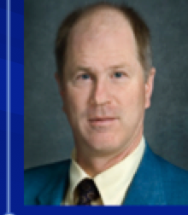
Fast Timing and TOF in PET Medical Imaging
William W. Moses
Lawrence Berkeley National Laboratory
October 15, 2008
Outline:
Time-of-Flight PET
History
Present Status
Future
This work was supported in part by the U.S. DOE (contract No. DE-AC02-05CH11231) and in part by the NIH (NIBIB grant No. R01-EB006085).
Thanks to M. Ullisch and W.-S. Choong of LBNL, M. Casey, J. Young, and B. Bendriem of Siemens Medical Solutions, and Y. Hämisch of Philips.

Slide 17

Time-of-Flight in PET
c = 30 cm/ns
500 ps timing resolution
⇒ 7.5 cm localization
Can localize source along line of flight.
Time of flight information reduces noise in images.
Variance reduction given by 2D/cΔt.
500 ps timing resolution
⇒ 5x reduction in variance!
D
Time of Flight Provides a Huge Performance Increase!
Largest Improvement in Large Patients
Notes:
One normal variation in PET cameras is the “time-of-flight” or TOF design. By measuring the difference in arrival time at the two detectors, the positron source can be localized along the line of flight. Doing this does not improve the spatial resolution, but improves the signal to noise ratio (the mechanism will be described in more detail in the next slide) — the variance improves by a factor of 2D/cΔt, where D is the diameter of the radionuclide distribution, c is the speed of light, and Δt is the TOF resolution. Several TOF PET systems were built in the 1980’s with barium fluoride or cesium fluoride scintillators. They achieved ~500 ps timing resolution, which results in 8 cm localization. For objects the size of the human head (which was what most PET cameras imaged in the 1980’s) the net result is a tomograph with a factor of ~2 lower variance than a non-TOF BGO tomograph.
Problems arose from the use of barium fluoride as a scintillator. It is less dense than BGO, and so the spatial resolution is degraded. In addition, the wavelength of its fast emission is in the hard UV, which made it difficult to work with (i.e. expensive) because it does not penetrate glass-windowed photomultiplier tubes or any known glue (to couple the crystal to the photomultiplier tube). Finally, it was difficult to keep these cameras in tune. Thus, TOF PET largely died at the end of the 80’s. However, the advent of LSO and other new PET scintillators (that can provide excellent timing resolution without the material drawbacks of barium fluoride) makes TOF a promising direction for modern PET.

Slide 18
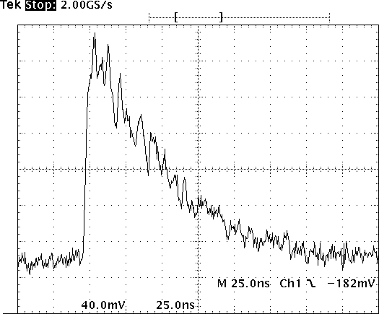
Raw Signal
From Photomultiplier Tube
Important Region for Timing
Oscilloscope
Trace from
One Event
Small Signal Level — 0.000000511 TeV
Small Fraction of Scintillation Light in Leading Edge
Fundamental Limit Due to Statistical Fluctuations

Slide 19

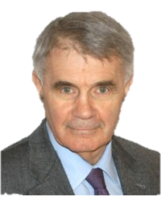

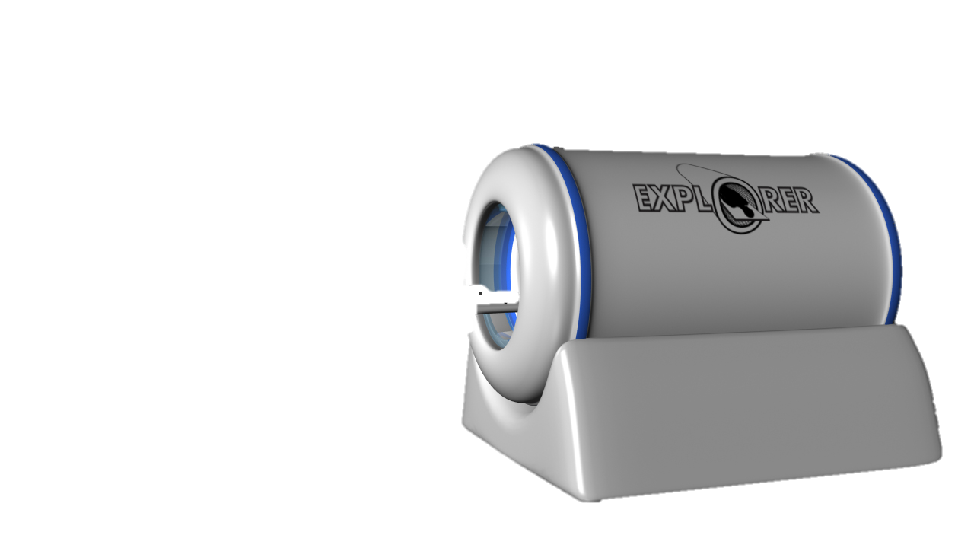
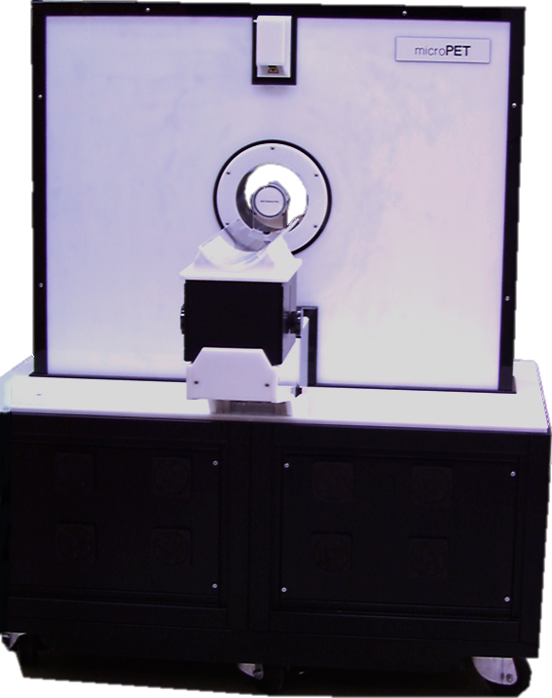

Adventures in the
Nuclear Medical Imaging Wonderland
Simon R. Cherry
Departments of Biomedical Engineering and Radiology
Notes:
Thank Bill
Cant think of a nicer person to receive award from, Bill has been a great teacher and friend over the years, has done so much for our field.

Slide 20
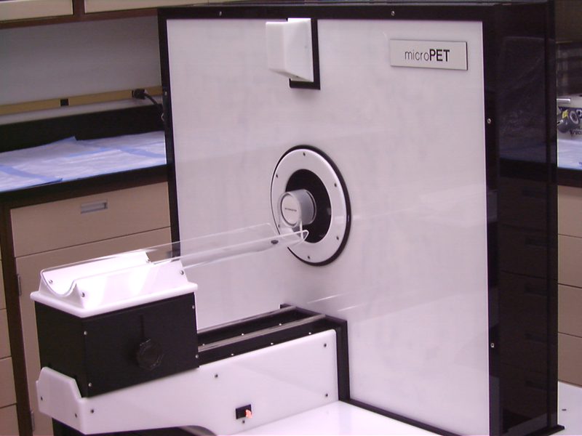
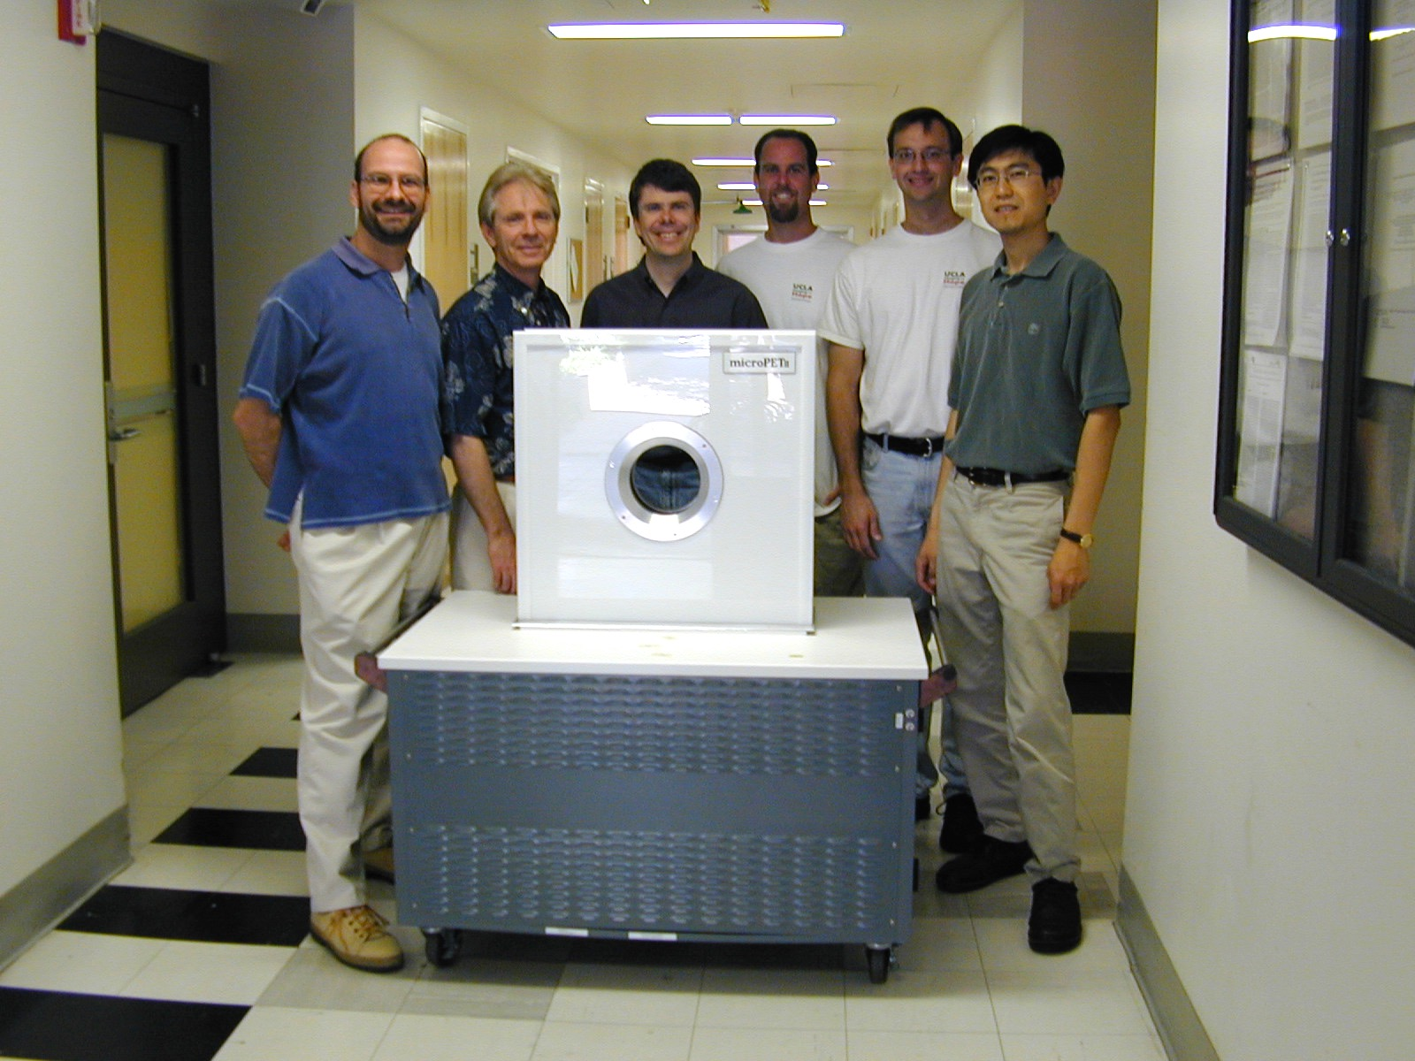
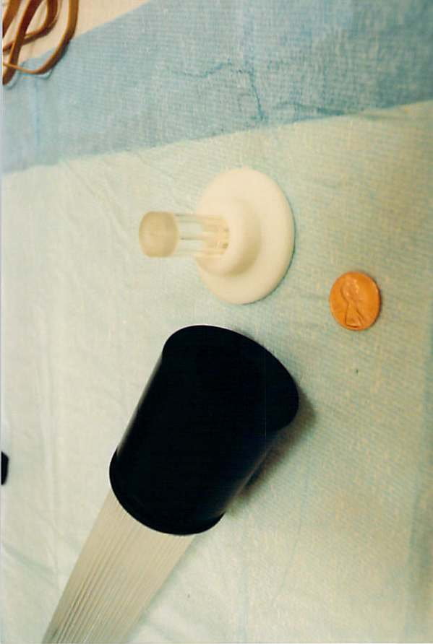
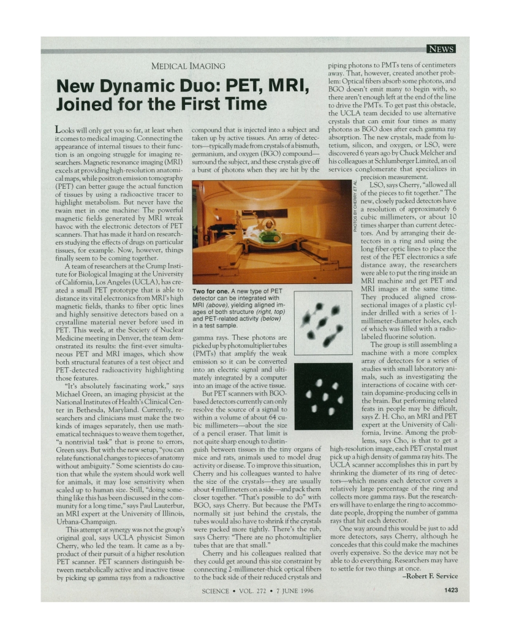
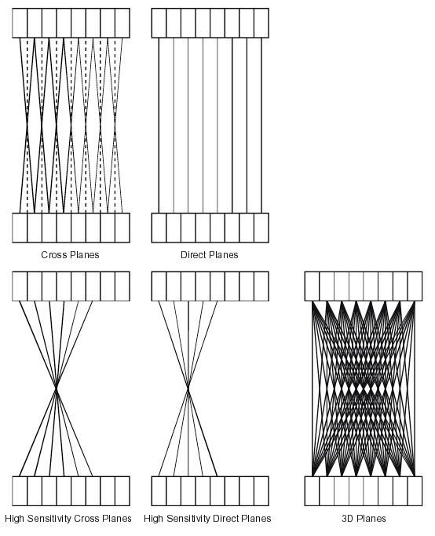
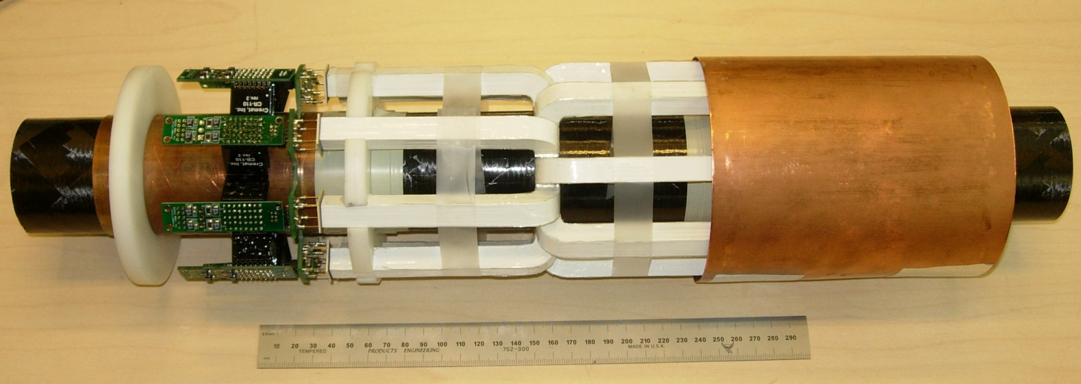
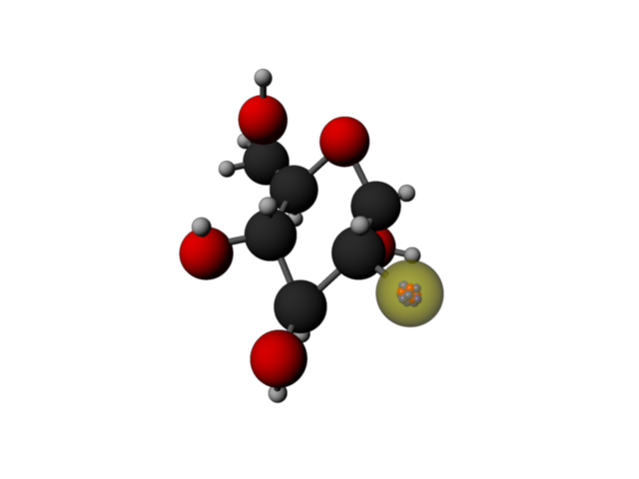
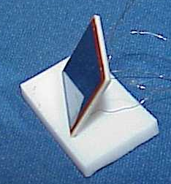
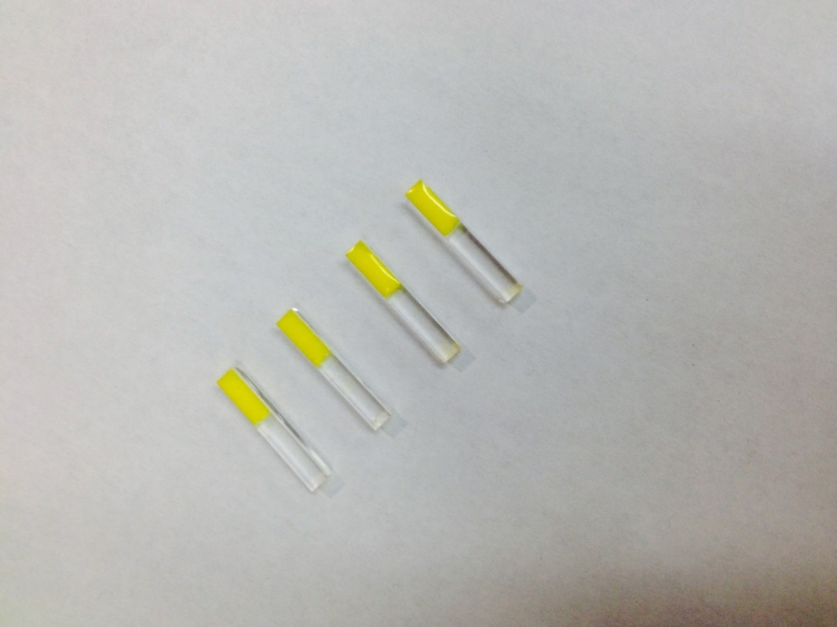
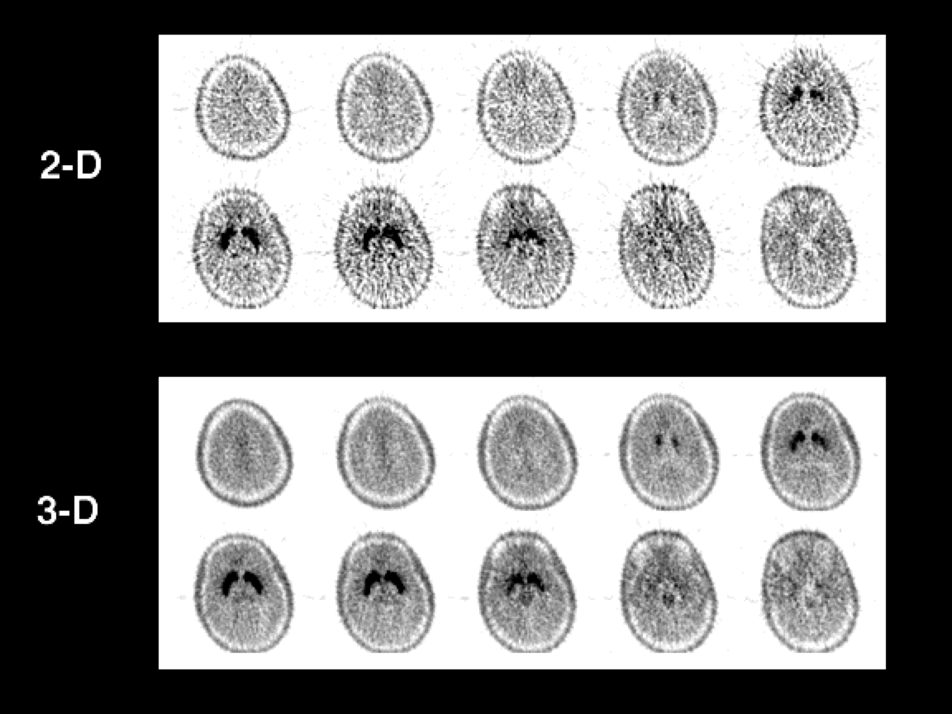
Positron Emission Tomography
Positron Emission and Annihilation
MWPC PET
Small-animal PET
PET/MRI
3-D PET
Depth-Encoding Detectors
Notes:
Two playgrounds

Slide 21


Thallium Bromide
Improve detector efficiency
Cross-Section (cm^{–1}) | Total | Photoelectric | Compton
L(Y)SO | 0.82 | 0.28 | 0.54
BGO | 0.89 | 0.40 | 0.49
TlBr | 0.95 | 0.42 | 0.53
Friday 09:30
R15-5
Ariño-Estrada et al.
Notes:
There are higher stopping power materials for PET, interested in exploring those also.

Slide 22
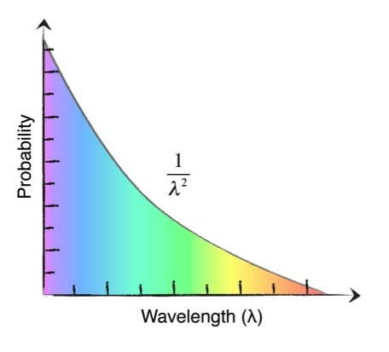
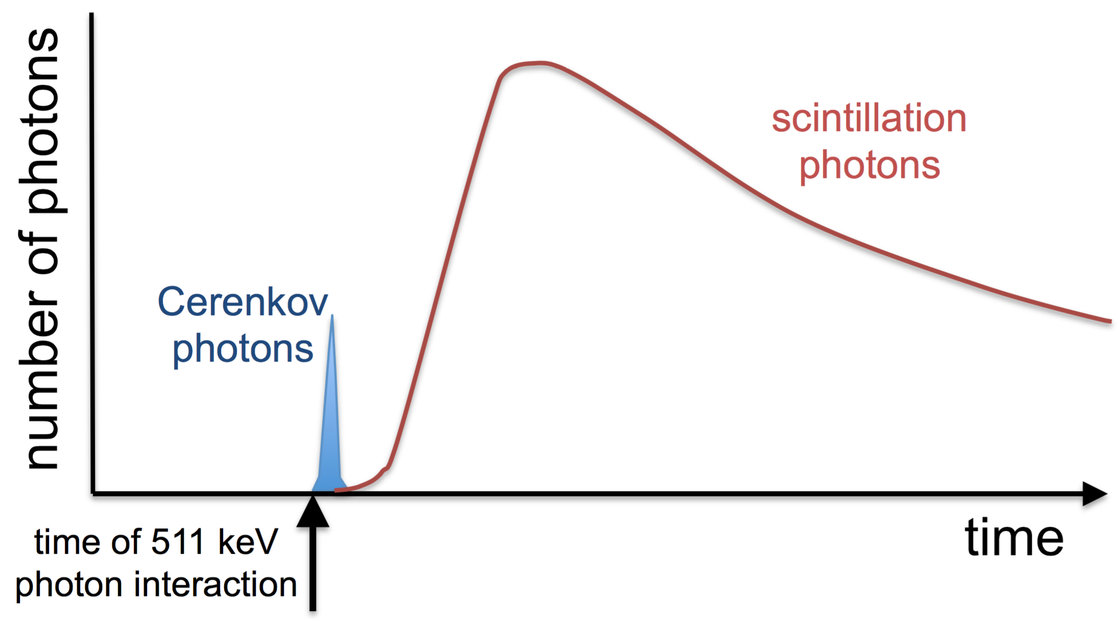
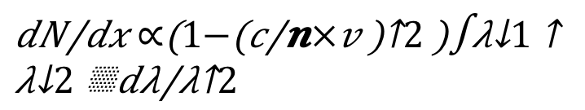
Using Cerenkov Radiation for Time-of-Flight PET
Needs:
• Dense materials with high index of refraction and high transparency in blue/UV
• Photodetectors with high blue/UV sensitivity and low noise
Korpar et al, Nucl Instr Meth A654; 532-8 (2011)
Brunner et al, IEEE Trans Nucl Sci 61; 443-7 (2014)
Lecoq et al, IEEE Trans Nucl Sci 61; 229-34 (2014)
Somlai-Schweiger et al, Med Phys 42; 1825-35 (2015)
Notes:
BGO: 70%
LSO: 52.6%
x 1.35

Slide 23
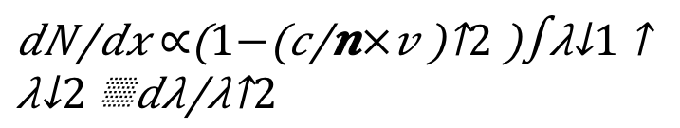
Bismuth Germanate
Improve detector efficiency
Cross-Section (cm^{–1}) | Total | Photoelectric | Compton
L(Y)SO | 0.82 | 0.28 | 0.54
BGO | 0.89 | 0.40 | 0.49
n=2.15
Notes:
BGO: 70%
LSO: 52.6%
x 1.35

Slide 24
Few words about about Posters
What Makes a Good Poster?
TOP : Title, Names (s)photo, mail and institute/university logo
  Title is short and draws interest
  Includes acknowledgments, your name and institutional affiliation
Not too much information :
  Separate clearly text, results and figures
  Consistent and clean layout
Important information should be readable from about 10 feet away
Word count of about 300 to 800 words
Text is clear and to the point
Use of bullets, numbering, and headlines make it easy to readEffective use of graphics, color and fonts

