Slide 1
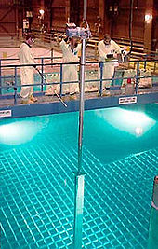
Nuclear Security and Safeguards
NPSS School
Dakar, Senegal
November 15, 2022
Richard Kouzes
Laboratory Fellow Emeritus
Pacific Northwest National Laboratory
Some of this work was sponsored by the U.S. Department of Energy and the U.S. Department of Homeland Security
Notes:
Nuclear Security and Safeguards
The detection of ionizing radiation is a little over 100 years old, dating from the first observation of natural radioactivity. Today, radiation detection plays a key role in diverse fields from medicine to defense to basic science. For homeland security, countries around the world are deploying passive radiation detection instrumentation to interdict the illegal shipment of radioactive material crossing international borders at ports of entry. These efforts include deployments in the United States and several European and Asian countries by governments and international agencies. Safeguards are activities carried out by national and international agencies to assure that nuclear material is secure and not diverted for clandestine use. Administered by the International Atomic Energy Agency, international safeguards serve to monitor nuclear activities under the Non-Proliferation Treaty and are the primary vehicle for verifying compliance with peaceful use and nuclear nonproliferation undertakings. For safeguards, radiation detection is used to assure accountancy for nuclear materials in order to protect us from the illicit production and use of nuclear weapons. This talk will discuss some of the aspects of radiation detection applied to safeguards and our experience with radiation detection interdiction for national security.

Slide 2
Talk Outline
International Safeguards
  Ensuring that nuclear material remains under a nation’s control and complies with international agreements
Border Security
  Protecting from external nuclear threats crossing a country’s border

Slide 3

Safeguards

Slide 4
International Safeguards
Nuclear safeguards include “an extensive set of technical measures by which the International Atomic Energy Agency (IAEA) Secretariat independently verifies the correctness and the completeness of the declarations made by States about their nuclear material and activities”
IAEA monitors declared facilities and quantities of fissile material at:
  Enrichment plants
  Fuel fabrication plants
  Power reactors and storage facilities
  Spent fuel reprocessing plants
4

Slide 5
Safeguard Methods
IAEA methods:
  Containment and Surveillance
  Remote monitoring
  Non-destructive analysis
  Destructive analysis
  Environmental samples
Measurements of plutonium (Pu) and highly enriched uranium (HEU)
Gamma ray detectors to determine isotopics
Large variety of neutron detectors to observe fission
5

Slide 6
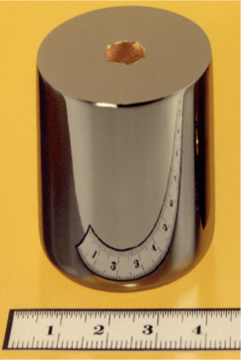
Gamma Ray Detection for Safeguards

Slide 7
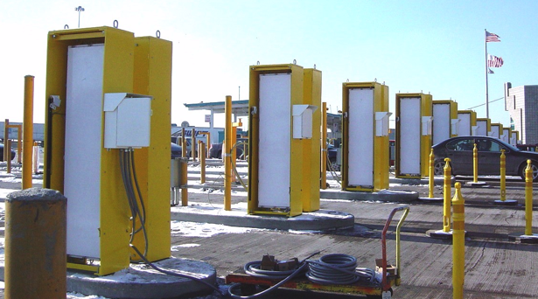
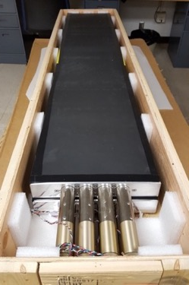
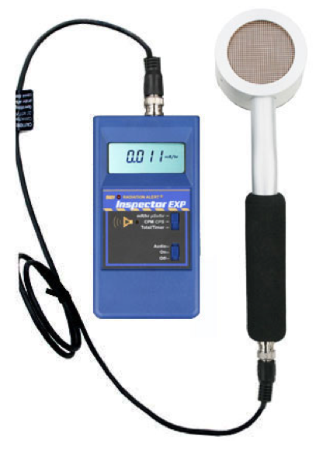
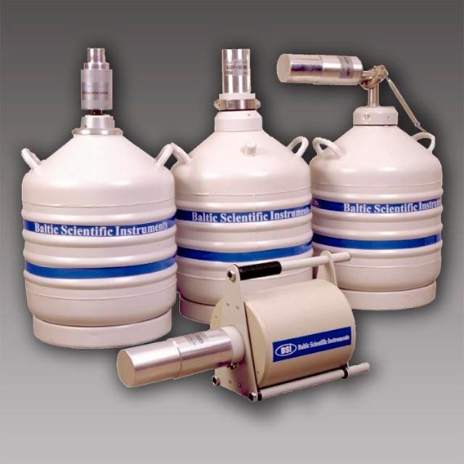
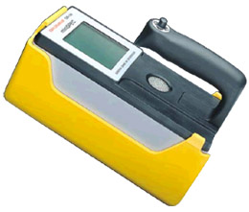
Gamma Ray Detectors
Gas counters
  Ionization chambers
  Proportional counters
  Geiger counters
Scintillators
  NaI(Tl)
  Plastic: polyvinyl toluene (PVT)
Solid state detectors
  Si
  High purity Ge (HPGe)
PVT
HPGe
Scintillator
Gas
Notes:
Gamma and neutron detection are complementary.

Slide 8
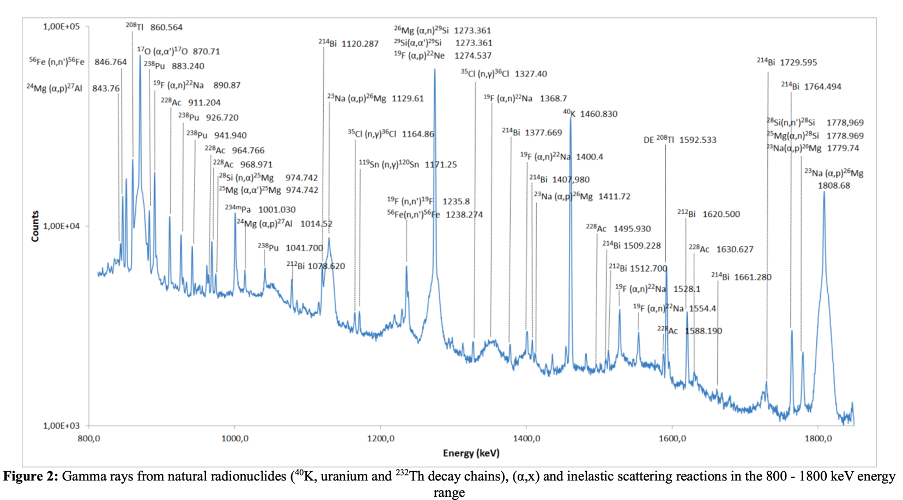
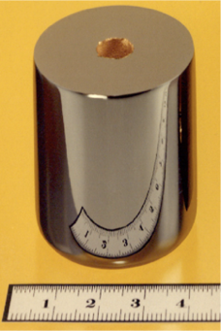
Isotopic Identification
Characteristic gamma rays can be used to identify what radionuclides are present in what quantities
Non-destructive analysis
Can be shielded from view
V. Bottau, Study of gamma-­‐‑ray background noise for radioactive waste drum characterization with plastic scintillators, EPJ Web of Conferences 225, 05004 (2020)

Slide 9
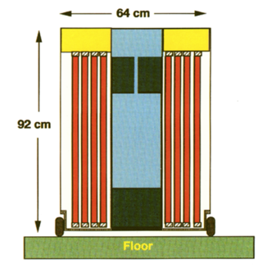
Neutron Detection for Safeguards

Slide 10
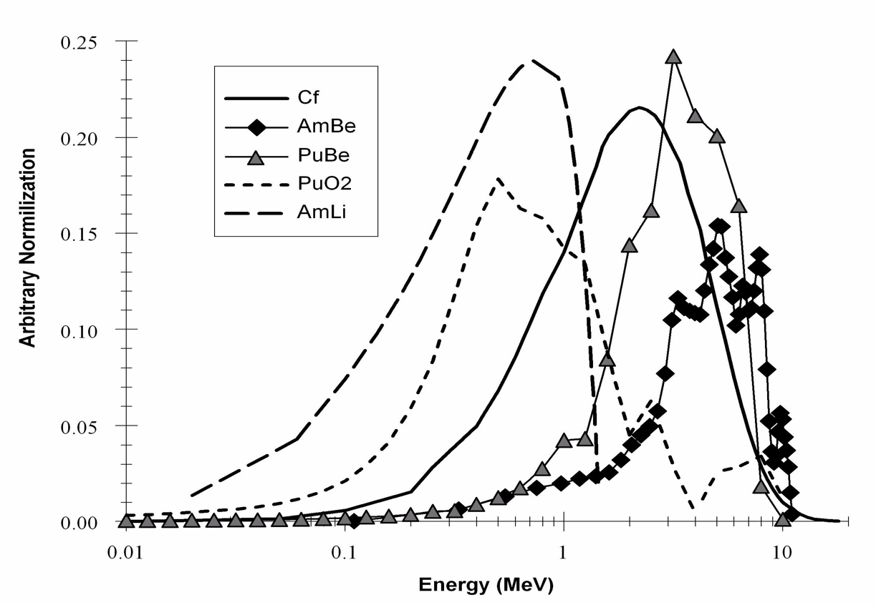
Fission
Fission of a heavy nucleus such as plutonium and uranium can be spontaneous or induced
Fission produces two daughter nuclei and one to several neutrons
Neutron
Spectra
Kouzes, NIM 584 (2008)

Slide 11

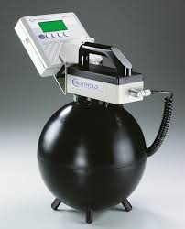
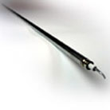
Neutron Detectors
Neutrons observed from fission sources
Energy not unique to special nuclear material (SNM) – Pu and U
Background
  From cosmic rays
  ~1/1000 of gamma-ray background
  Few commercial sources
Many scatterings prior to capture
Difficult to shield
Detectors: ³He, ⁶Li, ¹⁰B
Bonner Sphere
³He Tube
Moderator
Notes:
Gamma and neutron detection are complementary.

Slide 12
Safeguards Neutron Detection
Gross neutron counters
Coincidence neutron counters: measure “singles” and “doubles” neutrons from fission in plutonium and uranium
Multiplicity neutron counters: measure “singles,” “doubles” and “triples” neutrons
From these measurements, can determine:
  Mass – the amount of fissile material present
  Multiplication – the geometry of the material allows for limited chain reactions to amplify the number of neutrons
  Alpha-n – alpha particles from decays impacting on matrix materials generate additional neutrons from reactions
These three values define the material being measured
12

Slide 13
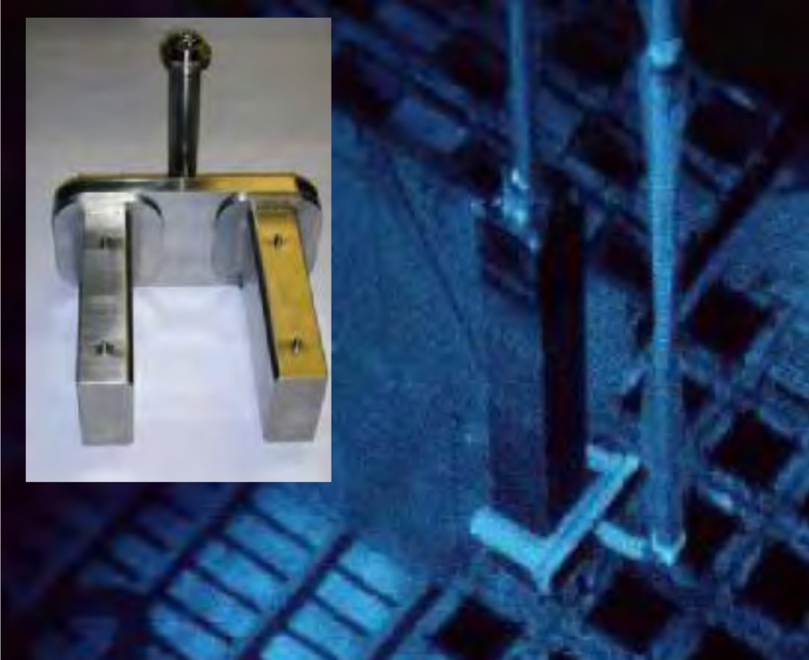
Fork Detector
³He Neutron detector housed in a submersible “fork” assembly that is lowered into a spent fuel storage pool
Spent fuel assemblies raised and placed between the forks
Analysis is performed to assay/verify spent fuel burn-up.
13

Slide 14
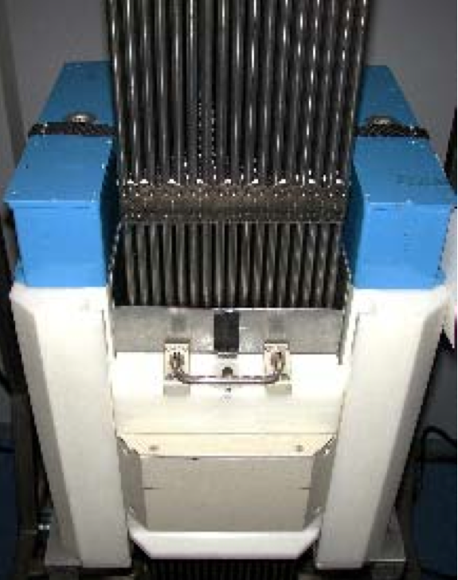
UNCL
³He based Uranium Neutron Coincidence Collar
Measurement of Pu in MOX fuel – passive mode
Verification of ²³⁵U in low enriched U fuel assemblies – active mode
Measure to an accuracy of less than 1% in a time of ~15 minutes
UNCL in active mode configuration
14

Slide 15
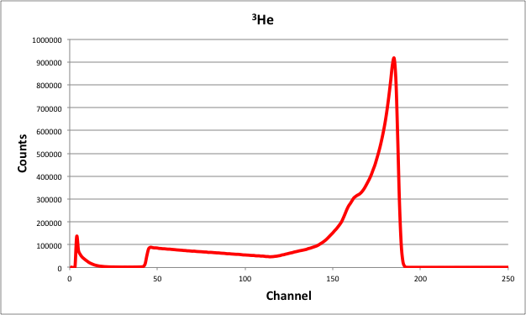
The ³He Problem

Slide 16
The ³He Supply
By-product of nuclear weapons program
  Tritium decays with 12.4-year half-life to ³He
  U.S. accumulated 200,000 liters of ³He by the end of 1990s
  Tritium was produced for nuclear weapons in reactors
  U.S. tritium production ended in 1988 - weapons needs met through recycling and reductions in the weapons stockpile
  Tritium production restarted in U.S. at Watts Bar reactor in 2007 only to support a smaller weapons stockpile
  U.S. ³He now made available through DOE Office of Science / Office of Nuclear Physics Isotope Program
  Decay now produces ~8,000 liters/year of ³He in U.S.
  Russia is only other supplier of ³He besides the US
16

Slide 17

The ³He Problem (~2008)
National security and science applications drove up demand for ³He for neutron detection
Currently, ³He comes solely from the processing of tritium
No significant production of new tritium
Production of tritium solely for ³He need is cost prohibitive
Reserves of ³He have been consumed
Projected ³He Supply ~10-20 kL/y (U.S. & Russia)
Demand for ³He in 2007 was ~65 kL/y
Nothing matches all of the capabilities of ³He
Alternatives are needed
³He Tubes

Slide 18
Supply and Demand (2009)
Projected demand ~65 kL/y - Projected Supply ~10-20 kL/y
U.S. ³He inventory ~40,000 liters (Bentz 2011)
18
Data from Steve Fetter, OSTP

Slide 19
³He Supply Projection (2016)
Demand decreases to 2,178 L/y in FY21.
Several increases of 1,900-7,600 L occur between FY15 & FY40
~8,500 L added to sales inventory each year at SRS.
This projects availability of gas to the end of this century.
19
Plots From Jehanne Gillo, DOE Office of Nuclear Physics
Notes:
May not be accurate to list top plot as ³constant². It is more like previous projections over past couple of years ­ it is a hypothetical situation and assumes a 4000l a year auction (which we do not approach) and a 10,000l/yr federal use, which we don¹t come close to. It does assume two new increases in supply of about 8000 liters in both 2014 and 2024.
- The bottom plot is what our actual projections are now, based on federal agency input, and assuming the two supply additions in 2014 and 20124. It assumes no auction.
- So if you will, the two plots were intended to show a range ­ the possible maximum utilization for fed use and the minimum use (assuming no auction). (we also typically do better than the conservative 9,700 liters/year extraction. We have already done better than plot one. so range is maybe enough he-3 for 20-100 years?

Slide 20
Alternative Neutron Detectors
Proportional Counter Alternatives
  BF₃ filled proportional counters
  Boron-lined proportional counters
Scintillator-based Alternatives
  Coated wavelength shifting fibers/paddles
  Scintillating glass fibers loaded with ⁶Li
  Crystalline: LiI(Eu), LiF(W), Li₃La₂(BO₃)₃(Cr), CLYC
  Liquid scintillator (fast neutrons)
Semiconductor Neutron Detectors
  High intrinsic efficiency, but limited in size
  Gallium arsenide, perforated semiconductor, boron carbide, boron nitride, pillar-structured detectors
20

Slide 21
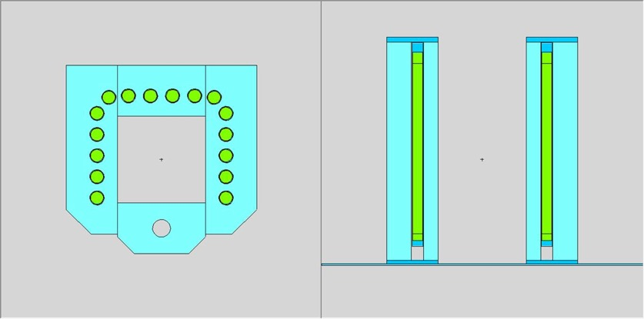
Alternatives Neutron Detectors for Safeguards

Slide 22
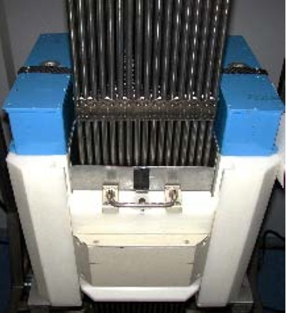
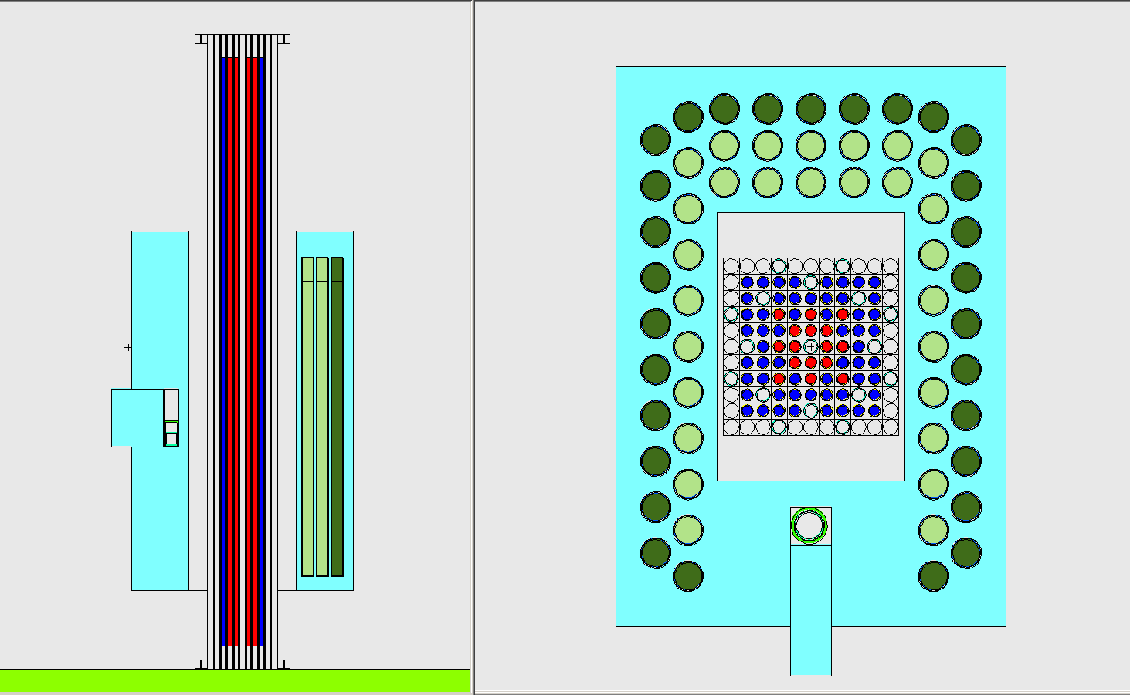
Alternative UNCL
Uranium Neutron Coincidence Collar (UNCL)
Measurement of Pu in MOX fuel in passive mode
Verification of ²³⁵U in low enriched U fuel assemblies in active mode
Want accuracy of less than 1% in ~15 minutes
UNCL active mode configuration
ABUNCL models

Slide 23
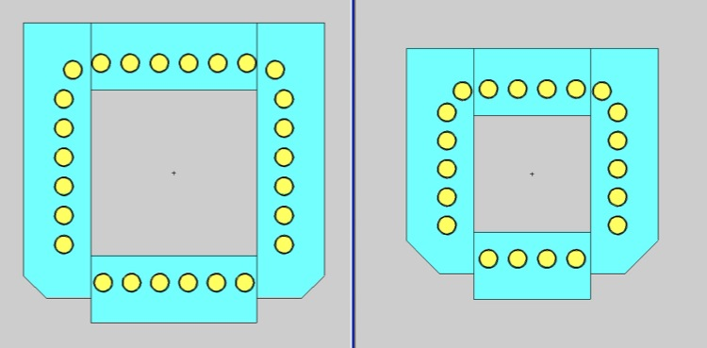
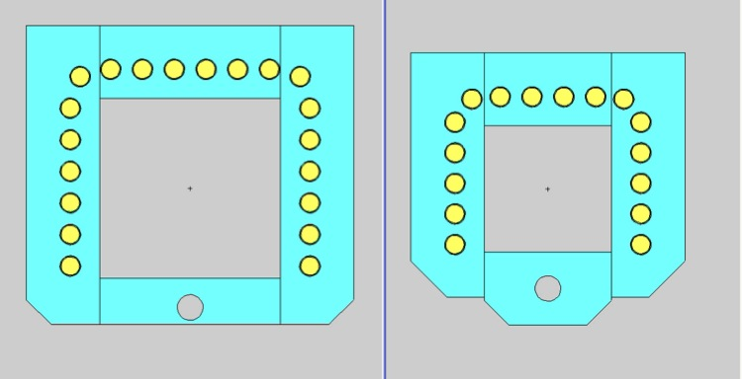
Modeling
MCNP modeling plays a central role in development of safeguards instruments
Modeling of Active and Passive UNCL
Passive ³He-based UNCL
Active ³He-based UNCL
PWR
BWR
23

Slide 24
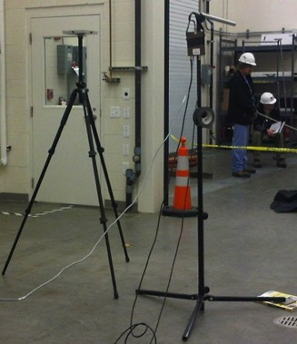
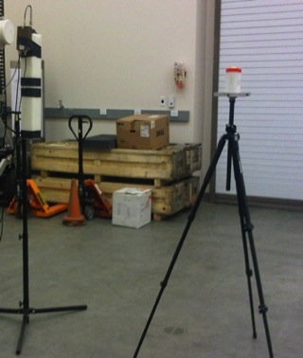
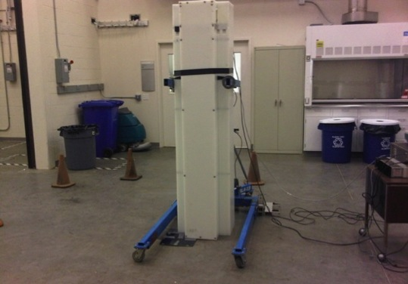
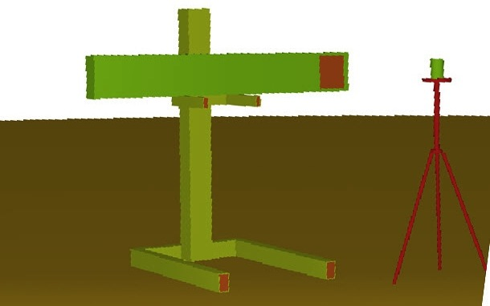
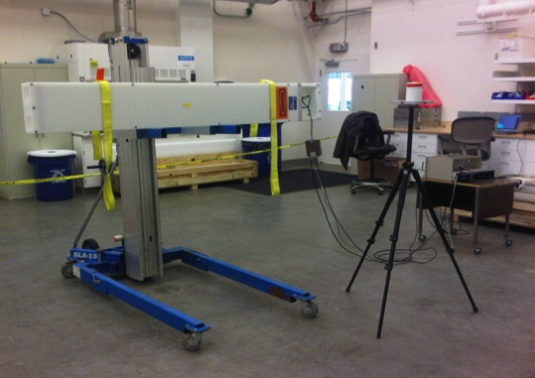
Validation Testing of Models
Models compared to measurements
Testing Bare B-10 Tube
Testing Moderated B-10 Tube
Testing of B-10 Tube Array
Model of B-10 Tube Array
Testing of B-10 Tube Array
24

Slide 25
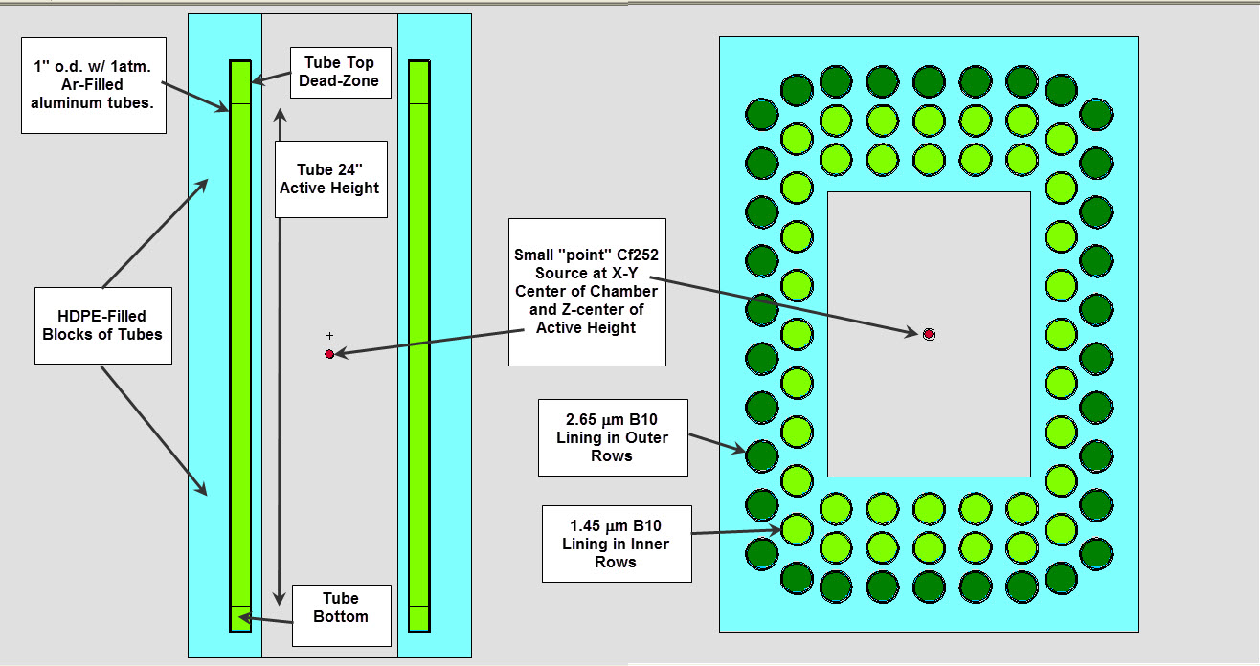
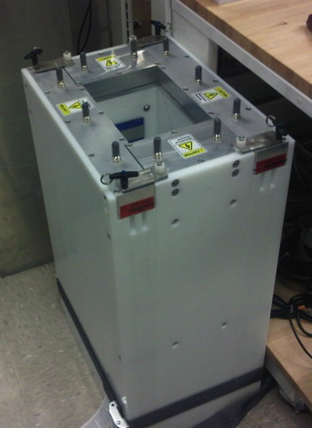
GE Reuter Stokes ABUNCL
GE Reuter Stokes constructed a passive ABUNCL and provided it for testing
ABUNCL in Passive Configuration

Slide 26
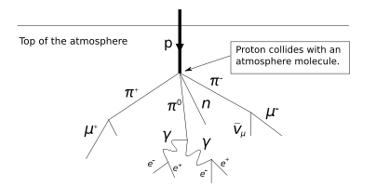
Muons for Safeguards

Slide 27
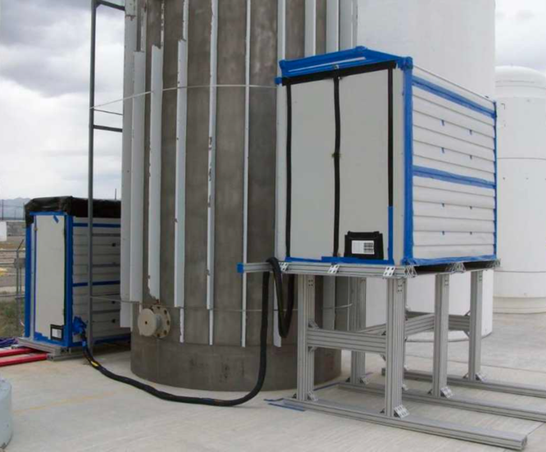
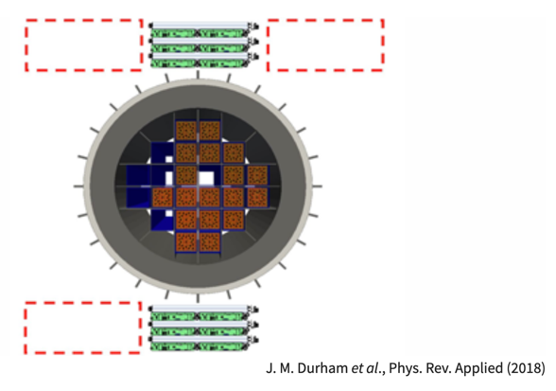
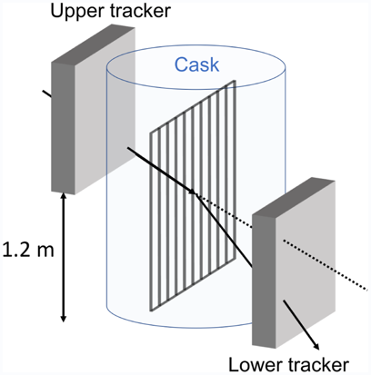




Rad Waste Monitoring with Muons
Muons can be used for diversion monitoring in spent fuel in casks
  Casks shield gamma rays and neutrons
  Measure muon scattering over periods of weeks
  Muon flux is ~160 s⁻¹m⁻² at sea level

Slide 28
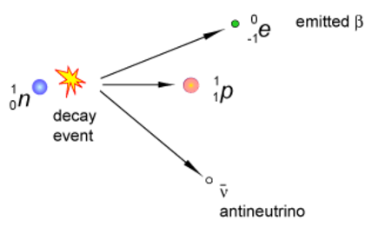
Antineutrinos for Safeguards

Slide 29
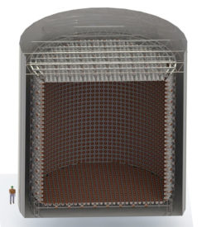
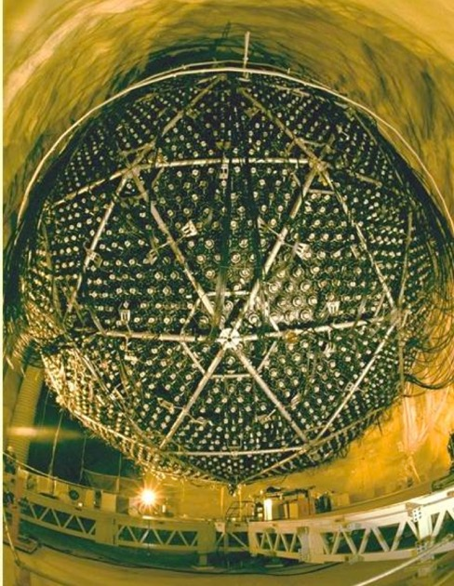
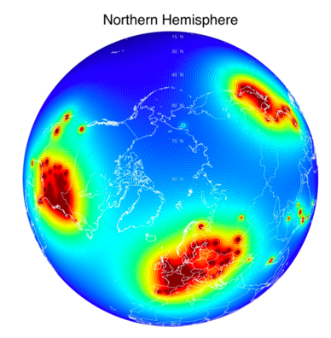
Antineutrino Reactor Monitoring
Antineutrinos first observed at reactor in 1956
Remote monitoring antineutrinos from reactors
  Safeguards approach to monitor diversion of fuel
  Provides independent monitor of power output
Watchman Experiment (cancelled?)
  Boulby potash mine in England
  Cherenkov detector with 35 metric tonnes of water
  25 km from reactor
29

Slide 30
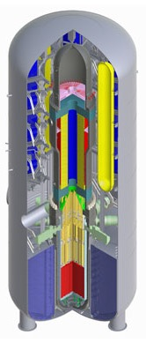
New Safeguards for New Reactors?
Despite the climate change threat, nuclear power is declining
Will small modular reactor (SMRs) become widespread?
  Up to 300 MW electric
  Factory-fabricated and transported to a location for on-site assembly
  Light water, gas-cooled, molten salt, or liquid metal
  2-10 years of fuel
  Modular, inherently safe, scalable, small land use, siting flexibility, process heat
  Independence from the grid
Will new safeguards methods be needed?
Westinghouse

Slide 31
Conclusions on Safeguards
Radiation detection (gamma ray and neutron) for safeguards is routinely used by the IAEA
Alternative neutron detectors being tested for safeguards applications
Muons may play a role in future safeguards
Antineutrino detection is being investigated for use in safeguards
New small modular reactors will pose new problems for safeguards
  Number of reactors
  More countries with nuclear power
  New types of fuel
  New reactor cycles
31

Slide 32
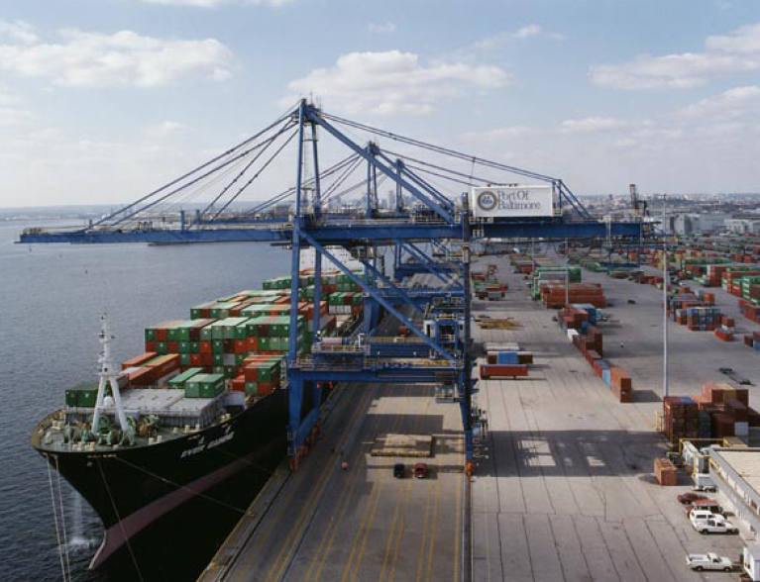
Nuclear Security

Slide 33
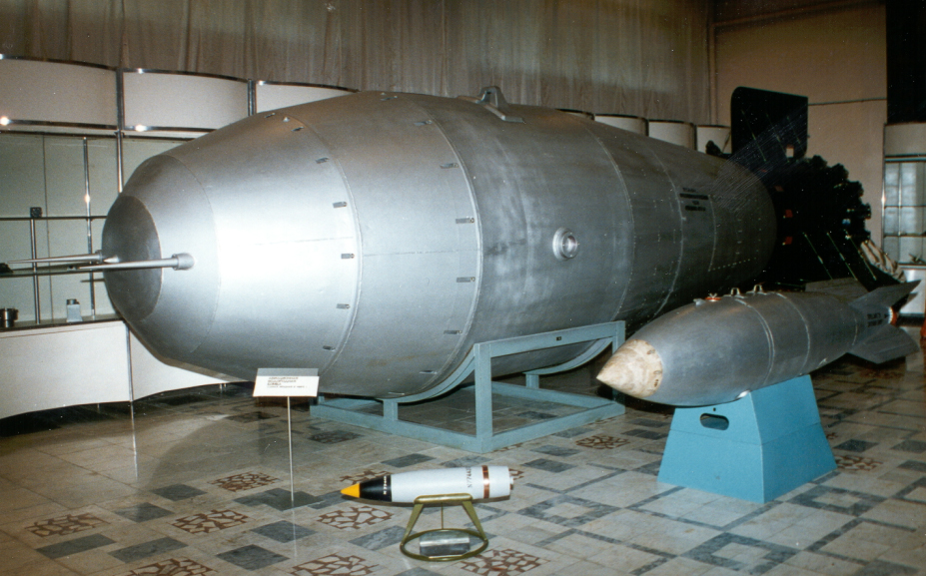
The Problem And The Threat
Weapons of Mass Destruction (WMD)
Improvised Nuclear Devices (IND)
Special Nuclear Material (SNM)
Radiation Dispersal Devices (RDD)
DOE: 4 kg ²³⁹Pu or 25 kg HEU are sufficient for a nuclear explosive device
IAEA Significant Quantity: 8 kg ²³⁹Pu or 25 kg HEU
    NRC & IAEA Cat I: 2 kg ²³⁹Pu and 5 kg HEU with >20% ²³⁵U

Slide 34
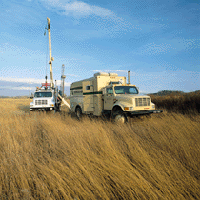
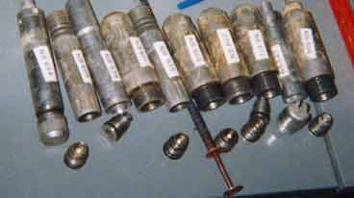
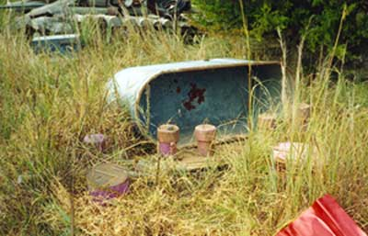
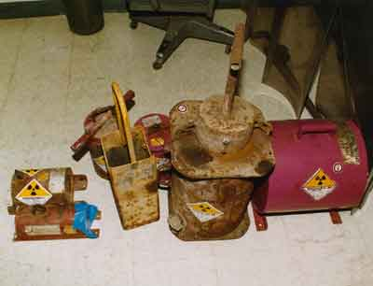
Orphaned Well Logging Sources
Notes:
Gamma backscatter and neutron induced gamma emission are both used to look for hydrogenous material.

Slide 35
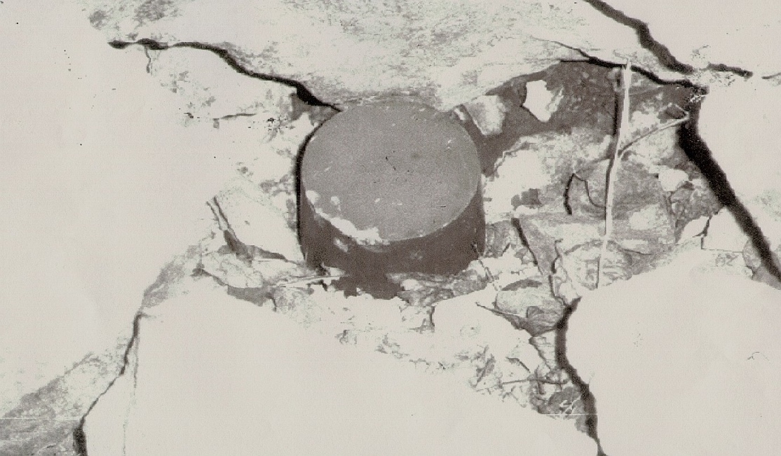
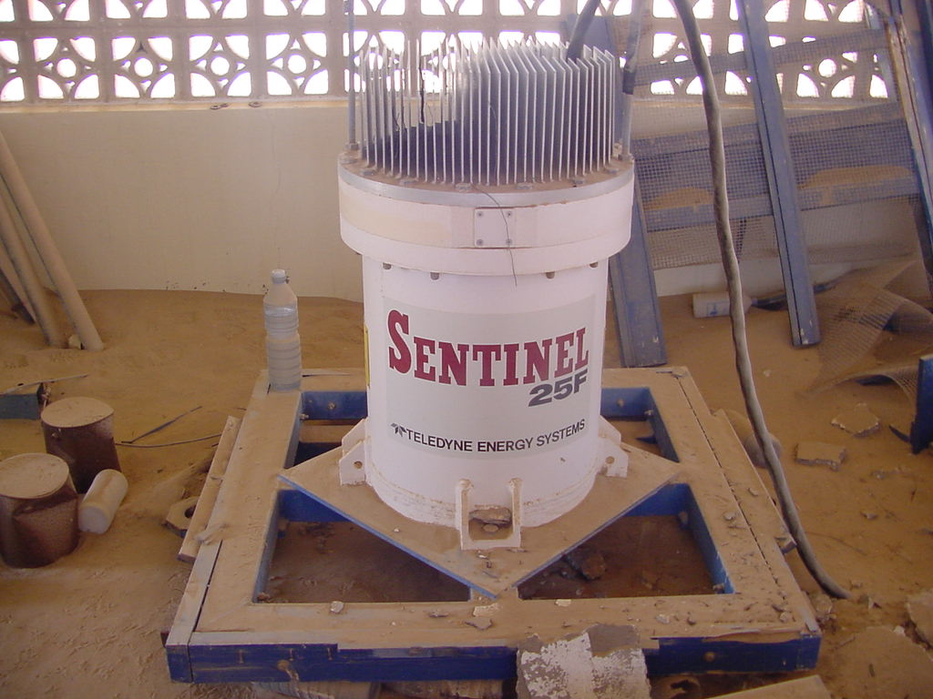
Soviet Sr-90 (~40 kCi) RTG
Recovered in Georgia
December 2001: three woodsmen in former Soviet republic of Georgia suffered severe radiation burns after handling the strontium-90 core from an abandoned radiothermal generator.
Notes:
RTGs exist in the thousands

Slide 36
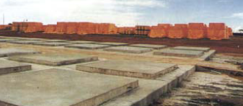
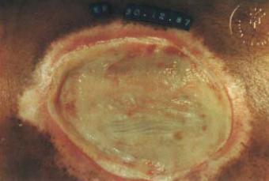
1987 Incident in Goiania, Brazil
Container of ¹³⁷Cs scavenged from defunct medical clinic
Children played with the glowing powder (1400 Ci)
11 days before discovered (up to 100 miles away)
Four people died (450-600 rem)
28 suffered radiation burns, 249 contaminated
More than 112,000 requested medical monitoring!
Clean-up effort cost ~$20M (275 truckloads of waste).
36
Notes:
5000 m^3 of stored waste
3800 200 liter drums
1400 1.2 m^3 boxes
10 32 m^3 ship containers
6 waste containers
7 houses demolished
Cheap labor
50% drop in agriculture, housing prices fell, cars were stoned, tourism dropped
Goiania ~800,000 people
CsCl in 2” x 2” source 1375 Ci, 456 rad/hr @ 1m
Sept 13 - salvagers took home and opened source
Sept 15 - 1 sought medical help - sent home as allergic reaction to bad food
Sept 14-15 - disassembled, punctured source, scooped out material, sold to salvage yard
Sept 28 - wife of junk yard dealer sought medical care - carried source to clinic; diagnosed as tropical disease
Doctor got 100 rad dose
Suspected radiation
4 deaths at 1 month: wife, 2 junk yard employees, 6 yr old niece
Oct 3 - situation fully appreciated

Slide 37
International Incidents
IAEA reported 18 incidents involving the smuggling of weapons grade nuclear materials between 1993 and 2004.
1994: police at the Munich airport intercepted a suitcase from Moscow with half a kilogram of nuclear-reactor fuel (363 grams weapons grade Pu).
1994: Prague police seized 2.7 kilograms of HEU from a former worker at a Russian nuclear institute.
1995: Chechen rebels buried a small amount of ¹³⁷Cs in a Moscow park and notified Russian television crew.
2004: Russian Customs uncovered some 200 attempts to smuggle nuclear or radiological materials.
37
37

Slide 38
Radiation Detection Effectiveness
Source activity (A)
  Strength, type, and energy
Detection geometric efficiency (e_{g} ~ 1/r²)
  Source and detector size and distance
Detector intrinsic efficiency (ε_{i})
  Material, geometry, collection
Shielding (S ~ e^{-μx})
  Amount, type, and geometry
Background (B)
  Type, energy distribution, and intensity
  Naturally occurring radioactive material (NORM)
Time for detection (t)
  Statistics for signal to noise
  Operational limitation
Expert/Automated analysis of information
r
Time
Distance
Shielding
38

Slide 39
Border Security

Slide 40
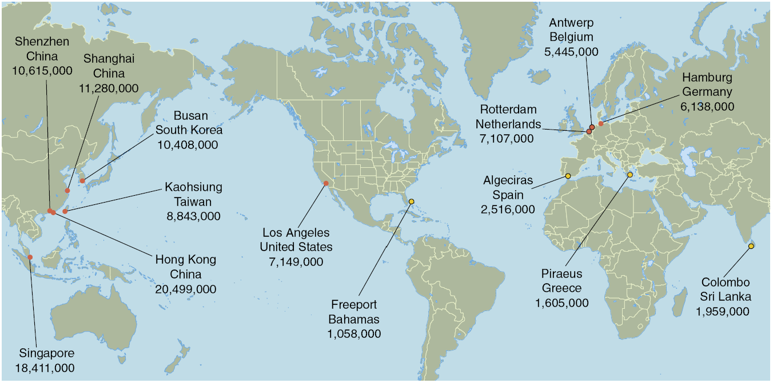
The Global View of Commerce
20 foot Shipping Container Traffic Per Year

Slide 41
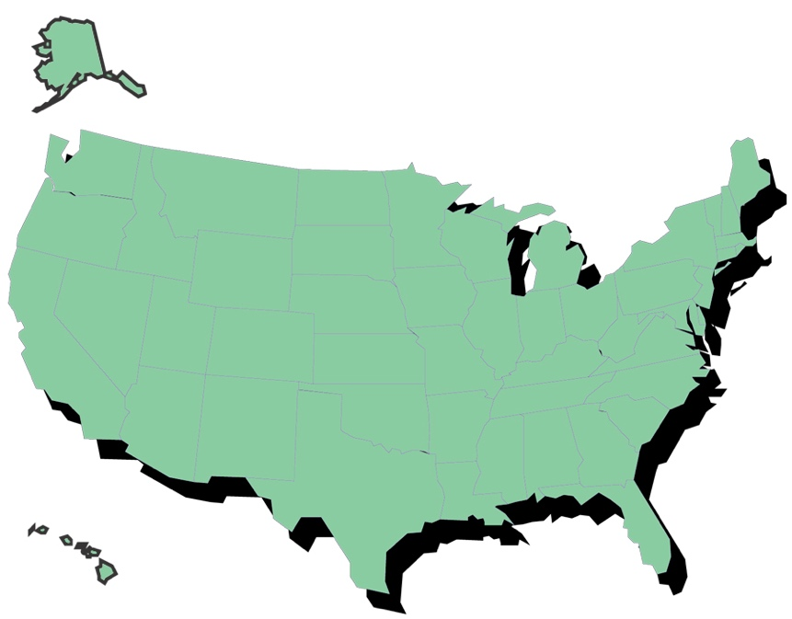
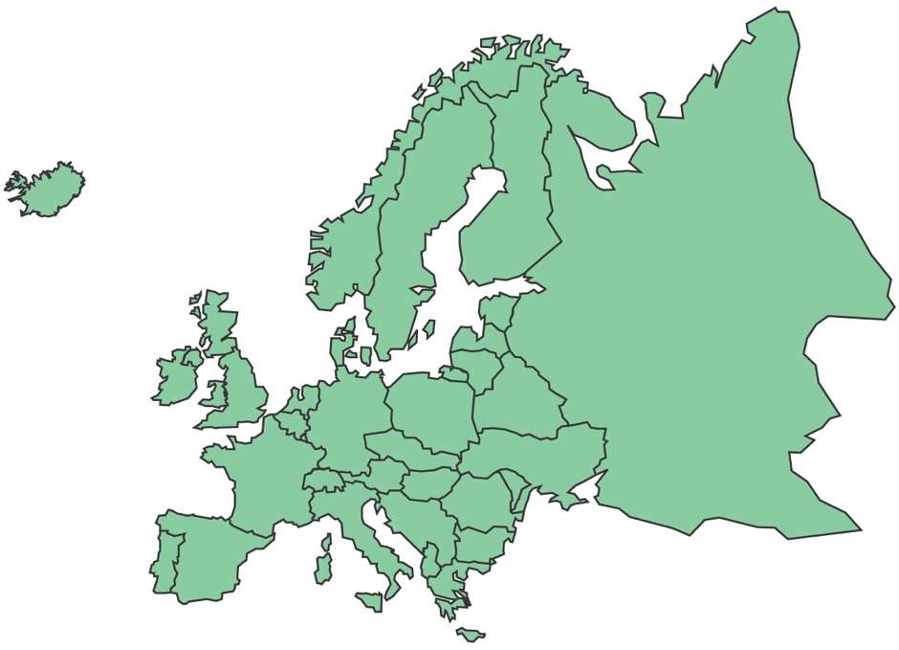
Layered Lines of Defense: Interdiction Opportunities
Europe
U.S.
3
2
5
1
7
6
Target
Transit
4
Secure [MPC&A]
Outbound Borders [SLD]
Loading [Megaports, CSI]
Transit [DoD]
In-Bound Borders [CBP]
Transit [TSA]
Delivery [UNWD]
Graphic From Rich Tighe, BNV

Slide 42

The Challenge: U.S. Ports of Entry
100% of containerized cargo is screened for radiation
Mail/ECCF
Land Border
Maritime
Air Cargo
307 Ports of Entry representing:
621 border sites to protect
332,622 vehicles per day
57,006 trucks/containers per day
2,459 aircraft per day
580 vessels per day
42
Notes:
The dots represent each of the ports of entry. Each has unique challenges to be addressed: quantity of traffic, natural radiation background, seasonal variation in cargo, environmental/weather

Slide 43

Radiation Portal Monitors
Used for decades in the scrap steel industry.
Sensitive to small quantities of SNM & RDD materials.
Large area, high-efficiency gamma-ray detectors & ³He neutron detectors.
Best cost/performance ratio of any detection technology.
Provide the capability to rapidly screen cargo.

Slide 44


Homeland Security Systems
Second Line of Defense / Megaports (1997)
  RPMs deployed overseas
Radiation Portal Monitor Project (2002)
  Over 1600 systems deployed in US
Guardian Program (2003)
  Screening at DoD bases
44

Slide 45




Border Security Examples
Notes:
US Customs (CBP) is deploying COTS at POEs

Slide 46





RPM Concept of Operations
Detect
Confirm
Isolate
Identify
Respond
Primary Detection
Secondary Detection
Isolation
Identification of Isotope
Seize/Arrest
or Release
Gamma Detectors – Poly-Vinyl Toluene (PVT) Plastic Scintillators
Neutron Detectors – Moderated Helium-3 Gas Tubes
Neutron Scan

Slide 47



Layered Approach: Imaging
X-ray and gamma-ray transmission or backscatter imaging
Aracor Eagle
AS&E

Slide 48

Challenges & Solutions
48

Slide 49
Naturally Occurring Radioactive Material and Man-Made Sources
NORM is the dominant source of alarms for cargo, but not passenger cars
NORM, and technologically enhanced NORM, contain:
  uranium series (²³⁸U; 4.5 billion years)
  thorium series (²³²Th; 14 billion years)
  potassium (⁴⁰K; 1.3 billion years)
Commercial isotope examples
  ²⁴¹Am, ¹³³Ba, ¹³⁷Cs, ⁵⁷Co, ⁶⁰Co, ¹⁹²Ir, ²²⁶Ra, ²⁵²Cf, nuclear fuel, depleted uranium
Medical radioisotopes
  92% of procedures are ^{99m}Tc for stress tests
  ¹⁸F, ¹⁴C, ¹¹¹In, ⁵⁷Co, ²⁰¹Tl, ¹⁵³Sm, ⁸⁹Sr, ¹³¹I, ⁶⁷Ga, ⁵¹Cr
  One in 2600 Americans carries a radioactive burden large enough to be seen in an RPM
Skyshine from radiography
49

Slide 50
Decay Chain Example
²³⁸U 4.5 Gy
α
²³⁴Th 24 d
β
²³⁴Pa 1.2 m
β
²³⁴U 250 ky
α
²³⁰Th 7.5x10⁴ y
α
²²⁶Ra 1502 y
α
²²²Rn 3.8 d
α
²¹⁸Po 27 m
β
²¹⁸At 1.8x10⁻⁴ s
…
²⁰⁶Pb

Slide 51


“Nuisance” or “Innocent” Alarms
Neutron Alarms - Few sources
  Troxler gauges, nuclear fuel, yellowcake, well logging sources
  Ship effect
Gamma Ray Nuisance Alarms
  Naturally Occurring Radioactive Material
  agricultural products like fertilizer
  kitty litter
  ceramic glazed materials
  aircraft parts and counter weights
  polishing compounds and abrasives
  propane tanks
  road salt
  welding rods
  ore and rock
  smoke detectors
  medical radioisotopes
  skyshine
Troxler Gauge
51

Slide 52
Baseline Depression
Potential
Threshold
Above NORM
Potential
SNM Source
in NORM
Potential
Medical
Signal
Normal
“No-Vehicle”
Background
Potential NORM Profile
Potential
SNM Source
w/o NORM
Depressed Baseline
SNM Calibration
Source Signal
w/o Vehicle
Fraction of
Normal
Background
Extra Baseline Dip
52

Slide 53

Skyshine
Radiation scattered from the air above a source
Radiography (¹⁹²Ir, ⁶⁰Co) or “x-ray” imaging sources
Very large sources (~100 Ci)
Can produce interference with radiation detection systems at very large distances (1% strength at 200 m)
Impacts all detector types (gross-counting or spectral)
Requires mitigation through distance, shielding, and operations
¹⁹²Ir Radiography Skyshine Source
53

Slide 54



Neutron Ship Effect Event Example
3 neutrons in 30 microseconds in an IAT detector
54

Slide 55







Observations of Plastic Aging
Polyvinyl toluene (PVT) and polystyrene (PS) are widely used plastic scintillators
Most new and old PVT & PS shows no significant change in response to gamma radiation with temperature
Various forms of damage are observed in PVT and PS
Internal temporary and permanent fogging are two forms of damage that may be seen even at room temperature
Severe fogging sometimes observed at low temperature
The effect, first observed in 2009, was not reproduced in the lab for new PVT samples until 2013
Surface Crazing
Surface Clouding
Internal Fogging
55

Slide 56

Active Interrogation
From Morse

Slide 57



Active Interrogation (AI)
AI initiated by energetic photons, neutrons or muons
Detected signal is photons, neutrons or muons
Large source required giving large dose
Our study includes only:
  High-Z: presence of high atomic number (Z) material
  Photofission: presence of fissionable material
  Differential die-away: presence of fissile material
  Nuclear resonance fluorescence: presence of HEU or Pu
57
Notes:
CAARS: SAIC – L3 – AS&E
Raytheon - Passport

Slide 58


Modeling With MCNP & GEANT4
Analytical calculations performed to establish order of magnitude requirements
MCNP models of differential die-away (DDA): comparison made to published information provided model validation
MCNP models of PF for SNM and surrogates
9 MeV Bremsstrahlung beam GEANT4 simulation
Neutron die-away times observed for bare tungsten, DU, HEU and Pu.
58

Slide 59


Is Active Interrogation Feasible?
Can we do 100% imaging?
Is active interrogation operationally possible?
  AI cannot be used in primary screening, so limited to targeted containers
  Large dose
  Large footprint (on private land)
  Large cost
  If looking for a weapon, it is too late!
Passport
Rapiscan

Slide 60
Conclusions on Security
Radiation detection (gamma ray and neutron) for security is routinely used around the world
Radiation portal monitors are the main detector technology for border security
Many portable, handheld, and personal radiation detectors are used in diverse applications
Radiation detection technology for security is undergoing continuous improvements
People, not technology, are the key to successful security systems
60

Slide 61

Pacific Northwest National Laboratory
Questions

Slide 62
Backup Slides

Slide 63
Traffic Monitoring Example
Traffic flow over 7 hours - each dip or rise is a passing vehicle
63
Notes:
Example of RPM traffic monitoring.

Slide 64
High-Z & Photofission Detection
Interrogate with x-rays and look for gamma-rays or neutrons
DU is a good surrogate material for High-Z detection and Photofission
Surrogate for high-Z detection can be 2 kg DU
Surrogate for Photofission detection can be 2 kg
  Consider prompt neutrons, delayed neutrons and delayed gamma rays
  Too many combinations of possible surrogate masses: Pb attenuators used to reduce signal to correct value
64

Slide 65
Differential Die-Away
Interrogate with neutron pulse
LEU is a usable surrogate for DDA
Surrogate mass for DDA is 2 kg LEU
Surrogate provides similar response as HEU & Pu
Comparison of PNNL validation model results with measured data (Jordan et al. 2007)
65

Slide 66

Nuclear Resonance Fluorescence
Interrogate with gamma-rays and observe gamma-ray signal
DU is good surrogate material for NRF
NRF signal size depends on mode (transmission or scattering) and HEU or Pu
Surrogate for NRF is 2 kg DU
  2 kg DU provides more signal than SNM
  Pb attenuators used to reduce signal to correct value and depends on transmission or scattering modes
66

Slide 67



Muon Scattering Detection
Cosmic ray muons used
Muon scattering is highly dependent on density
Measure the muon path through a vehicle
Demonstrated to show presence of high-density material like HEU and Pu
Takes minutes to make a measurement because of small muon flux of ~160 m⁻¹s⁻¹
Decision Sciences
67

Slide 68
Energy-Based Algorithms for Enhanced Portal Sensitivity
Energy-based algorithms can preferentially alarm on low-energy gamma-ray signals
  HEU, WGPu & Medical Radionuclides
Energy discrimination avoids many NORM alarms
  NORM spectra contain a significant high-energy component from thorium and potassium
Energy ratio modeling also handles baseline depression
  Background spectral ratios nearly constant with and without a vehicle in the portal
68

Slide 69


Energy-Window Ratio Algorithm
Use PVT spectral shape for discrimination
Low
Window
High
Window
Create the ratio:
Using ratios of energy regions enhances discrimination significantly and minimizes effect of intensity variations
Notional
Threshold
69

Slide 70
PVT Degradation Mitigation
Keep the plastic in an environmentally controlled space
Heat the plastic so it never gets cold
Dehumidify so water is not available to permeate the plastic
Encapsulate the plastic in a water impermeable membrane
  Requires material with MVTR ~ 10⁻⁵ g·m⁻²·d⁻¹
  Requires sealants for edges
  Might require electrical feedthroughs
New formulations of plastic scintillator
70

Slide 71

Spectroscopic Portal Monitors
Pros and cons of NaI(Tl) versus plastic scintillator
  Pros:
    Higher energy resolution
    Allows for identification
    Improved NORM rejection
    Improved identification rate
  Cons:
    Higher cost
    Physical limitations of NaI(Tl)
Efficiency requirement for SPMs
  Equivalent efficiency to plastic based RPMs
  For example, Five 4”x2”x16” crystals per panel
Automated secondary isotopic identification

Slide 72
Standards
ANSI N42.41: Minimum Performance Criteria for Active Interrogation Systems used for Homeland Security
  Non-intrusive inspection of closed containers, vehicles, and packages, but not imaging
  Inspection times of 90-900 s depending on size
  Test masses: explosives (200 kg), chemicals (200 kg), fissionable material (25 kg), weapon shells (16 kg)
Standards establish test methods based on threat-informed unclassified source materials and configurations
Standards establish performance requirements for automated active systems that detect shielded SNM
20 cm
20 cm
72
72
20 cm

