Slide 1

Real Time 2022 - Welcome
David Abbott – CANPS Chair

Slide 2
Real Time – Virtual 2.0
Seems like this pandemic is lasting VIRTUALLY forever…
We made the difficult decision back in December to postpone in-person once more.
  It seems perhaps the best decision after all.
  However, we are smaller this year compared to past RT conferences.
Regional breakdown: 58% Asia/Pacific, 30% Europe, 12% North America
  Participation is spanning 16 time-zones.
In the spirit of traditional Real Time we plan to embrace the opportunity.
  Fully interactive Zoom plenary sessions
  Live mini-oral presentations in the plenary program
  Browser-based interactive poster sessions each day using oVice
Welcome everyone who have chosen to participate this week – Thank you!

Slide 3
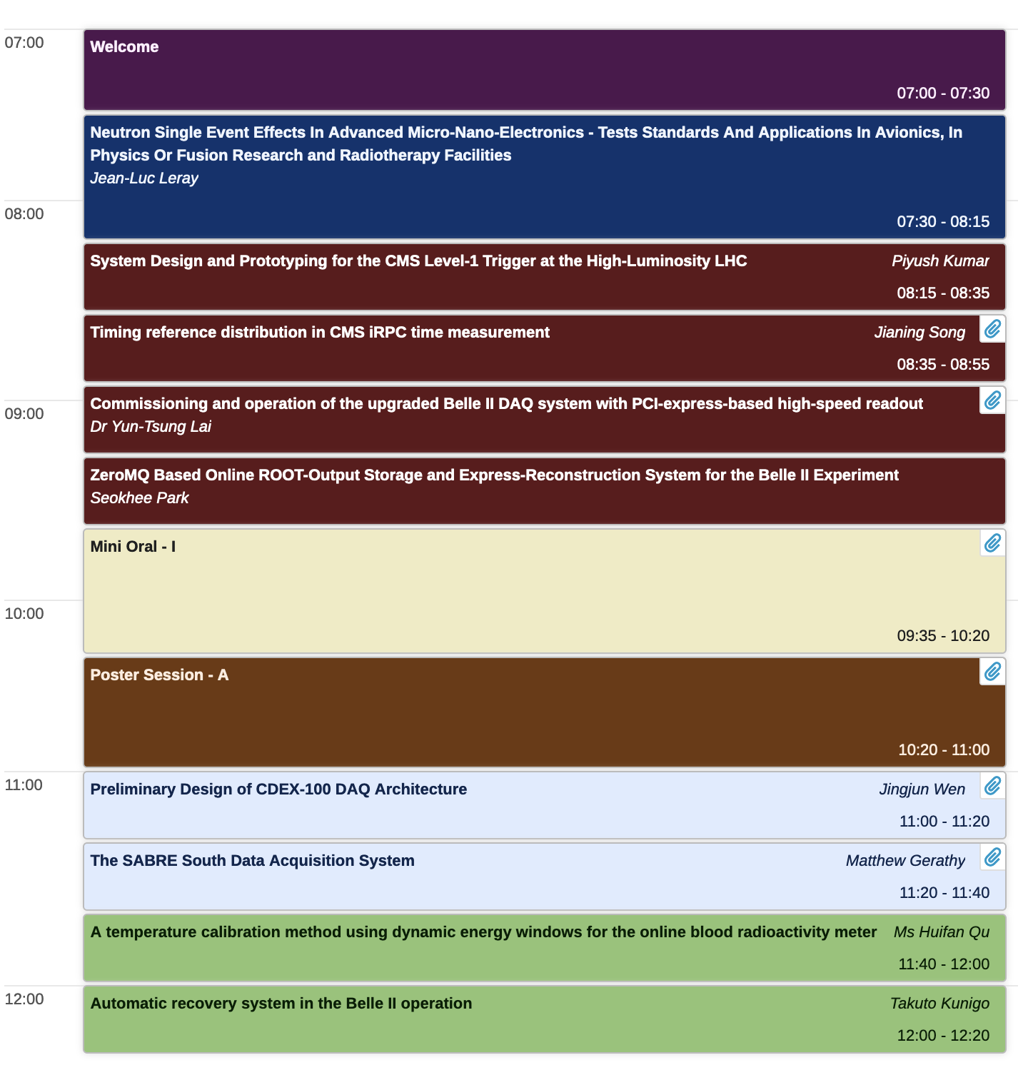
Daily Sessions
Monday-Thursday + Friday
Each day will start at the same time - GMT 11:00
  Early Plenary (Mon-Fri)
  Mini-Oral Plenary (Mon-Thurs)
  Poster Session (Mon-Thurs)
  Late Plenary (Mon-Fri)
Posters will stay up for two sessions
  Monday/Tuesday (Posters A&B)
  Wednesday/Thursday (Posters C&D)
Awards Presentations
  CANPS Award and Talk (Thurs Late-Plenary)
  Student Paper Awards (Friday Late-Plenary)
Early
Plenary
Mini-Orals
Poster Session
Late
Plenary

Slide 4
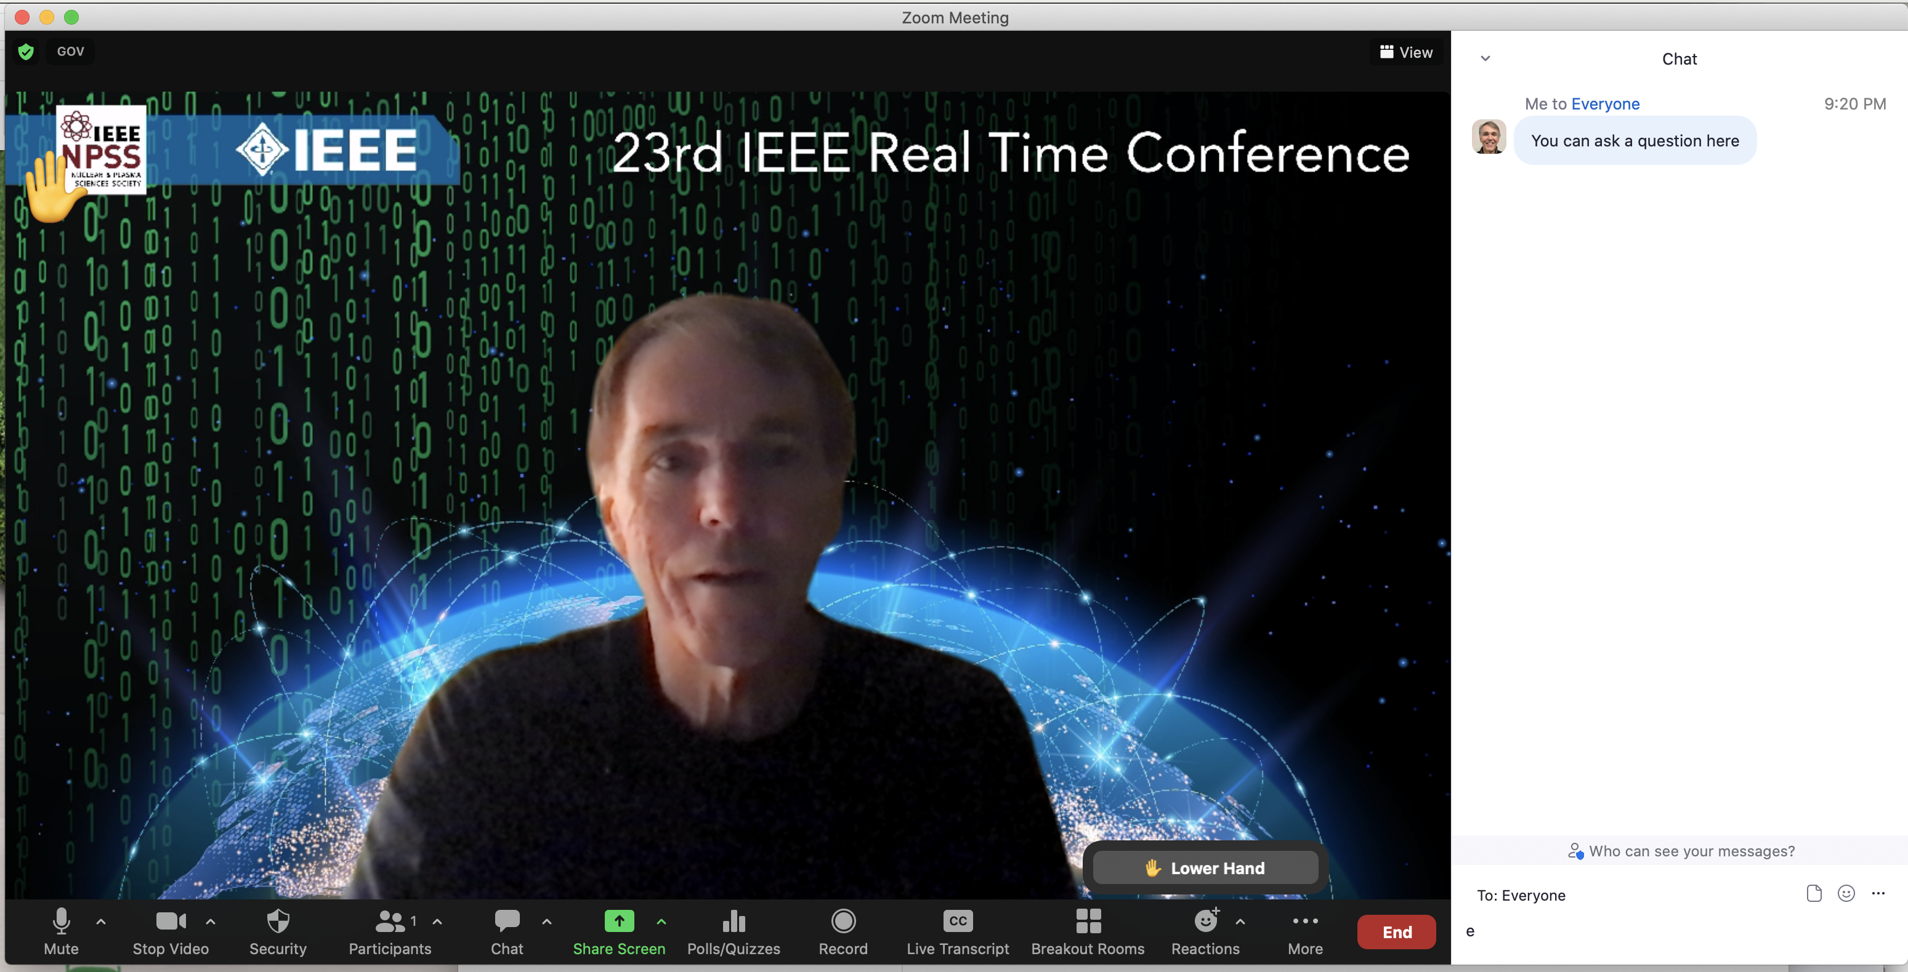
Zoom Basics
Hopefully we are all familiar with the fundamentals by now
Generally
  Mute microphone
  No Video
Questions?
  Raise Hand
  or Chat box
Presenters
  Share Desktop
  or ask Zoom Host to control slides.
Session Chairs
  Introductions
  5 min warnings

Slide 5
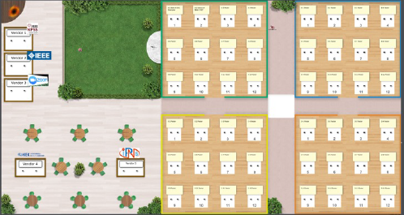
Poster Sessions
General space for small group conversations
Using the Interactive Virtual Space oVice
https://rt2022.ovice.in
Instructions and password can be found on the conference website.
This space will be accessible for the whole conference (24hrs/day).
Hint: to “move” your avatar, just search the space and then double-click where you want to be.
Vendor Desks
Posters

Slide 6
Making Real Time Possible
CANPS, NPSS and IEEE
Computer Applications in Nuclear and Plasma Sciences (CANPS)
  Technical committee of the NPSS Society of IEEE
  Approximately 45 members total (10 member Executive Committee)
CANPS ExCom takes a leadership role with respect to:
  Real Time Conference organization/decisions
  Approval for new CANPS General membership
  Representation in NPSS/AdCom
CANPS General Membership acts in a scientific advisory capacity.
  Recommendations/Nominations to ExCom for Real Time and CANPS Award
  Reviewing for the RTC scientific program and voting for CANPS Award
  Advocate in their scientific communities for participation in RTC and NPSS/IEEE
CANPS Executive Committee
David Abbott (CANPS Chair, Jefferson Lab)
Martin Grossmann (General Chair, PSI)
Pierre-André Amaudruz (Program Chair, TRIUMF)
Adriano Luchetta (Senior Editor, Universita di Padova)
Ryosuke Ito (KEK)
Martin Purschke (BNL)
Patrick Le Dû (CEA retired)
Zhen-An Liu (IHEP)
Masaharu Nomachi (Osaka University)
Keith Erickson (PPPL)

Slide 7

Nuclear and Plasma Sciences Society (NPSS)
Are you interested in getting more involved?
NPSS supports:
  8 technical committees (including CANPS)
  4 technical Publications (including Transactions in Nuclear Science)
  Programs for Students, Women In Engineering (WIE), Young Professionals
Consider joining IEEE and NPSS while at the conference.
  Information can be found on the website and virtual poster session
  Special deals for 2022 Memberships
Want more info on joining the CANPS General Committee?
  Find a CANPS ExCom member and strike up a conversation
Option for publication in a special Real Time Conference issue of TNS
  TNS Senior Editor – Adriano Luchetta – will provide details

