Slide 1

Timepix detectors in space:
From radiation monitoring in low earth orbit to astroparticle physics
B. Bergmann
Institute of Experimental and Applied Physics, Czech Technical University in Prague
Benedikt.bergmann@utef.cvut.cz

Slide 2
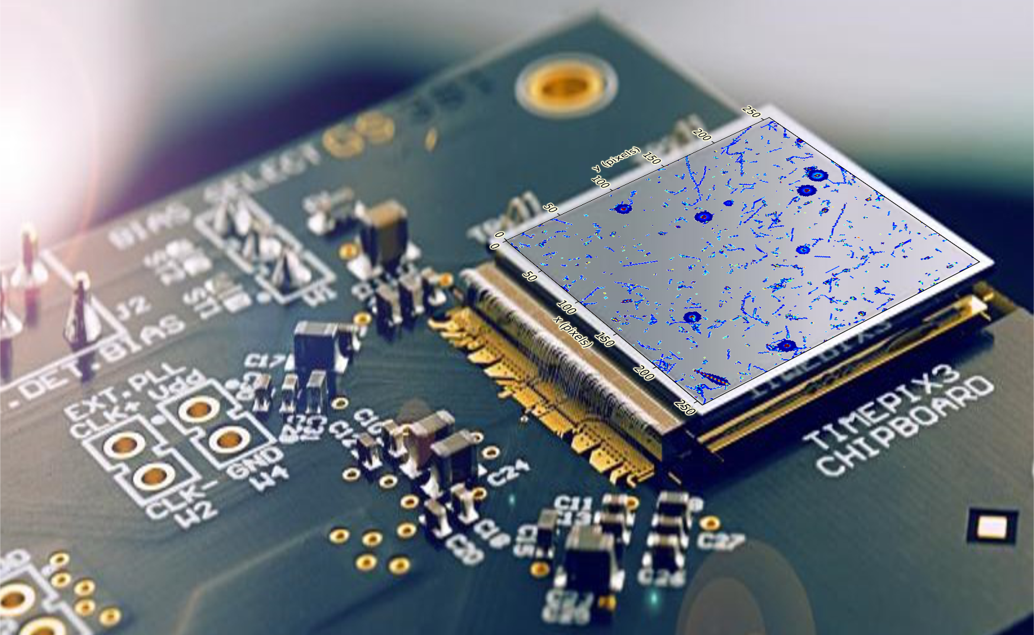
Measuremenct of traces left by ionizing particles in semiconductors
→ Radiation imaging detector
Notes:
Timepix are hybrid pixel detectors, i.e. that the sensitive volume (in this cast silicon) is divided into 65536 pixels.
Energy left in the pixel is visualized.
We can see traces left by ionizing particles.
Different particles leave different signatures.
Detector visualizing ionizing radiation in the form of tracks.

Slide 3
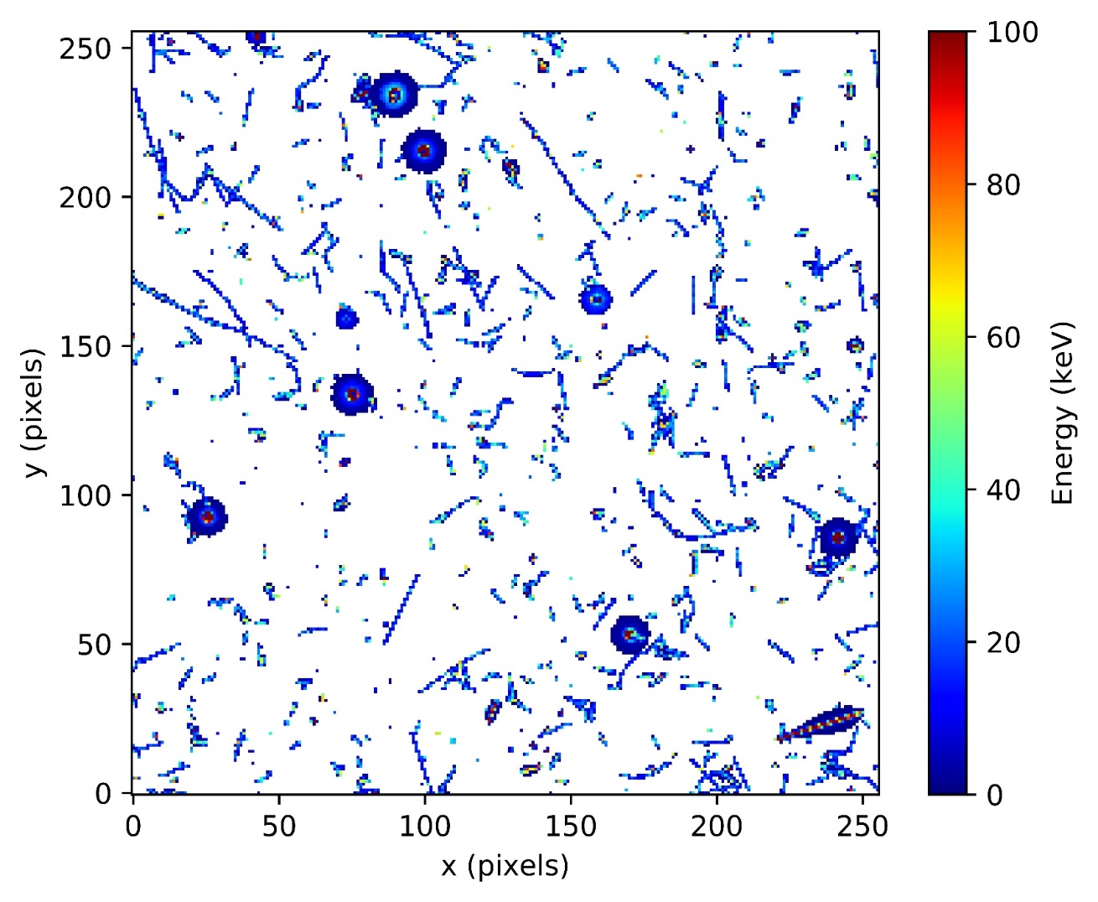
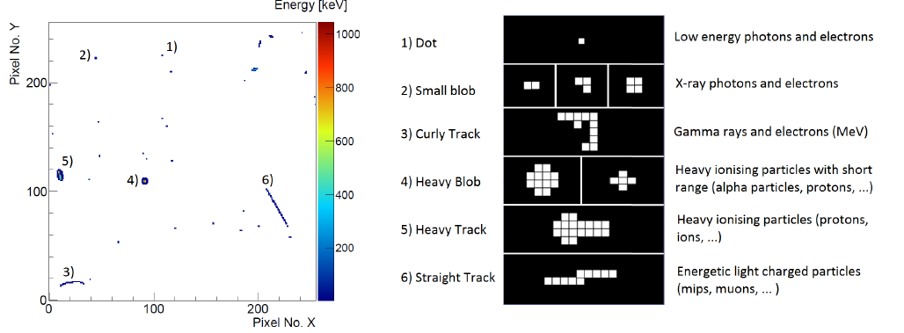
Working principle:
Pattern recognition
Pattern recognition together with dE/dX information allows determination of incident particle type - and energy?
T. Holy, et al. Pattern recognition of tracks induced by individual quanta of ionizing radiation in Medipix2 silicon detector, Nucl. Inst. Meth. Phys. Res. A, 591(1):287 – 290, 2008.
α-particle
µ
γ/e⁻
p⁺
20 s frame of natural radiation (at 2,231 m altitude)
60 minutes measurement at an altitude of 2 700 m
Notes:
Different track shapes can be put into different categories indicating different particle classes. A work from 2008 proposes a classification scheme purely relying on the morphology of the tracks. It does not utilize the pixel energy measurement.

Slide 4
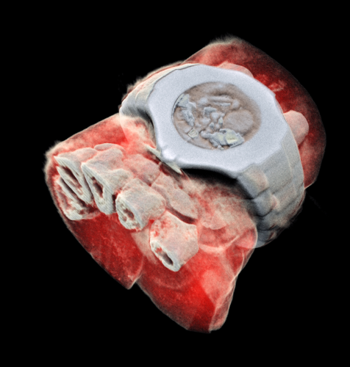
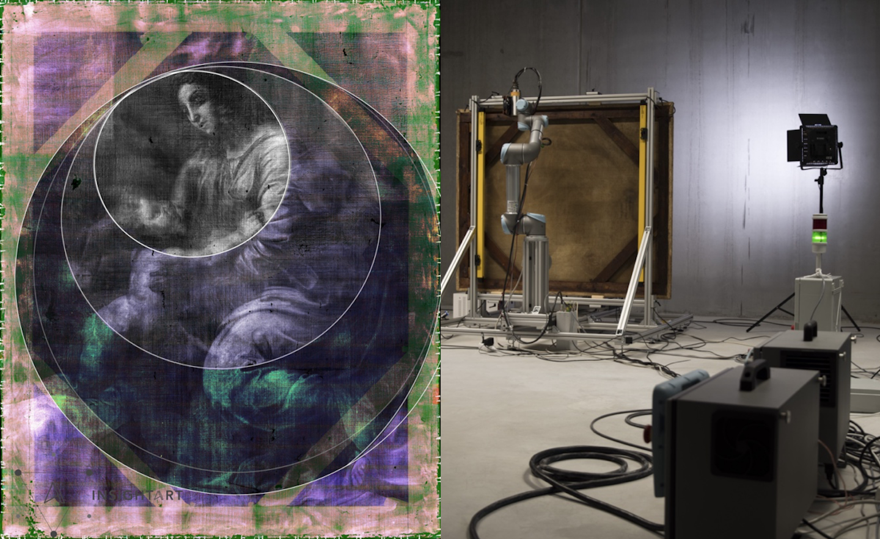
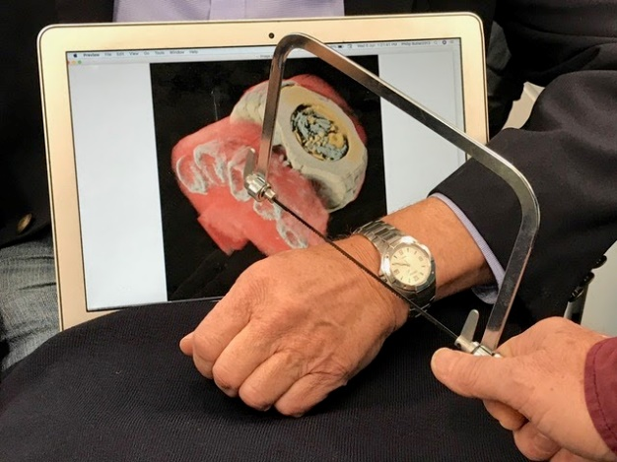
Medipix collaboration(s)
https://home.cern/news/news/knowledge-sharing/first-3d-colour-x-ray-human-using-cern-technology
https://medipix.web.cern.ch/collaborations
Founded in 1999 to bring technology developed for high energy physics to biomedical applications ...
https://insightart.eu/
MARS Bioimaging Ltd..
The Medipix technology is one of CERN’s most successful knowledge transfer cases. Each collaboration has triggered a significant number of commercial activities in widely differing application areas.
https://medipix.web.cern.ch/index.php/news/news/timepix/cern-technology-helps-rediscover-lost-painting-raphael

Slide 5

Hybrid pixel detector of the
Medipix/Timepix family
1998 Medipix1: 64 x 64 pixels, pixel pitch 170 µm
2005 Medipix2 (Mpix2MXR20): First hybrid pixel detector at a pitch below 150μm.
Pixel processing chips (Measurement and characterization of single quanta of ionizing radiation)
Each pixel can measure energy and/or time of arrival and number of interactions.
2006 Timepix
2013 Timepix3
2020 Timepix2
2021 Timepix4
Photon counting chips (Optimized for energy sensitive x-ray imaging applications)
Each pixel measures the number of interacting photons in few energy bins.
2011 Medipix3 RX
2022 Medipix4

Slide 6
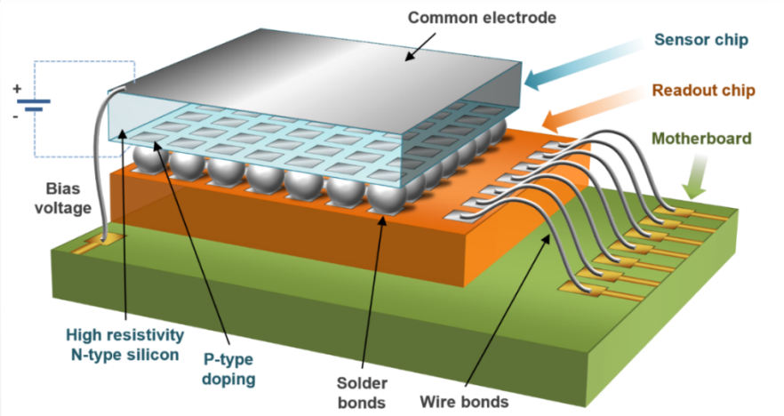
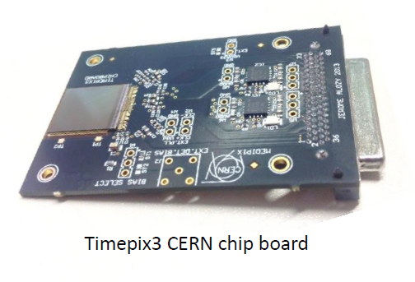
Timepix and Timepix3
256 x 256 pixels with 55 µm pitch (1.98 cm²)
  Sensor layer (Silicon, GaAs, CdTe, ...) flip-chip bump bonded to the ASIC
Timepix(2):
Frame based readout (92 fps) – dead time > 11 ms
Measurement of energy or/and time (Δt = 20.8 ns)
Minimal detectable energy: ~ 3.5 keV
Timepix3:
Data-driven readout (Max. count rate 40 Mpix/s)
Per-pixel dead time of 475 ns
Measurement of energy and time (Δt = 1.56 ns)
Minimal detectable energy per pixel 2.5 keV
Timepix3 with chipboard.

Slide 7
Working principle:
Modes of operation - Timepix
Timepix pixel processing:
Common electrode
Ionizing particle
V
+
-
Analogue
Threshold
+
-
Sensor
Bias voltage
source
+
-
+
-
t
Start Frame
End frame
Bump bonds
Pixel-site electrodes
ASIC
ToA (Time-of-Arrival)
Wire bonds
Pixel registers
PCB
ToT (Time-over-Threshold)
Readout pads

Slide 8
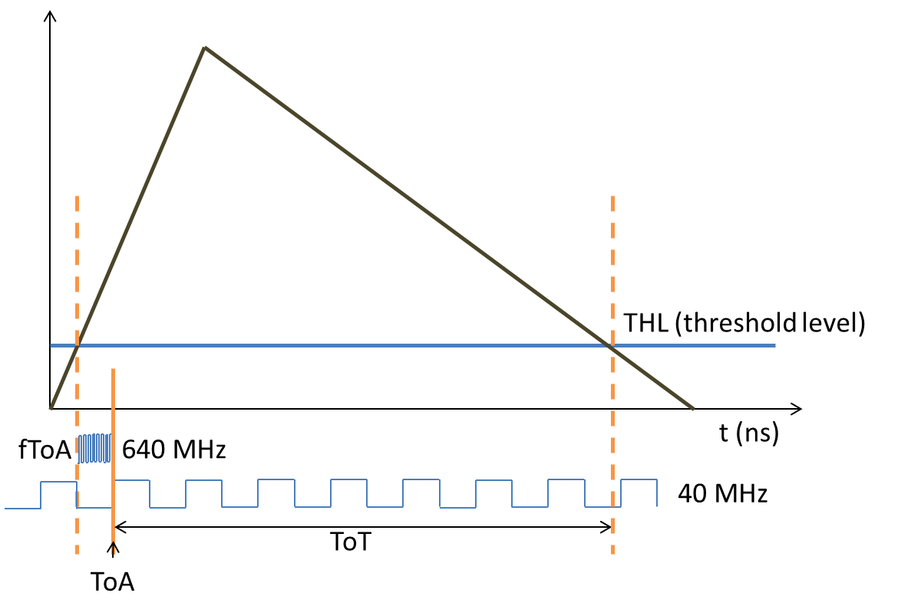
Working principle:
Timepix3
Data-driven readout with continuously running 40 MHz base clock
Simultaneous measurement of ToT and ToA
Local oscillator creates 640 MHz clock for precise time stamping

Slide 9
Demonstration
Timepix3 with 500 µm thick silicon sensor layer

Slide 10
Low Earth Orbit (LEO) - Radiation environment

Slide 11
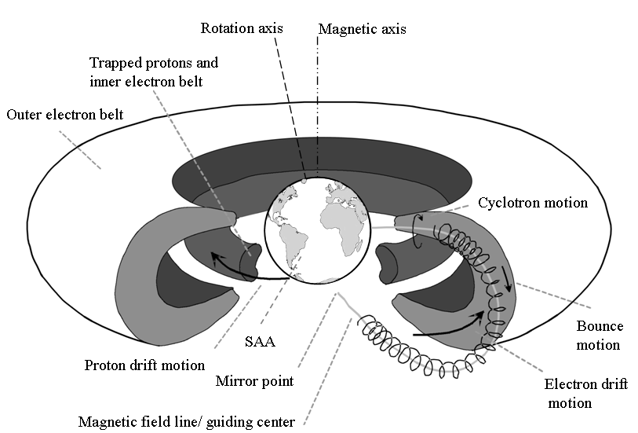
Radiation environment in LEO
E_{p} < 400 MeV
E_{e} < 7 MeV
Mauk, B.H., Fox, N.J., Kanekal, S.G. et al. Space Sci Rev (2013) 179: 3.
Notes:
ISS astronauts get ~50% of their radiation dose in the SAA, other 50% from GCR
Particles are trapped by the earth magnetic field …
In the LEO radiaation environment, we find mainly electrons and protons, which are „trapped“ in the earth magnetic field and form 2 radiation belts. The so-called Van-Allen belts.
The outer belt consists of electrons which spiral around the magnetic field lines until they come clos to the polse where bounce back.
In the inner belt there is a mixed radiation field of electrons and protons.

Slide 12
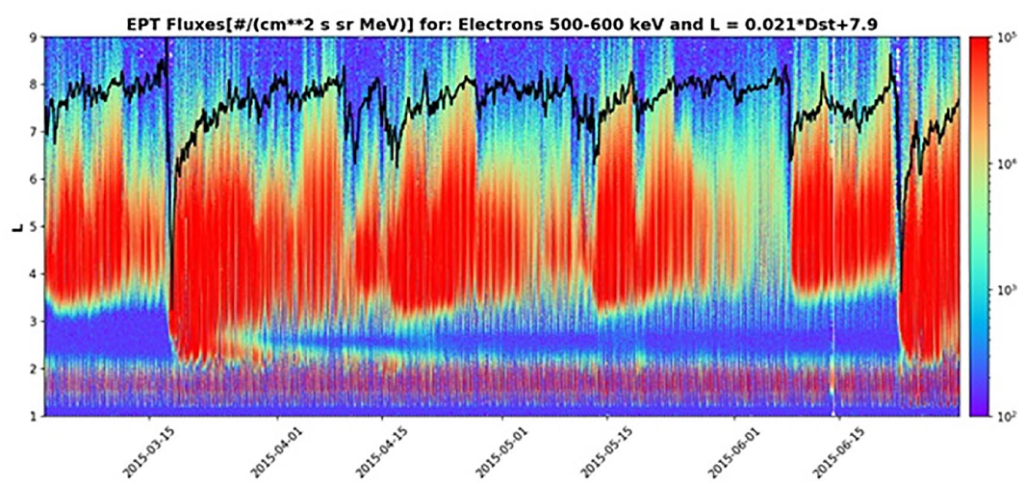
Temporal fluctuations of the radiation belts
Radiation belts structure highly dynamic.
Solar Flares
Solar Particle Events
Interplanetary shock waves
...
V. Pierrard et al., “Electron dropout events and flux enhancements associated with geomagnetic storms observed by PROBA-V/Energetic Particle Telescope from 2013 to 2019”, Journal of Geophysical Research: Space Physics 125, e2020JA028487 (2020).
https://doi.org/10.1029/2020JA028487
Notes:
L-parameter: where magnetic field line crossed the equatorial plane.

Slide 13
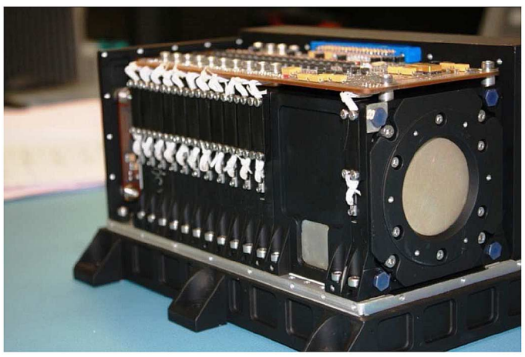
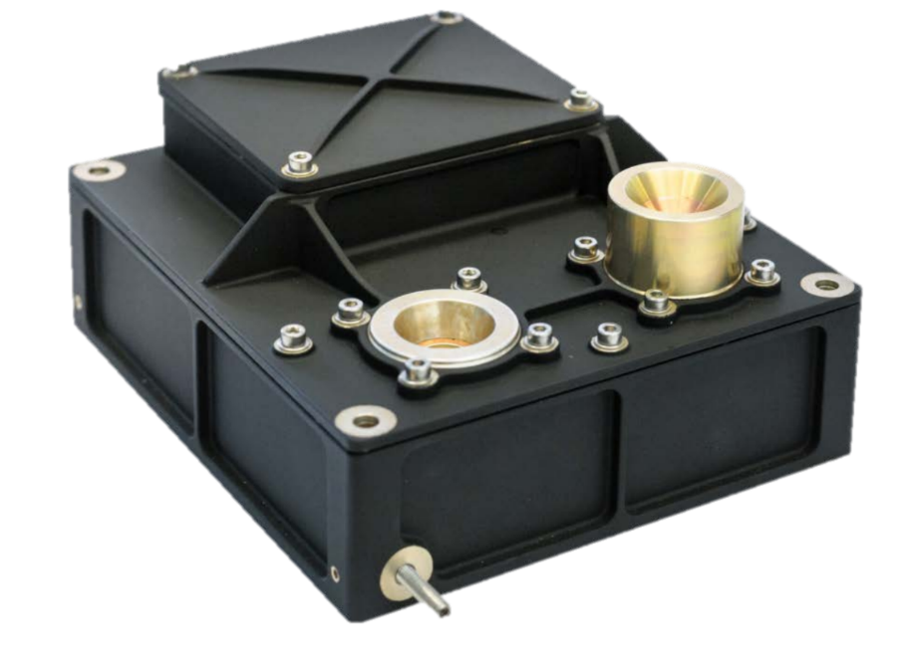
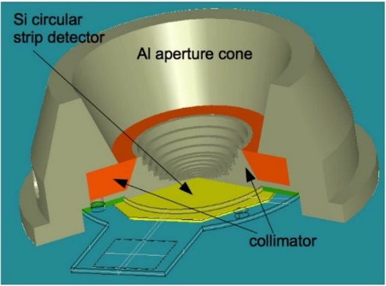
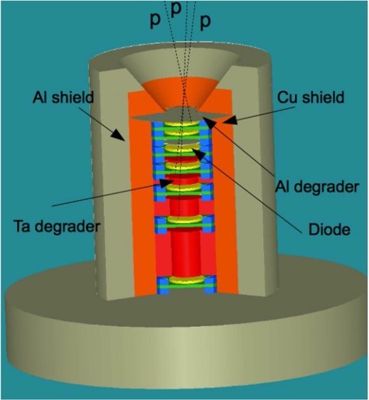
Instruments for measurements in LEO
EPT (Energetic Particle Telescope)
Mass: 4.6 kg
Consumption: 5.6 W
Next Generation Radiation Monitor (NGRM)
Mass ~ 1 kg
Consumption ~1-2 W
ICARE-NG:
Mass: 2.4 kg
Consumption: 3 W
Notes:
These devices need shielding and since protons have to penetrate several layers they also come with a relatively low field of view.

Slide 14
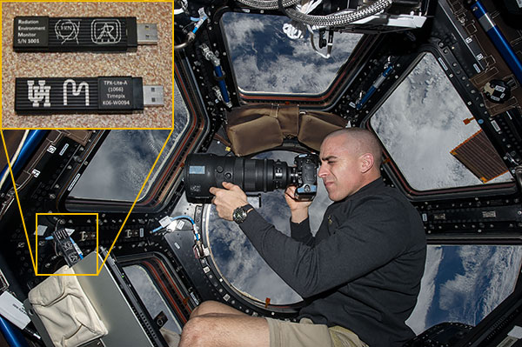
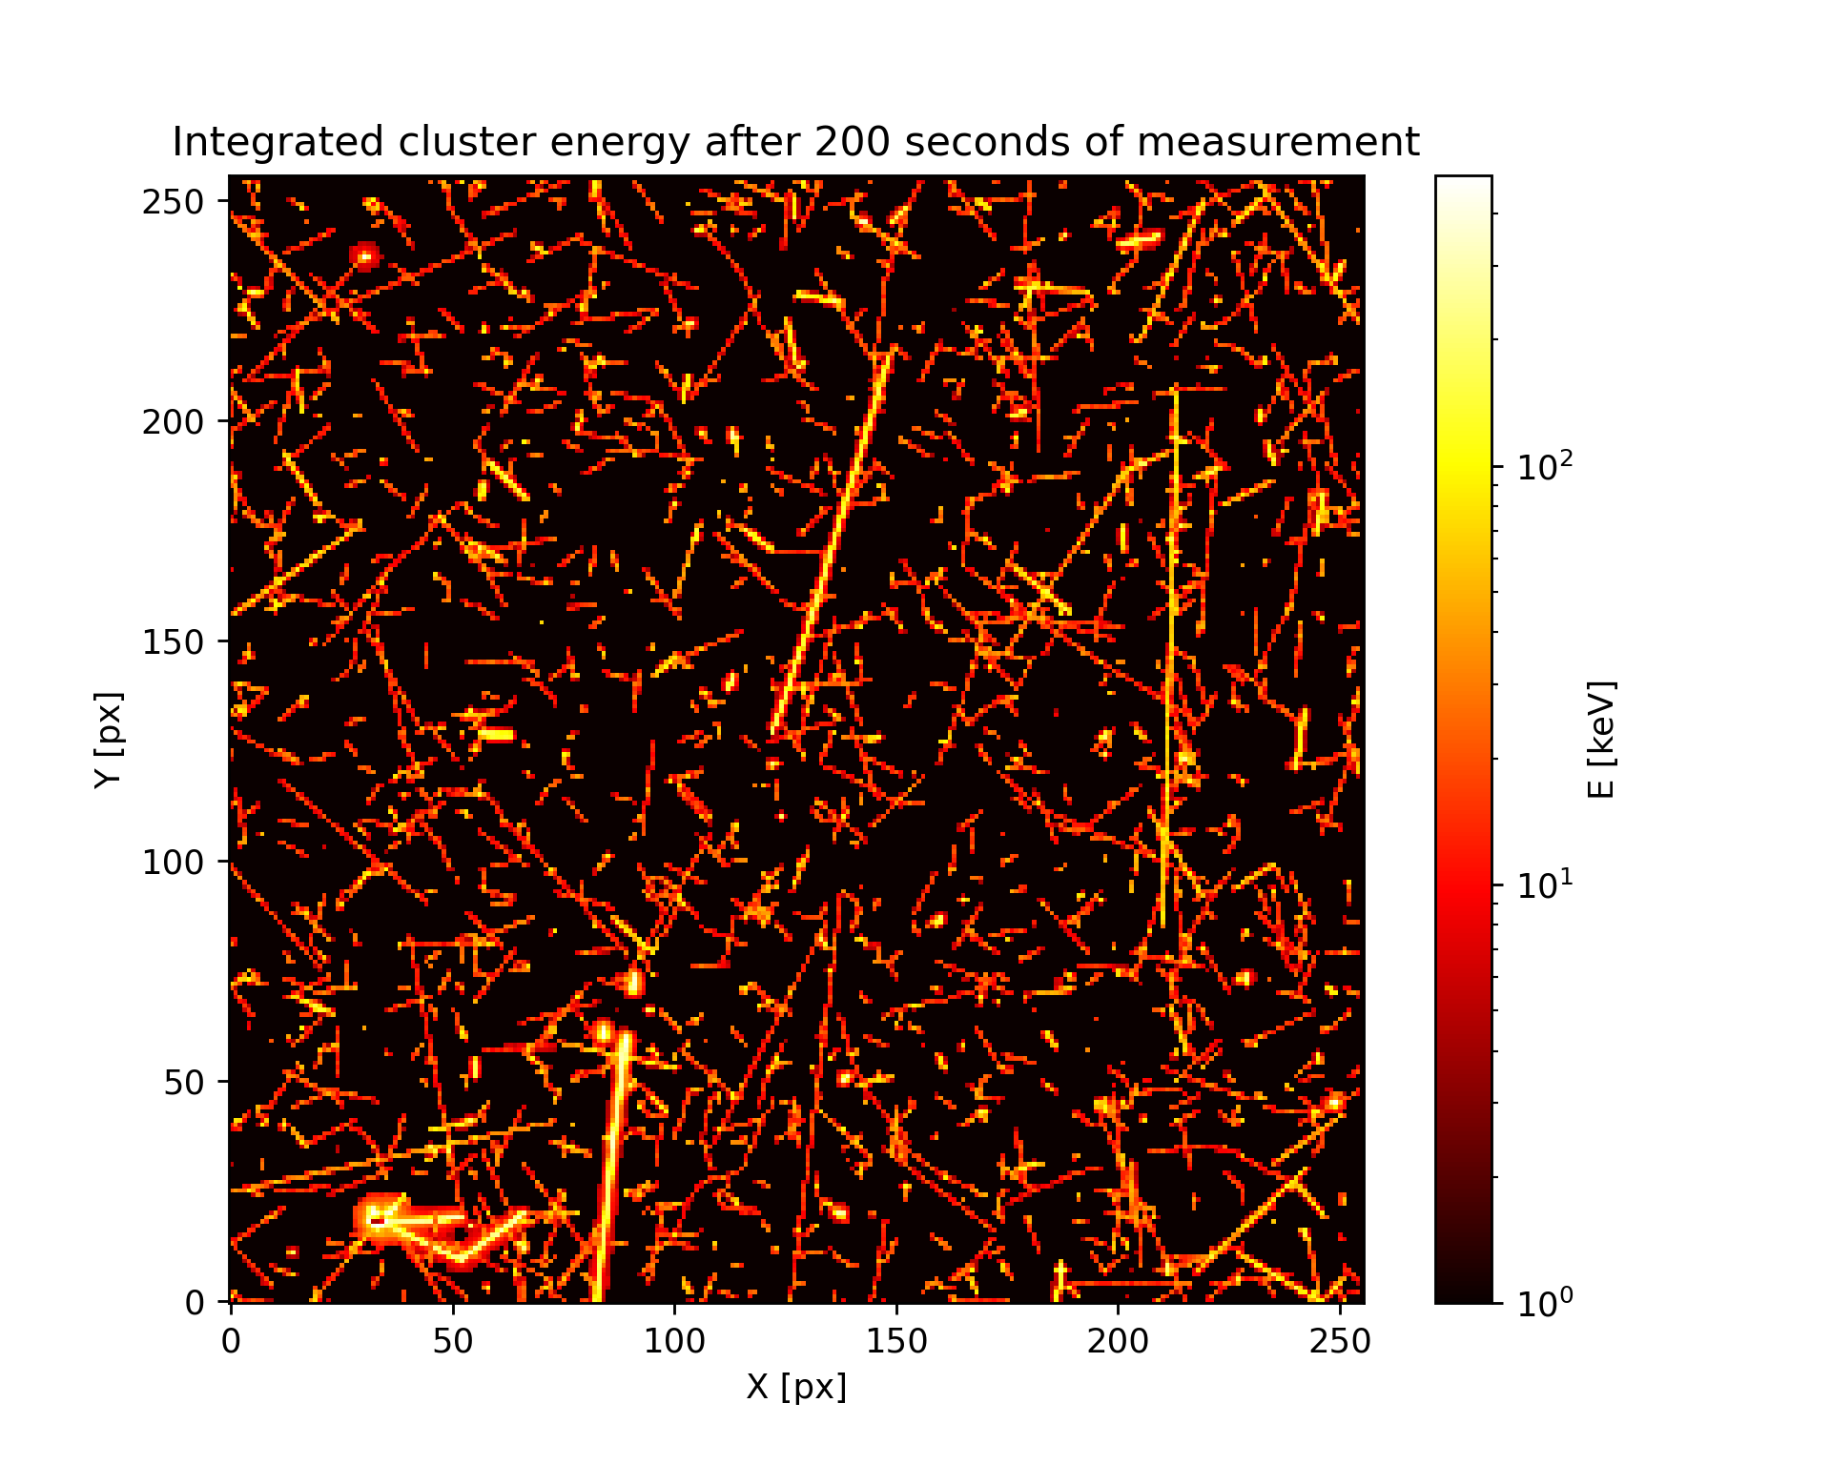
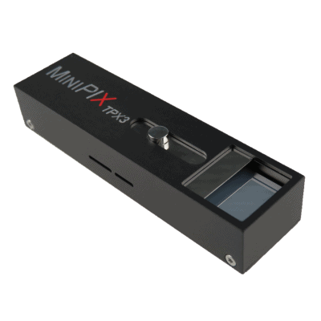

Timepix devices in Space
Single-layer particle discrimination
Small dimensions and low mass
Large field of view
Current missions (chronologically sorted):
REM on ISS (since 2012: different versions; MiniPIX TPX3 by Advacam deployed in 2021)
SATRAM on Proba-V (launch in 2013, 820 km)
LUCID-Timepix (2014-2017, 635 km)
VZLUSAT-1 (launch in 2017, 510 km)
RISESAT (launch in 2019, 500 km)
VZLUSAT-2 (launch in 2022, 500 km, CdTe 2 mm)
Space radiation in LEO measured by TPX3, integrated frame, 200 s, energy display
Minipix TPX3 and shielding by ADVACAM
*
First deployment of TPX3 detector in space
Notes:
The key advantage of Timepix is that if provides particle species separation by track analysis in single layers.
This allows a production of radiation monitors with small dimension and low mass, while providing a large field of view and a large dynamic range.
The first Timepix in Space was in 2021 the USB lite on ISS, which was then soon followed by SATRAM which was the first Timepix deployed in open space.

Slide 15



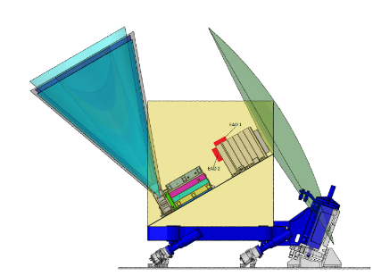
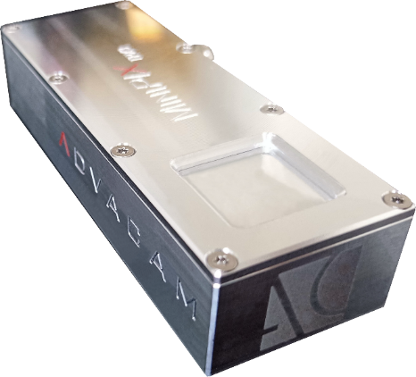
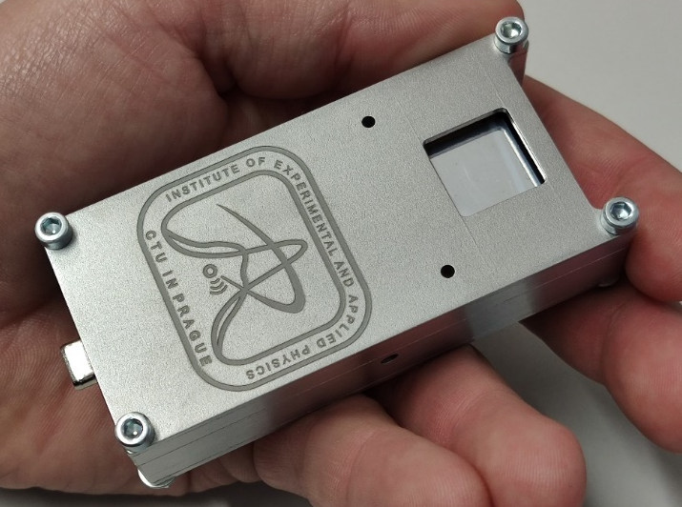
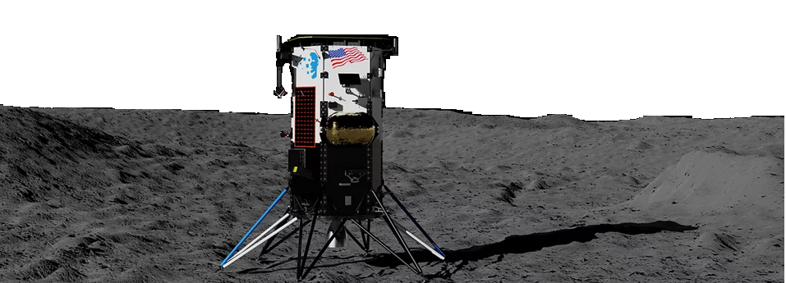

(Near future) flights
*⁾ St. Gohl et al., “A Miniaturized Radiation Monitor for Continuous Dosimetry and Particle Identification in Space“, JINST 17 C01066 (2022).
MIRAM (Miniaturized Radiation Monitor)*⁾
GOMX-5 cubesat mission (12U, 20 kg) – 2023
2 Modules outside of the Lunar Gateway as a part of the ESA ERSA (European Radiation Sensors Array) – 2024
Scientific payload for ASE EL3 rover (neutron spectrometer for water mapping on the moon)
MiniPIX TPX3:
IM Nova-C lunar landing module, carried by a SpaceX Falcon 9 rocket 2022/23 (Minipix Timepix3 will measure during the entire duration of the mission)
2x Minipix TPX3 silicon sensor with hardened shielding and space RO port by ADVACAM
Two detector units
Nova-C lunar landing module by Intuitive Machines

Slide 16
C. Granja et al., “The SATRAM Timepix spacecraft payload in open space on board the Proba-V satellite for wide range radiation monitoring in LEO orbit”, Planetary and Space Science 125, pp. 114-129, ISSN 0032-0633 (2016).
https://doi.org/10.1016/j.pss.2016.03.009
Timepix
256 x 256 pixels
pixel pitch 55 µm
Energy measurement in each pixel
Sensor: Si 300 µm
SATRAM
Space Application of Timepix Radiation Monitor
Notes:
I would like to discuss results achieved with SATRAM and provide some details about the analysis methodology used.

Slide 17
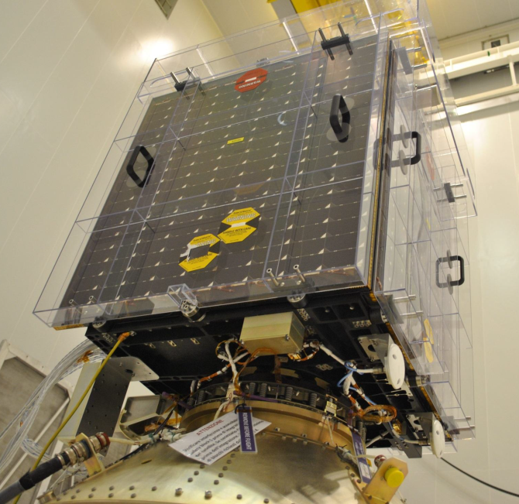
SATRAM:
Space Application of Timepix Radiation Monitor
First Timepix in open space
Power consumption of 2.5 W
Total mass 380 g (107 x 70 x 55 mm)
SATRAM is a platform technology demonstrator
Proba-V
Minisatellite (158 kg)
Altitude ~ 820 km (LEO)
101.21 minutes orbit duration
Inclination 98.6°
Sun-synchronous
Launched 7th March 2013
Notes:
Proba-V ans SATRAM was lauchned 2013. Since then and up to now we are getting high quality data..

Slide 18
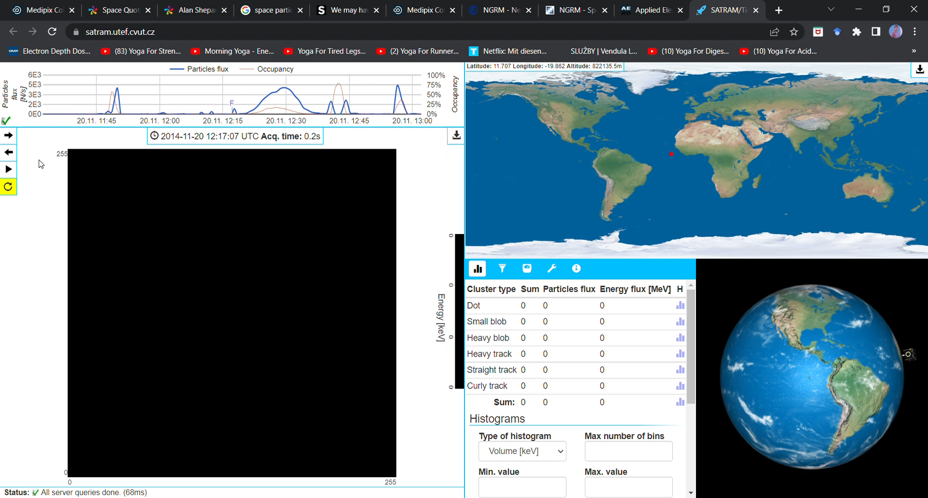
https://satram.utef.cvut.cz/
Notes:
I would like to show you how the data we are analysing look like

Slide 19
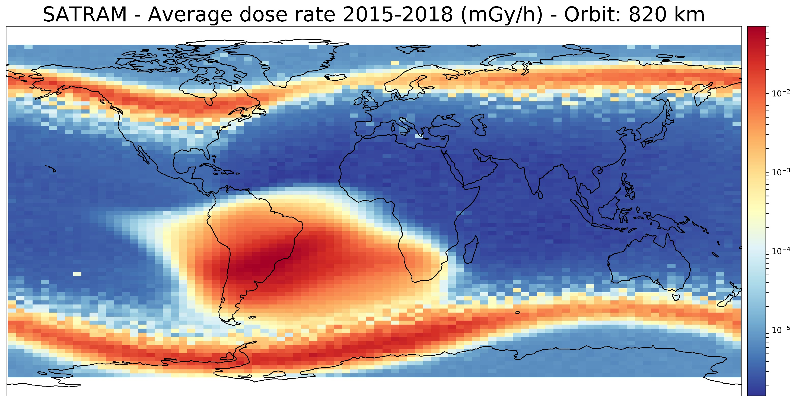
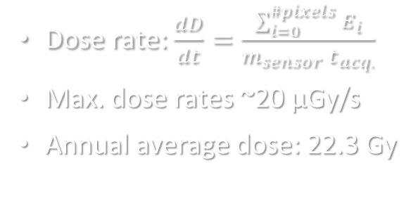
Dose rate: $\frac{dD}{dt}=\frac{\sum_{i=0}^{\#pixels}{E_{i}}}{m_{sensor} t_{acq.}}$
Max. dose rates ~20 µGy/s
Annual average dose: 22.3 Gy
Notes:
You can see there the typical structures which are the polar horns (outer belt) and the SAA (inner belt)

Slide 20
Solar proton event
September 10, 2017
Reference period
SPE - Sept. 2017
Notes:
The belt structure reacts to Solar Proton Events. Enhanced dose rate in the polar region.

Slide 21
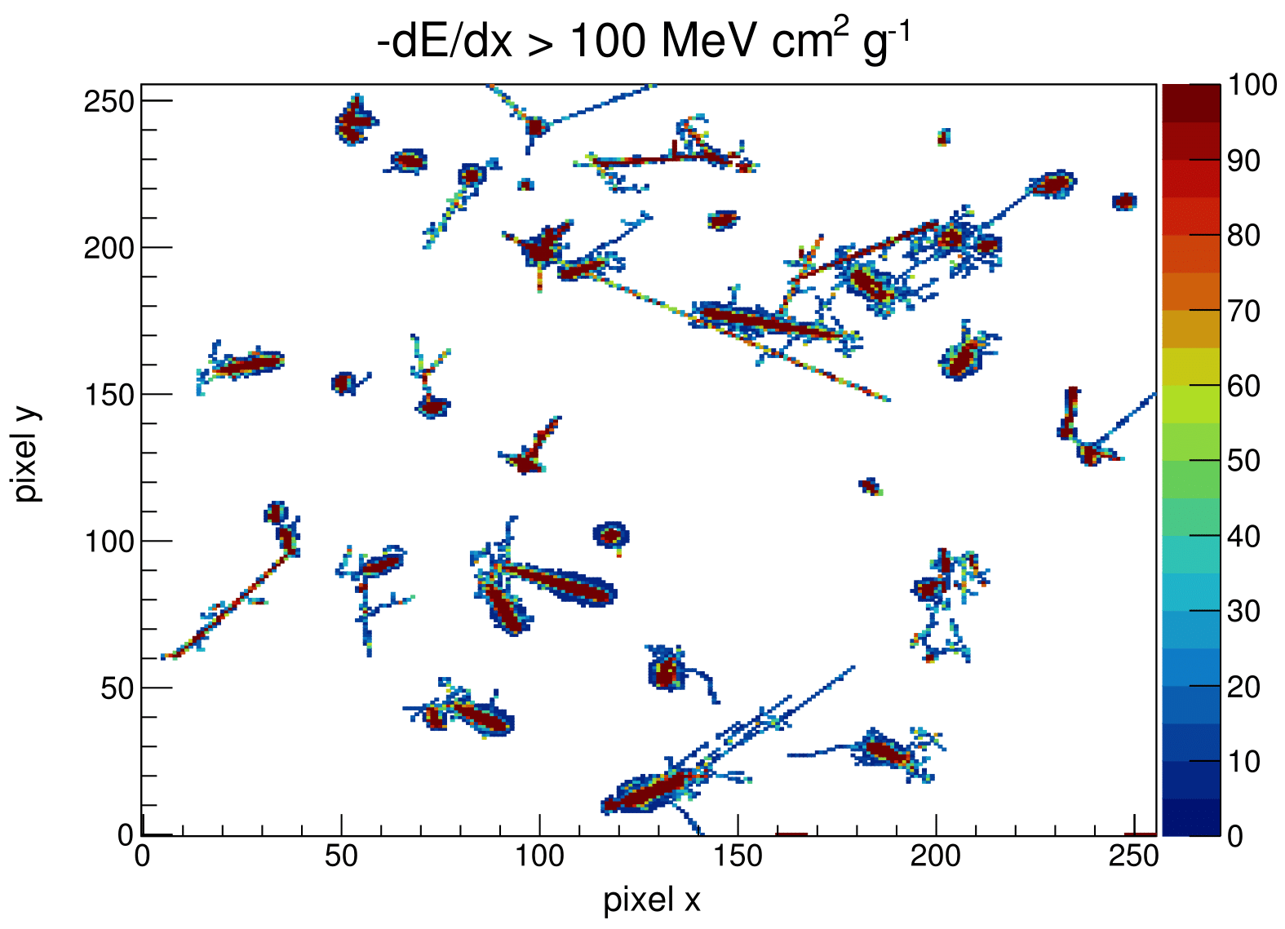
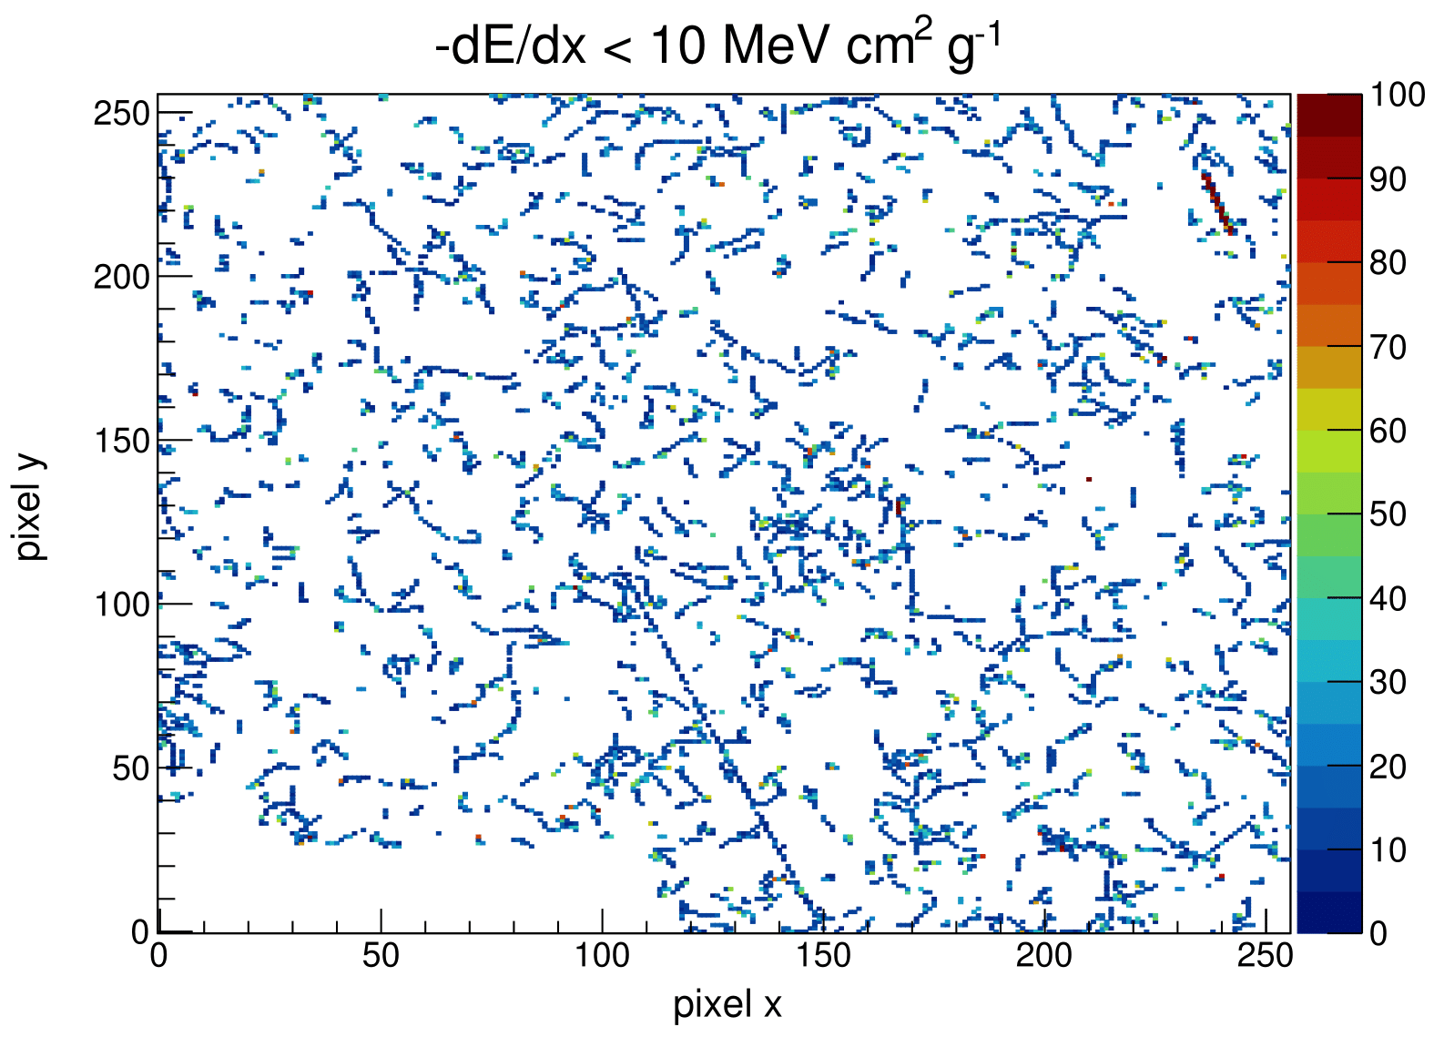
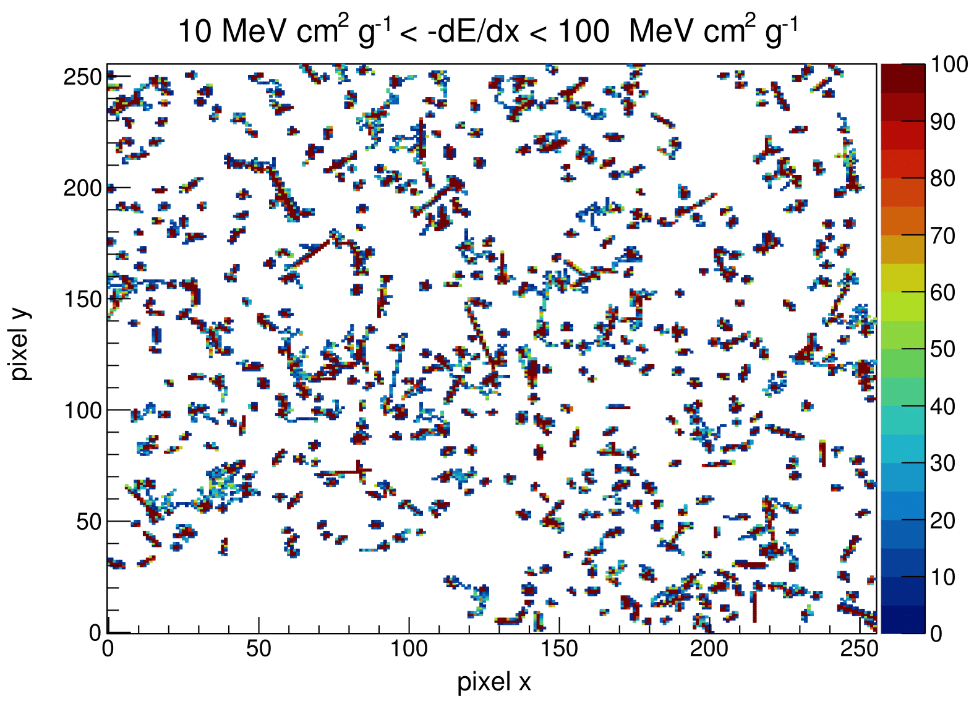
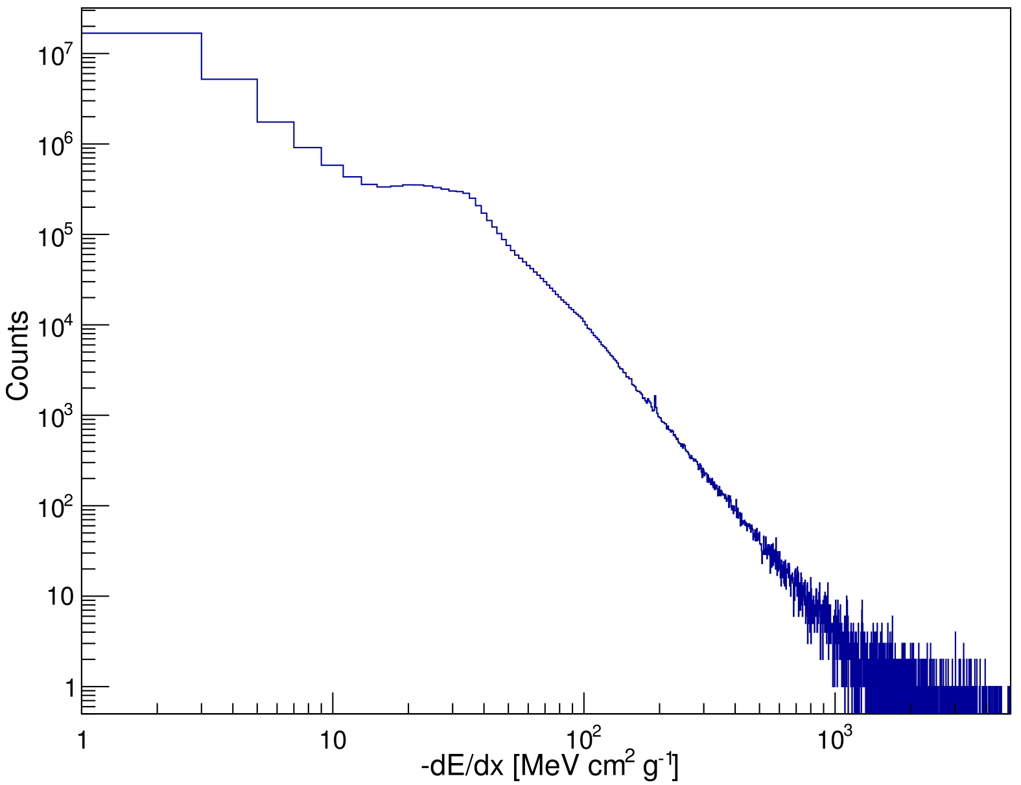
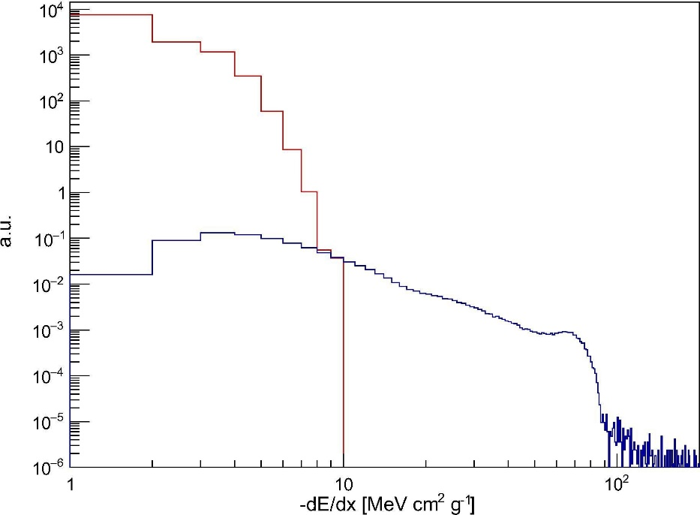
dE/dX and particle classification
Simulation
e⁻
e⁻
p⁺
p⁺
St. Gohl et al., “Study of the radiation fields in LEO with the Space Application of Timepix Radiation Monitor (SATRAM)”, Advances in Space Research 63, Issue 5, pp. 1646-1660, (2019).
HZE

Slide 22
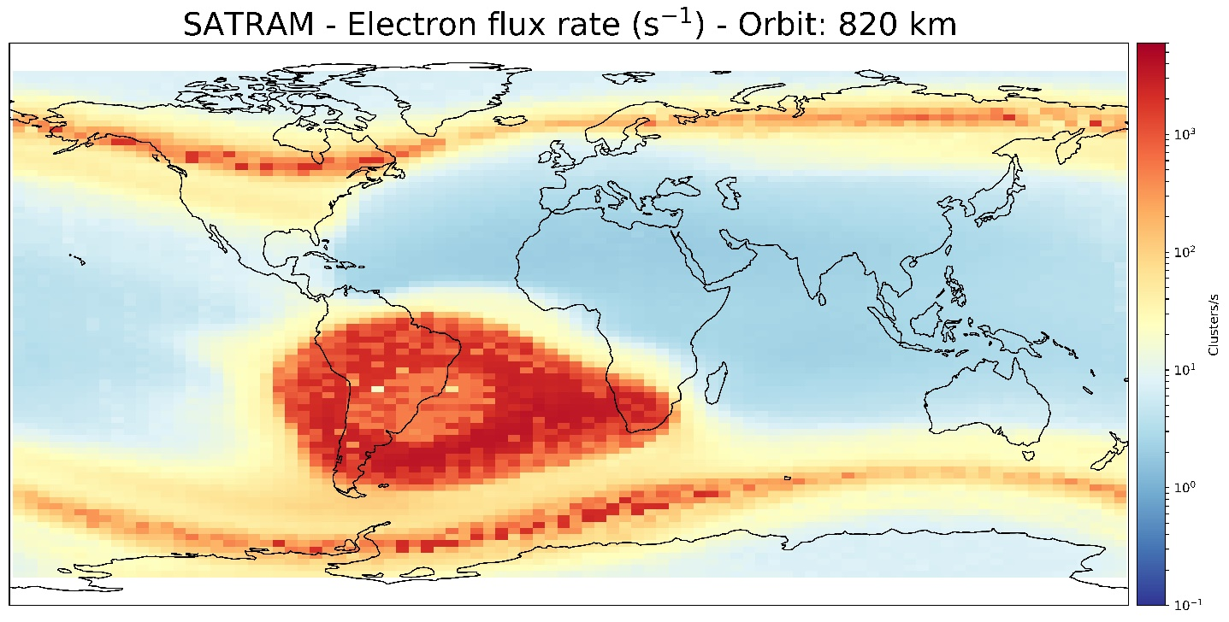
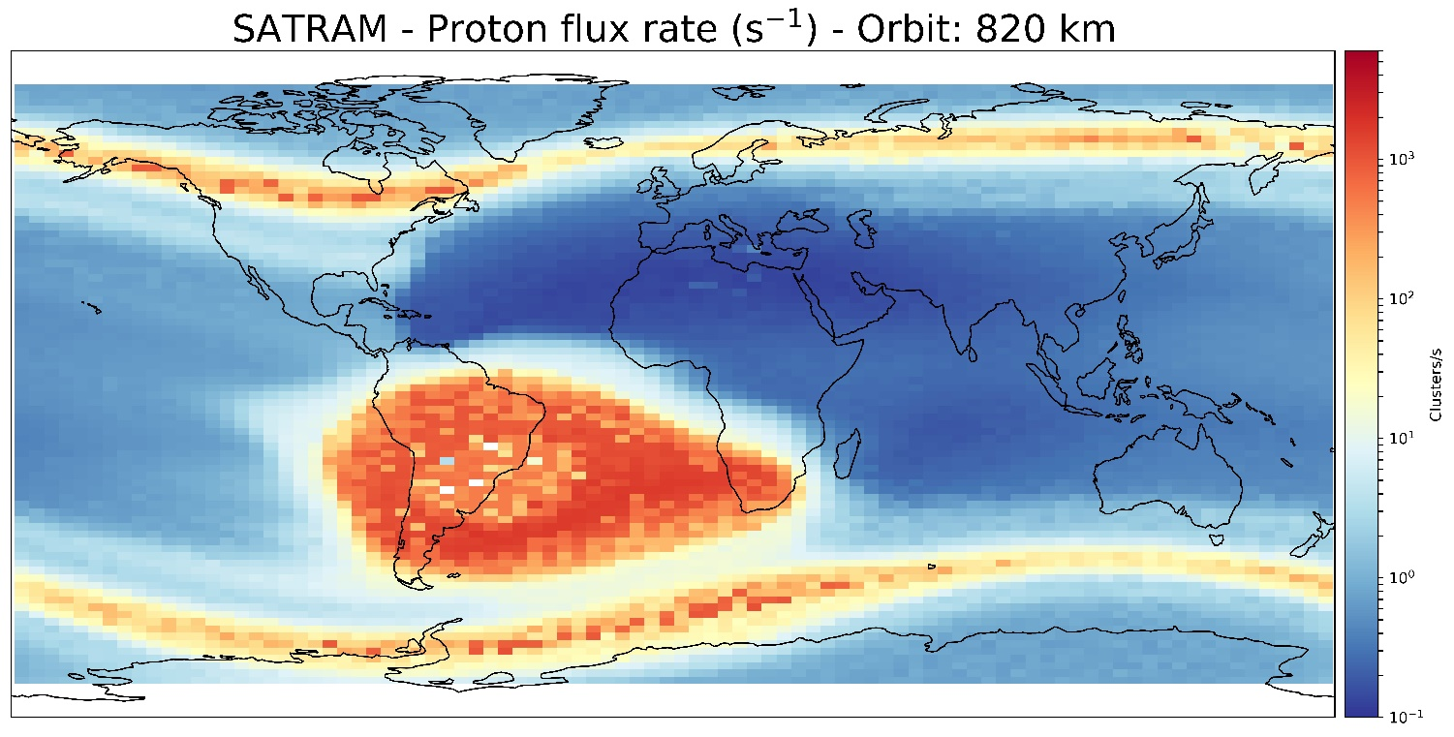
Average electron and proton flux rates for 2015-2018
St. Gohl et al., “Study of the radiation fields in LEO with the Space Application of Timepix Radiation Monitor (SATRAM)”,
Advances in Space Research 63, Issue 5, pp. 1646-1660 (2019).
For the analysis only frames whith an occupancy of less than 20% and t_{acq}>= 0.2 s were selected
Less track overlap
Proper particle identification
Occupancy and frame-length cuts strongly reduced available frames in SAA
Notes:
Overall electron fluxes are at least one order of magnitude higher than proton. Fluxes
We said that we can only provide proper dE/dX assignment if the frame occupancy was less than 20% and with an acquisition time of <=0.2 we find very little frames in the center of SAA.
There should be no protons in the outer belts. Polar horns. → Misinterpreted electrons

Slide 23
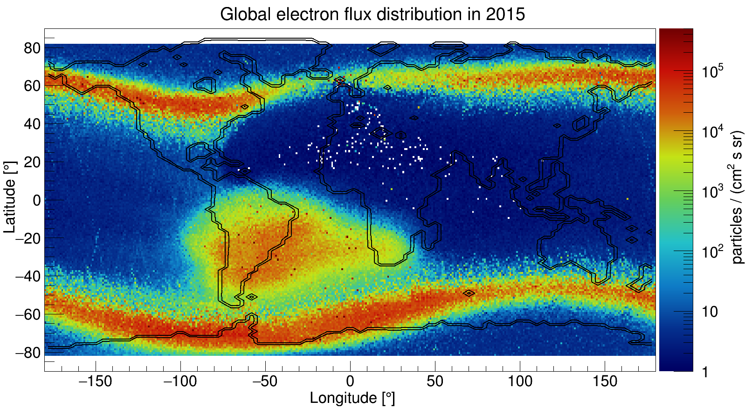
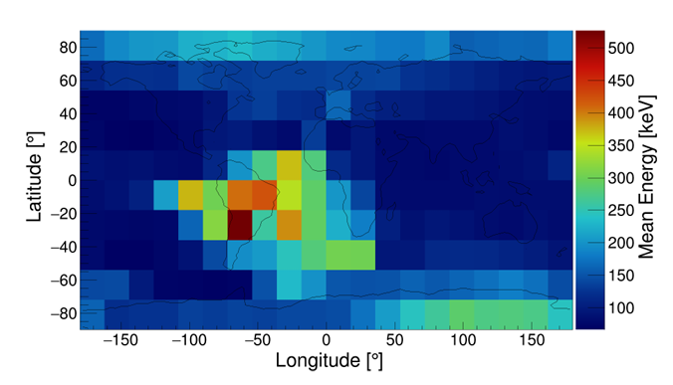
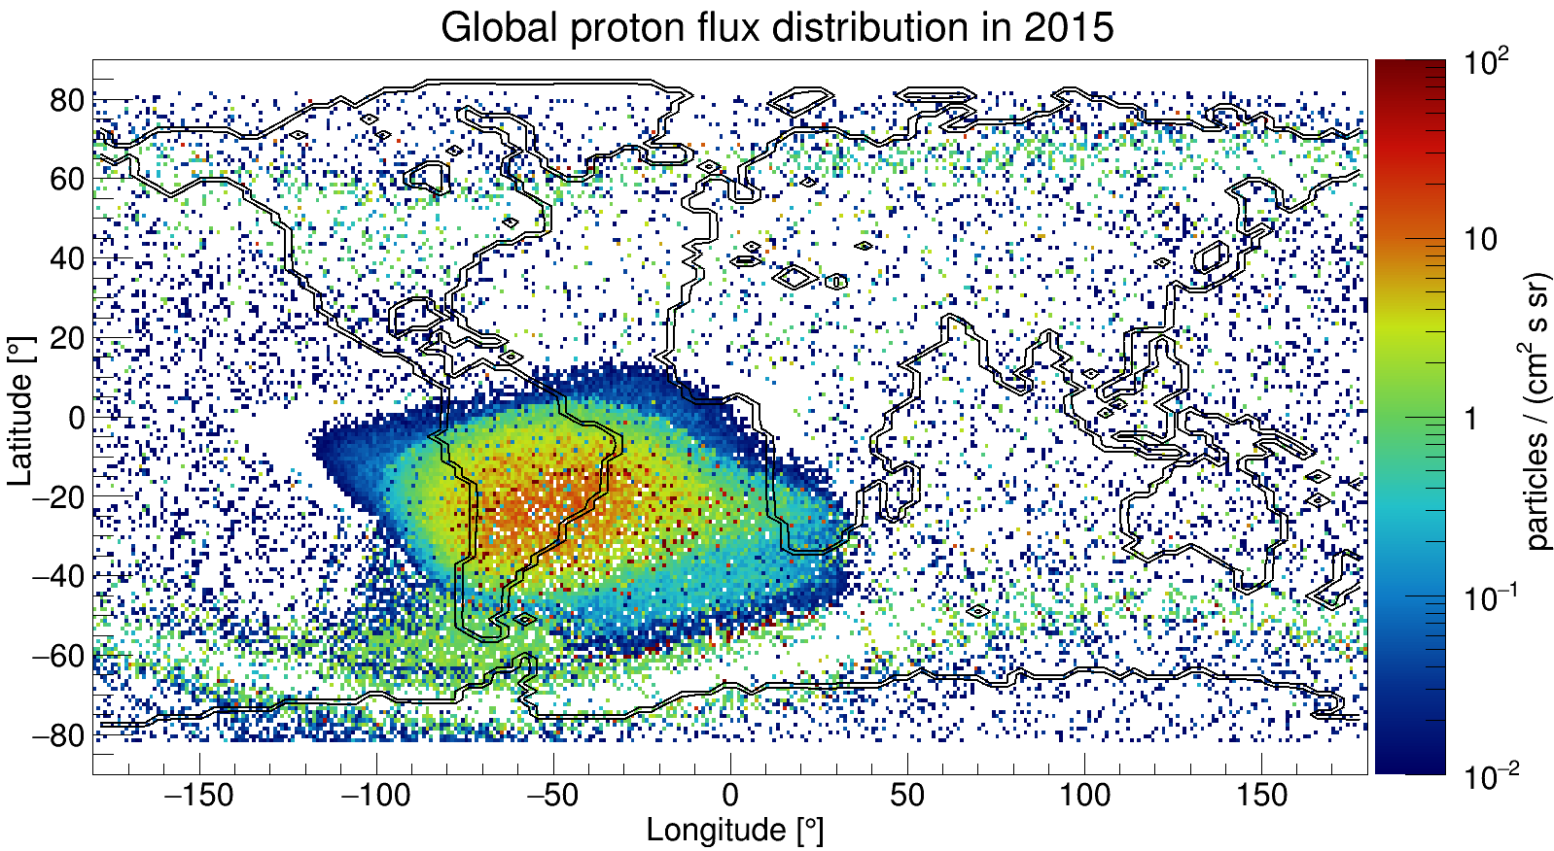
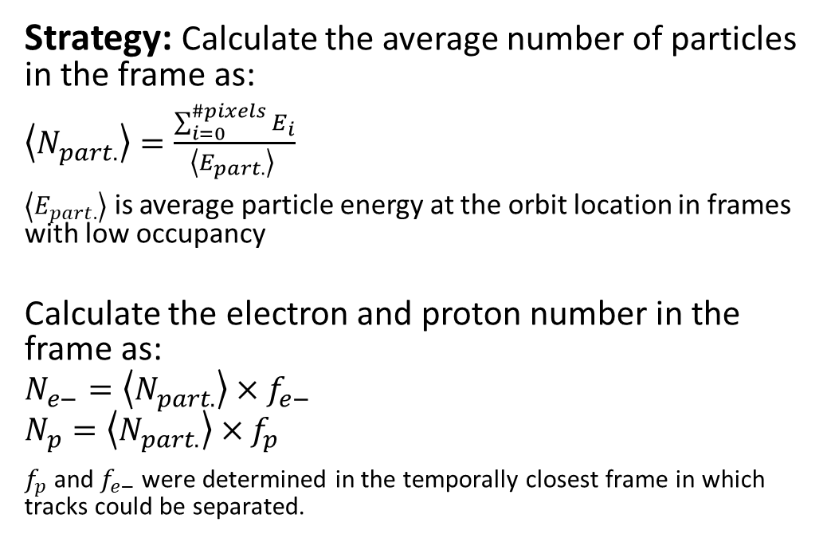

SATRAM electron flux measurement:
Interpolation method based on statistical consideration
$$\left\langle E_{part.}\right\rangle$$
Strategy: Calculate the average number of particles in the frame as:
$\left\langle N_{part.}\right\rangle =\frac{\sum_{i=0}^{\#pixels}{E_{i}}}{\left\langle E_{part.}\right\rangle }$
$\left\langle E_{part.}\right\rangle$ is average particle energy at the orbit location in frames with low occupancy
Calculate the electron and proton number in the frame as:
$$N_{e−}=\left\langle N_{part.}\right\rangle ×f_{e−}$$
$$N_{p}=\left\langle N_{part.}\right\rangle ×f_{p}$$
$f_{p}$ and $f_{e−}$ were determined in the temporally closest frame in which tracks could be separated.
Notes:
Check the value!!!

Slide 24
Improving particle identification and spectroscopy using machine learning
Notes:
Ok. So far so good, but can’t we do better, e.g. using neural networks.

Slide 25


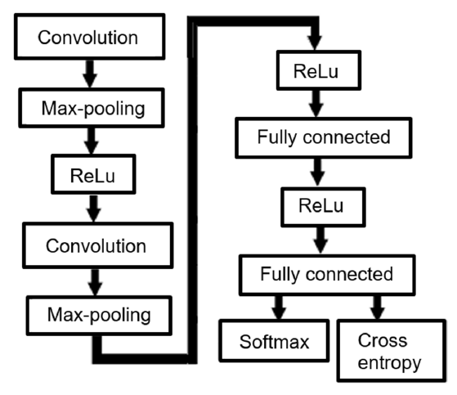
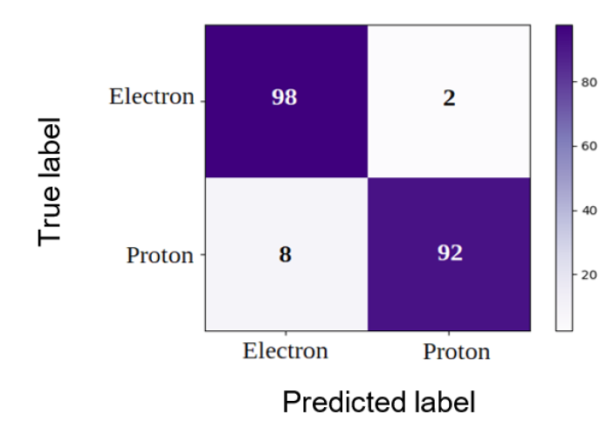
CNN – convolution neural network for separation of electrons and protons
Ground truth - simulation:
Spherical source with cosine distributed angles
10 Mio electrons from 0.4 to 5 MeV
10 Mio protons from 17 to 200 MeV
M. Ruffenach et al., “A new technique based on convolutional neural networks to measure the energy of protons and electrons with a single Timepix detector”, in IEEE TNS, 68, 8, pp. 1746-1753, (2021). doi: 10.1109/TNS.2021.3071583
Notes:
At the end of the 50 epochs, the accuracy of the training set is about 95.35% and the accuracy of the validation set is about 96.06%.
Normalized confusion matrix.
Here a nice study was done by Marine from CNES / Onera! As ground truth, she simulated 10 Mio electrons in the relevant energy range and the same amount of protons.
Electrons were identified correctly in 98% while 92% were identified correctly.

Slide 26
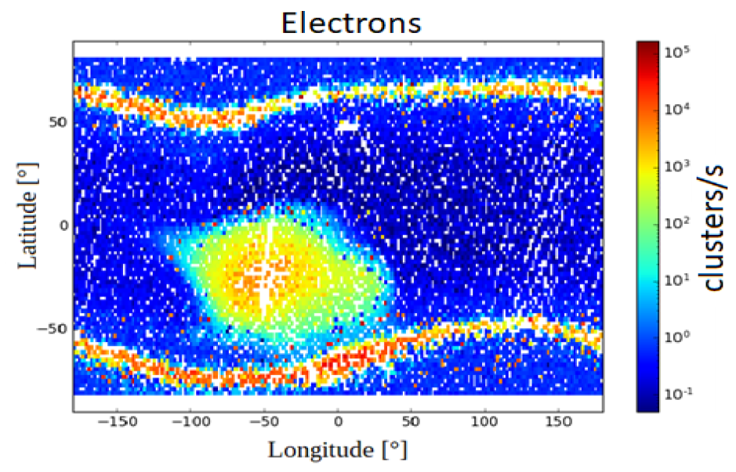
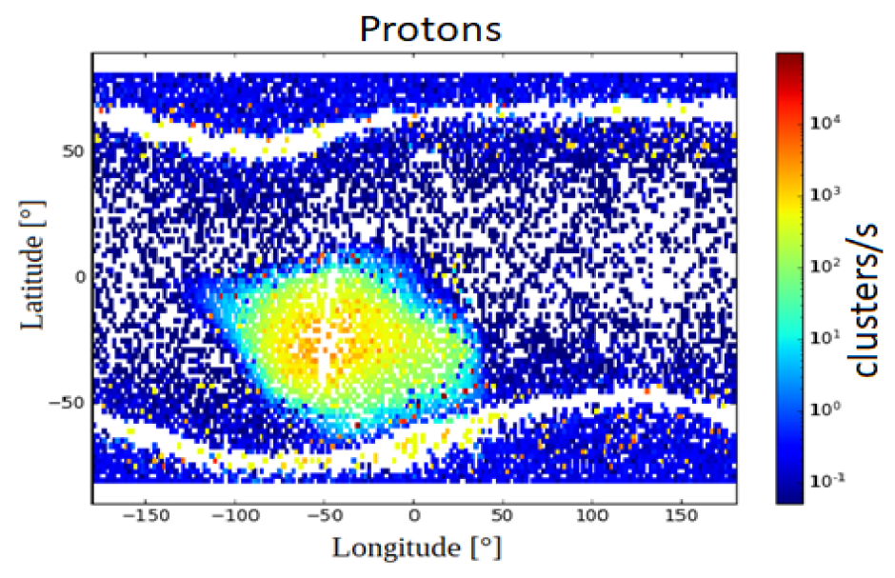
CNN – convolution neural network for separation of electrons and protons
M. Ruffenach et al., “A new technique based on convolutional neural networks to measure the energy of protons and electrons with a single Timepix detector”, in IEEE TNS, 68, 8, pp. 1746-1753, (2021). doi: 10.1109/TNS.2021.3071583
Notes:
The in-orbit maps of this study are seen here … They confirm the results seen with the analytical model with statistical interpolation.

Slide 27
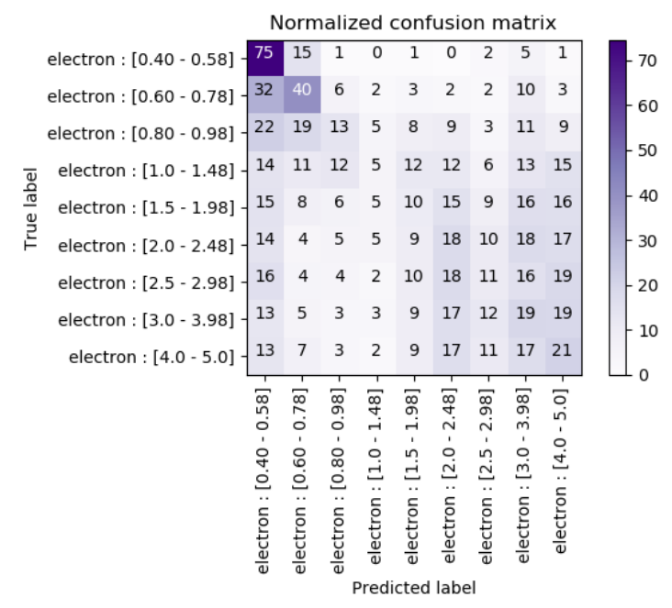
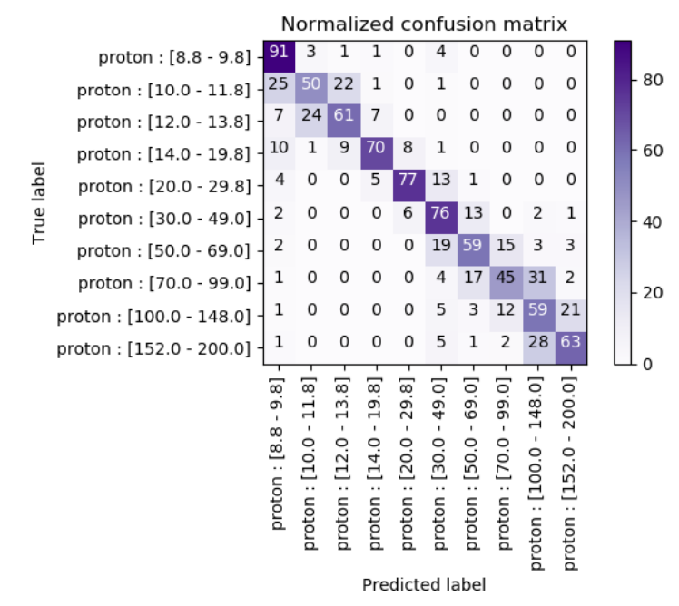
CNN – convolution neural network for incident energy determination
Particle spectroscopy capability is key for improvements of models in space physics
Proton incident energy determination with reasonable accuracy
Electron incident energy determination was not possible with good accuracy
Use e.g. stopping filters defining different regions on the sensor and do statistical analysis
Notes:
In a next step the question was whether such a network would also be able to determine the imping particle energy. Therefore the electron and proton categories were divided into energy bins. The resulting normalized confusion matrices are shown here. While for protons a crude energy separation could be achieved , there is no sensitivity to the electron spectrum.

Slide 28
Comparison with other radiation detectors in LEO

Slide 29
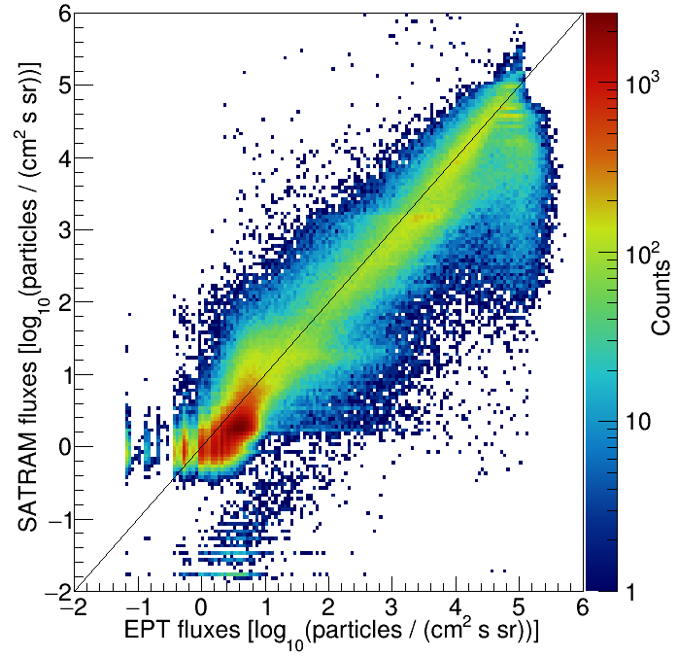
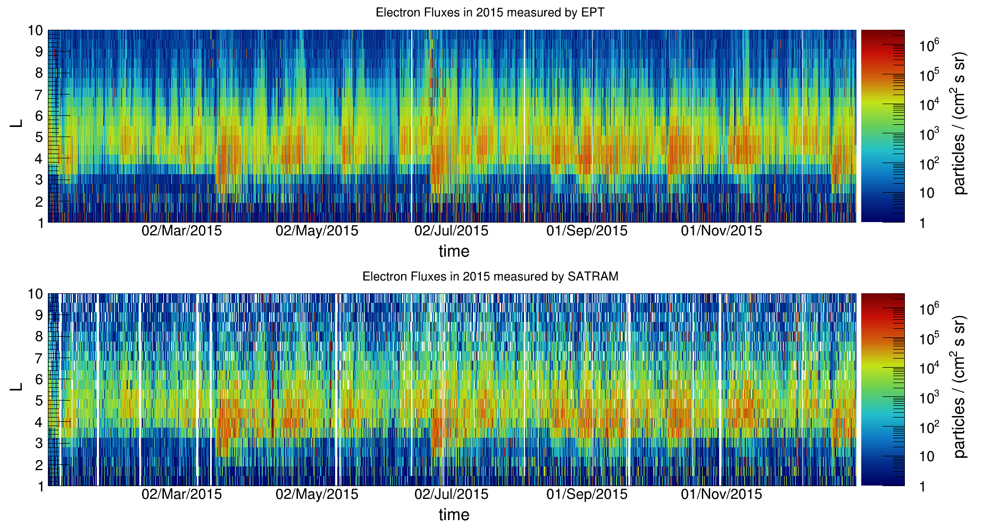
SATRAM vs. EPT (Energetic Particle Telescope)*⁾:
Electron fluxes
*⁾ EPT and SATRAM are both on Proba-V.
60 seconds integration time
Notes:
Electron energy spectra as a function of time and the L-parameter;
Binning 60 s

Slide 30
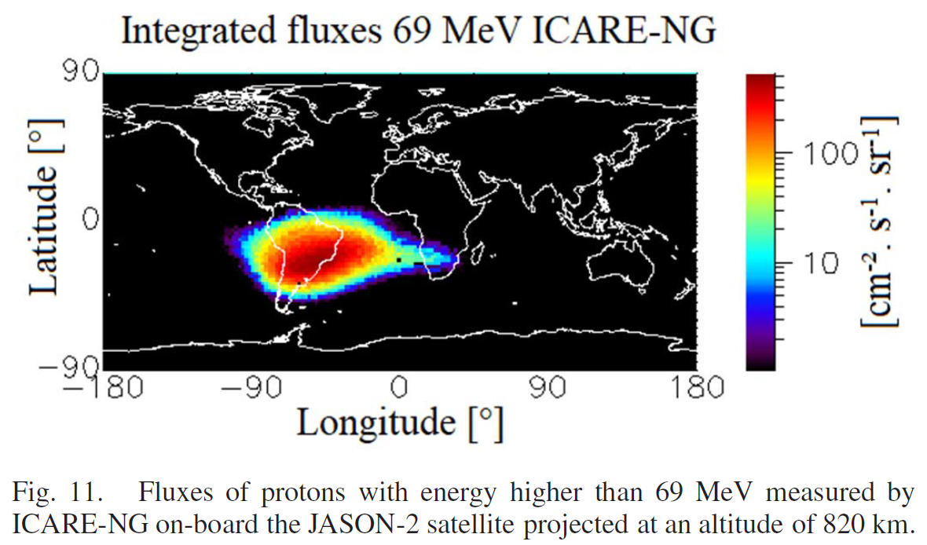
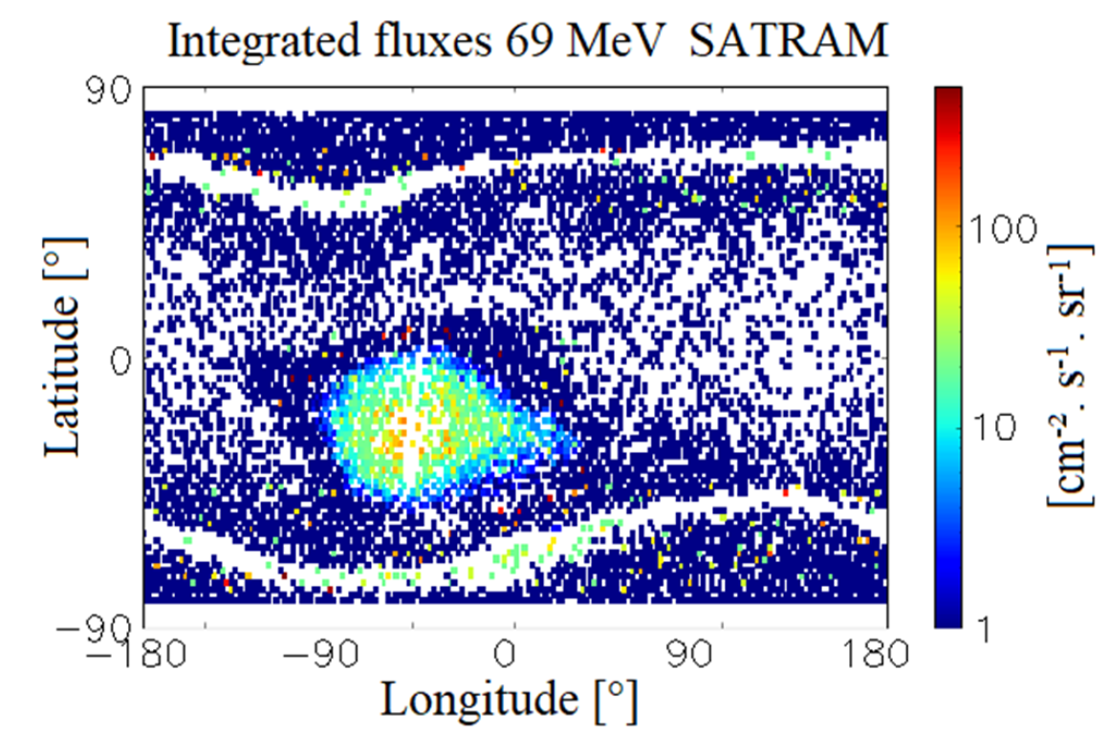
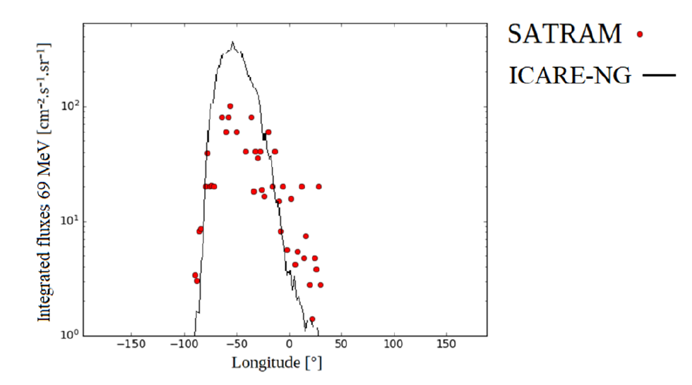
SATRAM vs. ICARE-NG:
Proton fluxes
Latitude = -30°
M. Ruffenach et al., “A new technique based on convolutional neural networks to measure the energy of protons and electrons with a single Timepix detector”, in IEEE TNS, 68, 8, pp. 1746-1753, (2021). doi: 10.1109/TNS.2021.3071583

Slide 31




Development of a demonstrator penetrating particle analyzer (mini.PAN) for deep space missions
This project has received funding from the European Union's Horizon 2020 research and innovation programme under grant agreement No 862044.
X.Wu et al., Penetrating Particle ANalyzer (PAN), Adv. Space Res. 63, 8, 2672-2682 (2019) https://doi.org/10.1016/j.asr.2019.01.012
http://www.pan-space.eu/

Slide 32
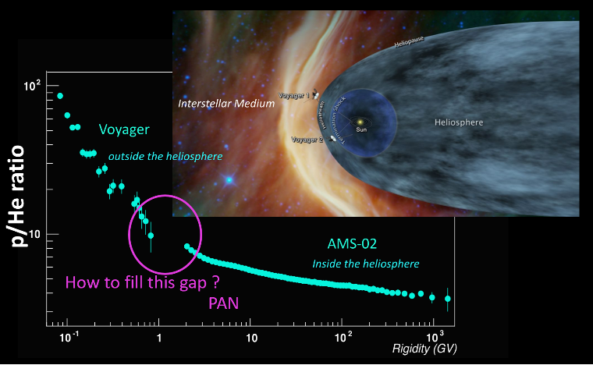
Scientific objectives
  Precisely measure and monitor flux, composition, and direction of penetrating particles ( up to ~20 GeV/nucleon)
Galactic cosmic ray (GCR) physics:
Understand origin, acceleration mechanisms and propagation properties
Antimatter content
Dosimetric aspect:
GCR major source of dose for astronauts on (interplanetary) missions

Slide 33
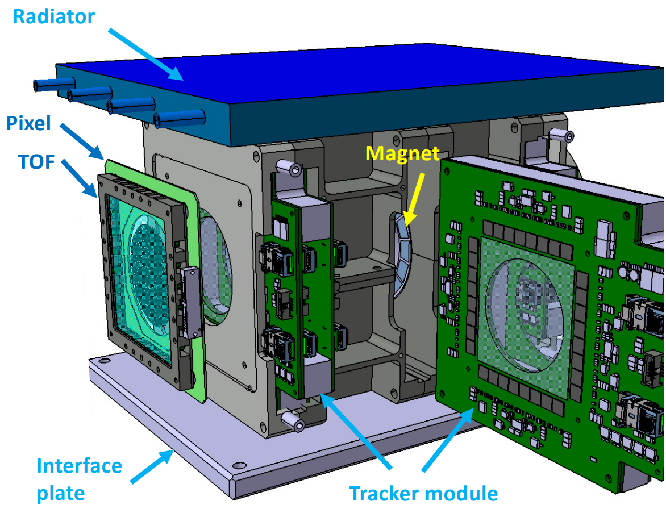
Conceptual design
Expected performance:
Magnetic spectrometer:
2 magnet sectors in Halbach geometry 0.4 T
3 Tracker modules with 3 layers of strip detectors
  2 StripX (bending direction) – pitch: 25 µm
  1 StripY – pitch: 500 µm
2 Pixel modules
  Timepix3 quad (262,144 pixels, pitch: 55 µm)
2 ToF modules (time resolution < 100 ps):
  Scintillators (EJ230) coupled with SiPMs
  Mini.PAN ~10 kg, ~20-30 W
Notes:
Many handles for particle ID: dE/dx, TOF, bending direction, cluster size, …
High TRL at the component level: all have been flown in space
Overall an energy resolution better than 30%.

Slide 34



Magnet sectors
Ring, aluminium
Permanent magnet block, NdFeB
120 mm
50 mm
Mapping the B-field strength

Slide 35








Tracking modules
Mapping the B-field strength
Notes:
Next steps will be the mechanical and electrical integration!

Slide 36


TOF module
Plastic scintillator coupled to SiPM
Time resolution is ~200 ps.
Mapping the B-field strength
Notes:
Next steps will be the mechanical and electrical integration!

Slide 37


Mechanics integration
SPS test beam setup
Pixel module integration

Slide 38

Electronics integration
Preparation of a common readout system after mission requirements are known
Mapping the B-field strength

Slide 39
Penetrating particle analyzer based on Timepix4 - Pix.PAN

Slide 41



Pix.PAN:
Performance considerations and Timepix4
Mini.PAN with 3 tracking station consisting of 2 Timepix4 quads as sensing element
Significant simplification of mini.PAN
Add high rate capability
Self-triggered operation in data-driven mode
5D vector ($\overset{⃑}{x}$,$t$,$\frac{dE}{dX}$) with $∆t<200$ ps in each station
Requirements/challenges:
Thin sensor and ASIC (total thicknesss < 400 µm)
Synchronization of 24 Timepix4 with low jitter
Desired power consumption < 20 W (vs 60 W)
Bending direction spatial resolution needed is < 5µm (vs current Timepix4 baseline design 16 µm)
(optional)

Slide 42

Pix.PAN:
Rectangular pixel design as solution?
Pitch in non-bending direction is not crucial for particle kinetic energy determination
Use asymmetric “long thin“ pixels with a “pitch adapter“ for oversampling in one direction and connect only 1/8 pixels!
Pixel 13.75 x 1760 µm - creates a matrix of 8224 in bending by 56 pixels in non-bending direction with $dx=3.7$ µm
Power comsumption reduced to ~25 W. Further reduction by explointing chip configurations (operation at reduced clock, ... )
32 Timepix4 pixels

Slide 43
Acknowlegdements
St. Gohl, M. Kaplan, S. Pospisil, M. Ruffenach, X. Wu
Advacam s.r.o. (L. Marek, J. Jakubek, C. Granja)
PAN collaboration
Medipix collaborations

Slide 44
Conclusion and outlook
The Timepix detector‘s capability of single-layer particle tracking and particle species separation allows production of competitive radiation monitors with one order of reduction in mass
Future development should focus on improving
  Resource-efficient algorithms for on-board processing and data compression
  Electron and proton spectroscopy
Latest generation of Timepix detectors could be the baseline for particle spectrometers for astroparticle physics

Slide 45
Thank you for your attention!

Slide 46
Back up

Slide 47

SAA
Mauk, B.H., Fox, N.J., Kanekal, S.G. et al. Space Sci Rev (2013) 179: 3.
Notes:
ISS astronauts get ~50% of their radiation dose in the SAA, other 50% from GCR
Particles are trapped by the earth magnetic field …
In the LEO radiaation environment, we find mainly electrons and protons, which are „trapped“ in the earth magnetic field and form 2 radiation belts. The so-called Van-Allen belts.
The outer belt consists of electrons which spiral around the magnetic field lines until they come clos to the polse where bounce back.
In the inner belt there is a mixed radiation field of electrons and protons.

Slide 48





Slide 49
Steady flux of Galactic Cosmic Rays
98% Baryonic component
87% protons
12% alpha-particles
1% heavy ions (Z > 2)
2% Leptons (electrons and positrons)
Galactic cosmic ray flux modulated by solar activity

Slide 50
Hybrid pixel detectors of Timepix technology and their application in particle physics and space
Benedikt Bergmann
Institute of Experimental and Applied Physics, Czech Technical University
benedikt.bergmann@utef.cvut.cz

Slide 51
Medipix collaboration(s)
https://home.cern/news/news/knowledge-sharing/first-3d-colour-x-ray-human-using-cern-technology
https://medipix.web.cern.ch/collaborations
Founded in 1999 to bring technology developed for high energy physics to biomedical applications ...
https://insightart.eu/
MARS Bioimaging Ltd..
The Medipix technology is one of CERN’s most successful knowledge transfer cases. Each collaboration has triggered a significant number of commercial activities in widely differing application areas.
https://medipix.web.cern.ch/index.php/news/news/timepix/cern-technology-helps-rediscover-lost-painting-raphael

Slide 52

Working principle:
Detector response to ionizing radiation
Electrons:
Photons produce electrons through
Photoelectric effect
Compton-effect
(Pair production)
2D projections of ~60 keV photons from ²⁴¹Am-source.
835 keV electrons (“curly tracks“)
Energy spectrum of a ²⁴¹Am-source.

Slide 53
Working principle

Slide 54

Working principle:
Detector response to ionizing radiation
Charged particles: Energy loss per unit track length -dE/dX is described by the Bethe-Bloch formula.
Below: 75 GeV/A argon ion track passing through a 1 mm thick silicon sensor layer.
δ-ray
Above: 1 GeV/A carbon ion track passing through a 1 mm thick silicon sensor layer.
Increased energy deposit in the medium at the end of its range (Bragg-Peak) - 350 MeV/A He track.

Slide 55



Working principle:
Energy deposition spectra of charged energetic particles
Energy loss of energetic charged particles described by Landau-Vavilov distribution with Gaussian smearing.
$$\frac{dE}{dX}=\frac{{dE}_{Z=1}}{dX}Z^{2}$$
Different track shapes observed in a mixed relativistic ion beam.
P. Smolyanskiy et al., ”Tracking and separation of relativistic ions using Timepix3 with a 300 µm thick silicon sensor”, JINST 16 P01022, 2021.
Notes:
Here I would like to show you the energy deposition spectra of penetrating charged particles.
Described by Landau distribution convolved with Gaussian.
Look at the spectrum measured in a mixe relativistic ion beam ... Here, the spectrum is a superposition of different landau functions.

Slide 56


Working principle:
3D reconstruction of particle tracks with Timepix3
+
-
-
-
z
Charge carrier drift motion:
+
-
+
-
-
-
+
e⁻ and h⁺ drift described by
$$v_{e }=−μ_{e} ×E\left(z\right)$$
$$v_{h }=μ_{h} ×E\left(z\right)$$
$μ_{e/h}:$ Mobility of e⁻/h⁺
+
-
-
+
+
-
+
-
+
-
+
-
+
+
+
-
+
+
+
+
+
+
-
-
+
+
+
+
+
-
+
+
+
t ~ 25 ns
t ~ 15 ns
t = 0 ns
Electric field parametrization:
Si: $\vec{E}\left(z\right)=\frac{U_{B}}{d}\vec{e_{z}}+\frac{2U_{dep}}{d^{2}}\left(\frac{d}{2}−z\right)\vec{e_{z}}$ ;
CdTe: $\vec{E}\left(z\right)= \frac{U_{B}}{d}\vec{e_{z}}$
$U_{B}:$ Bias voltage; $U_{dep}:$ Depletion voltage; $d:$ Sensor thickness
Ramo-Theorem:
Q_{ind} = [Φ(z(t_{i})) - Φ(z(t₀))] x Q₀
Small pixel effect:
Measureable signal if charge carriers are in close vicinity to the pixel electrodes
→ Look-up table: z(t_{meas.},E_{meas.})
Bergmann et al. Eur. Phys. J. C (2017) 77: 421. https://doi.org/10.1140/epjc/s10052-017-4993-4
Bergmann et al., Eur. Phys. J. C (2019) 79: 165. https://doi.org/10.1140/epjc/s10052-019-6673-z

Slide 57

Timepix3 as solid-state TPC
Different signatures
e^{-/+} like event
pair production (!?)
cosmic µ
fragmentation
z-resolution:
σ_{z} ~ 30 - 60 µm
Improved determination of track directions
Improved separation of different particle classes

