Slide 1


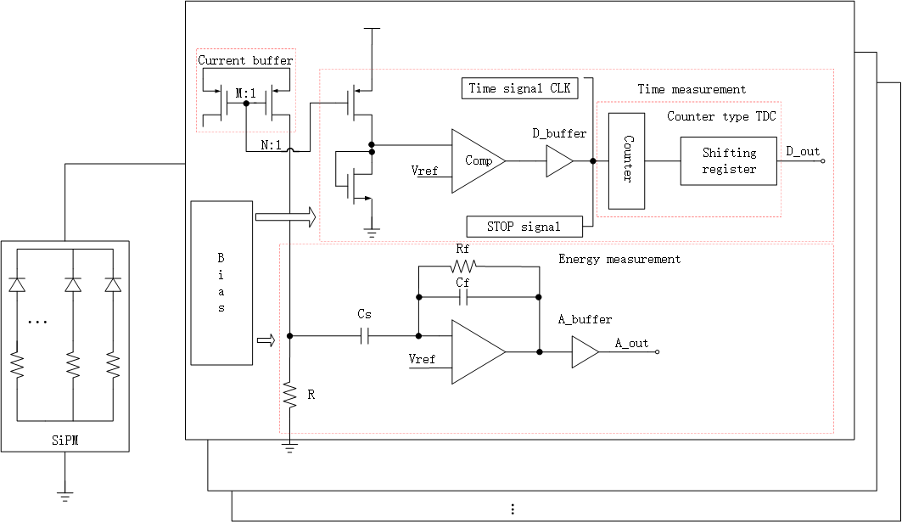
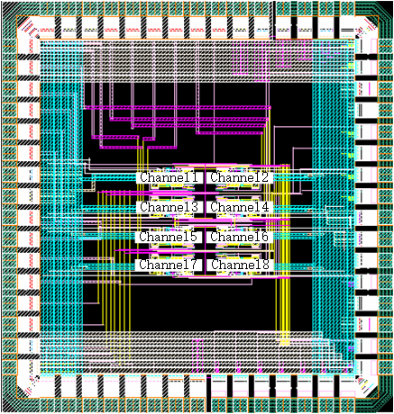
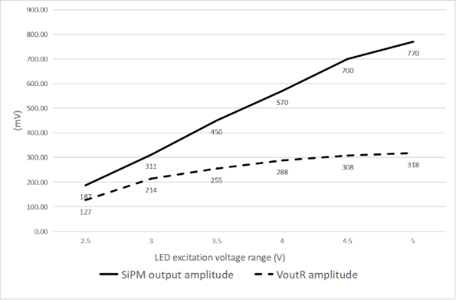
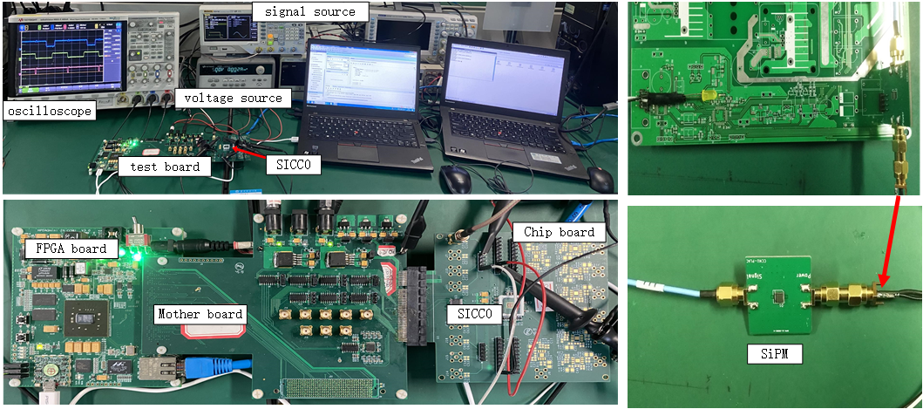
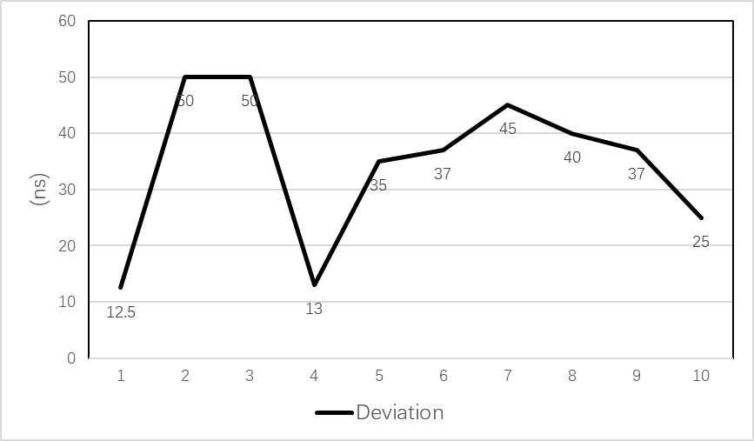

SiPM readout chip design for Heavy-ion Physics
1970um
1865um
Block diagram of the SICC0 system
Layout of SICC0
Current buffer test results
SICC0 test platform
TDC DNL test results for SICC0 chip at 40MHz

Slide 2
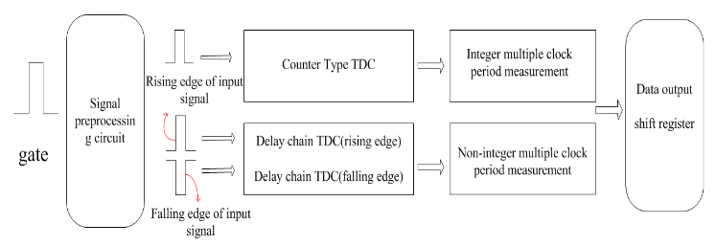
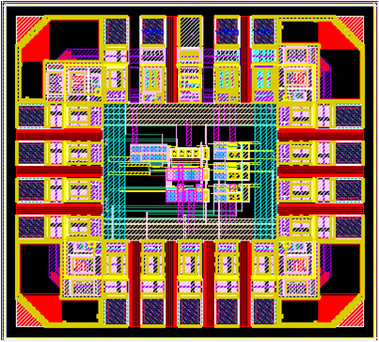
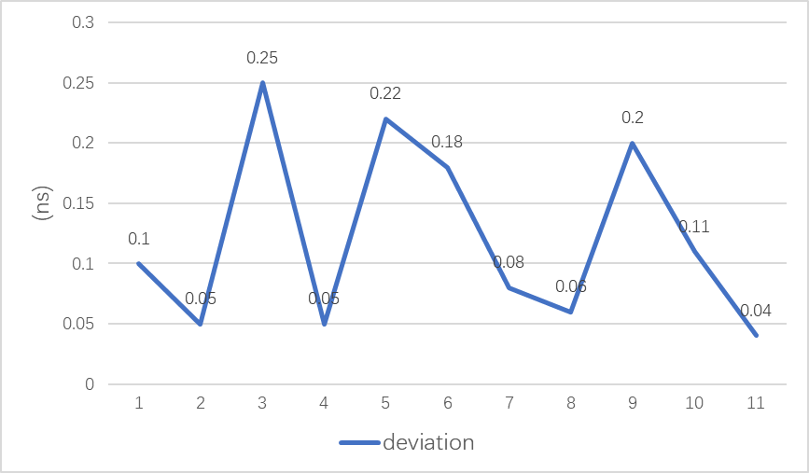
Two-step TDC Circuit
960um
Two-step TDC circuit structure
1065um
Layout of SICC1
The new two-step TDC is designed to improve the time resolution. The post-simulation results of the two-step TDC circuit show that the resolution of the TDC can be up to 70ps, the dynamic range is 640ns, and the RMS is about 3ps.
Post-simulation DNL results of a two-step TDC

