Slide 1
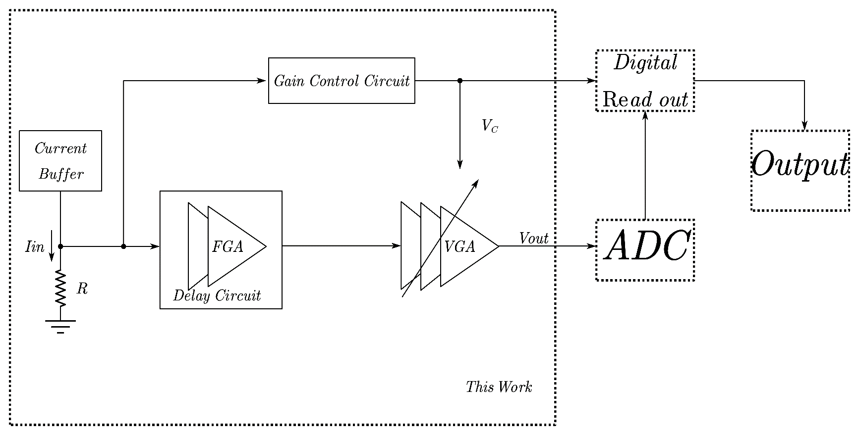
Fast-Settling high input dynamic range Automatic Gain Control Front-end circuit for particle detect
School： Central China Normal University
Traditional SiPM readout circuits
Circuit we proposed

Slide 2
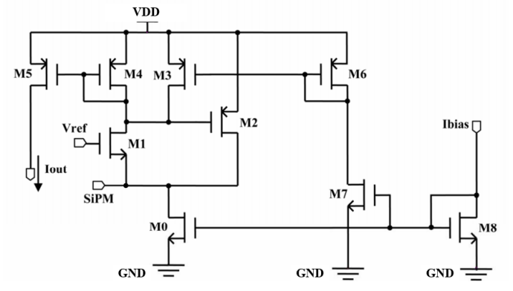
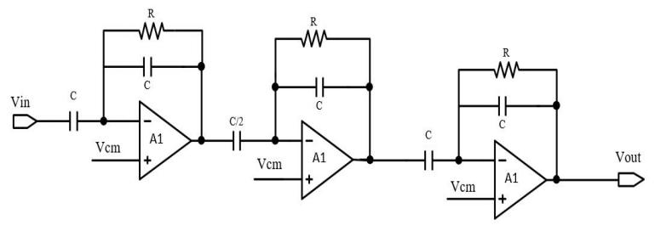
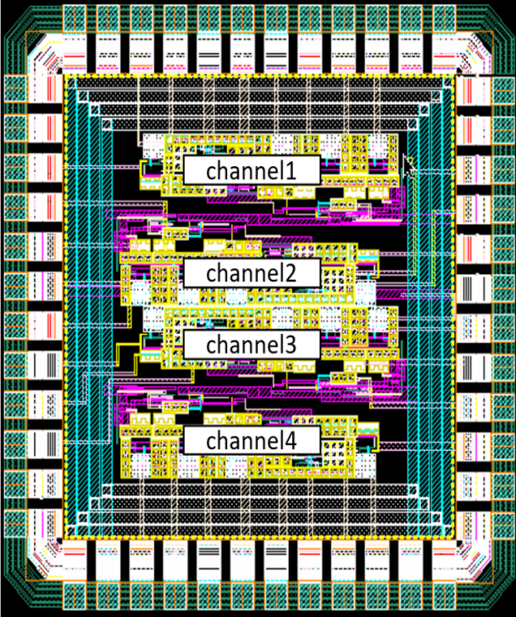
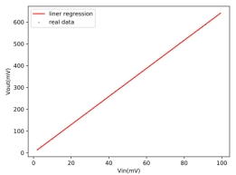
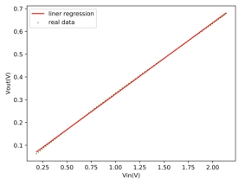
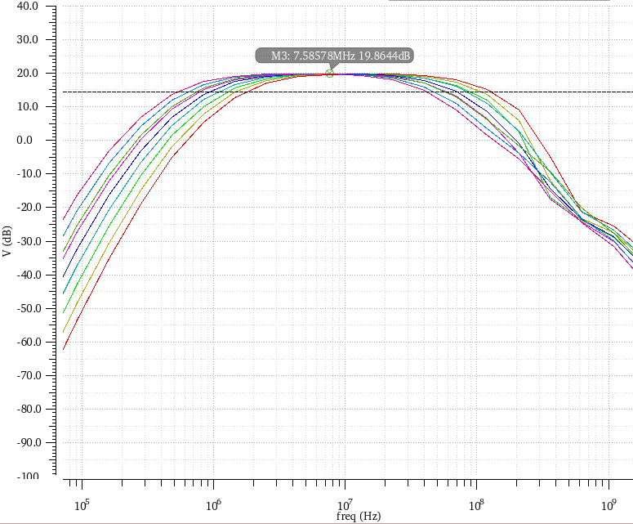
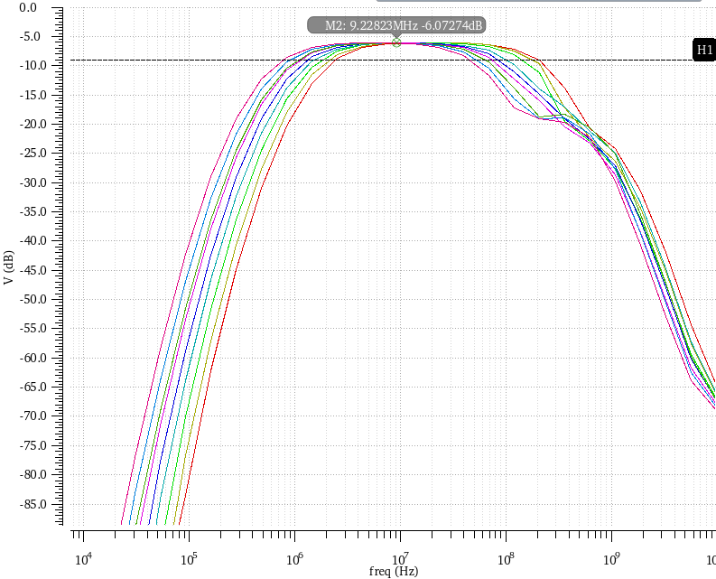
Layout of the die
Current Buffer
Delay Circuit
Post-simulation result
0.27%
1.29%
High gain
Low gain
High gain(19.73dB)
Low gain(-6.6dB)
linearity
GAIN

