Slide 1
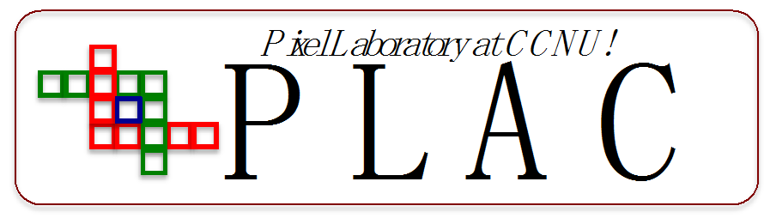


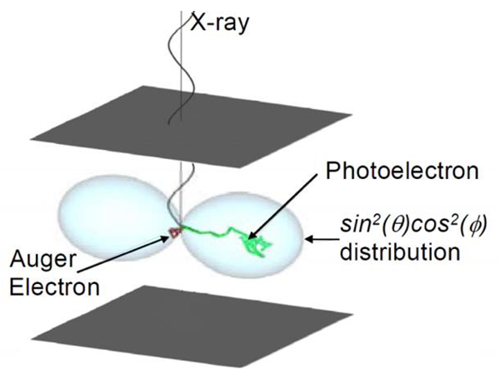
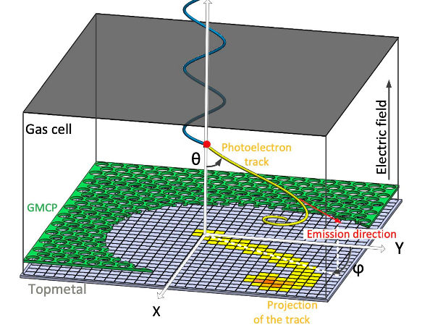
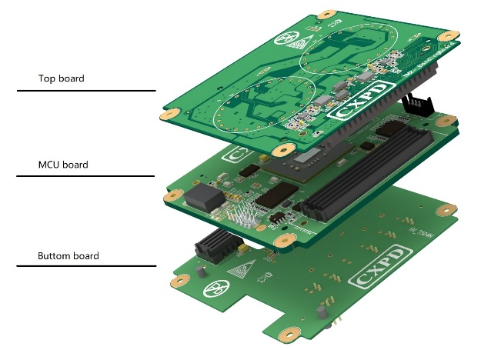
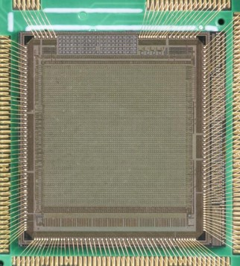
X-ray polarization detection helps humans explore the universe. With the advent of highly sensitive compact polarimeters, We can detect x-ray polarization in the X-ray energy range of a few keV.
Fig.1 Module of X-ray polarimetry and experiment platform

Slide 2
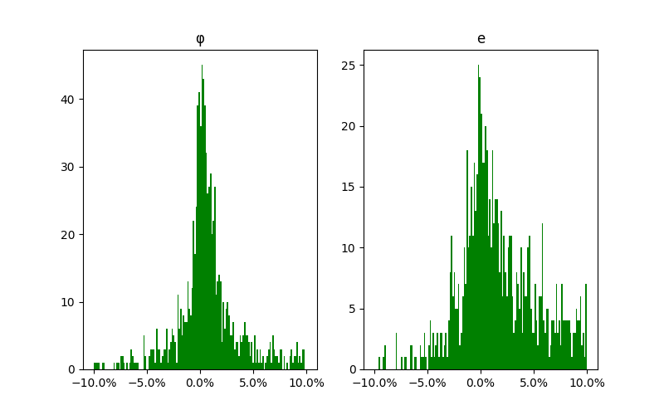
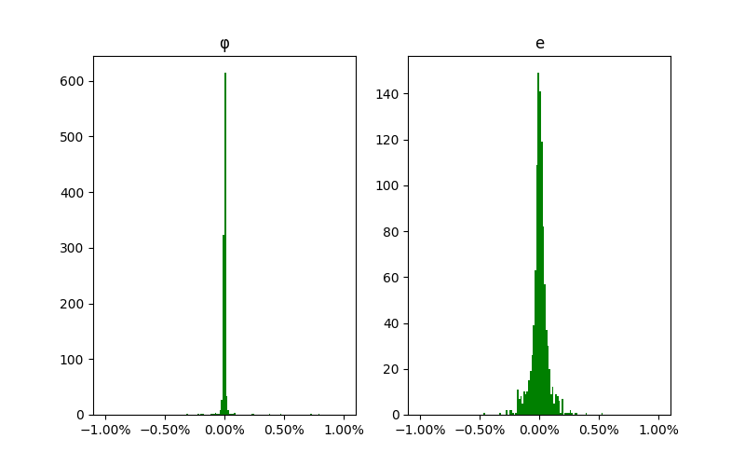
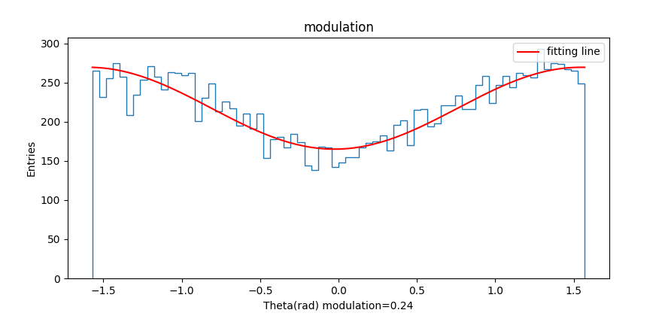
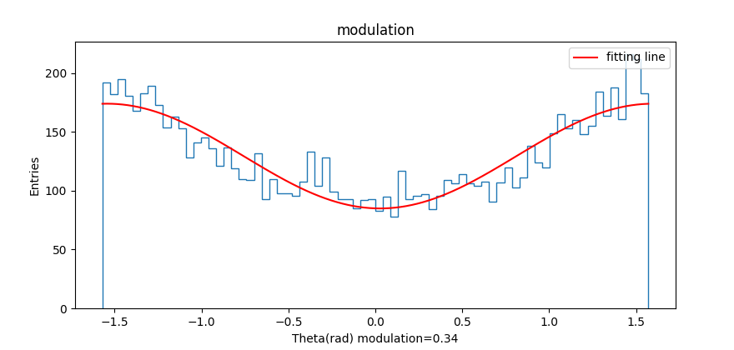
FPGA-Based Real-Time photoelectron track reconstruction can obtain X-ray reconstruction polarization angles at a pixel scan frequency of 2MHz. The main error of this angle is in the quantization accuracy.
Fig.2 Polarization angle quantization error and modulation

