Slide 1


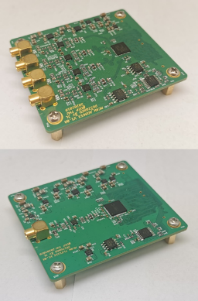
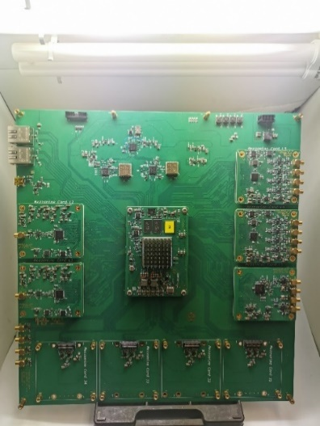
Development of the Test-bench “Wukong” for
Readout Electronics and Pulse Digitizer
On behalf of
Lin Jiang, Jingjun Wen, Jingzhe Yang, Tianhao Wang, Xiaowei Guo, Zhi Zeng, Ming Zeng, Yang Tian, Jianfeng Zhou, Tao Xue, Jianmin Li
Department of Engineering Physics, Tsinghua University

Slide 2

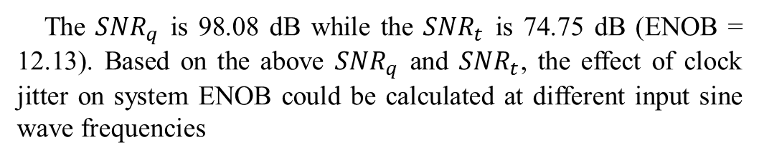
Analysis of the Reasons for the Deterioration of ADC ENOB
The SNR of ADC is mainly caused by 3 parts, ADC the quantization noise of ADC, the thermal noise of ADC and sampling clock jitter. The total SNR of ADC is,
The $SNR_{q}$ is 98.08 dB while the $SNR_{t}$ is 74.75 dB (ENOB = 12.13). Based on the above $SNR_{q}$ and $SNR_{t}$, the effect of clock jitter on system ENOB could be calculated at different input sine wave frequencies
The thermal noise contribution of the ADC and peripheral circuits is shown in the table below,
Section | Noise Contribution
AD5686R | 53.32𝜇𝑉 RMS (52.1𝜇𝑉 RMS from internal reference)
AD8676+ADA4927 | 55.874𝜇𝑉 RMS
AD9653 | 82.4𝜇𝑉 RMS
Total | 113.89𝜇𝑉 RMS
AD9653 Channel A measured | 129.39𝜇𝑉 RMS
Without considering the clock jitter, the ENOB of the ADC can be estimated by the following 3 equations,
The three figures above show the ENOB for theoretical calculations and measurements at a frequency of input sine wave 10MHz, 30MHz, and 40MHz, respectively. The measured results agree well with theoretical predictions.
Consequently, the maximum ENOB of the AD9653 is 12.13

