Slide 1
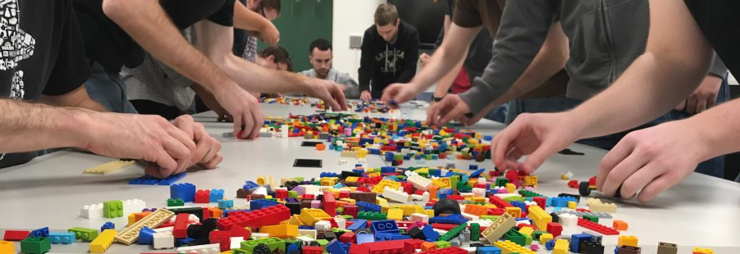
ERSAP: Towards Better HEP/NP Data-Stream Analytics With Flow-Based Programming
Environment for Real-time Streaming, Acquisition and Processing
V. Gyurjyan, D. Abbott, N. Brei, M. Goodrich, G. Heyes, E. Jastrzembski, D. Lawrence, B. Raydo, C. Timmer

Slide 2

“Enable full offline analysis chains to be ported into real-time, and develop frameworks
that allow non-expert offline analysis to design and deploy physics data processing systems.”
A Roadmap for HEP Software and Computing R&D for the 2020s. HEP Software Foundation, Feb. 2018

Slide 3
Outline
Looking forward to future experiments at the JLAB and EIC
  Reevaluate existing readout systems and their interface to the back-end
Reactive, actor-model based programming model
Results from ERSAP based pilot applications.

Slide 4


Streaming system components: Tiered storage model
Storage capacity/ retention time >= . Processors latency
Detector
Tier 1
DAQ
Tier 2
Tier N
Final Tier
Online/nearline data processing
Offline data processing
FE
Detector 1
FE
Buffer
Online
Storage
Nearline
Storage
Permanent
Storage
Aggregator
Processor
FE
Detector 2
FE
Buffer
Processors
Processors
FE
Detector N
FE
Buffer
Processor
Processors
Components | Framework Support
A stream-oriented timing system
A standard stream data format
Front-end electronics that outputs time-based streams of data
Efficient streaming data transport
A stream oriented random-access data storage tier
A framework for data processing tasks (virtual triggers, calibration, reconstruction, monitoring, data storage, etc.)
A framework for data-flow orchestration and data-stream processing application design and deployment

Slide 5

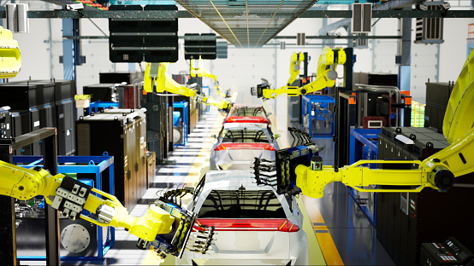
Flow-Based Programming Paradigm
Proposed in the late 60s by J. Paul Rodker Morrison
“Assembly line” data processing
Data flows through asynchronous, concurrent processors (“black box” actors)
Actors communicate via data chunks (called information packets or data-quanta)
Data-quanta are traveling across predefined connections (conveyor belts), where connections are specified externally to the processors.
Data is pushed through actors, while actors are reacting on passing data quantum.
Actors are performing independent, well-defined functions
Simple reconfigure
Minimizes side-effects

Slide 6



ERSAP architecture
Reactive event driven actor, data-stream pipe, and orchestrator.
Stream of data quanta, flowing through directed graph of actors.
Application is a network of independent “black box” actors.
Data moves across actors not instructions
Actors communicate with each other by exchanging the data quanta across predefined connections by message passing, where connections are specified externally to actors.
User provided data processing single-threaded algorithms (engines) are presented as fully scalable actors in the framework.
S4
Data processing station
S5
S8
S9
S1
Service engine
S2
S10
Data–stream pipe
S3
S6
S7
Workflow manager

Slide 7
ERSAP 3-layer structure
Orchestration Layer
Local Registration
Local Registration
DPE
DPE
SC
SC
SC
SC
FE
Registration
gateway
security
Local Registration
Local Registration
DPE
DPE
SC
SC
SC
SC
Actor Layer
Meta-Data
Data
ZeroMQ(xMsg)
POSIX Shared Memory (FIPC)
in-Memory Data-Grid

Slide 8
Data processing station: actor
User engine run-time environment.
Engine follows data-in/data-out interface.
Engine gets JSON object for run-time configuration.
Runtime Environment
Multi-threading
Communication
Configuration
User provided code
Engine
Data Processing Station
Data Processing Actor

Slide 9
Streaming data transport (conveyer belt)
Address
Topic
Envelop
Metta-Data
Version
Status
Data Location
Shared Memory address
Description
Author
Severity-ID
Sender
Sender State
Communication ID
Composition
Execution Time
Action
Control
Data Type
Data Description
Reply To
Byte Order
Data
Serialized Native
Serialized Custom
Publish/Subscribe
P2P
Engine
Communication
Transient Data
Meta-description
Serialization
0MQ/POSIX_SHM/Data-Grid
Data-Stream Pipe
Data Processing Actor

Slide 10
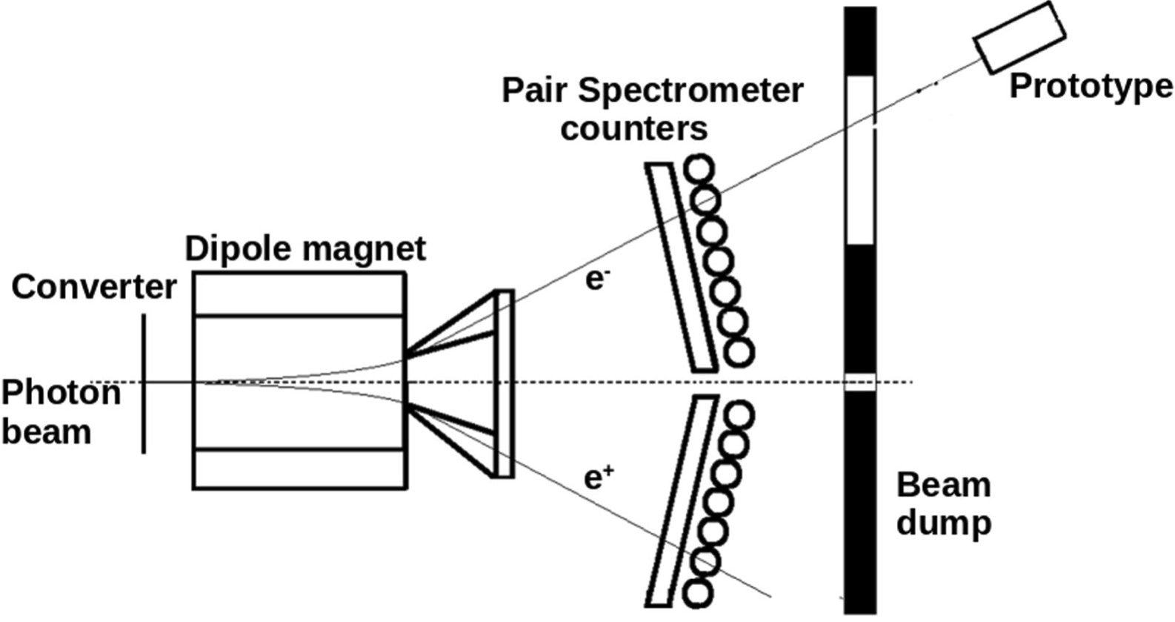
Hall-D EIC prototype calorimeter setup

Slide 11

Hall-D prototype calorimeter ERSAP SRO pipeline
ERSAP
Cosmic Event
Identifier
Calorimeter
VXS Crate
VTP payload
F
ADC
VT
P
Data
Lake
VTP
Receiver
Format1
VTP
Frame Decoder
Data
Lake
VTP
File
Writer
Beam Event
Identifier
VXS Trigger Processor
Zero
Suppression
4Gbyte
DDR3
Frame Builder
10Gbps Ethernet
(TCP) Stream
1 FADC250
Stream
(9 channels)

Slide 12
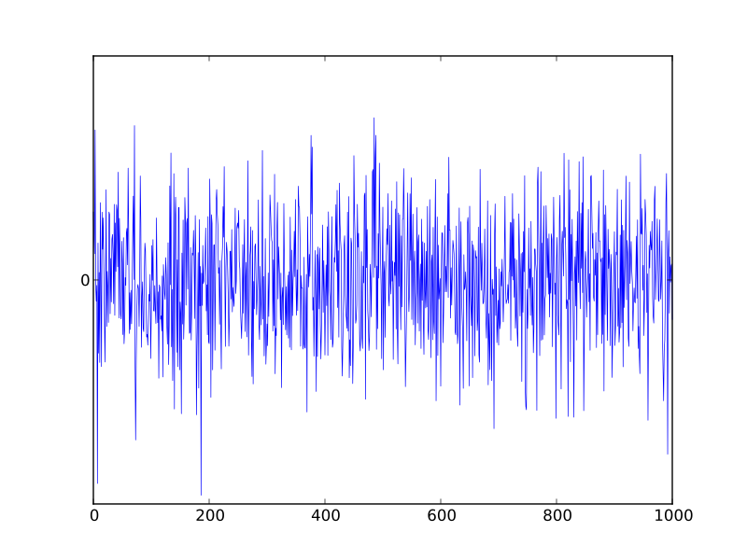
VTP fADC data stream frames
65.5us VTP frame

Slide 13
Event Identification. Sliding window technique
65.5us VTP frame
Sliding pointers
Find min/max time of hits within the frame
Cosmic Event
Hits in only 3 modules on the path of muons
Beam Event
Only 1 hit/channel
Cut on min number of hits
Central channel energy deposition > than any other
Sliding step - 1ms
Sliding window - 32ms

Slide 14
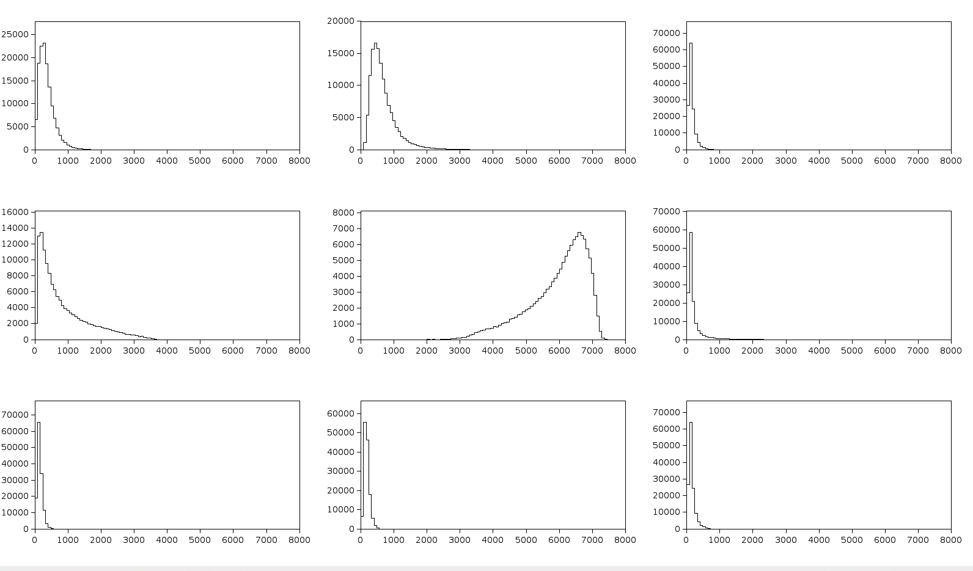
3x3 Calorimeter. Beam

Slide 15
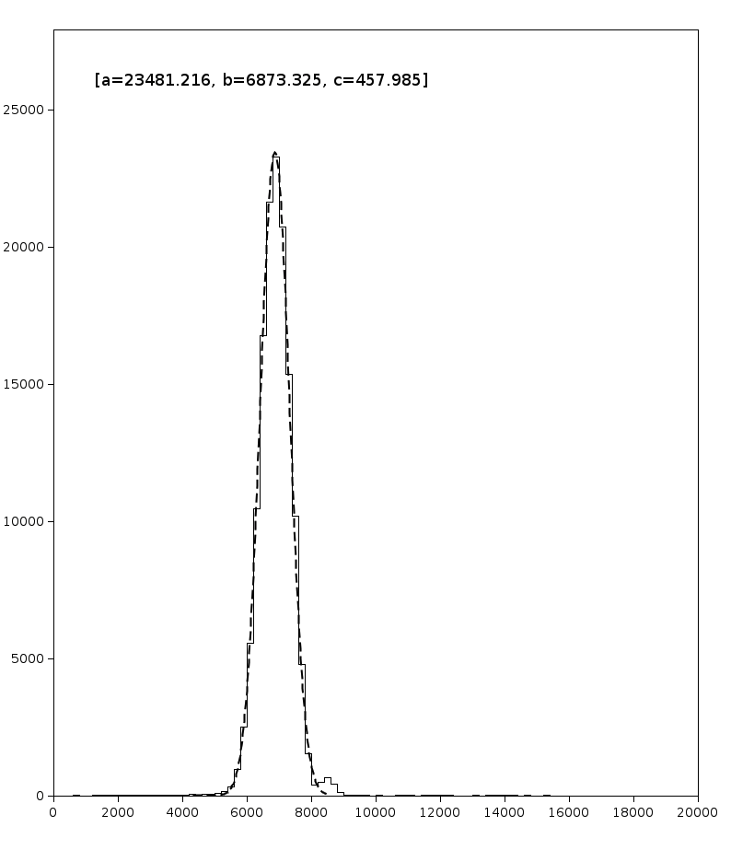
3x3 Calorimeter. Beam sum
~2GeV
Based on cosmic muon deposition
(see next slide)

Slide 16
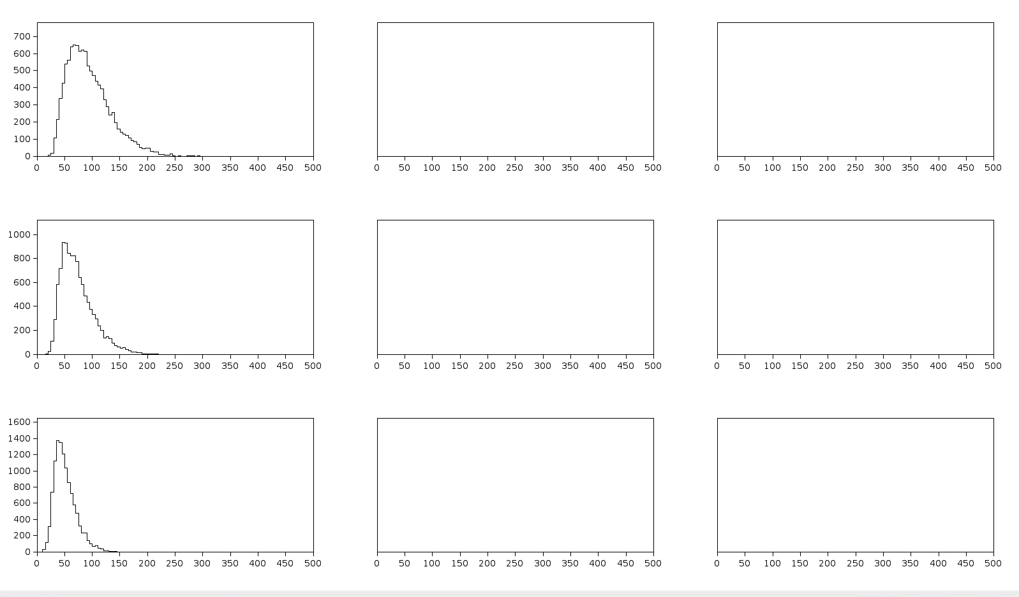
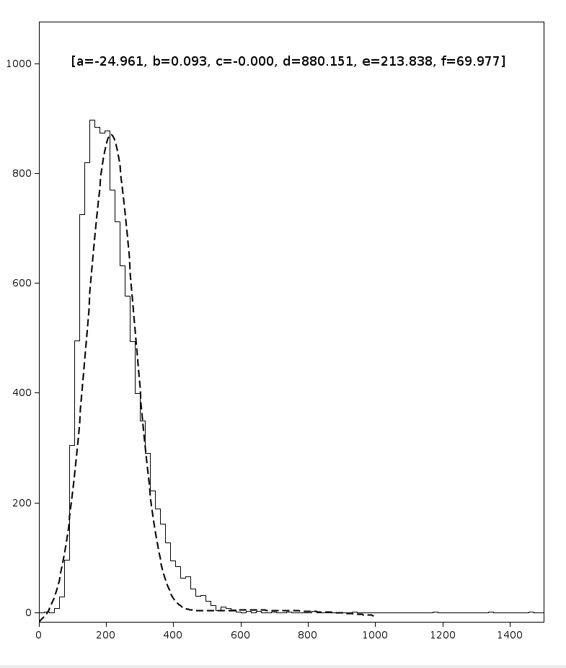
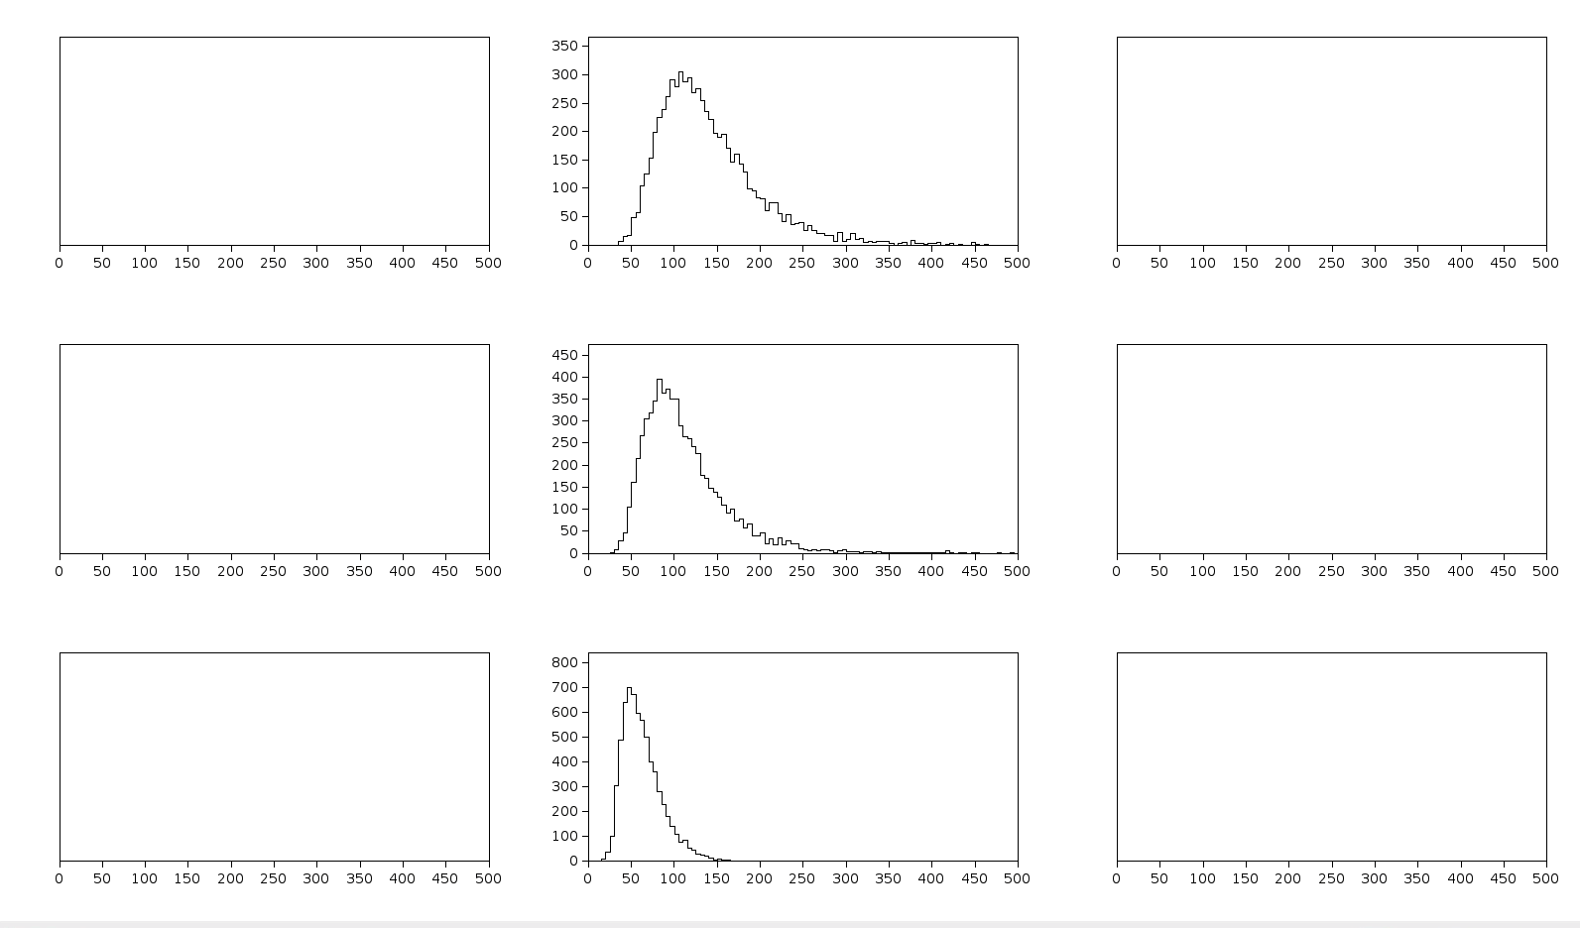
3x3 Calorimeter. Cosmic
~60MeV

Slide 17

Hall-D prototype calorimeter ERSAP SRO pipeline
CODA
ERSAP
ERSAP
Calorimeter
Cosmic Event
Identifier
Cosmic Event
Identifier
Calorimeter
VXS Crate
VXS Crate
VTP payload
VTP payload
F
ADC
F
ADC
VT
P
VT
P
ROC
Data
Lake
DC
VTP
Receiver
Format1
VTP
Frame Decoder
VTP
Receiver
Format2
VTP
Frame Decoder
Data
Lake
VTP
File
Writer
ET
Beam Event
Identifier
Beam Event
Identifier
VXS Trigger Processor
VXS Trigger Processor
Zero
Suppression
Zero
Suppression
4Gbyte
DDR3
4Gbyte
DDR3
Frame Builder
10Gbps Ethernet
(TCP) Stream
Frame Builder
10Gbps Ethernet
(TCP) Stream
12FADC250
Stream
(32 channels)
1 FADC250
Stream
(9 channels)

Slide 18
EIC prototype calorimeter SRO pipeline at DESY
CODA
ERSAP
Calorimeter
Cosmic Event
Identifier
VXS Crate
VTP payload
F
ADC
VT
P
ROC
DC
VTP
Receiver
Format2
VTP
Frame Decoder
ET
Beam Event
Identifier
VXS Trigger Processor
Zero
Suppression
4Gbyte
DDR3
Frame Builder
10Gbps Ethernet
(TCP) Stream
12FADC250
Stream
(32 channels)

Slide 19
EIC prototype calorimeter SRO application design and configuration
configuration:
io-services:
writer:
frame_title: "ERSAP"
frame_width: 1400
frame_height: 1200
#> hist_titles is a string containing the list of crate-slot-channel separated by ,
hist_titles: "1-17-0, 1-17-1, 1-17-2, 1-17-3, 1-17-4, 1-17-5, 1-17-6, 1-17-7, 1-17-8, 1-17-9, 1-17-10,
hist_bins: 100
hist_min: 0
hist_max: 8000
scatter_reset: true
#> grid_size defines a layout for histogram visualization
#> (e.g. 5 will plot 25 histograms in 5x5 matrix)
grid_size: 5
services:
Beam:
s_window: 32
s_step: 1
s_hits: 5
# t_slot: 17
# t_channel: 14
b_thr: 20
bc_slot: 17
bc_channel: 12
bc_qmin: 0
bc_qmax: 8000
Cosmic:
s_window: 32
s_step: 1
s_hits: 5
mime-types:
- binary/data-evio
- binary/data-jobj
---
io-services:
reader:
class: org.jlab.ersap.coda.engines.AggFileReaderEngine
name: Source
writer:
class: org.jlab.ersap.coda.engines.AggStoreHistogramEngine
name: Sync
services:
- class: org.jlab.ersap.coda.engines.FAdcIdEngine
name: Beam
- class: org.jlab.ersap.coda.engines.FAdcCosmicIdEngine
name: Cosmic
# -class: KMeanEvtdentifier
# name: cppBeam
# lang: cpp

Slide 20
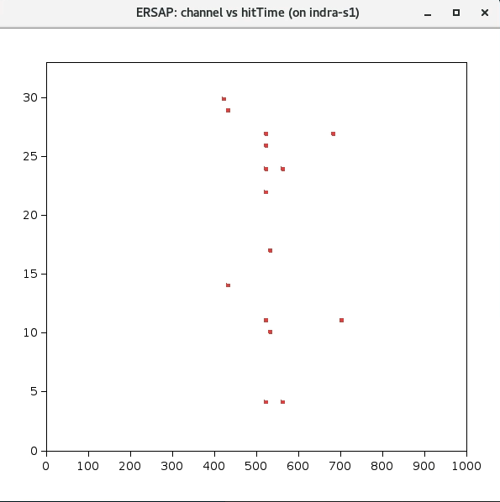
Time distribution of hits
32nsec
fADC Channel
Time[ns]

Slide 21
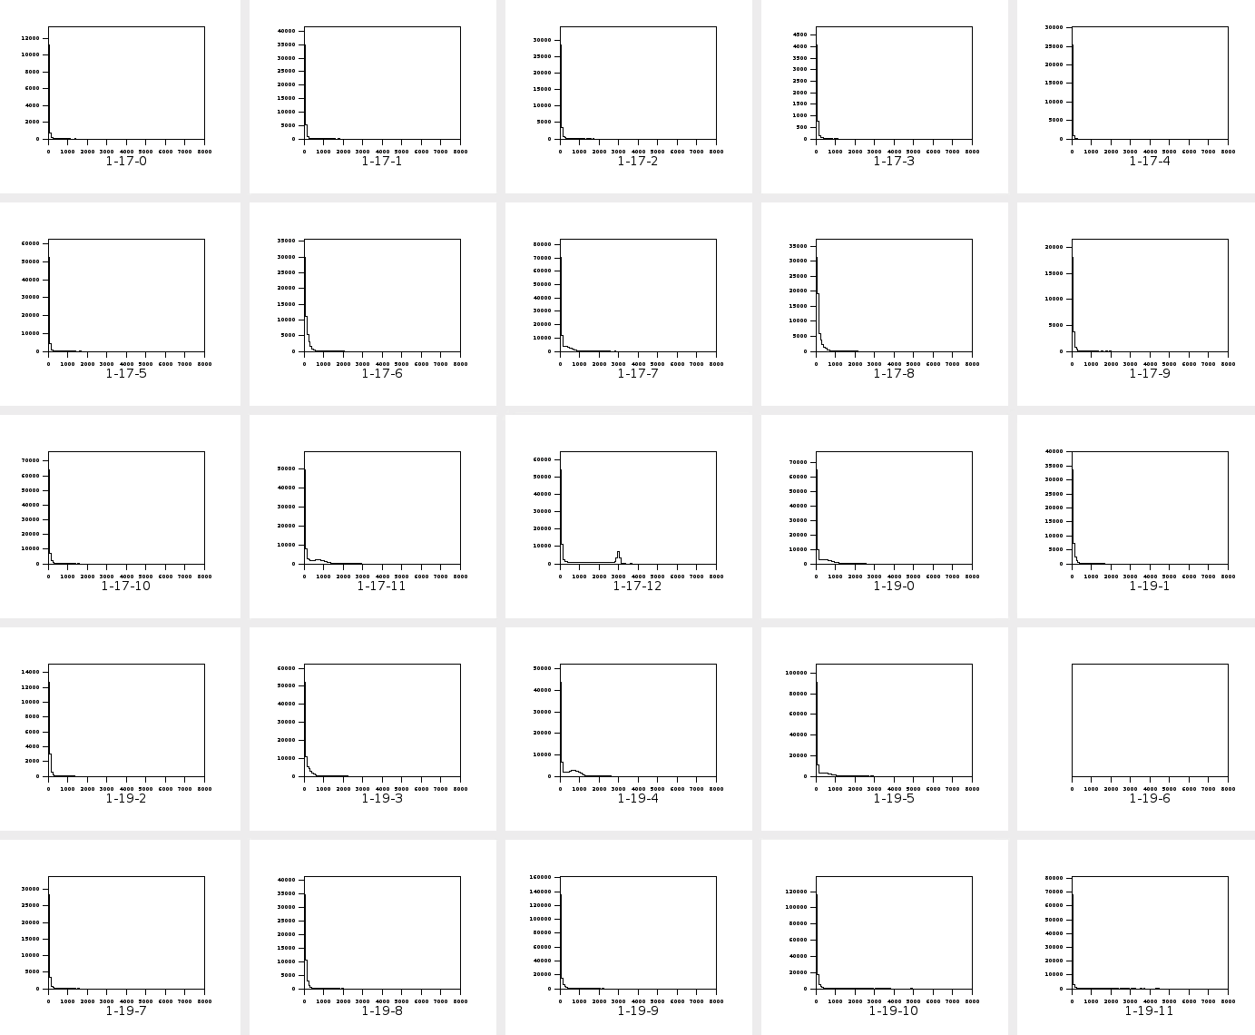

Slide 22
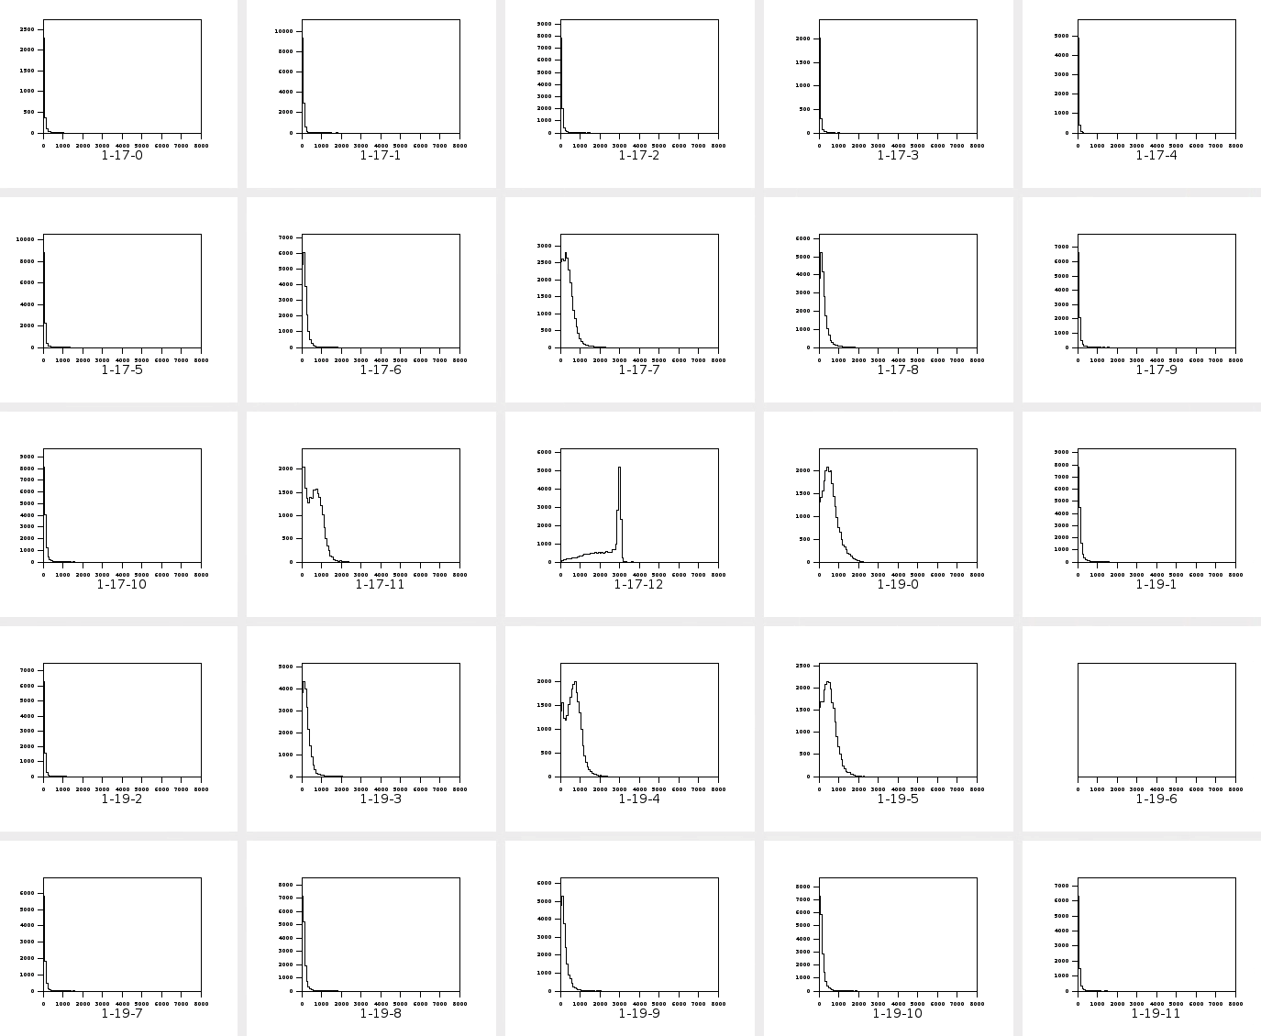

Slide 23
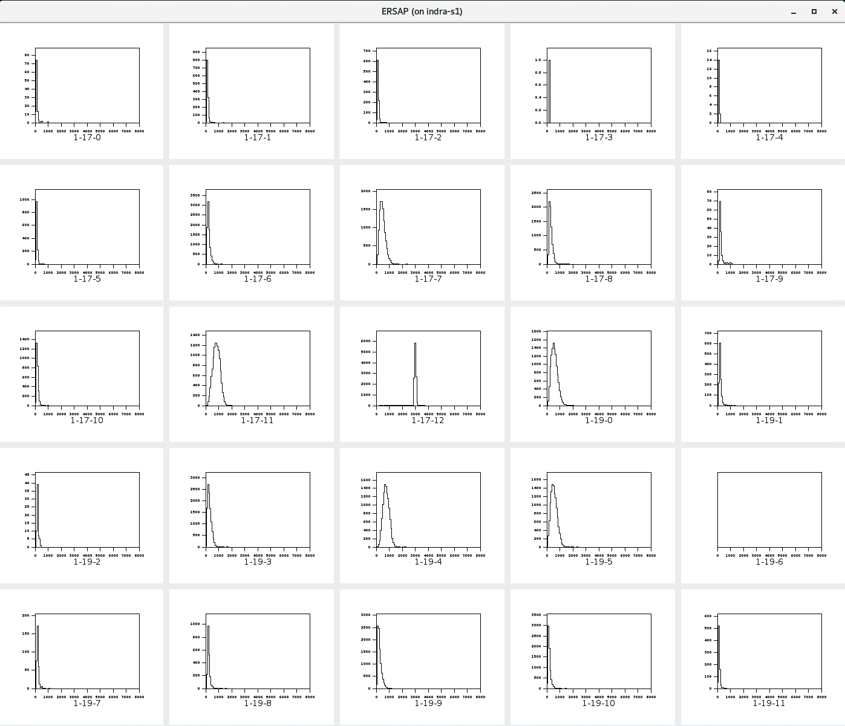

Slide 24
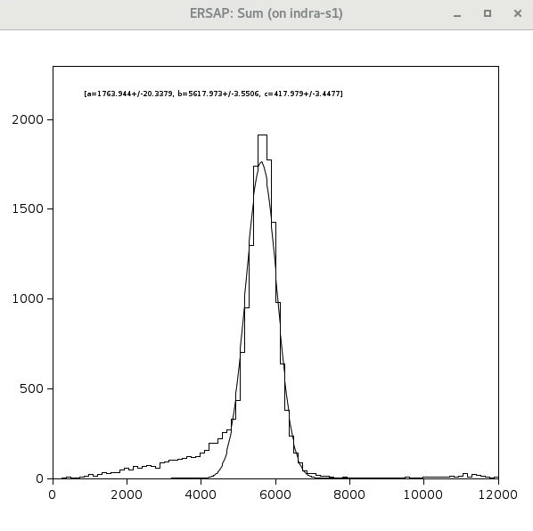
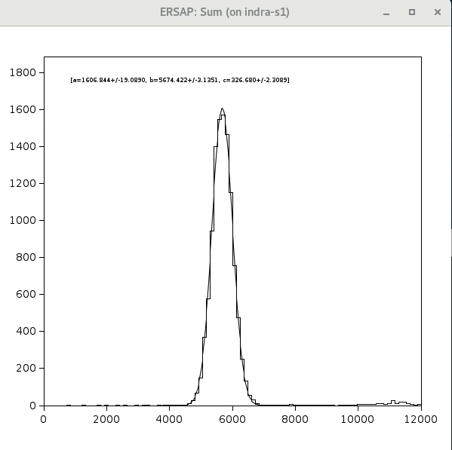
Charge cut effect
No energy/charge cut in the soft trigger
2GeV, TET=50
DESY_stream_134.evt.0
Total frames – 1861687
Empty frames – 1807602
Total identified (soft trigger) – 18774
97% empty frames
34.71% identified as beam events
2GeV, TET=50
DESY_stream_134.evt.0
Total frames – 1861687
Empty frames – 1807602
Total identified (soft trigger) – 11487
97% empty frames
21.24% identified as beam events

Slide 25
fADC threshold effects (2GeV)

Slide 26
Calorimeter response linearity

Slide 27
Summary
ERSAP is a software LEGO system
  Encourages application design based on software artifacts (LEGO bricks)
    Easier to understand and develop
    Reduced develop-deploy-debug cycle
    Easy to migrate to data
    Scales independently
    Independent optimizations
Improves fault isolation
Easy to embrace hardware as well as software heterogeneity.
Eliminates long term commitment to a single technology stack.
Agile framework that makes easy software evolution over time!

Slide 28
Current status and future plans
ERSAP is a reactive actor/micro-service based data-stream processing framework. https://wiki.jlab.org/epsciwiki/index.php/ERSAP
Combines decade-long experience: CODA, AFECS and CLARA
  ERSAP Java binding, betta release: https://github.com/JeffersonLab/ersap-java.git
  ERSAP C++ binding development in progress: https://github.com/JeffersonLab/ersap-cpp.git
  ERSAP Python binding in the design stage
  Plans to design ERSAP Julia binding
Many ERSAP engine development projects are in progress
  CODA engines: https://github.com/JeffersonLab/ersap-coda.git
  JANA2 based engines: https://github.com/JeffersonLab/ersap-jana.git
  TriDAS engines: https://github.com/JeffersonLab/ersap-tridas.git
  CLAS12 AI reconstruction engines https://github.com/JeffersonLab/ersap-vtp.git
  INDRA ASTRA project ML engines
Collaborative effort between JLAB Physics and CST divisions.

Slide 29
Thank You

Slide 30
Streaming CODA and ERSAP to achieve data stream acquisition and processing
VXI Crate
Flash ADCs/TDCs
Detector reconstruction services (DRS)
Full detector reconstruction
Calibration, alignment
Kalman filter
Note: some DRS services might run on GPGPU/TPU
VTP/FPGA
Detector reconstruction services (DRS)
Cluster, segment finder
Road finder
SIS
Analysis services
Detector 1
Sector 1
Some detectors might need
other detector’s data to
complete their reconstruction.
DRS
ANAS 1
VXS
EB service
Geometry matching
Partial software trigger
SIS
Stream interface services (SIS)
Runs on FPGA
0 suppression
Electronic noise removal
SRS
EBS
ERS 1
DRS X
ERS N
ANAS 2
FPGA/EJFAT
SIS
Event reconstruction services
DSTP
ANAS N
EP
Detector N
Sector N
DST persistency
Reconstructed data
DRS
Event persistency
Raw data
SIS
Note: FPGA based ERSAP service’s code base (C++) will be deployed in CPU first for
verification and quality control, and only after will be deployed into FPGAs.
To use existing hardware in a streaming mode data must be reduced while streaming.

Slide 31
Hardware vs. software event identification
CODA
CODA Streaming
TS
trigger type
ROCs
strob
EB
FE
Modules
L1
ack
DL
Processor N
Event Builder
user
L2
EH
L1 accept
FE
Modules
L2 accept
L3
L3 accept
ER
clear
DL
busy
Processor N
ER
TS | Trigger supervisor
ROC | Readout controller
EB | Event Builder
EH | Event Hub
ER | Event Recorder
DL | Data Lake/tiered storage
Challenging to deal with event-pileups
Not ideal to read general purpose detectors
Cary bias to low-energy particles
Data is digitized at fixed rate
Data is read out continuous parallel streams
Data is cooled down at the tiered storages

Slide 32
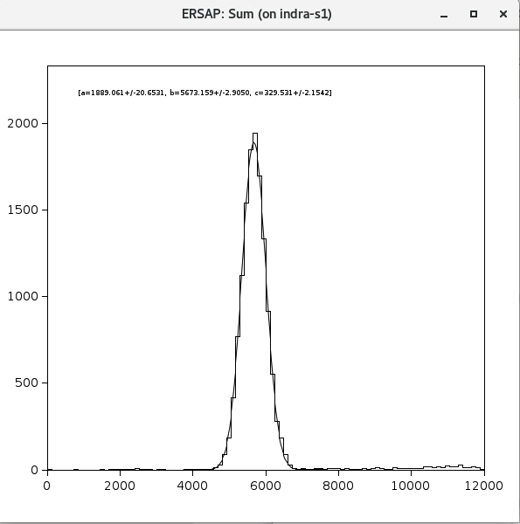
fADC threshold effect
2GeV, TET=10
DESY_stream_138.evt.0
Total frames – 1832550
Empty frames – 1262899
Total identified (soft trigger) – 15409
68.9% empty frames
2.7% identified as beam events
2GeV, TET=50
DESY_stream_134.evt.0
Total frames – 1861687
Empty frames – 1807602
Total identified (soft trigger) – 11487
97% empty frames
21.24% identified as beam events

Slide 33
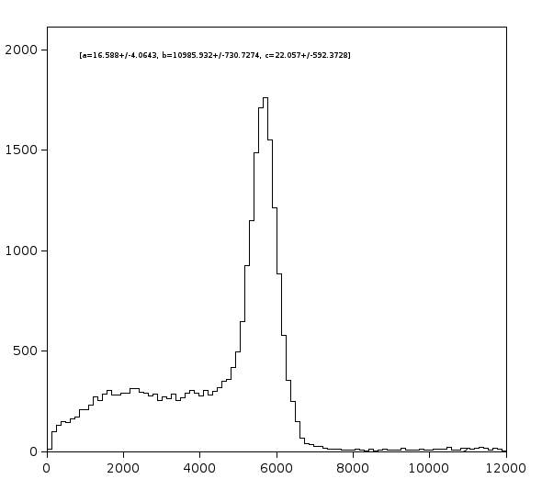
No charge cut in the soft trigger
No energy/charge cut in the soft trigger
2GeV, TET=50
DESY_stream_134.evt.0
Total frames – 1861687
Empty frames – 1807602
Total identified (soft trigger) – 18774
97% empty frames
34.71% identified as beam events
2GeV, TET=10
DESY_stream_138.evt.0
Total frames – 1832550
Empty frames – 1262899
Total identified (soft trigger) – 24965
68.9% empty frames
4.4% identified as beam events

Slide 34
2GeV, TET=10
DESY_stream_138.evt.0
Total frames – 1832550
Empty frames – 1262899
Total identified (soft trigger) – 15409
68.9% empty frames
2.7% identified as beam events

Slide 35
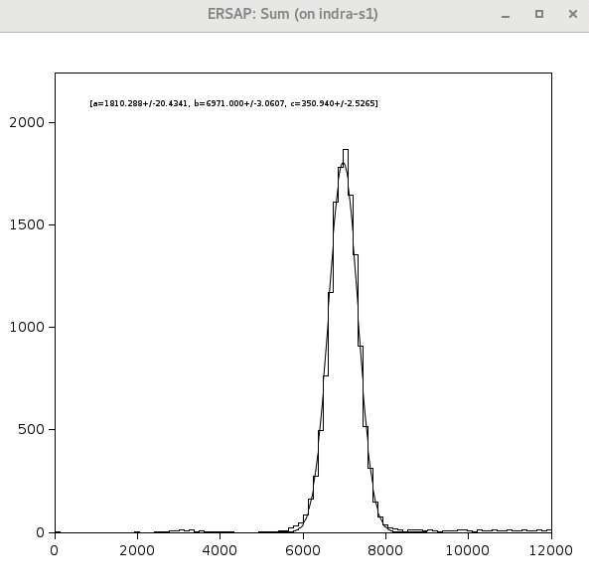
3GeV, TET=10
DESY_stream_129.evt.0
Total frames – 1832550
Empty frames – 1262899
Total identified (soft trigger) – 15409
68.9% empty frames
2.7% identified as beam events

Slide 36
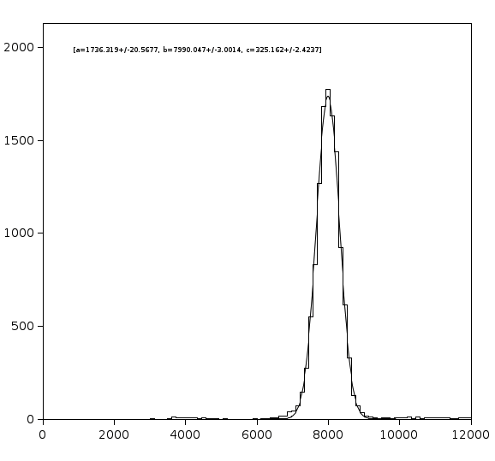
4GeV, TET=10
DESY_stream_128.evt.0
Total frames – 2336701
Empty frames – 1633961
Total identified (soft trigger) – 17086
69.9% empty frames
2.43% identified as beam events

Slide 37
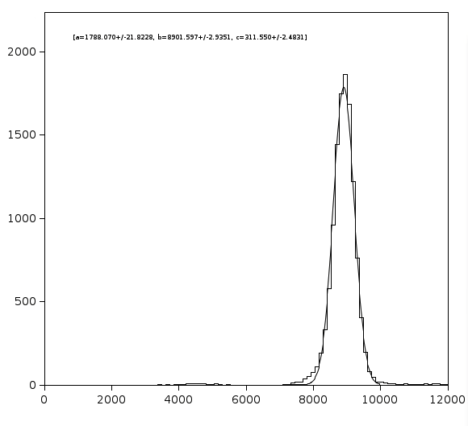
5GeV, TET=10
DESY_stream_120.evt.0
Total frames – 5390065
Empty frames – 3702572
Total identified (soft trigger) – 17257
68.7% empty frames
1.02% identified as beam events

Slide 38
2GeV, TET=50
DESY_stream_134.evt.0
Total frames – 1861687
Empty frames – 1807602
Total identified (soft trigger) – 11487
97% empty frames
21.24% identified as beam events

Slide 39
2GeV, TET=10
DESY_stream_138.evt.0
Total frames – 1832550
Empty frames – 1262899
Total identified (soft trigger) – 24965
68.9% empty frames
4.4% identified as beam events
2GeV, TET=10
DESY_stream_138.evt.0
Total frames – 1832550
Empty frames – 1262899
Total identified (soft trigger) – 15409
68.9% empty frames
2.7% identified as beam events

Slide 40
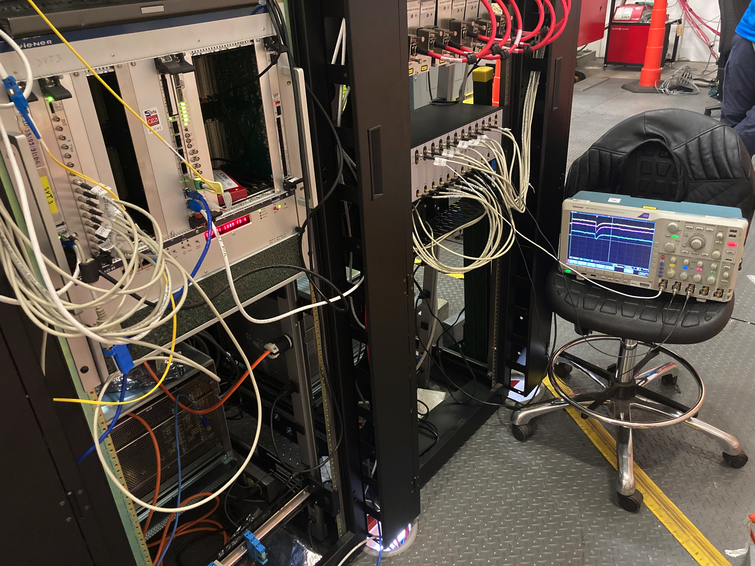
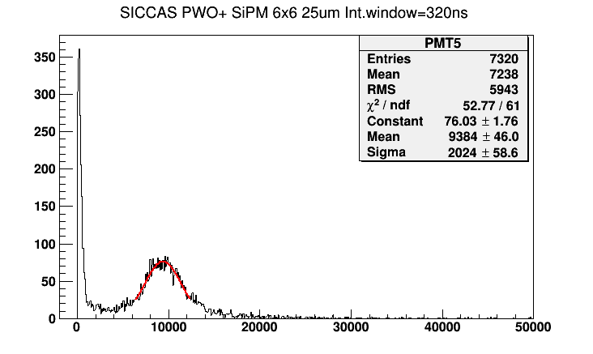
PbWO₄ Christal based 3x3 Calorimeter

