Slide 1
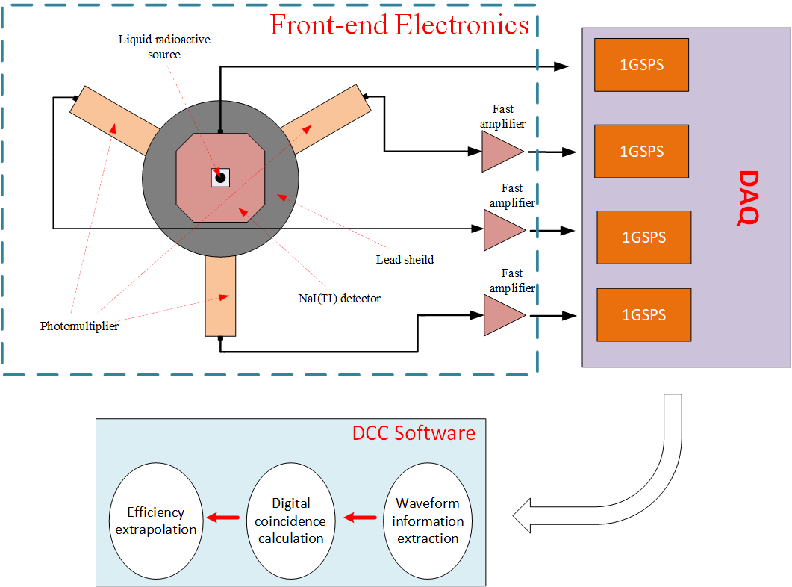
Notes:
Hello everyone, welcome to my short presentation about our work on the self-design high speed nuclear instrument. In our study, we developed a high sped nuclear digitizer and an advanced offline DCC software. The digitalizer support four channel 1GSPS Acquisition and 320MBPS stable transmission. In the software part, we put forward a developed Campion counting correction method so that it can be easily impended in the software and can handle the fixed dead time mode and extendable dead time mode both.

Slide 2
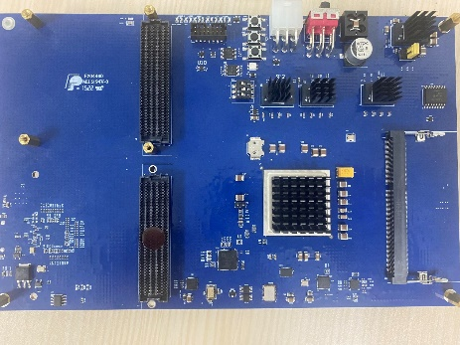
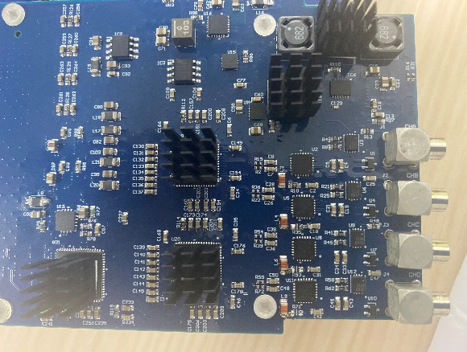
Notes:
Here is our PCB and it meets the FMC standard.

Slide 3
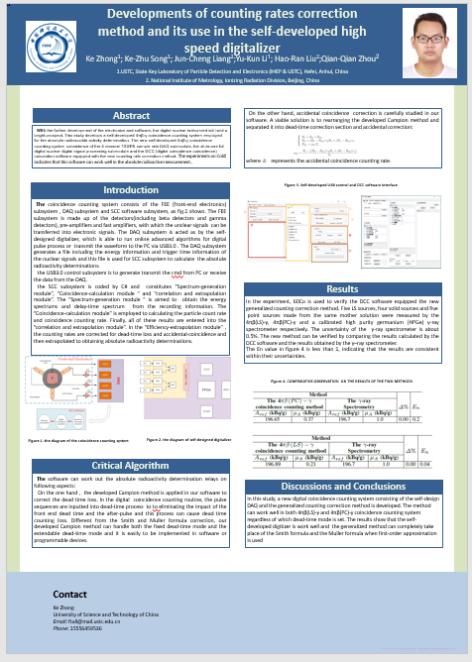
Notes:
That’s all, you are welcome for further discussion in my chat room.

