Slide 1



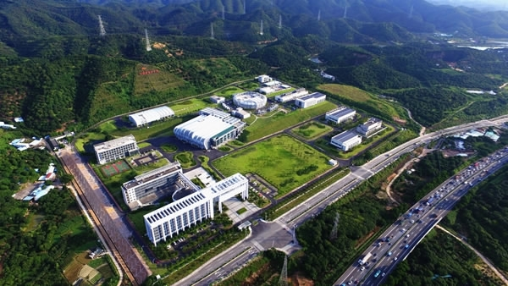
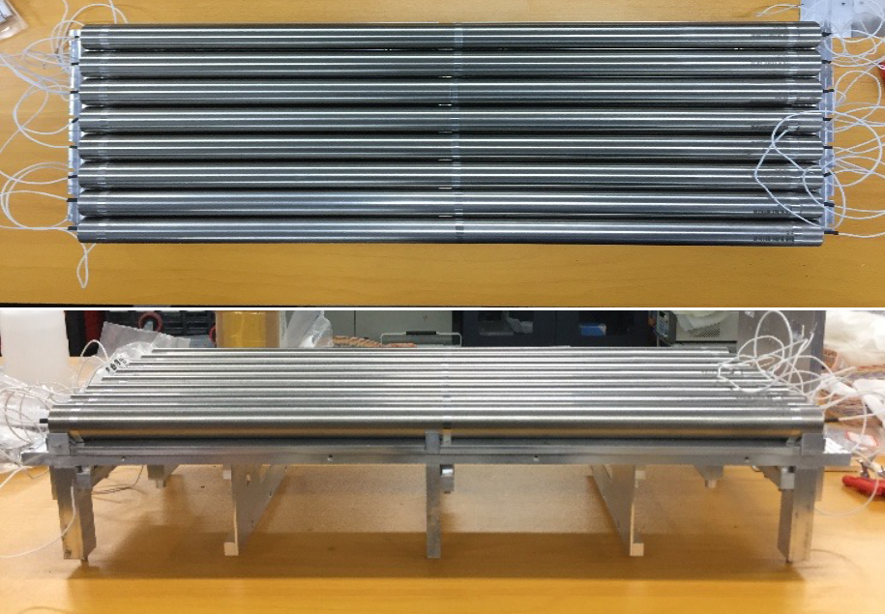
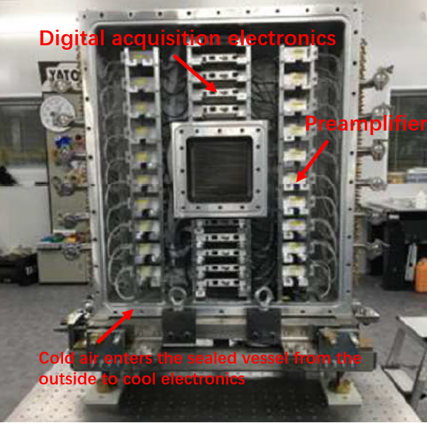
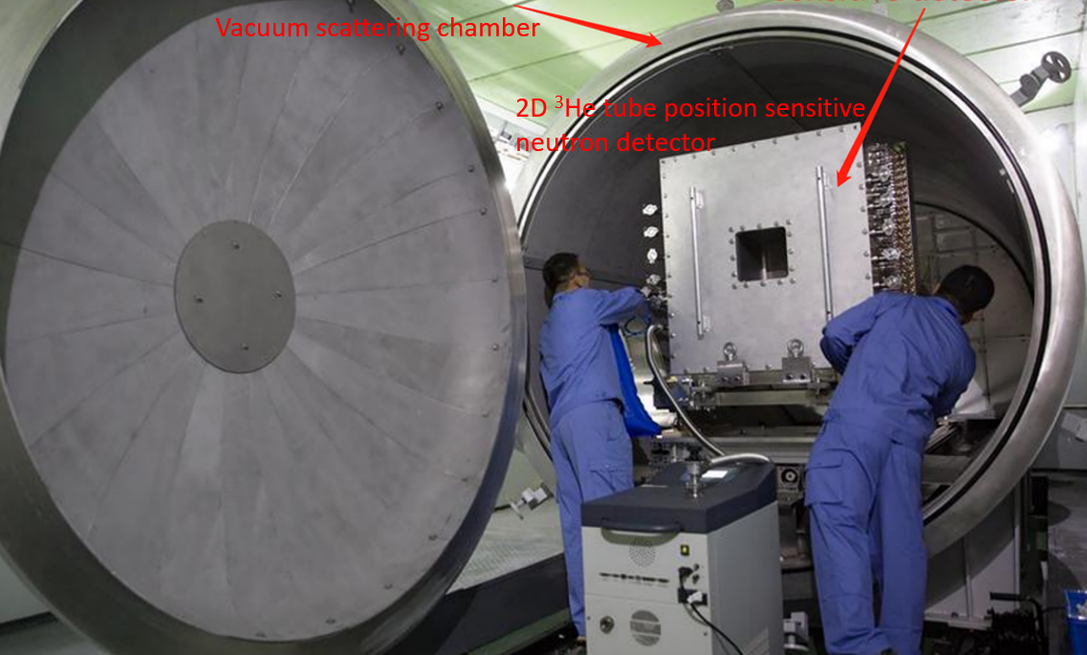
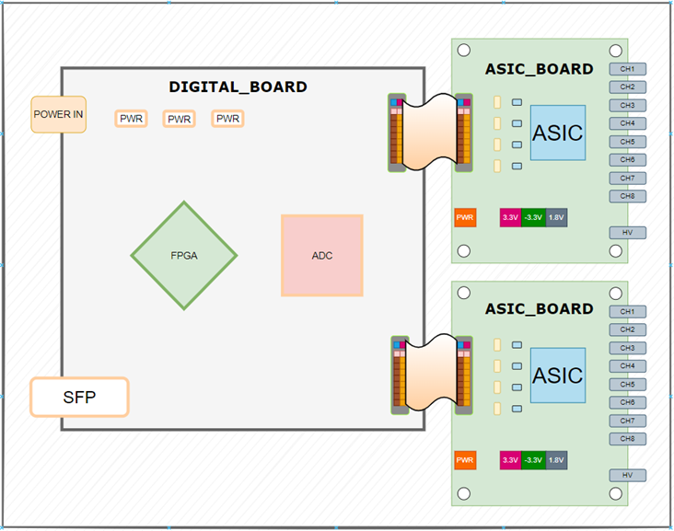
Design of Low-Power Readout Electronics for
³He Tube Position-Sensitive Neutron Detectors at CSNS
Qicai Li, Hongbin Liu, Jiayi Ren, Hong Luo, Yubin Zhao, Zhijia Sun
Scattering Vessel
³He tube
Vacuum
Input cold air
Flowing air
Traditional electronics
csns
Output hot air
External cooling
³He Tube Position-Sensitive Neutron Detectors
How to avoid overheating of electronics?
Advantage:
Stable operation in vacuum
Support up to 8 ³He tubes
Support TOF
Maintenance is more convenient.
Scattering vessel
Both detectors and electronics are placed in vacuum scattering vessel.
New choice
³He tube
Vacuum
Front-end Board
Low-power electronics
Front-end Board

