Slide 1
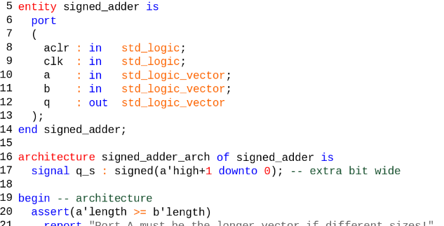
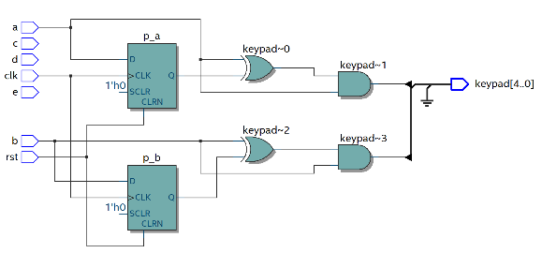
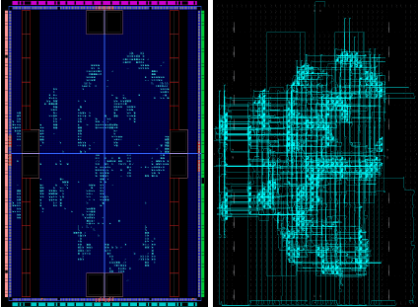


Application of the IEC61508 standard to carry out the Verification and Validation process of FPGA-based Intelligent Acquisition Systems designed using OpenCL-HLS
A. Carpeño, M. Ruiz, I. García-Siguero and E. Barrera
antonio.cruiz@upm.es
Instrumentation and Applied Acoustic Research Group, Universidad Politécnica de Madrid (UPM), Madrid, Spain
The use of high-level HDL based on C/C++ in FPGA development is increasing considerable.
The effort required to carry out the V&V process for systems requiring safety compliance is very costly and complicated.
There is no specific safety standard fully oriented to systems designed using High-Level Synthesis languages.
There is no complete control over the HDL auto-generated.
Kernel
RTL
FPGA Map
Autogenerated VHDL

Slide 2
Application of the IEC61508 standard to carry out the Verification and Validation process of FPGA-based Intelligent Acquisition Systems designed using OpenCL-HLS
A. Carpeño, M. Ruiz, I. García-Siguero and E. Barrera
antonio.cruiz@upm.es
Instrumentation and Applied Acoustic Research Group, Universidad Politécnica de Madrid (UPM), Madrid, Spain
The work proposes a methodology for V&V based on the requirements recommended by the IEC 61508 standard
Describes how to integrate a set of Third Party tools to assist the V&V process
The methodology is applicable for Xilinx HLS and Intel OpenCL.
ACKNOWLEDGEMENTS
This work was supported under grant PID2019-108377RB-C33 funded by MCIN/AEI/ 10.13039/501100011033

