Slide 1
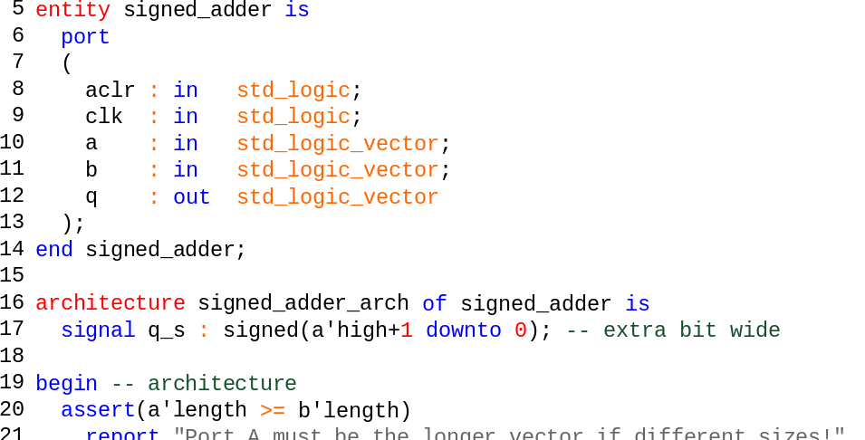
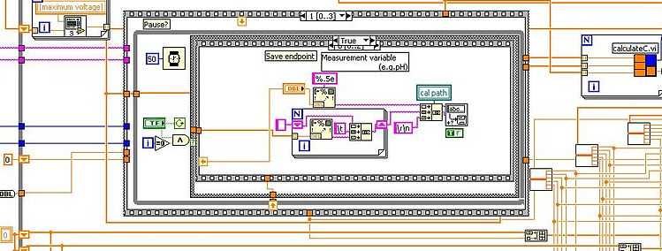
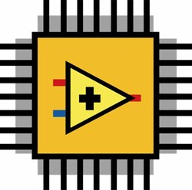
Verification and Validation of ITER Interlock System Fast Architecture according to IEC 61508 standard
I. García-Siguero¹, A. Carpeño¹, E. Barrera¹, D. Karkinsky², Ignacio-Prieto Diaz³, and A. Marqueta²
${}_{}^{1}{\text{Instrumentation}}$ and Applied Acoustic Research Group (I2A2), Universidad Politécnica de Madrid, Madrid, Spain;${}_{}^{2}{\text{ITER}}$ Organization, St. Paul-lez-Durance, 13067 France;${}_{}^{3}{\text{F}\text{4}\text{E}}$, Torres Diagonal Litoral Edificio B3, C/ Josep Pla 2, 08019 Barcelona, Spain.
Email: i.gsiguero@i2a2.upm.es
Interlock Fast Architecture based on National Instruments CompactRIO hardware.
“Double-decker” solution. Two NI9159 chassis running in parallel.
LabVIEW FPGA as developing tool.
LabVIEW Graphic Code (User)
Autogenerated VHDL Code (NI and Xilinx tools)
NI FPGA programmed

Slide 2
Verification and Validation of ITER Interlock System Fast Architecture according to IEC 61508 standard
I. García-Siguero¹, A. Carpeño¹, E. Barrera¹, D. Karkinsky², Ignacio-Prieto Diaz³, and A. Marqueta²
${}_{}^{1}{\text{Instrumentation}}$ and Applied Acoustic Research Group (I2A2), Universidad Politécnica de Madrid, Madrid, Spain;${}_{}^{2}{\text{ITER}}$ Organization, St. Paul-lez-Durance, 13067 France;${}_{}^{3}{\text{F}\text{4}\text{E}}$, Torres Diagonal Litoral Edificio B3, C/ Josep Pla 2, 08019 Barcelona, Spain.
Email: i.gsiguero@i2a2.upm.es
IEC 61508 is developed for HDL, not for high-level synthesis languages or graphical languages.
ITER has the challenge to develop the FA with failure-per-hour similar to IEC61508 SIL-3 (3IL-3).
Verification and Validation process was carried out on a previous developed plant system.
Extracting the possibilities and limitations.
ACKNOWLEDGEMENTS
This work was supported under grant PID2019-108377RB-C33 funded by MCIN/AEI/10.13039/501100011033

