Slide 1
Enhancements of the Fast Interlock System for Wendelstein 7-X operational phase OP2.1
O_A_52
J. Schacht¹, R. Vilbrandt¹, S. Degenkolbe¹, O. Grulke¹, A. Winter¹, U. Herbst¹, A. Wölk¹, S. Pingel¹, H.-S. Bosch¹ and the W7-X Team
¹ Max-Planck-Institut for Plasma Physics, Greifswald, Germany

Slide 2
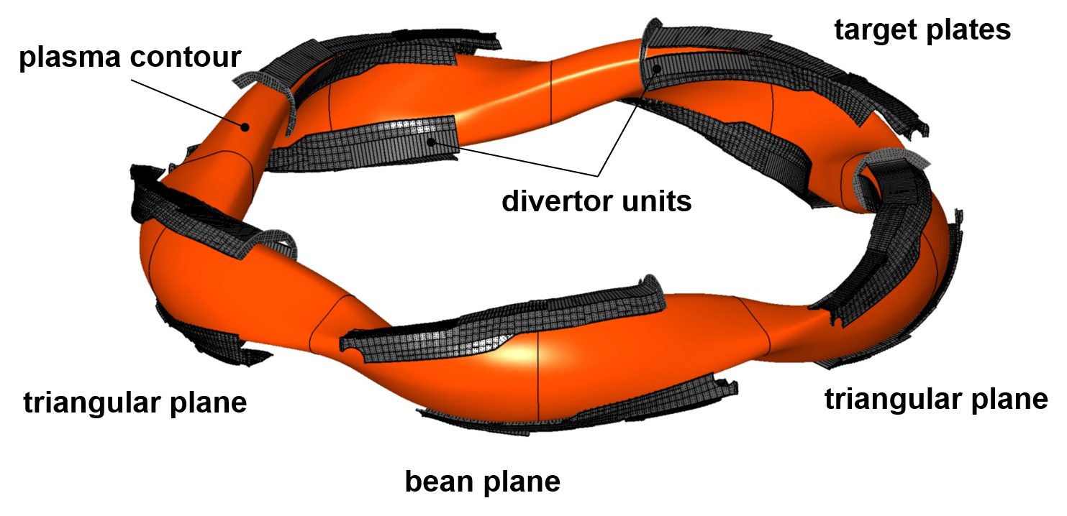
Stellarator Wendelstein 7-X: Ready for Operation Phase 2.1
Fig. 1: Stellarator Wendelstein W7-X
Fig. 2: Actively cooled divertor units
High heat flux operation OP2: September 2022+
Full water cooling of all PFC to provide max. heat load 10MW/m^{2,}
Considerable enhancement of heating, fueling and diagnostics systems,
Consecutive increase of energy turnaround 1GJ (OP2.1 → 18GJ),
New requirements for Fast Interlock System (FIS) for actively cooled divertor operation in OP2 led to an extensive revision of technical implementation and the software of FIS!

Slide 3
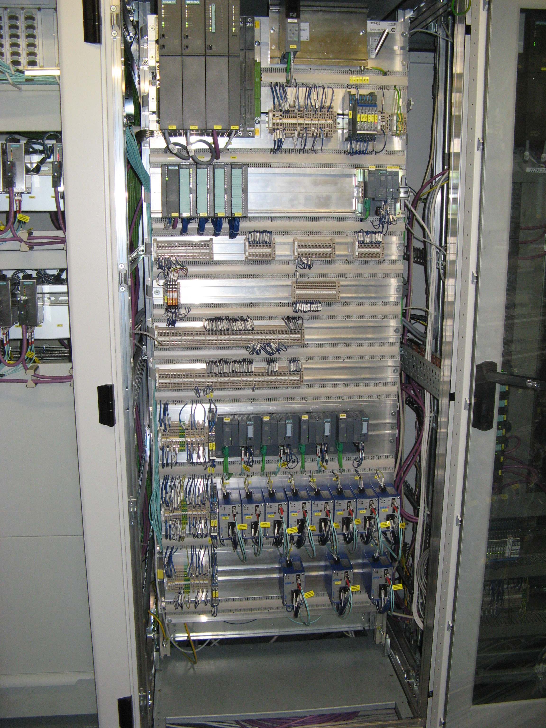
Highlights of W7-X Fast Interlock System
        Enhancement of the Fast Interlock System for operational Phase 2.1 of W7-X,
        Using fast PLC CPU Siemens 1573 for processing of cFIS Interlock Functions,
        Input/Output of interlock signals via decentral periphery devices ET200SP,
        Using Profinet bus for connection the CPU 1500 with all ET200SP devices,
        Integration of new FIS diagnostic signals for divertor protection, for ICRH heating and Continuous Pellet Fulling System (CPFS),
        Integration of new FIS actuator signals: NBI20, ICRH, Continuous Pellet Injection (CPFS),
        Extension and modification of Interlock Functions for Op2.1,
        Implementation of a new Unlock_Request / Heating_Release cycle for all heating systems,
Fig. 3: Structure of FIS

Slide 4
Thanks for attention!
Please contact me during the poster session!
Poster session , Poster ID # 56

Slide 5
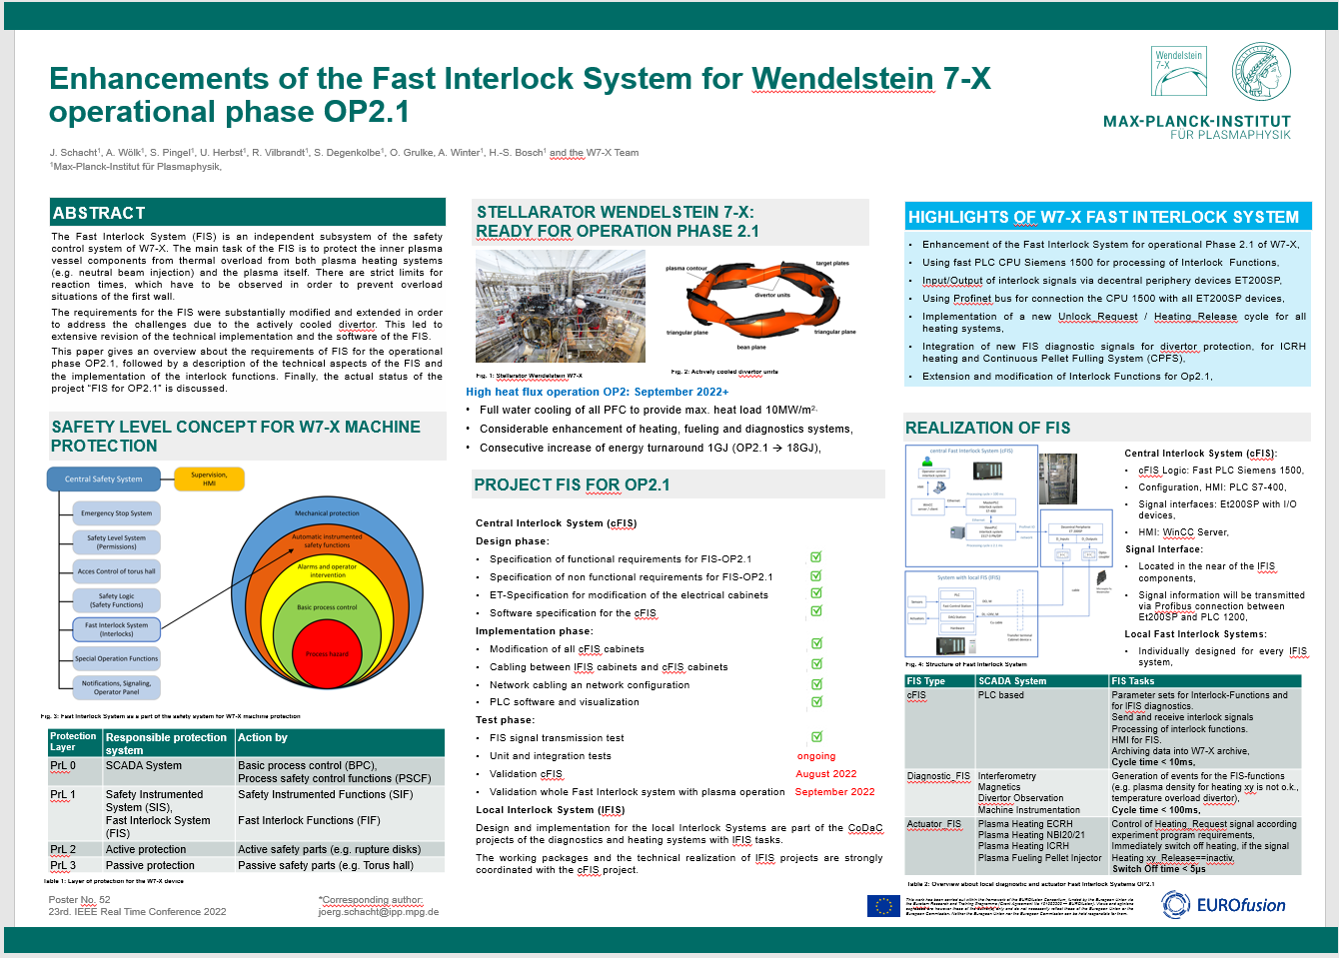
Preview of Poster #56

