Slide 1

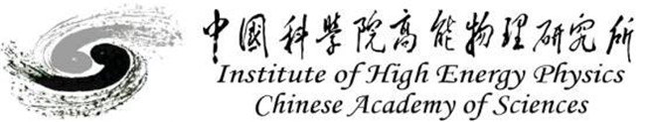
PMT Waveform Timing Analysis Using Machine Learning Method
Reporter: Qi Wu Tutor: Sen QIAN ( 钱 森 )
Institute of High energy Physics, Chinese Academy of Science
qians@ihep.ac.cn 3rd. Aug. 2022

Slide 2
Outline
I. Background
II. Timing of a TOF system
III. CNN model and Timing results
IV. Summary

Slide 3
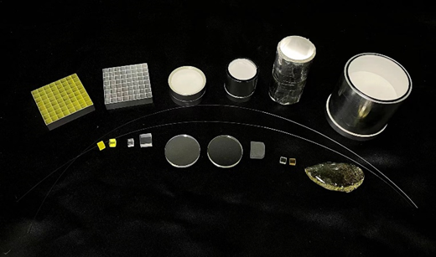
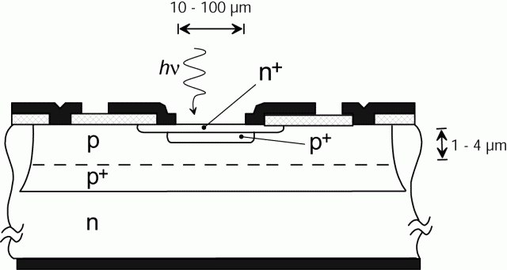
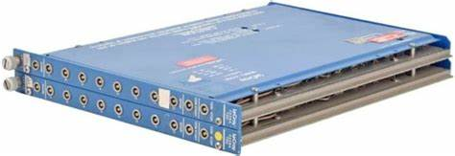
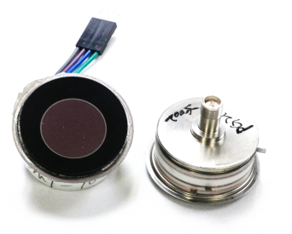
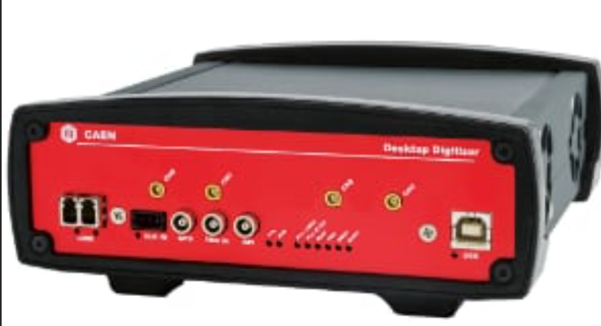
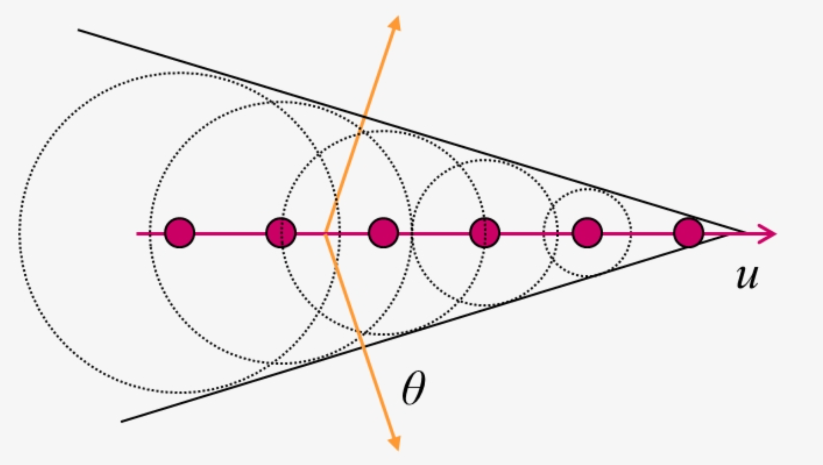
1.1 Background
Time of Flight System$→$ Fast Time & Real Time
Source
Detector
Acquisition
algorithm
SiPM
High QE & Cheap
Temperature Dependance
High Noise
TDC
Early time acquisition plugin
Support CFD & LED
LED
Constant Threshold leading Edge Discrimination
Scintillators
Strong Light Yield
Slow Time Performance
CFD
Constant Fraction leading edge Discrimination
FADC
Newly Developed acquisition device
Whole waveform stored for analysis.
MCP-PMT
Fast!
Low QE & Expensive
Template Fitting
Reduce time jitter caused by noise
Cherenkov Radiator
Fast!
Low Light Yield
CNN
Time correction by features extracting
Notes:
Time of Flight System is widely used in high energy physics experiments and medical imaging devices. The timing performance is very important for the time of flight system including the fast time resolution and real time. The time of flight system usually contains four parts including the source, the detector, the acquisition system and the timing algorithm. The light source directly affect the timing accuracy. The scintillators used contains the fiber, the glass, the ceremic and the crystal which are produced with different methods. The have similarities that the light yield is strong and the time performance is relatively slow. The Cherenkov radiation is very fast but the light yield is low. The second part of the time of flight system is the photon detector. The SiPM is a compact photon detector which is composed of lots of avanlanche photodiodes. The SiPM has high QE and its price is usually low. But its performance is greatly affected by the tempareture and the noise is high. The MCP is a exquisite multiplication structure which ensures the MCP-PMT with great time resolution. But the MCP-PMT usually has QE of less than 30% and the price is high. At early time, the time-to-digital converter is widely used. It supports the CFD and LED timing method. In recently yeas, the development of the waveform sampling instrument makes it possible to obtain the whole waveform and extract more information. Therefore, more algorithms are also developed. In this report, the algorithms are mainly discussed especially the CNN method.

Slide 4
Outline
I. Background
II. Timing of a TOF system
III. CNN model and Timing results
IV. Summary

Slide 5
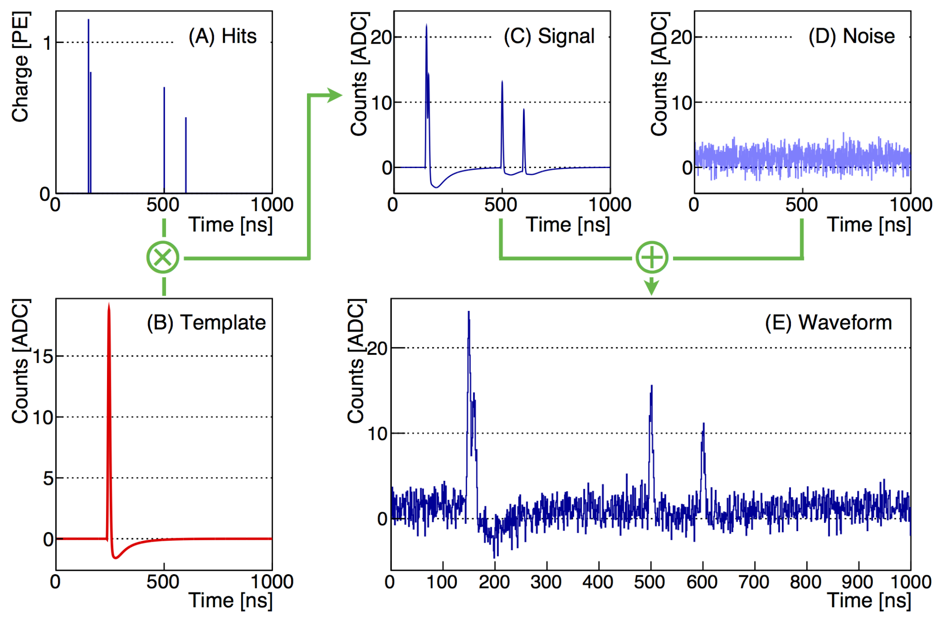
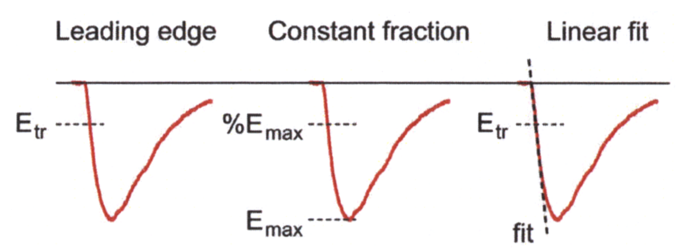
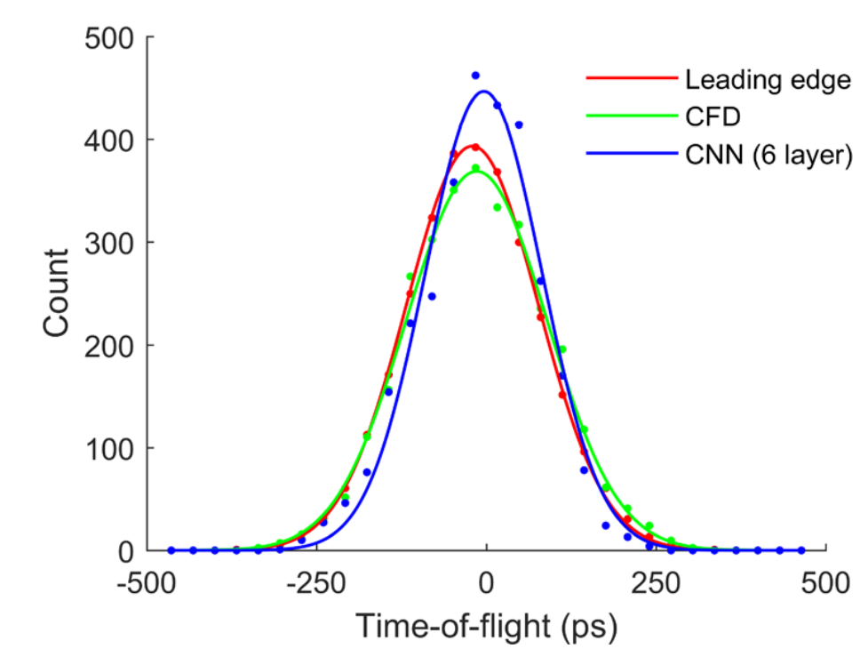
2.1 Different Timing Methods
Leading Edge Discrimination (LED)
Constant Fraction Discrimination (CFD)
Timing
Template Fitting Before timing
PMT waveform Formation Process [1]
CNN Timing Regression[2]
Locating the original time point from the waveform.
Amplitude fluctuation-Noise-PMT instinct jitter
Ref 1. BRIGATTI A, GRASSI M, et al. Charge reconstruction in large-area photomultipliers. Journal of Instrumentation, 2018, 13(2)
Ref 2. Eric Berg and Simon R Cherry, Using convolutional neural networks to estimate time-of-flight from PET detector waveforms, 2018 Phys. Med. Biol. 63 02LT01
Notes:
Lets begin from the formation of the PMT waveform. The hit time of the photons is convolved with the SPE template, and then convolved with the noise waveform. The simulated PMT waveform is obtained. What we are going to do in the timing process is to locate the original time point from the waveform. There are several elements which affect the final timing performance. The amplitude fluctuation of the waveform can be corrected with the CFD method. The noise effect can be corrected with the pre template fitting. But the LED, CFD and the template fitting can not improve the instinct jitter from the PMT. The CNN method is expected to furtherly improve the time resolution.

Slide 6
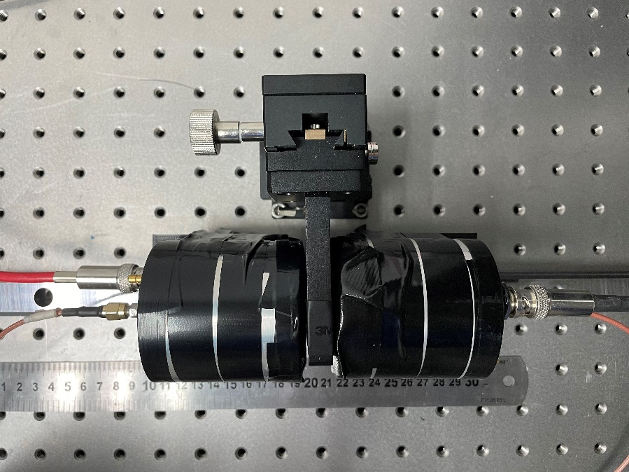
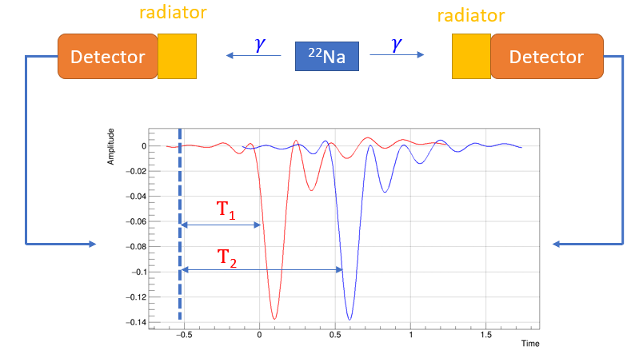
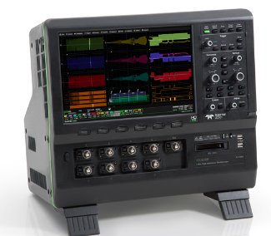
2.2 Time of Flight System
Cherenkov radiation detection
Time of Flight System
Detected by Fast time MCP-PMTs (FPMT)
FPMT1
 | Gain | RT | TTS
FPMT1 | 1.9E6 | 104 | 46
FPMT2 | 2.9E6 | 96 | 44
FPMT2
²²Na
Recorded by oscilloscope
Sampling Rate: 20GSa/s
BandWidhth:4G
Notes:
The Cherenkov radiation detection system built in our laboratory is different from the typical system. The window of the FPMT is used as the Cherenkov radiator and a sodium 22 is used as the radioactive source. The two FPMTs used has RT of around 100 ps and TTS of around 45 ps. The output waveforms are recorded with the oscilloscope whose sampling rate is 20GSa/s and BandWidth is 4G.

Slide 7
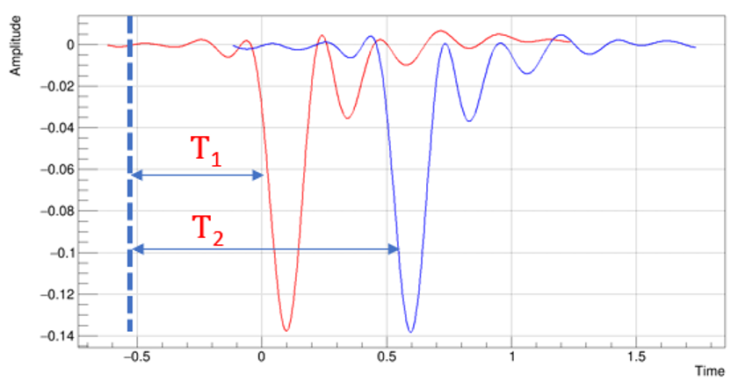

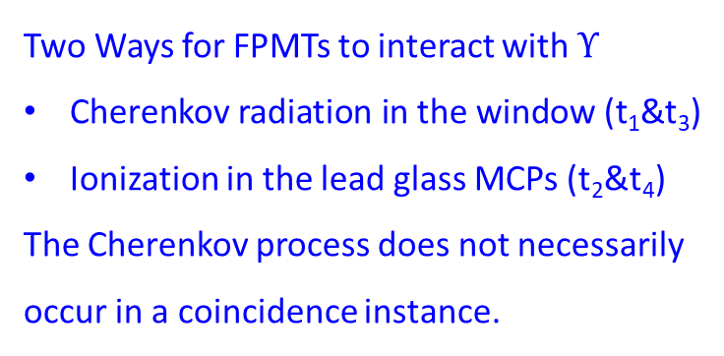

2.3 Timing of Flight System
Anode
Window
MCP
Two Ways for FPMTs to interact with $Υ$
Cherenkov radiation in the window (t₁&t₃)
Ionization in the lead glass MCPs (t₂&t₄)
The Cherenkov process does not necessarily occur in a coincidence instance.
t₂
t₁
t₃
t₄
²²Na
T₁
$$γ$$
$$γ$$
T₂
Time Difference = T₁ – T₂
The leading edge of the waveform is used for timing.
Four components in Time Difference
Time Difference = (t₁||t₂) – (t₃||t₄)
Notes:
In this system, there are two ways from FPMTs to interact with gamma. The first is the Cherenkov radiation in the window which does not necessarily occur in a coincidence instance. The second is the ionization process in the lead glass MCPs. Since the leading edge of the waveform is used from timing, there should be four components in the Time difference distribution. the t1 or t2 minus the t3 or t4;

Slide 8
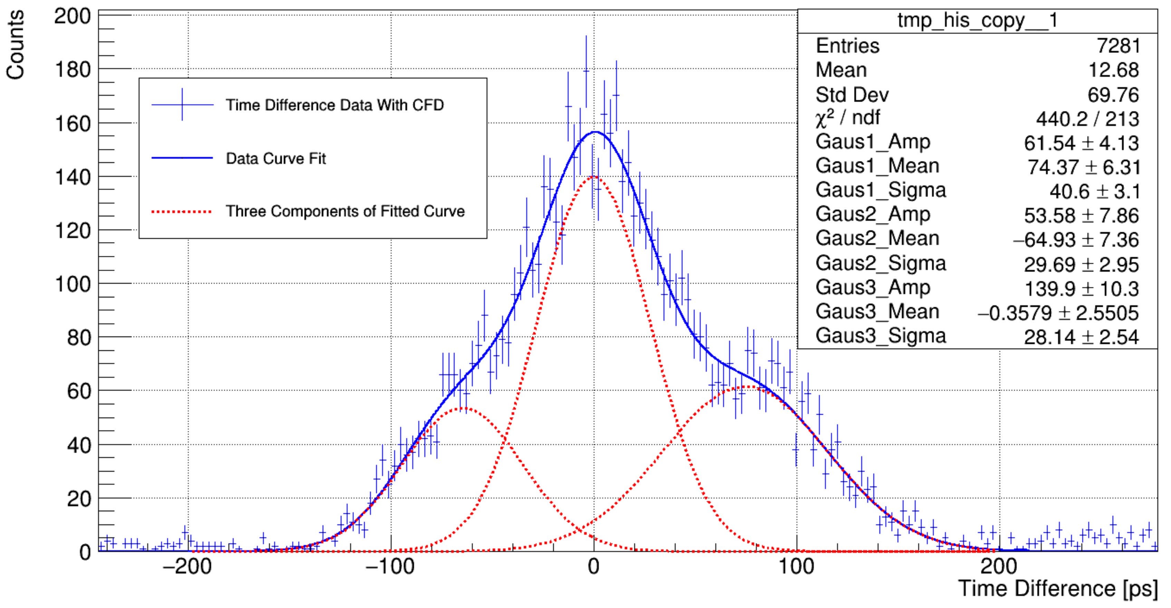
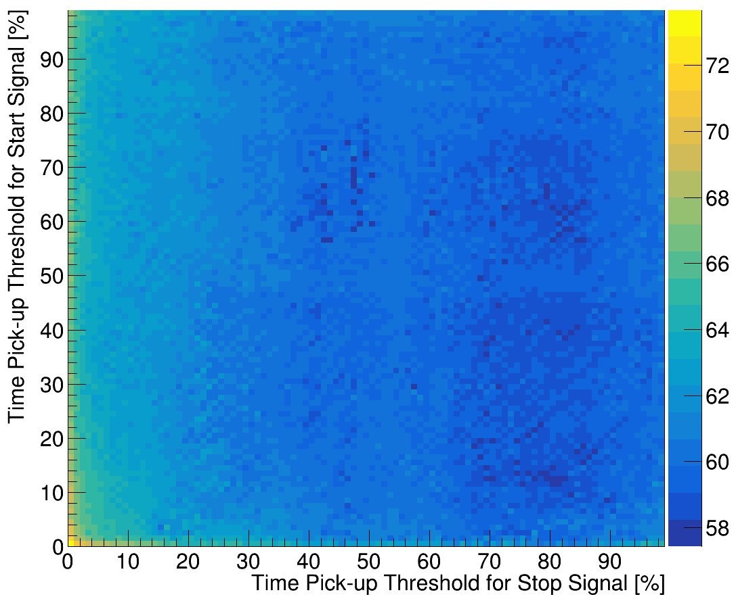
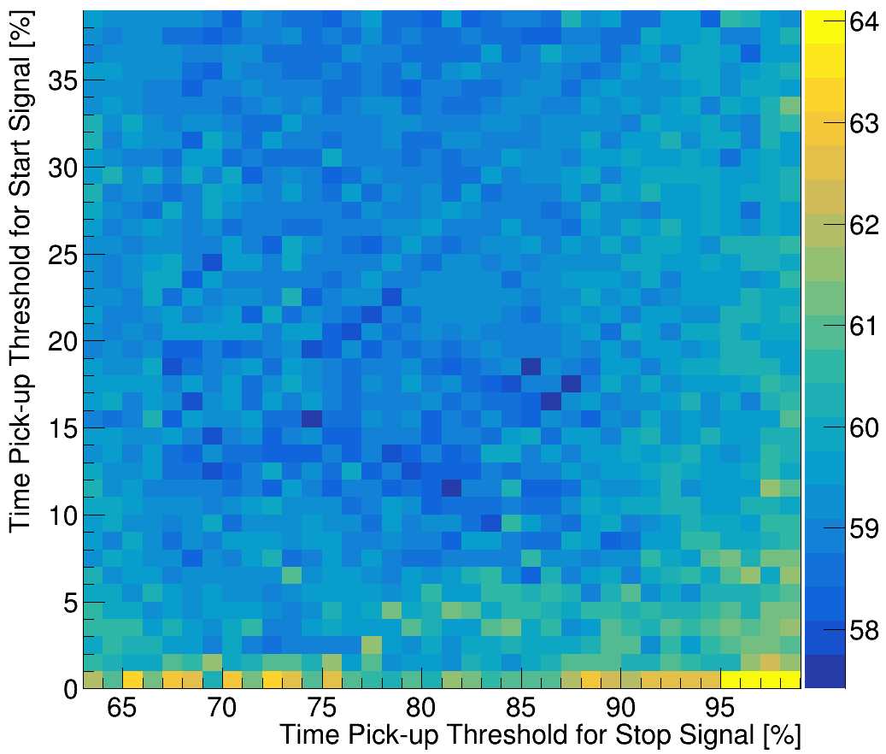
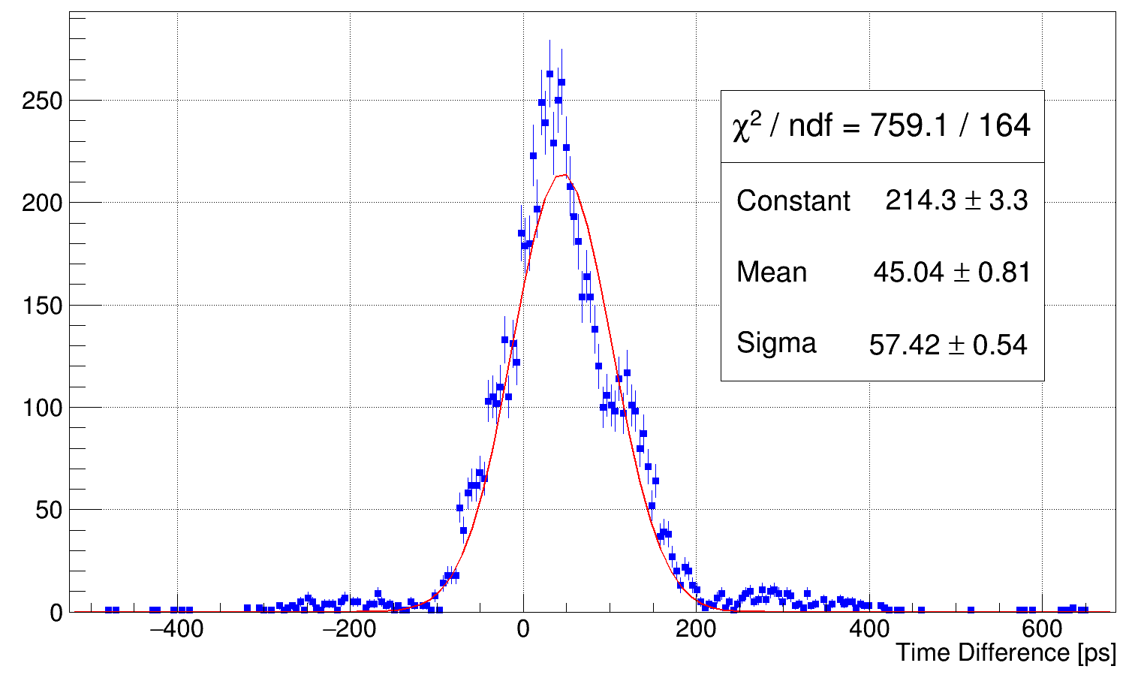
2.4 Time of Flight System
Gaus1: t₂ - t₃ Sigma = 41 ps
Gaus2: t₁ - t₄ Sigma = 30 ps
Gaus3: t₁-t₃ & t₂-t₄ Sigma = 28 ps
Global Std Dev = 70 ps
Gaus3
Time resolution is greatly deteriorated when different parts of PMT contribute at the same time.
Gaus2
Gaus1
Time Difference distribution obtained with CFD
Best TTS with CFD: 57.4 ps
18% Thre. for start
85% Thre. for stop
Notes:
In the real time difference distribution obtained with CFD. Three gaussian fucntions are used to fit the data and respectively correspond to the four components metioned before. Though the sigma of all three gaussian are bellow 50 ps, the global standard deviation is 70 ps, which measn the time resolution is greatly worsen when different parts of PMT contribute at the same time. In order to make comparison with the CNN method, the threshold of the CFD method is optimized and the best TTS is 57 ps.

Slide 9
Outline
I. Background
II. Timing of a TOF system
III. CNN model and Timing results
IV. Summary

Slide 10
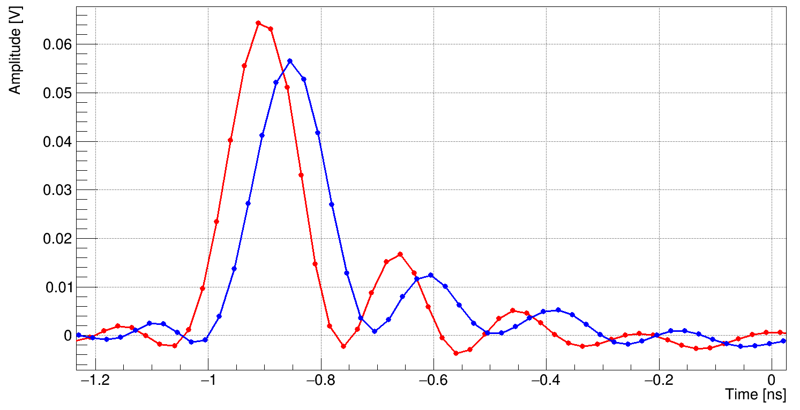
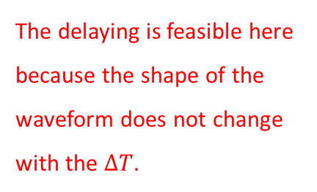
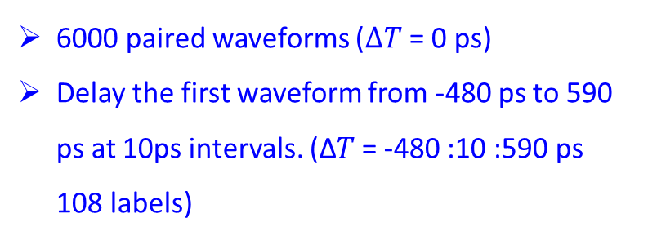
3.1 CNN structure and Data Preparation
Convolution-2D
BatchNormalization
x4
Linear
Output
Time Difference
Amplitude
Normalization
Activation (RELU)
The structure of timing CNN-based model
Training Dataset
CNN Paramaters
6000 paired waveforms ($ΔT$ = 0 ps)
Delay the first waveform from -480 ps to 590 ps at 10ps intervals. (∆𝑇 = -480 :10 :590 ps 108 labels)
LR: 0.0001
EOPCH: 461
Batch Size: 36
Lose Function：MSE
Optimizer：Adam
GPU NVIDIA Quadro T1000
The delaying is feasible here because the shape of the waveform does not change with the $ΔT$.
Delay
Notes:
This figure gives the structure of the CNN-based model. The input is a paired waveform. After four layers of convolution, the output is the time difference obtained with the CNN model. In order to obtained the trained dataset with different labels. 6000 paired waveform with 0 time difference are obtained. The waveform is delayed from -480 ps to 590 ps at 10 ps interval. The delaying is feasible here becaused the shape of the waveform does not change with the time difference. The detailed CNN parameters are given at the right side. The learning rate is fixed to 0.0001. The loss function is the MS

Slide 11
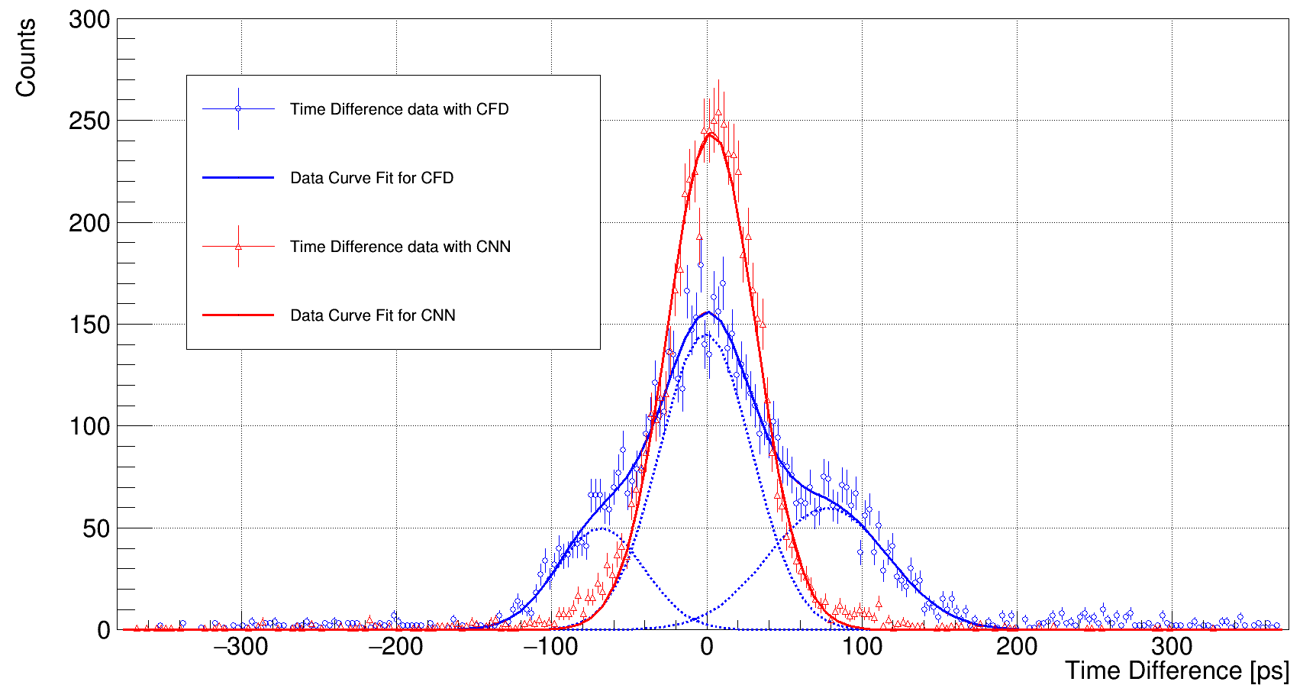
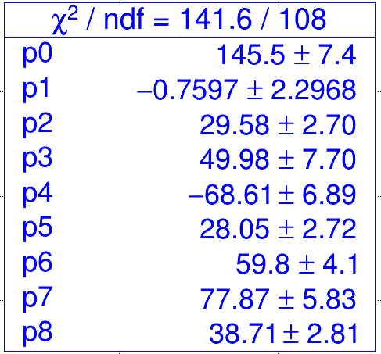
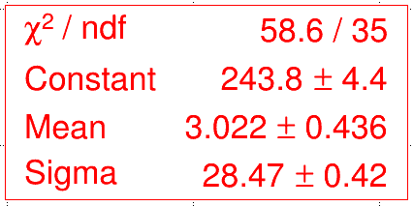
3.2 CNN timing results
Global Sigma: 57.4 ps
t₁-t₃
t₂-t₄
t₁ - t₄
t₂ - t₃
For the Global Std Dev, the CNN has 50% improved compared with the optimized CFD.
The results show that the CNN successfully corrects the side peaks to the middle and furtherly improve the time resolution.
Notes:
The timing results show that the CNN has nearly 50% of improvement compared with the optimized CFD. The distribution proves the CNN successfully corrects the side peaks to the middle.

Slide 12
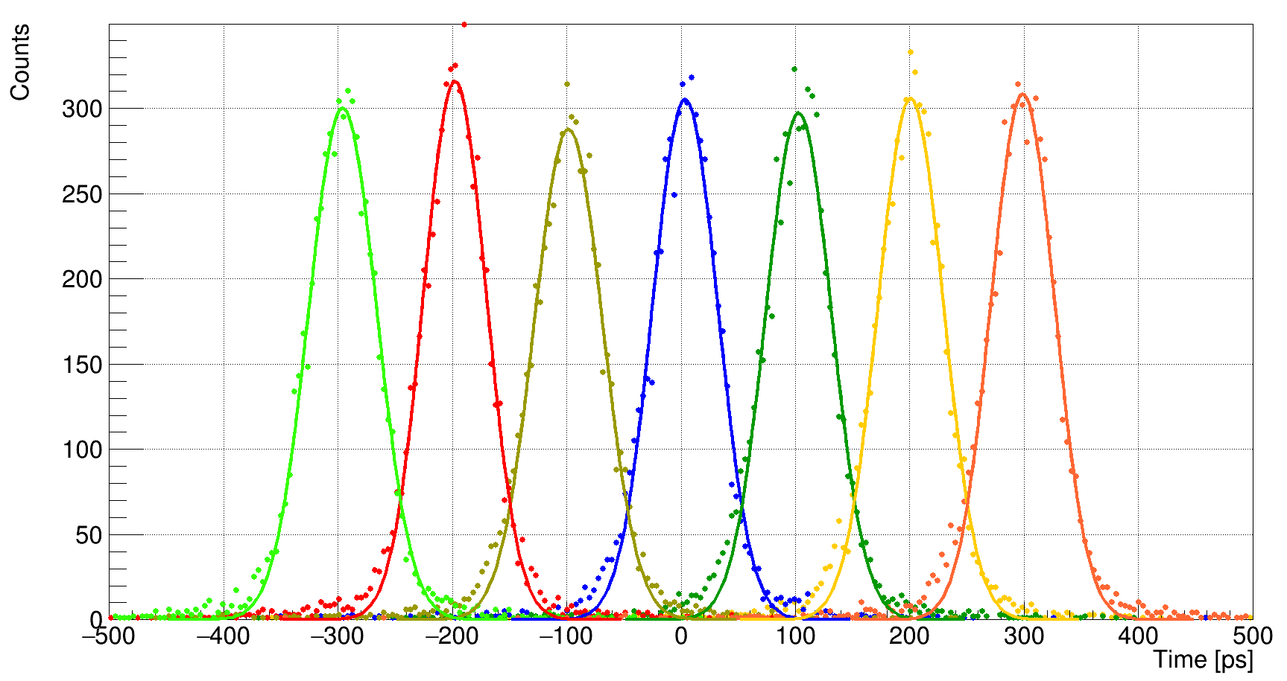
3.3 CNN timing among trained labels
Fit Range [mean-50,mean+50]
Real Time | -300 | -200 | -100 | 0 | 100 | 200 | 300
Mean | -295.9 | -197.7 | -98.5 | 3.6 | 102.8 | 200.8 | 298.9
Sigma | 29.7 | 27.4 | 29.9 | 28.5 | 28.8 | 28.6 | 29.9
For the six groups whose labels are among the trained labels, the CNN shows uniform, precise and accurate time resolution.
Notes:
For the six groups whose labels are among the trained labels, the CNN shows uniform, precise and accurate time resolution. The accuracy is around 5 ps and the timing precision are all bellow 30 ps.

Slide 13
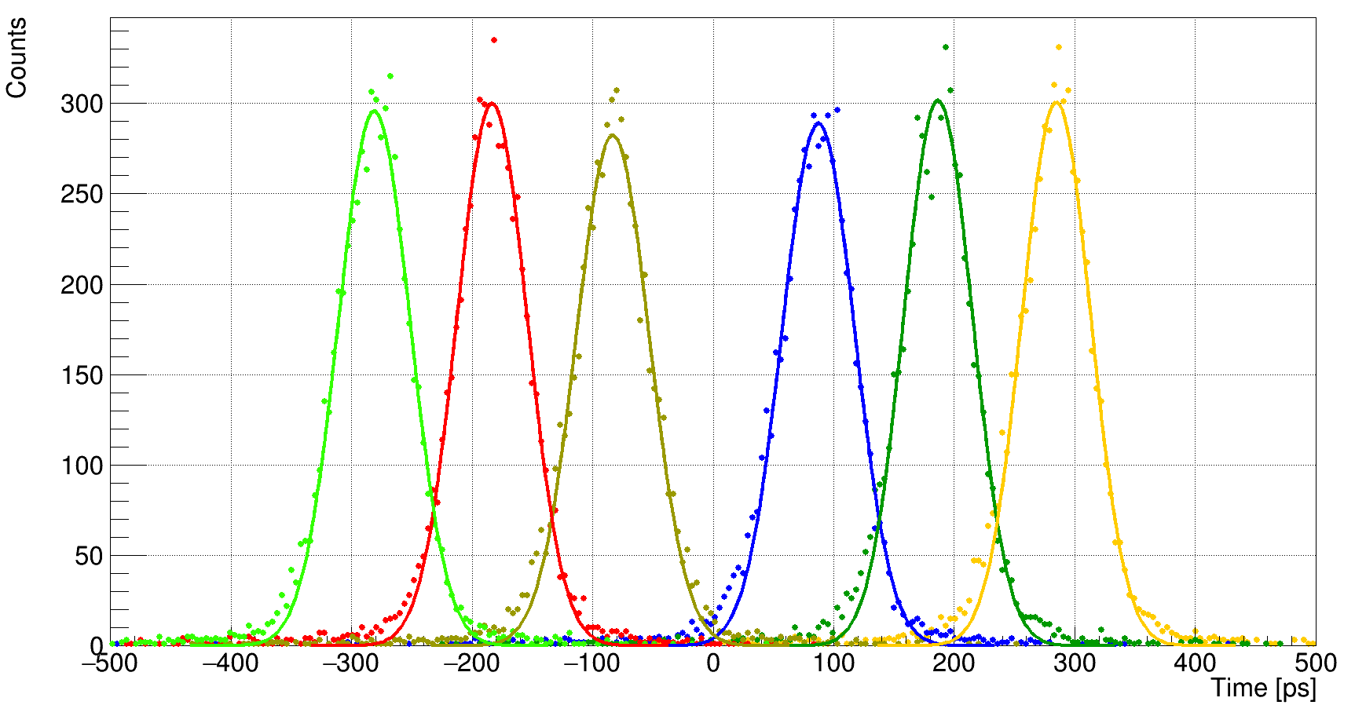
3.4 CNN timing beyond trained labels
Fit Range [mean-50,mean+50]
Real Time | -285 | -185 | -85 | 85 | 185 | 285
Mean | -281.2 | -183.4 | -83.3 | 87.3 | 186.6 | 284.7
Sigma | 29.8 | 29.1 | 30.0 | 30.0 | 28.5 | 28.5
For the six groups whose labels are beyond the trained labels, the CNN also shows uniform, precise and accurate time resolution. (No overfit in the model)
Notes:
For the six groups whose labels are beyond the trained labels, the CNN also shows uniform, precise and accurate time resolution, which proves the model is not overfitted.

Slide 14
Outline
I. Background
II. Timing of a TOF system
III. CNN model and Timing results
IV. Summary

Slide 15
4 Summary
The CNN method shows excellent ability in the PMT waveform feature extraction and make improvements on the time information correspondingly.
The fasting timing MCP-PMT is being developed and improvement in our laboratory. In order to furtherly realized the real-time timing analysis with the CNN method, more efforts are to be done in the electronics to write CNN into FPGA.
Notes:
CNN的输入为一对切伦科夫波形幅度构成的二维矩阵，输入到CNN的四层网络结构中，最终输出定时结果。训练使用的数据集为样管与源近贴采集的6000组事例，通过对第一个波形做延迟获得不同label的事例，验证集是另外6000组符合事例。相关的网络参数也在这里列了出来，目前都是还没优化的结果。

