Slide 1

Assessment of IEEE 1588-based timing system of the ITER Neutral Beam Test Facility
23rd Virtual IEEE Real Time Conference
L. Trevisan
A. Luchetta, G. Manduchi, C. Taliercio, A. Rigoni, P. Barbato

Slide 2
OUTLINE
NBTF
The synchronization problem
ITER CODAC networks
Time Communication Network (TCN)
Precision Time Protocol (PTP) in ITER
MITICA TCN topology
Omnet++ Simulation tool
Omnet++ network modelling
Hardware apparatus
Simulation data comparison (Slave - Switch)
Simulation data comparison (Slave - GMC)
Performance comparison (real data)
Performance comparison (simulation data)
TCN application: "Lazy Trigger"

Slide 3
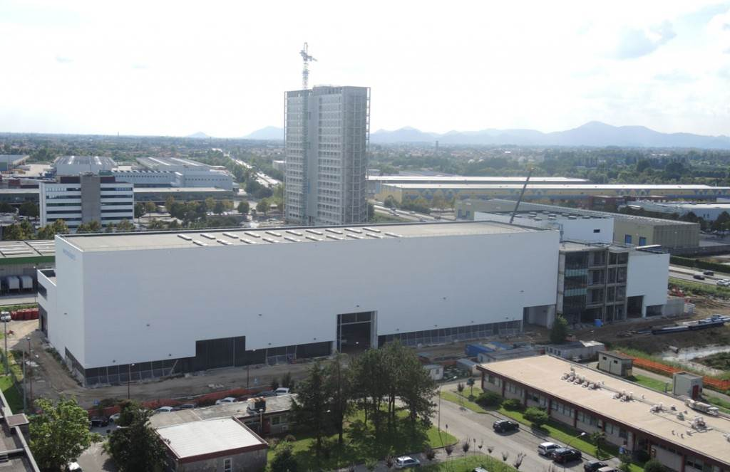
1 - NBTF
NBTF buildings

Slide 4


2 – The synchronization requirement
NETWORK
≤50 ns

Slide 5
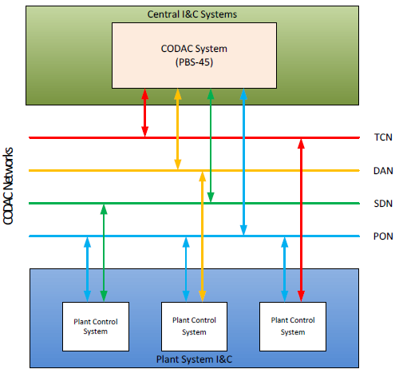
3 - ITER CODAC Networks
Time Communication Network (TCN)
Data Archive Network (DAN)
Synchronous Databus Network (SDN)
Plant Operation Network (PON)

Slide 6
4 – Time Communication Network (TCN)
Ethernet multicast UDP/IPv4 strategies
It ensures the synchronization of all the connected devices
It relies on the Precision Time Protocol (PTPv2)
Sub-microsecond accuracy with an RMS of 50 ns at maximum
Its APIs support various kinds of hardware modules to synchronize the plant hosts to the network time

Slide 7
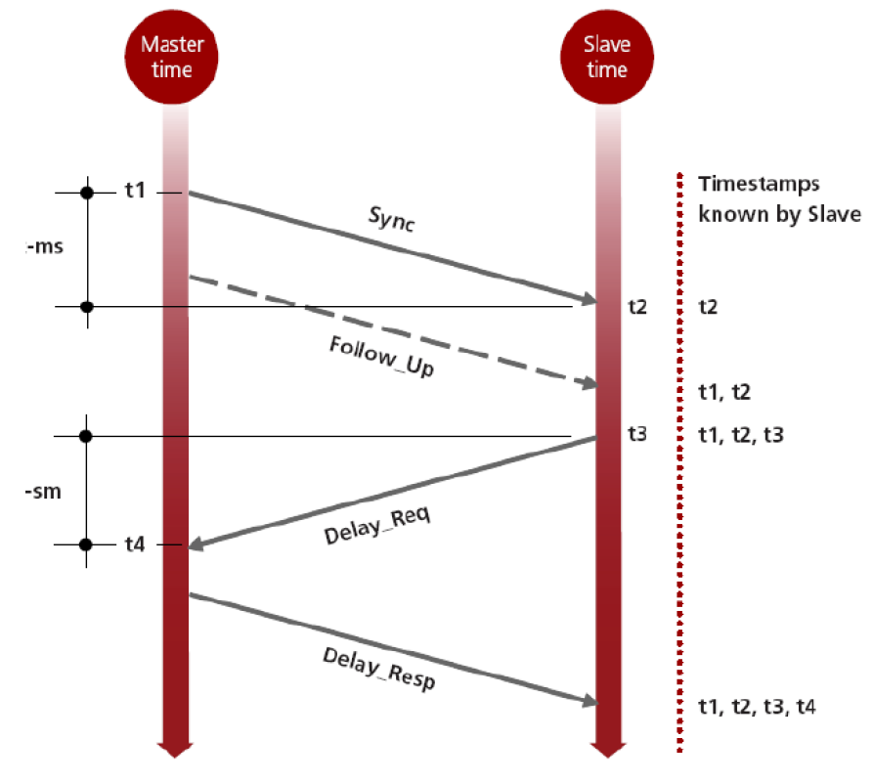
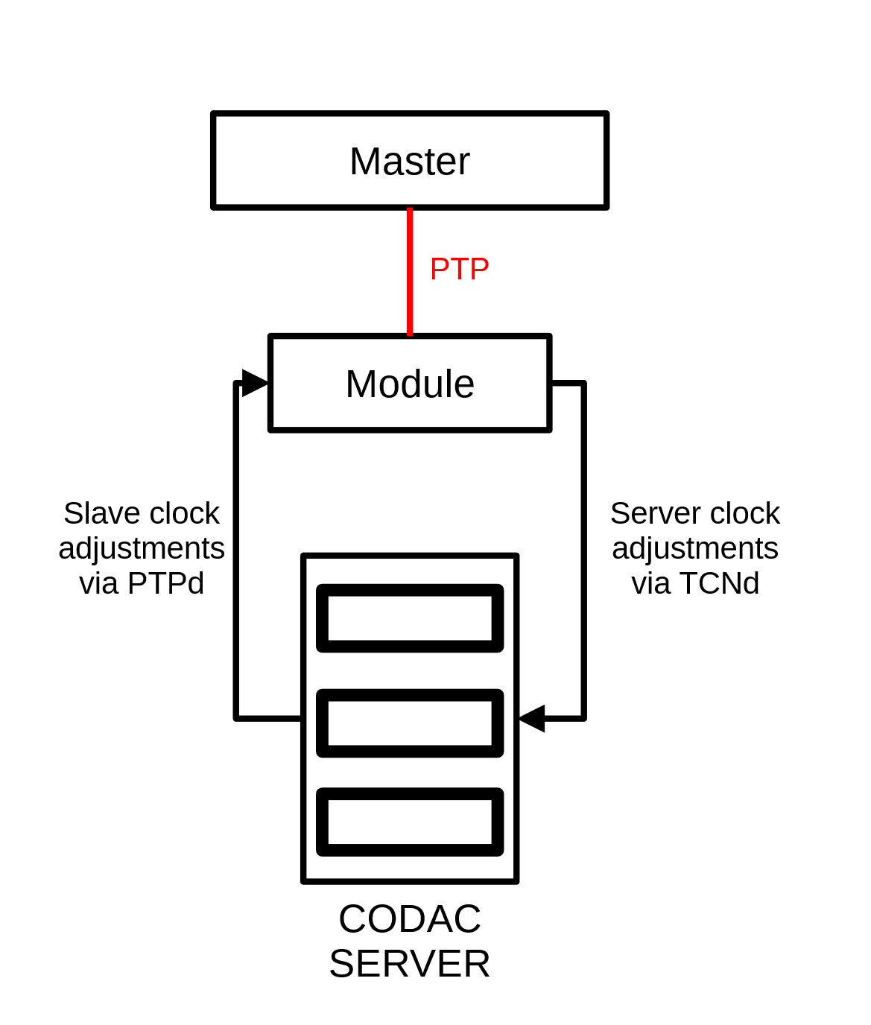
5 – Precision Time Protocol (PTP) in ITER
PTPd software pre-installed in CODAC
Hardware timestamping performed by external devices
TCNd software to synchronize the CODAC servers to the TCN
PTP timestamping scheme

Slide 8
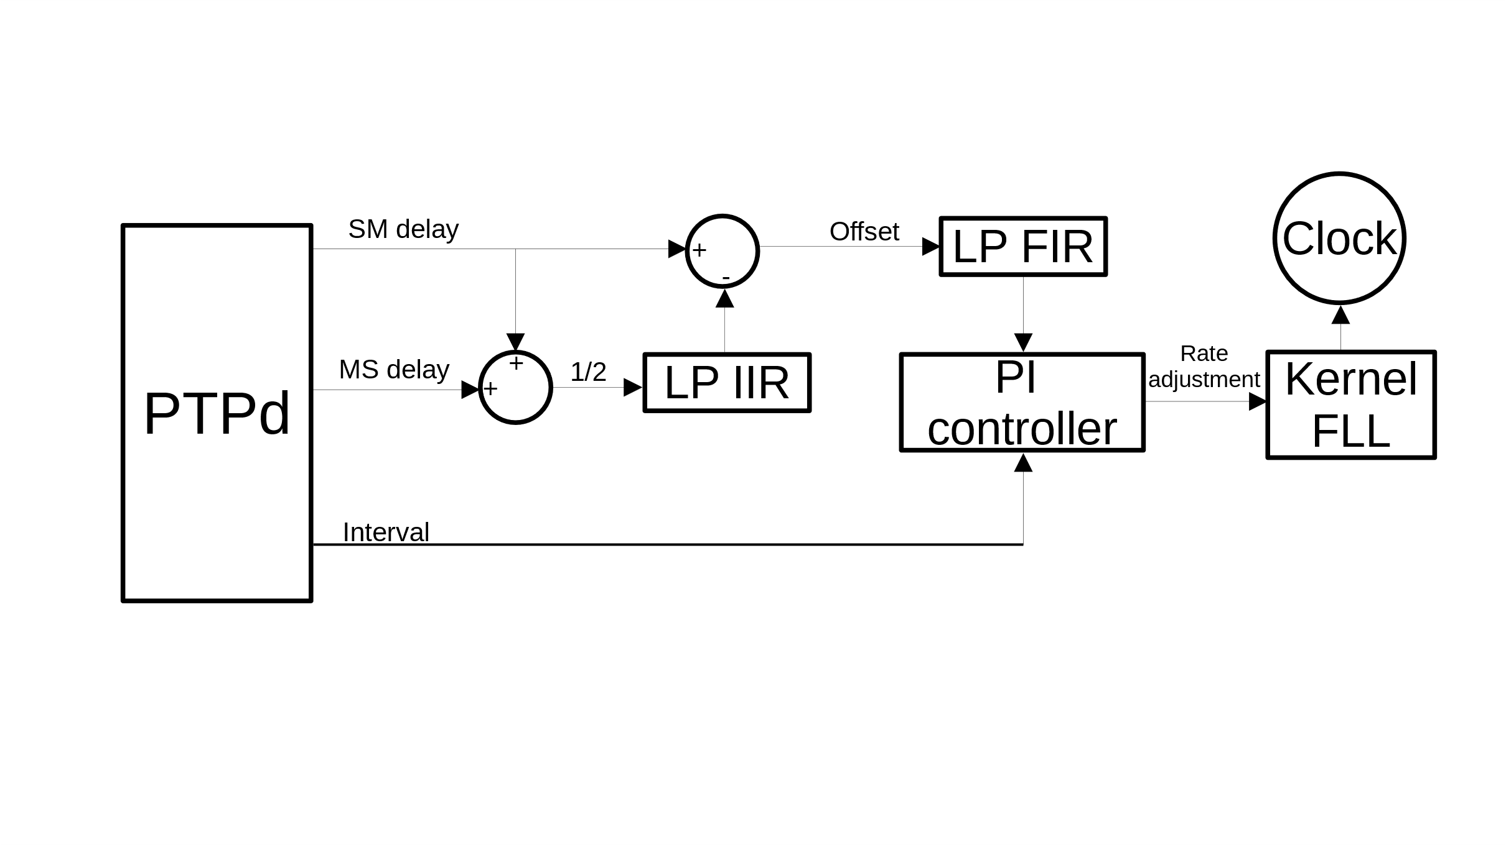
5 – Precision Time Protocol (PTP) in ITER
PTPd clock servo model

Slide 9
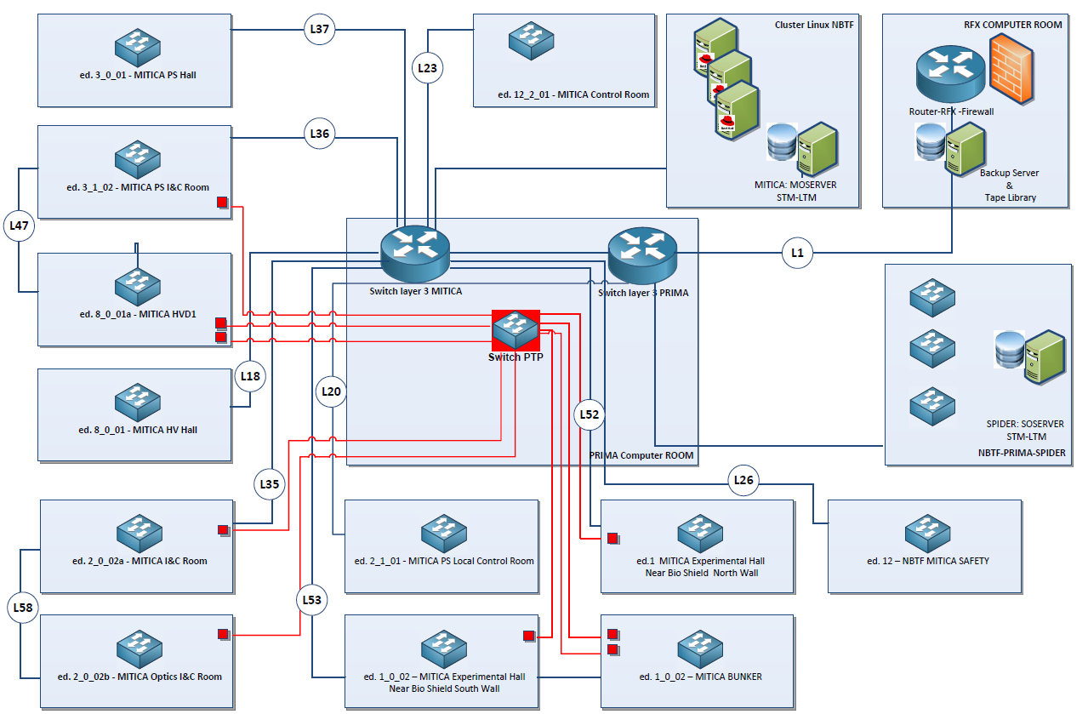
6 – MITICA TCN topology
MITICA networks scheme

Slide 10
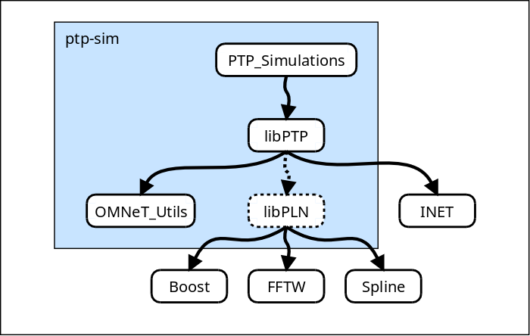
7 – Omnet++ Simulation tool
Open-source discrete event simulator
Based on C++ libraries and frameworks
Modular and highly extensible
“PTP-sim project” to simulate PTP networks
  libPTP library
  libPLN library
PTP-sim flow

Slide 11
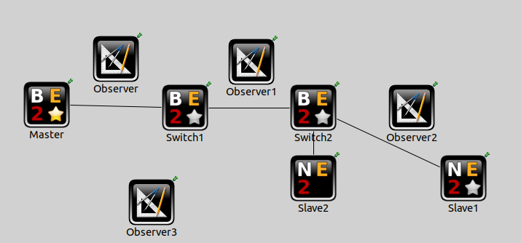
8 – Omnet++ network modelling
Omnet++ test simulation

Slide 12
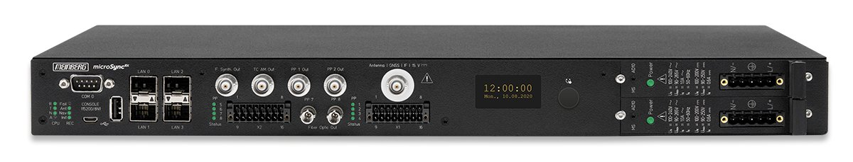
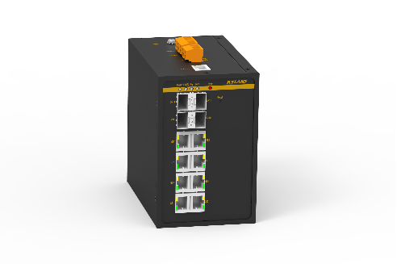
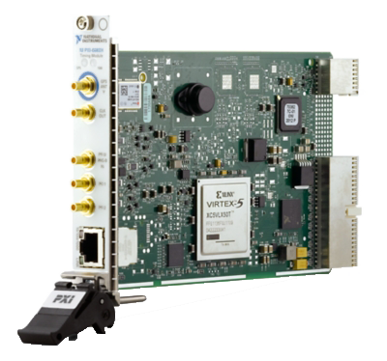
9 – Hardware apparatus
1 GMC: Meinberg Mycrosync RX201
2 switches: Kyland SICOM 3000A
2 slaves: NI PXI-6683H

Slide 13




9 – Hardware apparatus: GMC time
GPS SYNCHRONIZATION
TCN
GPS SYNCHRONIZATION

Slide 14
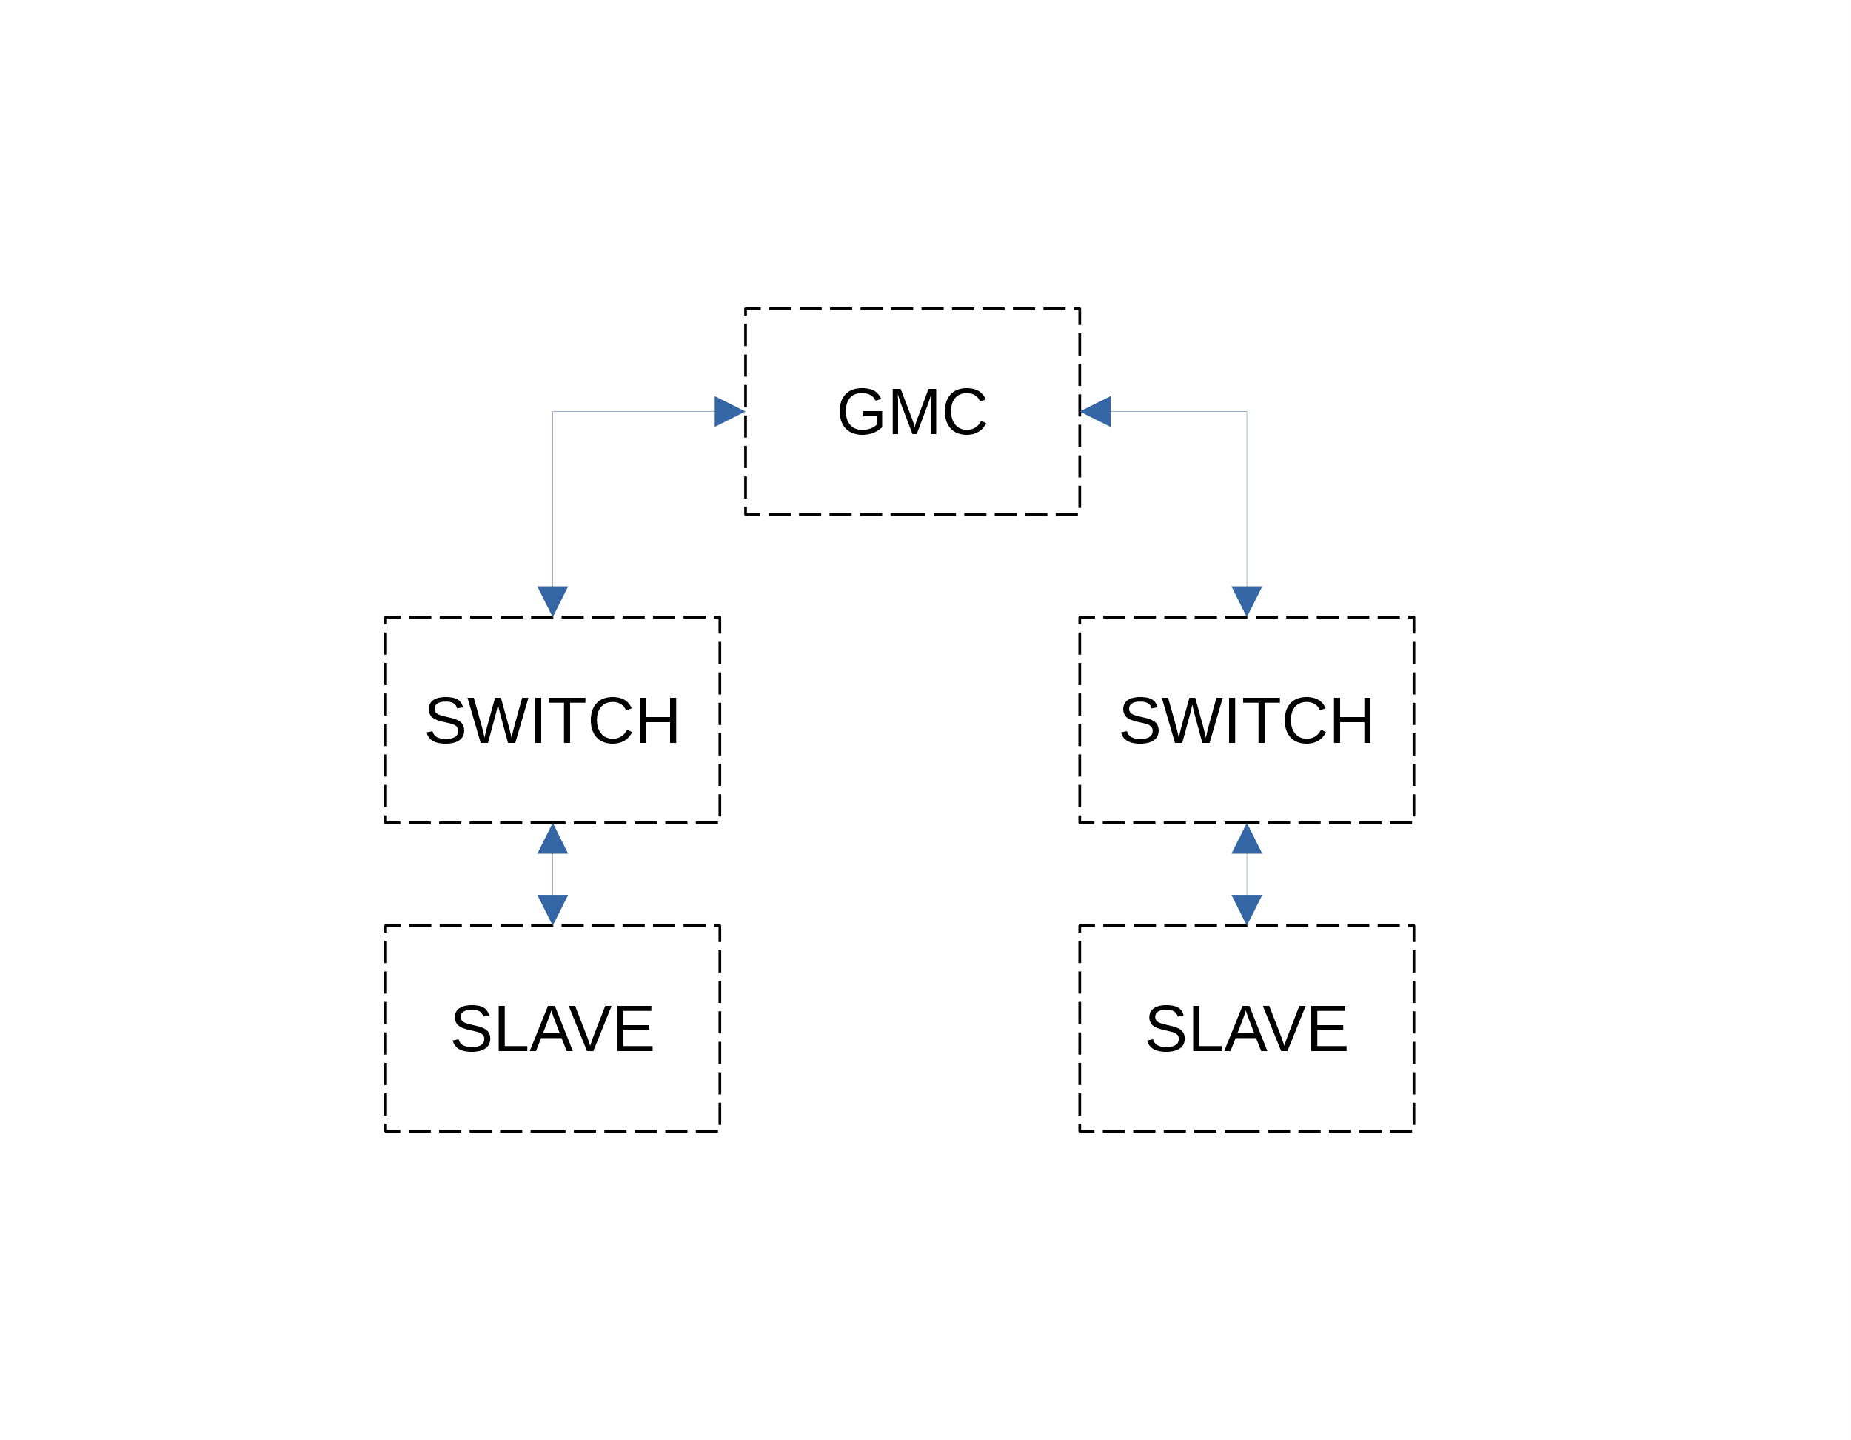
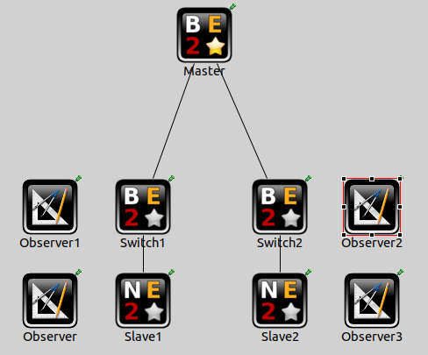
10 – Simulation data comparison (Slave - Switch)
offset from master

Slide 15
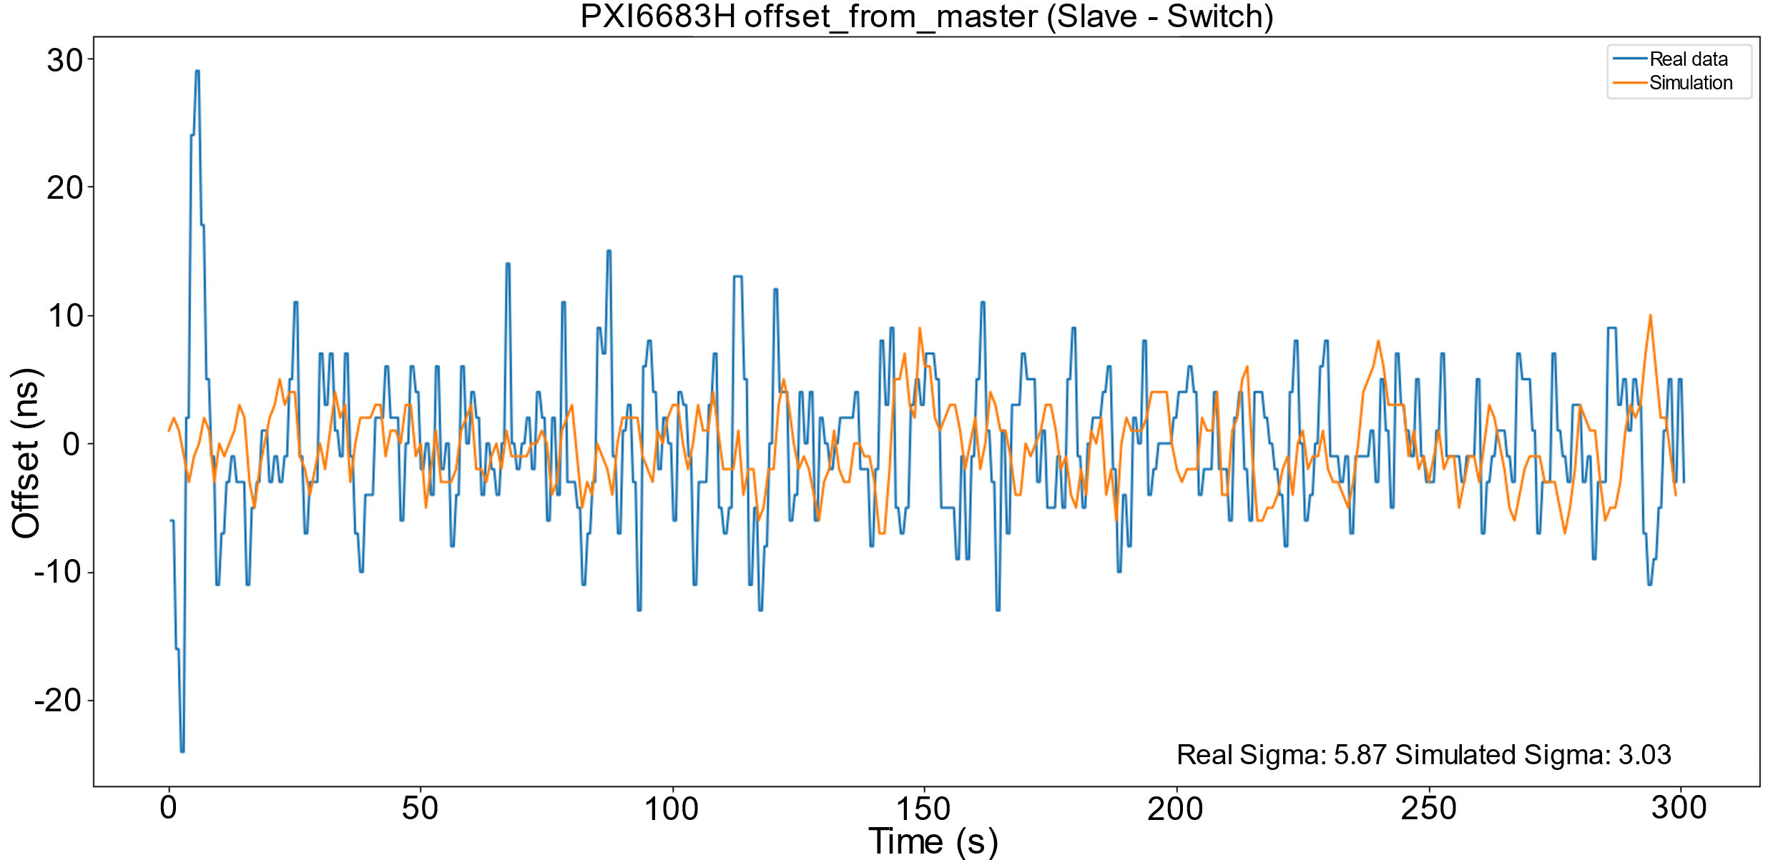
10 – Simulation data comparison (Slave - Switch)

Slide 16
11 – Simulation data comparison (Slave – GMC)
offset from GMC

Slide 17
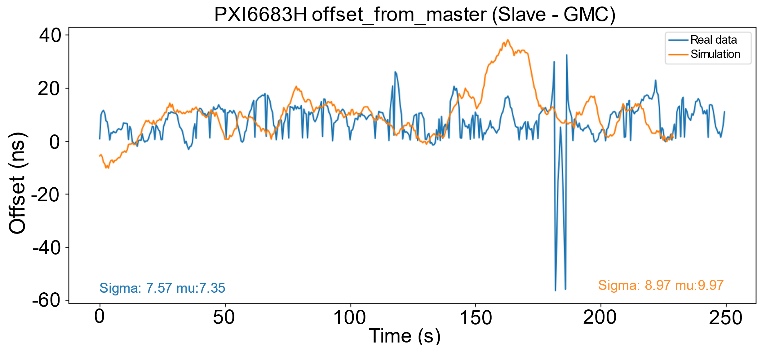
11 – Simulation data comparison (Slave - GMC)

Slide 18
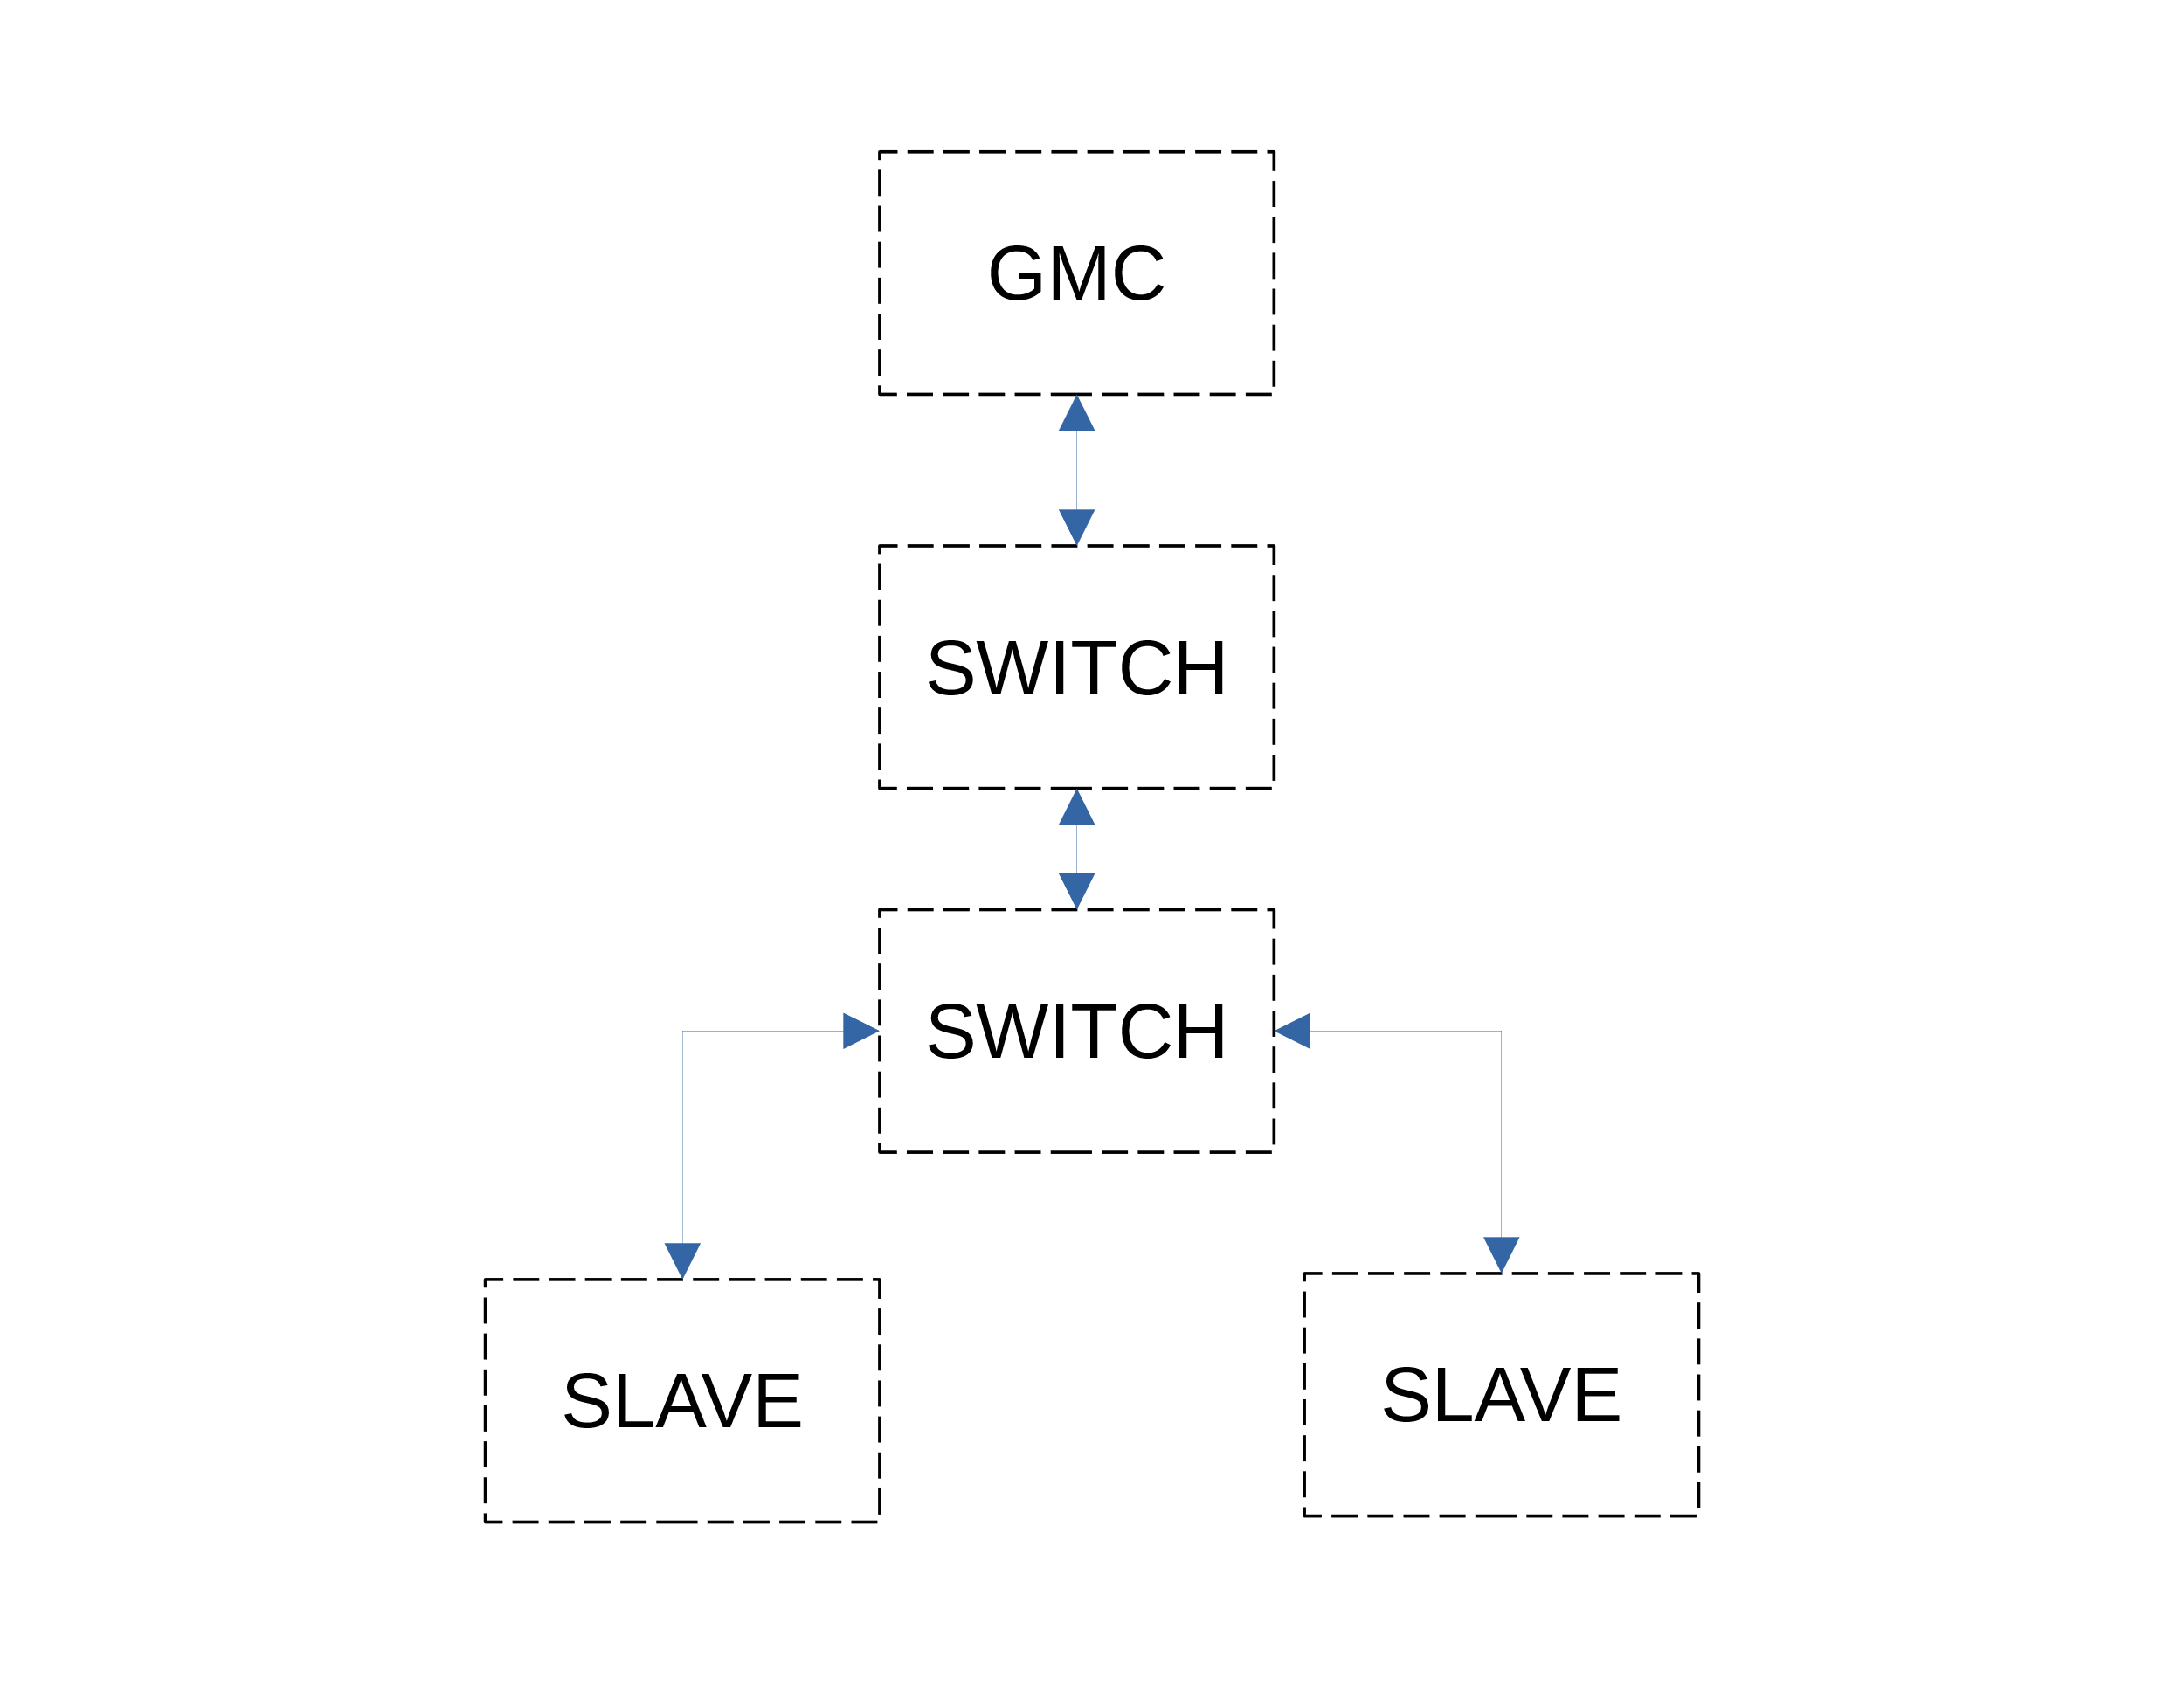
12 – Performance comparison (real data)
VS

Slide 19
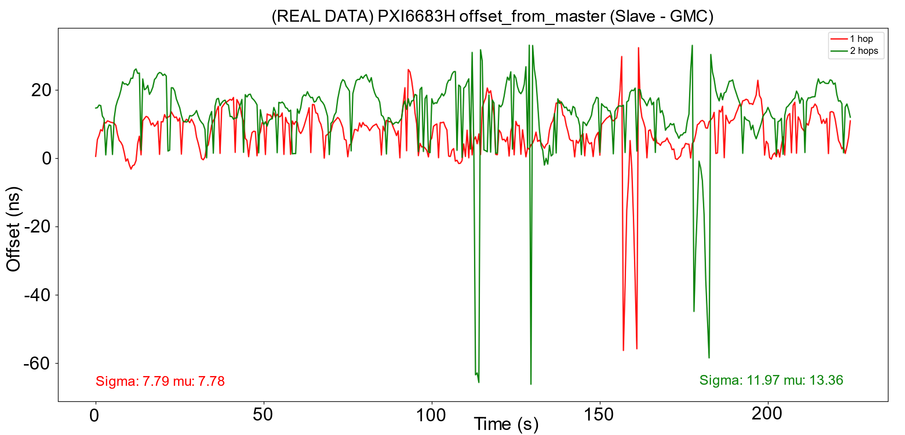
12 – Performance comparison (real data)

Slide 20
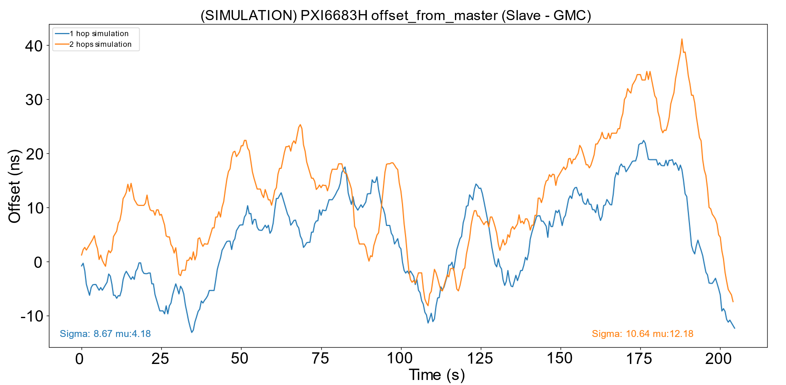
13 – Performance comparison (simulation data)

Slide 21
14 – TCN application: "Lazy Trigger"
event
event
t₀
t₀+ Δt_{s} + Δt_{n}
Network
Lazy Trigger
synchronization
event + timestamp
event + timestamp
t₀
t₀ + Δt_{n}
TCN

Slide 22
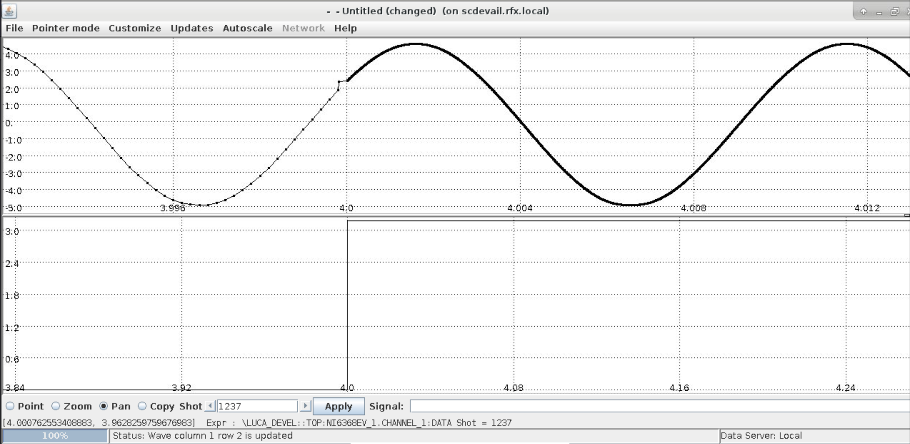
14 – TCN application: "Lazy Trigger"
1st system switches frequency
2nd system acquires the trigger

Slide 23
14 – Conclusions
Hardware apparatus compliant with the project requirements
TCN APIs and features have been tested
Omnet++ simulation tool gave good results and will be adopted to study more complicated topologies
The test campaign has been concluded and the RMS constraints have been respected both in the 1 switch case and in the 2 switches scenario

