Slide 1
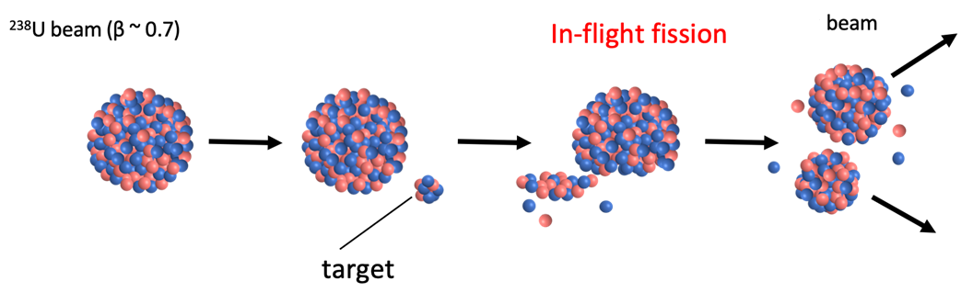
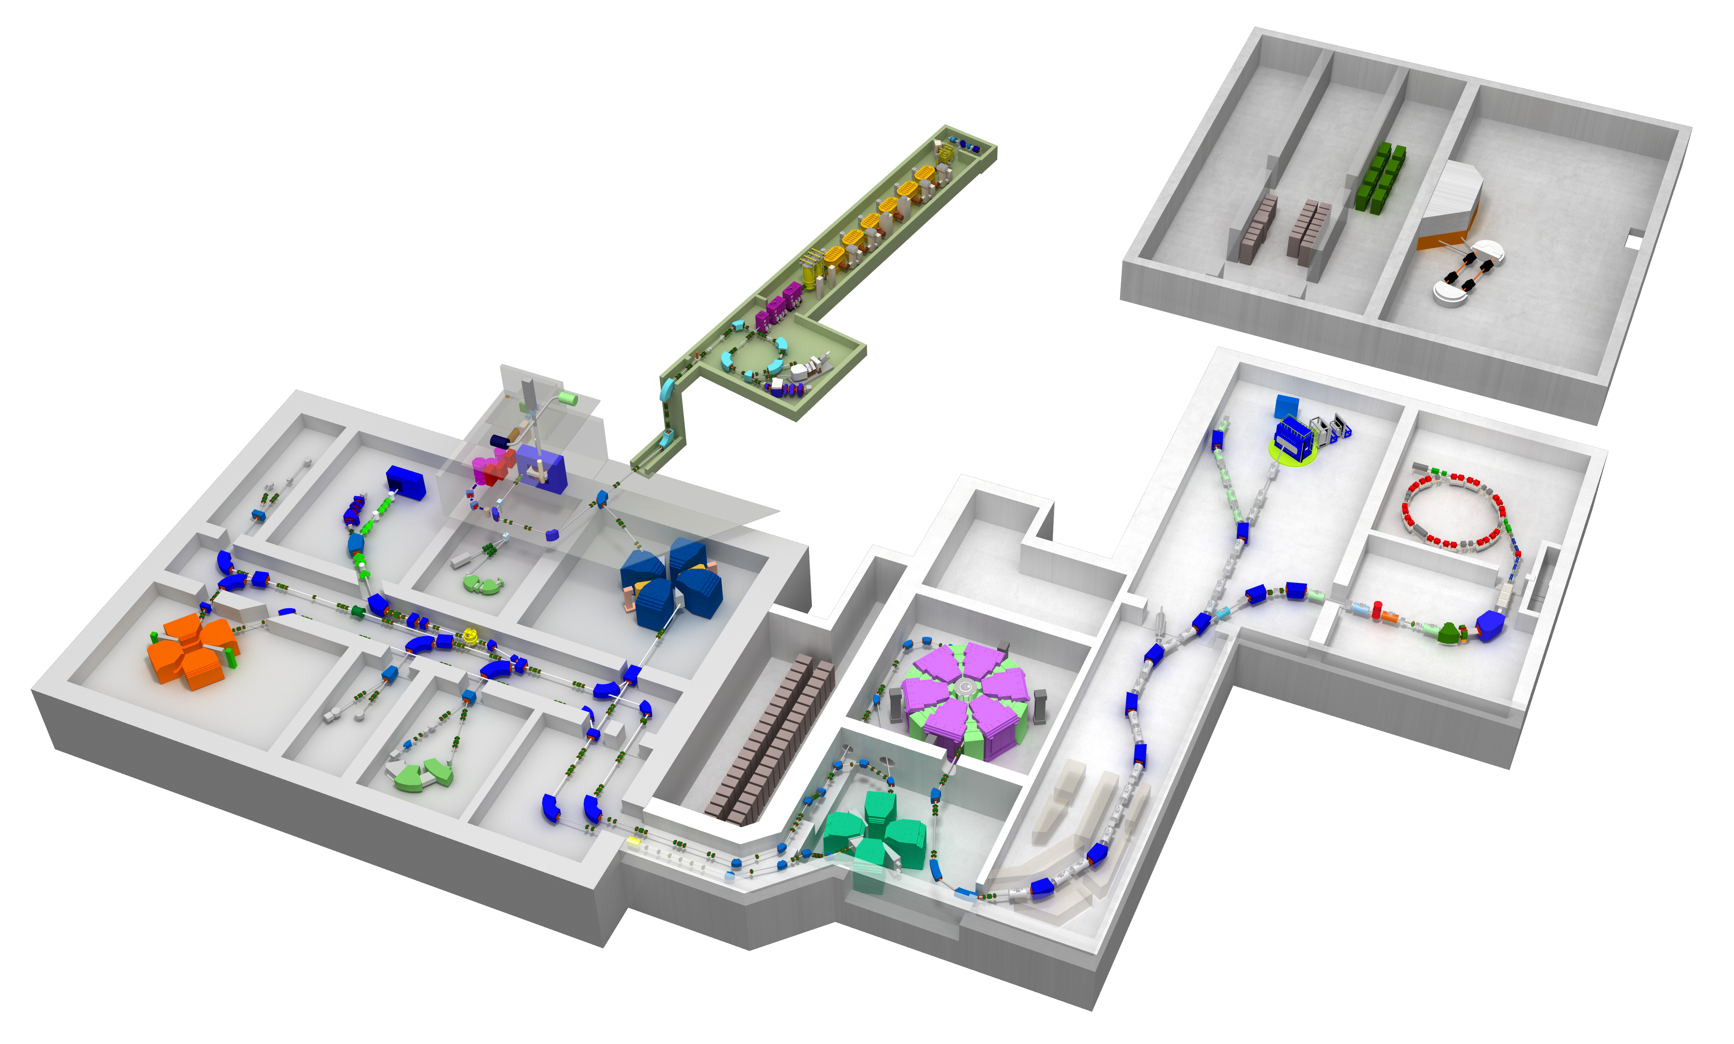
RIKEN RI Beam Factory(RIBF)
Time determination method using digital waveform processing with RFSoC for RI beam experiments
Shoko Takeshige^{A,B}, H.Baba^{B}, K.Kurita^{A}, Y.Togano^{B}, J.Zenihiro^{C}, Y.Hijikata^{B,C}
Rikkyo U.^{A}, RIKEN Nishina Center^{B}, Kyoto U.^{C}
Radioactive Isotope Beam
Uranium Beam
We are working on a data acquisition system for RIKEN RIBF that is a RI beam facility in Japan.
Experiments performed at RIBF require TOF measurements with high-rate and high-resolution.
RIKEN RIBF
Notes:
、これがビームライン。ここでRIビーム実験を行っている

Slide 2
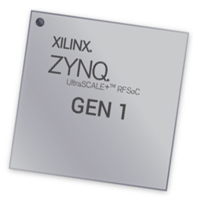
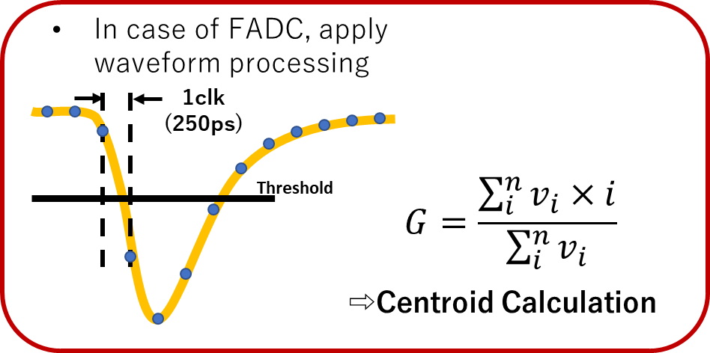
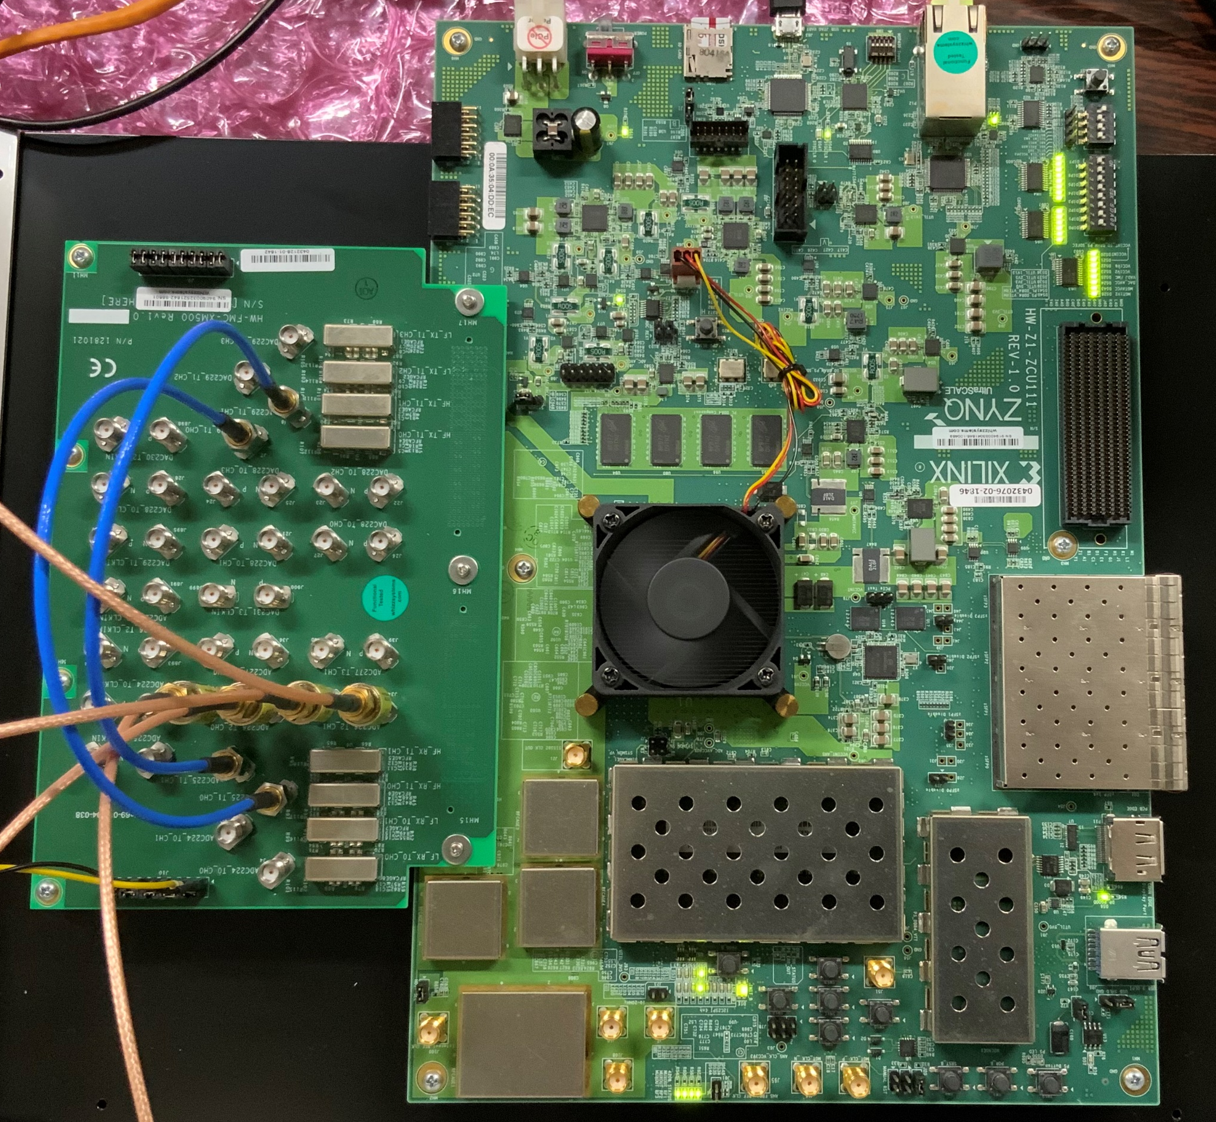
Xilinx RFSoC
Timing Resolution
4GHz ADC x8
FPGA
ARM CPU (Linux OS)
RFSoC
ZCU111 Evaluation kit
We have applied centroid calculation to waveform analysis to achieve the timing resolution of 10 pico seconds in sigma.
In this contribution, we report the method of real-time waveform processing for TOF measurement.
Notes:
登場：2018年夏

