Slide 1


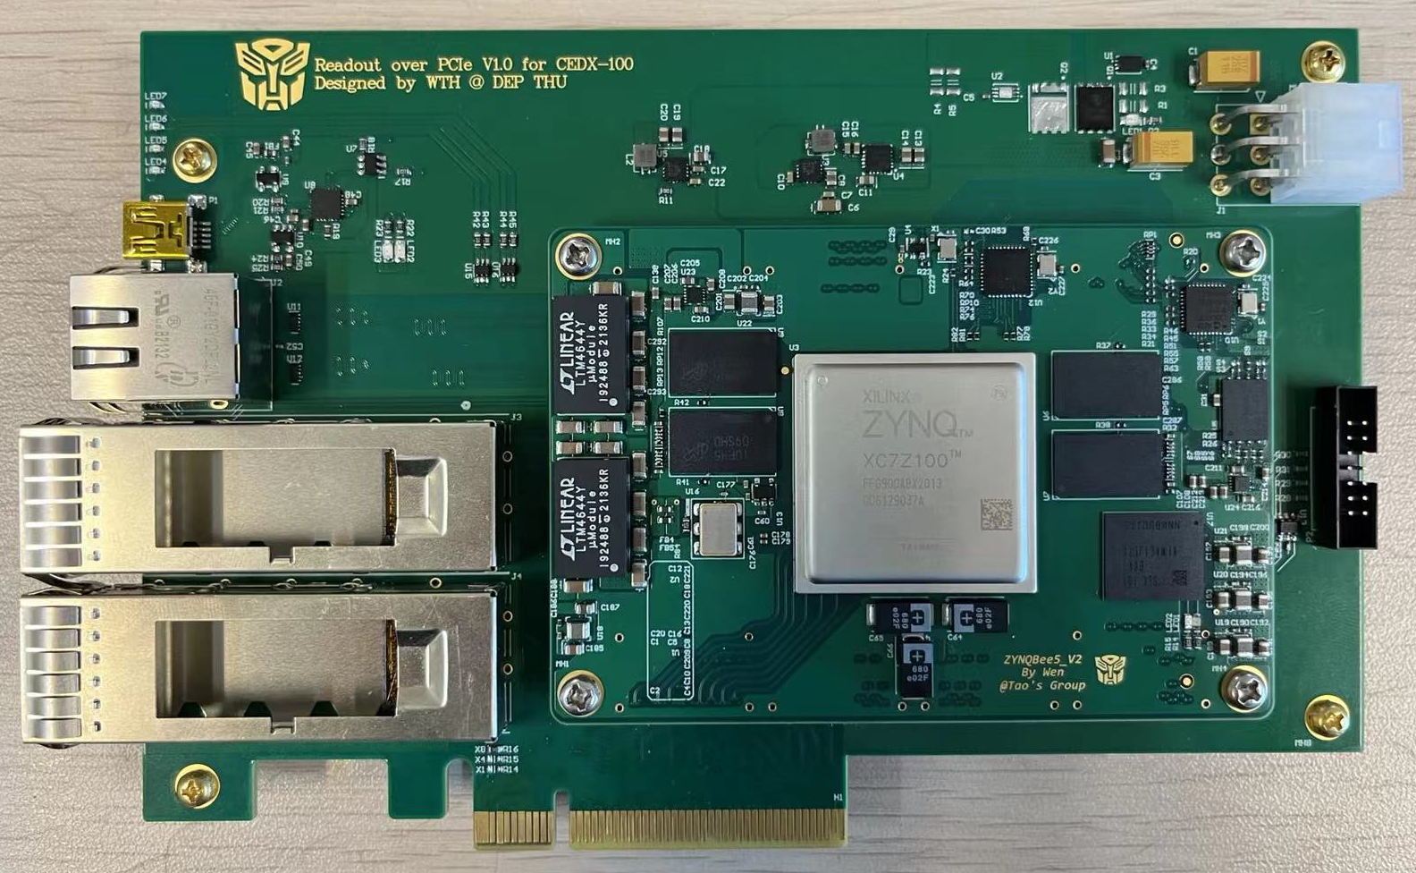
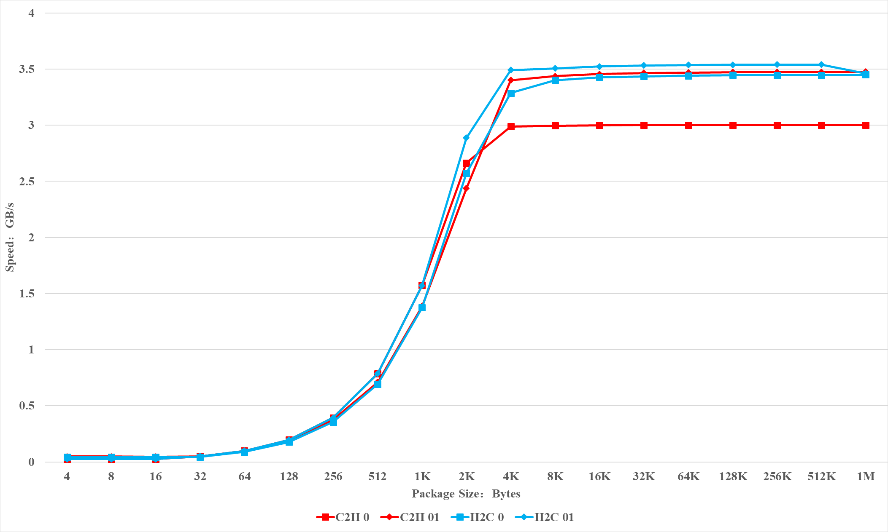
Preliminary Design and Performance Optimization of Readout over PCIe for CDEX-100
On behalf of
Lin Jiang, Tianhao Wang, Jingjun Wen, Tao Xue
Department of Engineering Physics, Tsinghua University

Slide 2

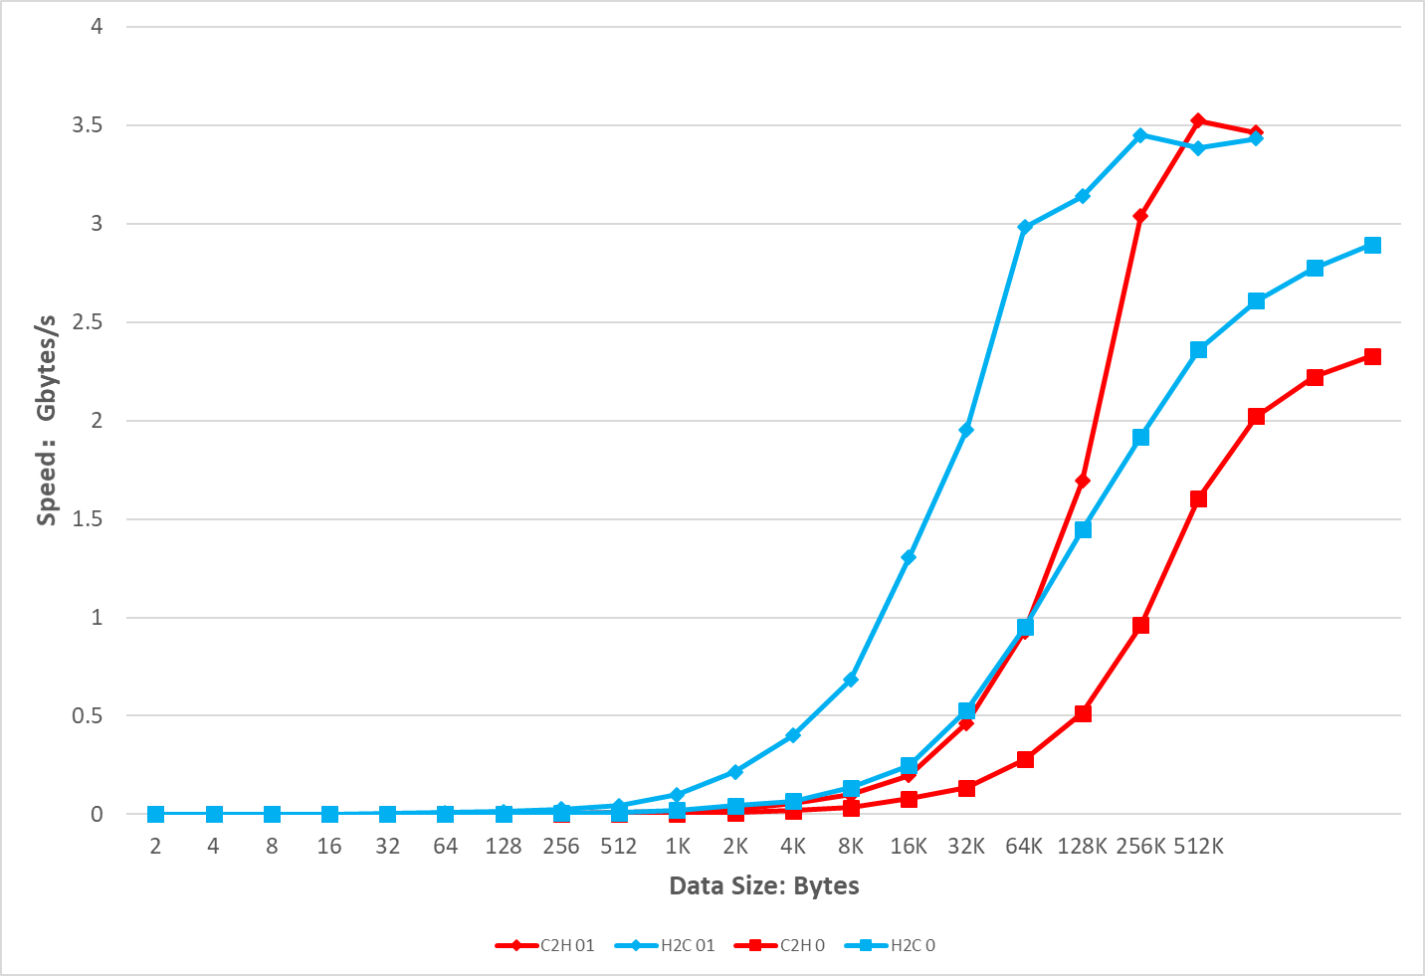
System Design and Data Transfer Test Result
Analysis of Influencing Factors of PCIe Bandwidth:
  Encoding: Gen 2 uses 8b/10b encoding, Gen 3 uses 128b/130b encoding;
  TLP efficiency: Maximum Payload Size, Read Completion Boundary and Maximum Read Request Size;
  ACK/NAK mechanism and FC mechanism;
  DMA;
  CPU, memory and system
According to the above calculation, the total time to send 51.2 Kbytes of data is,
The corresponding macroscopic theoretical transmission speed is,
Combining the above several factors affecting PCIe performance, this paper simulates the transmission environment faced by RoPe.
Calculation of character time symbol time:
The larger the packet, the higher the utilization of the PCIe lane;
The maximum transmission bandwidth can reach 3.55GB/s, which is consistent with the calculation results;
The performance law of software speed test is basically the same as that of hardware speed test;
When the data packet reaches a certain volume, the software speed will be close to the hardware speed, which can reach more than 3.5 GB/s
When MPS = 256 Bytes and the base address is set to a 64-bit address, the corresponding TLP Header size is 24 Bytes, and the minimum transmission time of a TLP containing data is,
For 200 Write Requests, the total data transfer volume is,

