Slide 1

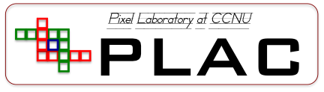

A Low power 4 × 14-Gbps VCSEL Driver in 65 nm CMOS for Particle Physics Experiments
Qiangjun Chen
Central China Normal University
Wuhan, Hubei 430079, P.R. China
23rd Virtual IEEE Real Time Conference
August 1 – 5, 2022
23rd Virtual IEEE Real Time Conference August 1 – 5, 2022

Slide 2
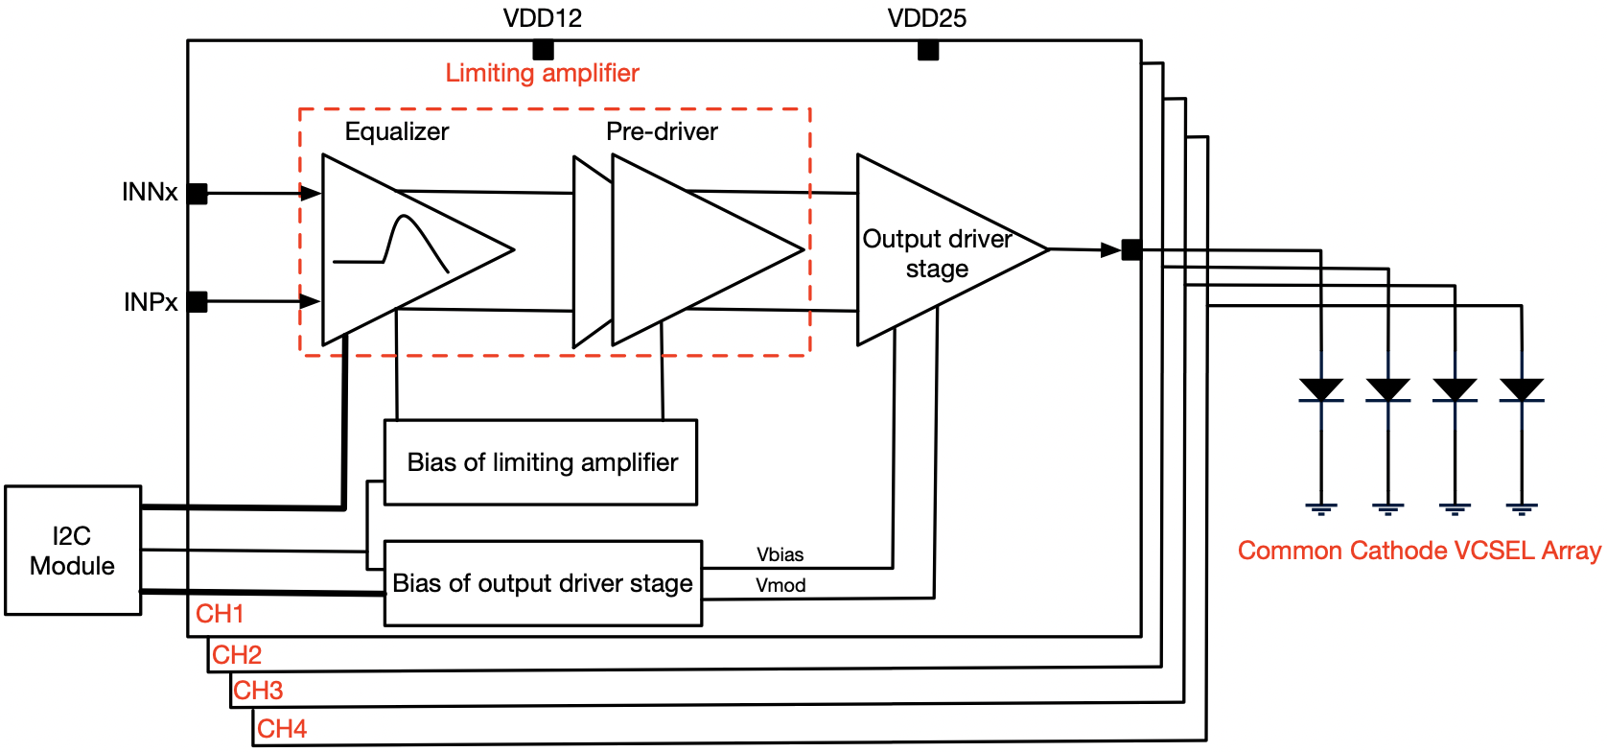
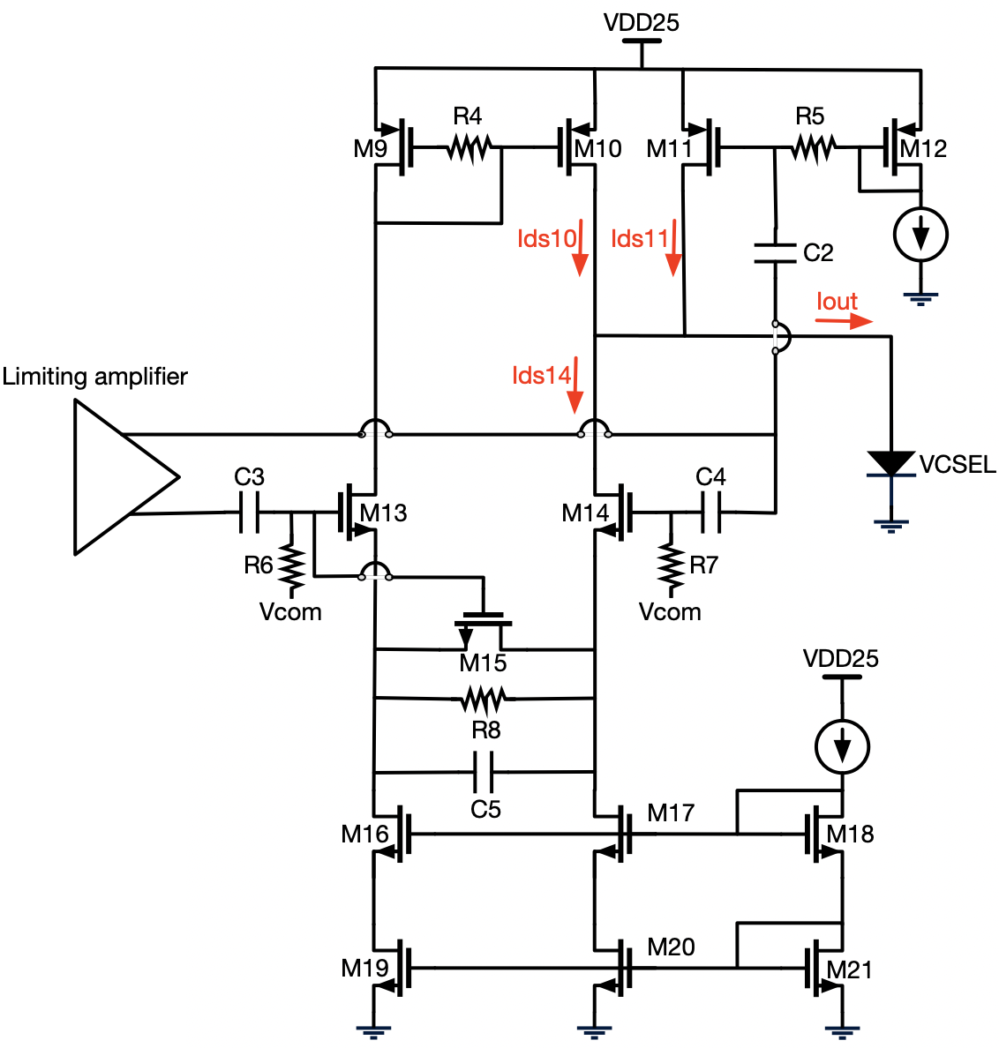
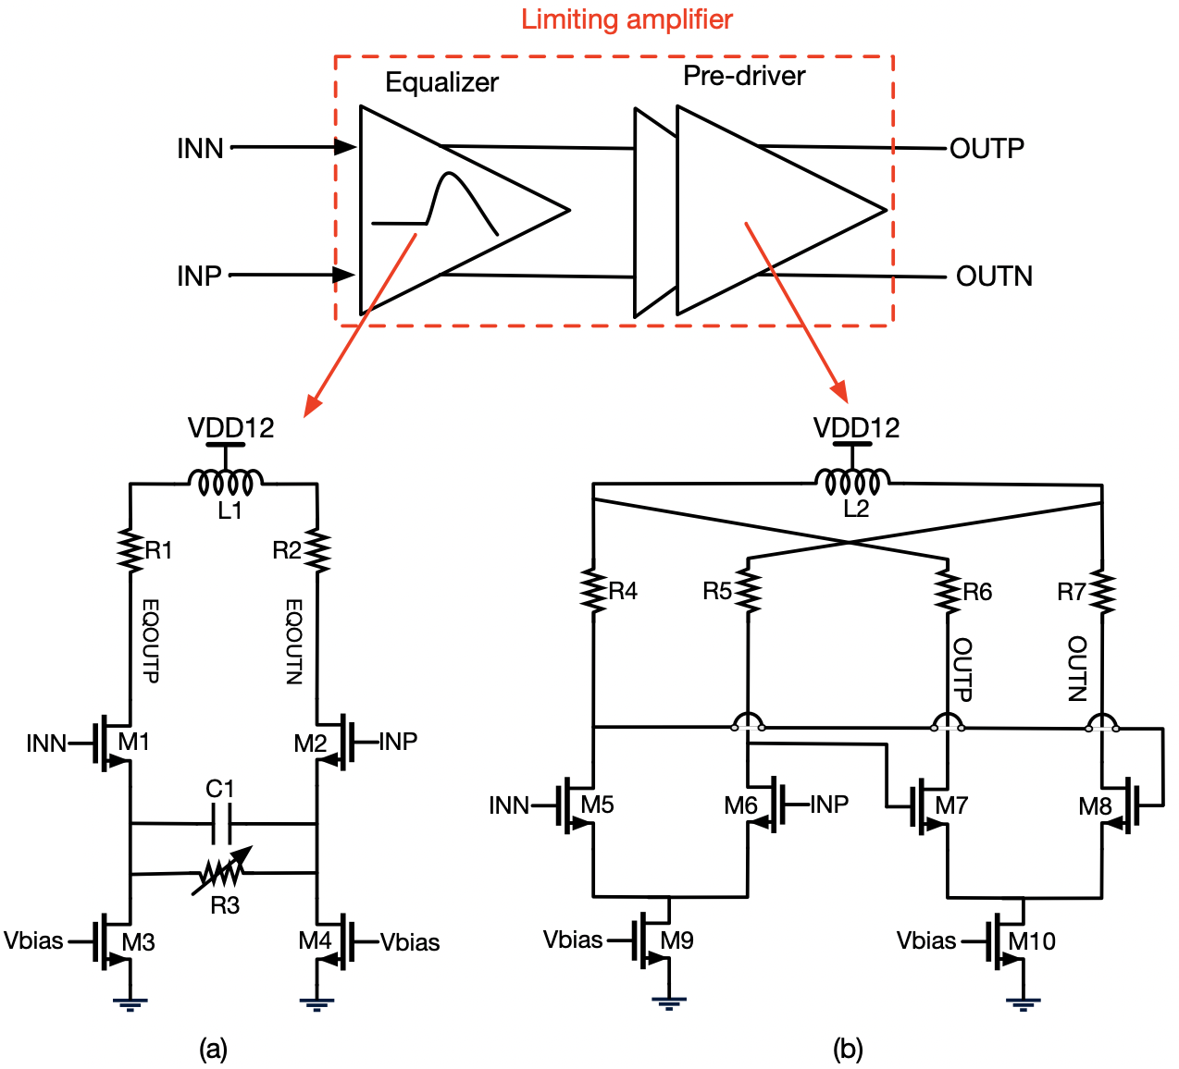
Qiangjun Chen, A Low power 4 × 14-Gbps VCSEL Driver in 65 nm CMOS for Particle Physics Experiments
Overall schematic diagram
Data rate: 14 Gbps
65nm CMOS technology
2000 μm × 1230 μm
44 mW/ch
Typical output current: 2 mA~7 mA
Limiting amplifier
Proposed output driver
The limiting amplifier is composed of an input equalizer stage and a pre-driver stage.
The proposed output driver stage proposes an effective way to contribute current to the VCSEL.
23rd Virtual IEEE Real Time Conference August 1 – 5, 2022

Slide 3
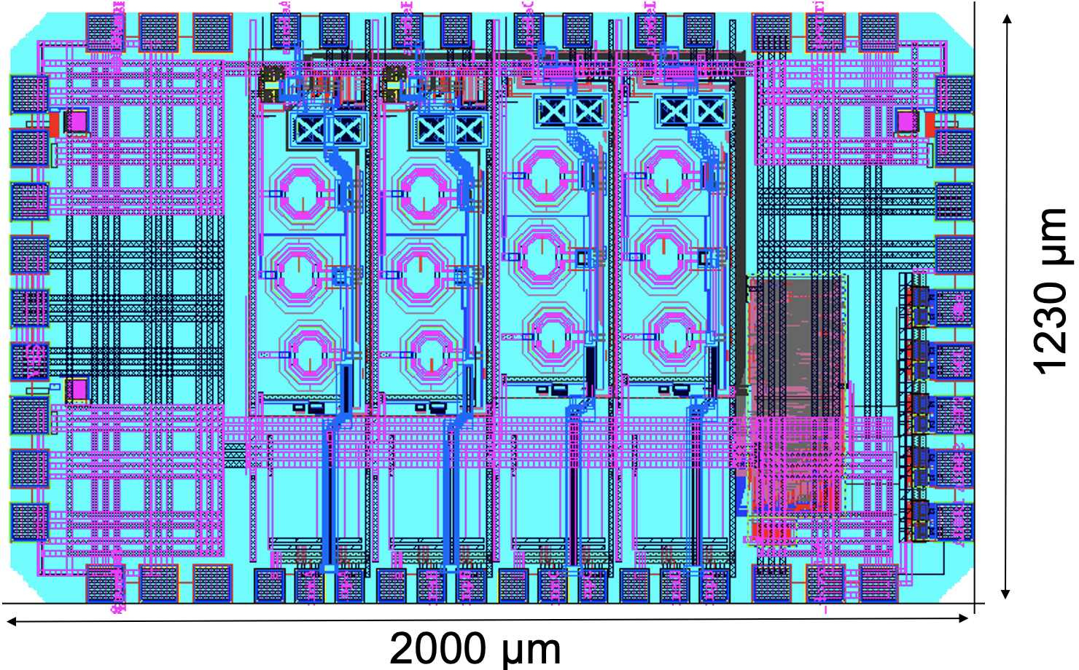
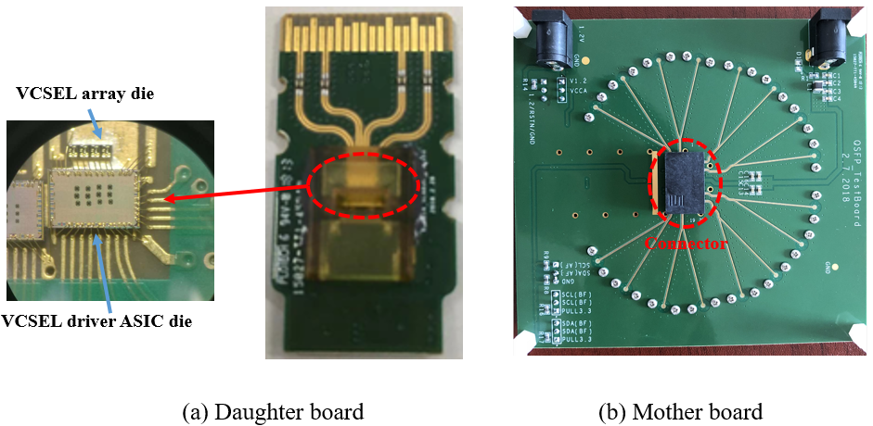
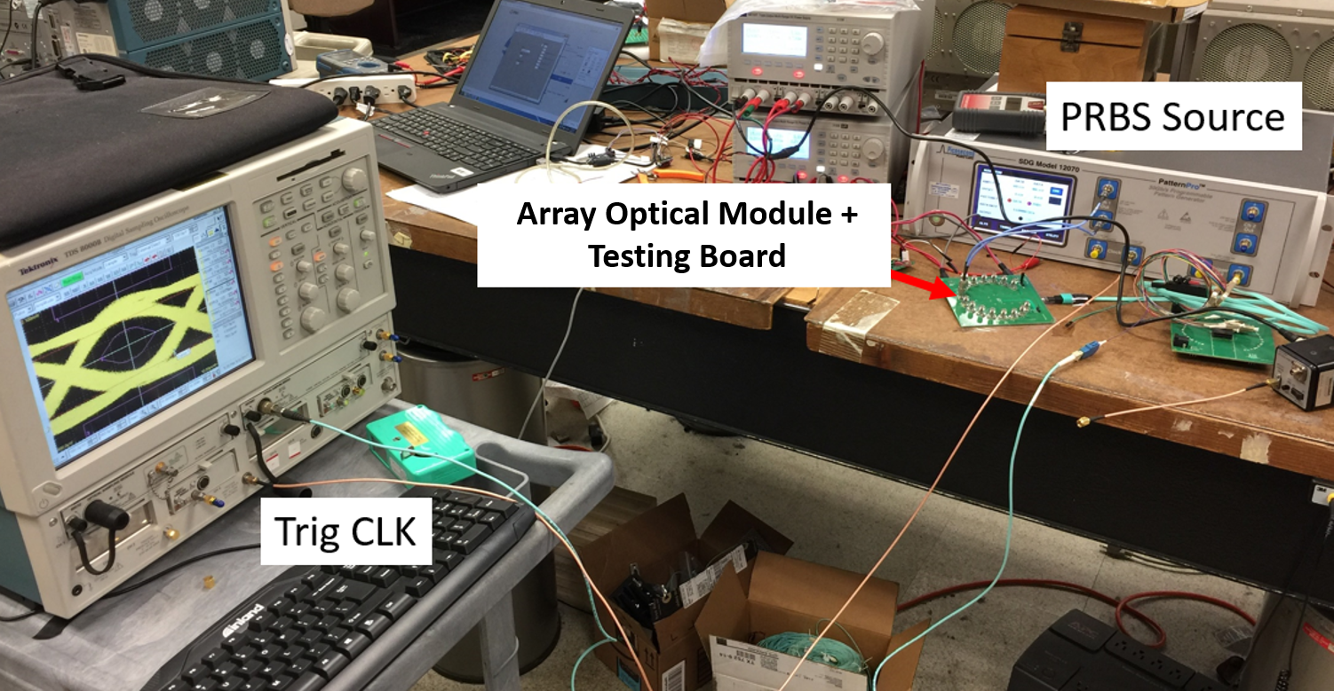
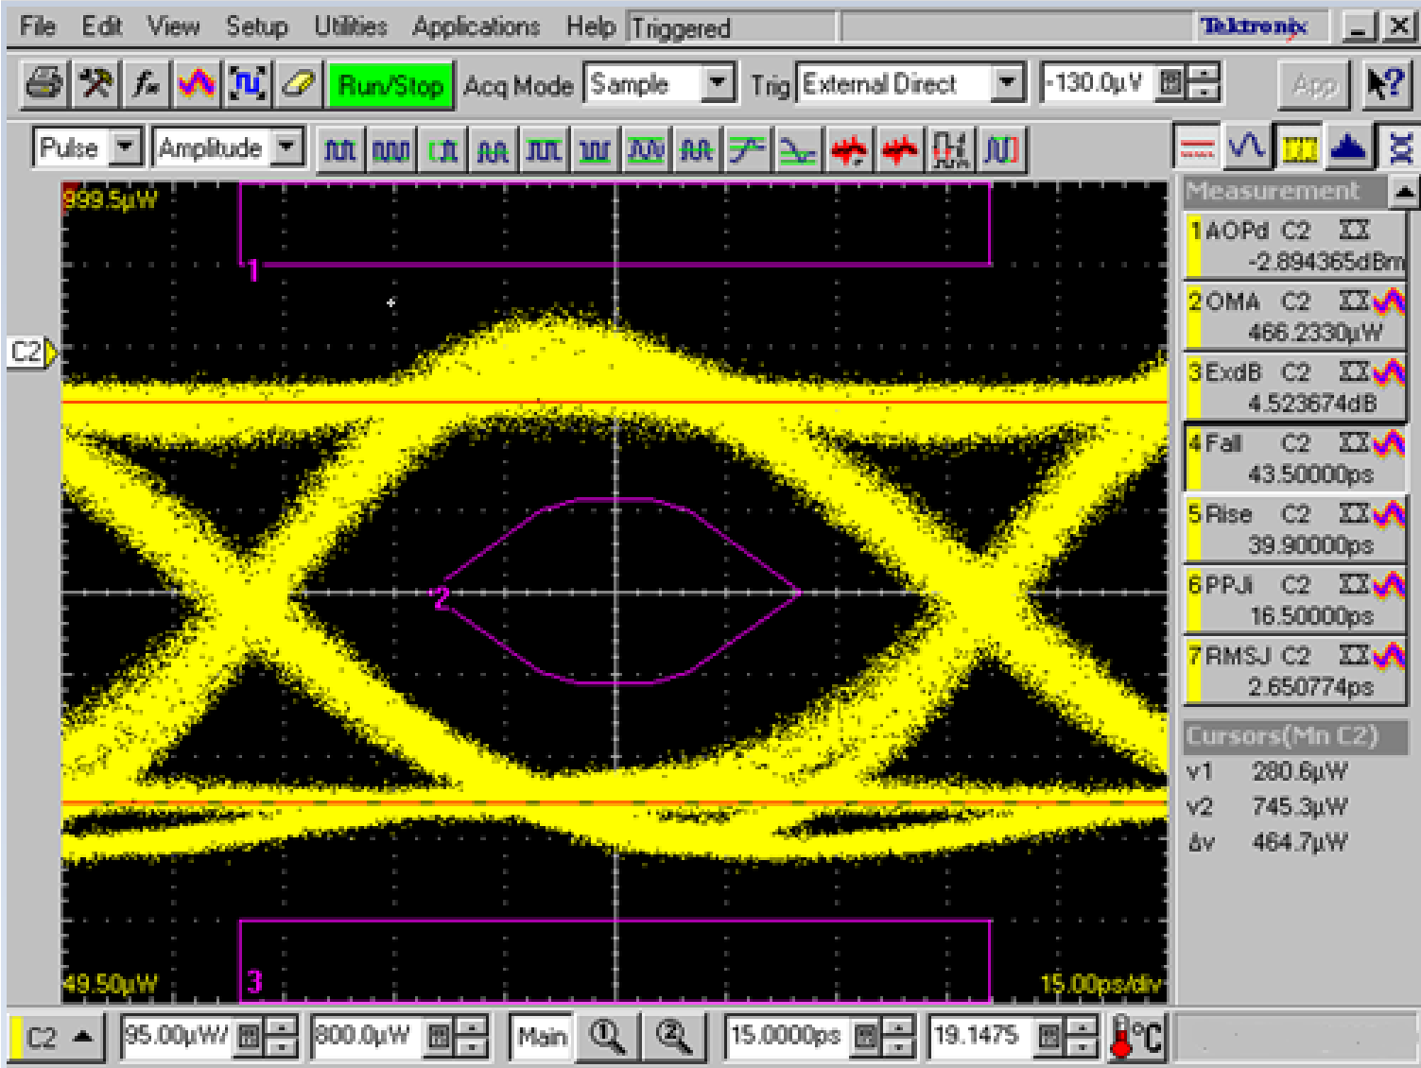
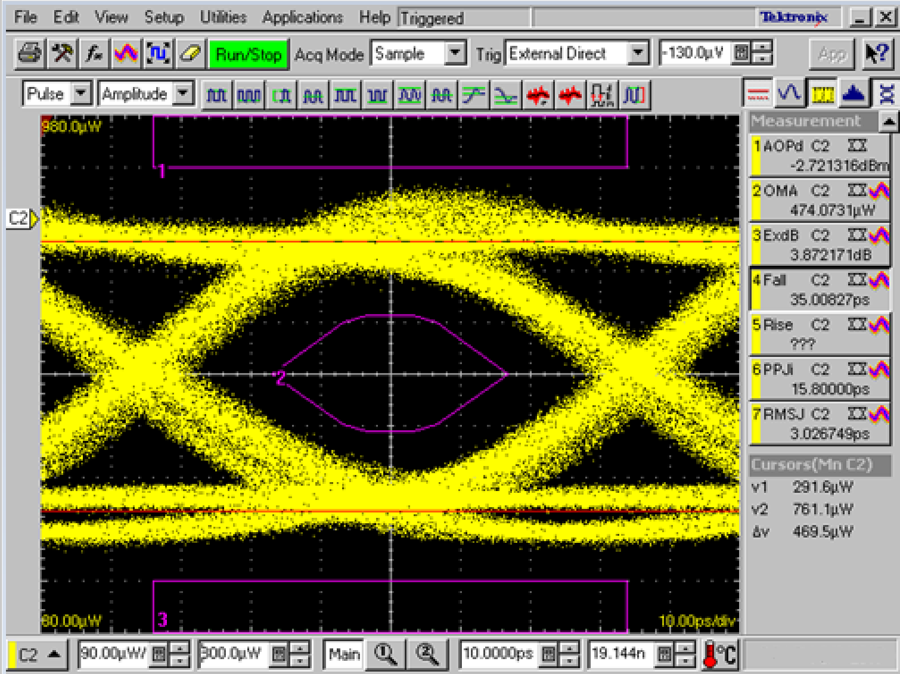
Qiangjun Chen, A Low power 4 × 14-Gbps VCSEL Driver in 65 nm CMOS for Particle Physics Experiments
Layout of VCSEL driver ASIC
QSFP optical module
10 Gbps optical eye diagram
14 Gbps optical eye diagram
Test setup
Data rate | PPJ | RMSJ
10 Gbps | 16.5 ps | 2.65 ps
Data rate | PPJ | RMSJ
14 Gbps | 15.8 ps | 3.02 ps
23rd Virtual IEEE Real Time Conference August 1 – 5, 2022

