Slide 1


RT2022
A 25 Gbps VCSEL driving ASIC For Detector Front-end Readout
Cong Zhao
Central China Normal University
August 1-5, 2022
23rd IEEE Real Time Conference

Slide 2
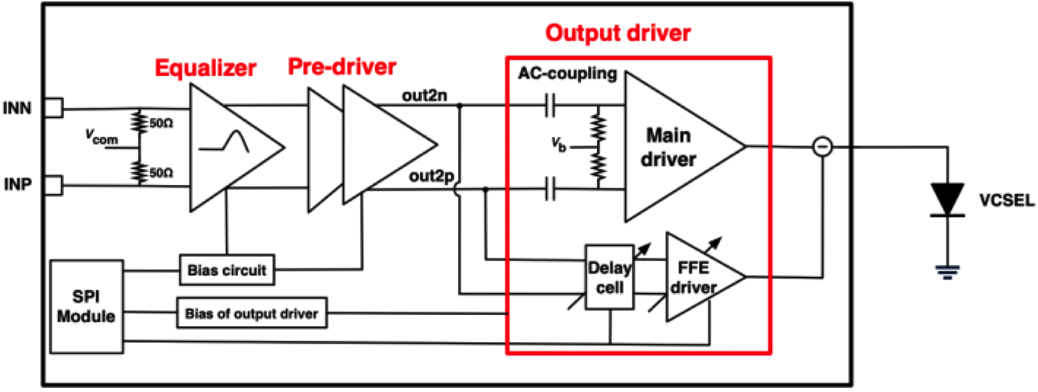
Introduction
Design
Fig.1 Block diagram of the 25 Gbps VCSEL driving ASIC
It includes an input equalizer stage, a pre-driver stage and a novel output driver stage. The input equalizer stage receives a pair of 25 Gbps diﬀerential CML signals with appropriate peaking eﬀect. The pre-driver stage receives the signals from the input equalizer stage, and further ampliﬁes the diﬀerential signals with suﬃcient gain and bandwidth (>18 GHz) for the output driver stage. Following the pre-driver stage, the proposed output driver stage includes a main driver, an adjustable delay cell and an emphasis driver (FEE driver). The main driver converts the ampliﬁed diﬀerential voltage signals from the pre-driver to single-ended high speed current signal, and drives the external VCSEL.

Slide 3
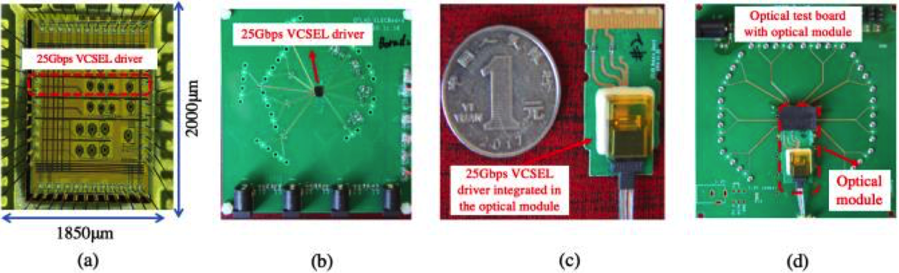
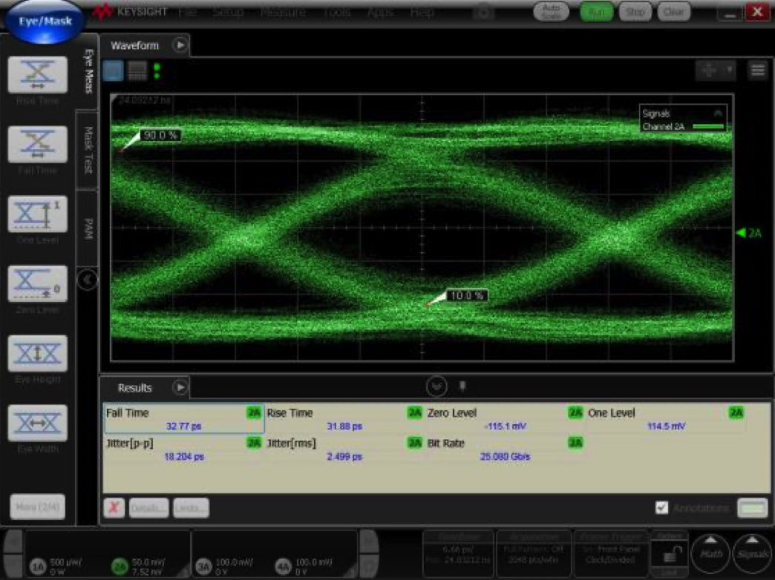
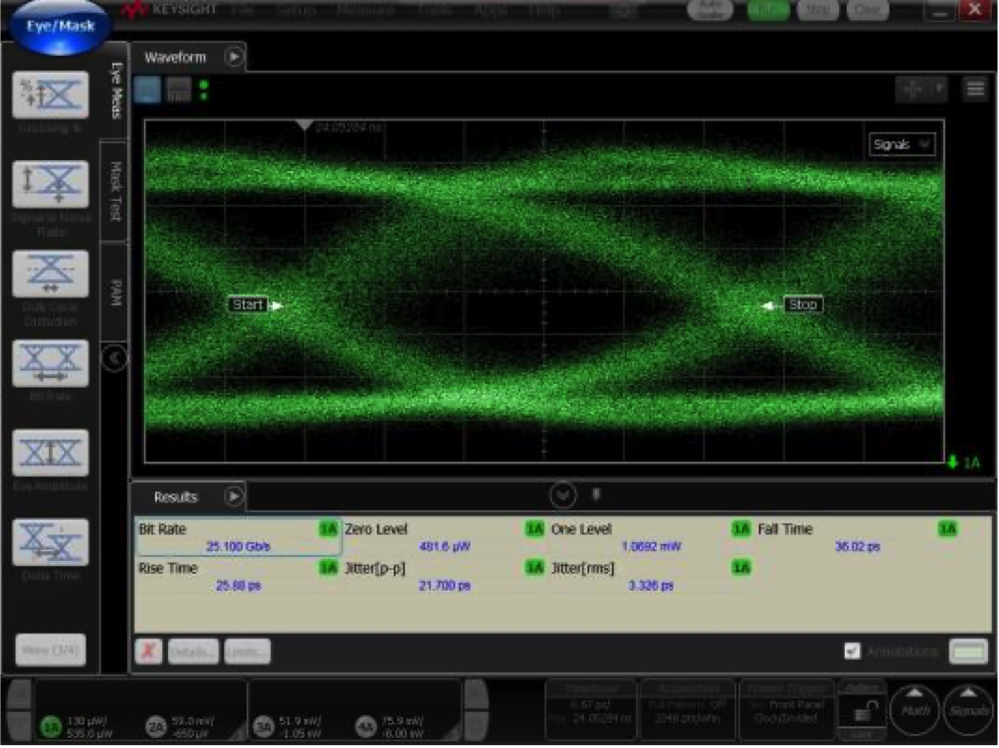
Introduction
Test results
Fig.2 Chip micrograph and test boards (a)chip micrograph (b)electrical test board (c)optical module (d)optical test board
Fig.3 Electrical eye diagram
Fig.4 Optical eye diagram
RMS jitter：2.5ps
PP jitter ：18.2ps
RMS jitter：2.9ps
PP jitter ：19.5ps

