Slide 1

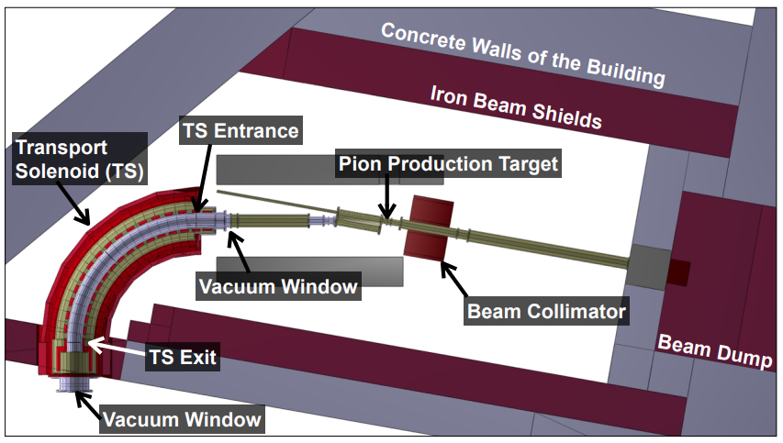
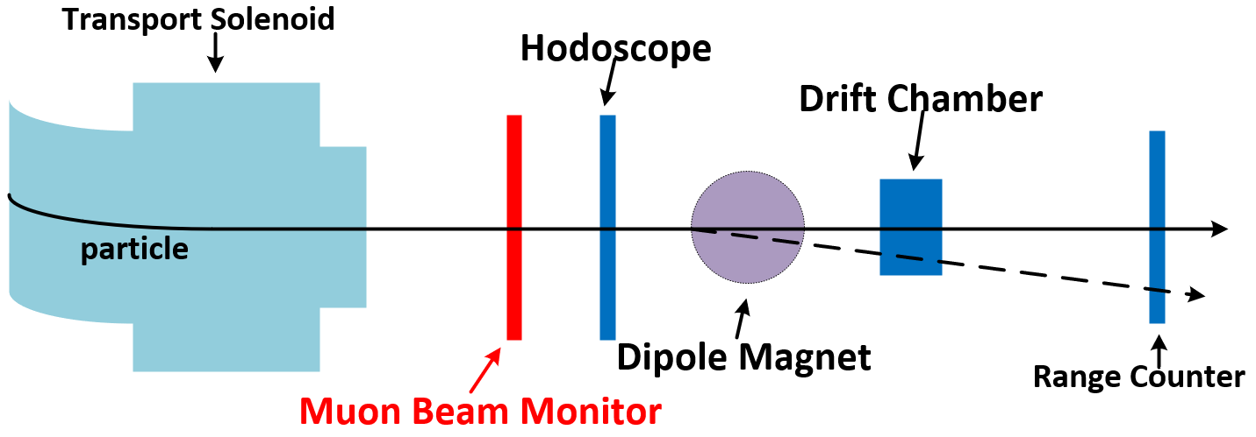
Progress of Readout Unit (RU)
The COherent Muon to Electron Transition (COMET) experiment
  COMET Facility
    Search for CLFV (μ⁻N → e⁻N)
    Single event sensitivity of 3.1 × 10⁻¹⁵
    Muon beam
    Phase-α : understand the proton beam
  Muon Beam Monitor
    Measure the timing and position of the muons
    Total size is 90 x 90 cm²
    128 + 128 scintillating fibers
    Cross-sectional area of fiber is 1x1 mm²
    Spatial resolution of 1 mm
    Masked with aluminum foil
USTC
7/27/2022

Slide 2
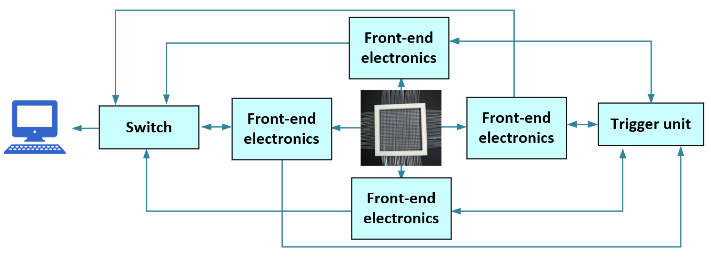
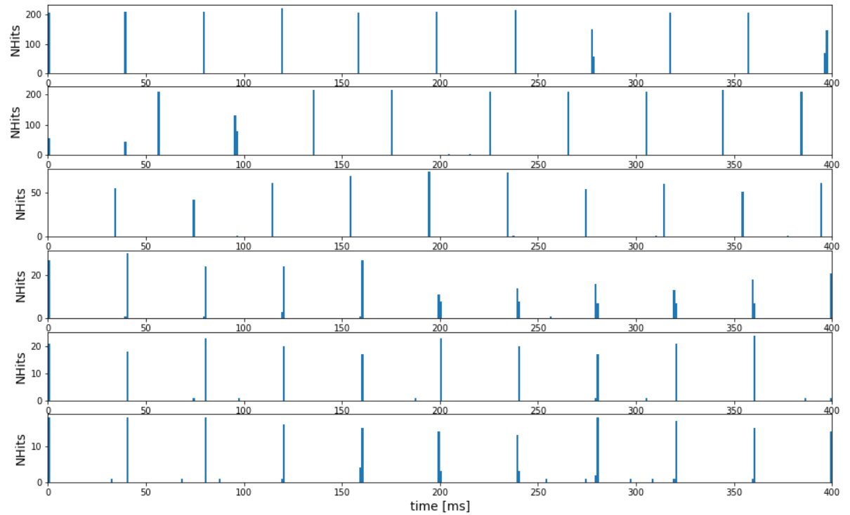
Progress of Readout Unit (RU)
Readout Electronics
  4 front-end electronics modules
  Front-end electronics readout modules
    SiPM Carrier
      Place the SiPM
      photoelectric conversion
    FEB Board
      Amplification of the signal
      Initial data process
    DAQ Board
      Data acquisition
Test Results
  CSNS proton beam test
  Clear beam pulses with an interval of about 40 ms
USTC
7/27/2022

