Slide 1



Timing reference correction for the CMS improved Resistive Plate Chambers (iRPC)
Jianing Song*, Zhen-an Liu, Jingzhou zhao, Qingfeng Hou, Weizhuo Diao, Wenxuan Gong On behalf of the CMS Muon Group
23rd Virtual IEEE Real Time Conference (RT2022)
1 Aug 2022

Slide 2
Outline
  Introduction
  iRPC timing reference issue
  Timing reference correction
  Test results
  Summary

Slide 3
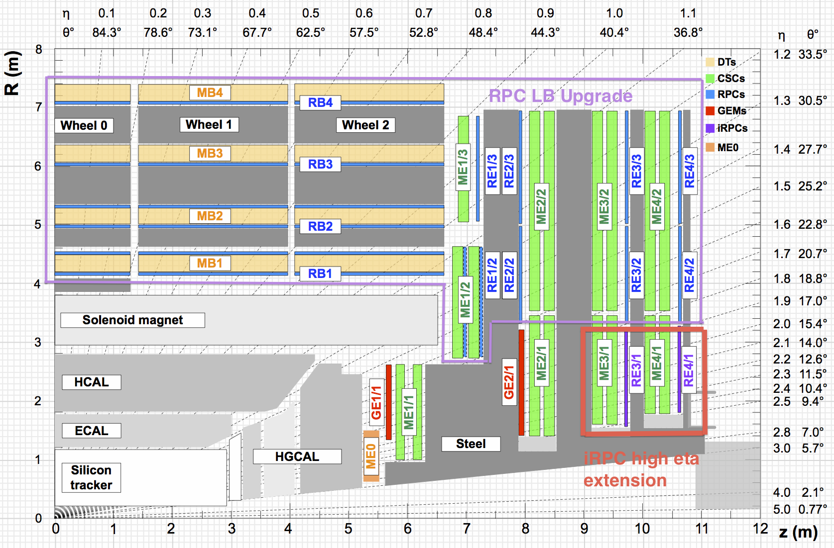
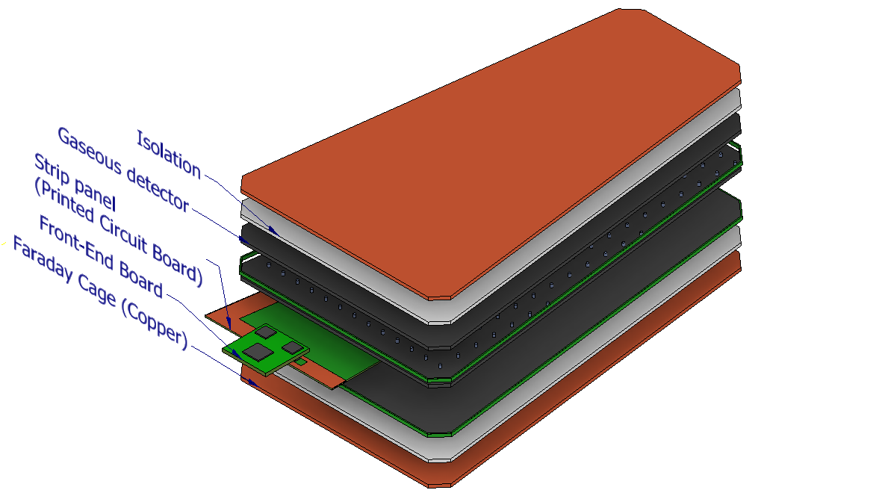
iRPC introduction
Main motivations/goals:
  Increase rate capability (2 kHz/cm²).
  Better time resolution for background rejection 25 ns -> 1.5 ns.
  Better spatial resolution for tracking in r direction
  40 cm-> 2 cm.
  Improved contribution of RPCs to muon triggering in the forward region.
Electronics:
  Two ends readout.
  New frontend electronics.
  New backend electronics.
Extend the RPC coverage up to |η | = 2.4 to increase redundancy in high eta region in stations 3 and 4
RE 3.1 and RE 4.1 Improved RPC
1 chamber ≈ 1.6 x 1.2 m² trapezoidal shape
20° in φ 18 chambers/disk
Total of 72 iRPC chambers
3

Slide 4
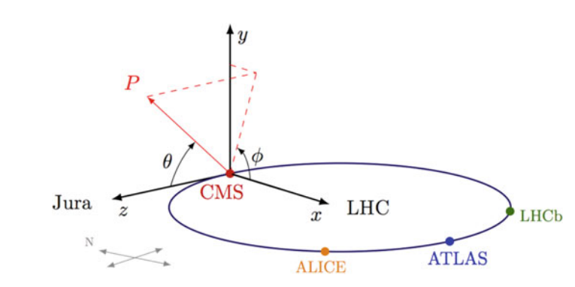



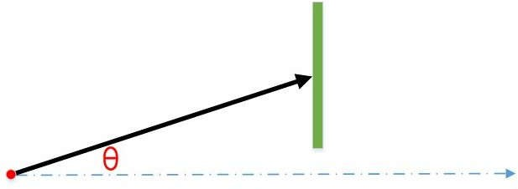
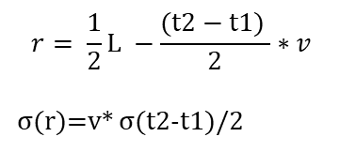
Principle of iRPC position measurement
Two-end readout iRPC used in CMS Phase II upgrade
Double Gap layout
Time Difference of Arrival Method
FEB1
strip length L
FEB2
upper gap
LR side
HR side
Beam axis
t1
t2
Φ direction
iRPC strip
r
$$r= \frac{1}{2}L −\frac{(t2−t1) }{2}∗v$$
σ(r)=v* σ(t2-t1)/2
hits
r
lower gap
Collision
Beam axis
Z
Electronics
  Each iRPC chamber is equipped with 2 Frontend Electronics Boards (FEBs), connected to the backend electronics board (BEB) via 2 GBT links.
    The GBTx is a radiation tolerant chip that can be used to implement multipurpose high speed (3.2-4.48 Gbps user bandwidth) bidirectional optical links for high-energy physics experiments.
iRPC spatial resolution (θ direction)
  Hit position: r is calculated by the time difference of signals from two ends.
  Much improved hit localization along the strip can be achieved. ~2 cm from cosmic test result.
Dimensions: 165 cm x (63-114) cm

Slide 5
BE Roadmap and Schedule agreed in RPC
iRPC backend
  2 Steps Installation Roadmap: uTCA+ATCA
  2022-2023: iRPC BE uTCA (current work for demonstrator)
  2024: iRPC BE ATCA-Serenity (final system)
Link System installation (+1 year vs. TDR)
2016
2017
2018
2019
2020
2021
2022
2023
2024
2025
2026
LS2
EYETS
YETS
EYETS
LS3
MUON TDR
EDR
Prototyping
ESR
Production
3. RPC BE: Serenity
Chamber
Design
Preproduction
Chamber installation(2. iRPC BE: Serenity )
Serv. Inst.
1. iRPC BE：uTCA

Slide 6
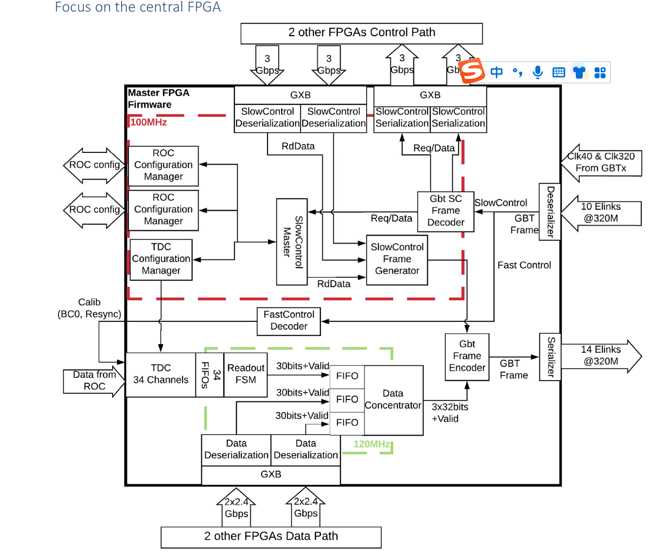
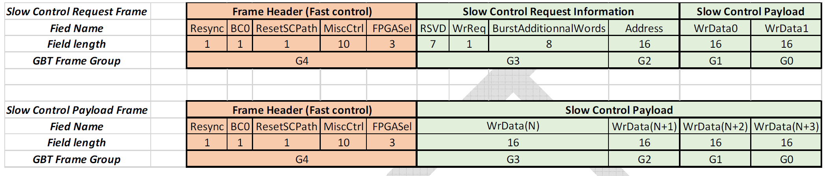
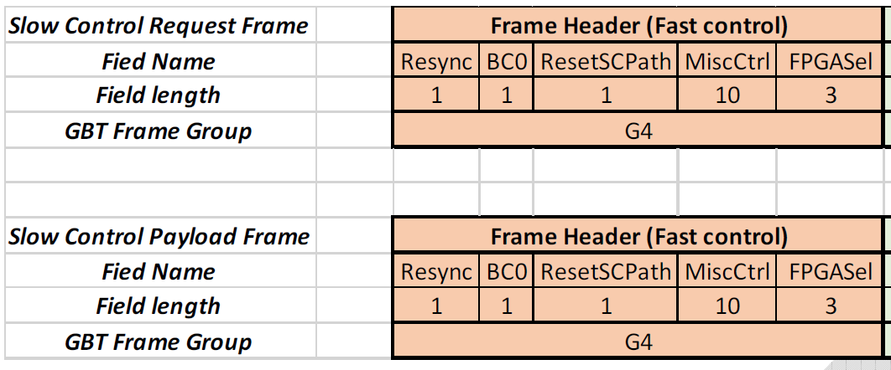
FEB signal timing
FEB TDC timing principle
Fast control signal (BC0, Resync, etc.)
  BC0—the first bunch among 3564 bunch crossing as time reference for FEB.
    3564 : circumference (26659 m )/bunch distance(7.48 m)
  Received from backend on all FEBs within a fixed latency.
BC0
BEB
BC0 feedback

Slide 7
System timing from backend
Functionalities/tasks of iRPC Backend
  Slow Control (powering up FEB, TDC configuration, Petiroc configuration…)
  Monitoring
  Fast Control (BC0 distribution …)
  Trigger primitive (Clusterzation)
  Readout (DAQ)
Difficulties
  How to develop and verify BEB functions in lab without test facility like detector, FEB, or GBTx chip ?
  What is the clock requirement of FEE and how to realize?
  How to synchronize different links in the backend ?
  iRPC FEB emulator study.
  Timing reference distribution and correction of distribution difference .
iRPC data source
FEE Emulator GBT-FPGA
GBT link
BEB
（GBT-FPGA）

Slide 8
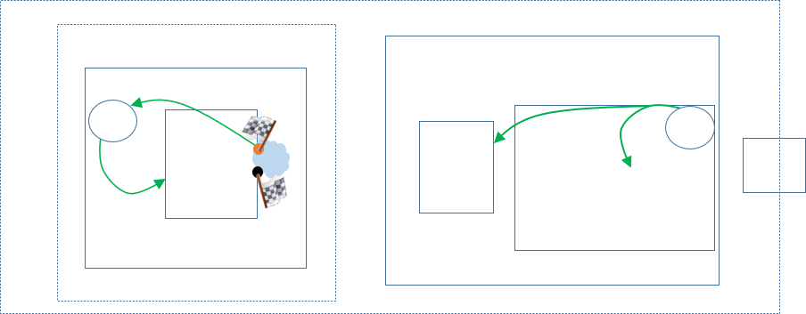
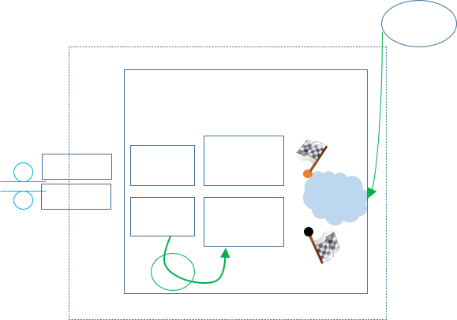
Timing reference distribution
Problem
  The Bunch Cross 0 (BC0) signal from AMC13 as a timing reference is distributed to each FEB located in different RPC stations by BEB.
    AMC13: This module is designed to provide TTC, DAQ and TTS services to modules in a MicroTCA crate for CMS.
  Arrival times of BC0 between links are different.
    Latency = T_GBT FPGA + T_length + T_GBTx , T_GBT FPGA and T_GBTx are the same for all FEBs.
    Different fiber lengths lead to different latencies and this need to be measured and corrected.
Cyclone V
Frontend electronics_1
The backend electronics
AMC13
GBTx chip
PLL
CDR
BC0
E-LINK SERDES
E-LINK SERDES
SFP
GBT SERDES
BC0
GBT-FPGA Tx
MiniPOD
MGT Tx
BC0 arrival time difference
Frontend electronics_2
BC0
MiniPOD
MGT Rx
Cyclone V
GBT-FPGA Rx
GBTx chip
PLL
CDR
CDR
E-LINK SERDES
E-LINK SERDES
SFP
GBT SERDES

Slide 9
Correction of distribution difference
Solution
  Latency measurement need to be done.
    latency must be fixed values and measured accurately.
  A 12-bit counter of the 2.5 ns step is developed in BEB and used to measure the loopback time of different links. through a self-defined handshake mechanism.
    The downlink and uplink are estimated to have same time consuming and the difference is caused by different fiber length.
    Taking the faster link as the reference we apply a correction value to the slower link according to the loopback time via slow control.
    Correction value (1.25 ns step) = (Latency_big - Latency_small)/2 .
    TDC data on each FEB will minus its specific correction value to minimize the latency difference between paths.

Slide 10
Implementation in FEB emulator
Before we have the real FEB electronics, we did the test using GBT-FPGA based emulator.
FEB emulator Rx CDR clock is synchronous with BEB system clock.
Managed to use Rx CDR clock as GBT-FPGA Tx clock.
  Through RJ-45 daughter board.
The backend electronics
AMC13
CDR
MGT Tx
GBT-FPGA Tx
GBT-FPGA RX
MGT RX
MiniPOD
MiniPOD
oscillator
MiniPOD
MGT Rx
GBT-FPGA Rx
GBT-FPGA TX
MGT TX
MiniPOD
CDR

Slide 11
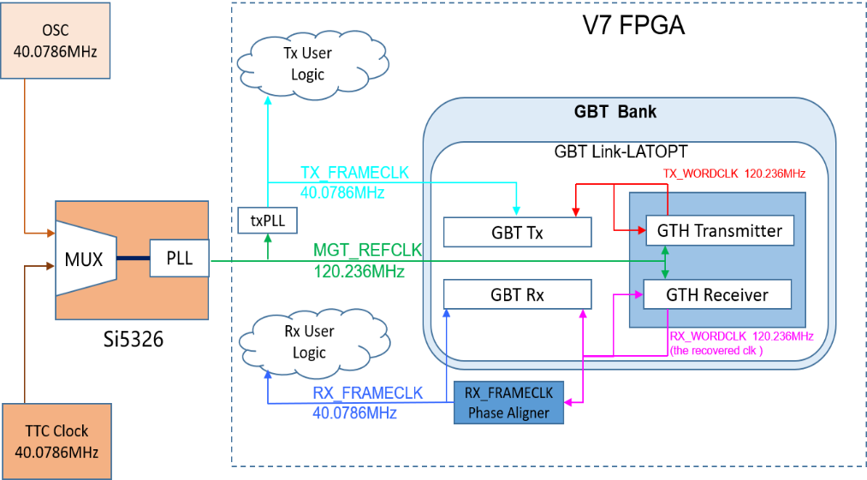
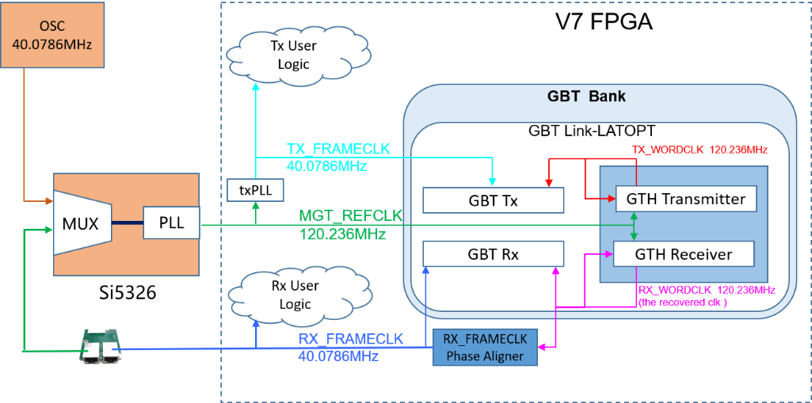
System clock generation in FEB emulator
The backend -- 40.0786MHz system clock from AMC13 .
FEB emulator –40.0786MHz OSC after power up.
Rx CDR clock is generated and aligned on FEB emulator.
Then Rx CDR clock is fanned out through RJ45 A and connected to RJ45 B .
Clock from RJ45 B replaces OSC as FEB emulator system clock after MUX.
FEB Emulator clock distribution
BEE clock distribution
B
A
CDR
synchronous with system clock
GBT link

Slide 12
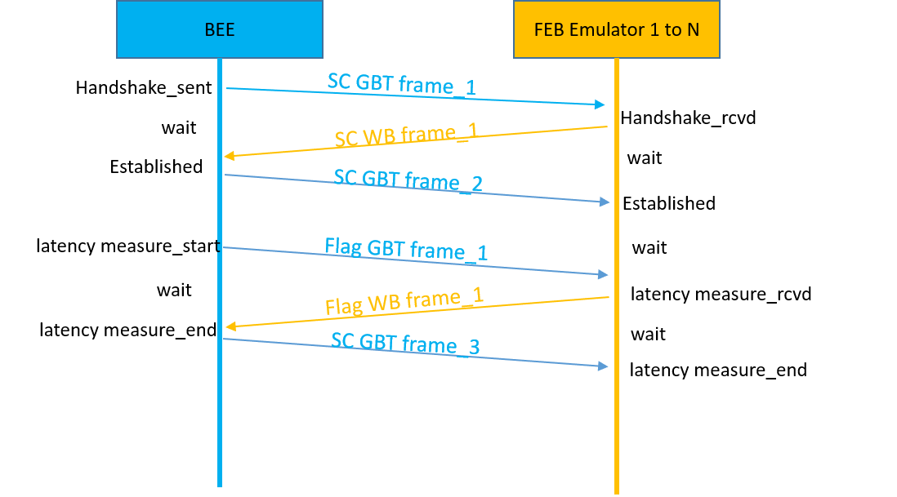
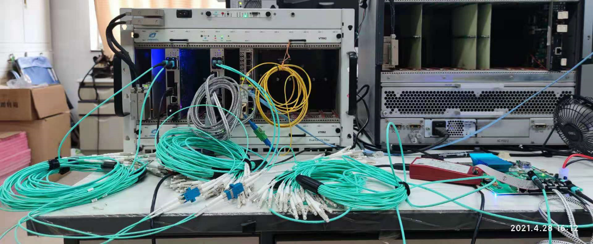
Correction implementation
  Latency measurement
Test System setup in Beijing lab
  System clock source: AMC13
  Backend : 1 BEB
  Frontend :2 FEB emulators(represent the 2 FEBs on 1 iRPC chamber)
BEB
AMC13
MTCA crate
FEB emulator 1
400MHz counter
FEB emulator 2
measurement mechanism
GBT link 1
GBT link 2

Slide 13
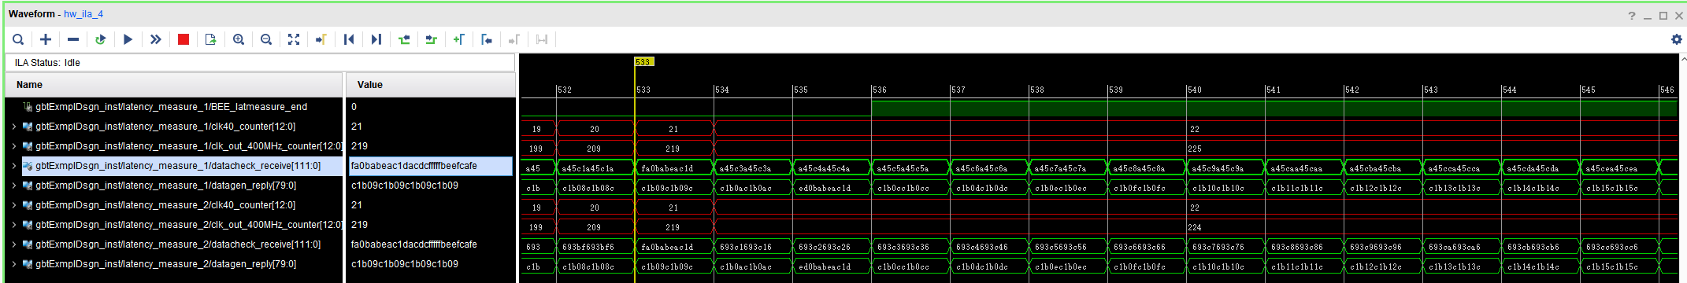
test result
Latency measurement Test result
Measurement time step | 25ns --BX clock | 2.5 ns --coarse time
BEB to FEB emulator1 cnt | 22*25 = 550 ns | 216 * 2.5 = 540.0 ns
BEB to FEB emulator2 cnt | 22*25 = 550 ns | 215 * 2.5 = 537.5 ns
Δ = 2.5 ns
A deterministic latency between BEB and FEB emulator was achieved and measured, indicating that
the test system works normally.

Slide 14
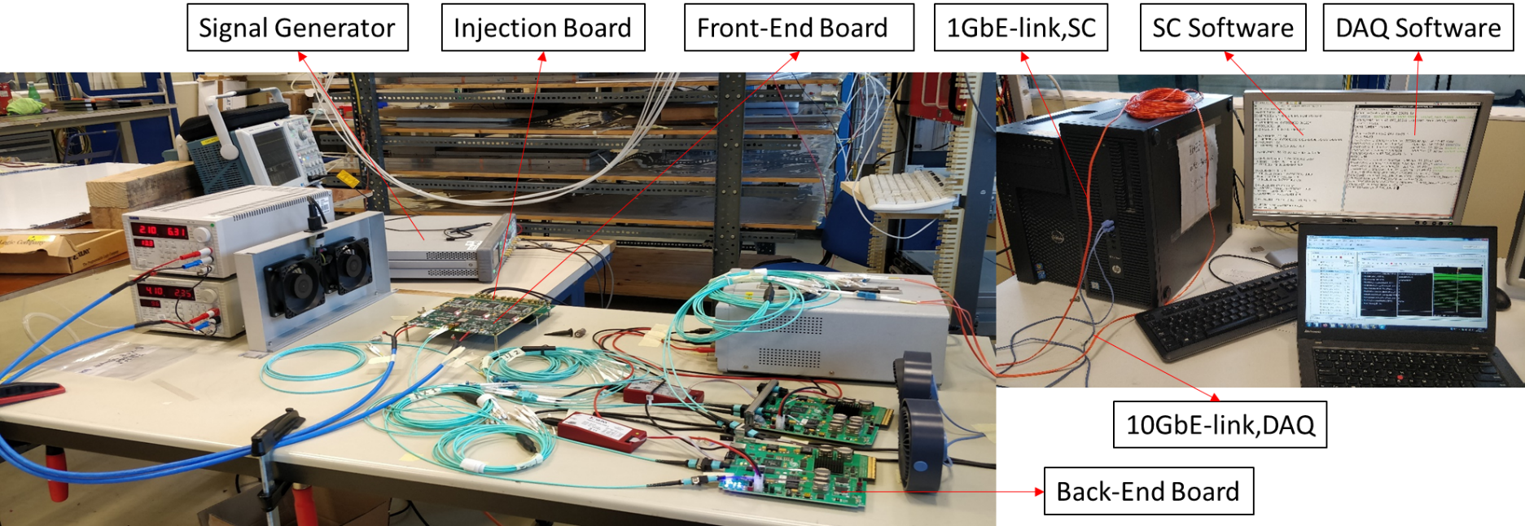
BEB to one FEB joint test
Joint test system setup
  One backend board receives 1 link from FEB.
  The backend performs slow control (FEB powering up, configuration, etc.) and fast control (BC0 distribution, etc.)
  for the FEBs.
Test results
  When the FEB receives a BC0, it will sent the BC0 timestamp to backend. The result shows that the backend sends
  BC0 to FEB every 3564BX constantly, indicating the system works normally.
  The sigma of BC0 timestamp from FEB is 23.32 ps proves that the distribution of BC0 is successful.

Slide 15
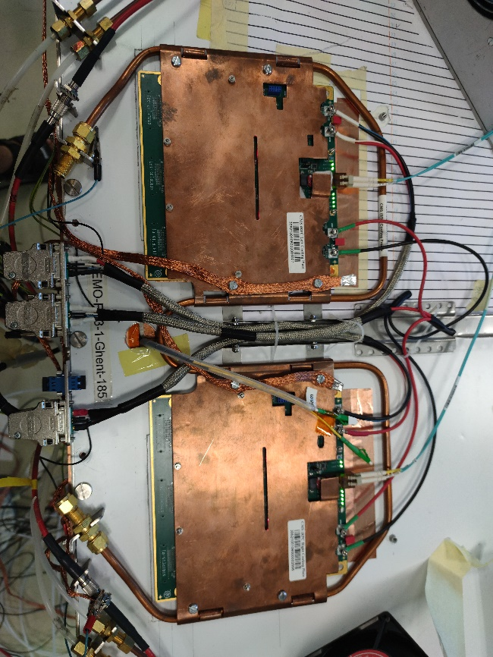
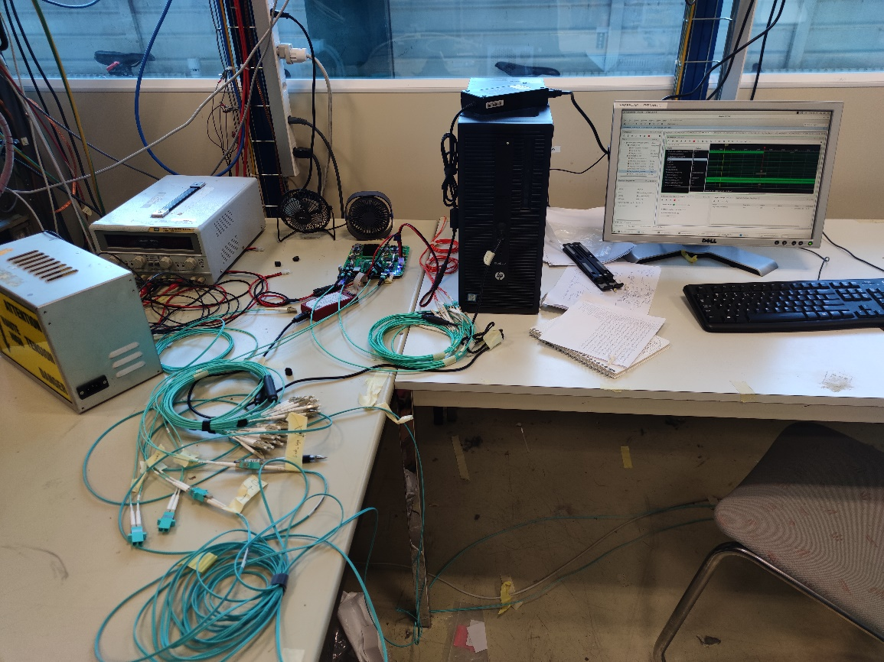
BEB to two FEB joint test
Joint test system setup
  One backend board receives 2 links from FEBs.
  The length of fibers are different to simulate real cases.
Server
BEB
FEB1
Different length fibers
FEB2

Slide 16
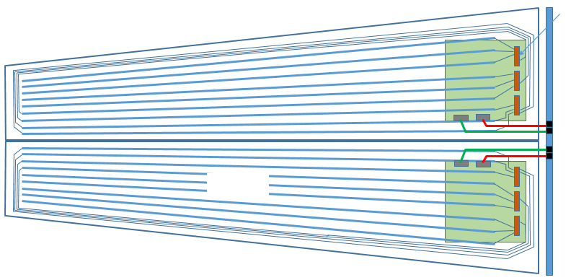


BEB to two FEB test method
Detail
  The BC0 distribution to one FEB has been proved successful.
  This method was used to measure the latency between two links, which will affect the backend trigger function rather than iRPC position resolution.
    Eg. If muons hit the middle of the chamber, FEB1 and FEB2 will give same position(~2 cm) but different timing because of different latency.
  The backend records the start of BC0 distribution and the end of BC0 feedback via a 12-bit counter of the 2.5 ns step.
  Half of the the time difference(1.25 ns step) between two links will be used to correct the slower link via slow control.
return lines
BC0
link 1
2.5ns step counter
FEB1
48 strips
BC0 feedback
BC0
BEB
Δφ=20°
link 2
2.5ns step counter
48 strips
FEB2
BC0 feedback
return lines

Slide 17
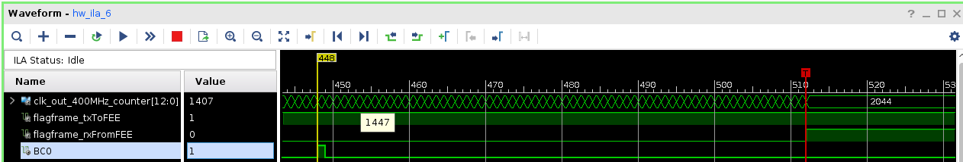
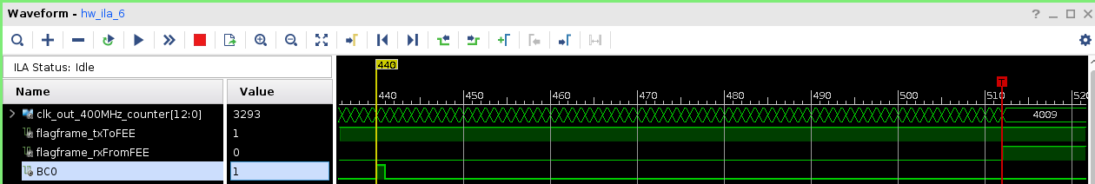
BEB to two FEB quick test result
Latency measurement test result
Latency_FEB1 = 2044-1407=637 (2.5 ns)
Latency_FEB2 = 4009-3293=716 (2.5 ns)
Correction value = (716-637)/2 = 39.0
A deterministic latency between BEB and FEB was achieved and measured, this latency difference can be used to
correct the FEB TDC timestamp.

Slide 18
Next step
The latency measurement requirement (2.5 ns/1.25 ns/smaller?) and effect need to be studied further.
The implementation of latency measurement can be improved based on requirement.

Slide 19
Summary
iRPC timing reference issue including FEB signal timing and backend system timing has been researched and verified.
Timing reference distribution and correction has been studied in both emulator and FEB.
The test results show that the sigma of BC0 distribution is 23.32 ps which will be used for iRPC position calculating. The latency between two links was measured and waiting to be corrected and verified in the next step.

Slide 20
Thanks!

Slide 21
Backup

Slide 22
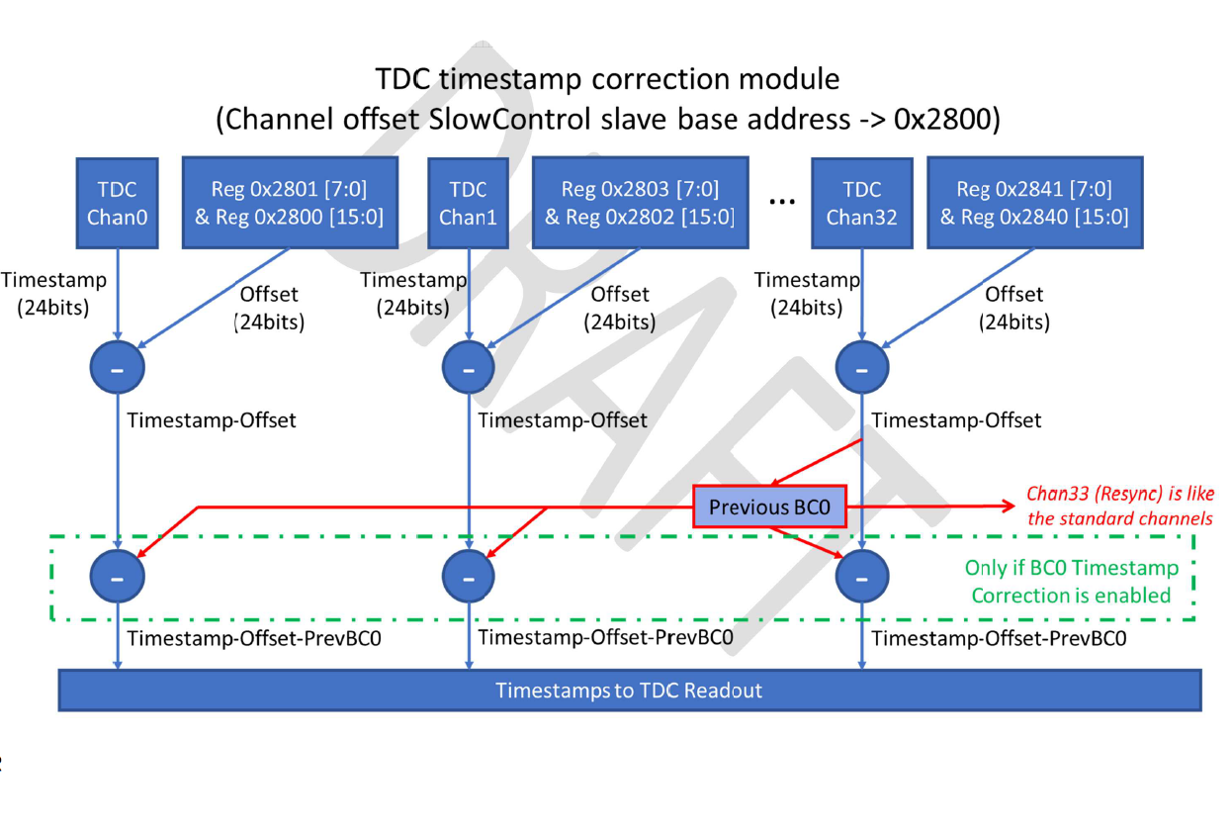
FEB TDC timestamp correction module

Slide 23
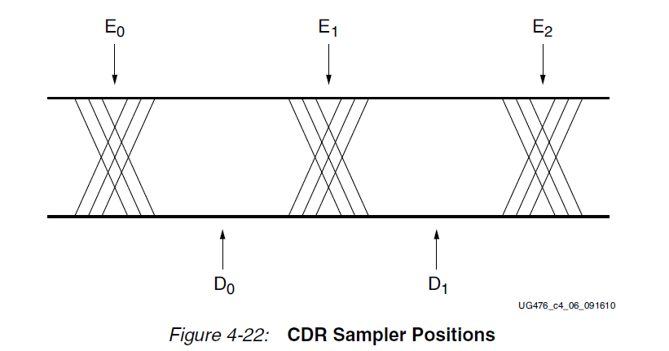
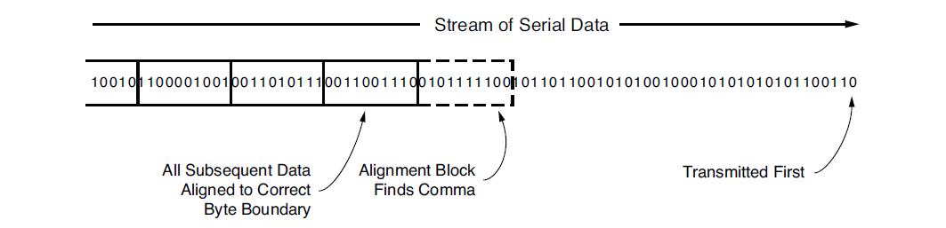
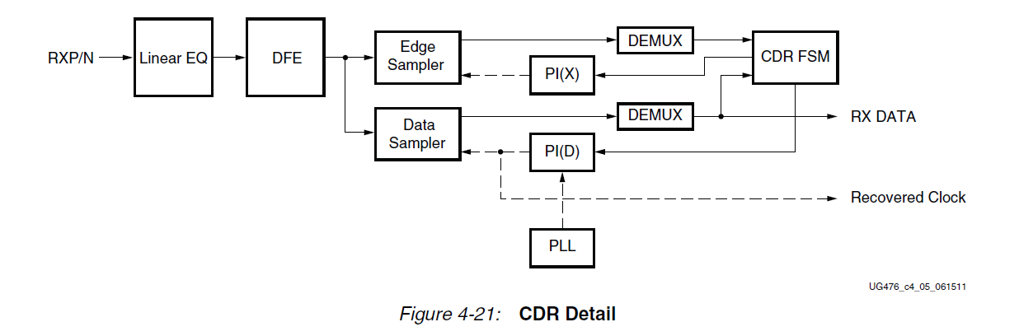
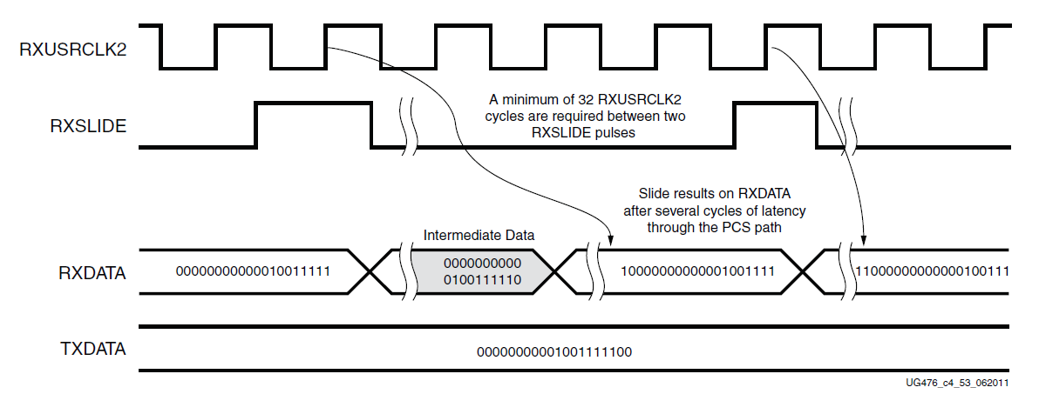
Rx CDR clock introduction
Edge
Data sampler
Alignment Block Finds Comma or Header
RXSlide
The CDR state machine uses the data from both the edge and data samplers to determine the phase of the incoming data stream and to control the phase interpolators (PIs)
The data is shifted right by one bit for every RXSLIDE pulse issued. The GBT receiver searches for the Header in the incoming data and checks it. Link is established after GBT Rx receiving 24 successive Headers(0110/0101). Then use Header flag to align the Rx CDR clock.

Slide 24
Phase 2 RPC Upgrade Project Overview
Certification for HL_LHC
Upgrade of Link System to improve timing resolution for existing RPC (|η | < 1.9)
Back-End for present and new high eta region RPCs
Extend the RPC coverage up to |η | = 2.4 to increase redundancy in high eta region in stations 3 and 4

