Slide 1




Martin Grossmann

Slide 2
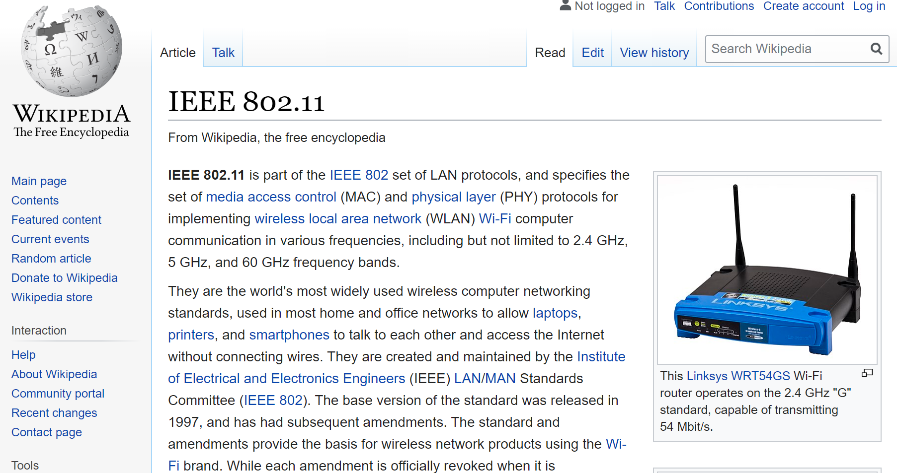
Do you know anything about IEEE?

Slide 3
IEEE is …
• The largest technical/scientific professional organization
The most prolific technical publisher
International with activities in all regions of the world
Organizes the most number of technical meetings and has the highest aggregate attendance
The professional organization with the broadest technical scope with 38 Technical Societies

Slide 4
NPSS is …
• The Technical Society that covers
  Fusion
  Nuclear Medical and Imaging Sciences
  Particle Accelerator Science and Technology
  Pulsed Power Systems
  Radiation Effects
  Radiation Instrumentation
  Plasma Sciences and Applications
  Standard for Nuclear Instruments and Detectors
  Computer Applications in Nuclear and Plasma Science

Slide 5
NPSS is …
• Organizes and supports many symposia, conferences and workshops each year
Publishes 4 Transactions (peer reviewed journals)
Publishes Newsletter to all members
Presents awards each year to recognize major contributions to the field
Provides access to publications on-line (IEEE Xplore)
Members save on conference registration
Members keep in touch via the Newsletter
Supports the growth of the profession
Members can get involved with NPSS and help direct and further promote our profession
Excellent network!

Slide 6
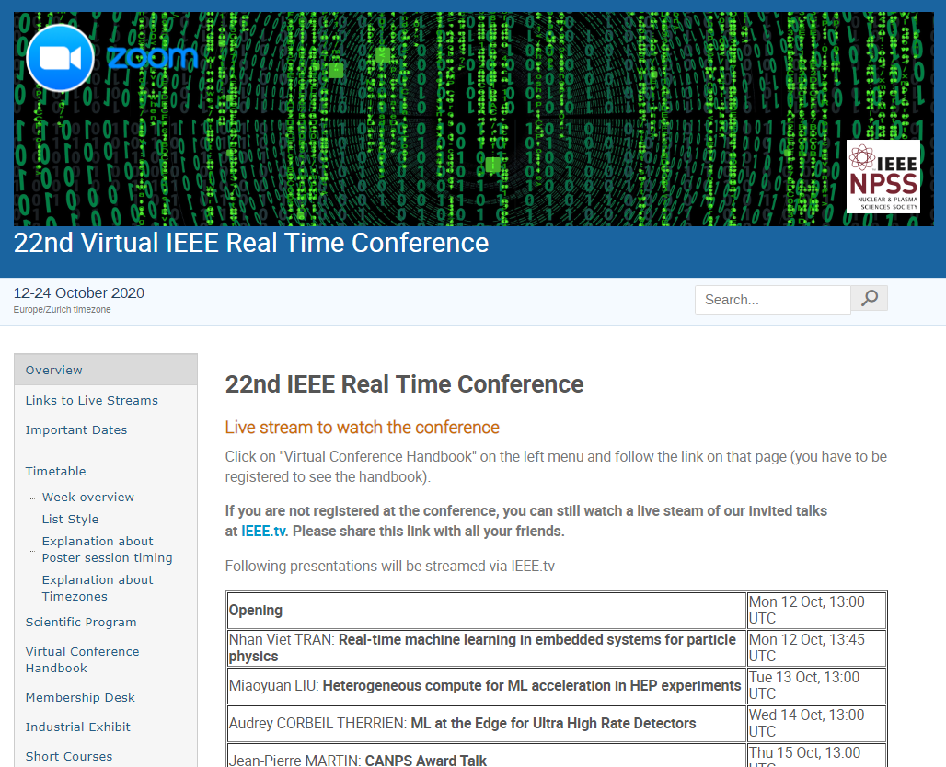
Conferences

Slide 7
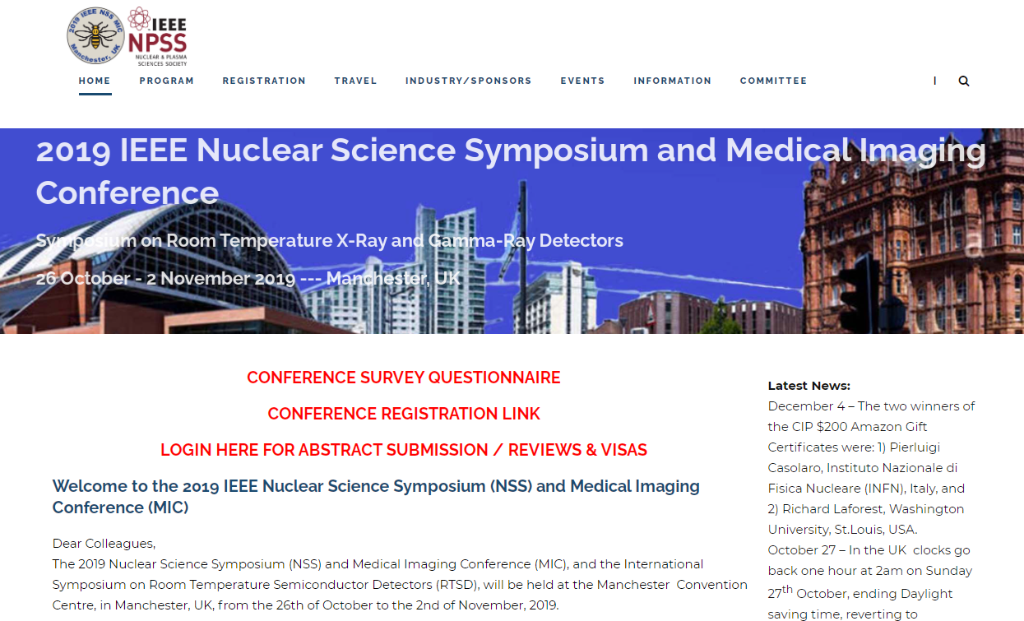
Conferences

Slide 8
Instrumentation Schools
• 2016: Ho Chi Minh City, Vietnam
2018: Capetown, South Africa
2019: Quy Nhon, Vietnam & Kuala Lumpur, Malaysia
2020: São Paulo, Brazil
2020 virtual schools: Jakarta, Dakar/Senegal

Slide 9
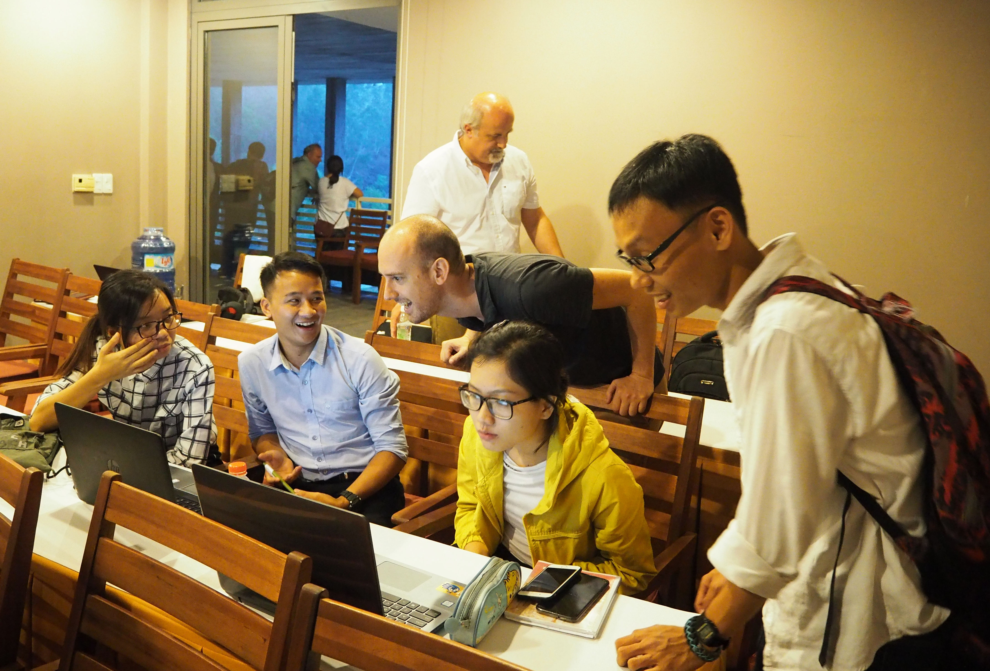
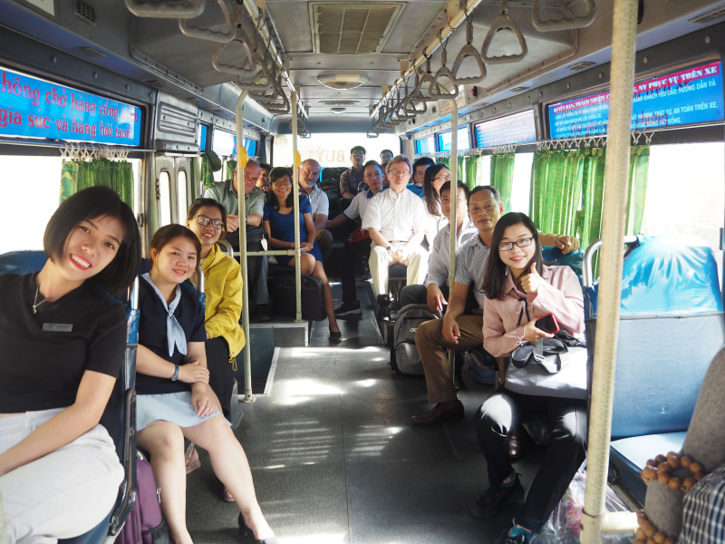
Instrumentation Schools

Slide 10
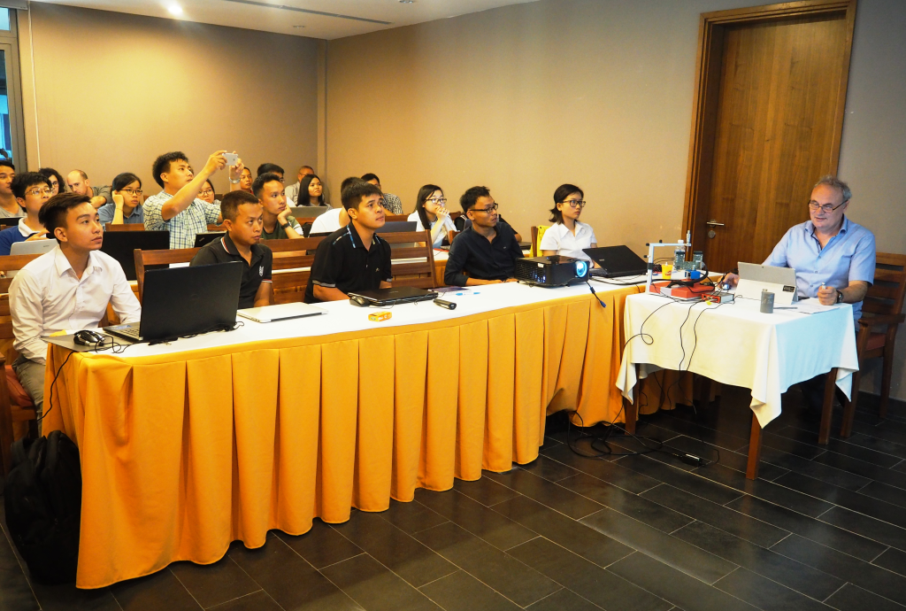
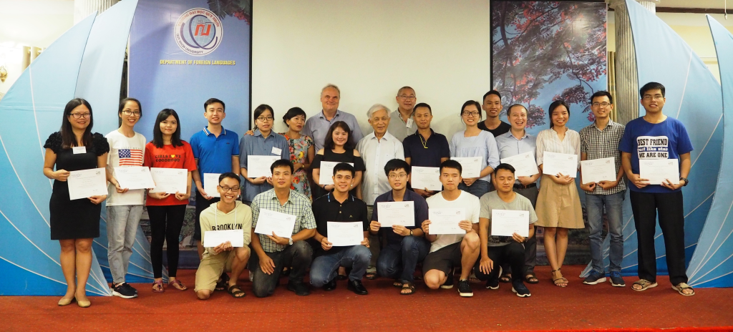
Instrumentation Schools

Slide 11
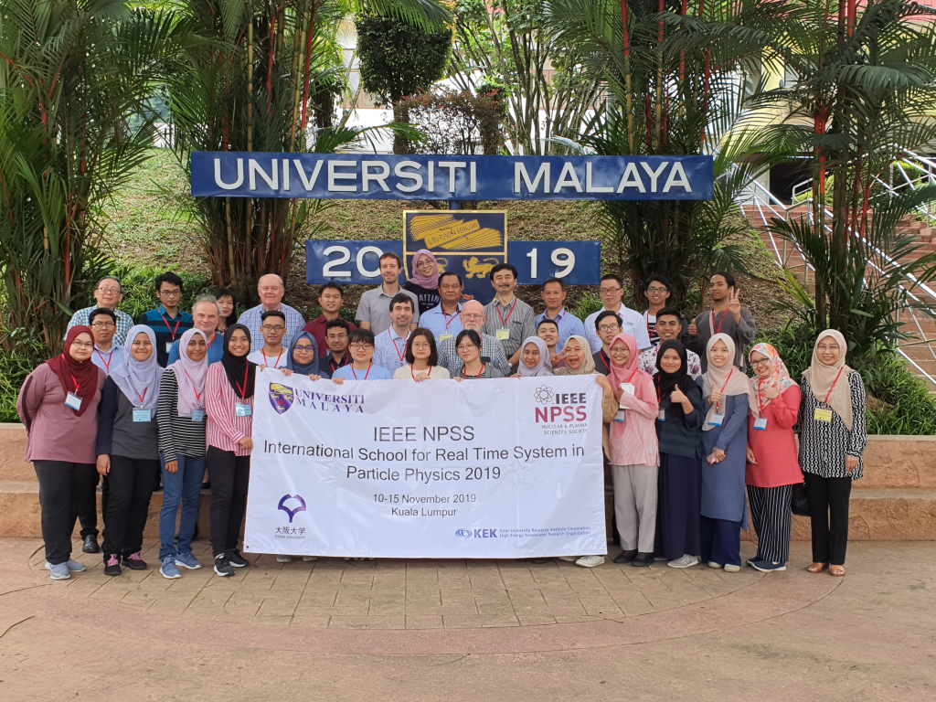
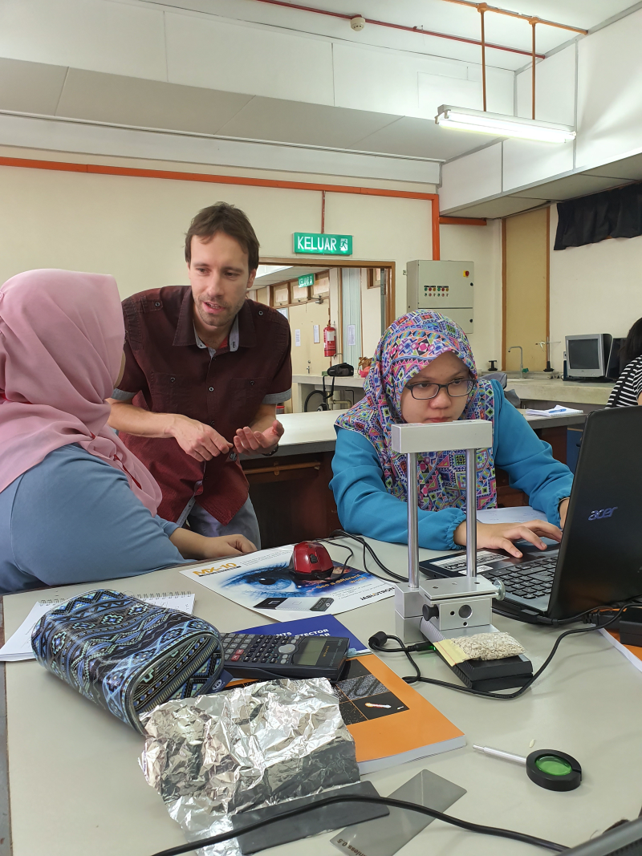
Instrumentation Schools

Slide 12
Instrumentation Schools

Slide 13
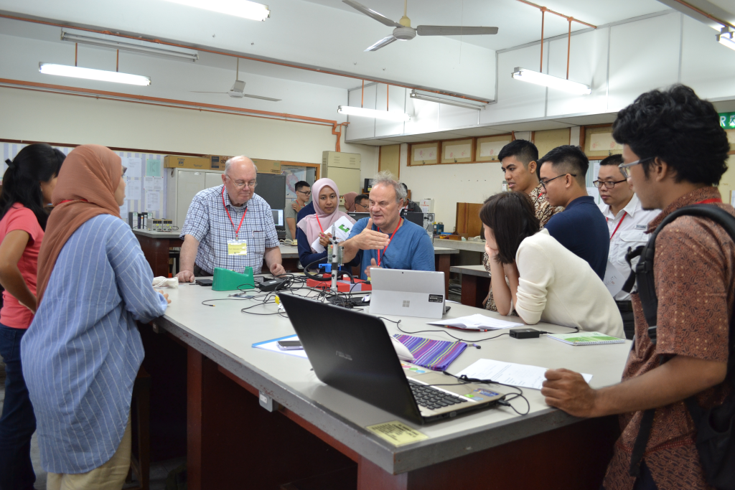
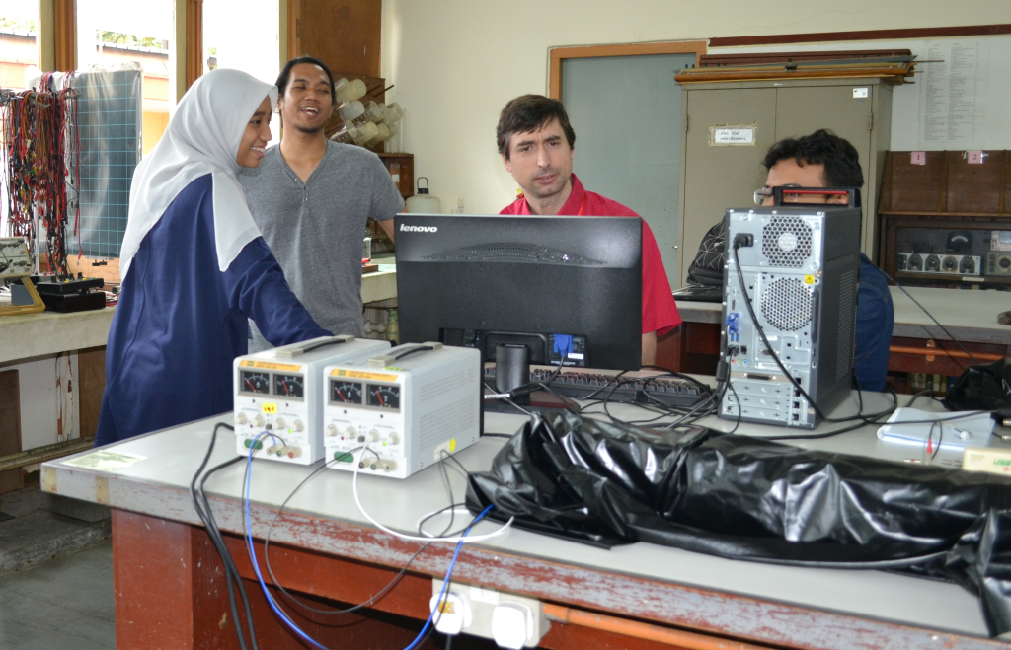
Instrumentation Schools

Slide 14
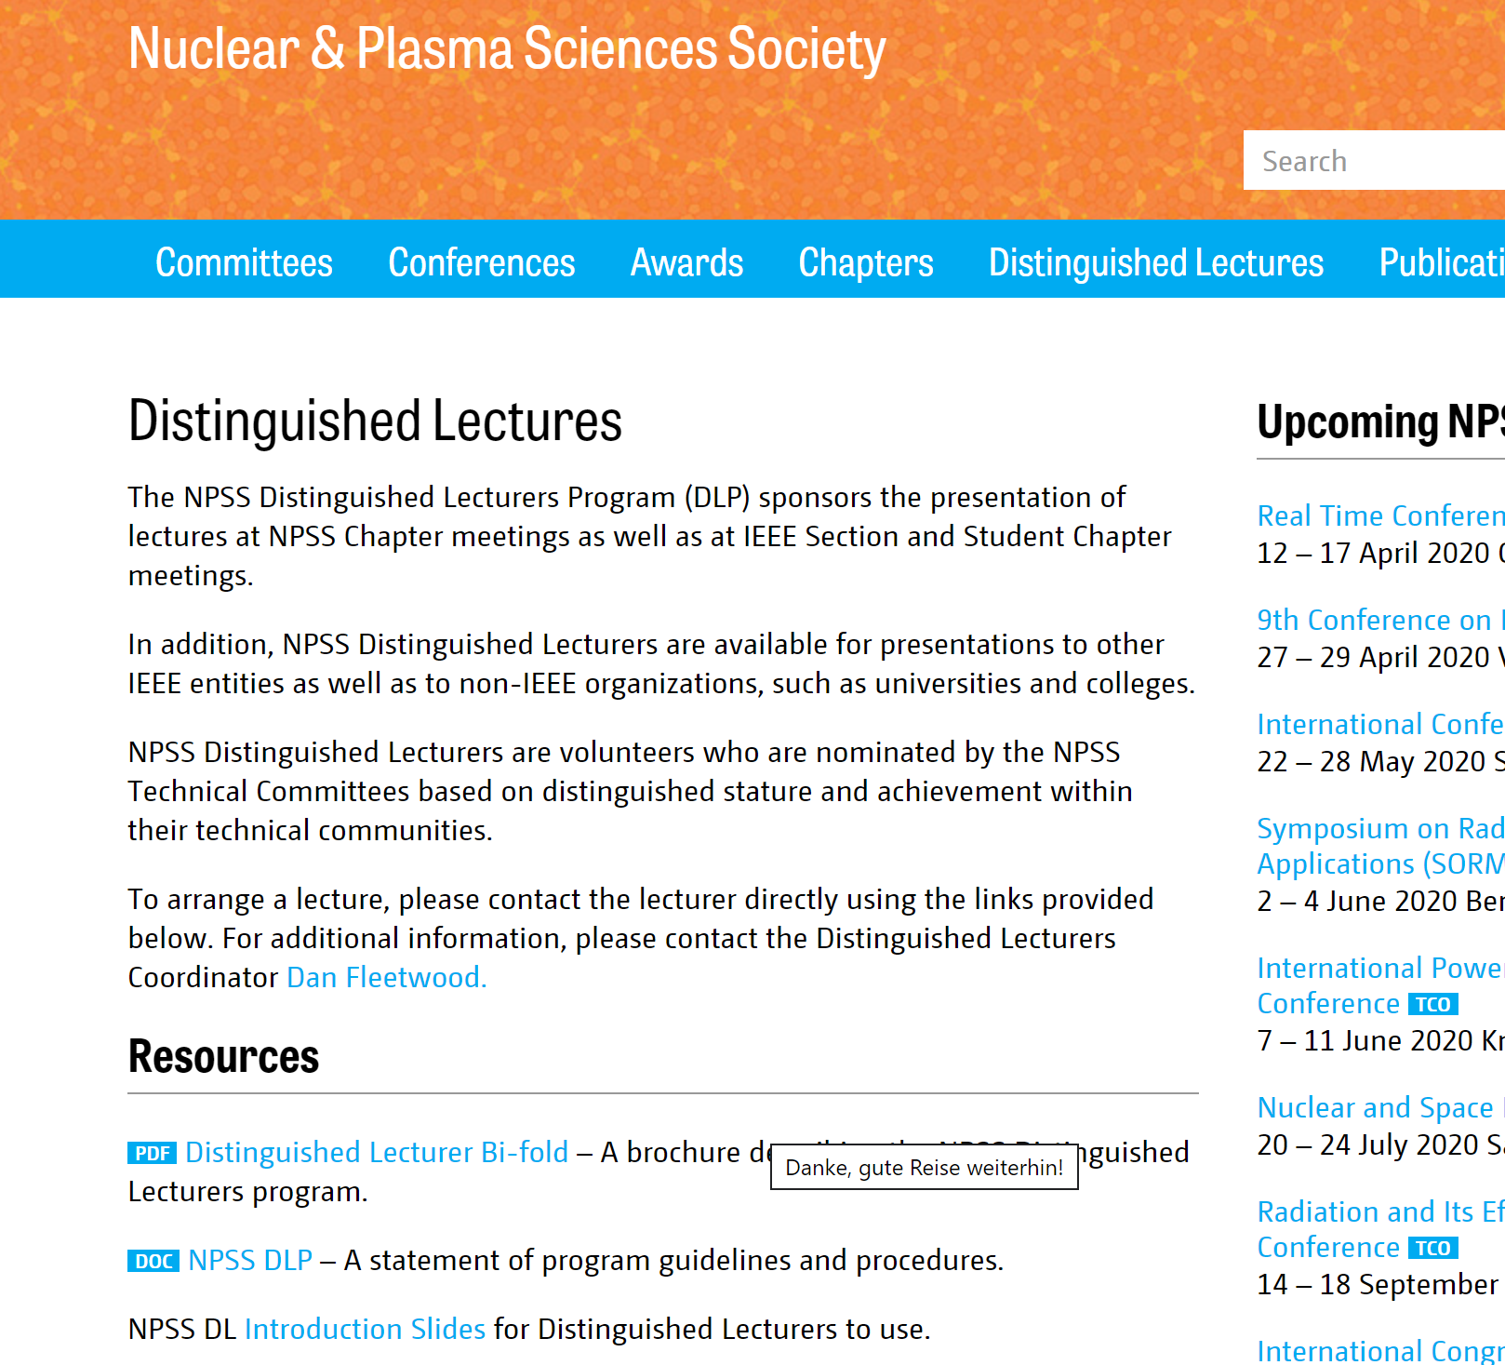
Distinguished Lecturers Program

Slide 15
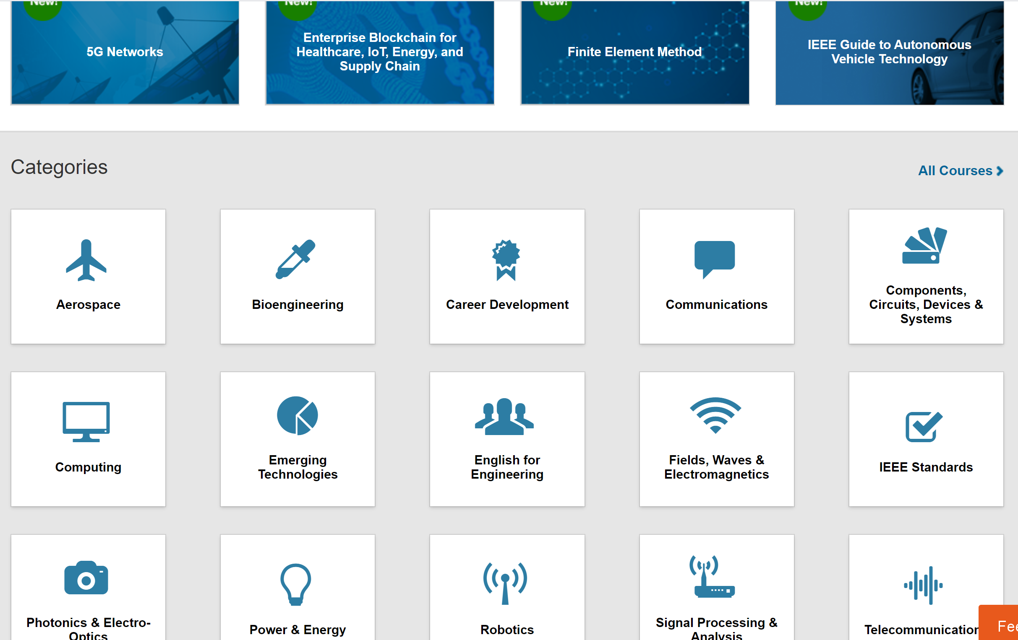
eLearning

Slide 16
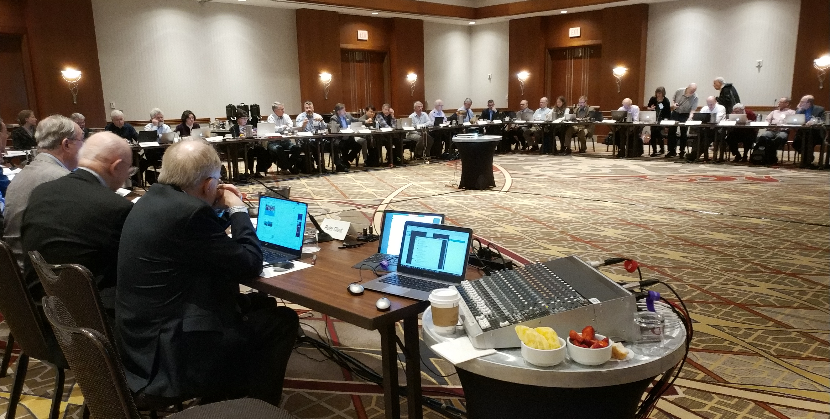
Networking
• International professional contacts

Slide 17
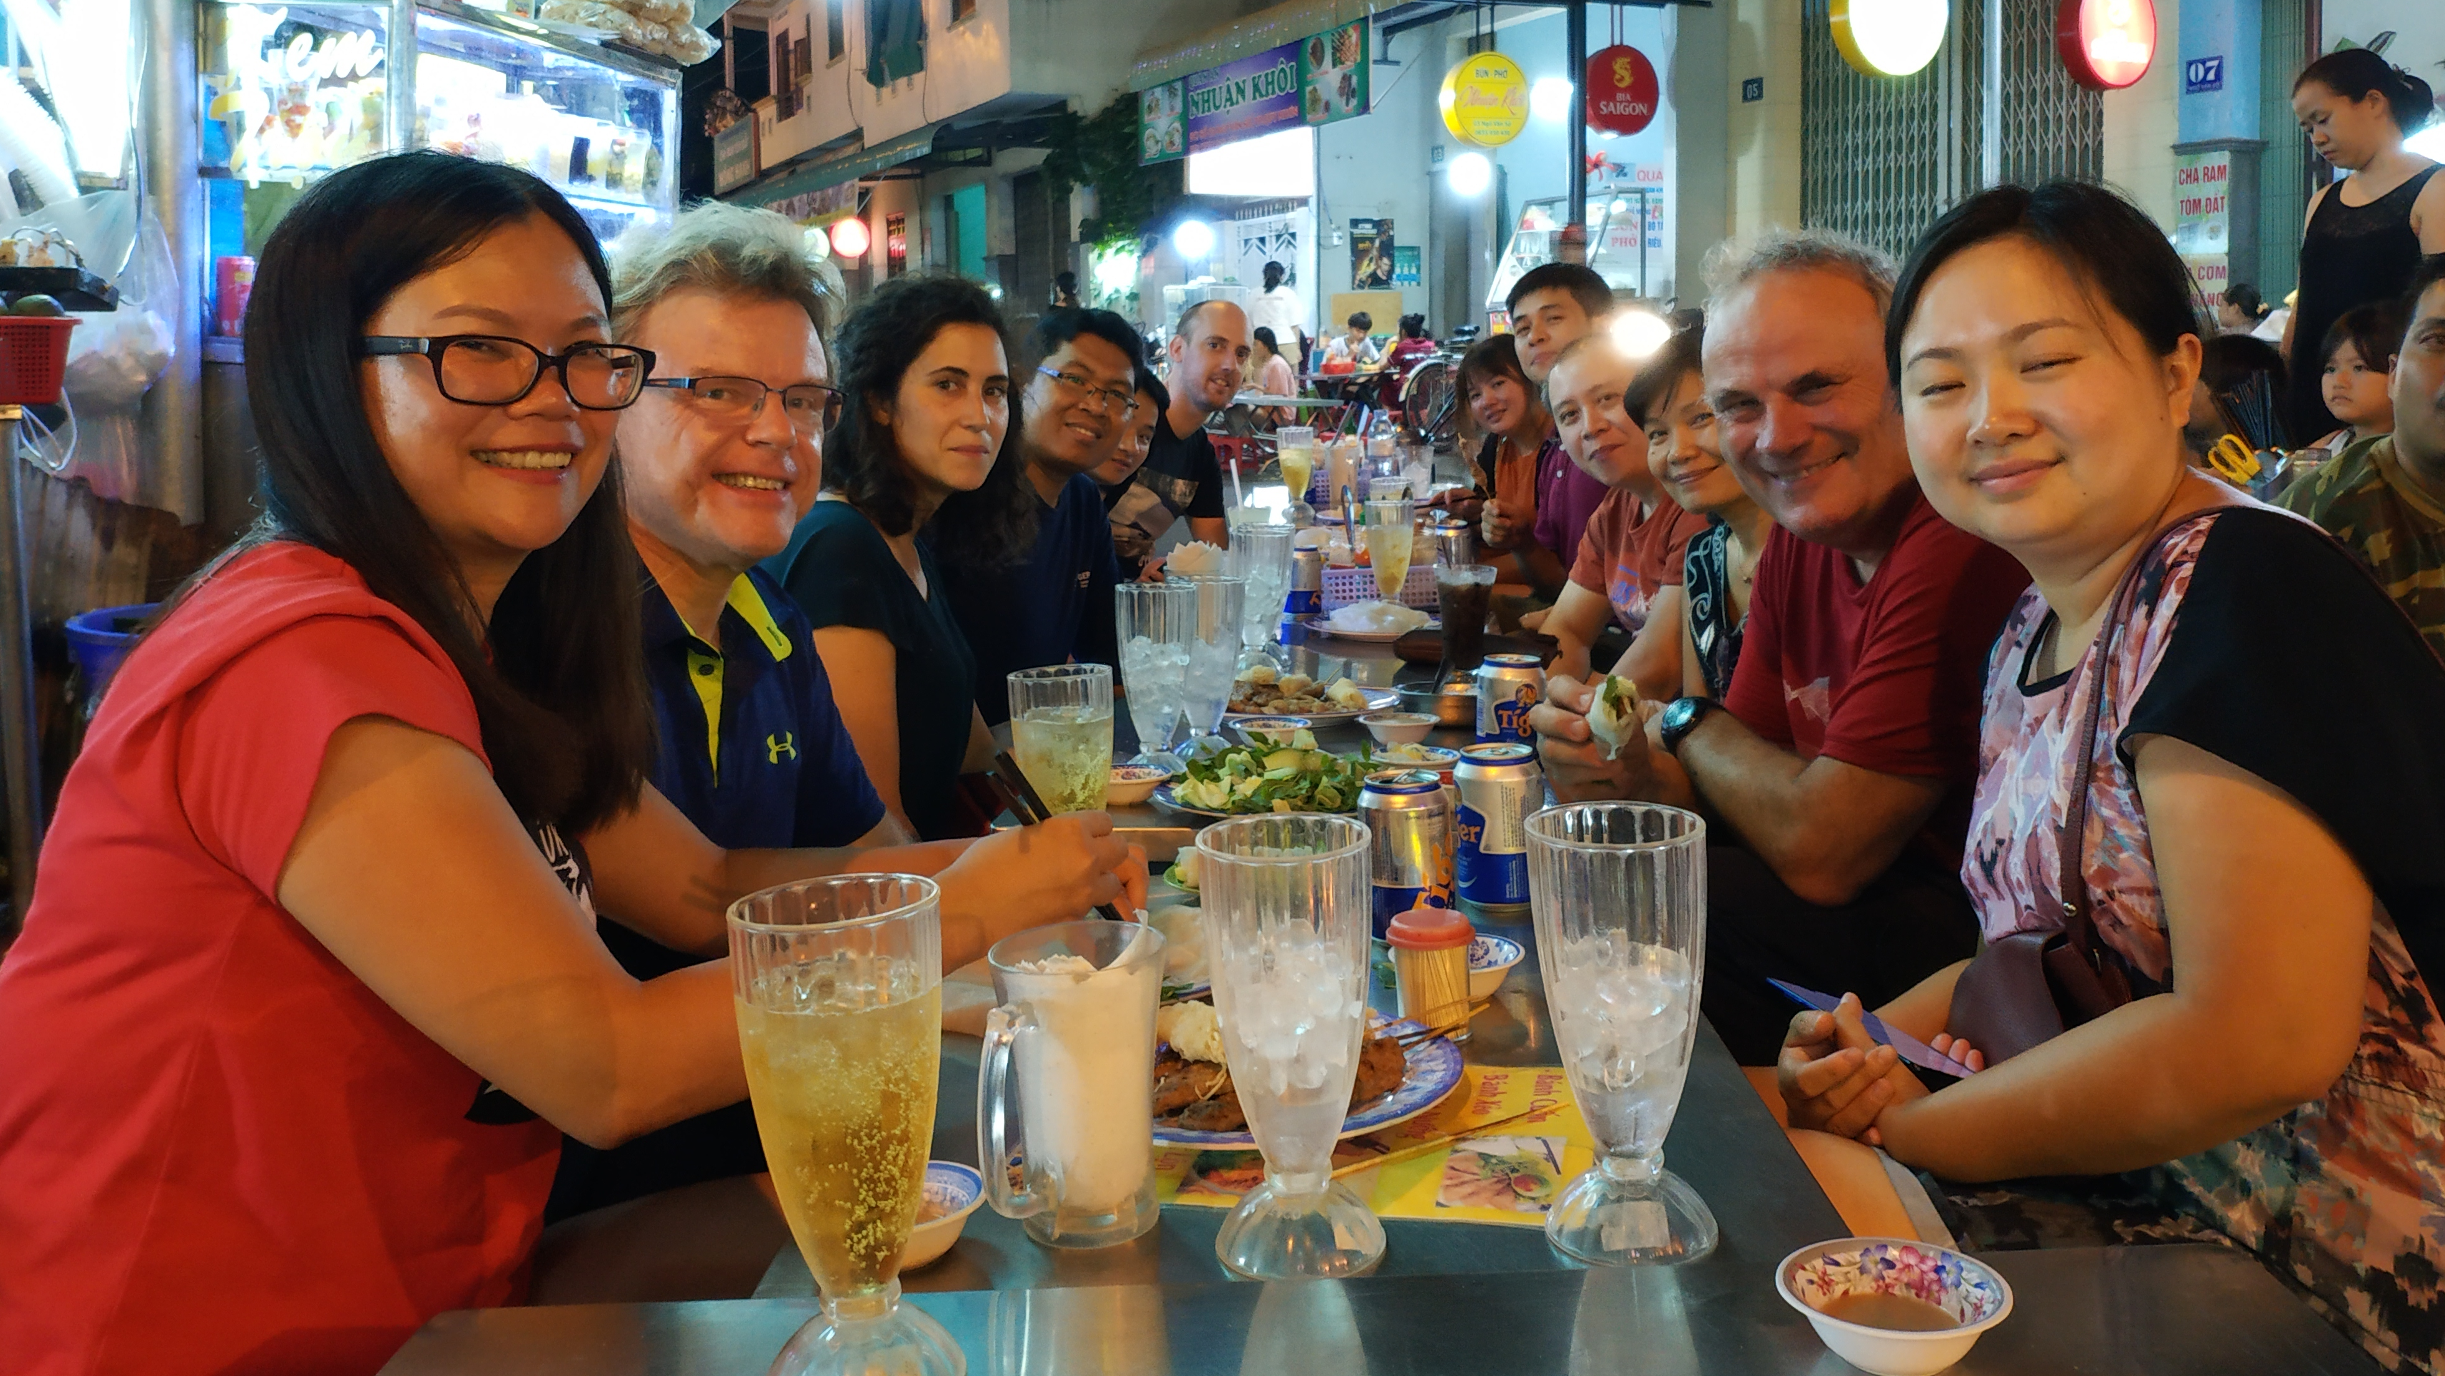
Networking

Slide 18
Membership
• Join a community of over 420’000 technology and engineering professionals
Get the resources and opportunities you need to keep on top of changes in technology
Get involved in standards development
Network with other professionals in your local area or within a specific technical interest
Mentor the next generation of engineers and technologists

Slide 19
Membership
• Gain expertise and open career doors
Stay current and get ahead
Build a network

Slide 20
Membership
• Membership cost per year:
  Professional USD 157
    eMembership: Indonesia/Malaysia/Vietnam USD 84
  Student USD 27

