Slide 1
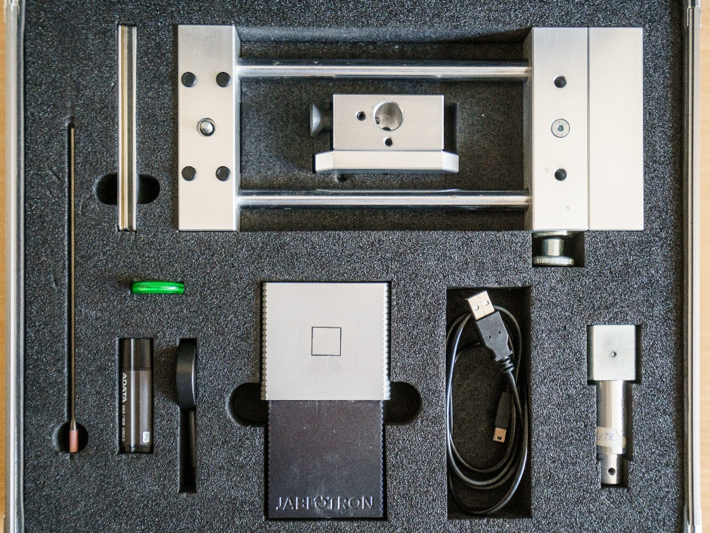
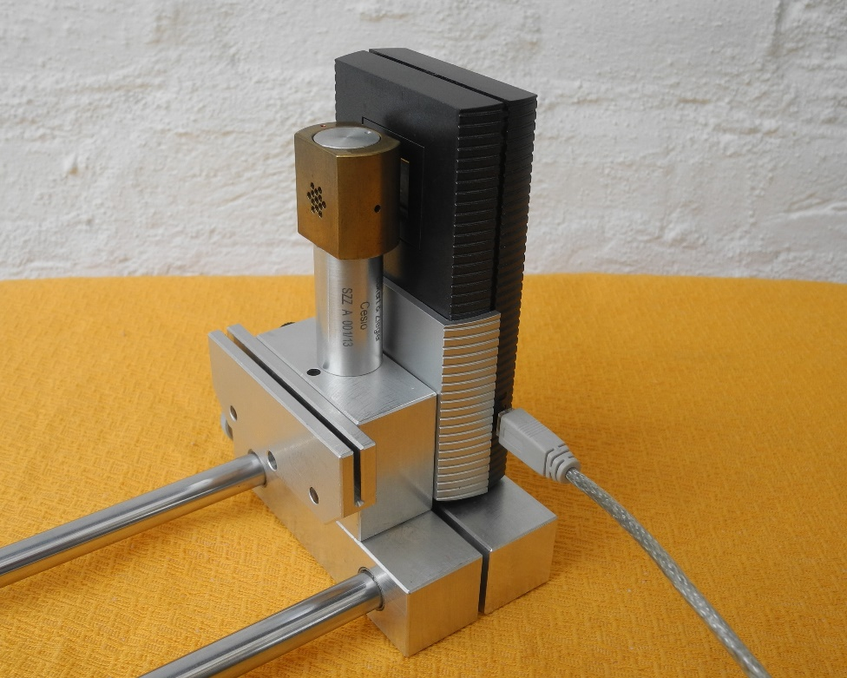
Detection of Neutrons
Using Pixel Detector
Vladimir Vicha, Michael Holik, IEAP CTU Prague
Virtual IEEE NPSS Workshop on Applications of Radiation Instrumentation, Jakarta 2020

Slide 2
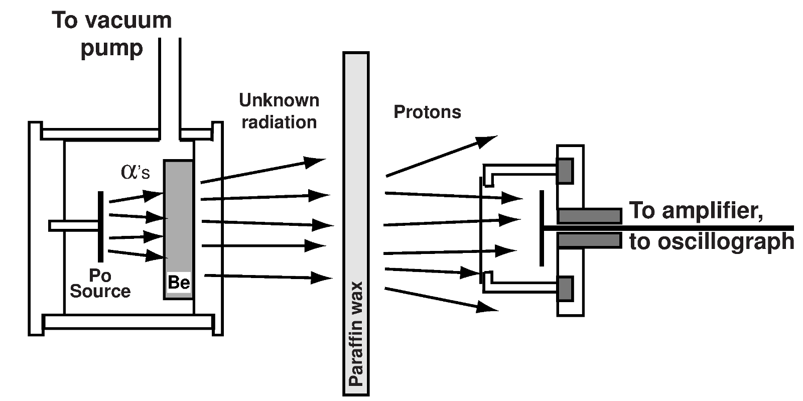

How to get free neutrons?
1931 Walther Bothe a Herbert Becker
Neutrons have not been known yet.
Beryllium exposed to alfa radiation (Po) → “beryllium radiation” (photons?) He + Be → ??
1932 James Chadwick – ability of “beryllium radiation” to recoil protons from paraffin – neutron discovery
$${}_{2}^{4}{He}+{}_{4}^{9}{Be→}{}_{6}^{12}{C+{}_{0}^{1}{n, }}$$
Bdushaw, CC BY-SA 4.0, https://commons.wikimedia.org/w/index.php?curid=6398200

Slide 3
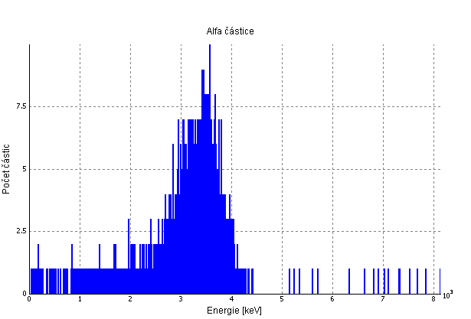
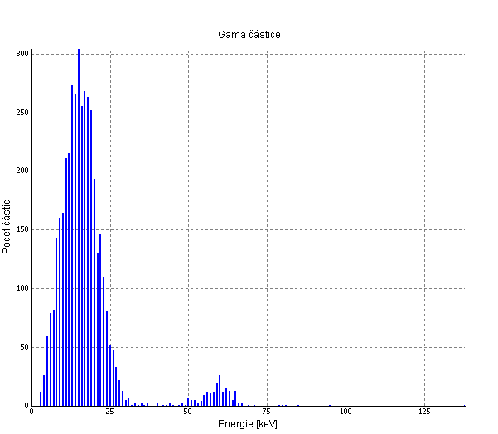
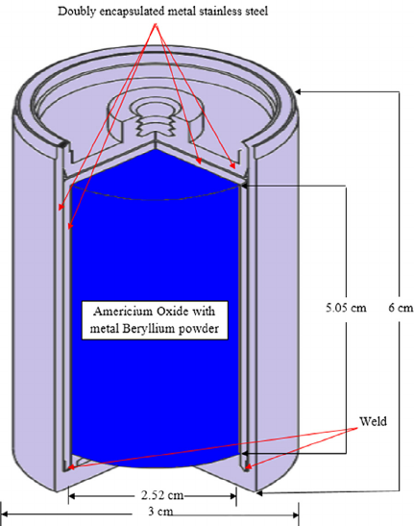
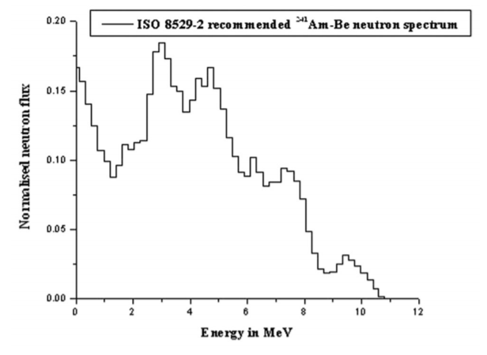
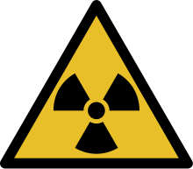



How to get free neutrons?
AmBe – neutron source
$${}_{95}^{241}{Am→{}_{93}^{237}{Np+{}_{2}^{4}{He}}}$$
E (He) = 5,5 MeV, E_{γ}= do 60 keV
$${}_{2}^{4}{He}+{}_{4}^{9}{Be→}{}_{6}^{12}{C+{}_{0}^{1}n}$$
E_{max} (n)= 11,1 MeV
$${}_{2}^{4}{He}+{}_{4}^{9}{Be→}{}_{6}^{12}{C+{}_{0}^{1}{n+γ}}$$
E_{max} (n) = 6,4 MeV, E_{γ}= 4,4 MeV
10 000 alpha particles is needed for generation of 1 neutron
Exemplar AmBe source with activity A = 1 Ci = 3,7.10¹⁰ Bq produces about ~10⁶ neutrons per second
https://www.researchgate.net/publication/285711386_Calculating_the_ambient_dose_equivalent_of_fast_neutrons_using_elemental_composition_of_human_body
Pujala, Usha, Selvakumaran, T.S., Mohapatra, D.K., Raja, E. Alagu, Subbaiah, K.V., Baskaran, R. “Analysis of Neutron Streaming Through the Trenches at LINAC Based Neutron Generator Facility, IGCAR.” Indian Association for Radiation Protection, 34(2011):262-266.

Slide 4


Is it possible to detect neutrons directly with silicon detectors?
Energy of reaction of neutron with Silicon is negative
The minimal threshold energy E_{thr} is needed to let the reaction to happen
 | Q (MeV) | E_{thr} (MeV) | E_{max} (MeV) products
 | -2,65 | 2,75 | 8,21
 | -3,86 | 4,00 | 7,22
$${}_{0}^{1}{n+{}_{14}^{28}{Si→{}_{12}^{25}{Mg+{}_{2}^{4}{He}}}}$$
$${}_{0}^{1}{n+{}_{14}^{28}{Si→}}{}_{13}^{28}{Al}+{}_{1}^{1}p$$
AmBe source provides fast neutrons with energies up to 11 MeV
The minimal threshold energy is lower than max energy of emitted fast neutrons
Therefore reaction of neutrons with Silicon is realistic.
The Si sensor can detect produced alphas and protons.

Slide 5
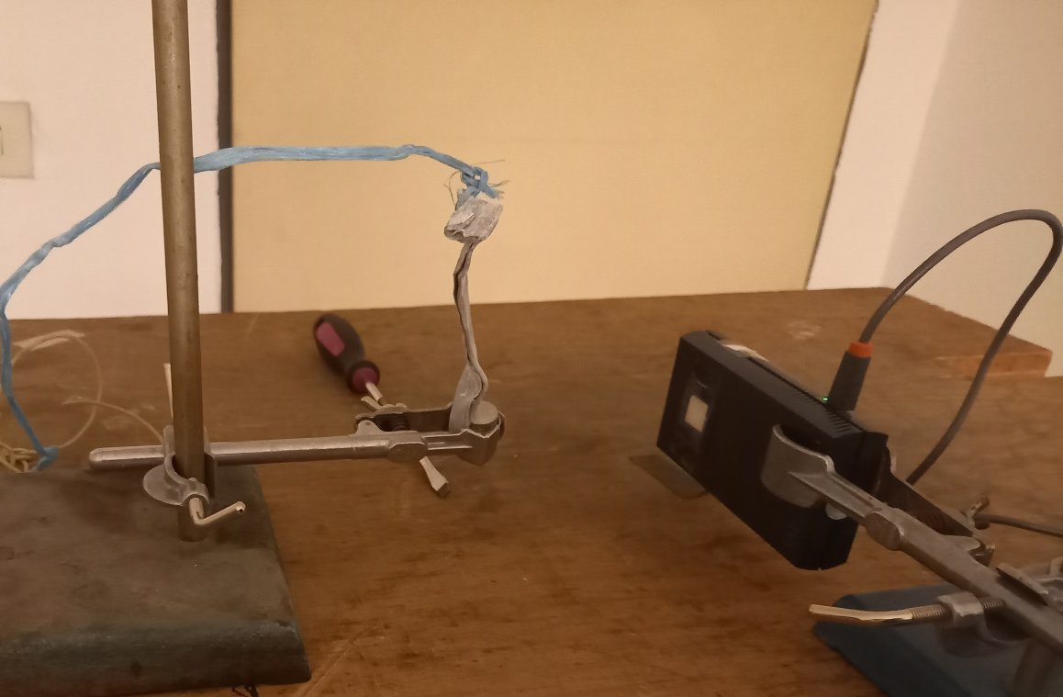
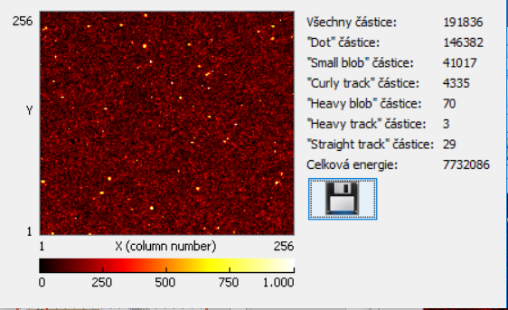
Detection of Fast Neutrons
Bare MX-10 sensor
AmBe source inside Pb cover is placed in distance 12 cm
Frame exposition time 0.1 s
Frame count 2400
Total measurement time 4 minutes
Pb Shielding
Videoclip 9
Sensor
MX-10
AmBe
Extended particle recognition analysis is used.
Tracks created by heavy charged ions are classified as “Heavy Blobs”.

Slide 6
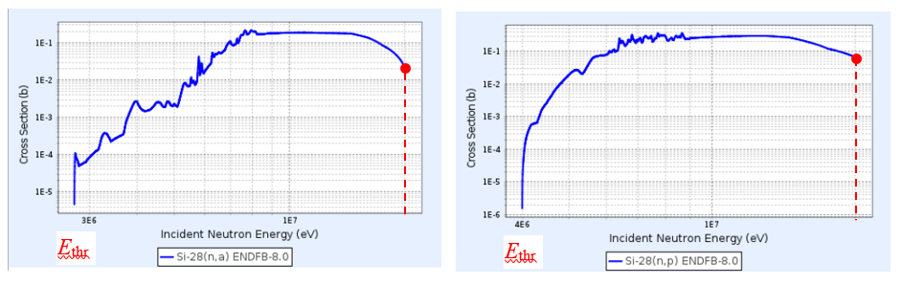
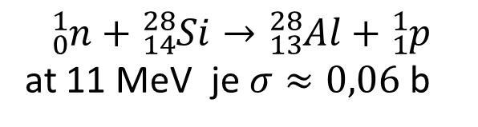
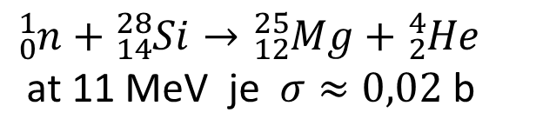
Microscopic cross section σ
Microscopic cross-section σ, interaction probability, significantly depends on energy of neutron and kind of the targeting nucleus.
Value is stated in barns (marked b)
1 b = 10⁻²⁸ m²
11 MeV
11 MeV
$${}_{0}^{1}{n+{}_{14}^{28}{Si→{}_{12}^{25}{Mg+{}_{2}^{4}{He}}}}$$
at 11 MeV je$σ≈0,02 \text{b}$
$${}_{0}^{1}{n+{}_{14}^{28}{Si→}}{}_{13}^{28}{Al}+{}_{1}^{1}{p }$$
at 11 MeV je $σ≈0,06 \text{b}$
Considering entire spectrum of AmBe generated neutrons the maximal cross section value reaches 0.3b

Slide 7
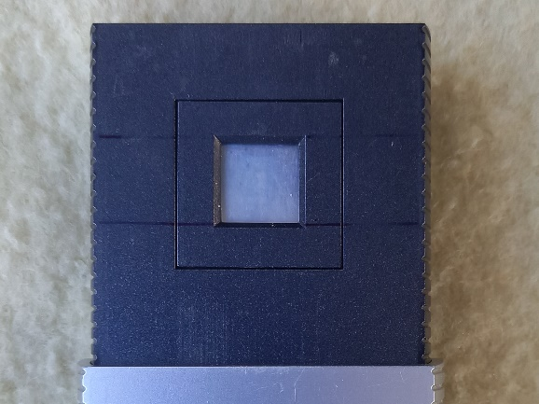
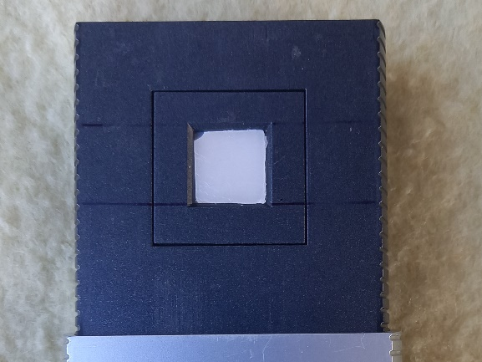
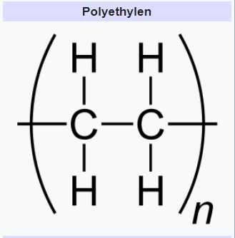
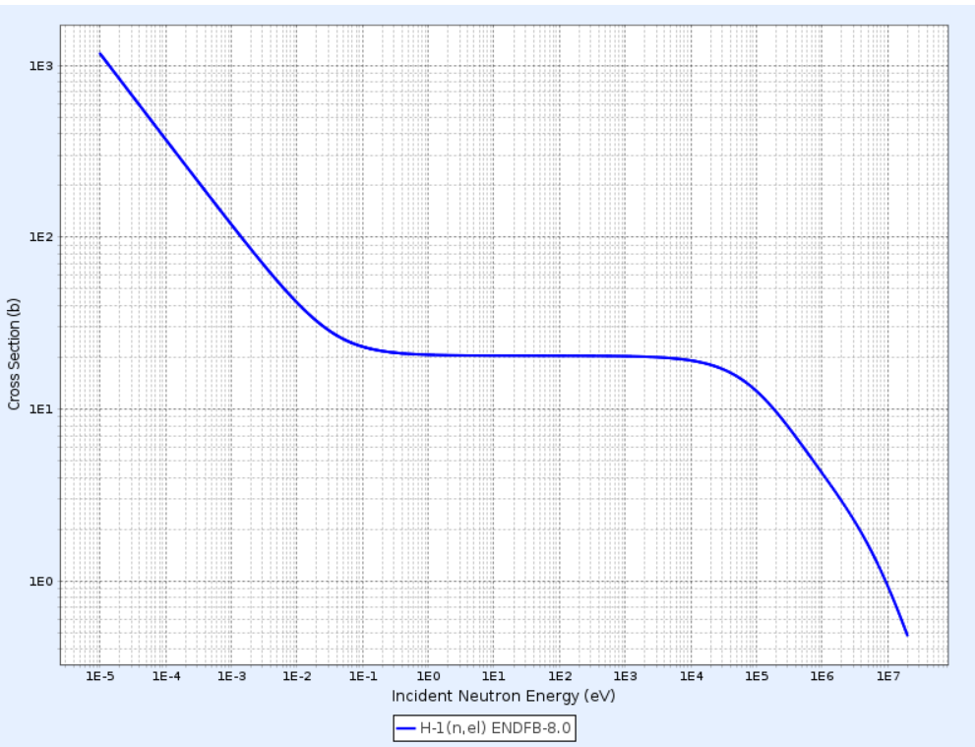
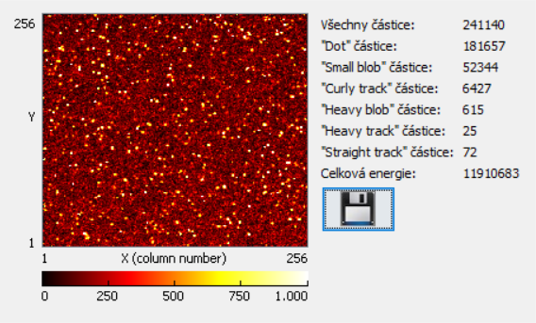
Paraffin as a Neutron Convertor
Left – bare silicon sensor MX-10 without any converter Right – MX-10 assembled with paraffin converter
Effective cross-section for elastic scattering neutron for ¹H at energies in MeV order is σ = 20 b.
Videoclip 10

Slide 8
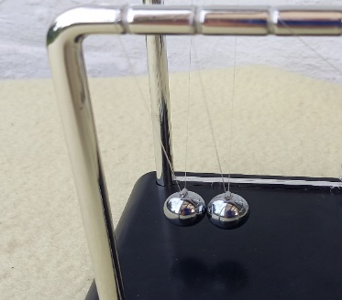
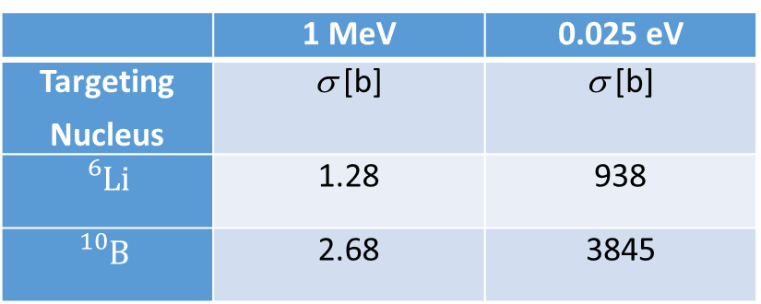
Thermalized neutrons interact with significantly higher probability
When neutrons get slowed down and original fast neutrons become thermal neutron then effective cross section of reaction with light nuclei like lithium and boron increases significantly
 | 1 MeV | 0.025 eV
Targeting Nucleus | σ [b] | σ [b]
$${}_{}^{6}{Li}$$ | 1.28 | 938
$${}_{}^{10}B$$ | 2.68 | 3845
Neutron hydrogen nucleus scattering can be modelled with “Newton's cradle”, i.e. collision of two balls with the same mass.
Impacting ball (neutron) gets stopped if target ball is centrally hit. The targeting ball (hydrogen nucleus) starts to move with speed of the impacting ball.
If the target is not hit centrally then the impacting ball keeps on moving with partially reduced speed and energy. After several consequent collisions, energy of free neutron is reduced down to the level of surrounding atoms determined by temperature.
Materials that effectively slow down fast neutrons are called moderators. These materials are often
rich in hydrogen concentration, e.g. paraffin, polyethylene, water…

Slide 9

Reaction of neutrons with lithium ⁶Li nuclei
$${}_{3}^{6}{Li+{}_{0}^{1}{n→{}_{2}^{4}{α+{}_{1}^{3}H}}}$$
Energy of reaction is positive Q = +4.78 MeV (there is no minimal threshold energy)
Tritium product nucleus shares 2.73 MeV and alpha particle product shares 2.05 MeV from released energy
Reaction products have the same momentum but directed oppositely
Products, charged ions, can be registered by the pixel detector

Slide 10
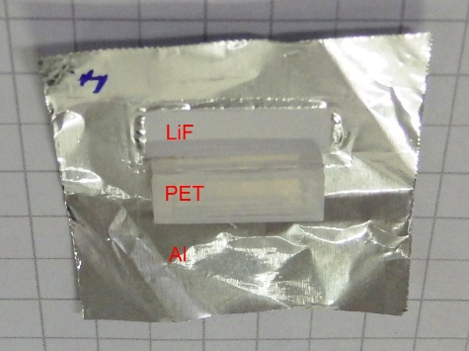
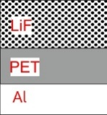
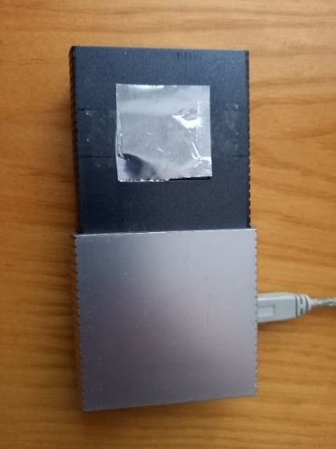
LiF Converter
Lithium Fluoride, containing enriched isotope ⁶Li
LiF is spread on the aluminium foil (supporting material)
Area density - 3,6 mg/cm² ………. Layer thickness - 18 μm

Slide 11
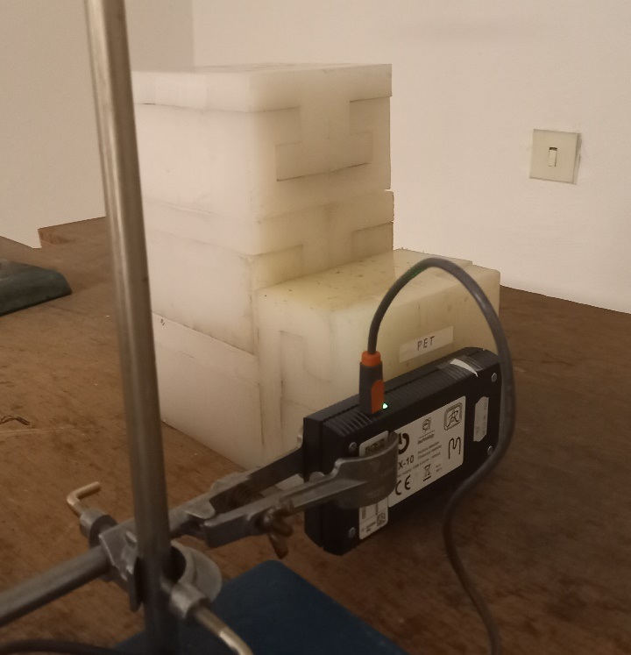
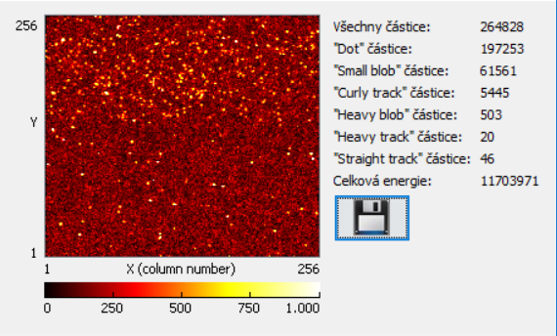
Detection of thermal neutrons using LiF converter
Videoclip 11
AmBe source has been put in the cavity inside the polyethylene block serving as a moderating material to get thermal neutrons
Another moderating polyethylene block has been added side-by.
The upper third of the MX-10 sensor area has been covered with LiF converter.

Slide 12
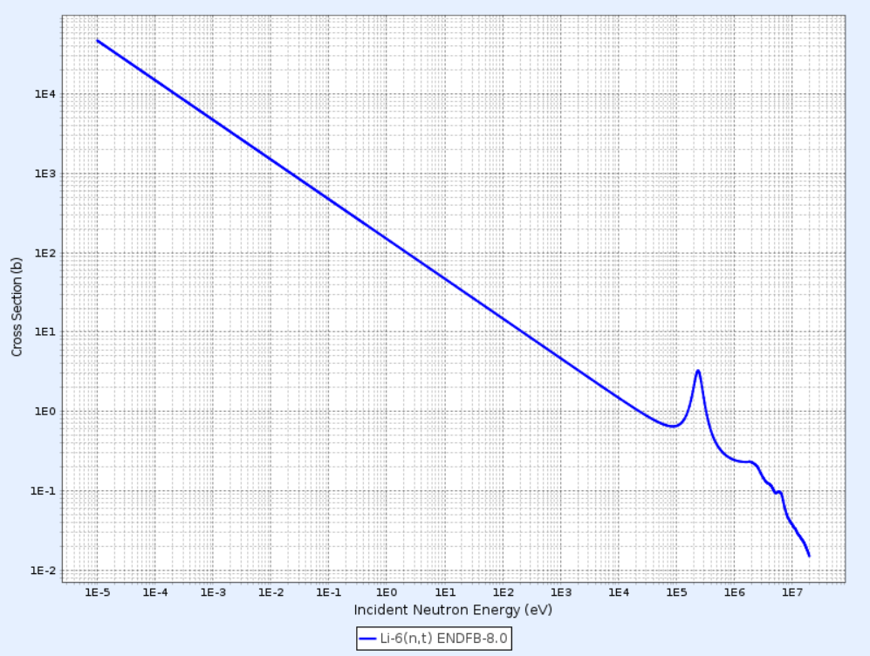
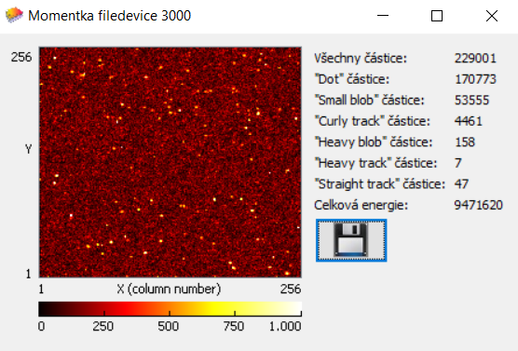

Shielding of thermal neutrons using lithium ⁶Li
$${}_{3}^{6}{Li+{}_{0}^{1}{n→{}_{2}^{4}{α+{}_{1}^{3}{H }}}}$$
Effective cross-section significantly rises with decreasing neutron energy (note logarithmic scale)
e.g. Thermal neutrons with energy 0,025 eV
σ = 938 b
938 b
0,025 eV
Videoclip 12
The pure polyethylene block is replaced by the lithium dopped block
(containing 10 % of lithium ⁶Li)

Slide 13
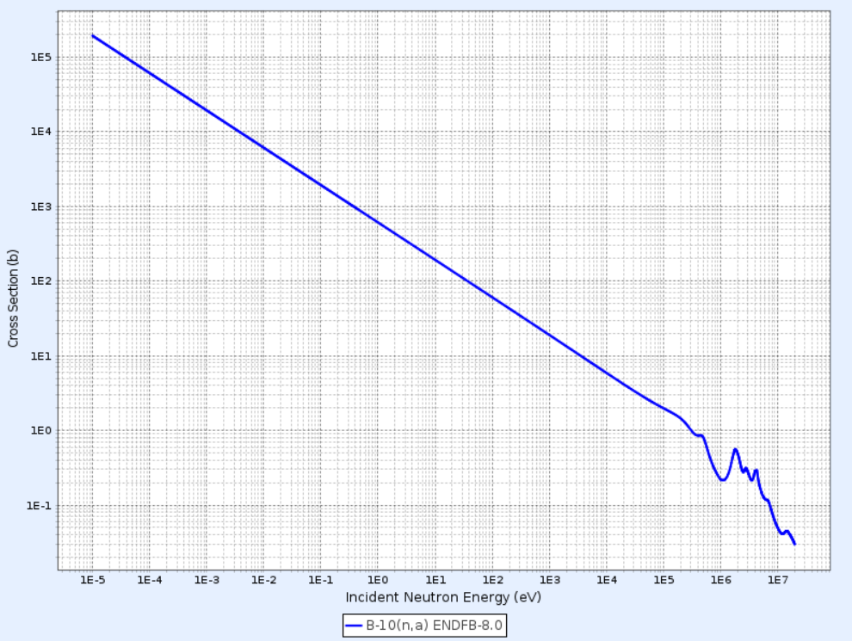
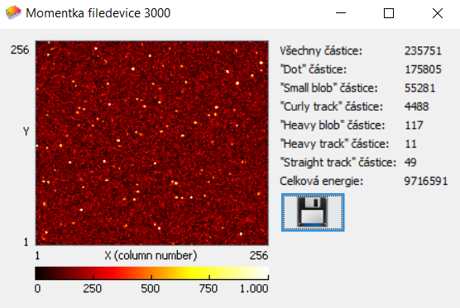
Shielding thermal neutrons using boron ¹⁰B
$${}_{5}^{10}{B+{}_{0}^{1}{n→{}_{3}^{7}{Li+{}_{2}^{4}{α 6 \%}}}}$$
${}_{5}^{10}{B+{}_{0}^{1}{n→{}_{3}^{7}{Li+{}_{2}^{4}α}}}+γ 94 \%,{ E}_{γ}=480 \text{keV} radiační záchyt$
cross section for reaction of ¹⁰B with thermal neutrons at energy 0,025 eV is σ = 3844 b.
(It poses four time higher value than
reaction with ⁶Li where σ = 938 b)
3844 b
0,025 eV
Lithium doped polyethylene block is replaced by the boron doped polyethylene block (containing 5 % of boron ¹⁰B)
Videoclip 13

Slide 14
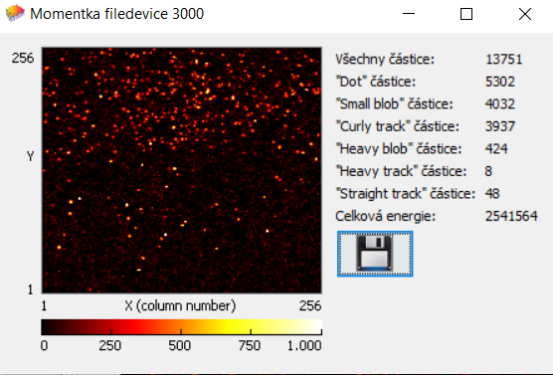
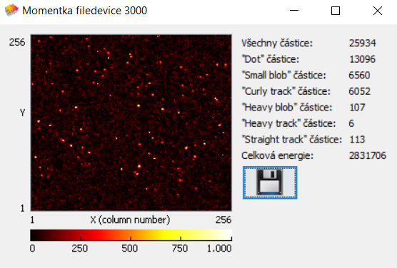
Shielding of thermal neutrons using lead and cadmium
Lead is often referenced as radiation shielding material. Would it also serve well to shield neutrons???
1mm thick Pb plate has been placed between polyetylene brick and sensor covered with LiF converter
In the next step, 0.7mm thick Cd plate has been placed between the polyethylene brick
and the sensor covered with LiF converter.
Videoclip 14
Videoclip 15

Slide 15
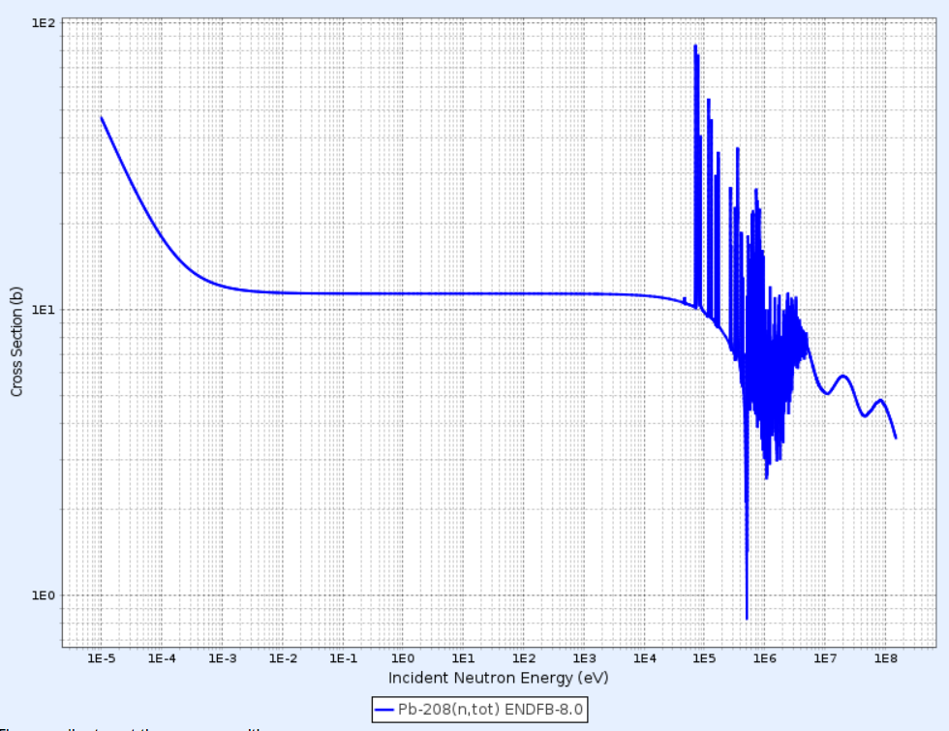
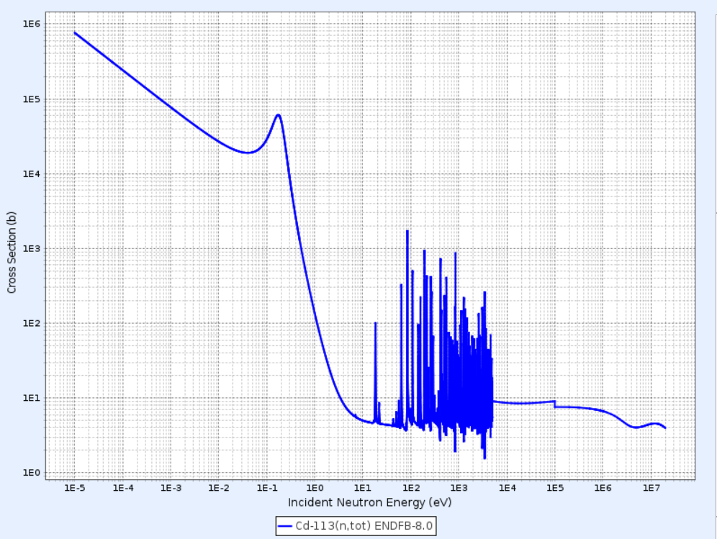
Effective cross section for neutron reaction with lead and cadmium
Isotopes ²⁰⁶Pb, ²⁰⁷Pb, ²⁰⁸Pb exhibit cross section σ = 11 b for thermal neutrons with energy 0,025 eV.
Isotope ¹¹³Cd exhibits cross section σ = 19 984 b for thermal neutrons with energy 0,025 eV.
19 984 b
11 b
0,025 eV
0,025 eV

Slide 16
References
Vícha V.: Experimenty s pixelovým detektorem pro výuku jaderné a částicové fyziky. České vysoké učení technické, Praha 2016. ISBN 978-80-01-05888-6, str. 41-43, 77-80.
Pujala, Usha, Selvakumaran, T.S., Mohapatra, D.K., Raja, E. Alagu, Subbaiah, K.V., Baskaran, R. Analysis of Neutron Streaming Through the Trenches at LINAC Based Neutron Generator Facility, IGCAR. Indian Association for Radiation Protection, 34(2011):262-266.
[3] Nuclear Data Center at KAERI, available online: http://atom.kaeri.re.kr/
[4] Rinard P.: Neutron Interaction with Matter. [cit 9. 9. 2020]. Dostupné online: https://www.lanl.gov/org/ddste/aldgs/sst- training/_assets/docs/PANDA/Neutron%20Interactions%20with%20Matter%20Ch.%2012%20p.%20357-378.pdf
[5] Hůlka J., Kánský Z., Janout Z., Pospíšil S.: Detektor tepelných neutronů využívající křemíkový polovodičový detektor s povrchovou bariérou. ACTA POLYTECHNICA – Práce, Praha 1980.

Slide 17
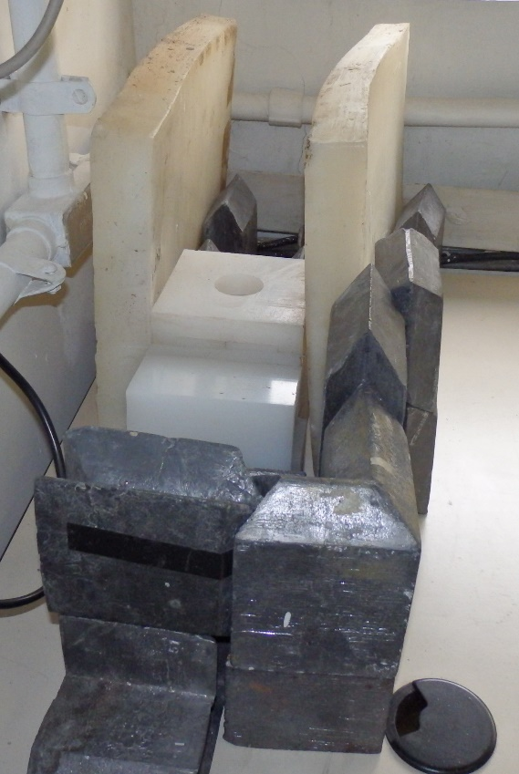
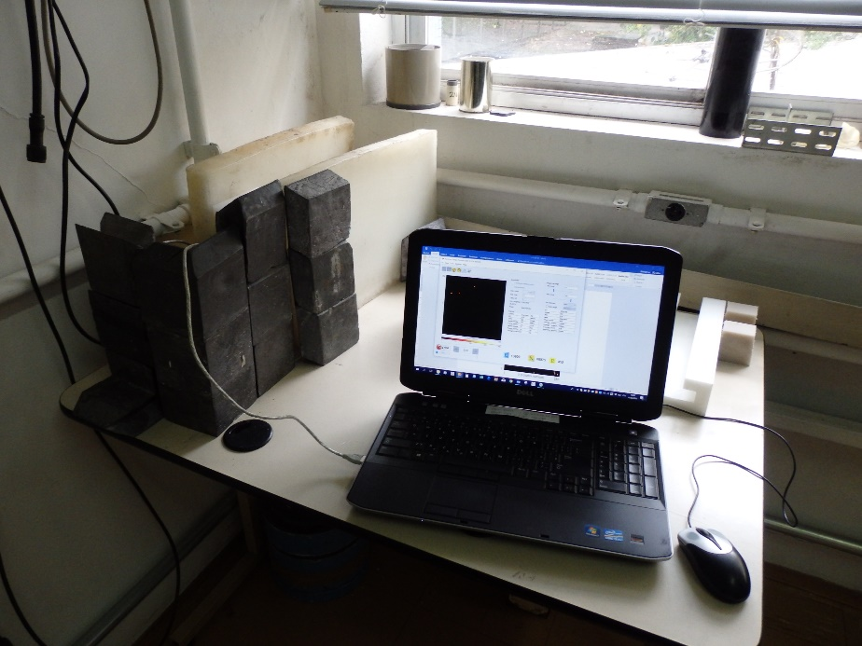
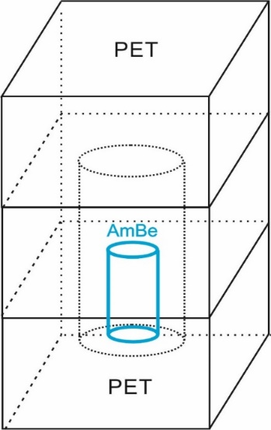
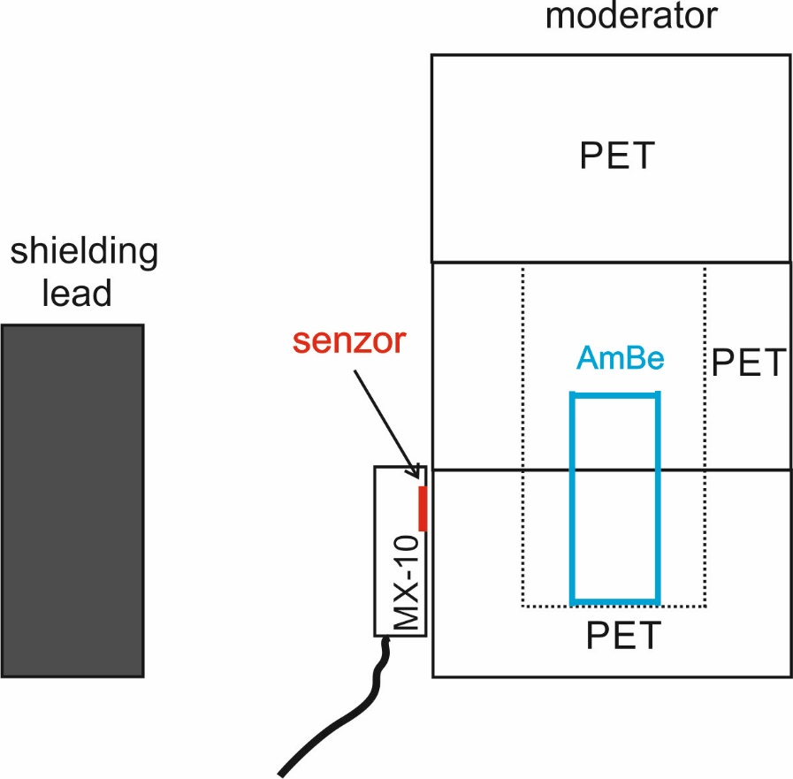
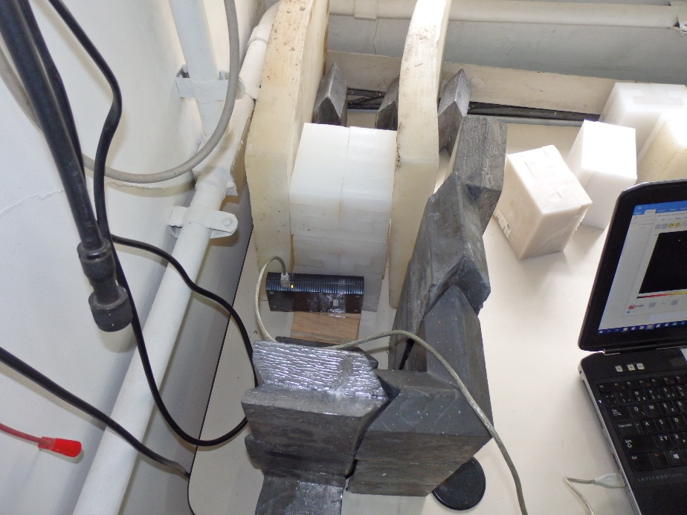
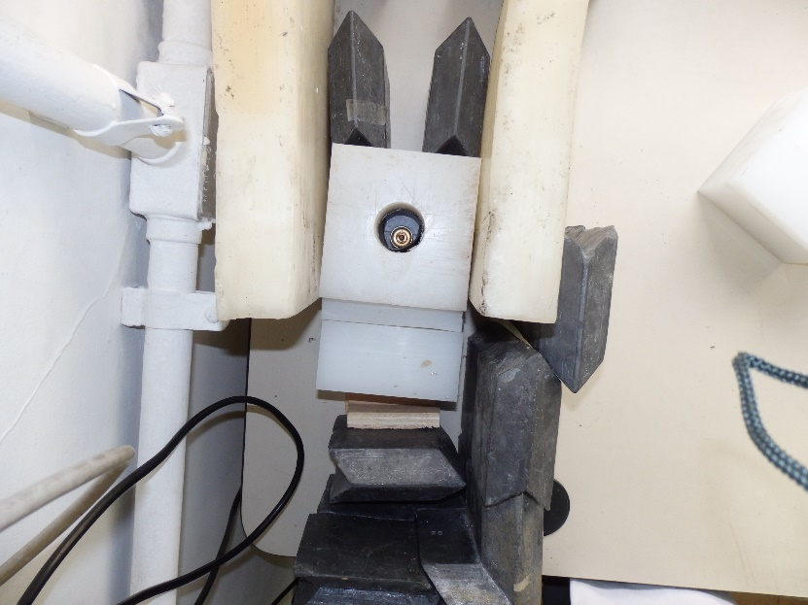
Measurement set-up assembled at IPEN laboratory in Sao Paulo Better shielding arrangement – In vivo demonstration

Slide 18
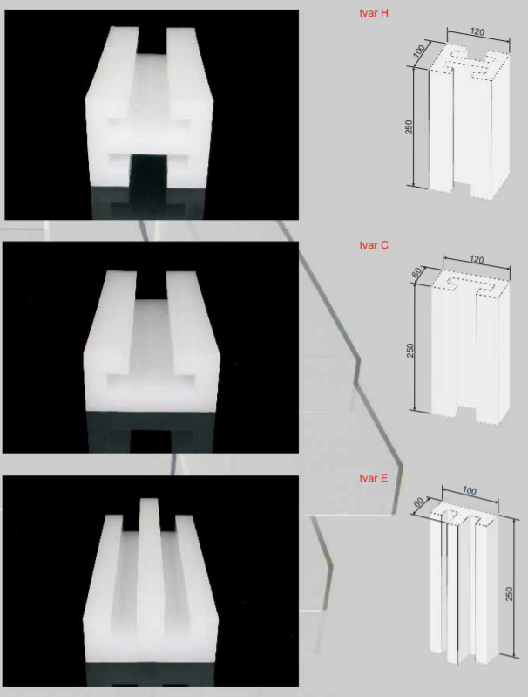
Profiles NEUTROSTOP
Exemplar fabricated profiles
(Czech Republic – Kolin)
H0, C0, E0 - pure polyethylen PET
H3, C3, E3 – Bor additive - 3,5 % BPET
H5, C5, E5 – Bor additive - 5 %
H10, C10, E10 – Lithium additive - 10 % LiPET

