Slide 1
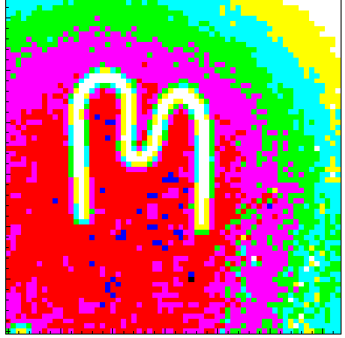

Semiconductor hybrid pixel detectors for detection of neutrons
Stanislav Pospíšil
Institute of Experimental and Applied Physics
Czech Technical University in Prague
https://indico.cern.ch/event/954199/

Slide 2
Outline
Efficient position and energy sensitive detection of neutrons is fundamental for advance in neutron imaging, neutron dosimetry and within many other subfields of research, where neutrons are used.
The general principles of neutron detection based on a brief overview of specific interactions of neutrons of different energies will be reminded in the presentation.
The presentation will focus on the concept of semiconductor pixel detectors with converters of neutrons to strongly ionizing charged particles designed for detection of neutrons in radiation hard environment.
Particular attention will be given to challenges associated with growing interests in neutron imaging with submicron resolution and in noiseless detection of single neutrons in mixed n-gamma radiation fields.
Perspectives of the proposed concept will be backed up by the latest experimental results obtained with Timepix pixel detectors using the methodology of "particle track pattern recognition".

Slide 3
The world of neutrons is very colorful
It deals with neutrons of kinetic energies T_{n} in the range of 15 orders, 10⁻⁷ eV <T_{n} <10⁸ eV, when we talk about ultra-cold, cold, thermal, resonance, intermediate, fast and relativistic neutrons.
In all reactions used to release neutrons from nuclei, born neutrons are always fast. Slowing down processes based on neutron scattering with nuclei are responsible for change of their energies in all environment.
The nature of neutron interactions with nuclei depends significantly on T_{n}:
In the case of cold, thermal and resonance neutrons, the neutron wavelengths have to be taken in account and radiative capture of neutrons (n,γ) is dominating process.
In the case of intermediate and fast neutrons, strong interactions with atomic nuclei dominate as two-particle interactions, such as elastic scattering and inelastic scattering, and classical (n, alpha) or (n, p) nuclear reactions.
In the case of neutrons with energies higher than 20 MeV, more complex reactions and fragmentation processes are becoming crucial.

Slide 4
About neutron converters, detectors and radiation background
All of the above mentioned processes can be used to detect neutrons. However, the choice of the converter depends on what neutrons are to be detected and for what purpose the detectors are to be used. This applies to all types of detectors, be the gas, scintillation (liquid, solid, hydrogen rich) or semiconductor detectors.
Neutrons from the source are always accompanied by high-energy gamma radiation from inelastic scattering, nuclear reactions and above all from radiation capture of neutrons (with energies up to 11 MeV) on the nuclei of elements from the surrounding environment.
Indeed, one can find everywhere a number of nice publications describing neutron detectors with high neutron detection efficiency, which however suffer from high efficiency also to gamma rays. Then, to get a net neutron-induced signal only, the undesirable gamma signal has to be discriminated, what is not an easy task at all. However, this problem can be successfully overcome by using a thin sensor with the neutron converter to energetic ions.

Slide 5
Why semiconductor neutron detectors can compete with gas and scintillating detectors?
Silicon detectors had become well developed for high resolution alpha and energetic ions spectroscopy in nuclear physics and for many applications profiting from their excellent resolution, window less detection, low bias, low power, small dimensions opening possibility to make portable devices.
The adaption of the detectors with small sensitive volume for detection and spectroscopy of neutrons based on their conversion to highly ionizing ions of relatively high energies permits the reliable discrimination of neutrons from gamma rays and electrons. Such devices were optimized for monitoring of neutrons in mixed n-gamma radiation fields with applications in nuclear reactor experiments and different moisture meters.
In the case of pixel detectors with neutron converters to short-range energetic particles (like ⁶LiF, ¹⁰B, hydrogen rich material as CH₂, ^{235,238}U), a thin pixelated sensor allows then discrimination of unwanted signal from gamma photons according to energy, but also "noiseless" recognition of a neutron according to its track observed in the detector.

Slide 6
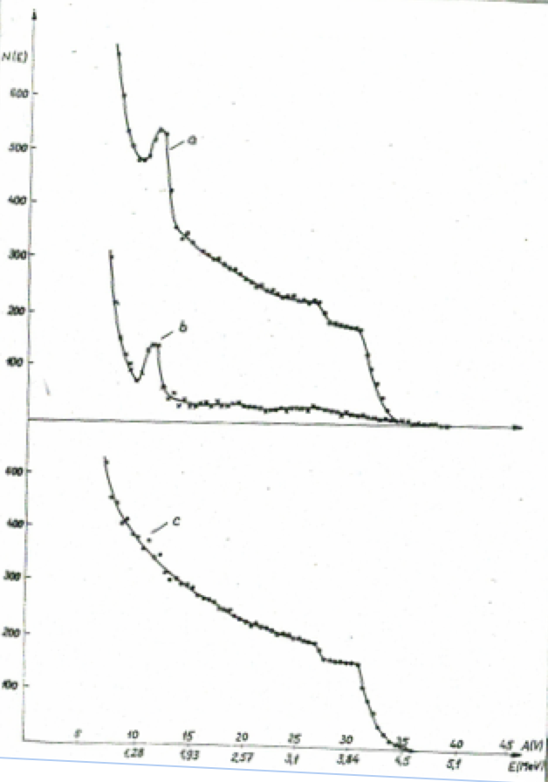
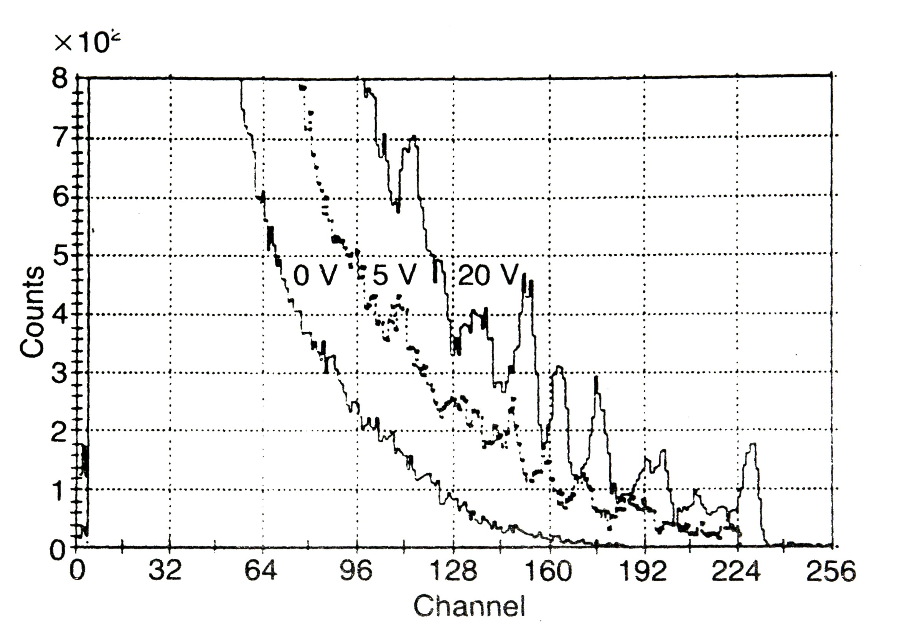
Response of the silicon diode with CH₂ converter to 4.2 MeV neutrons
(recoil proton spectroscopy)
Pulse height spectrum of Silicon diode when illuminated by fast neutrons (14.8 MeV) at different bias (0, 5, 20 V). Peaks from interaction of fast neutrons with ²⁸Si are clearly seen
Silicon diode with CH2 converter
Silicon diode without CH2 (background)
Pure spectrum of recoiled protons

Slide 7
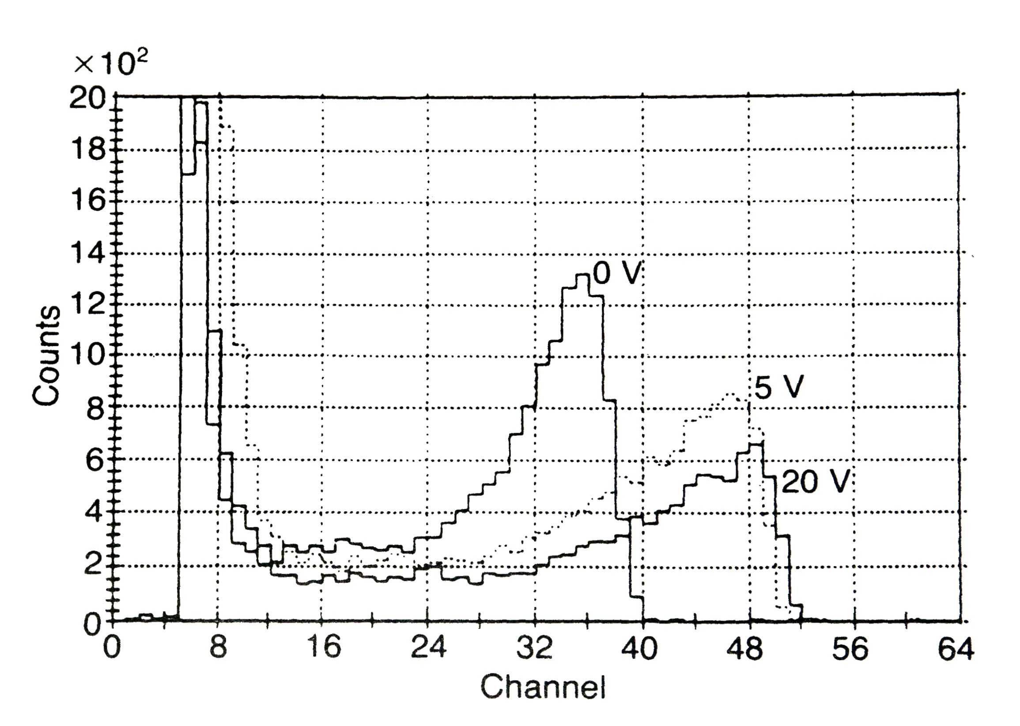
Responses of semiconductor diode with ⁶LiF converter to thermal and fast neutrons
Silicon diode + ⁶LiF converter
Illuminated by thermal neutrons
Silicon diode illuminated
by fast neutrons
Pulse height distributions of neutron detector on thermal neutrons at different bias (0, 5, 20 V). Detector operates well in the self-biased regime.
Pulse height distributions of neutron detector when illuminated by fast neutrons (14.8 MeV) at different bias (0, 5, 20 V). Peaks from interaction of fast neutrons with ²⁸Si are clearly seen

Slide 8
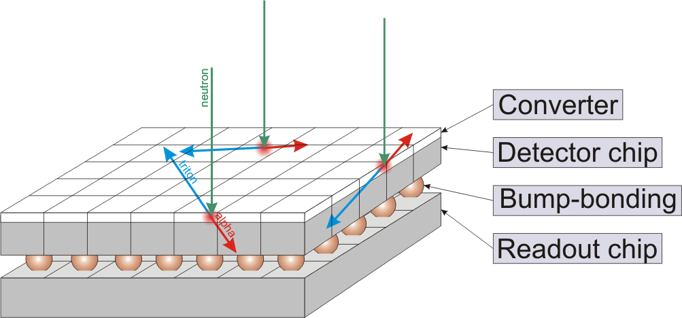
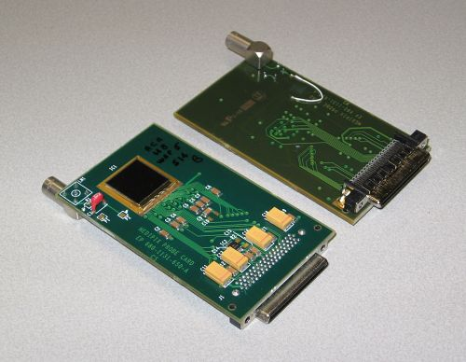
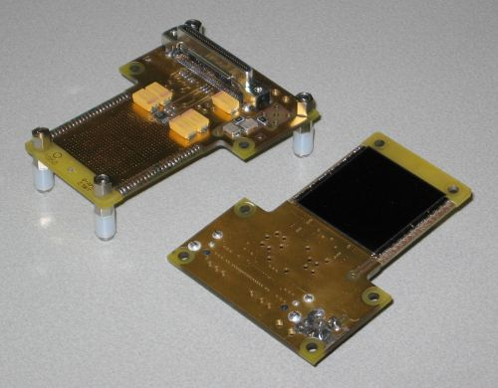
Medipix/Timepix hybrid pixel detector device
www.cern.ch/medipix
Planar pixellated detector (Si, GaAs, CdTe, thickness: 300/700/1000μm)
Bump-bonded to Medipix readout chip containing in each pixel cell:
- amplifier,
- double discriminator
- and counter
● Converter materials to detect
- thermal neutrons: 6Li(n,α)T, Q=4.78MeV
10B(n,α)7Li, Q=2.78MeV
- fast neutrons: recoiled protons from PE-foil
α, β, γ, ...
Detector chip
Medipix chip
Bump-bonding
Medipix2/Timepix
Pixels: 256 x 256
Pixel size: 55 x 55 μm²
Area: 1.5 x 1.5 cm²
Medipix2/Timepix
Quad
Pixels: 512 x 512
Pixel size: 55 x 55 μm²
Area: 3 x 3 cm²
Notes:
8

Slide 9
Medipix – single quantum counting detector
Timepix - spectroscopic pixel detector with ToT and ToA modes of operation
Threshold level above
electronic noise
No false counting.
Digital integration (counting)
No dark current.
Unlimited dynamic range
and exposure time. Counts obey poissonian distribution.
65k spectroscopic chains:
SCA in case of Medipix
MCA in case of Timepix
MCA+TDC with Timepix3
Energy calibration (Calibration of 65k MCA! Question: how to deposit defined energy into a volume 55x55x300 μm³?)
N⁺
P⁺
Si
+
Bias Voltage
Amplifier
Common
back-side
electrode
Pixelated
front-side
electrode
Compa
rator
Counter:
Particle count
Threshold
level
Energy
000
001
007
003
Pixel electronics
Timepix TOT mode
Notes:
9

Slide 10
High resolution X-ray radiography Experimental setup
Requirements:
Microfocus X-ray source to enable geometrical magnification
Adjustable object holder (three translations + rotation)
Sample stabilization (temperature, humidity)
Equipment for automatic calibration of pixel responses
Detector holder and detector stabilization (temperature, condensing point)
Geometric magnification
Enlarged projection
X-ray tube
Object
Notes:
In this picture there is shown our Experimental setup. On the left side we can see the Hamammatsu x ray tube and the translation stages with a sample. On the opposite side there are the detector Medipix and carroousel.

Slide 11
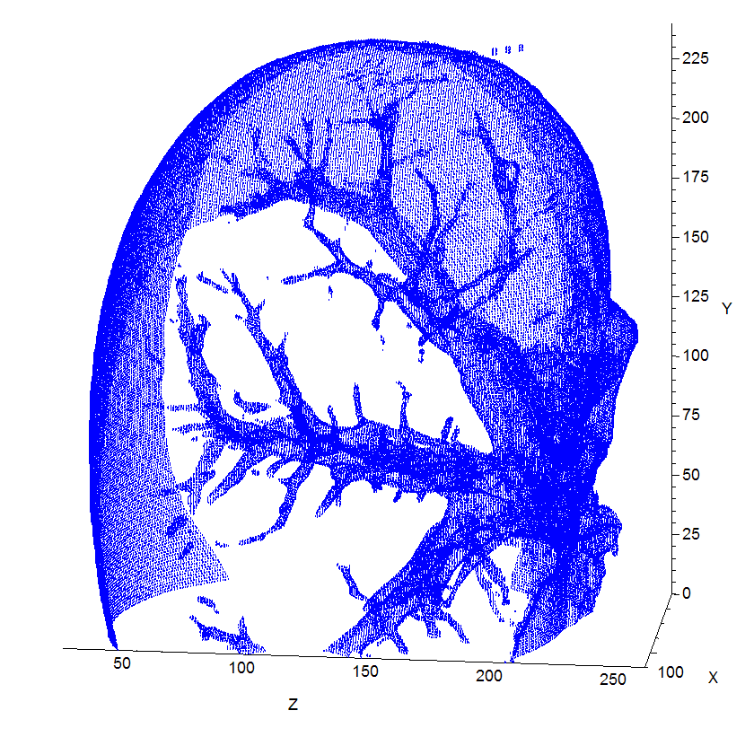
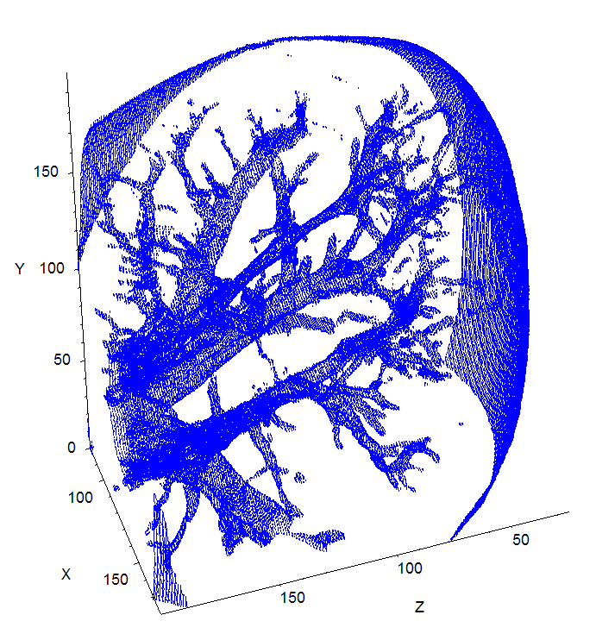
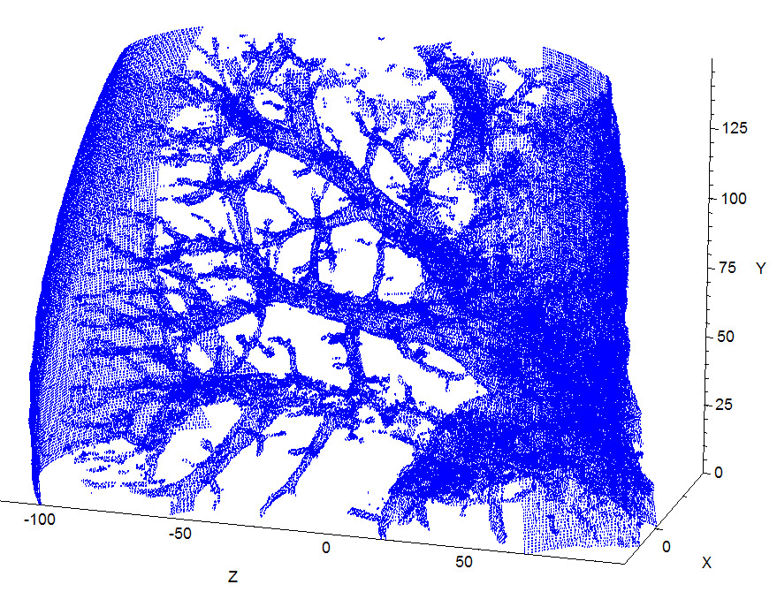
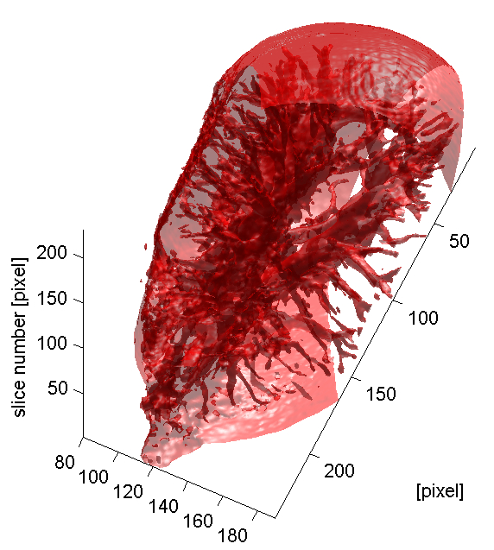
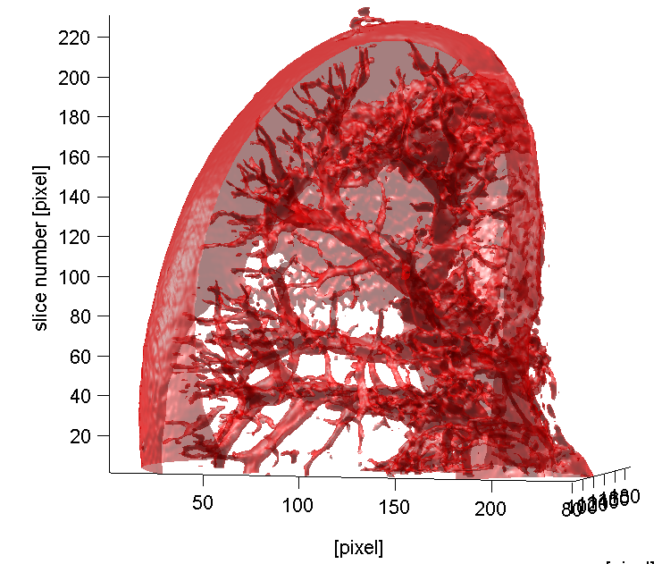
Mouse Kidney Tomography
Soft tissue X-ray imaging
Missing angles => Iterative algorithm instead of Filtered back projection (3 iterations in OSEM 5)
Notes:
Next, tomography was followed by reconstruction of every slice. For calculation of missing angles we use interactive algorithm instead (insted) of filtered back projection.
OSEM = Oredered Subset Expectancy Maximization (size of subset = 5)

Slide 12
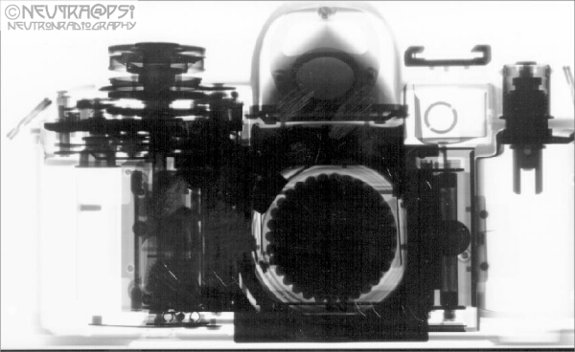
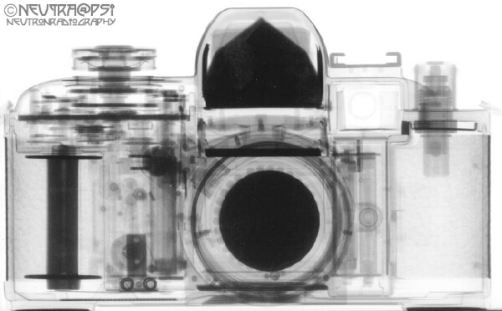
Motivation – neutron radiography
While X-rays are attenuated more effectively by heavier materials like metals, neutrons allow to image some light materials such as hydrogenous substances with high contrast.
Neutron radiography can serve as complementary technique to X-ray radiography
X-rays
Neutrons
In the X-ray image, the metal parts of the photo camera are seen clearly, while the neutron radiogram shows details of the plastic parts (courtesy of E. Lehmann, PSI)

Slide 13

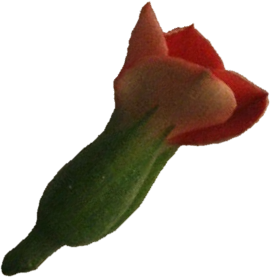
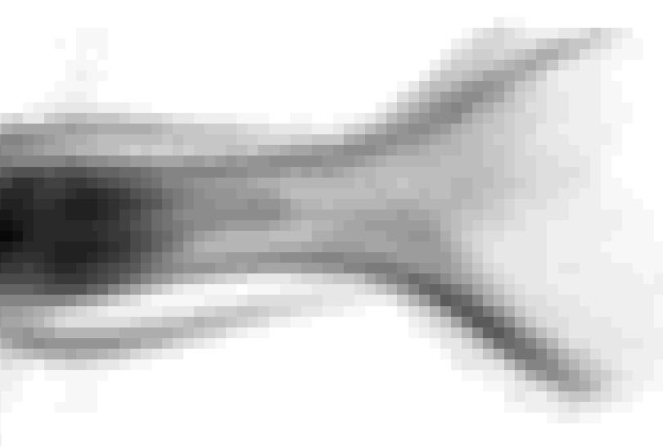
The Neutronography based on
⁶Li(n,α)T, Q=4.78MeV and¹⁰B(n,α)⁷Li, Q=2.78MeV
(energetic charged products define interaction with deeply subpixel resolution)
Parallel beam of thermal neutrons
Specimen attenuating the beam
Shadow on detector
plane
Neutronogram

Slide 14
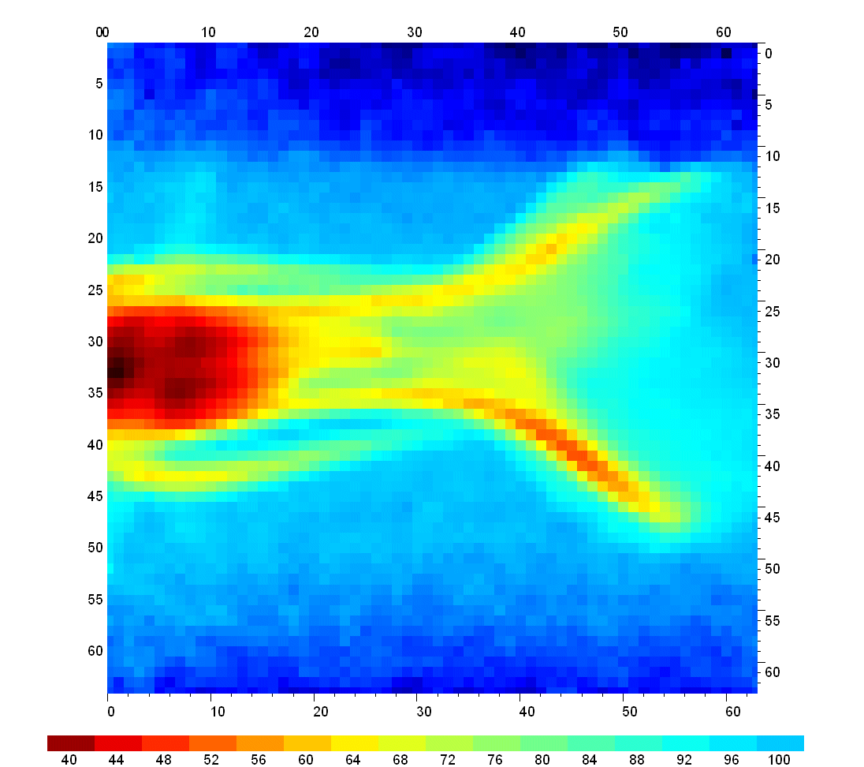
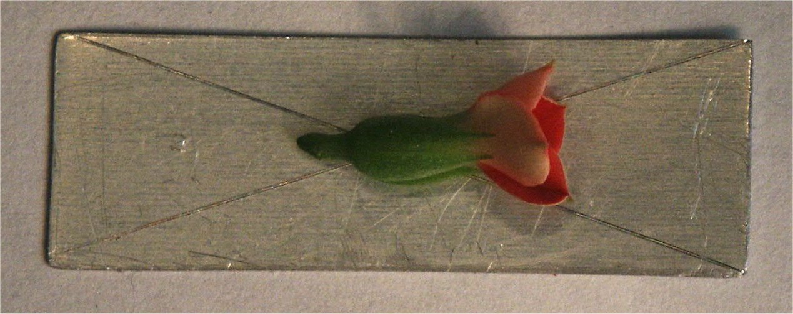
Flower behind Al plate
Look through metal with thermal neutron beam at NPI Rez by means of Medipix detector with ⁶LiF converter
Seeds

Slide 15
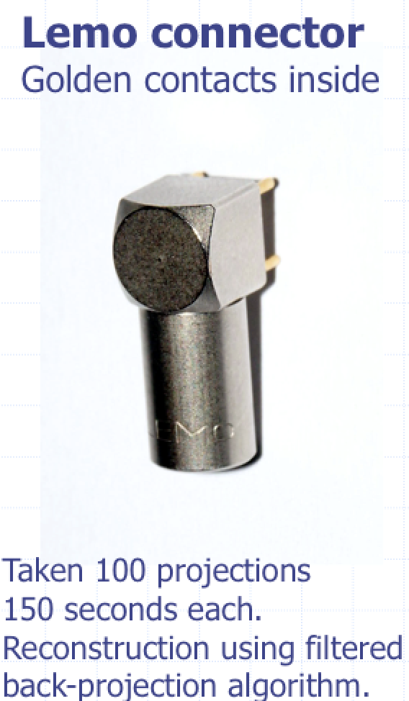
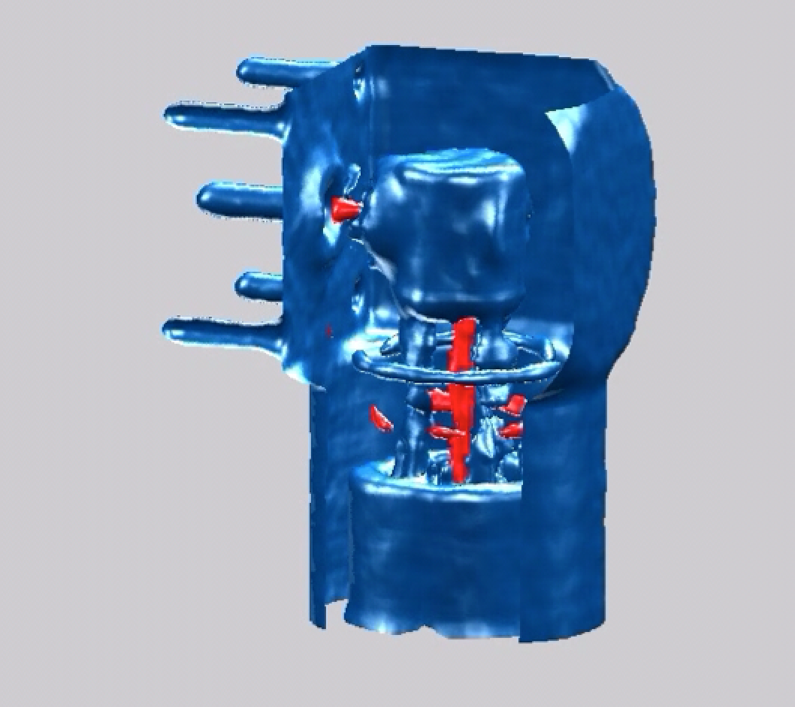
Neutron microtomography

Slide 16
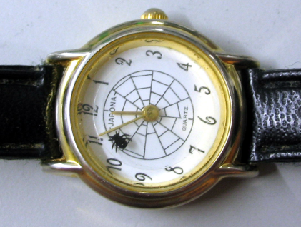
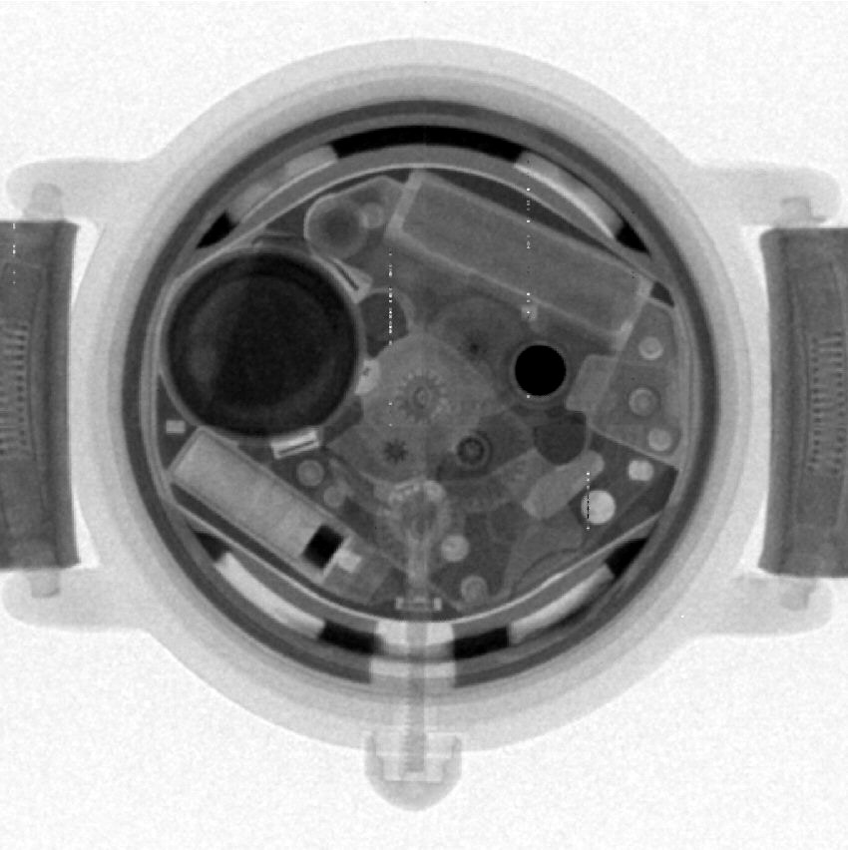
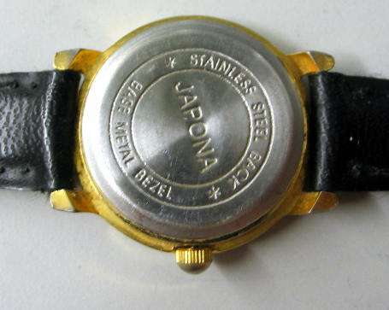
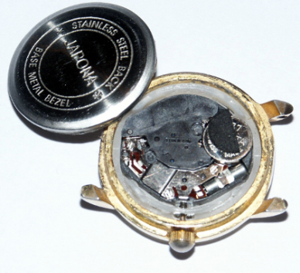
Cold neutron radiography performed at PSI
Wrist watch
Notes:
16

Slide 17
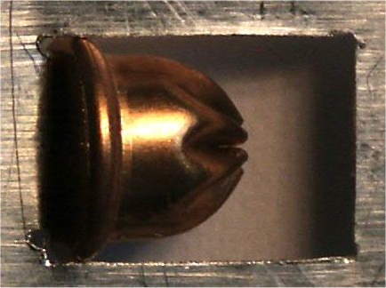
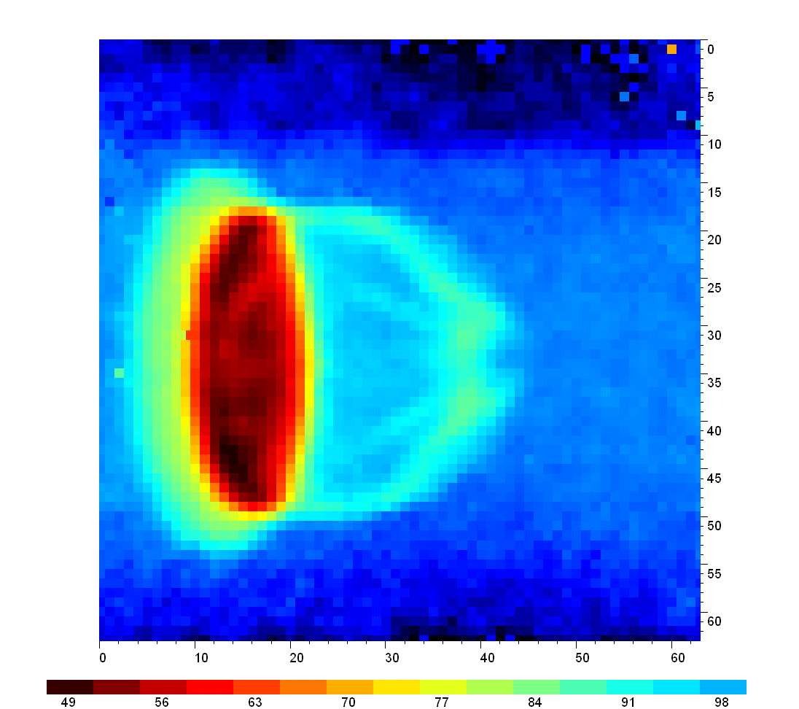
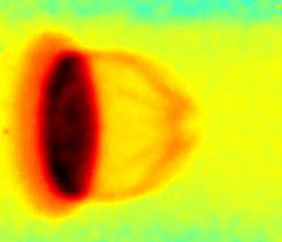
Neutron radiography with Medipix coated by ⁶LiF: Blank cartridge. Look through metal!
Photography
Roentgenogram
Neutronogram
Blank shell
(cartridge)
Explosive filling

Slide 18
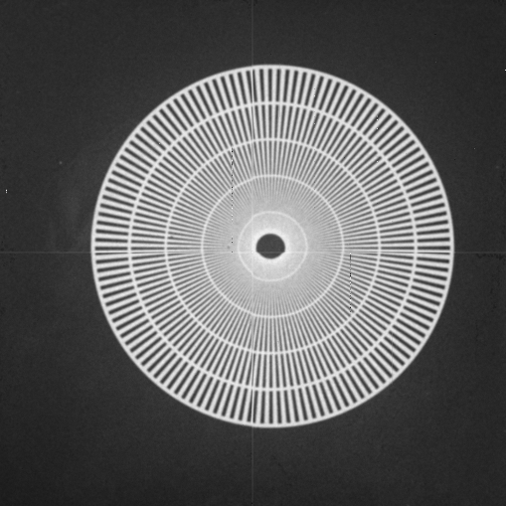
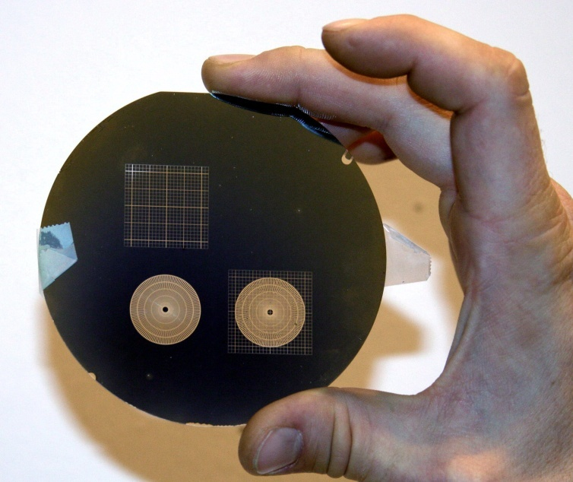

Test of Spatial Resolution
Medipix2 Quad system coated with 6LiF converter illuminated by cold neutrons
50μm
100μm
=>Resolution 65μm!

Slide 19
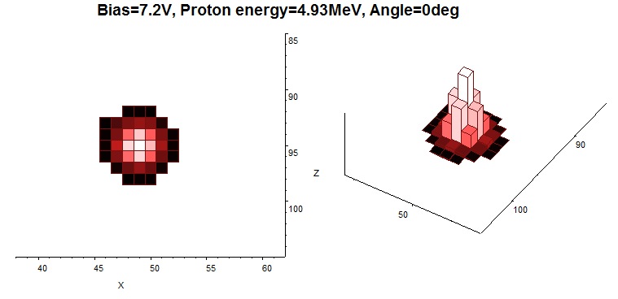
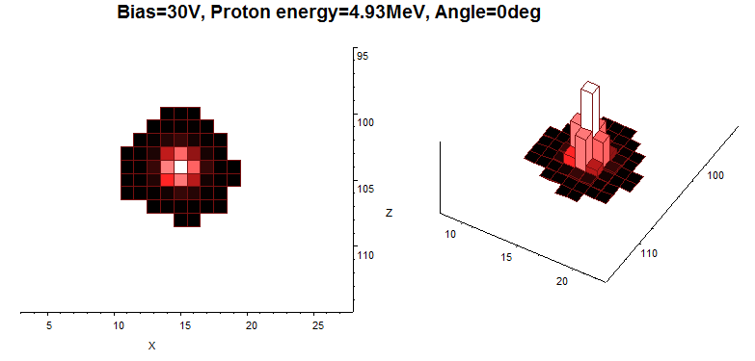
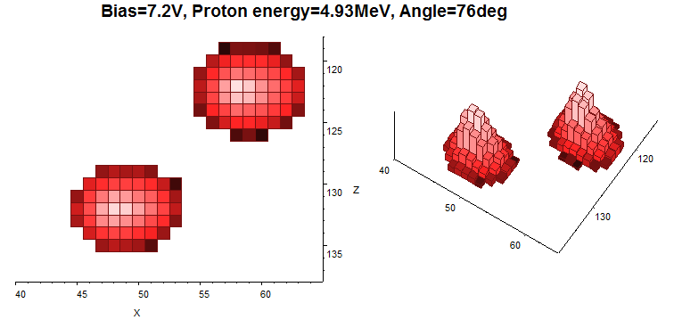
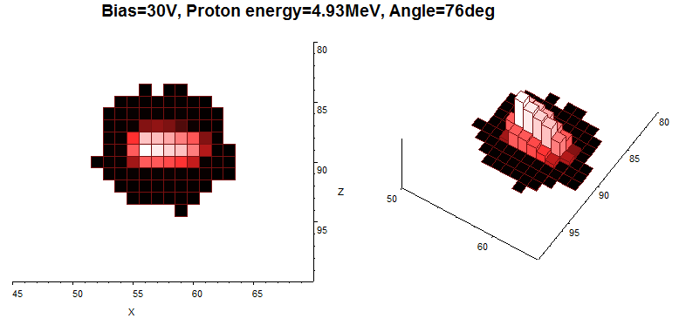
3D-visuallization of proton tracks in silicon pixel detector recorded by Timepix device.
Illumination under different angles (0 and 76 degrees) and different applied detector biases (7.2 V and 30 V)
What is the spatial resolution? X- and Y-coordinates are determined with a precision of about 500nm. Determination of angle is with a precision of about 1º. It needs additional experiments.

Slide 20
Principle of slow neutron detection using 6LiF converter
About detection efficiency and position resolution
Simulations performed using MCNP, SRIM and Matlab
Aim: To estimate detection efficiency and spatial resolution
Geometry used in simulations
Expected UCNs velocity: 500 cm/s. For such neutrons the cross section of ⁶Li increases to 0.34 Mbarn. The cross section of ¹⁰B reaches 1.67 Mbarn.
50% of such UCNs are fully absorbed in ⁶LiF layer of 85 ug/cm² (~ 320 nm thickness). For ¹⁰B it is layer of 7 ug/cm² (~ 30 nm thickness).
Used ⁶LiF density of 2.65 g/cm³ and ¹⁰B density of 2.35 g/cm³.
⁶LiF
Silicon
FWHM
Bragg
curve
³Η⁻
UCN
PSF
α
Insensitive Si layer
Range of α
Range of ³H⁻
Absorption
At ⁶LiF converter thickness of about 5 mg/cm², the thermal neutron detection efficiency achieved is about 5%.

Slide 21
High resolution position sensitive neutron detection based on ¹⁰B(n, α)⁷Li reaction
Pixel detector response to every charged article (alpha and 7Li) in a form of 3D-cluster with a shape corresponding to convolution of Gaussian and individual pixel responses
Corresponding amplitude spectrum measured by integration of cluster volumes. ¹⁰B converter thickness 1.8 ug/cm² (~ 36 nm)
The spectroscopy of alpha particles and ⁷Li and analysis of their clusters recorded
by Timepix detector permits to achieve spatial resolution up to 3 micrometers

Slide 22
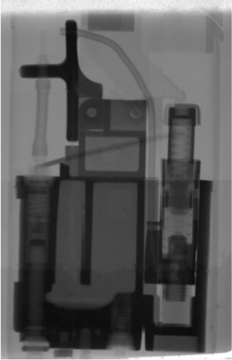
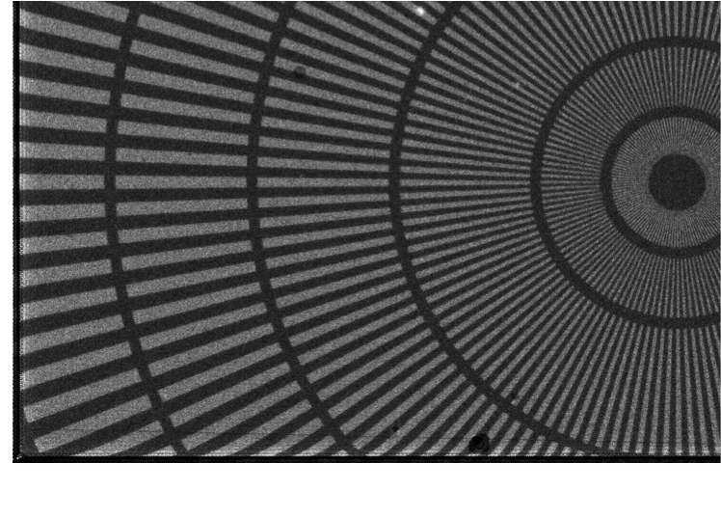
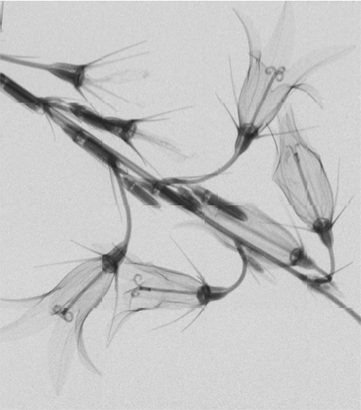
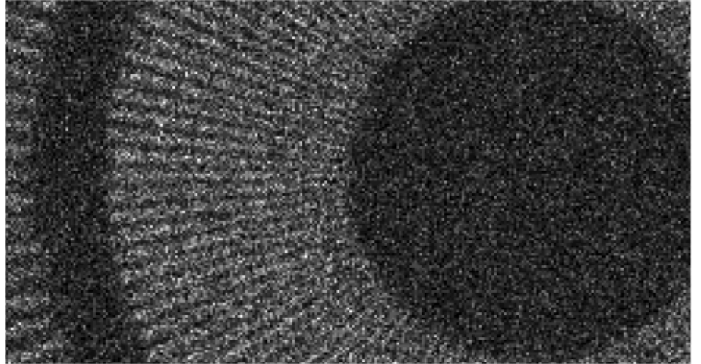
Neutron images with Timepix detector and resolution calibrated by Siemens star
50 µm
Alpha clusters centroiding => resolution ~ 3 um

Slide 23
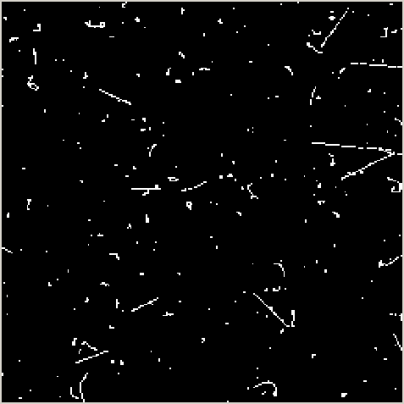
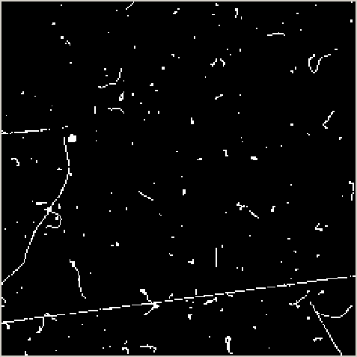
Response of Medipix2 device to natural background radiation
This slide inspired the concept of particle tracking and recognition
Clearly recognizable tracks and traces of X-rays, electrons generated mostly by gamma rays, alpha particles, muon, … . Muon tracks can be recognized by submicrometric precision.

Slide 24
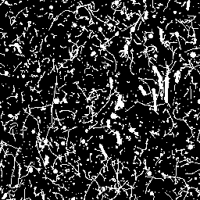
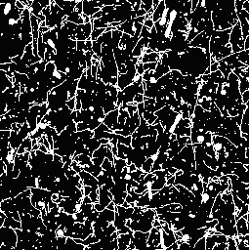
Response of MEDIPIX2 detector with
CH₂ converter to fast neutrons (17MeV)
The direction of the neutrons with respect to the image was upstream (from bottom to top). The huge background is due to gamma rays which accompany neutrons. Half of the sensor (the right-hand side) was covered with a CH2 foil about 1.3 mm thickness.
One can clearly recognize long and rather thick tracks of recoiled protons (up to 2 mm, vertically oriented) and big tracks and clusters generated via 28Si(n,α)25Mg, 28Si(n,p)28Al nuclear reactions in the body of the silicon detector. These events are displayed on the dense background caused by tracks and traces of electrons from interactions of gamma rays. One can even recognize that proton tracks shapes follows a Bragg law.

Slide 25
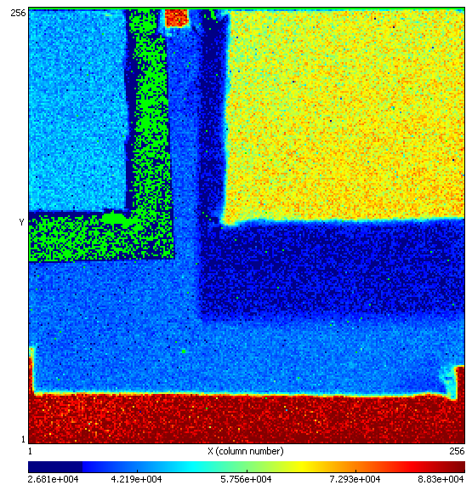
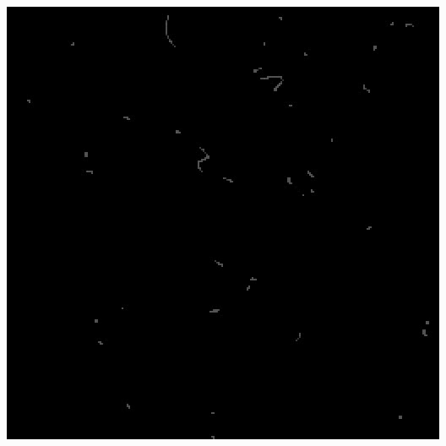
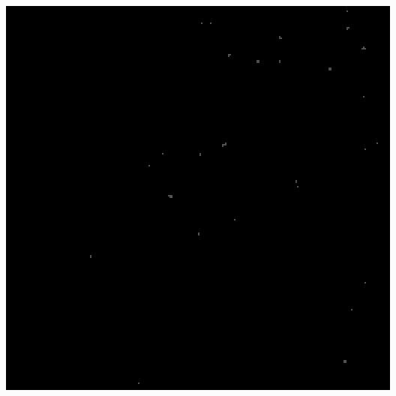
²⁵²Cf neutrons measured in counting mode at different thresholds
⁶LiF
PE
PE+Al
Al
PE
PE + Al
252Cf, high threshold (300 keV)
252Cf, low threshold (8 keV)
Al

Slide 26
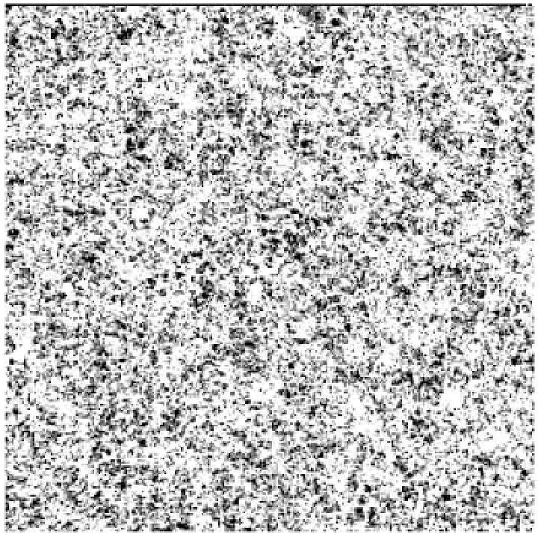
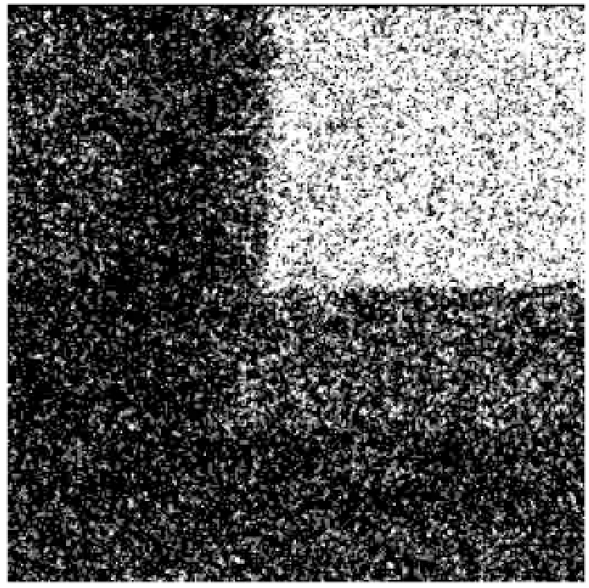
²⁵²Cf neutrons
measured in counting mode at different thresholds
⁶LiF
PE
PE+Al
Al
PE
PE + Al
252Cf, low threshold (8 keV)
252Cf, high threshold (300 keV)
Al

Slide 27
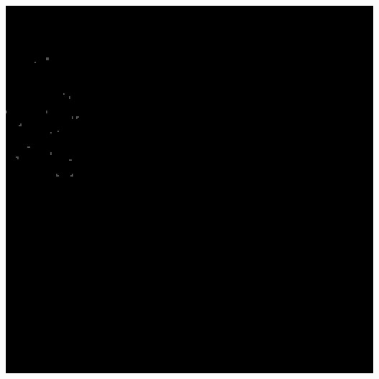


Responses to different neutron spectra measured at high threshold in counting mode
Thermal neutrons – 500s
Identification of spectral composition of neutron radiation fields can be done by comparing responses of different sensitive regions.
LiF
PE
PE + Al
Al
Uncovered
252Cf – 2000s
AmBe – 2000s
17 MeV neutrons at 0º

Slide 28
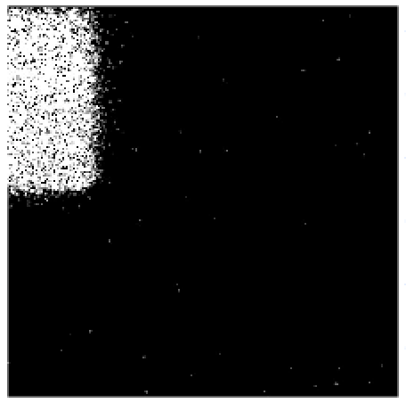
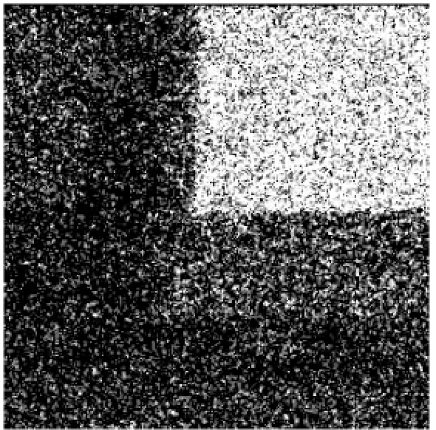
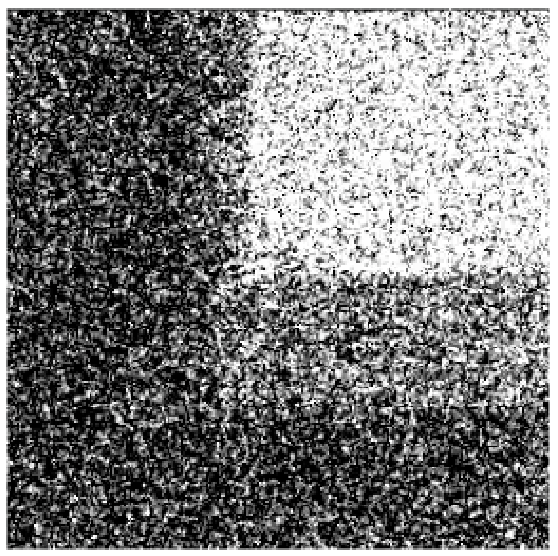

Responses to neutrons of different energies measured at high threshold in counting mode
Thermal neutrons – 500s
Identification of spectral composition of incoming neutron radiation can be done by comparing responses of different sensitive regions.
LiF
PE
PE + Al
Al
Uncovered
252Cf – 2000s
241AmBe – 2000s
17 MeV neutrons at 0º

Slide 29

On-line radiation monitoring in ATLAS experiment at LHC (16 devices installed within ATLAS)
MPX01 | between ID and JM plug
MPX02 | between ID, LARG and JM
MPX03 | between LARG and LARG EC
MPX04 | between FCAL and JT
MPX05 | between LARG and JT wheel
MPX06 | between LARG and JT wheel
MPX07 | top of TILECAL barrel
MPX08 | top of TILECAL EXT. barrel
MPX09 | corner between JF cyl. and hexagon
MPX10 | cavern wall A or C side
MPX11 | cavern wall USA side
MPX12 | small wheel
MPX13 | between ID and JM plug
MPX14 | between ID, LARG and JM
MPX15 | at the back of Lucid detector
MPX16 | in the USA15 cavern

Slide 30


ATLAS-TPX network
Neutron Efficiency Calibrations of sandwich device
All ATLAS-TPX devices were irradiated with thermal (25 meV) and fast (Cf, AmBe) neutrons from well characterized sources in the Czech Metrological Institute.
The reference device was also irradiated with fast 16.7 MeV neutrons from D+T reactions in the IEAP VdG accelerator.
Layout of neutron converters in ATLAS-TPX sandwich device

Slide 31


Fast neutron ToF measurement with TIMEPIX
LANSCE neutron sources and nuclear science flight paths
(combined ToA and ToT modes)
The layout of the LANSCE neutron sources and Nuclear Science flight paths
Time structure of the proton beam for typical Target-4 operation

Slide 32

Neutron efficiency calibration from ToA (Los Alamos)
Heavy Tracks and Blobs from 0 to 180 degrees
(0 degree)

Slide 33

Neutron efficiency calibration from ToA (Los Alamos)
Heavy Tracks and Blobs from 0 to 180 degrees
(180 degree)

Slide 34


Examples of heavy ionizing events induced by neutrons of different energies selected according their cluster sizes
Different colors and black numbers assigned to individual clusters indicate the energy of incoming neutrons as measured by means of the TOF technique

Slide 35


ESA Vega-2 rocket
SATRAM payload (arrow) onboard ESA Proba-V satellite.
ESA Vega-2 launcher rocket upper stage

Slide 36



Timepix/ESA Proba-V:
LEO space radiation @ 820 km
LETPs: Energetic light charged particles (I) + nuclear interactions

Slide 37
Types of neutron detectors already developed at IEAP CTU
The developed detectors are based on hybrid technology connecting a pixelated semiconductor sensor with R/O Timepix chip. The chip (developed within the Medipix2&3 collaboration) contains 65k pixels of 55x55µm² per 2 cm². It permits to register a position of an interacting ionizing quantum in the sensor and its ToA and/or ToT.
Presently available sensors: Si, GaAs, CdTe, SiC, 3D-Si, stuffed 3D-Si.
Convertors based on ¹⁰B and ⁶Li are used to detect ultra-cold, cold, thermal and epithermal neutrons, and CH₂ for fast neutrons.
Sensitive areas from 2 cm² to 200 cm² (with dead area less than 1%).
The fast R/O systems transferring the measured data from different developed Timepix based devices to PC by USB2, USB3, Ethernet interfaces, are available (some of them are displayed on the right).
A prototype of position sensitive detector of neutrons based on crossed strip sensors (resolution of about 30 µm²), what permits to increase neutron detection efficiency by stacking of sensors and place R/O electronics out of neutron beam, has been also developed.

Slide 38
Basic parameters and fields of application of pixel neutron detector devices developed and tested in IEAP CTU
Position sensitive detection of neutrons with resolution from 3 µm (applying neutron cluster analysis) to 50 µm (in counting mode).
Noiseless neutron detection efficiency up to 7% in case of planar arrangement of neutron converter to the pixelated sensor. Application of "stuffed" 3D-sensor technology promises an increase of the efficiency up to 20%.
Capability to measure time of single neutron arrival with 1.6 ns resolution is well applicable for high resolution ToF experiments.
High-resolution neutron radiography and tomography with ultra-cold, cold, thermal and epithermal neutrons as illustrated above by images of bell flower, a lighter and of the Siemens star of reference.
Energy dependent radiography and tomography performed with resonance neutrons by means of ToF technique.
Simultaneous neutron and X-ray radiography and tomography.
Fast neutron radiography.
Neutron diffraction, elastic and inelastic scattering experiments on relatively small samples using ToF technique.
Measurement of composition and spectral characteristics of mixed neutron-gamma radiation fields and their dosimetry through the network of Timepix wireless detection devices.

Slide 39
Acknowledgement
The presented results and many others have been achieved within research activities cultivated at IEAP CTU in Prague. They result from extensive partnerships in frame of the Medipix2@3 collaboration with significant contributions of the following colleagues:
R. Ballabriga², B. Bergmann¹, P. Burian^{1,12}, I. Caicedo¹, M. Campbell², J. Dammer¹, C. DaVia⁸, J. Dudák¹, C. Froejdh⁹, E. Froejdh², V. Georgiev¹², C. Granja¹, E. Heijne^{1,2}, M. Holík^{1,12}, R. Hall-Wilton¹⁰, T. Holý¹, J. Jakůbek¹, M. Jakůbek¹, J. Kirstead⁷, V. Kraus^{1,12}, F. Krejčí¹, E. Lehmann¹¹, C. Leroy⁴, X. Llopart², J. M. O‘Donnel³, R. Nelson³, M. Nessi², A. Owens⁵, L. Pinsky⁶, S. Petersson⁹, S. Pospíšil¹, M. Platkevič¹, K. Smith¹³, T. Slavíček¹, P. Soukup¹, M. Suk¹, J. Šolc¹, H. Takai⁷, G. Thungstroem⁹, D. Tureček¹, J. Uher¹, D.Vavřík¹, Z.Vykydal¹, S. Wender^{7,} J. Žemlička¹
¹ Institute of Experimental and Applied Physics, CTU in Prague, Czech Republic
² CERN, Switzerland
³ LANSCE, LANL, USA
⁴ Université de Montréal, Canada
⁵ ESA
⁶ NASA/University Houston, USA
⁷ BNL, USA
⁸ Manchester University, UK
⁹ MidSweden University, Sundsvall, Sweden
¹⁰ ESS, Sweden
¹¹ PSI, Switzerland
¹² WBU Pilsen, Czech Republic
¹³ Glasgow University

Slide 40
Now it is the right time for experiments with Timepix detectors managed by Michael Holík and Vladimír Vícha
We all are looking forward to meet you sometime in Prague!
Thank you for your attention!

