Slide 1
IEEE – Institute of Electrical and Electronics Engineers
~400000 members
Areas of Interest
Conferences, Standards, Publications, Education
41 Societies
Nuclear and Plasma Sciences Societies (NPSS)

Slide 2
NPSS - Nuclear and Plasma Sciences Societies
~3500 members
Areas of interest
Conferences, Standards, Publications, Education
7 Technical Committees (TC)
Computer Applications in Nuclear and Plasma Sciences (CANPS)
Fusion Technology Standing Committee (FTC)
Nuclear Medical and Imaging Sciences (NMISC)
Particle Accelerator Sciences and Technology (PAST)
Plasma Science and Applications (PSAC)
Pulsed Power Science and Applications (PPST)
Radiation Effects Committee (REC)
Radiation Instrumentation (RITC)
TransNational Committee (TNC)
Each TC organize one or several Conferences:
The Real Time Conferences (biannual) and the NSS/MIC conference (annual)
are physics and medical (radiation ) instrumentation conferences organized by CANPS, NMISC, RITC

Slide 3
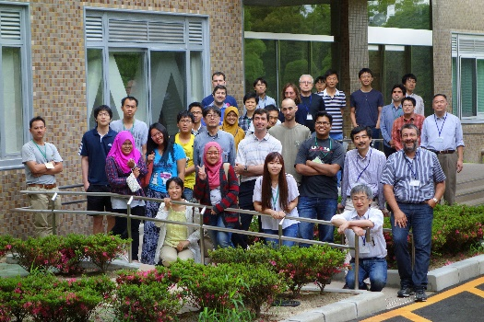
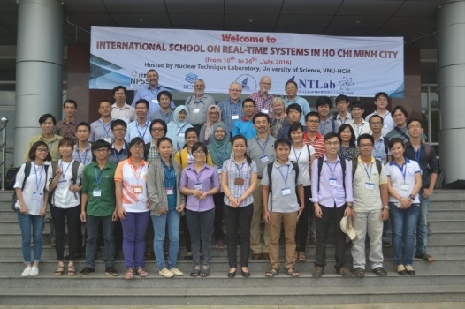
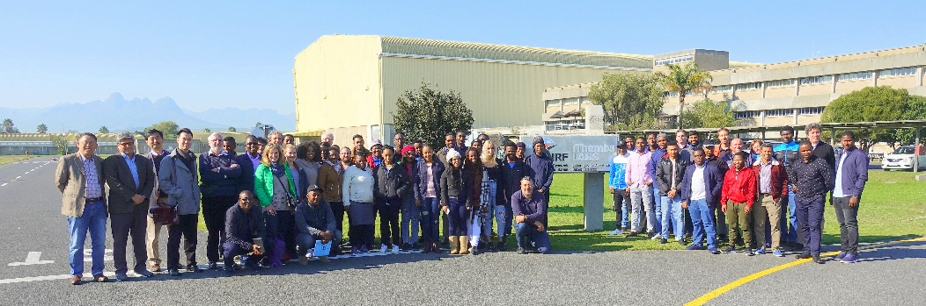
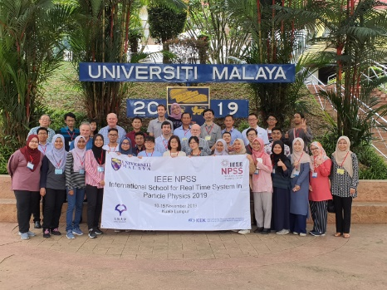
NPSS’s Instrumentation Schools
NPSS committees TNC, CANPS, NMISC, RITC have since 2014 been involved in conducting
Instrumentation Schools aimed at
To train master level students in the area of radiation detectors and its applications.
To promote the participation of young scientists in radiation measurements and related fields
This will be achieved through a combination of lectures and experiments (demonstrations)
Before, and hopefully after, COVID these have been in person
During COVID we have to make do with virtual or semi-virtual meetings
Our aim is to have an in person Instrumentation School in Dakar next fall
2014 Osaka, Japan
2016 HoChiMinh City,
Vietnam
2018 Cape Town, South Africa
2019 Kuala Lumpur,
Malaysia

Slide 4
Welcome
As present Chairman of the NPSS’
TransNational Committee
I would like to Welcome you to this Workshop on Radiation Instrumentation

