Slide 1


IEEE Real Time 2024 – Goodbye
Closeout Session
David Abbott

Slide 2
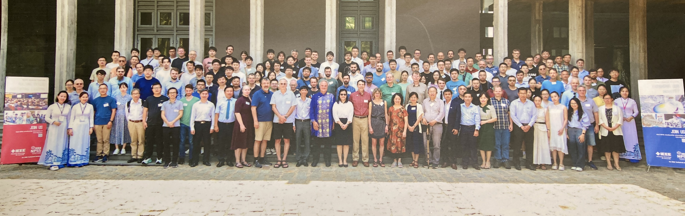
Thank you to all the participants!
We organize this conference for you.
Put out the good word. Real Time is the place to be!

Slide 3
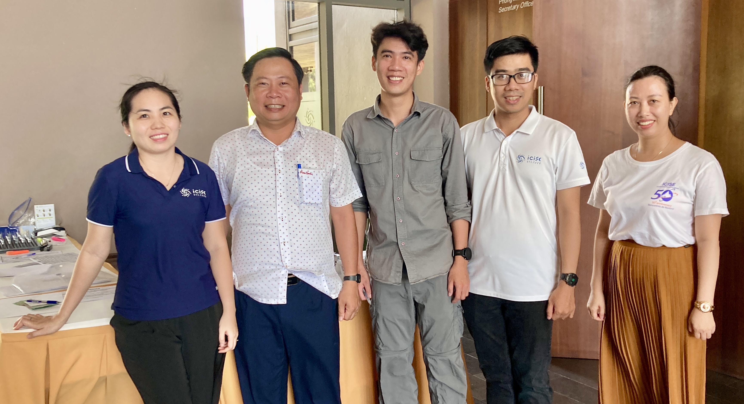
This could not happen without a LOT of help from our friends
A BIG thank you
to all the
ICISE staff!

Slide 4
Where are we going next?
Real Time
2026
???

