Slide 1


Welcome to Real Time 2024
April 22nd – 26th, 2024
ICISE Conference Center – Quy Nhon, Vietnam
David Abbott – Computer Applications Technical Committee Chair
Nuclear and Plasma Sciences Society (NPSS)

Slide 2
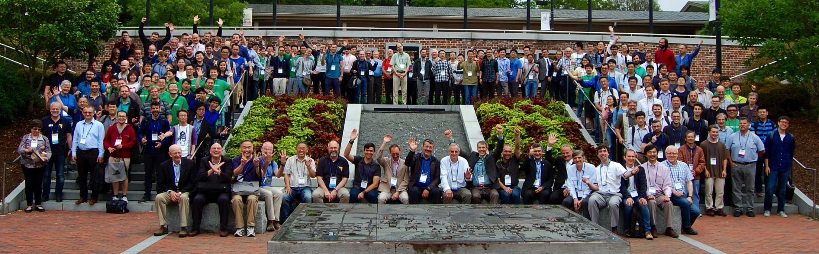
Where Were You Six Long Years Ago?
RT2018 – Williamsburg, Virginia USA
After two virtual conferences it feels good to finally be back together again

Slide 3
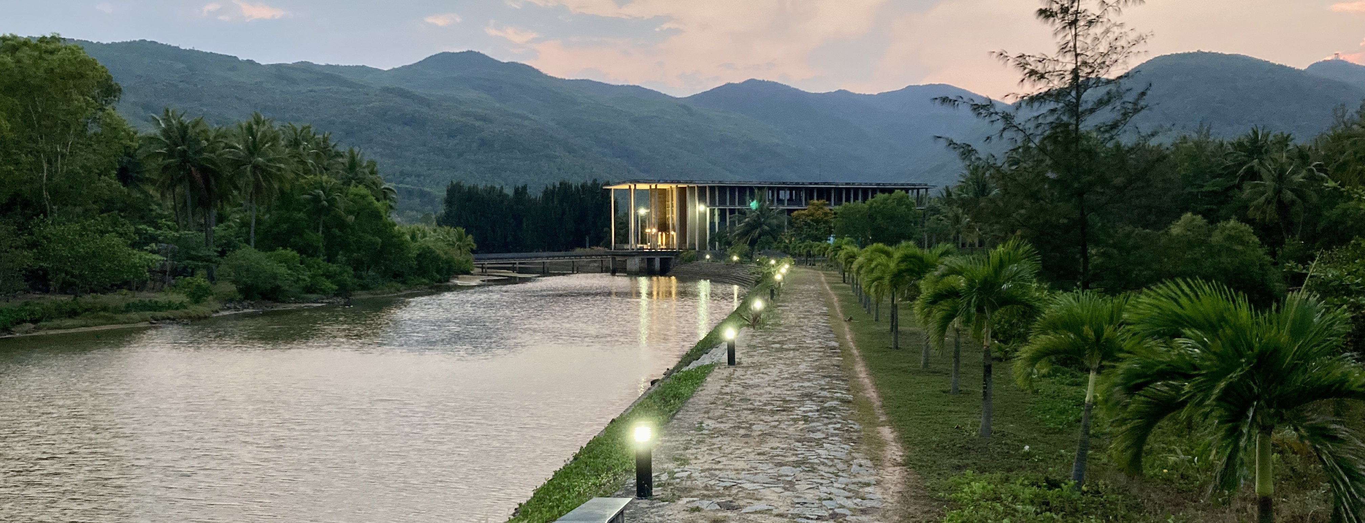
And what a beautiful place to meet…
RT2024 – ICISE, Quy Nhon, Vietnam
Who are we?
180+ Participants, 21 Countries
78% Asia, 12% North America, 10% Europe
What’s the Program?
56 Orals, 80 Mini-Orals, 120 Posters
Plus many opportunities to share and get to know fellow participants

Slide 4
Who are the Organizers?
Computer Applications in Nuclear and Plasma Sciences (CANPS)
CANPS is a technical committee of the IEEE Nuclear and Plasma Sciences Society (NPSS).
  Some 40 members globally representing our technical community.
  The NPSS President (Vesna Sossi) is here to talk more about what we do.
  ~15 CANPS members are here this week.
International Centre for Interdisciplinary Science and Education (ICISE)
  Our wonderful hosts - Vice Director Dr. Tran Son will make a short address this morning.
  Many thanks to Professor Van and Recontres du Vietnam for making RT2024 possible here.
Local organizers at VNU-HCM (Ho Chi Minh) University of Science
  Tran Thanh, Vo Hai, Hoang Trang

Slide 5
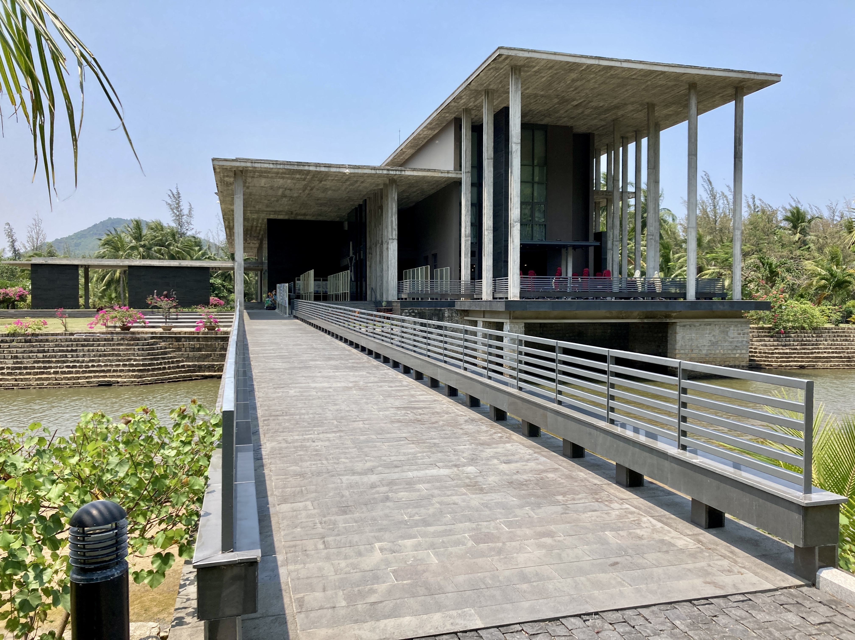
Important Updates and Information
Major Program Changes for Tuesday and Thursday
  Poster and Mini-Oral sessions moved to the morning.
  Please check your contribution on Indico. Let us know if we messed something up.
Please upload your presentation materials to your Indico contribution on the day prior to when you present.
  Poster presenters may want to take their poster down overnight. The wind can get strong.
Mini-Oral participants should return to the auditorium at least 5 minutes before the start of their session.
  Session chairs need time to organize
IEEE Transactions on Nuclear Science (TNS) Senior Editor, Adriano Luchetta, will give a quick overview on the guidelines for publication in the IEEE Real Time special issue

Slide 6
Mini-Oral Session #1
TODAY After Lunch
12 Dongwei Zou
13 Xiangshi Zhong
15 黎晃 li huang
25 Mircea Bogdan
29 Shuihan Zhang
37 Yinhui Wu
38 Thi Nhan Truong
39 Chao Chen
40 Xuan Chung Le
52 Hangchang Zhang
61 Shaoshuai Fan
62 Andrea Abba
71 Zhongtao Shen
79 Maoyuan Zhao
80 Ziwei Zhao
83 Gang Chen
91 Wenhao Duan
94 Liao Jianwei
99 Eric Lewis Flumerfelt
IF YOU SEE YOUR NAME HERE…
Please upload your MO presentation to the Indico site by the end of the morning coffee break
- No more than 2-slides
- PDF format

Slide 7
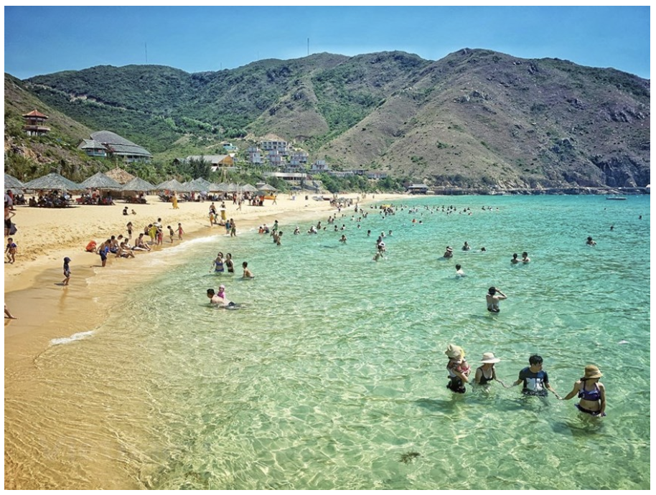
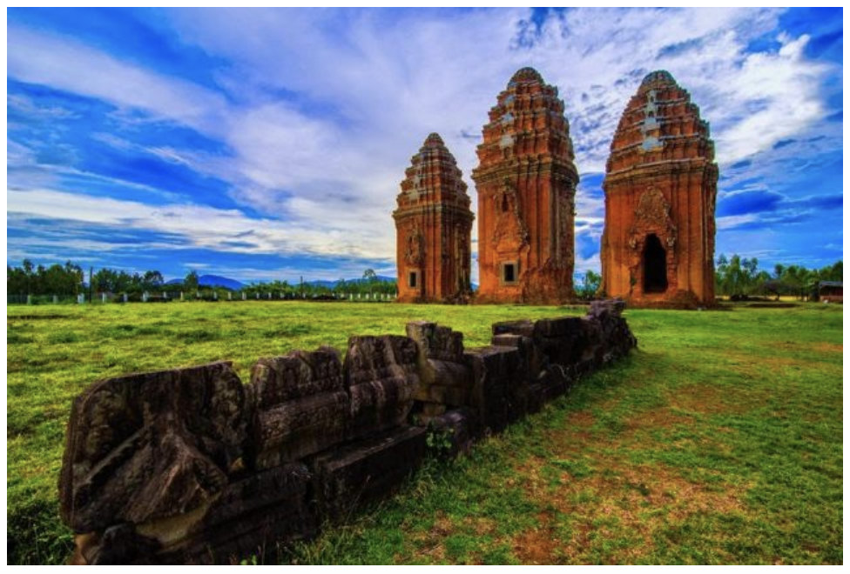
The Week at a Glance
Social Events
Monday: Welcome Reception
  Here at ICISE campus after today’s program.
Tuesday: Women In Engineering (WIE) Reception and Panel Discussion
  18:15 At the Seagull Hotel on the rooftop patio
  You can learn about the panel members and submit questions to them on the Indico site.
Wednesday: Excursions ( Ky Co Beach or Bahn It CAM Towers)
  ~13:30 Leaving from Seagull Hotel after lunch at ICISE
Thursday: Conference Dinner (Student Paper Award announcement)
  19:00 at ICISE
Friday: ICISE Beach Party!
  15:00 at ICISE. All remaining participants please RSVP to ICISE staff.

