Slide 1
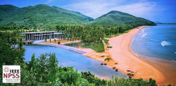
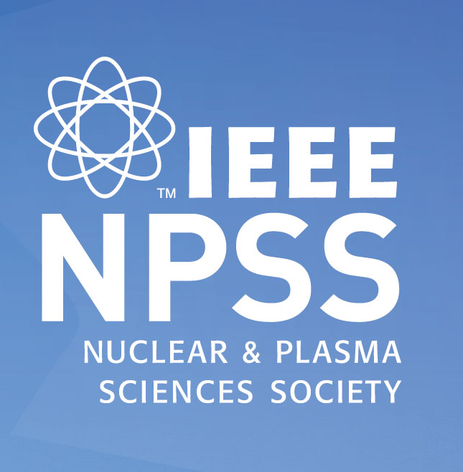
Welcome
Vesna Sossi
NPSS President
24th IEEE Real Time Conference - ICISE, Quy Nhon, Vietnam
Quy Nhon, ICISE center, April 22nd, 2024
Thank you to the local hosts for warm hospitality
(Prof. Van Tran and colleagues)

Slide 2
IEEE – NPSS

Slide 3
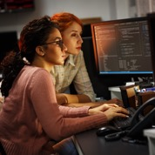

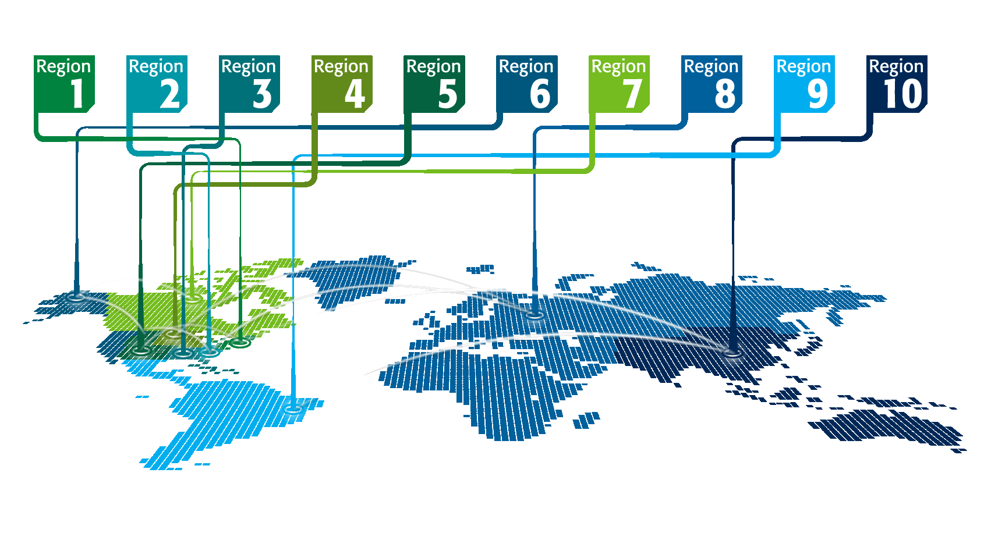
IEEE at a Glance
More than 409,000 members
in over 160 countries
39 Technical Societies and 7 Technical Councils
Publishes approximately 200 transactions, journals, and magazines
Over 5 million documents in
IEEE Xplore® with >15 million downloads/month
Sponsors more than 1,900 conferences in 96 countries each year

Slide 4







2023/4 TA Strategic Framework
Tools and Platforms
Resource Center
DataPort
AskIEEE and Foresight
ICX and its replacement
TechNav
PRAC Tool
SCRC Tools dev
Next Gen Tools & Processes
Governance Tools
New Tech
FDC initiatives
  AI Coalition
  Low Earth Orbit Satellite
  Metaverse
  Public Safety Tech
  SusTech
  Telepresence
  Smart LED Lighting
  Digital Privacy
  5G/6G Innovative Testbed
  Wireless Power Technology
Society New Tech Efforts
Graduated Initiatives
New Audiences
Enhance virtual audiences
Entrepreneurs
Industry (testbed, Chips Act, Corporate programs)
Young Professionals
Students
Women in Engineering
DEI
New Content
Increased Stds
TechEthics
Humanitarian and Social Responsibility
Climate Change
  SmartAg
New Delivery
Video Content
OA & R&P
Chinese Publications
Podcasts
Future of Events
Educational Programs
Roadmaps
Build Technology
Communities
Managing
Foundational
and Ongoing
Business Effectively
Assure Content Quality
Address Misconduct
Address Data Privacy
Deliver Data Analytics
Grow and Relook at Membership
→ IEEE Standards Activities (SA)
Notes:
This chart has helped to organize what TA does both as individual OUs and as a collective since we have a large turnover of volunteers. Sort of like trying to explain to the parade as it moves by.
This has been our framework for strategic planning over the 2020 -2025 period.
Note that we have also increased attention on Students: Scholarships, Travel Grants, Mentoring, Jobs

Slide 5
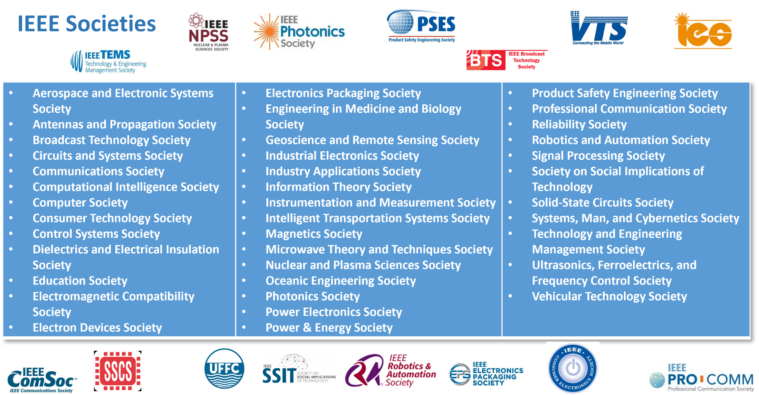
NPSS in IEEE
* As of October 2022

Slide 6

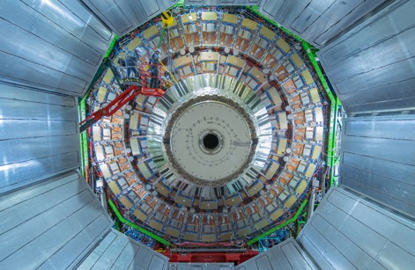
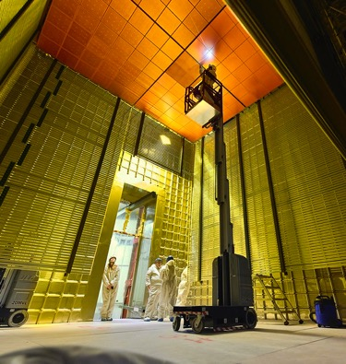
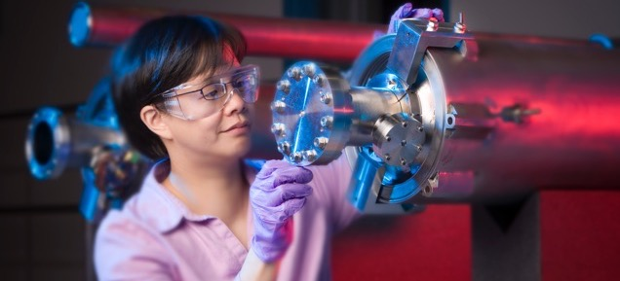
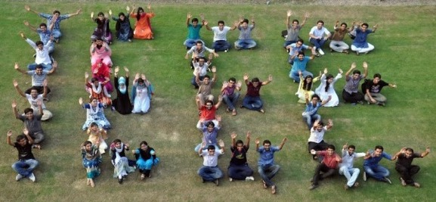
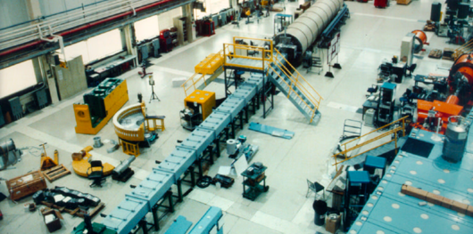
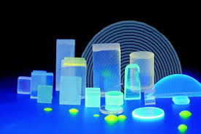
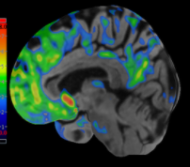

IEEE and IEEE Nuclear and Plasma Sciences Society

Slide 7
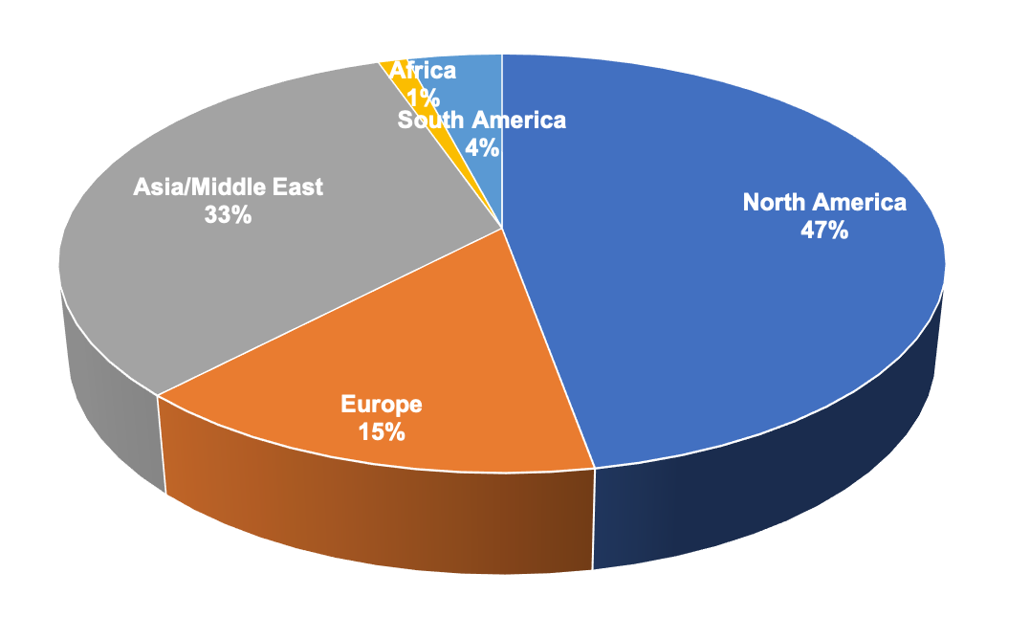
IEEE Nuclear and Plasma Sciences Society (NPSS)
Computer Applications in Nuclear and Plasma Science
Fusion Technology
Nuclear Medical and Imaging Sciences
Particle Accelerator and Technology
Plasma Science and Applications
Pulsed Power Science and Technology
Radiation Effects
Radiation Instrumentation
~3,250 members in 80 countries
Joined Nanotechnology Council and IEEE Brain Community

Slide 8
What can the society do for you?
Should I become an IEEE NPSS member?

Slide 9
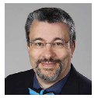
What does NPSS do for you at this conference (and beyond) ?
Organizes and financially sponsors this conference
Sponsors additional events at the conference (example WIE)
Provides grants
Give awards at all career levels
IEEE NPSS Richard F. Shea Distinguished Member Award 2023 Stefan Ritt
2024 CANPS award to be presented on Thursday

Slide 10
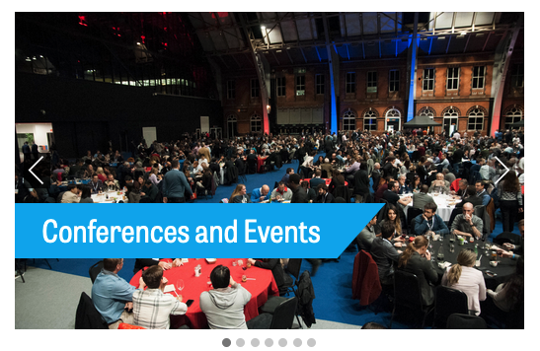
1. Networking Opportunities
Make friends and collaborations
Expand your professional network

Slide 11
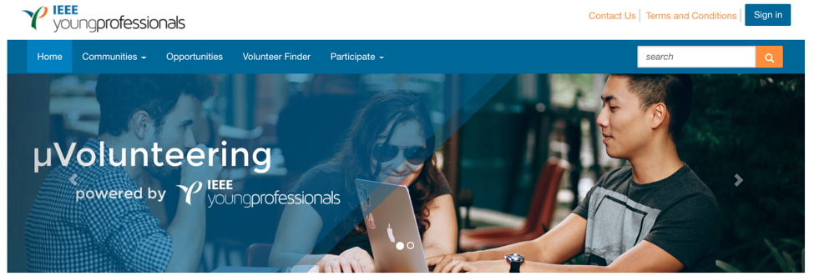
2. Volunteering Opportunities (two-way street)
Conference abstract reviewing
Journal article reviewing
Committee roles (CANPS, NPSS AdCom)
Conference organisation roles
http://uv.ieee.org

Slide 12
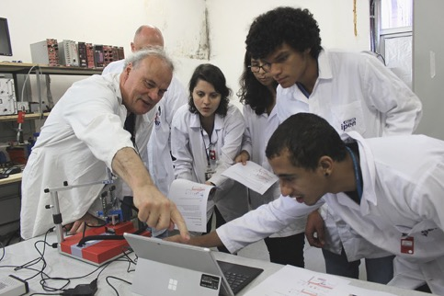
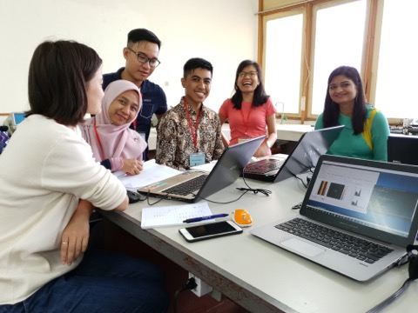
3. Develop your Leadership & Teaching Skills
Organise and teach a short course or a regional workshop
Nominate for a committee role on CANPS or NPSS AdCom

Slide 13
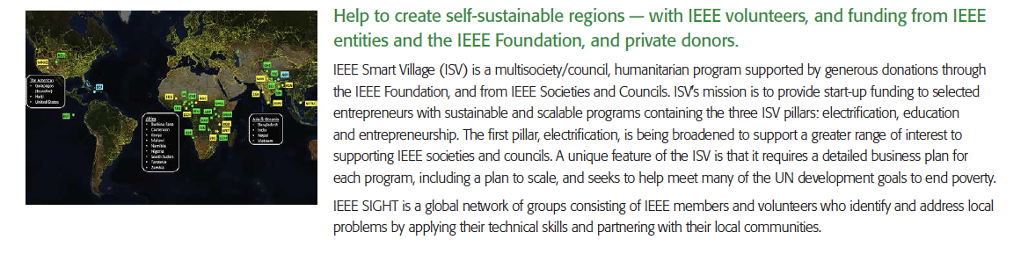
Humanitarian Outreach
Example: IEEE Smart Village

Slide 14
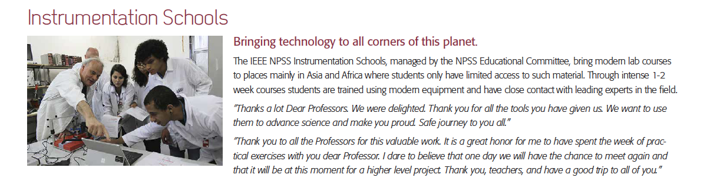
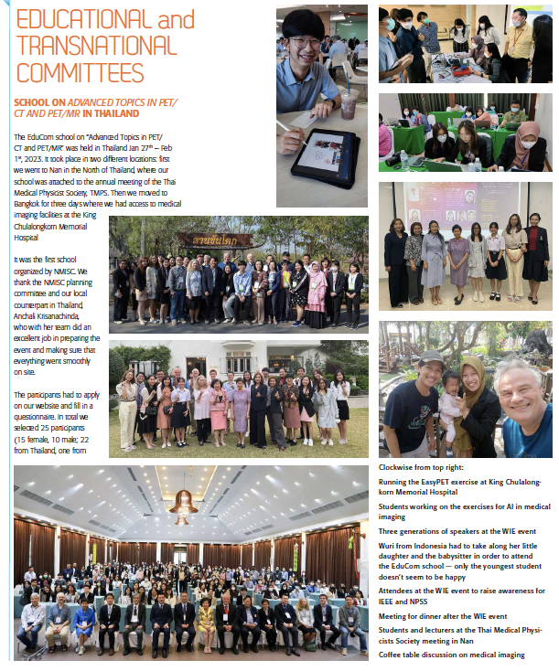
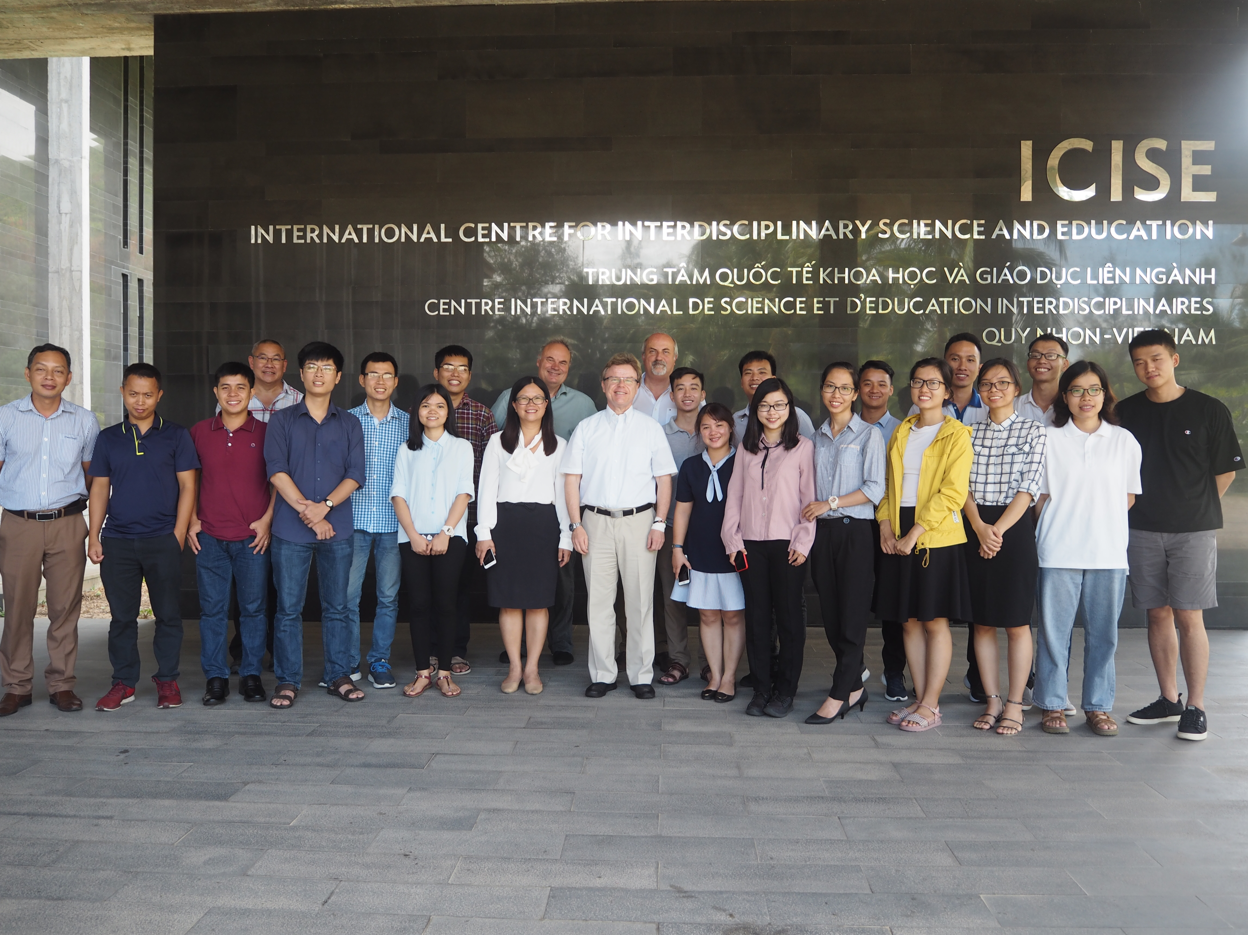
Schools

Slide 15
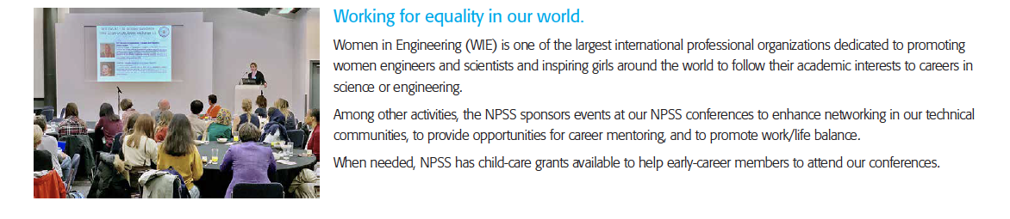
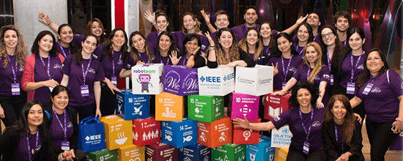
Women in Engineering and Diversity and Inclusion
WIE leadership summits
WIE events are held at most of our conferences supported by IEEE WIE
We are strengthening DEI activities Supported by IEEE DEI
NPSS joined the IEEE WIE pledge ‘IEEE WIE pledges to work towards gender-diversified panels at all IEEE meetings, conferences, and events, including our own’

Slide 16
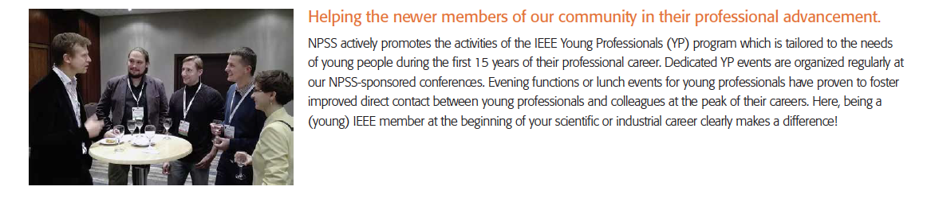

Young Professionals
YP events are held at most of our conferences supported by IEEE YP

Slide 17
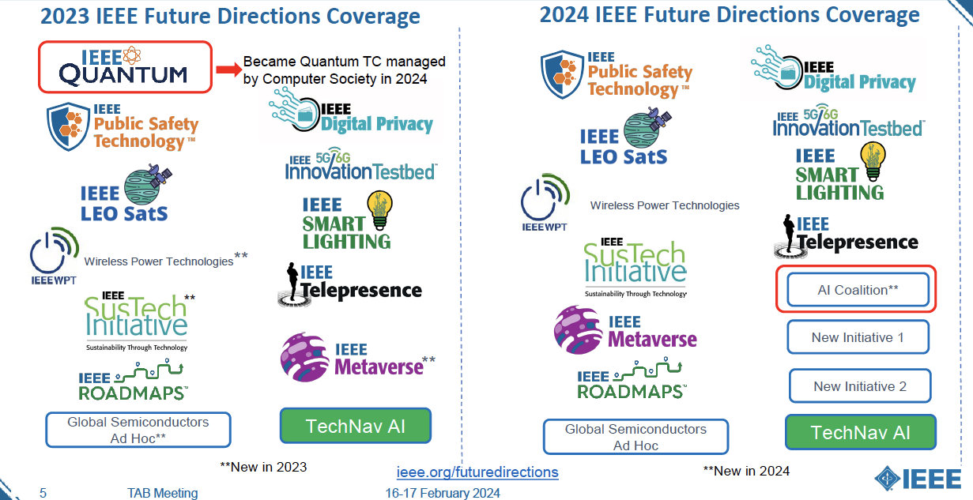
Opportunities within IEEE - IEEE Future Directions – Forward looking

Slide 18
AI COALITION
Classify and index AI work across IEEE into one area, and identify any gaps
Review how IEEE can use AI to enhance our services
D Visvikis NPSS representative

Slide 19

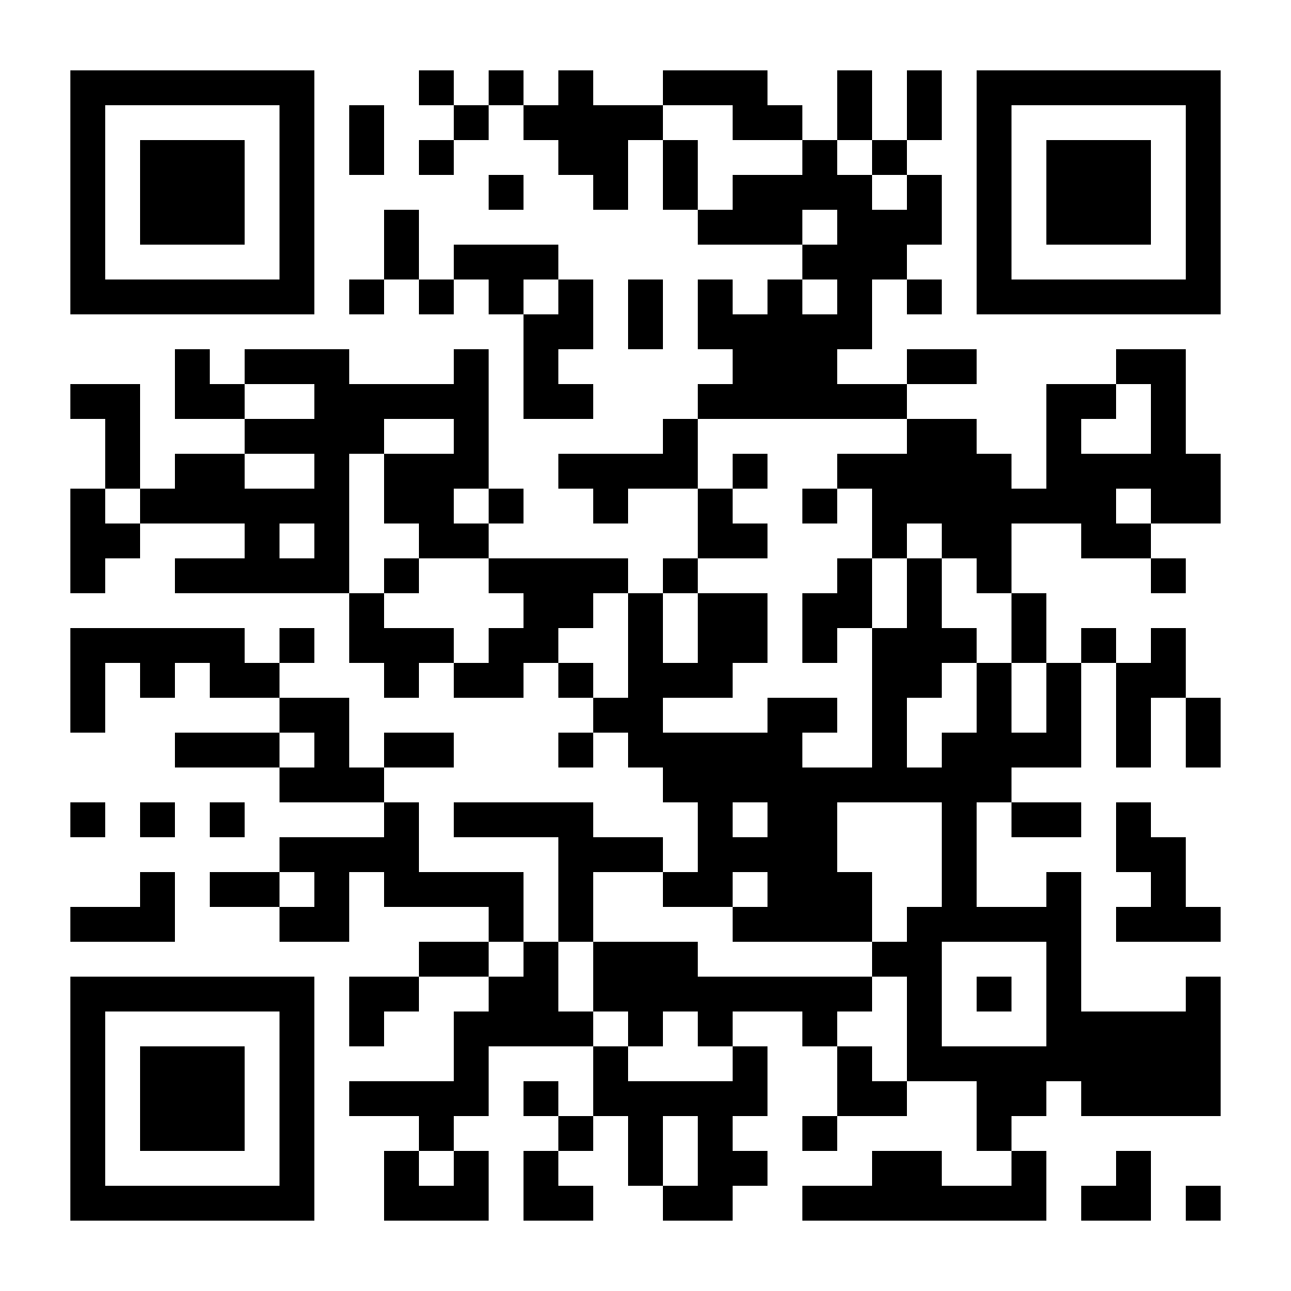


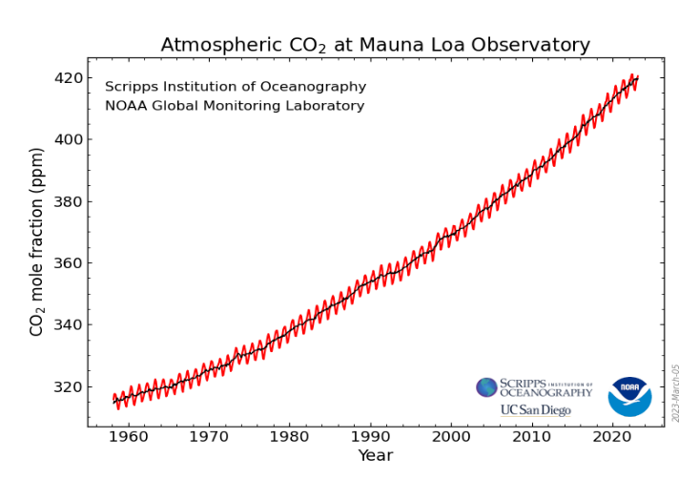
NPSS Climate Change Initiative (C Da Via)
The Nuclear and Plasma Sciences Society is starting a Climate Change Initiative to identify possible solutions to this urgent issue. We are planning to organize events to educate ourselves on the topic and to explore where we could actively apply our technical knowledge. A webpage is available on https://ieee-npss.org/climate-change-initiative/.
2024 Workshop Topics:
The Physics of Climate Change
Harvesting Energy
Nuclear Power Fission: Present and future
Nuclear Fusion: Current Status and Compact Designs
Cold Plasma Applications
Accelerator Based Solutions: Waste Management
Accelerator Based Solutions: Sub-critical Power Reactors
Sensors: Environmental Monitoring to Energy Harvesting
Electronics, Algorithms & Software: for Optimal Control
Big Data and Simulation
Non-thermal Plasmas in Electrification of Materials and Manufacturing
NPSSCCI Activities:
Monthly meetings
Website Generation
Preparation of information material
Organization of 1 day workshop in 2024
Organization of school section in 2024
Organization of 2025 events
Content:
If you are interested in knowing more or joining, please visit the membership desk

Slide 20
Apply for Initiative Funding
Do you have an idea for a project that aligns with the IEEE/NPSS strategic goals? (https://ieee-npss.org)
There is funding available
Talk to CANPS Chairs for more information on how to apply
Examples
  Development of virtual labs
  From membership to leadership
  Many educational and humanitarian efforts

Slide 21
Why am I part of (and volunteer for) IEEE NPSS?
I believe in the values promoted by IEEE/NPSS
I have the opportunity and privilege to work with people that I respect and admire
What am I getting out of it?
Opportunity for continuous learning – depth and breath – stepping stone to broader IEEE activities
Learning of transferable leadership and organizational skills
Meet people that influenced my career (and life)
Some wonderful friends

Slide 22
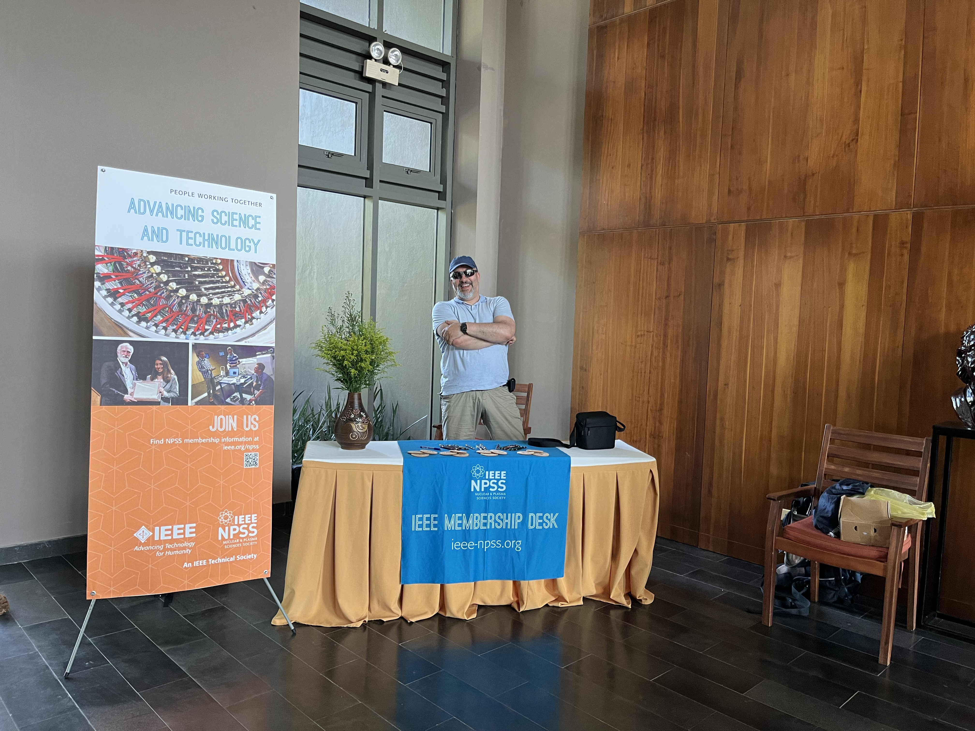
Where do I get more information:
  on involvement opportunities
  on financial benefits
  on IEEE and NPSS activities
  etc…
  Membership desk!
  Special offers for first time members

