Slide 1
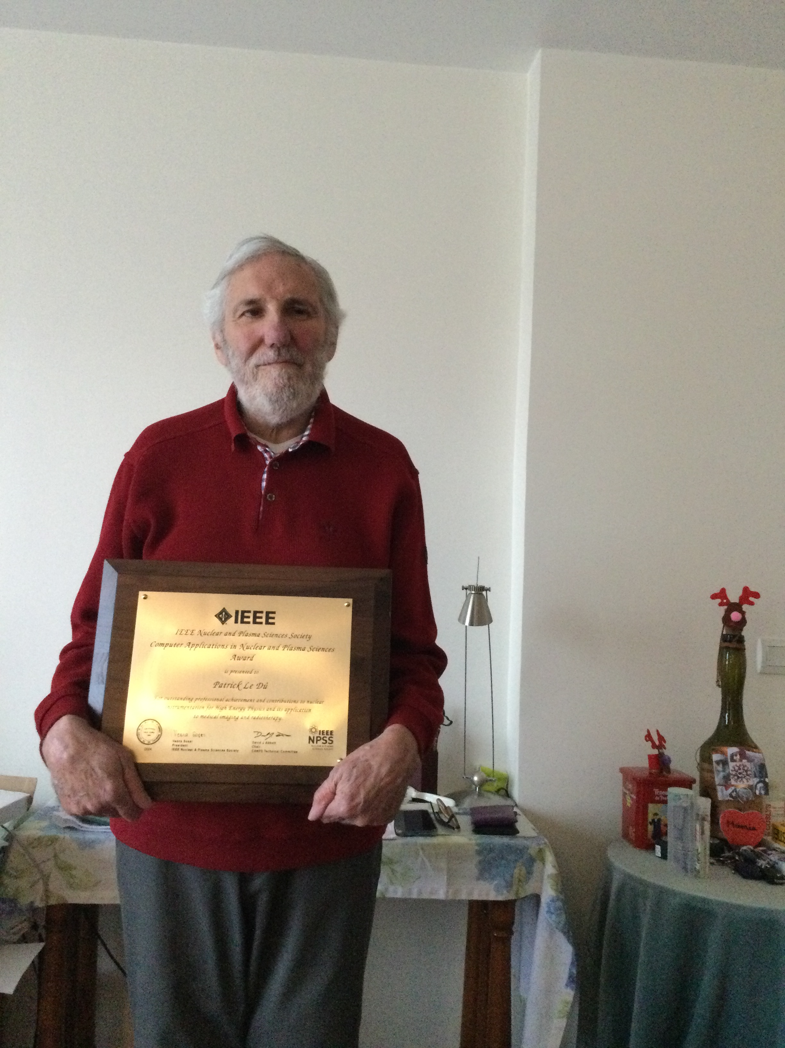

50 years of Trigger/DAQ evolution
Patrick Le Dû,
PhD
patrickledu@me.com

Slide 2
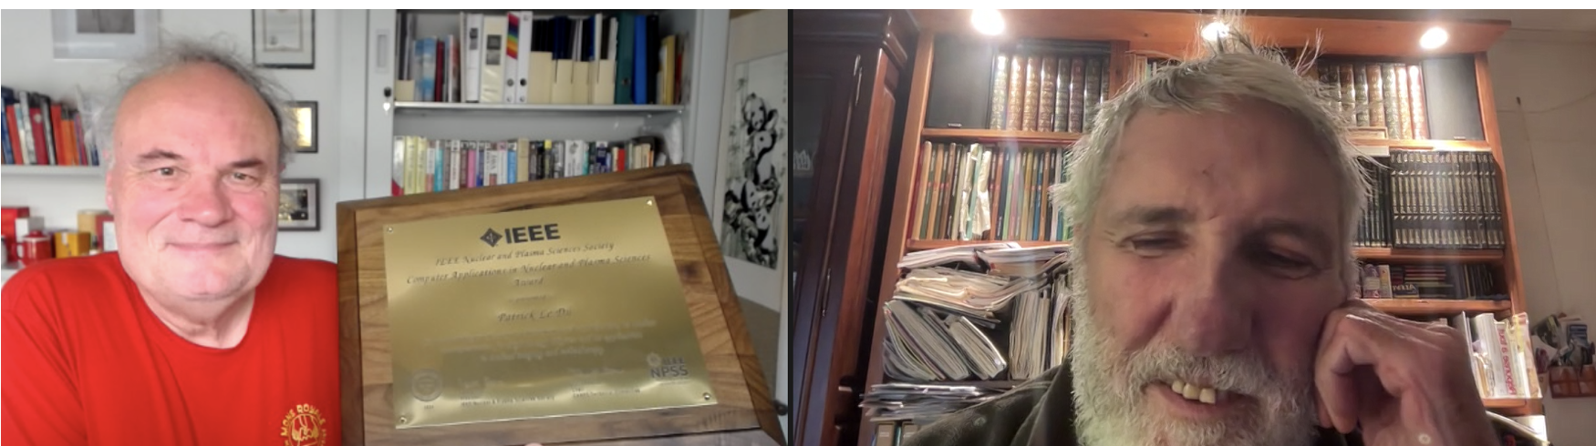
RT24 Award
For achievement and contributions to nuclear instrumentation for High Energy Physics and its application to medical imaging and radiotherapy"

Slide 3
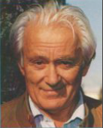
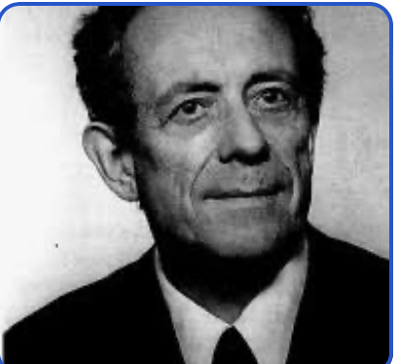
Gearges Charpak
1924-2010
MWPC development
I Dedicace this talk and Award to my MENTORS
Aldo Michelini
Omega Spark chamber testing
NA3 experiment Head
OPAL experoment Head
1930-2020

Slide 4
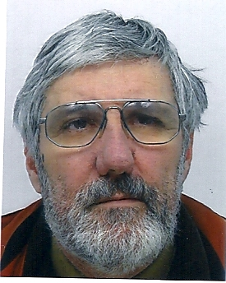
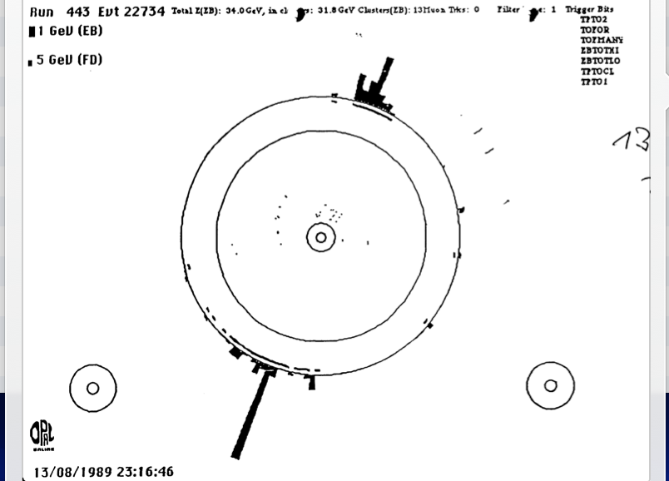
Who I am ? -
NA3 @ CERN (Di-Muon Drell Yan) : 1974-1980
  Large MWPC (4x4 m2)
  Trigger & DAQ
LEP - OPAL @ CERN (1980-1990)
  TOF system
  Trigger & DAQ → First Z⁰
SSC- SDC @ Dallas/LBL Berkeley (1990-1994)
  Trigger L2
  Shower Max Detector electronics (APD & SCA)
LHC- ATLAS @ CERN (1994-2000)
  L2 trigger & LARG calorimeter Read Out electronics (SCA)
D0 @ FNAL (1996-2005)
  L1 Calormeter trigger and L2 trigger.
ILC study group (1996-2008)
  Trigger & DAQ convener → Software trigeer
2000→Technology transfer advisor for medical application (PET & Particle therapy)
Ultra fast (picosecond) timing and TOF
Experimental Physicist
  CEA Saclay (1969-2008)
  IN2P3-IPN Lyon (2009 ..)

Slide 5
Goals of this lecture
The evolution during the last 50 yerars
of Electronics, Trigger and DAQ applied to HEP and medical domains
A short survey and light overview along my long career as experimental Physicist.
Give my own lessons and experiences of this period
Notes:
This overview interdisciplinary talk has the main purpose to present how HEP developments and evolution of front end deadtimeless low noise electronics, parallel read-out , real time selection of events (trigger), terabit data networking (DAQ) and on-line processing farms can be use to improve drastically the performances and efficiency of medical imaging devices like the Positron Emission Tomograph (PET) of next genration. The first part of the presentation will introduce the generic architectural model of future large colliding experiments like the future Colliders (ILC/CLIC) and its main features like the software trigger concept. An example of possible implementation will be shown using the new Advance Telecom Computing Architecture (ATCA) standard. Then, it will be discussed how these innovative ideas, tools and techniques of modern architectural concept in data acquisition can be applied in two particular applications of the future: the whole body Time Of Flight Positron Emission Tomography (TOF-TEP) for tumour diagnostic and the Hadrontherapy In-Beam PET for cancer treatment.

Slide 6
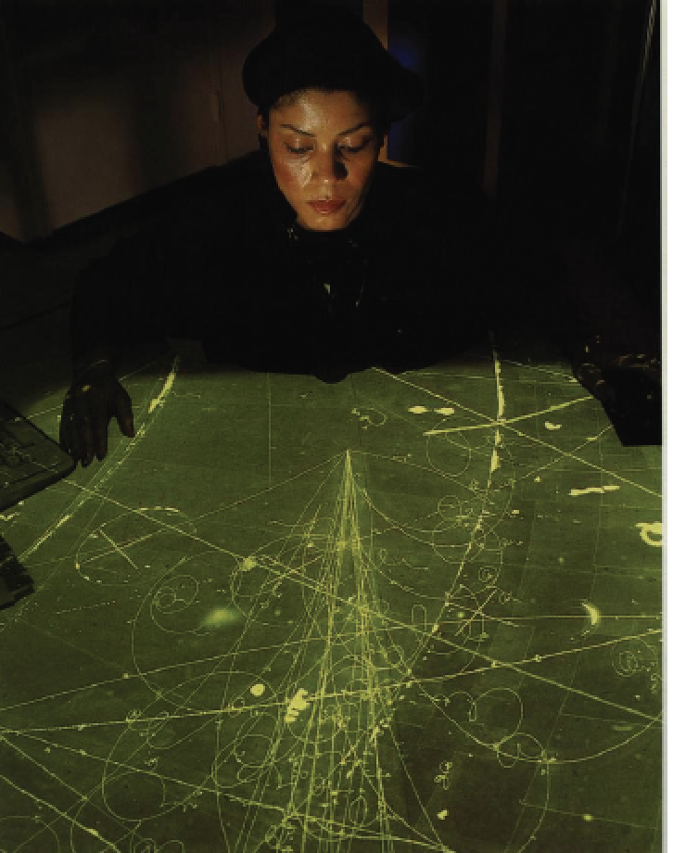
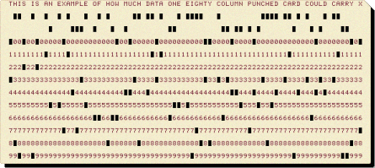
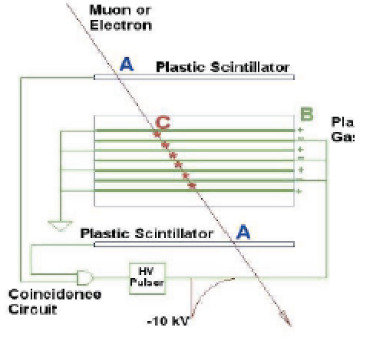
My CERN PS time ( 1969-1973)
Polarized target charge exchange with Neutral Pi zero and antiproton (Regge pole ) my diploma (71) and PHD thesis (73)
First coincidence unit with IC
Spark chambers with camera ,scaning and IBM card
12 bit computer (SDS 920 ?) that just register beam parameters with the First 12 wires MWPC from G. Charpak
Few Hz trigger with 1 crate NIM electronics (discri ,scalers and coincidence units)
Scanning table
Spark
Chamber
Fast Camera
IBM punched card
Notes:
This overview interdisciplinary talk has the main purpose to present how HEP developments and evolution of front end deadtimeless low noise electronics, parallel read-out , real time selection of events (trigger), terabit data networking (DAQ) and on-line processing farms can be use to improve drastically the performances and efficiency of medical imaging devices like the Positron Emission Tomograph (PET) of next genration. The first part of the presentation will introduce the generic architectural model of future large colliding experiments like the future Colliders (ILC/CLIC) and its main features like the software trigger concept. An example of possible implementation will be shown using the new Advance Telecom Computing Architecture (ATCA) standard. Then, it will be discussed how these innovative ideas, tools and techniques of modern architectural concept in data acquisition can be applied in two particular applications of the future: the whole body Time Of Flight Positron Emission Tomography (TOF-TEP) for tumour diagnostic and the Hadrontherapy In-Beam PET for cancer treatment.

Slide 7
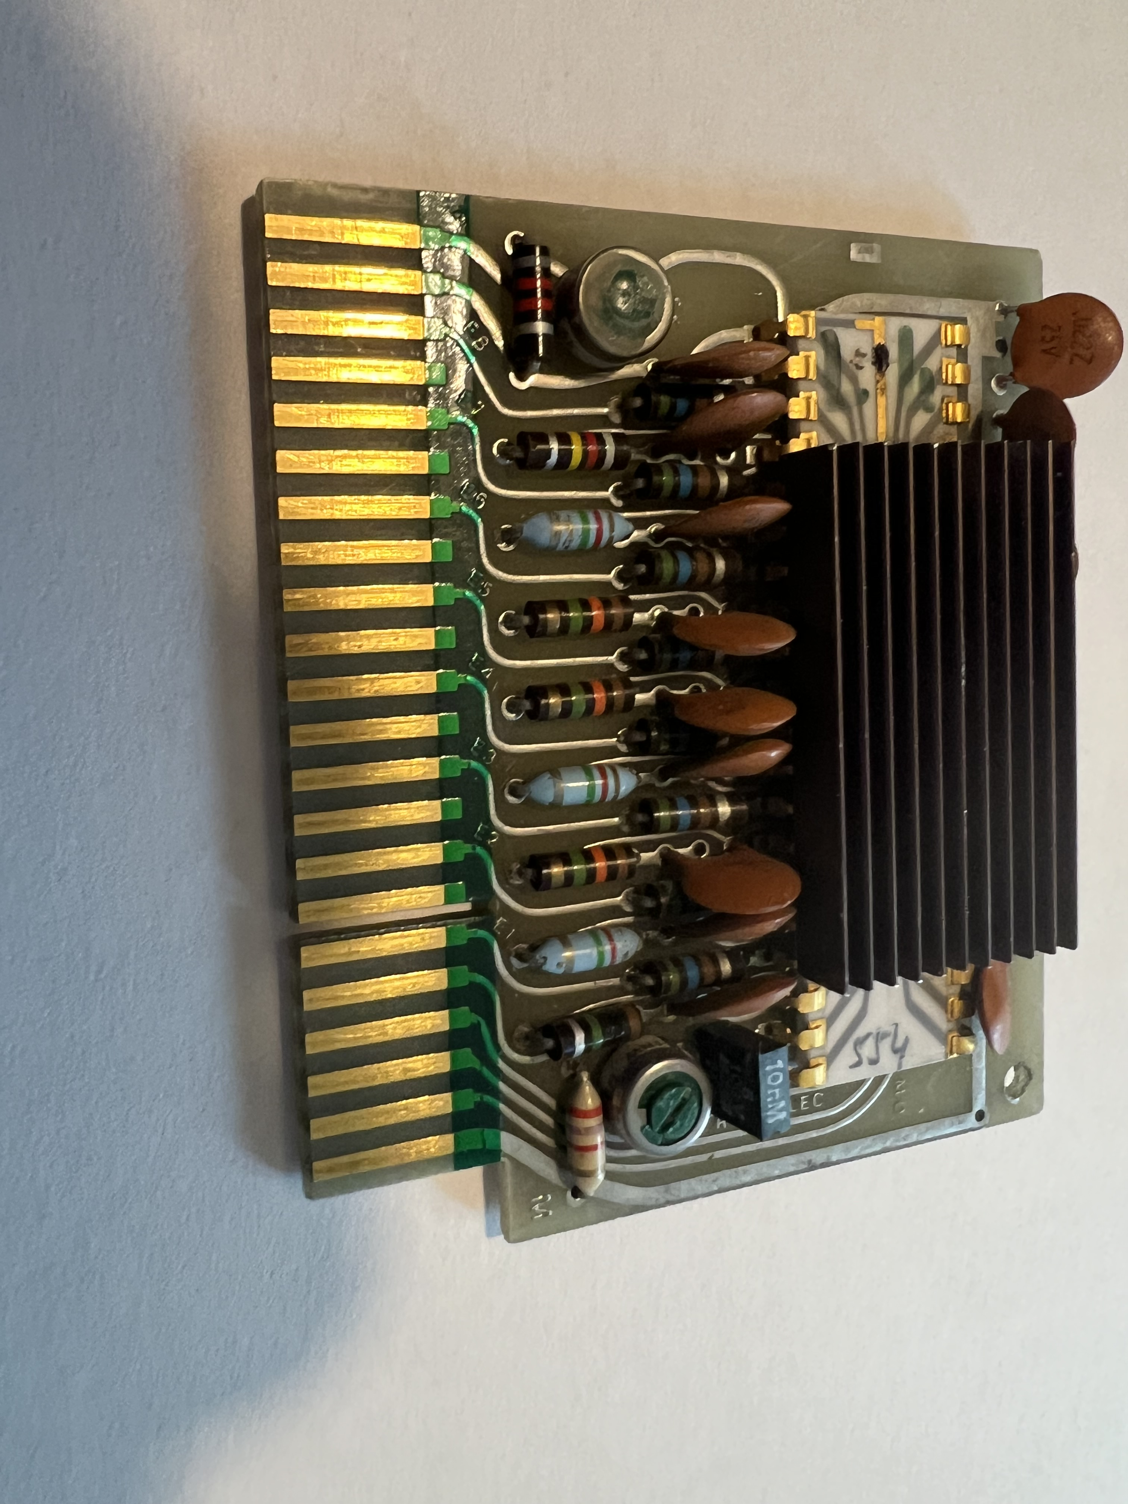
My MWPC time (1972-76)
Working with the Gearges Charpak team to develop small (20x20 cm2 up to 4 m2 (NA3) MWPC) mechanics (mylar cathodes and read out)
Test the first IC read out using the Filas LETI
8 channels discriminator

Slide 8
Deacreasing the dose
with HEP Gazeous detector
Georges Charpak idea!
A pioner !

Slide 9
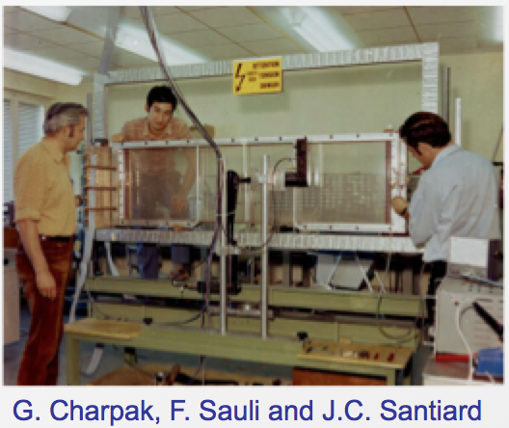
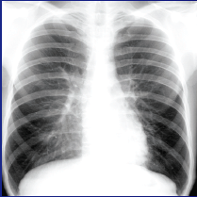
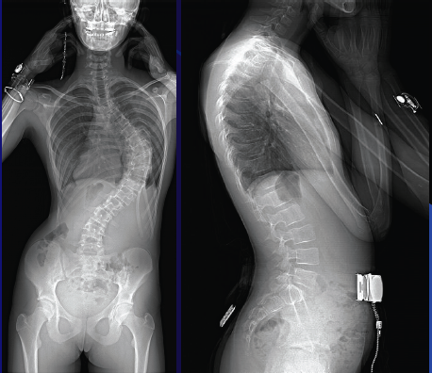
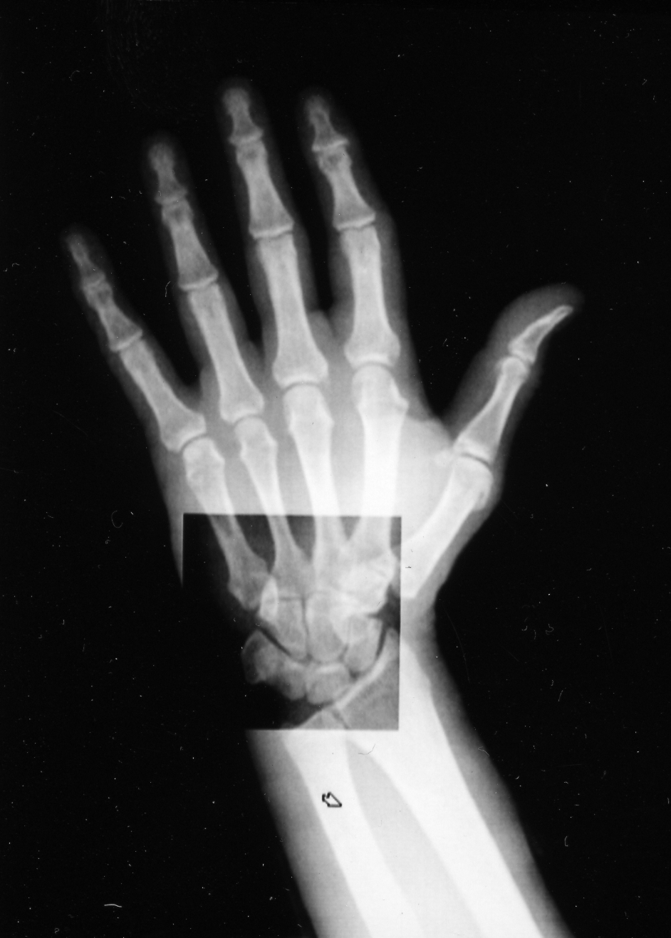
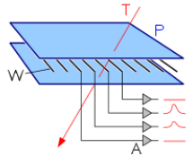
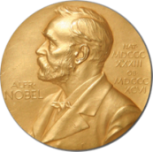
The 1970’s dream : Digital radiography with MWPC
A tribute to George Charpak
With 10 time less dose
1992
Multiwire Proportional Chamber
Georges Charpak
1924 - 2012
1968

Slide 10
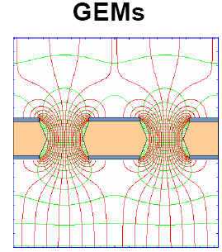
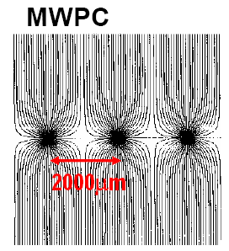
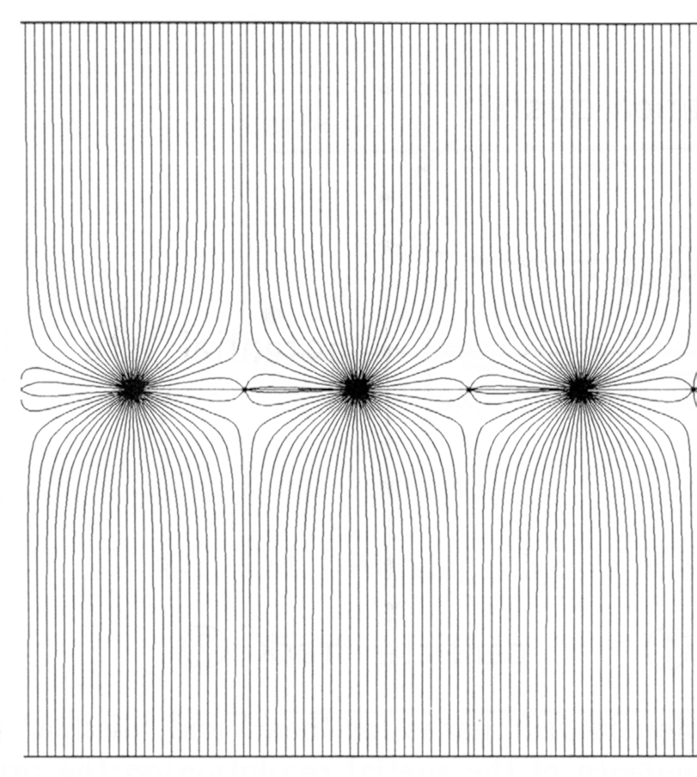
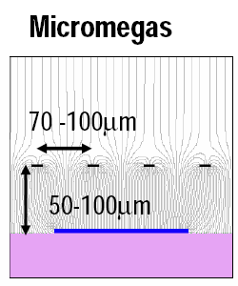
From MWPC’s to MGPD’s
MGPD
Drift Chamber
MWPC
1970 - 1990
PS- ISR- SPS- LEP
1975 - 1995
UA2-LEP
1990 -
Multiwire Proportional Chamber
Georges Charpak 1968
GEM F.Sauli)
Micromegas Y. Giomataris

Slide 11
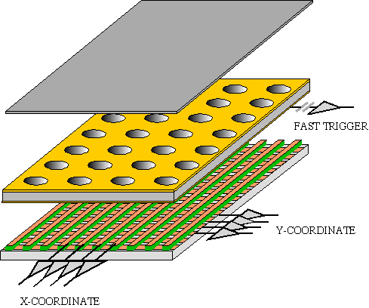
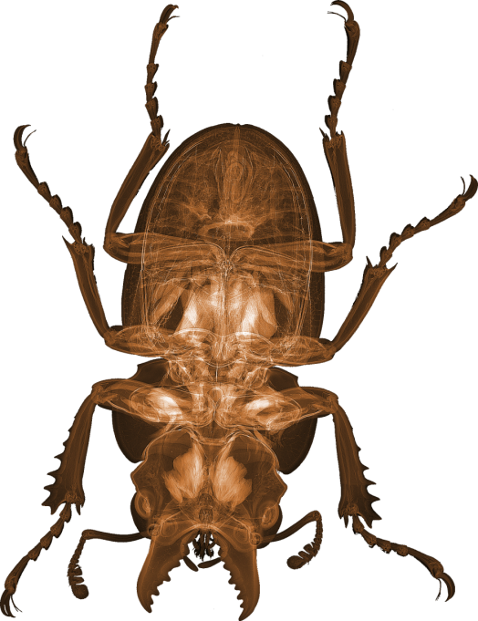
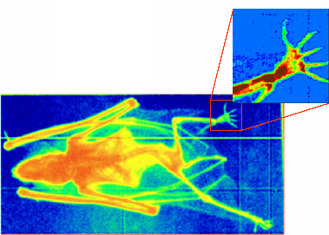
And 25 years later
GEM for 2D Imaging:
Using the lower GEM signal, the readout can be self-triggered with energy discrimination:
9 keV absorption radiography of a
small mammal
(image size ~ 60 x 30 mm²)
Position resolution ~ 100 μm
(limited by photoelectron range in the gas)

Slide 12
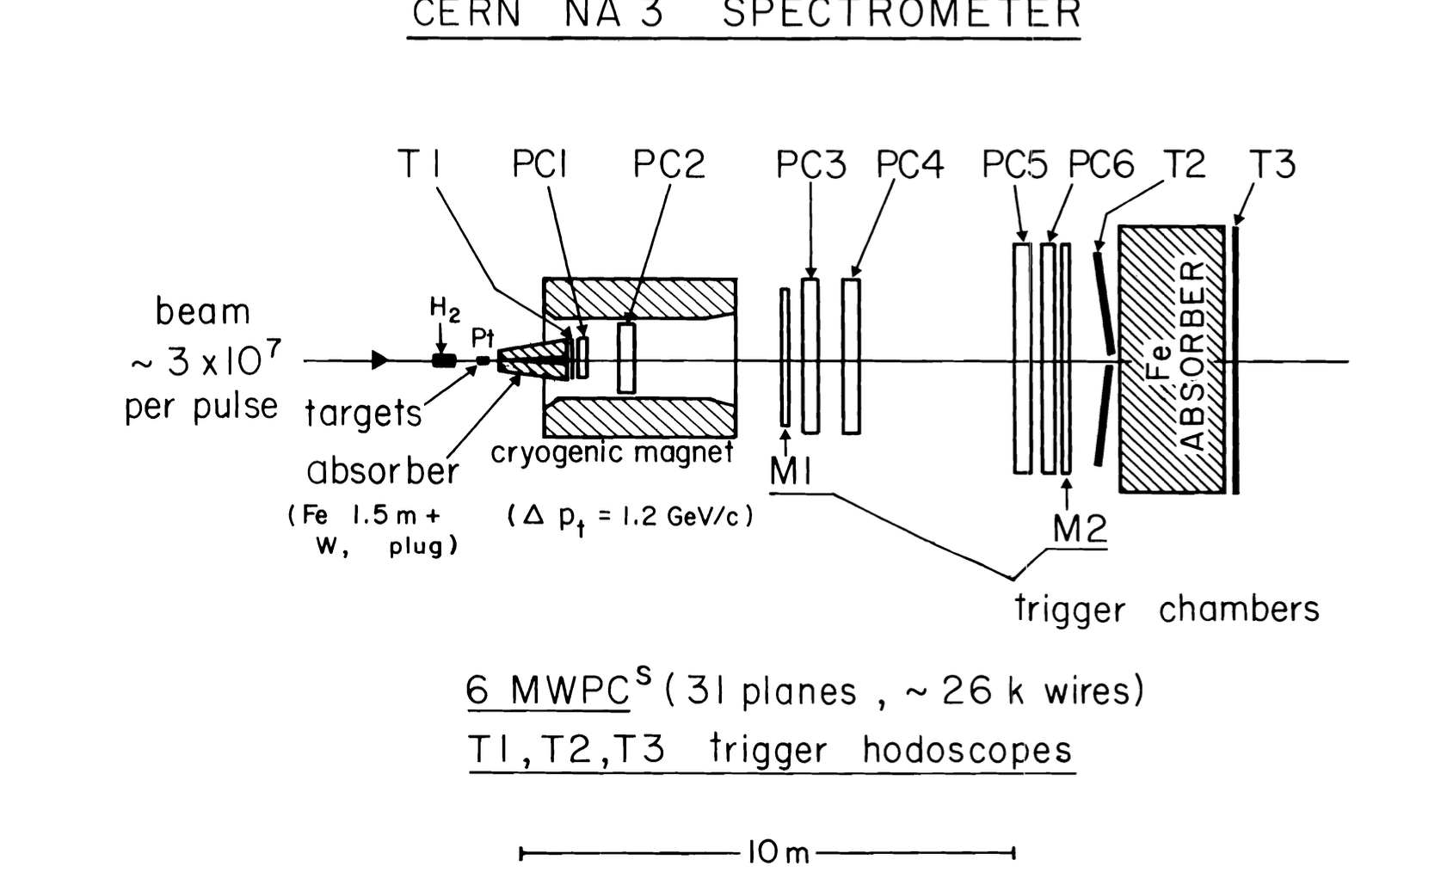
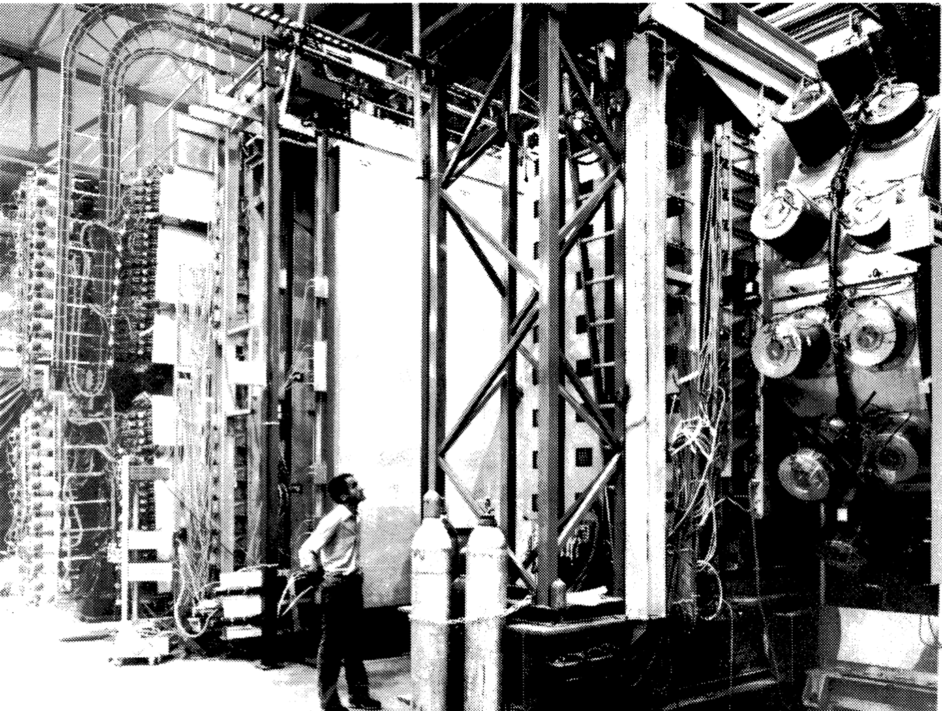
My CERN SPS time ( NA3 1973-1980)
Physics : Drell Yan Dimuon Spectrometer →PSI to UPSILON production by Hadron (quark composition)
Very Large MWPC (4 m2) with ASIC Read out
Trigger hodoscope
Hardired processor box with filter storage principle (Morpion)
Notes:
This overview interdisciplinary talk has the main purpose to present how HEP developments and evolution of front end deadtimeless low noise electronics, parallel read-out , real time selection of events (trigger), terabit data networking (DAQ) and on-line processing farms can be use to improve drastically the performances and efficiency of medical imaging devices like the Positron Emission Tomograph (PET) of next genration. The first part of the presentation will introduce the generic architectural model of future large colliding experiments like the future Colliders (ILC/CLIC) and its main features like the software trigger concept. An example of possible implementation will be shown using the new Advance Telecom Computing Architecture (ATCA) standard. Then, it will be discussed how these innovative ideas, tools and techniques of modern architectural concept in data acquisition can be applied in two particular applications of the future: the whole body Time Of Flight Positron Emission Tomography (TOF-TEP) for tumour diagnostic and the Hadrontherapy In-Beam PET for cancer treatment.

Slide 13
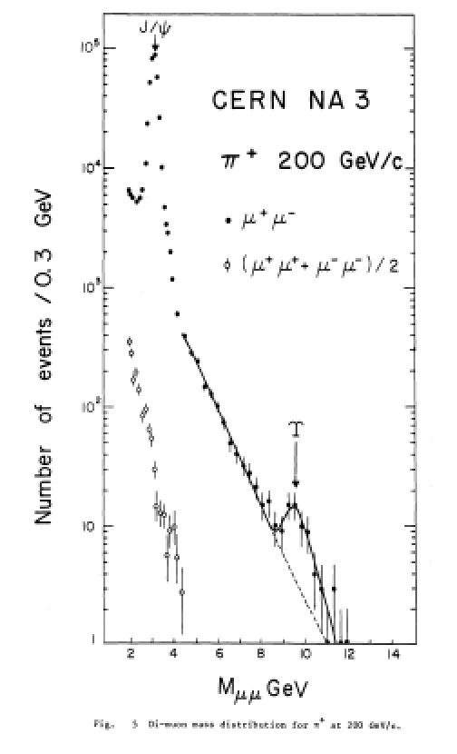
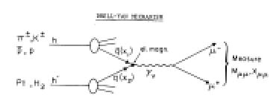
NA3 Physics
Harwired processor
For real time calculation of dimuon mass and separate stream of data

Slide 14
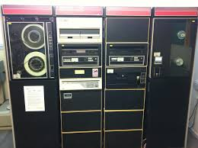
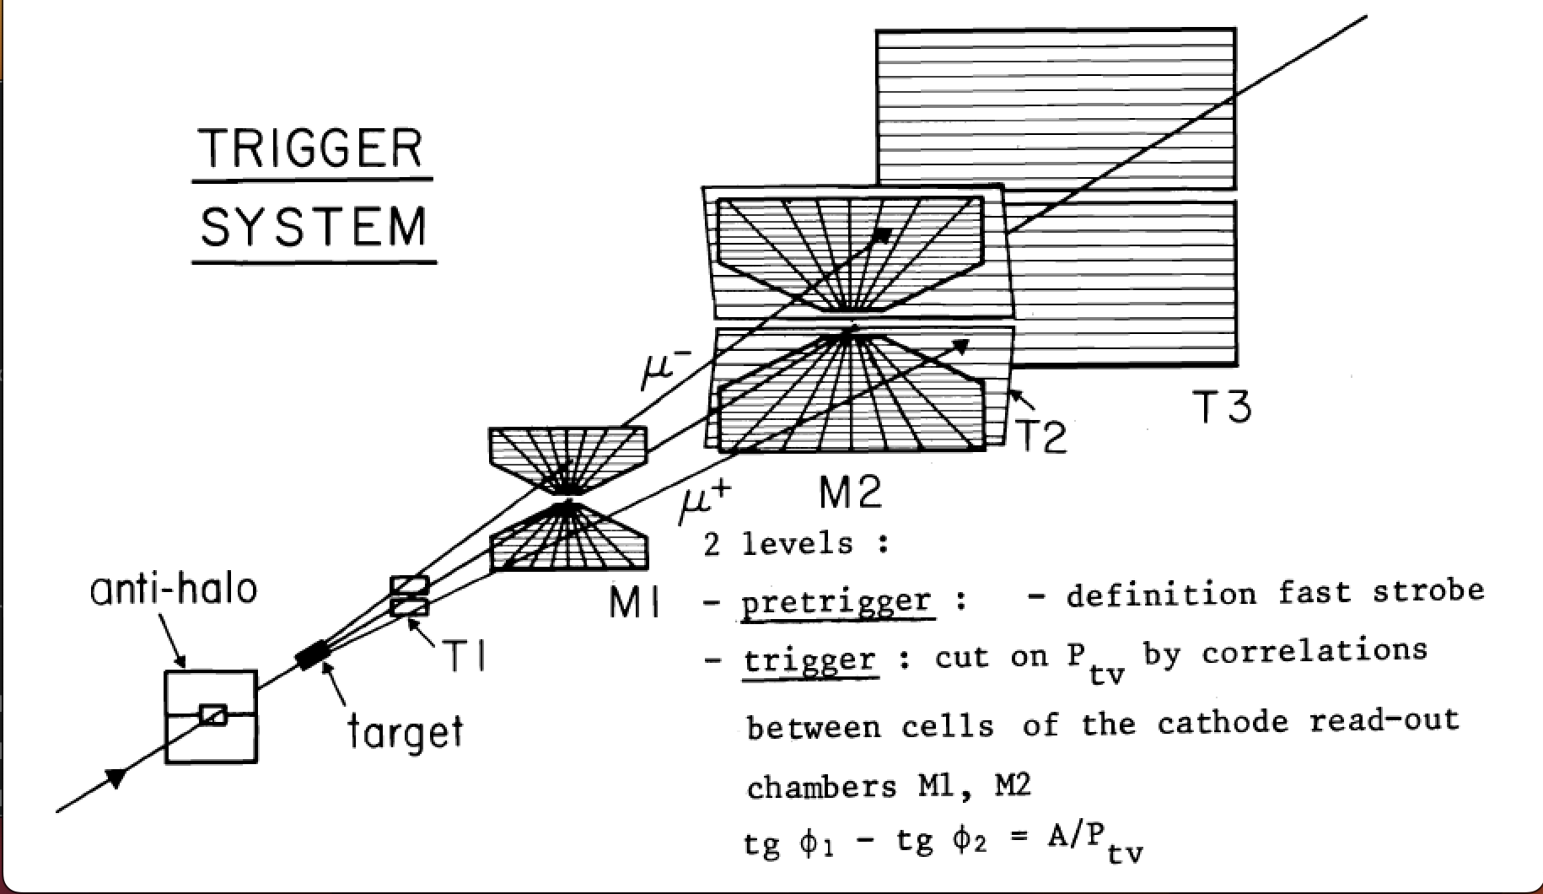
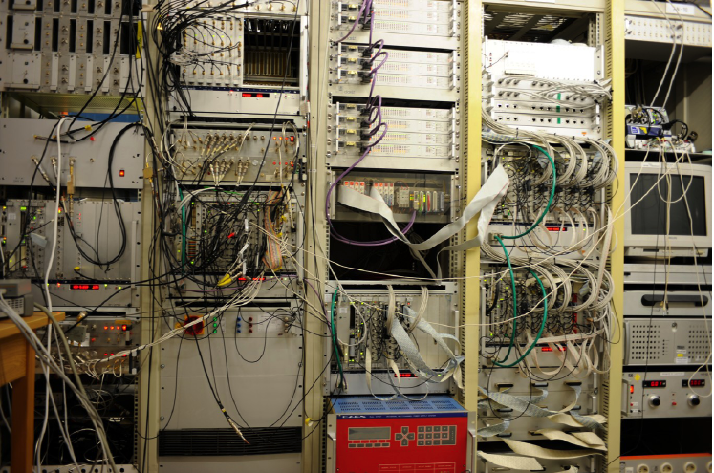
NA3 Trigger
NIM and CAMAC electronics,PDP 11/45
Harwired Trigger BOX to select Dimuon mass
Storage and filter between burst

Slide 15
My CERN –LEP OPAL time (1980-1990)
One level Simple hardware Trigger
160 Time of flight (TOF) counters hodoscope with 300 psec resolution. (development of cheap XP20 PMT (XP32 Philips) and CFD integrated to the PM base)
VME Motorola 68020 series processors to read in parallel each detector crate (30) OS9 SW
CAMAC, VME and NO Fastbus
Display and slow control using Apple Macintosh
Filter processor using RISC machine (Appolo)
Digital Vax to collect data upstair

Slide 16
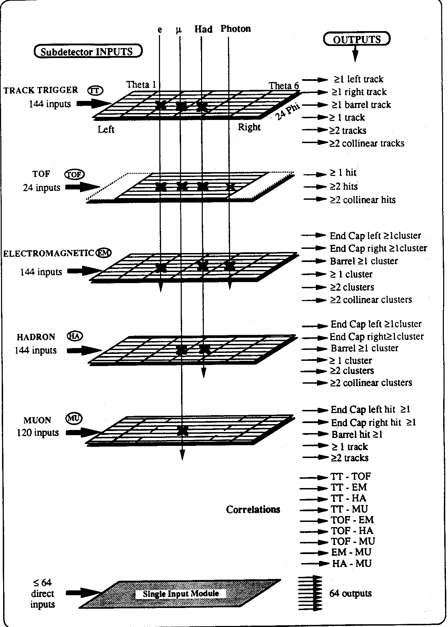
OPAL Trigger basic
TRACK
Matrix
  24 Phi
  6 Eta
  Total =144 trigger cells
TOF
EM
HAD
MUON
64 ‘Phi’ single input signals
80% of Trigger

Slide 17
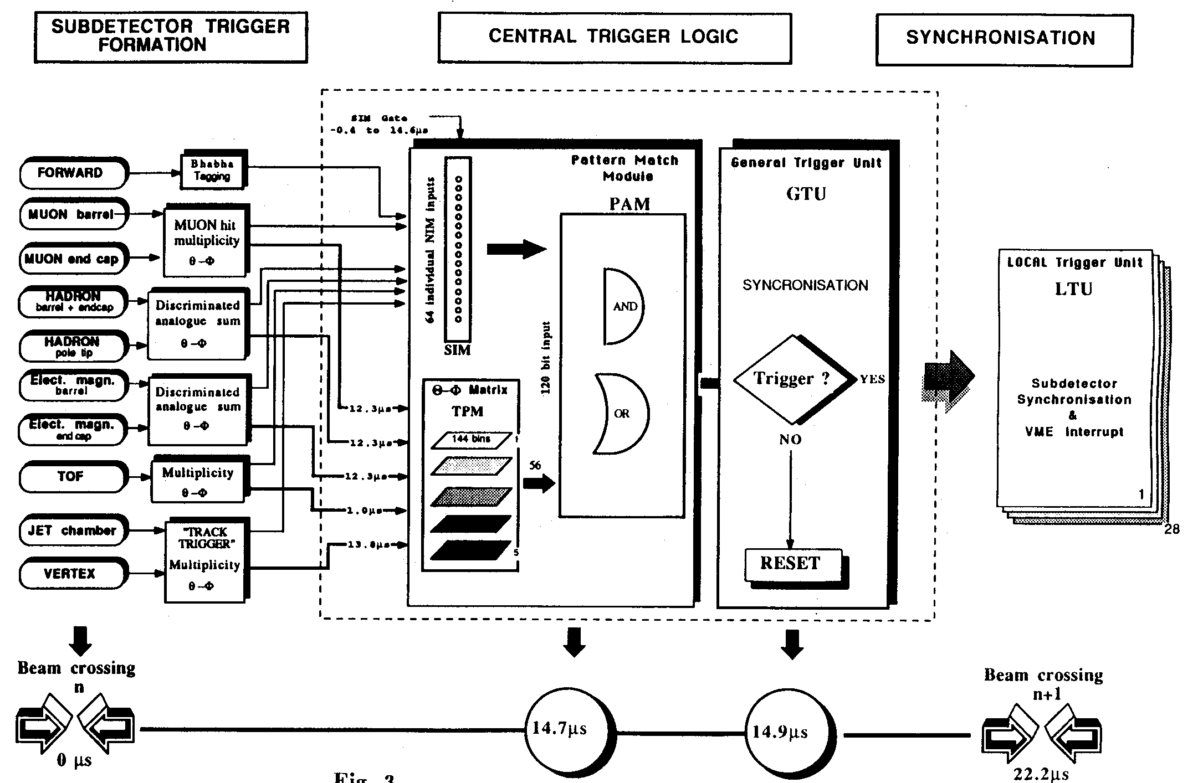
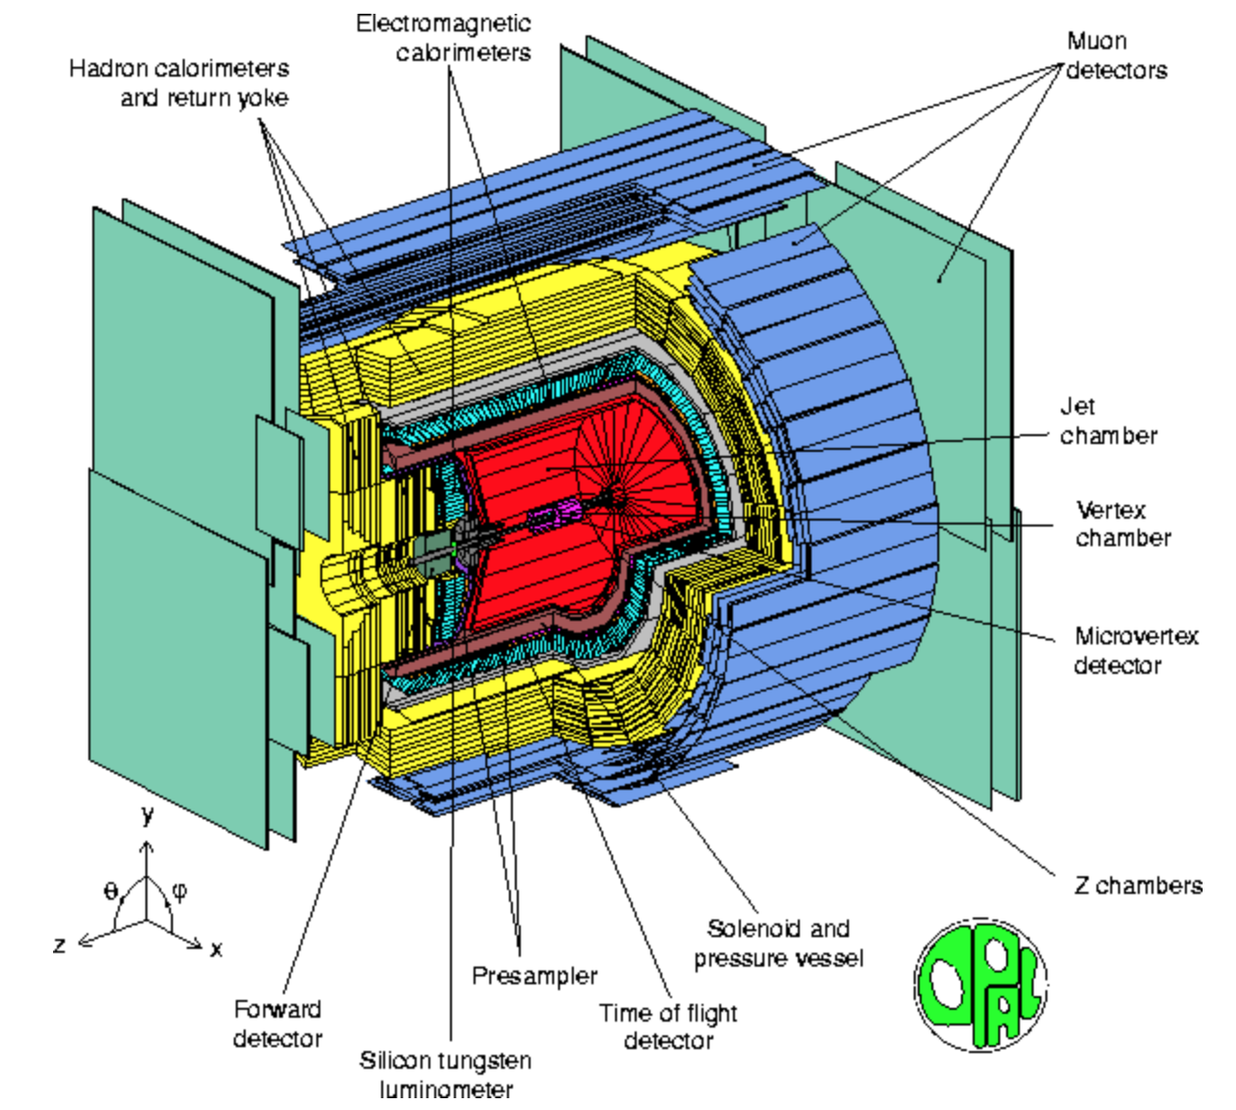
Simple:The LEP-OPAL TRIGGER
22 μSec
15 μSec

Slide 18
The LEP Z0 first event
EM
TOF
The First Z⁰ → e+e- at LEP
OPAL-13 August 1989
TOF + EM Lead glass Calorimeter only
A.Michelini, H. VonDerSmitt, R.Heuer, P.Le Dû

Slide 19
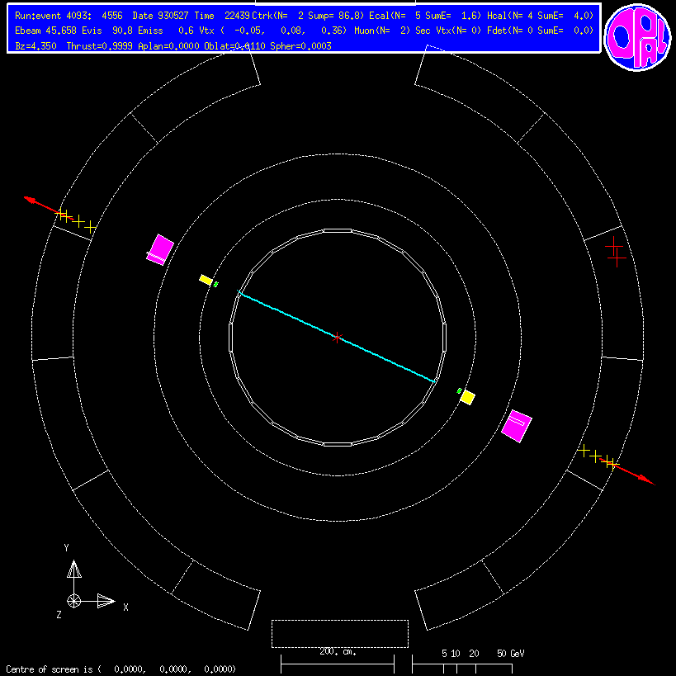
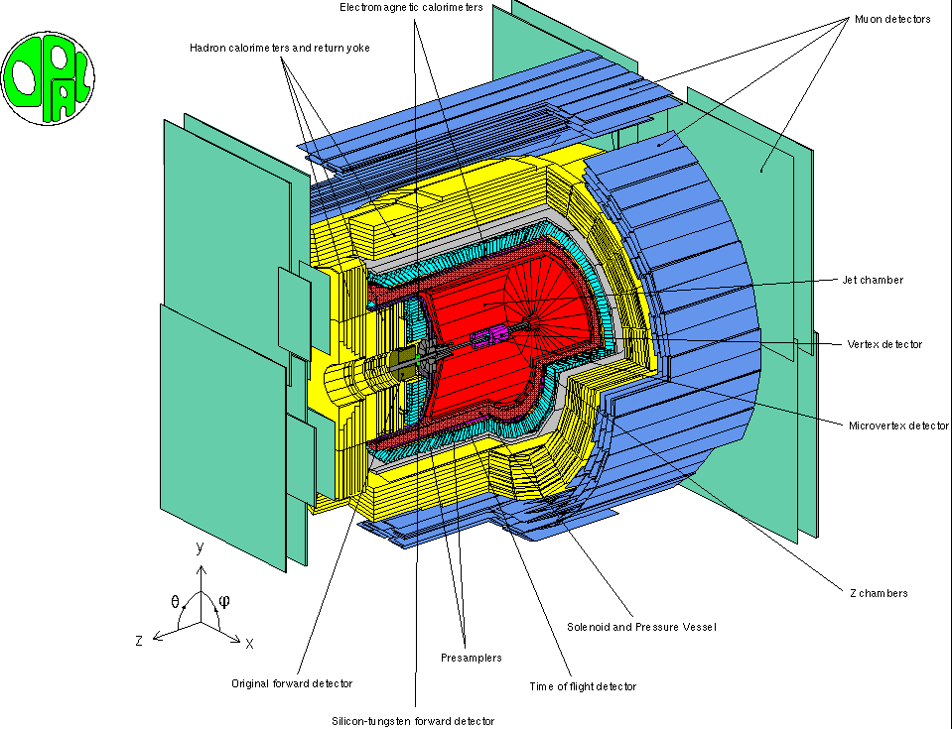
LEP-OPAL Z→ μμ
Z →μμ
First LEP event
Z→ee

Slide 20
My SSC Berkeley Time ( 1991-1994)
SSC_SDC project in Dallas : FNAL,Chicago,LBNL
L2 trigger with Univ of Chicago (CDF)
Read out of the EM shower max detector (160 K Channels)
APD’s Read Out development
Kleidelder SCA (Switch Capacitor Array) electronics
Notes:
This overview interdisciplinary talk has the main purpose to present how HEP developments and evolution of front end deadtimeless low noise electronics, parallel read-out , real time selection of events (trigger), terabit data networking (DAQ) and on-line processing farms can be use to improve drastically the performances and efficiency of medical imaging devices like the Positron Emission Tomograph (PET) of next genration. The first part of the presentation will introduce the generic architectural model of future large colliding experiments like the future Colliders (ILC/CLIC) and its main features like the software trigger concept. An example of possible implementation will be shown using the new Advance Telecom Computing Architecture (ATCA) standard. Then, it will be discussed how these innovative ideas, tools and techniques of modern architectural concept in data acquisition can be applied in two particular applications of the future: the whole body Time Of Flight Positron Emission Tomography (TOF-TEP) for tumour diagnostic and the Hadrontherapy In-Beam PET for cancer treatment.

Slide 21
My CERN –ATLAS & FNAL D0 Time ( 1994-2000)
ATLAS LVL2 Trigger (ROB : Read Out Buffer)
FNAL Tevatron RUN 2 DO LVL1 upgrade
ATM study as posssible ‘event building’ network ???
ILC trigger study → Software trigger concept (1996)
Notes:
This overview interdisciplinary talk has the main purpose to present how HEP developments and evolution of front end deadtimeless low noise electronics, parallel read-out , real time selection of events (trigger), terabit data networking (DAQ) and on-line processing farms can be use to improve drastically the performances and efficiency of medical imaging devices like the Positron Emission Tomograph (PET) of next genration. The first part of the presentation will introduce the generic architectural model of future large colliding experiments like the future Colliders (ILC/CLIC) and its main features like the software trigger concept. An example of possible implementation will be shown using the new Advance Telecom Computing Architecture (ATCA) standard. Then, it will be discussed how these innovative ideas, tools and techniques of modern architectural concept in data acquisition can be applied in two particular applications of the future: the whole body Time Of Flight Positron Emission Tomography (TOF-TEP) for tumour diagnostic and the Hadrontherapy In-Beam PET for cancer treatment.

Slide 22
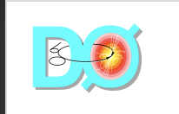
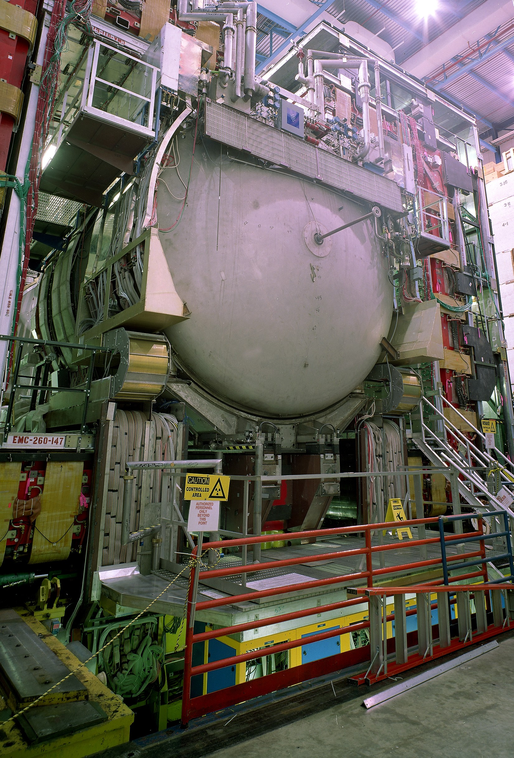
Tevatron RUN 2 TRIGGER architecture
7.6 MHz Xing rate
D0
Detector
L1 Buffer
Pipeline)
L1 Trigger
10 KHz
Accept
4.2 µs
L2 Buffer
&
digitization
Preprocessing
Farm
L2
L2 Global
Acce/rej
100 µs latency
< 1KHz
48 Input nodes
1 s latency
L3 Farm
<50 Hz
Mass
Storage

Slide 23
LHC Logical structure
ATLAS
CMS
40 MHz
Sub- Detectors
Synchronous
Custom made
Hardware pipelined
rigger processor
Level 1
Front end buffers
( ~10⁷ channels)
Level 1
2.5 μs
fixed
1000 - 1500Gbit/s
100 KHz
Region Of Interest
ROI
Asynchronous
Commercial DSPs,
RISCs, etc.
Read Out Buffers
1000-1500 units
few m s
variable
Level 2
1KHz
20 Gbit/s
250-500 Gbit/s
10KHz
100 Mbit/sec
1 Gbit/sec
1000 x1000
256 x 256
Switching Network
(Event builder)
“Virtual”
level 2
Farms of RISCs,
workstations, etc.
Processor farm
(~2 to 5 x 10 MIPS)
High
Levels
Level 3
6
1-10 s
variable
10 Gbit/s
100 Hz
Permanent storage
100 MBytes/sec --> TBytes/day

Slide 24
Software Trigger concept → No hardware trigger !
Data Flow
Detector
Front End
up to 1 ms
active pipeline
(full train)
Sub-Detectors FE Read-out
Signal processing – digitization, no trigger interrupt
Sparcification,cluster finding and/or data compression
Buffering
Dead
time
free
Read-Out
Buffer
1 ms
3000 Hz
Network
Data Collection is triggered by every train crossing
Trigger :Software Event Selection using partial information of a complete train (equivalent to L1)
Select ‘Bunches Of Interest’
Event classification according to physics, calibration & machine needs (HLT)
Processor
Farm(s)
1 MBytes
Average
event size
200 ms
Few Hz
Monitoring & on-line processing
Storage
Few sec
Data streams
S1
S2
S3
S4
Sn

Slide 25
ILC DAQ conceptual (ILD) Architecture 2005)
5K
1 G
5 M
2.6 M
9215K
4568 K
12K
Machine
VFD
VTX
SiT
TPC
ECAL
HCAL
MUON
10k
5MB
1MB
110 MB
20 MB
3 MB
1 MB
Detector Buffering (per bunch train in Mbytes/BT = 140 MB/s)
Links
Event
manager
& Control
Event building
Network
10-20 Gbit/sec
Processor farm (one bunch train per processor)
P
P
P
P
P
P
P
P
P
P
P
P
P
P
P
P
Select Bunch Of Interest (200 Hz)
Data Steams Logger and Mass Storage
1GB/s = 100 PB/year

Slide 26
Summary of my Trigger/DAQ time in HEP
1970 -2000

Slide 27
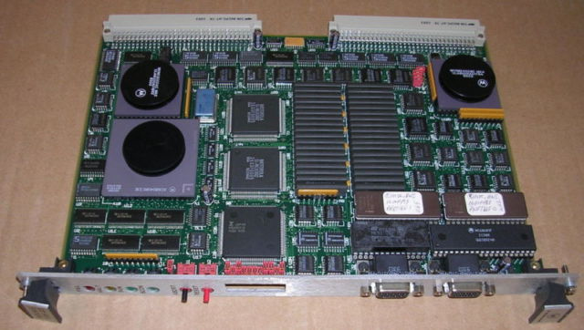
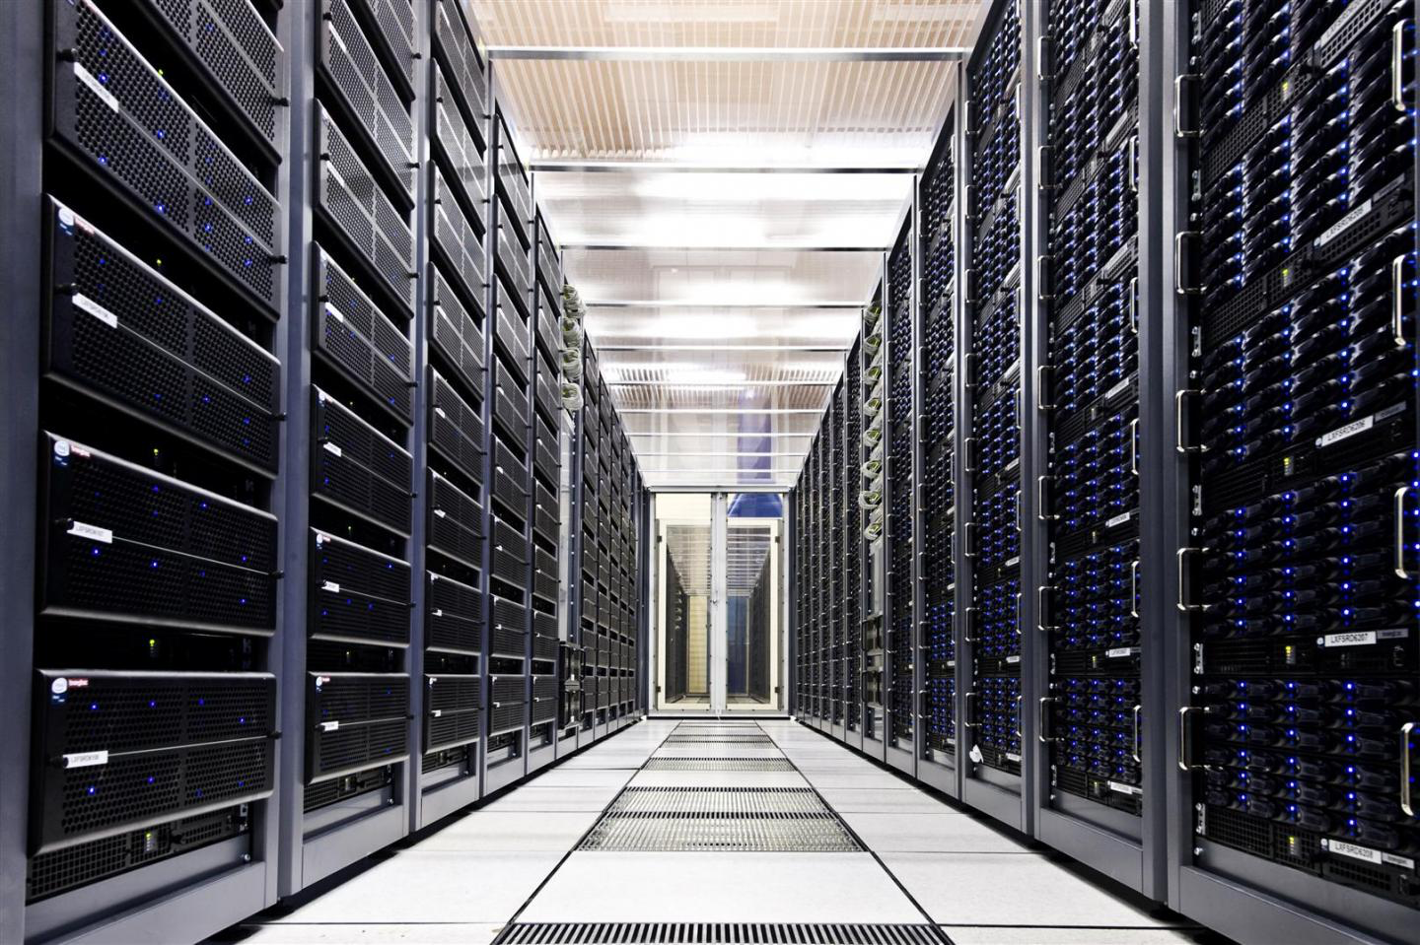
IBM card
Historical Evolution of
data collection
1970
Digital PDP 11/45 mini computer
1980
1990
VME (FIC) micro processor card
2010
LHC PC farm

Slide 28
Signal processing first step → THE discriminator
Single threshold
Multiple threshold
Constant fraction
Waveform sampling
The single threshold is the least precise time extraction measurement. It has the advantage of simplicity
The multiple threshold method take into account the finite slope of the signal. It is still easy to implement
The constant fraction algorithm is very often used due to its relatively good performance and its simplicity for Timing measurement
The waveform sampling above the Niquist frequency is the best algorithm since its preserve the signal integrity (time and amplitude)

Slide 29
Evolution of Standards
CAMAC
BCNAF
1970 - 1990
PS- ISR- SPS- LEP
From Computer INDUSTRY
From HEP
(ESONE)
FASTBUS
VME
1980 - 2007
UA1-LEP -LHC
1980 - 1995
UA2-LEP
2010 - ?
AGATA-PANDA
LHC/ ILC
ATCA
From Telecom
INDUSTRY

Slide 30
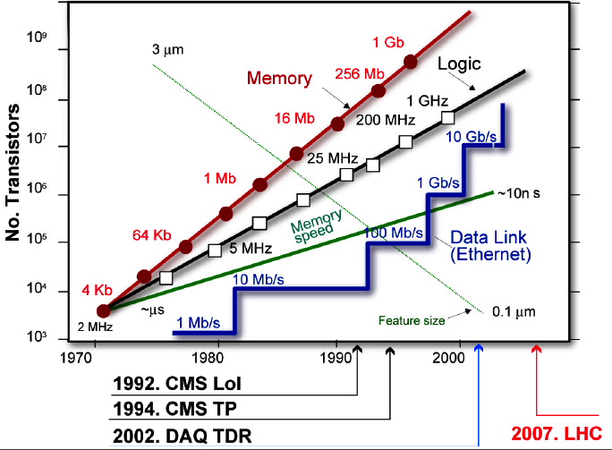
The Long Term issue challenge →
15 years of design-20 years of life
Tevatron
CDF/DO
1980-2012
The ‘More law’
LHC example

Slide 31
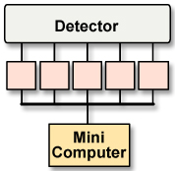
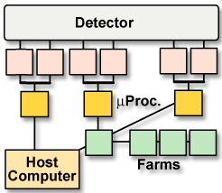
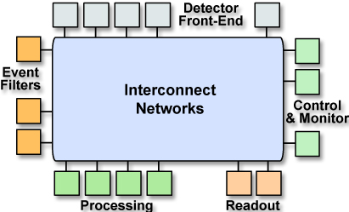
Evolution of DAQ technologies and architectures
1970-80
CERN PS/SPS
Minicomputers
Readout custom design
First standard: CAMAC
kByte/s
1980-90
LEP
Microprocessors
HEP standards (Fastbus)
Embedded CPU,
Industry standards (VME)
MByte/s
2007 …
LHC (CMS)
Networks/Grids
IT commodities, PC, Clusters
Internet, Web, etc.
GByte/s
Detector Readout
Event building
On-line processing
Off-line data store
From S. Cittolin

Slide 32
Summary of T/DAQ architecture evolution
L1
L1
hardware
L2
Software
trigger
HLT
L3
Multipurpose
farm
On-line
On-line
farm
Off-line
Analysis
Pass1
Analysis
Pass2
GRID
Analysis
Pass2
Analysis
Pass2
GRID
Tevatron
LHC
32
TIPP09
ILC/CLIC

Slide 33
Technology forecast summary (2015)
End of traditional parallel backplane bus paradigm
  Announced every year since ~1989
  VME-PCI still there
    watch PCI Express, RapidIO, ATCA
Commercial networking products for T/DAQ
  Conferences:
    ATM, DS-Link, Fibre Channel, SCI
  Today: Gigabit Ethernet ( 1 → 10 → 30 GB/s)
The ideal processing / memory / IO BW device
  The past:
    Emulators (370E),Transputers, DSP’s, RISC processors
  Today: FPGA’s →
    Integrates receiver links, PPC, DSP’s and memory

Slide 34
Technology forecast (Con’t)
Point-to-point link technology
  The old style: Parallel Copper – Serial Optical
  The modern style: Serial Copper – Parallel Optics
    Today 10Gb/s → 30Gb/s
Processors → Moore’s law still true until 2015 ..at least!
  Continuous increasing of the computing power (Clock)
Memory size → quasi illimited !
    Today : > 100 GBytes
    2015: > Tera Bytes …
Modern wisdom (about technology)
  “People tend to overestimate what can be done in one year, and underestimate what can be done in 10 years.”

Slide 35
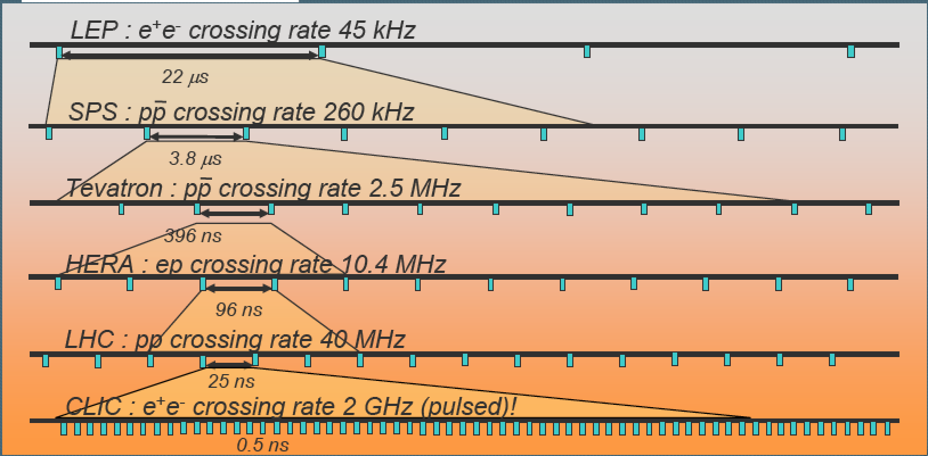
Timing & synchronization issues
μsec
Picosec
From microseconds → to picoseconds
How to synchronize 10⁶-10⁸ channels ?

Slide 36
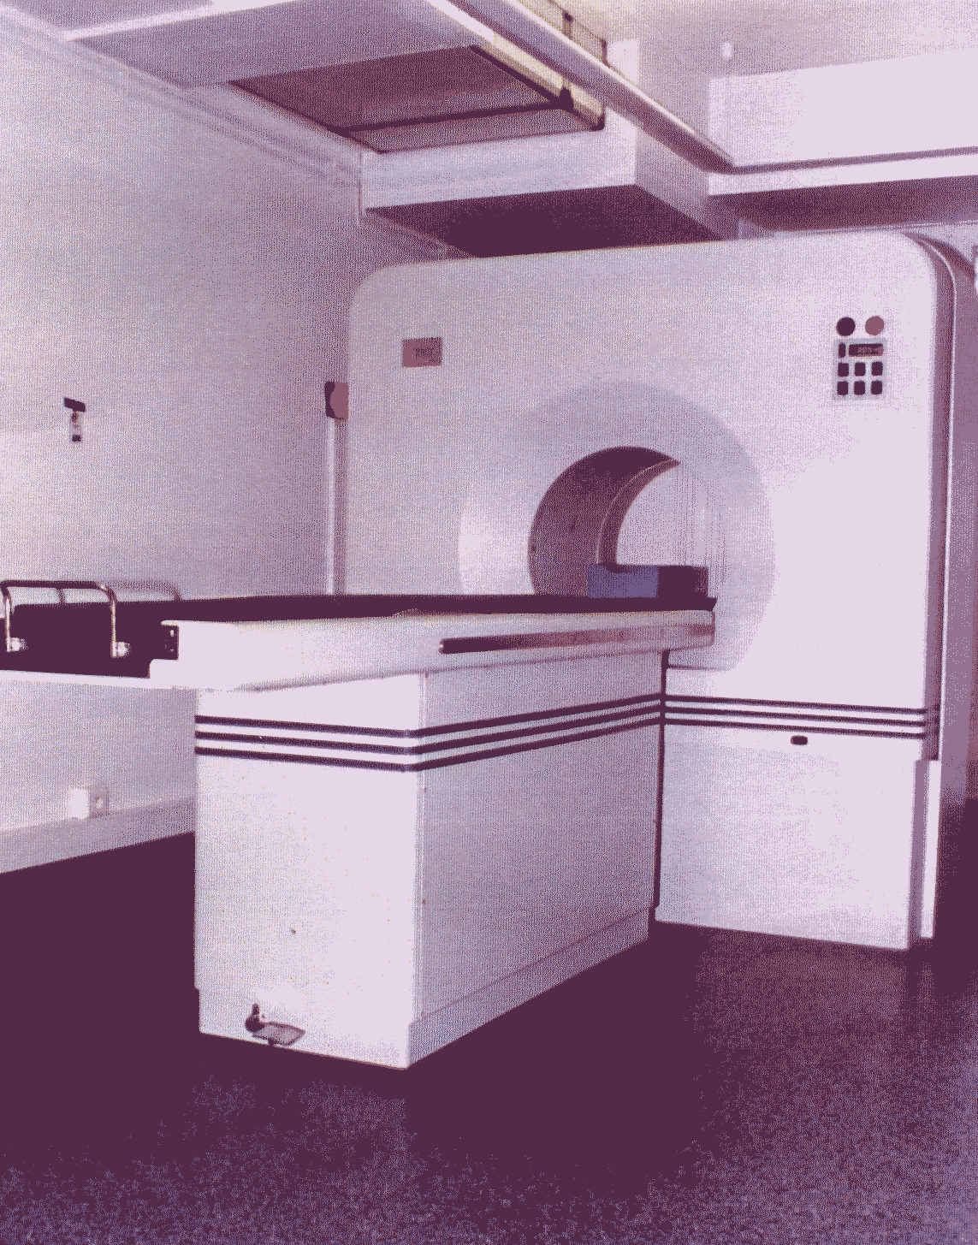
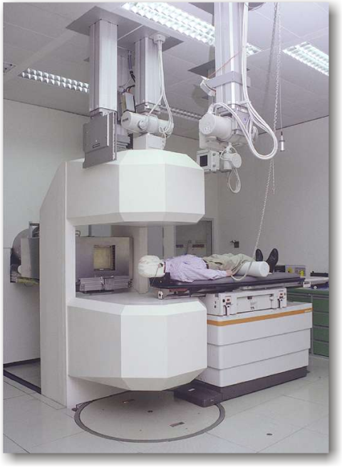
My medical time
1997- …as technology transfert advisor
In-beam PET scanner at GSI
¹²C-therapy unit
CPET Hopital Tenon

Slide 37
Some history
.. how the development of radiation instrumentation has been crucial for fundamental scientific discoveries
and for the improvement of human life...

Slide 38
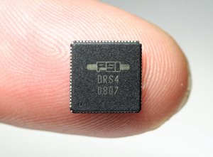
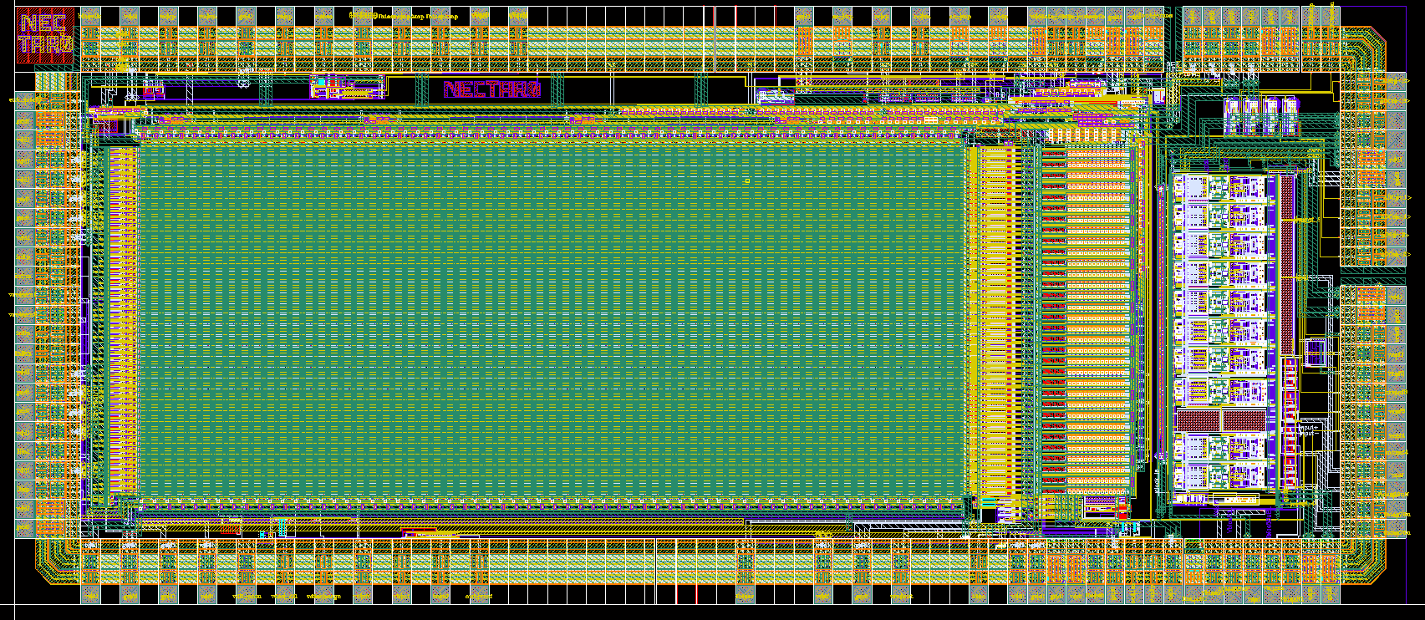
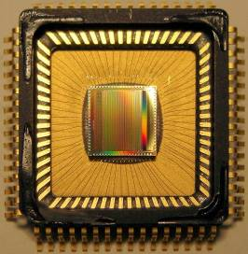
A survey of common area between HEP and medical
Front end electronics & signal treatment
    Fast shaping, integrated, low noise, low power, self trigger
    Digital filtering and signal analysis
      --> Waveform Digitizer :SCA
Read Out, Trigger & DAQ
    Pipeline and parallel read-out → FPGA
    Feature extraction techniques →like Time Of Flight (TOF)
    Real Time selection → GPU’s image processing
    High bandwidth networks → new telecom standard (xTCA)
Computing & software : handling high quantity of data
    Reconstruction, simulation & modelling --> GATE
Global design
    Compact integration of large number of channels
NECTAR
Giga sampling chip
LAL-Saclay)
DRS4 (PSI)

Slide 39
Survey of common area with HEP (2)
Energy
    From Kev to Tev with very good resolution
Scintillator & crystal
Photodetector
  compact, high QE, high gain and stability
  Standard : PMT ---> SiPM/MPPC,DSiPM
Fast Electronics devices
  We are speaking today to achieve the PICOSECOND
# Channels
  Billions due to ‘pixellated & high granularity’ detectors

Slide 40
My medical Time ( 1997 - ….)
Hopital Tenon collaboration (Prof. J.N. Talbot) to improve PET electronics (1997)
Implementing TOF for PET ‘U. Chicago electronics brainsturming’ & dedicated workshops series.
Fast timing (Psec) workshops organizer
GSI –Rosendorf collaboration for Real Time PET with SiPM.
ETOILE ion therapy project (Lyon)
ORSAY CPO protontherapy ‘new machine’ advisor

Slide 41
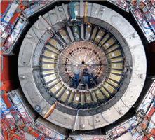




HEP & PET
Similarities and differences
PET
Camera
Calorimeter
HEP
Biomedical
Imaging
CMS
Similarities
Geometry and granularity
Detector (Crystals & scintillator)
Sensor (PMT,APD)
Digitizers: ADC,TDC,
Data volume (Gbytes)
Differences
Energy range
(10GeV → -511keV)
Event Rate 40 → 10 MHz
No synchronization
Self triggered elrctronics
Multiple vertices

Slide 42






Historical Evolution of PET
C-PET Philips
1977
First Steps
Townsend & Jeavons
1997
First mouse imaging with ¹⁸F
2007
Biograph PET + X ray-CT

Slide 43






From Today ---> Tomorrow Challenge
2017
no TOF
~600 ps TOF
TDM/PET-TOF (250 psec)
2022
Sucima PET-MRI EU project
~200-ps TOF PET Siemens Biograph Vision 600

Slide 44


From Today ---> Tomorrow Challenge
CRT = Laboratory 30ps
→ 10 to 1 psec 3 min scan
SNR, Direct imaging Multi-photon imaging, Positronium imaging
Scintillation, Cerenkov, Metascintillators, Photonics
AI vs TOF, Cost?
2022
2024
CEA Iseult 11.7T Whole-Body MRI
Explorer total body project

Slide 45





The Physician Dream (2005)
Courtesy of D.Townsend
Minute
PET/CT
Combined whole-body PET/CT or PET/MR…..
PET
Less dose
Less movment correction
Screaning capability
PET
MDCT
PET
CT
Image In Real Time !
PET/MRI
Magnet
PET
PET Insert with
Semiconductor photodetectors
PET
(S.R. Cherry, 2006)
Magnet
PET
MR

Slide 46
Particle Therapy

Slide 47



In beam Time-of-Flight PET for treatment planning and dosimetry monitoring
PET camera
  Carbon ion beam will induce ¹¹C after collision with cell DNA
  ¹¹C is a β⁺ emitter which can be used for online PET imaging
  ¹¹C activity profile correlated with dose profile: measure β⁺ profile to reconstruct “true” dose profile and check against planning
Carbon beam
Positron emitters are produced in situ by the carbon beam
Courtesy K.Parodi
47

Slide 48

What are the critical issues & challenges?
This is NOT a ‘simple target’ but a human body
  Treatment and quality assurance techniques of conventional radiotherapy not adequat for particle therapy
    A complex procedure for the ‘treatment planning’
How to be sure that the dose is delivered at the right place (tumour) ?
  Particle beam are error sensitive
    Displaced organ & overdose
    Moving organ in some case
What is the dose deposited ?
How to verify the treatment?

Slide 49
The two ‘simultaneous’ challenges
Reducing error means → Real Time imaging
  3D in vivo dosimetry and tomography
    Use fragments of beam projectile reactions in the biological matter emerging from the tumor target volume
Verification using Computed Tomography/Radiography:
  CT imaging in charged Particle therapy is needed for:
    Target volume definition (anatomical boundaries with additional information from multimodality imaging (CT/MRI/PET studies)
    Dose and range calculation
    Patient alignment verification
But today these process are made at different moment and place

Slide 50



Particle therapy workflow
Step 1 → Treatment planning after CT scan
  Dose to be distributed
  MC simulation
  Give information to the machine
Step 2 → Treatment
  10-20 fractions (tumour irradiation)
Step 3 → verification using CT scan
Overdosage in normal tissue

Slide 51


In-beam nuclear method principle for ‘in vivo’ dosimetry
Target
Nucleons
& projectile/target fragments
Projectile
10⁻²¹ 10⁻¹⁸ 10⁻¹⁵ 10⁻¹² 10⁻⁹ 10⁻⁶ 10⁻³ 10⁰ 10³
Time (s)
after collision
Particles
β⁺ - emitter decay
Prompt γ-rays
Balance of promptly emitted
particles outside the target:
Incident protons: 1.0 (~10¹⁰)
γ-rays: 0.3 (3·10⁹)
Neutrons: 0.09 (9·10⁸)
Protons: 0.001 (1·10⁷)
a-particles: 2 · 10⁻⁵ (2·10⁵)
However the photon energy different from standard medical (Anger) SPECT camera
Relation between dose and β+ activities

Slide 52


Radiograph of a phantom
Uwe Schneider PhD thesis (1978,PSI)
Another dream
The Proton CT
A tribute to G.Charpak

Slide 53
Schematic block diagram of an integrated concept of radiography / therapy system
In beam SPECT-PET
Sampling calorimeter
Beam hodoscope
Photon detector
CT
Tumour
Plastic
scintillator
Tracking
detector
Tracking
detector
Photon detector
CT
Treatment
CT
Identify tracks and energy deposition of individual protons
Scintillators for trigger to read-out detectors
Tracking detectors for 3D tracks
Sampling Calorimeter for energy determination
High rate integrated DAQ

Slide 54
Simulation & Sofware

Slide 55



GATE : Geant4 Application for
Tomographic Emission (2005)
Monte-Carlo simulation allowing to :
define geometries
(size, materials,…)
define sources
(geometry, nature, activity)
choice of physical process
(low energy package of G4)
follow track point by point
GATE specificities:
CERN GEANT4 libraries
Time modellign
(sources , movement,random…)
Script language(avoid C++)
Code interactivity
Sharing development

Slide 56

GATE ‘early ’Collaboration 2004)
Uni Louis Pasteur (IRES) Strasbourg
Uni Joseph Fourier (LPSC) Grenoble
Forschungszentrum-Jülich (IME)
Uni. Massachusetts, Worcester
CHU Morvan (LATIM) Brest
Uni California (CRUMP) Los Angeles
Uni Toronto (CAMH)
CEA (DAPNIA) Saclay
MSKCC New York
Uni Athens (IASA)
Uni Lausanne (IPHE)
Uni Clermont-Ferrand (LPC)
Uni Ghent (ELIS)
CHU Pitié-Salpêtrière (U494 INSERM) Paris
Vrije Uni Brussel (IIHE)
CERMEP, Lyon
CEA (SHFJ) Orsay
CHU Nantes (U463 INSERM)
Sungkyunkwan Uni. Seoul
Uni Claude Bernard (IPNL) Lyon
Irène Buvat CEA SHFJF – Orsay-F)
Technical Coordinator: S. Jan (CEA - Orsay, F)

Slide 57
Summary lessons & Conclusions
It take sometime between the discovery and initial ideas.
But when the technology is mature, it can make a gigantic breakthrough in the development of a technical device or system
Collaboration between various scientists and experts is fundamental and the key factor for success.
Building a community (network) about a specific subjects is the way to integrate students and experts

Slide 58

Final Conclusion

Slide 59
Thank you for your attention
Questions?
Or send me an email
patrickledu@me.com

Slide 60
Thanks to ALL my colleagues
CEA DPHPE –DAPNIA-IRFU & SHFJ Orsay
CNRS IN2P3
Hopital Tenon & Institut Curie (Paris)
CERN & PSI.
DESY, Dresden Rosendorf & GSI.
FNAL & Chicago University.
Canada/Quebec Montreal Univ. & Sherbrook
Lawrence Berkeley National Laboratory
Japan KEK & Osaka University
UK Rutherford Lab. & Manchester University
… and many others ….
See you in Elba in 2026

Slide 61


Without
them
I was not able
to get this award
Special THANKS
Since 1993
Vancouver RTC

Slide 62





1997 Beaune France
The Hotel Dieu
Chateau de Meursault diner
Wine tasting

