Slide 1
Mastering Picosecond Precision:
Lessons learned from Large-Scale Timing Systems
Stefan Ritt :: Head of Muon Physics Group :: Paul Scherrer Institute
IEEE NPSS Real Time Conference, Qui Nhon, Vietnam, April 25, 2024

Slide 2

Measuring precision timing
Detector
Detector
Electronics

Slide 3
Measuring precision timing
Two particle decay
Different Time

Slide 4
Measuring precision timing
Time-of-Flight
x [mm]
1 mm ≅ 7 ps
Electronics

Slide 5
Large systems
N Detectors
N² Clocks
N Detectors
N=1000 → 1,000,000 Clocks

Slide 6

Large systems with reference clock
2N Clocks
N Detectors
N Detectors
Reference Clock

Slide 7

Time inaccuracy
“Jitter”
Repeater
“Skew”
Timing inaccuracy occurs both on the detector side
and the clock distribution side: Skew & Jitter
Reference Clock

Slide 8
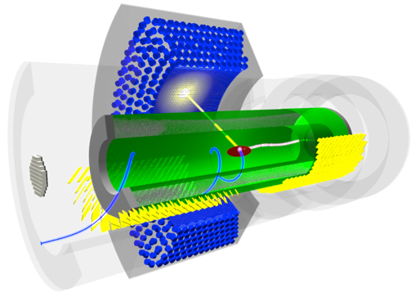
MEG II Experiment at PSI
detection in liquid
Xenon Calorimeter: 4760 channels
Normal μ decay
(Standard Model):
μ⁺ → e⁺ ν_{e} ν_{μ}
Lepton-Flavor Violating Decay
(New Physics):
μ⁺ → e⁺ γ
10⁸ μ⁺ / s
e⁺ detection in
Timing Counter: 1024 channels
MEG II Experiment requires
~10 ps at electronics level

Slide 9
How to achieve timing at the Pico second level?
Sources of timing jitter: Single ended lines, PLL jitter
Clock stability
Noise reduction strategies
Timing calibration
Lessons learned from the MEG II system

Slide 10
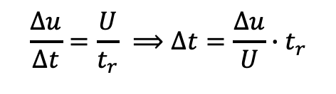
Jitter caused by voltage noise
voltage noise Δu
signal height U
timing uncertainty Δt
receiver threshold
$$\frac{Δu}{Δt}=\frac{U}{t_{r}} ⟹Δt=\frac{Δu}{U}∙t_{r}$$
Typical values
Δu = 10 mV
U = 3.3 V
t_{r} = 1 ns
Δt = 3 ps
rise time t_{r}

Slide 11
Differential Signals e.g. LVDS
+
-
+
-
+
-
+
-
FPGA
+
-
+
-
Do not send low-jitter clocks through FPGAs!

Slide 12
Optical Signals
Optical fiber
+
-
+
-
+
-
Careful with optical clock distribution!

Slide 13
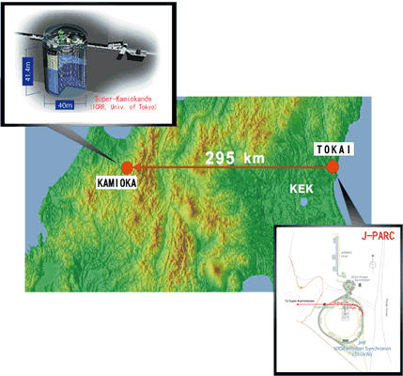

Clock stability
T2K, Japan
GPS clock for measurements far apart
Atomic clock for long term measurements
Particle physics:
Measurement periods O(100 ns)
→ Frequency stability of 10⁻⁵ is enough
100 ns * 10⁻⁵ = 1 ps
→ Excellent low-jitter clock distribution to all detector channels needed
MEG II, PSI

Slide 14
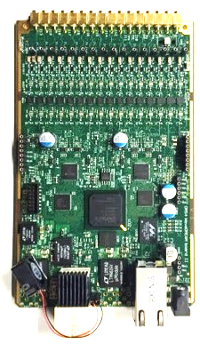
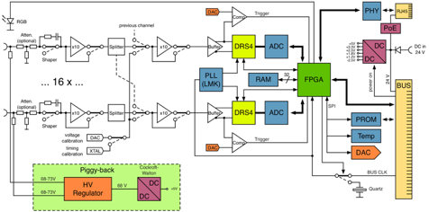
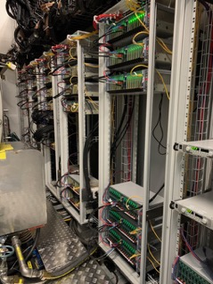
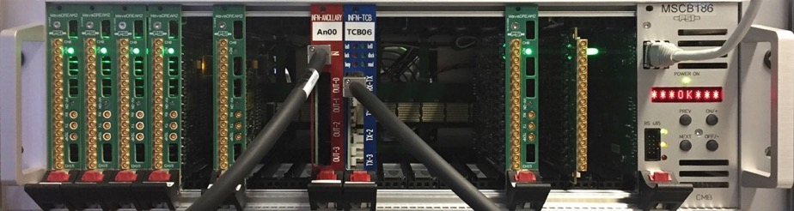
WaveDAQ system for MEG II @ PSI
DRS4 chip
WaveDREAM Board
WaveDAQ Crate
9000+ channels 5 GSPS / 12 bit

Slide 15
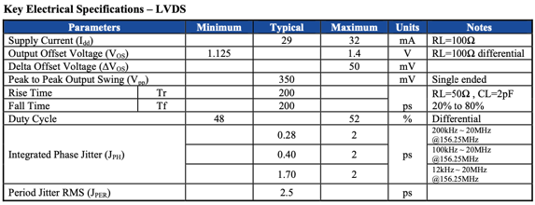
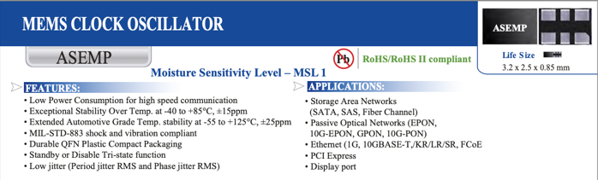
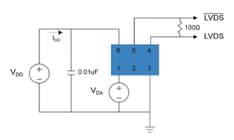
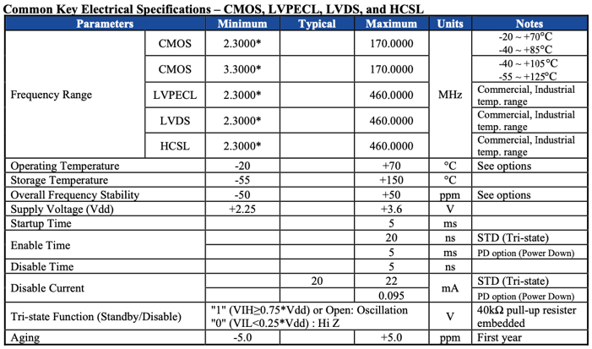
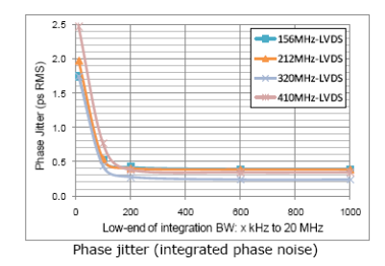
Low-jitter quartz

Slide 16
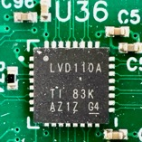
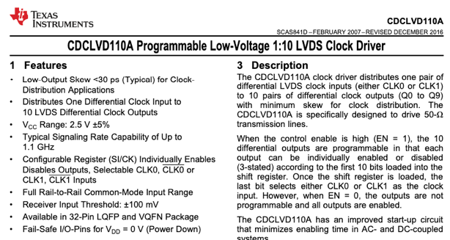
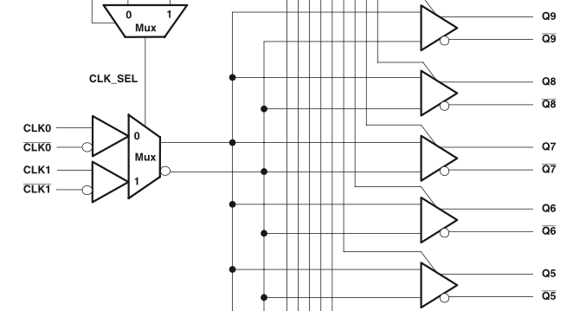
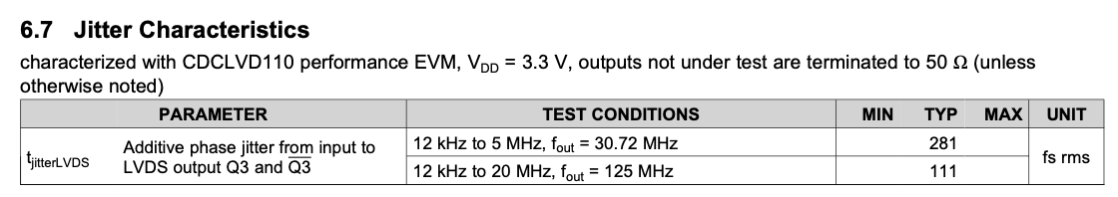
LVDS clock distribution
fully
differential

Slide 17
DRS4 Phase Locked Loop
Inverter Chain 1024x
sampling speed control
PLL
T
Q
Φ₁
Phase
Comparator
up
loop
filter
R
down
τ = RC
External
Reference
Clock
C
Φ₂

Slide 18

PLL Jitter
Perfect
Clock
PLL
Clock
Period
Jitter
Phase
Jitter

Slide 19
PLL Jitter
Low period jitter
Slow PLL
High phase jitter
High period jitter
Fast PLL
Low phase jitter

Slide 20
Jitter between two PLLs
Detector 1
PLL1
Timing jitter from PLL jitter
Detector 2
PLL2
To achieve minimal timing jitter, PLL phase jitter must be minimized

Slide 21
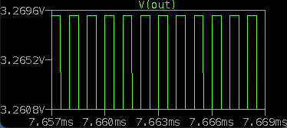
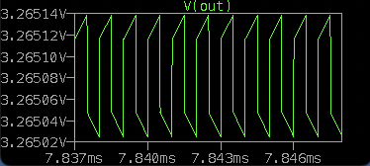
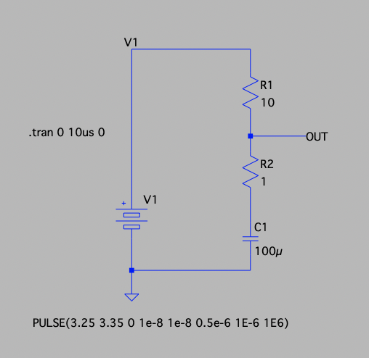
PLL jitter from power supply noise
Power Noise
VDD
ESR = 1 Ohm
8 mV
Jitter
ESR = 0.01 Ohm
0.1 mV
DRS4 chip: 1 mV noise → 10 ps jitter
Switching Regulator
SPICE simulation
R
3.3 V
Use low-ESR capacitors for power supply filtering
24 V
I_{noise}
ESR
C
ESR: Equivalent Series Resistance

Slide 22
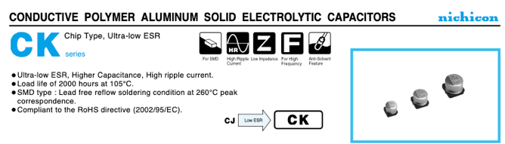
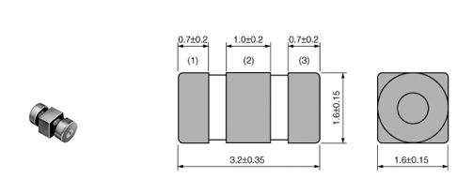
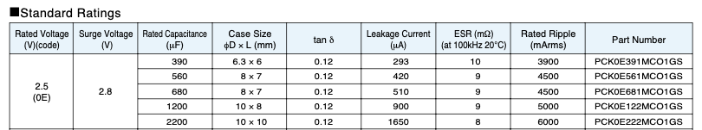
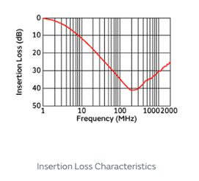
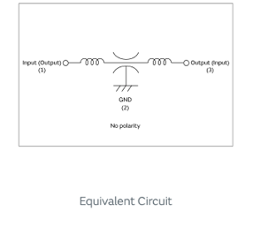
Used filter components
LC combines EMI Suppressor Filter
NFE31PT222Z1E9
R = 100 mΩ
560 μF / 9 mΩ

Slide 23
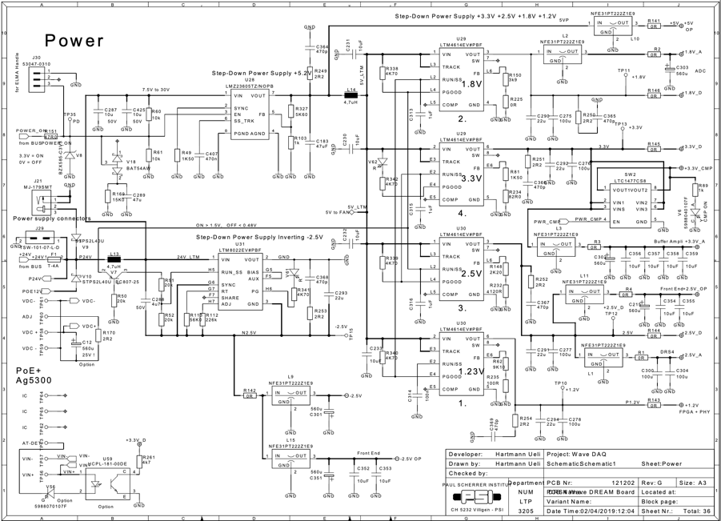
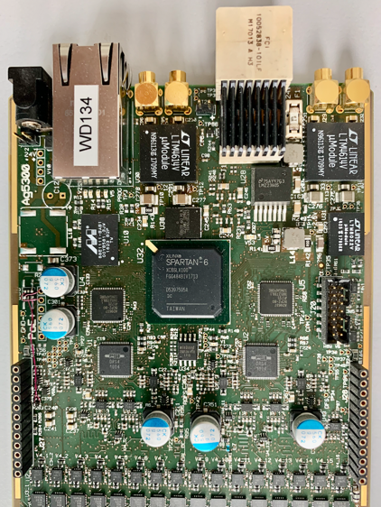
Power section WaveDREAM board

Slide 24
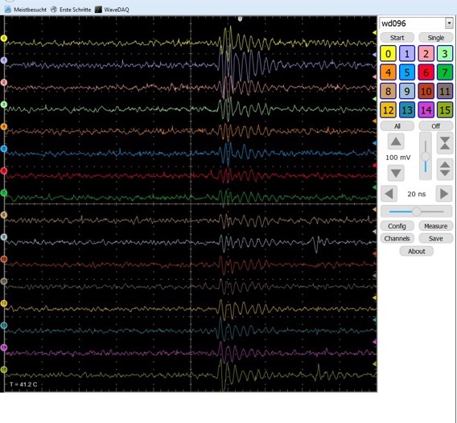
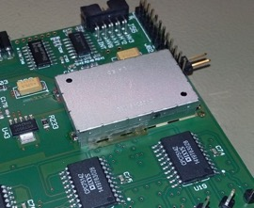
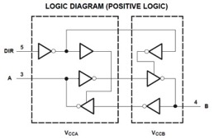
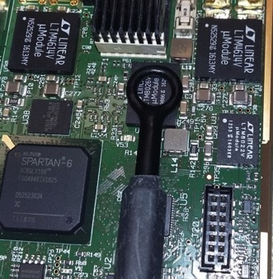
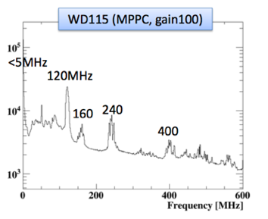
Electromagnetic Interference (EMI)
Shielding
Slew rate limiter
EMI pulse from switching converter

Slide 25
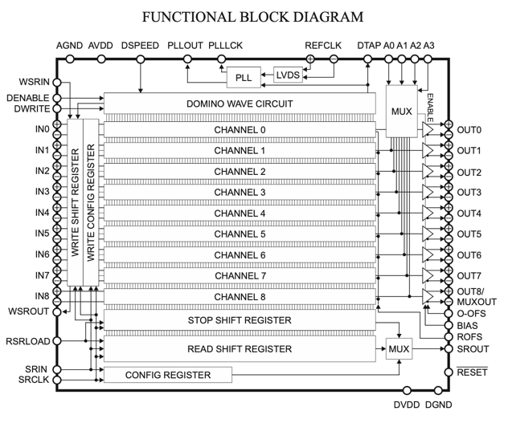
Use of DRS4 clock channel
1024 cells, 200 ns @ 5 GSPS
DRS4
Deviation
~ 50 ps
100 MHz, 10 ns
Sampling the clock channel reduces uncertainty from ~25 ps to <2 ps

Slide 26
The WaveDAQ system

Slide 27
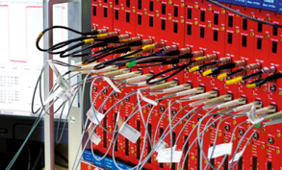
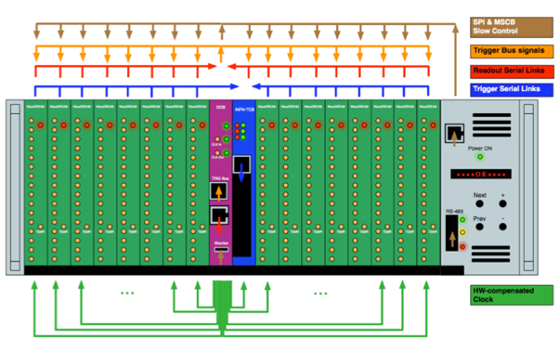
Custom Design “WaveDAQ”
Standard 19” crate + custom backplane (no VME, no xTCA)
Idea: Not only a solution for MEG II,
but more general “crate standard”
Features:
  Serial bus (SPI) for configuration
  Trigger / Busy signals in backplane
  “Dual Star“ Serial gigabit links
  Hot-swap functionality
  Low jitter (<5 ps) clock
  Shelf management with Ethernet and power
Data Concentrator Board (DCB)
Trigger Concentrator Board (TCB)

Slide 28
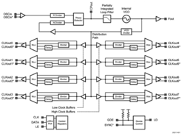
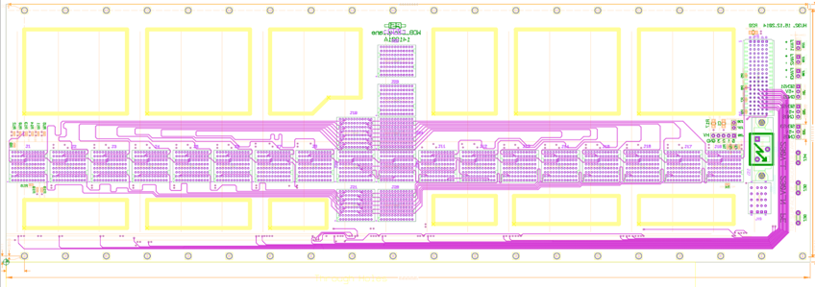
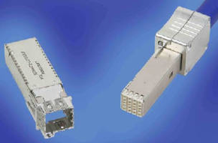
WaveDAQ Backplane
DCB
WD
WD
WD
WD
master clock
Crate
LMK03000 Jitter Cleaner
FCI Densishield Cable

Slide 29
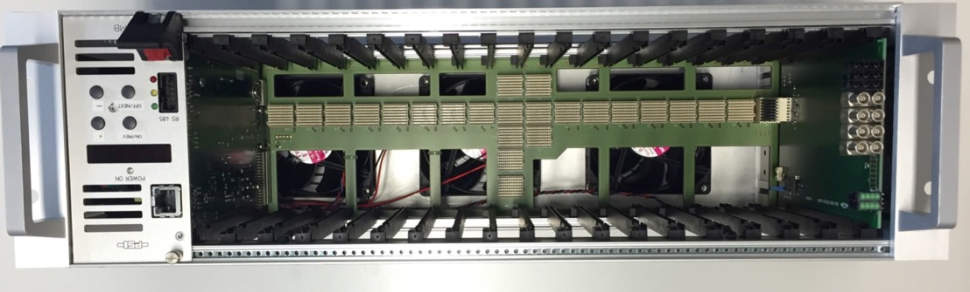

Half Height Backplane

Slide 30
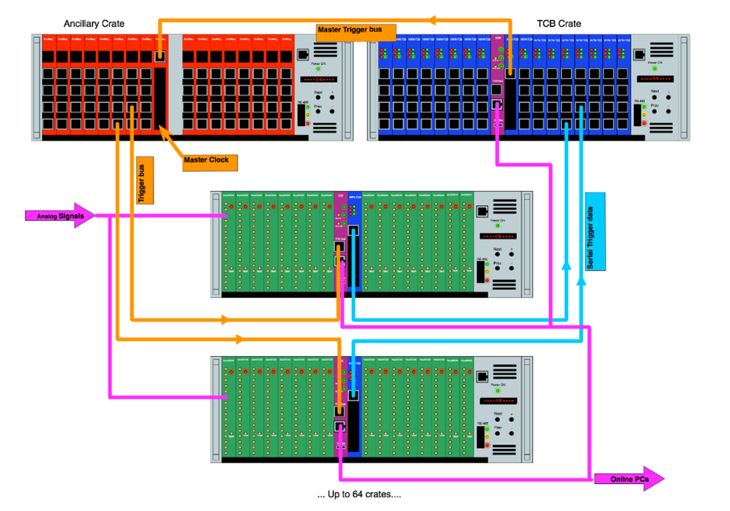
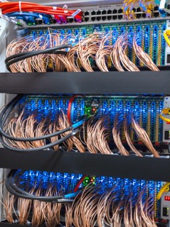
MEG II System
Clock and Trigger
distribution
Scaling up to 16000 channels
Synchronous System (single clock)

Slide 31
Synchronization
80 MHz
Master
Clock
Clock
PLL
Fanout
PLL
PLL
Trigger
Sync
Trigger
Busy
Trigger
Bus
80 MHz
PLL1
DRS4
DRS4
PLL2
Lesson learned: Make all PLL frequencies
integer multiples of each other

Slide 32

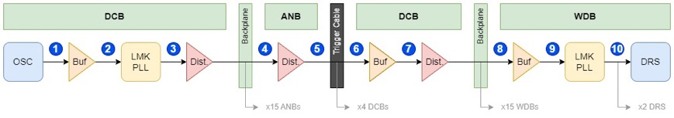
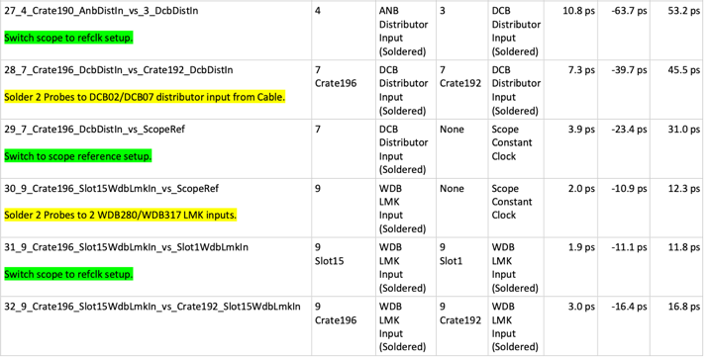
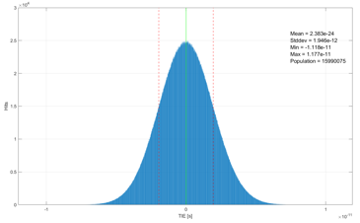
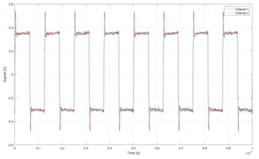
Jitter measurements courtesy E. Schmidt, PSI
Tektronix MSO64B
8 GHz, 50 GSPS
soldered diff. probes!
σ_{jitter} = 1.9 ps
Slot - Slot
Crate - Crate

Slide 33
Global calibration
Clock distribution is never perfect to the ps level
Global sync injection at ADC does not calibrate different cable lengths
Signal injection at detector can be difficult
Det.
ADC
Det.
ADC
Clock
Det.
ADC
Det.
ADC

Slide 34
Global calibration
Solution: Use a physics event which is seen by all detectors:
  LED flash in calorimeter
  Cosmic traversing many channels
  Correct for different light path
Det.
ADC
Det.
ADC
Det.
ADC
Det.
ADC

Slide 35
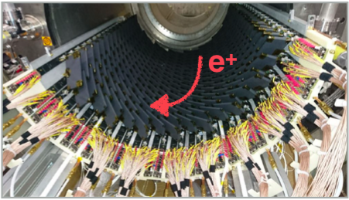
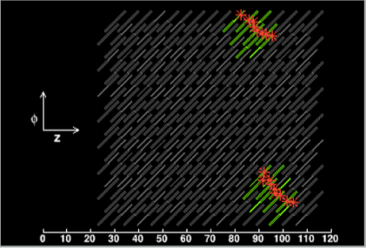
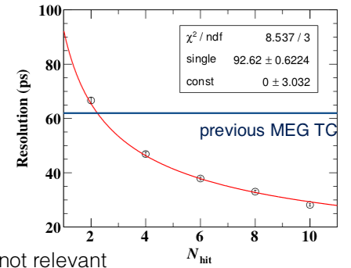
MEG II Timing Counter
8 x 10⁸ μ/s
256 scintillating tiles 4x6 cm,
512 WDB channels (2 crates)
Resolution scales with sqrt(N)
35 ps reached with 8 hits

Slide 36



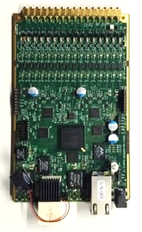
Lessons learned (so far...)
Designing a crate standard is easier than anticipated
(if no committee is involved 😉)
Distributing a 5 ps jitter clock is not so hard
Doing everything from scratch can simplify things
  shelf manager with 8-bit uC with few 100 lines of code
  crate costs ~ 2k$ including power supply
Mixed signal board with 40 μV of noise (gain=100 !) is tough
  whole project took 6 years from first idea with ~2 FTE
  analog front-end took 1.5 years, FW ~2 years
  careful selecting and shielding
  DC-DC converter, needed 4 revisions
  the more noise you fix, the more new sources you find
  Lots of experience obtained often missing in textbooks
DALL-E

Slide 37

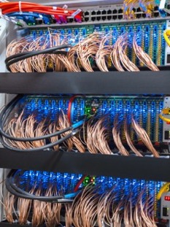
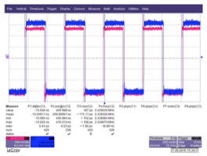
Conclusions for precision timing in large systems
Use end-to-end differential clock distribution
Careful filter power for all PLLs with
low-ESR capacitors
Identify and remove EMI sources
Large systems with
<5 ps timing can be built
This talk:
IEEE NPSS Educational Video at
https://ieee-npss.org/videos/
5.4 ps

