Slide 1
Challenges faced in the design and characterization of a sub femtoampere sensitive ASIC based ultra-low current measurement system for radiation monitoring
Sarath Kundumattathil Mohanan*, Hamza Boukabache, and Daniel Perrin
2024 IEEE NPSS Real Time Conference

Slide 2
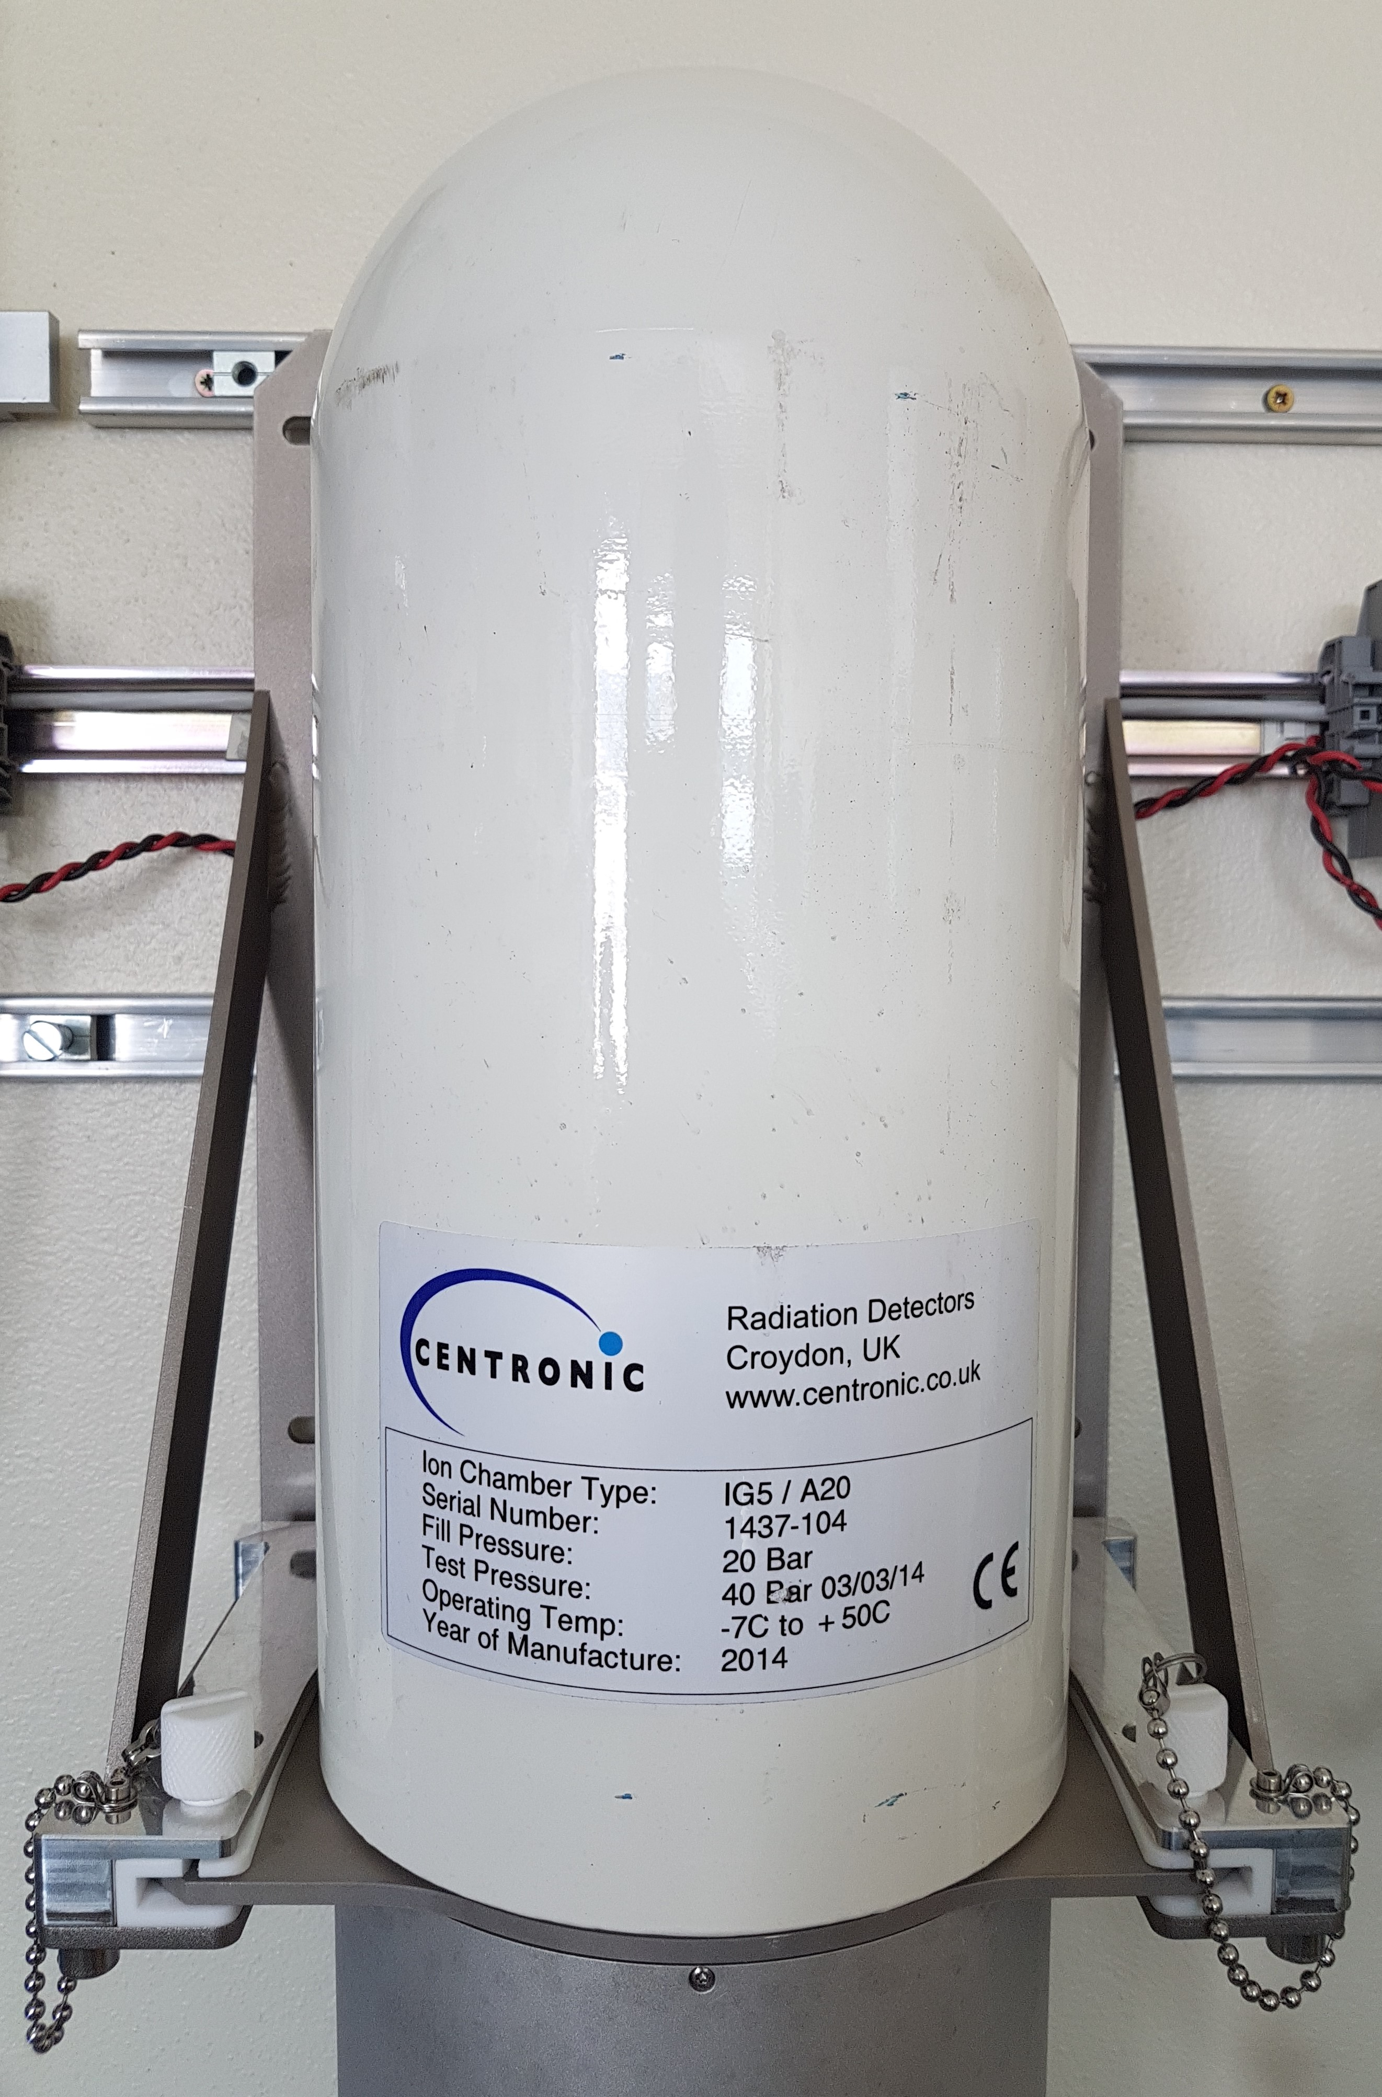
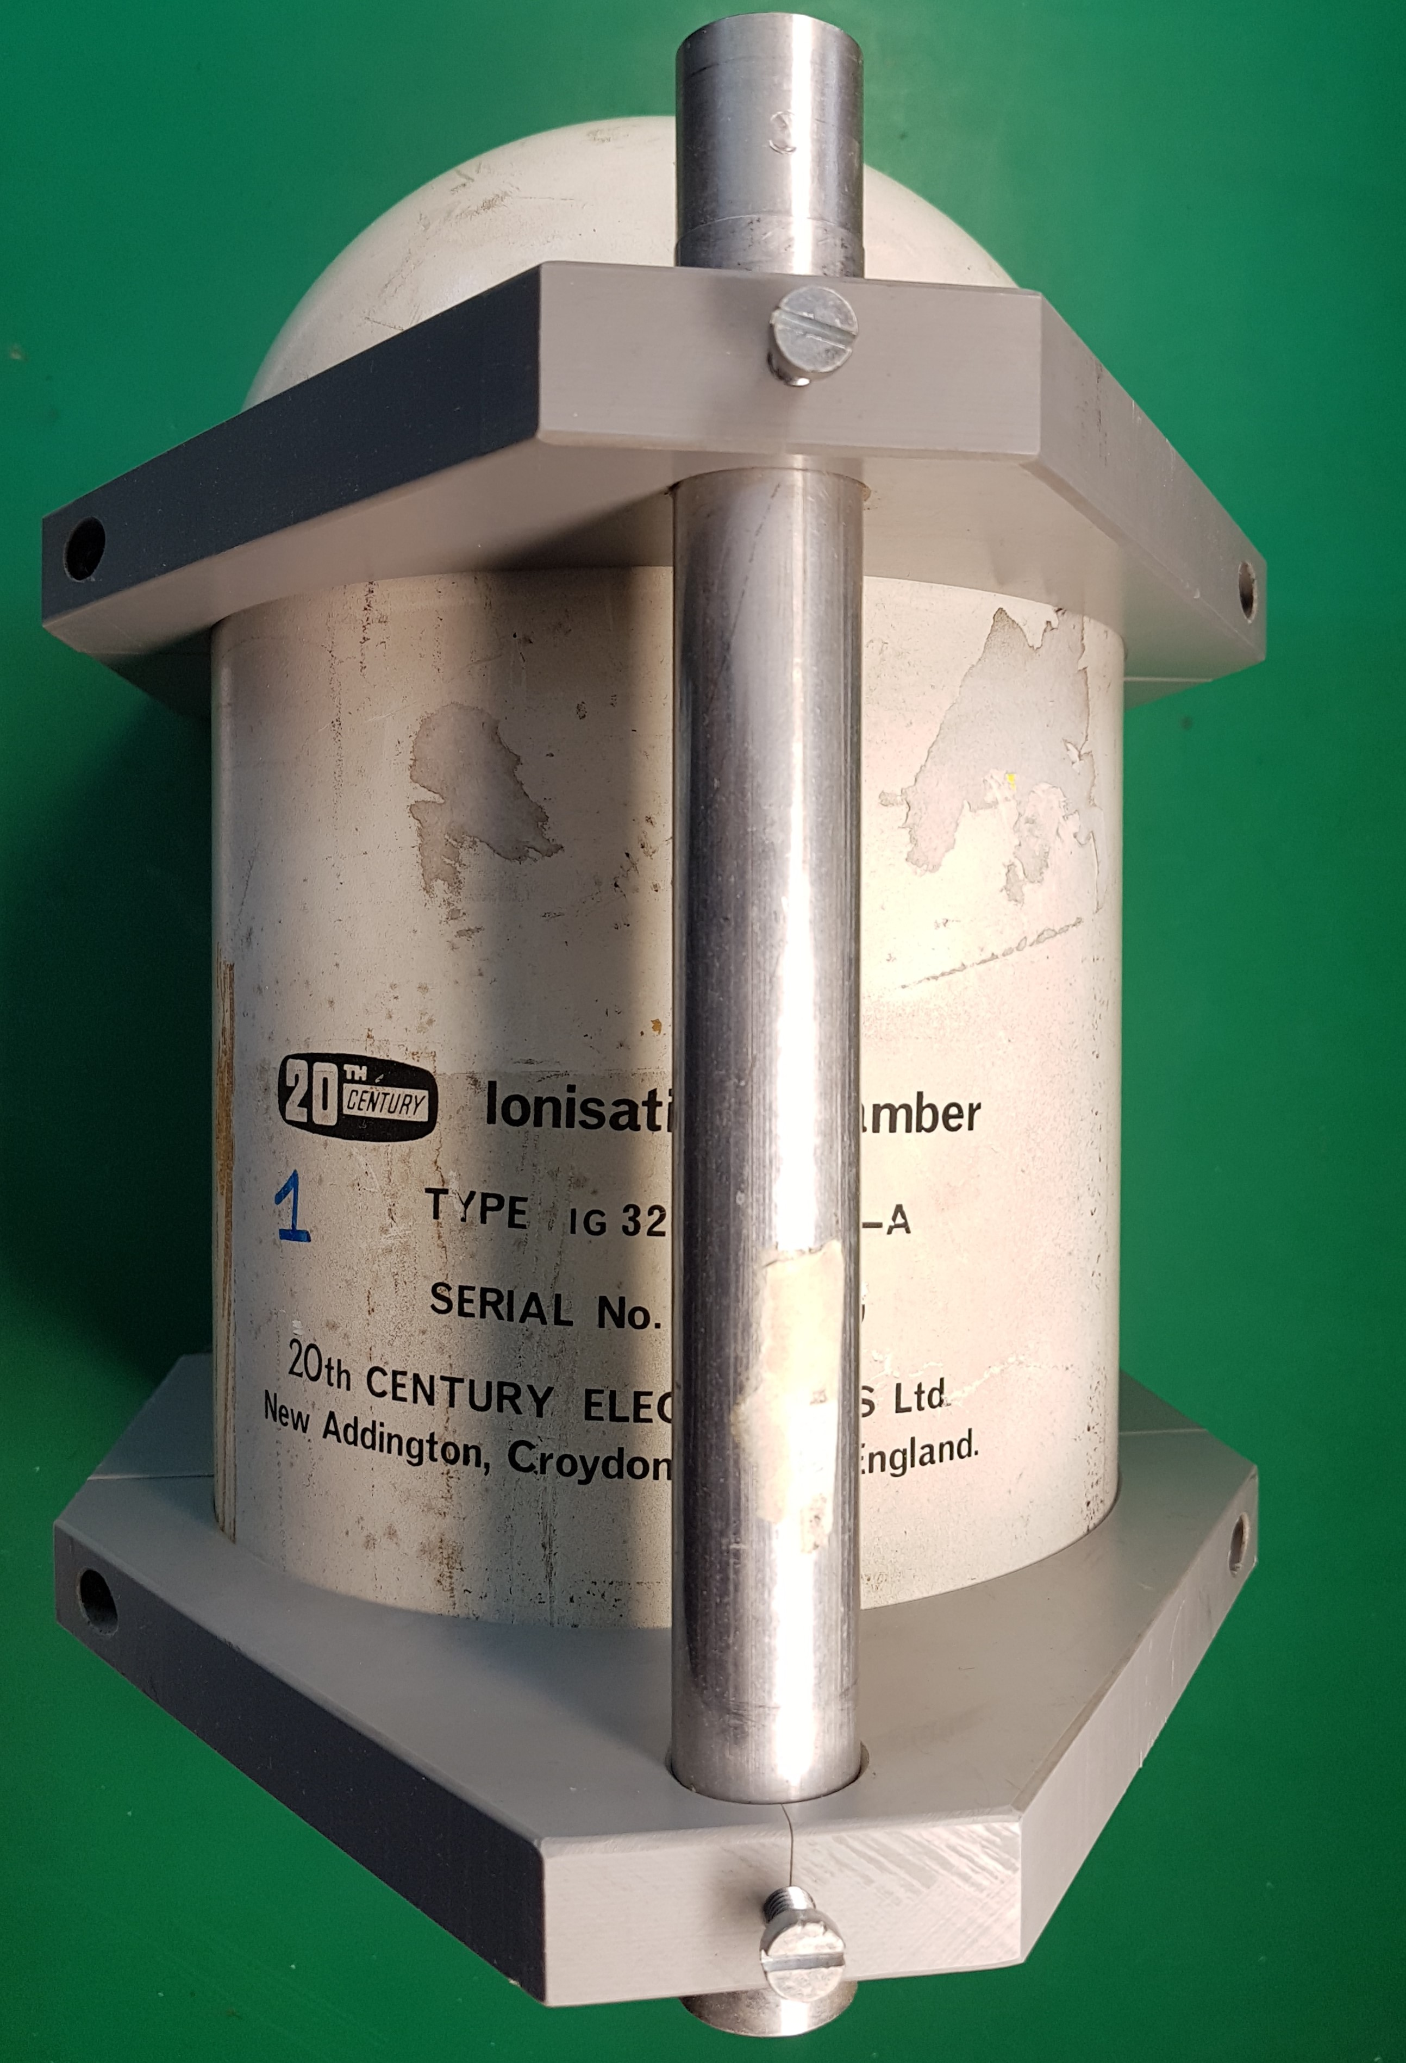
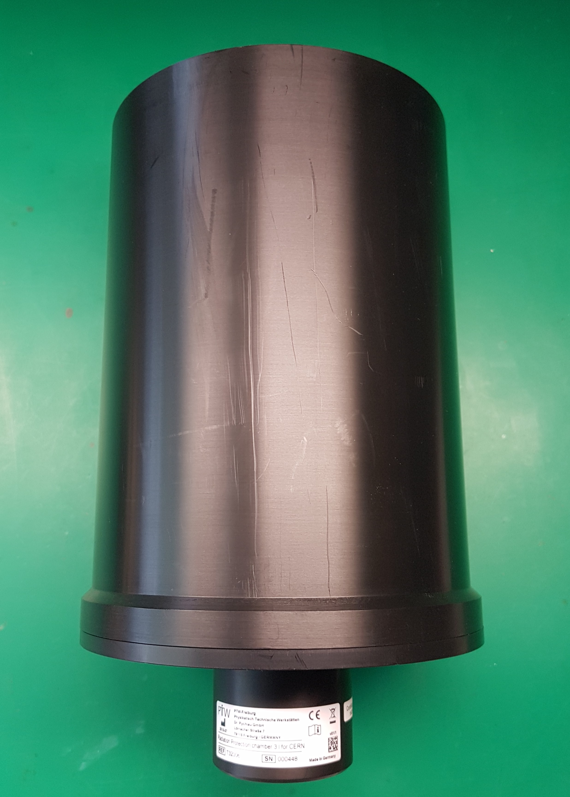
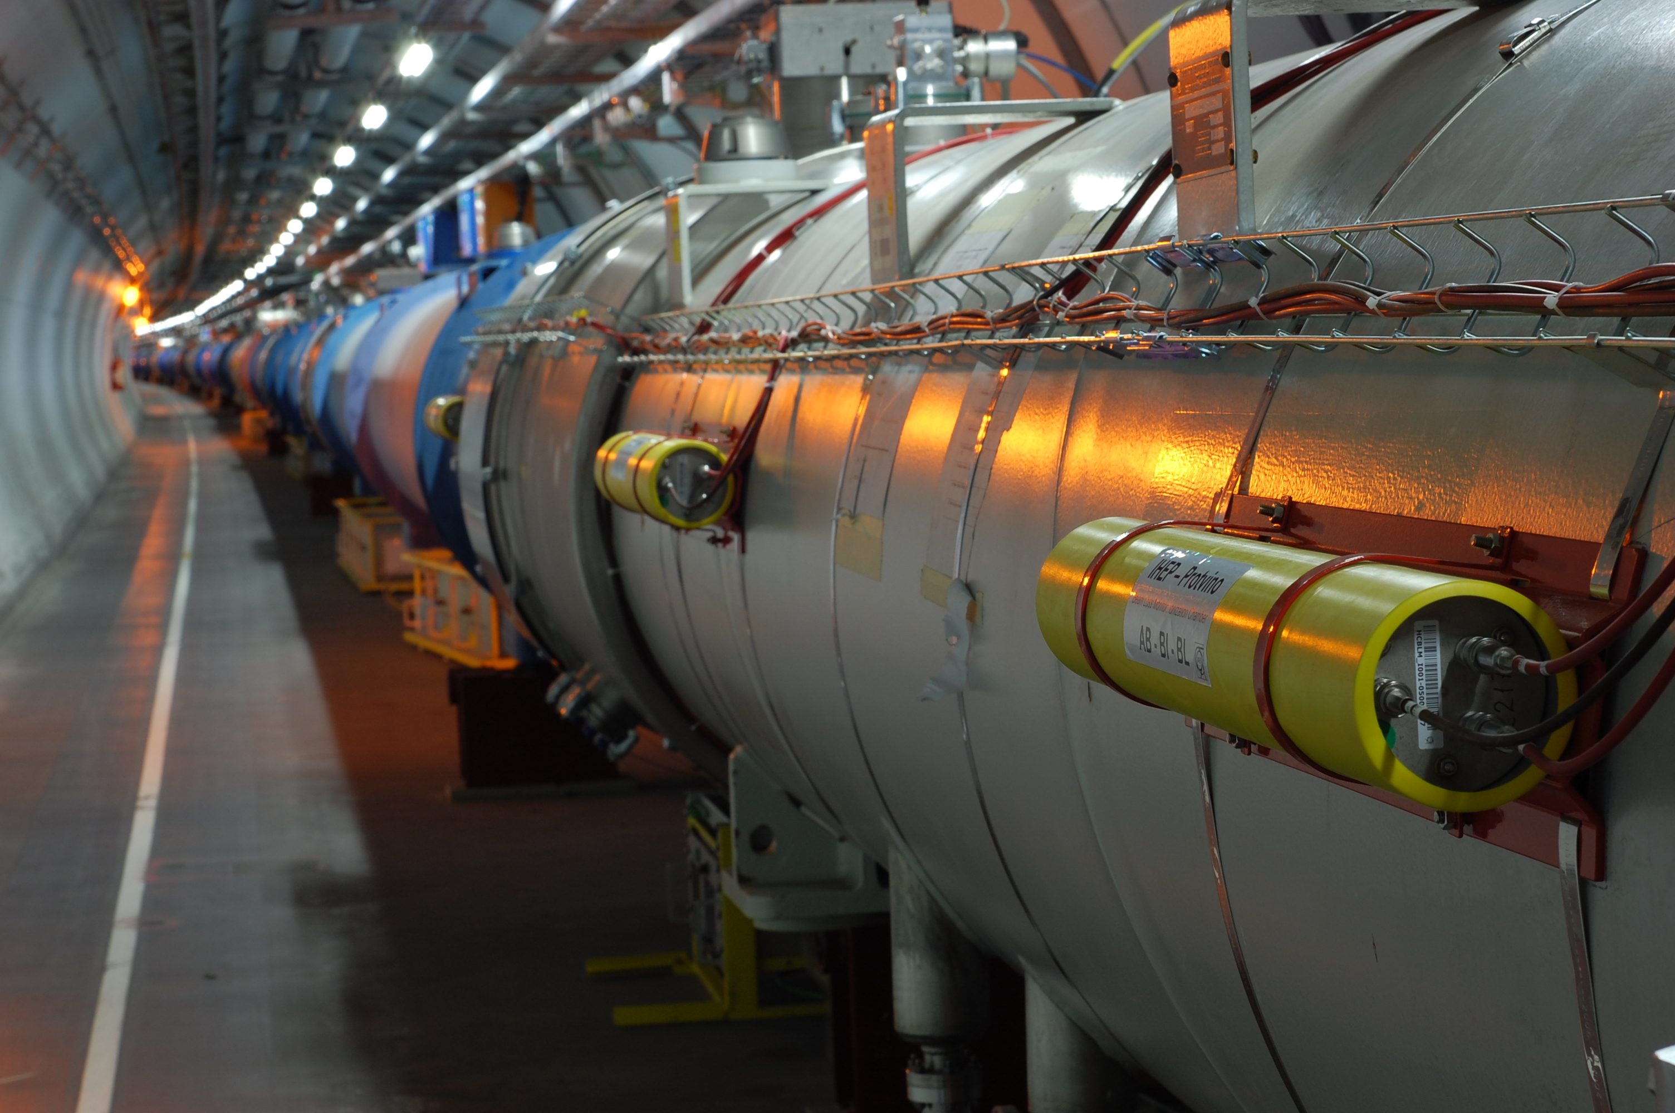
Radiation Monitoring System
Challenges
Complex radiation environment
  Different chambers
Output current dynamic range
  > 9 decade
Current resolution
  Femtoampere
IG5
IG32
PTW T32006
BLM Chamber
Complex input profile
  Pulsed or slow changing
Measurement Time
For currents >10 pA a measurement value is available every 100 ms; for lower currents it takes hundreds of seconds
Sarath Mohanan

Slide 3
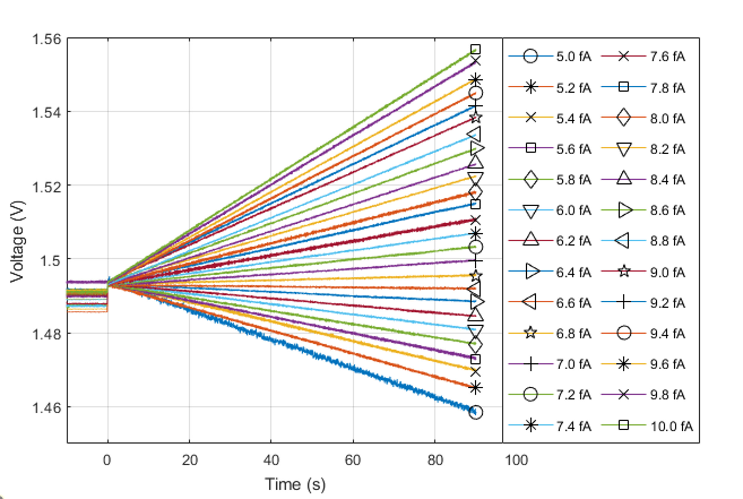
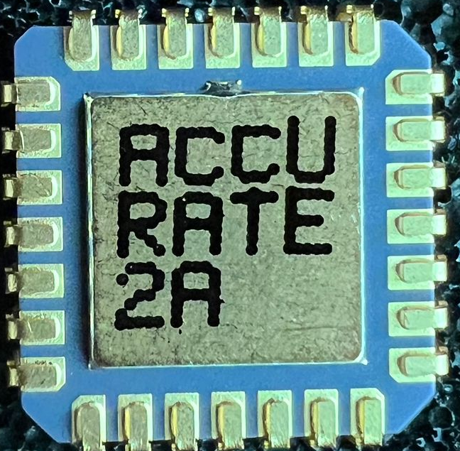
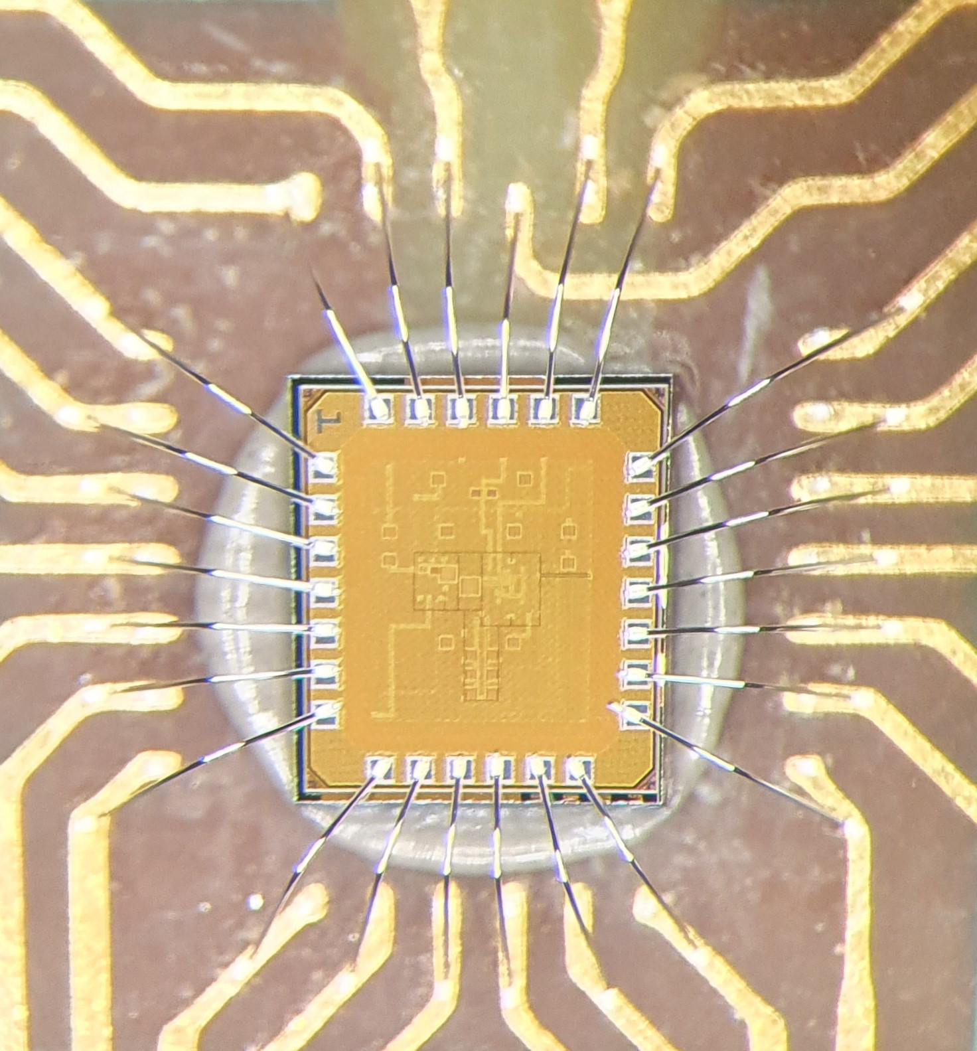
ACCURATE 2 ASIC
Integrator output of ACCURATE 2A for input current swept with 200 aA resolution under controlled environment
Design Critical Points
Simulator gm to be set for simulating femtoampere current
Using thick gate transistors in critical paths
Guarding the critical input as much as possible using a stable voltage
Characterising the current source – even best device in market has an accuracy of 1% + 7 fA in the lowest range
Sarath Mohanan

Slide 4
Thank you!

