Slide 1

Faraday Cup Development for Beam Monitoring in nA Scale and Its Application in the Cross section Measurement of p+¹²C Scatterings with E_{p}=1-3.2 MeV
N.T. Anh¹, L.X. Chung², L.T. Anh², T.T. Anh³, M. La Cognata⁴, M.V. Dien², B.T. Hoa³, P.D. Khue,
D.T.K. Linh², N.T. Nghia³, G.G. Rapisarda⁵, M. Sferrazza⁶, and D.T. Tran⁷
¹Hanoi Irradiation Center, Minh Khai, Bac Tu Liem, Hanoi, Vietnam;
²Institute for Nuclear Science and Technology, VINATOM, 179 Hoang Quoc Viet, Hanoi, Vietnam;
³Faculty of Physics, VNU-University of Science, 334 Nguyen Trai, Ha Noi 100000, Vietnam;
⁴Istituto Nazionale di Fisica Nucleare, Laboratori Nazionali del Sud, Catania, Italy;
⁵University of Catania, Catania, Italy;
⁶Université Libre de Bruxelles, Belgium;
⁷Institute of Physics, VAST, 18 Hoang Quoc Viet, Hanoi, Vietnam
24th IEEE Real Time Conference ICISE, 22-26 April 2024, Quy Nhon, Vietnam
Notes:
1

Slide 2
Introduction
A Faraday cup (FC) suitable for nA intensive beam has been developed to serve nuclear reaction study using the pelletron at the VNU-University of Science (HUS).
The FC operation was tested with a proton beam by varying the high voltage (-HV) applied in the repeller ring;
comparing with CST Studio Suite simulation.
The FC was used in an experiment to measure the cross sections of p+¹²C scattering with E_{p}=1-3.2 MeV at the laboratory angles of 50, 106, 120, 130, and 160º.
2
Notes:
2

Slide 3
FARADAY CUP DESIGN, SIMULATION MODELS
AND TESTING EXPERIMENT
The Faraday cup is designed in tradditional way. The testing experimental setup is presented in Figure 1.b. The experiments were carried out with proton energy of 0.8, 2.63 MeV, and varying HV from 0-500 (V).
The current loss measured by the the FC dependent on HV
Figure 1: FC design (a) and test setup (b)
CST simulation with the following assumptions:
Uniform source disk of 8 mm diameter at the botom of the FC
Electron polar angle took the average value of the cosin distribution.
Their energy obeys to the Maxwell distribuiton.
Good agreement between CST simulation and experimental results was obtained.
The plateau region is observered from about -50 V.
Figure3: The distribution of electrostatic field with -350 V applied in the repeller
3
Notes:
In some cases where potential has a bound state of particular angular momentum, the scattering of particles with that angular momentum will be especially enhanced. In such cases, the total scattering cross section will show a peak, and the angular distribution will be characteristic of the appropriate Pl(cos θ). This very strong scattering is known as resonance and is a powerful method for studying bound states
3

Slide 4
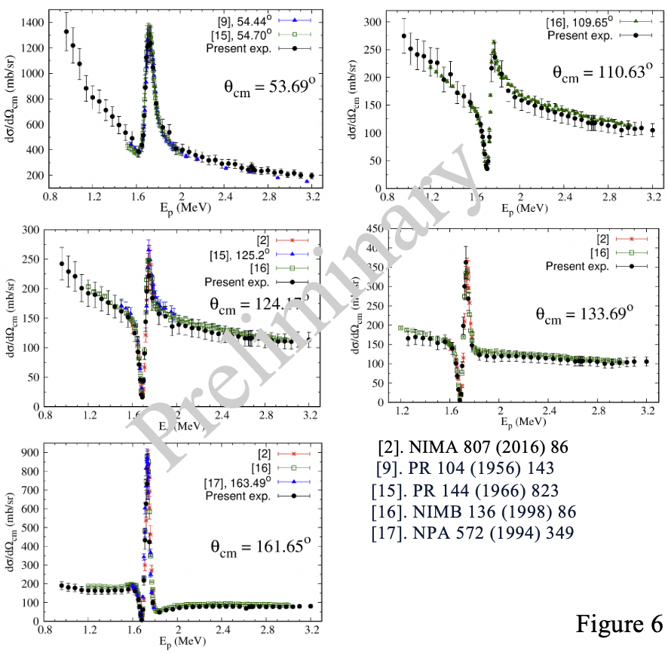
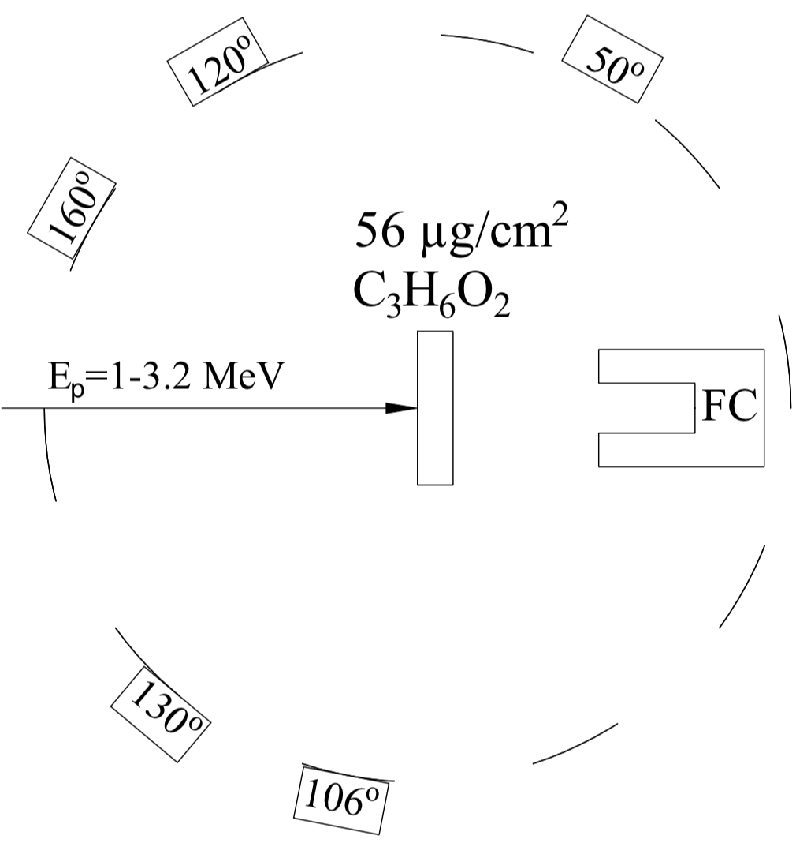
THE CROSS SECTION MEASUREMENT OF p+¹²C
SCATTERINGS WITH E_{p}=1-3.2 MeV
The experimental setup placed in a 10⁻⁶ torr vacuum chamber is shown in Figure 5.
Five silicon PIN didodes were located at different angles. Their bias voltage was +100 V.
The target was made of formva (C₃H₆O₂).
Proton energy was scanned from 1-3.2 MeV with 60 keV step.
The FC repeller ring was applied by -350 V.
Figure 5: Experimental setup
Figure 6: Excitation function of p+¹²C scattering
CONCLUSION
A FC for nA scale intensive beam has been successfully developed. From test results, the suppressing voltage should be greater than 100 V to avoid the secondary electrron loss.
Excitation functions of p+¹²C elastic scattering were measured from 1-3.2 MeV at five center-of-mass angles. The obtained results are in good agreement with published data.

Slide 5
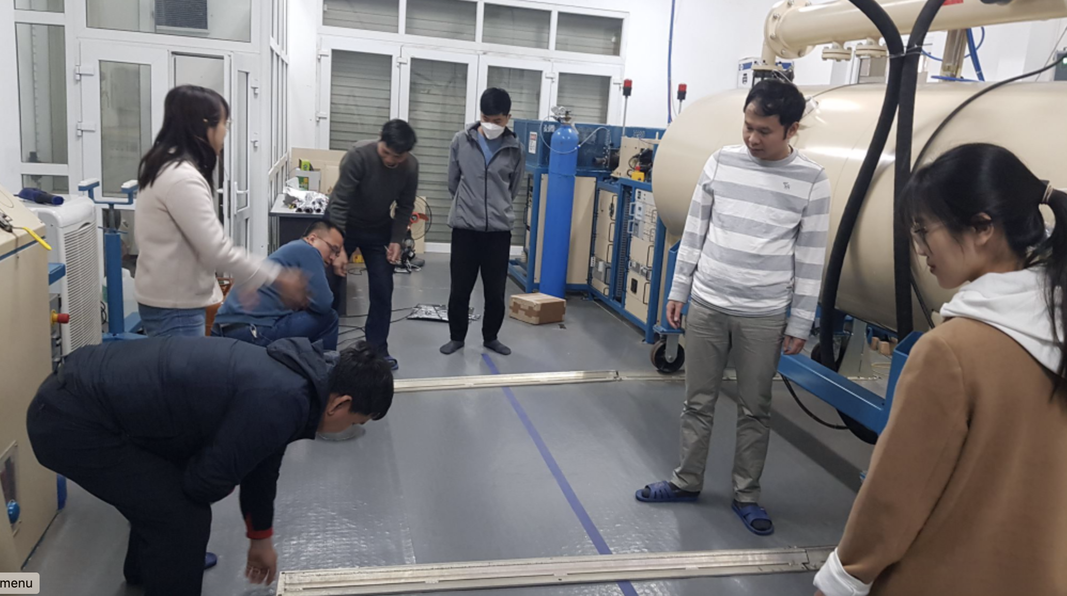
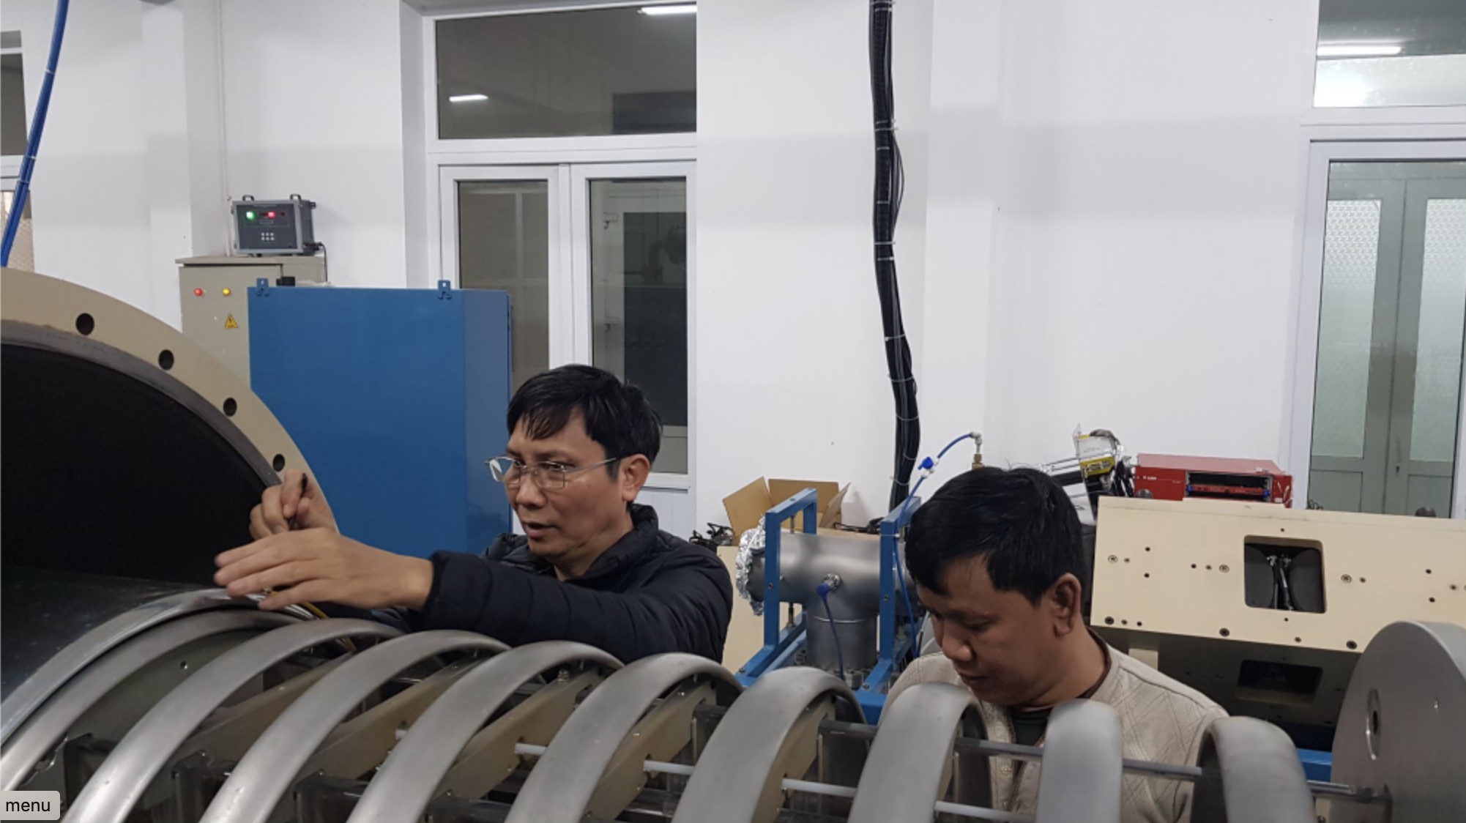
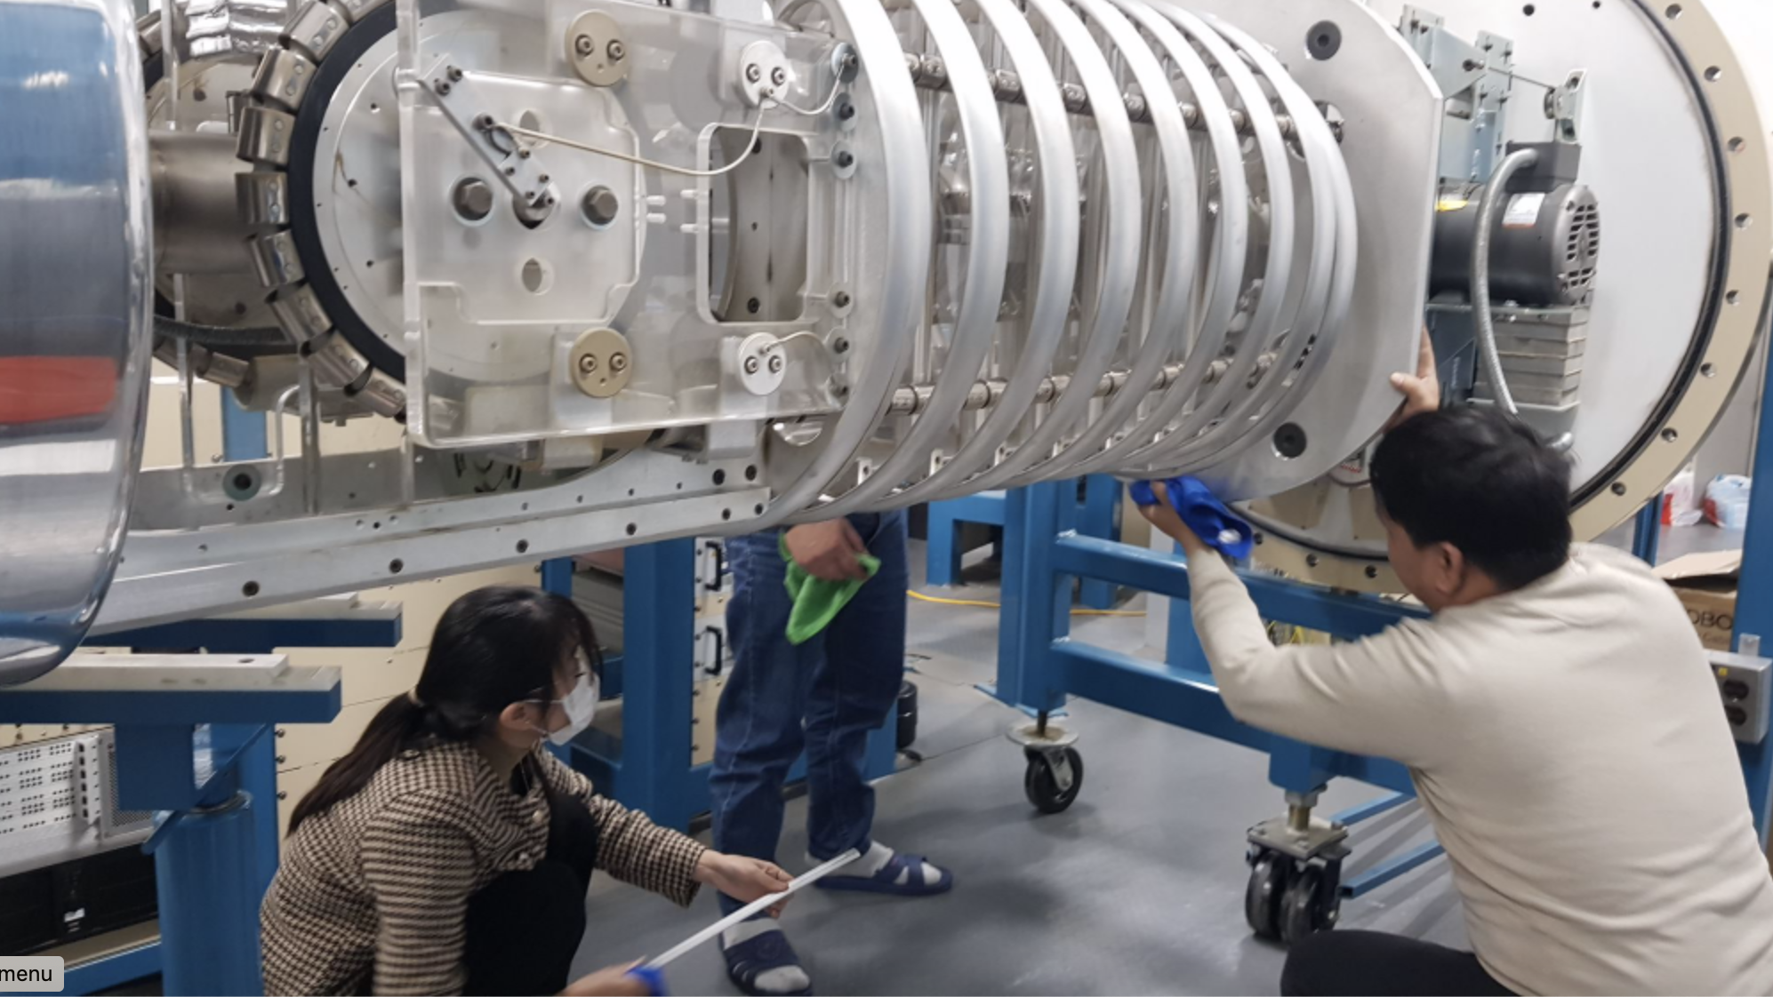
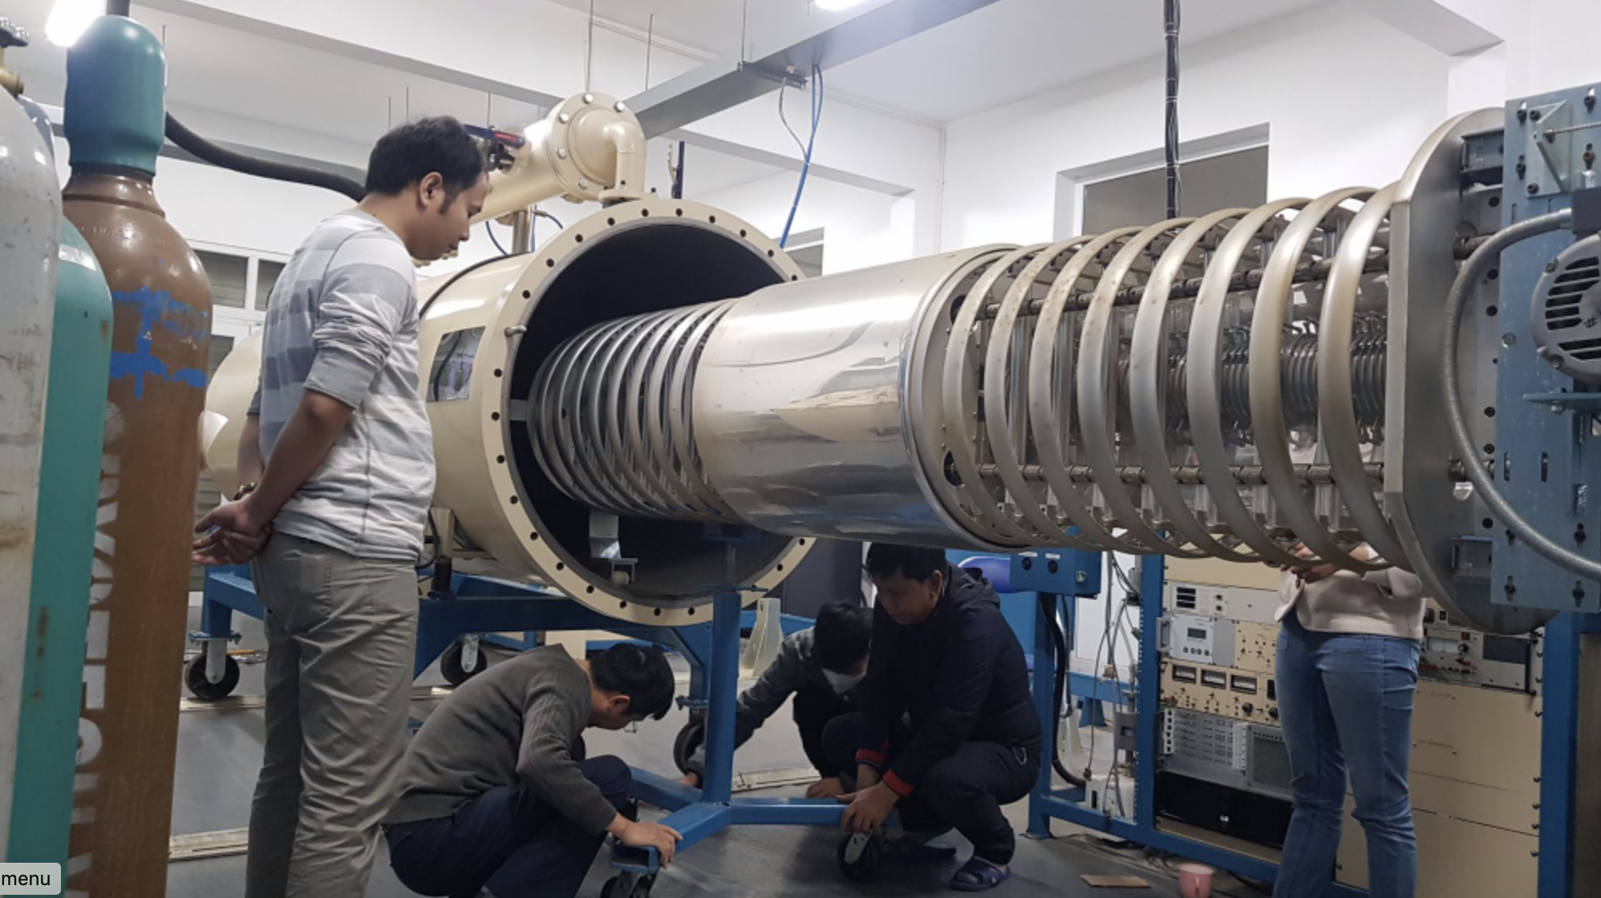
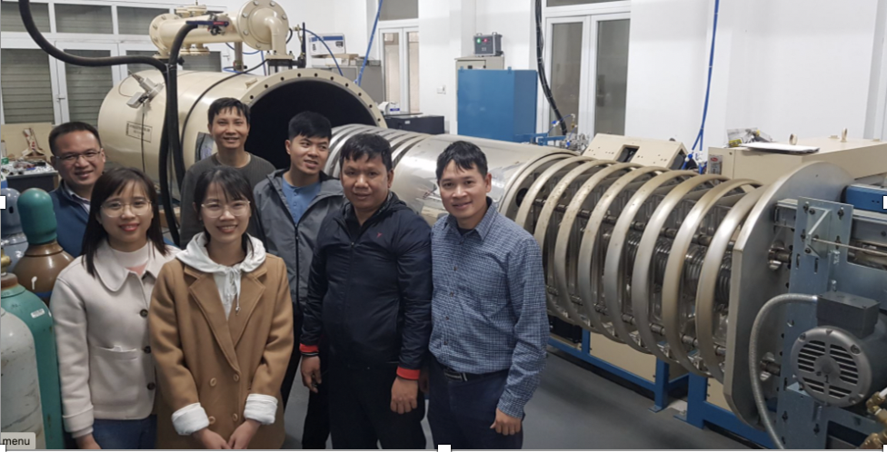
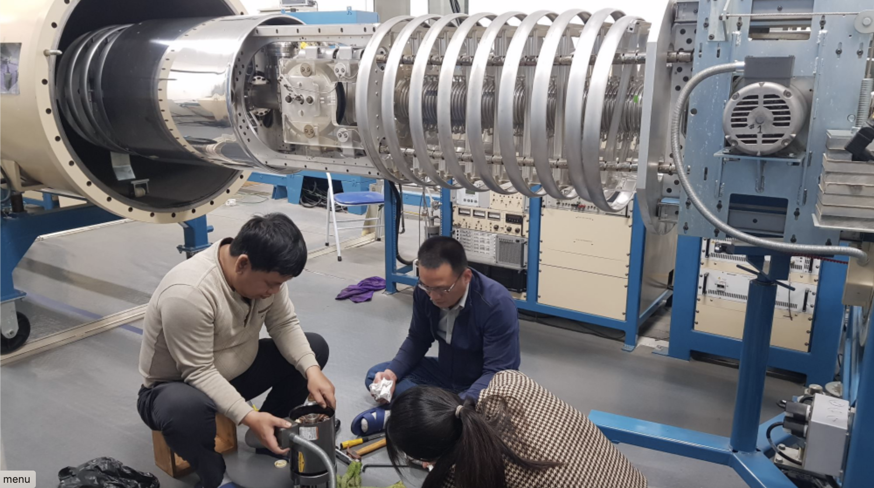
Pelletron Maintenance in 02/2023

Slide 6
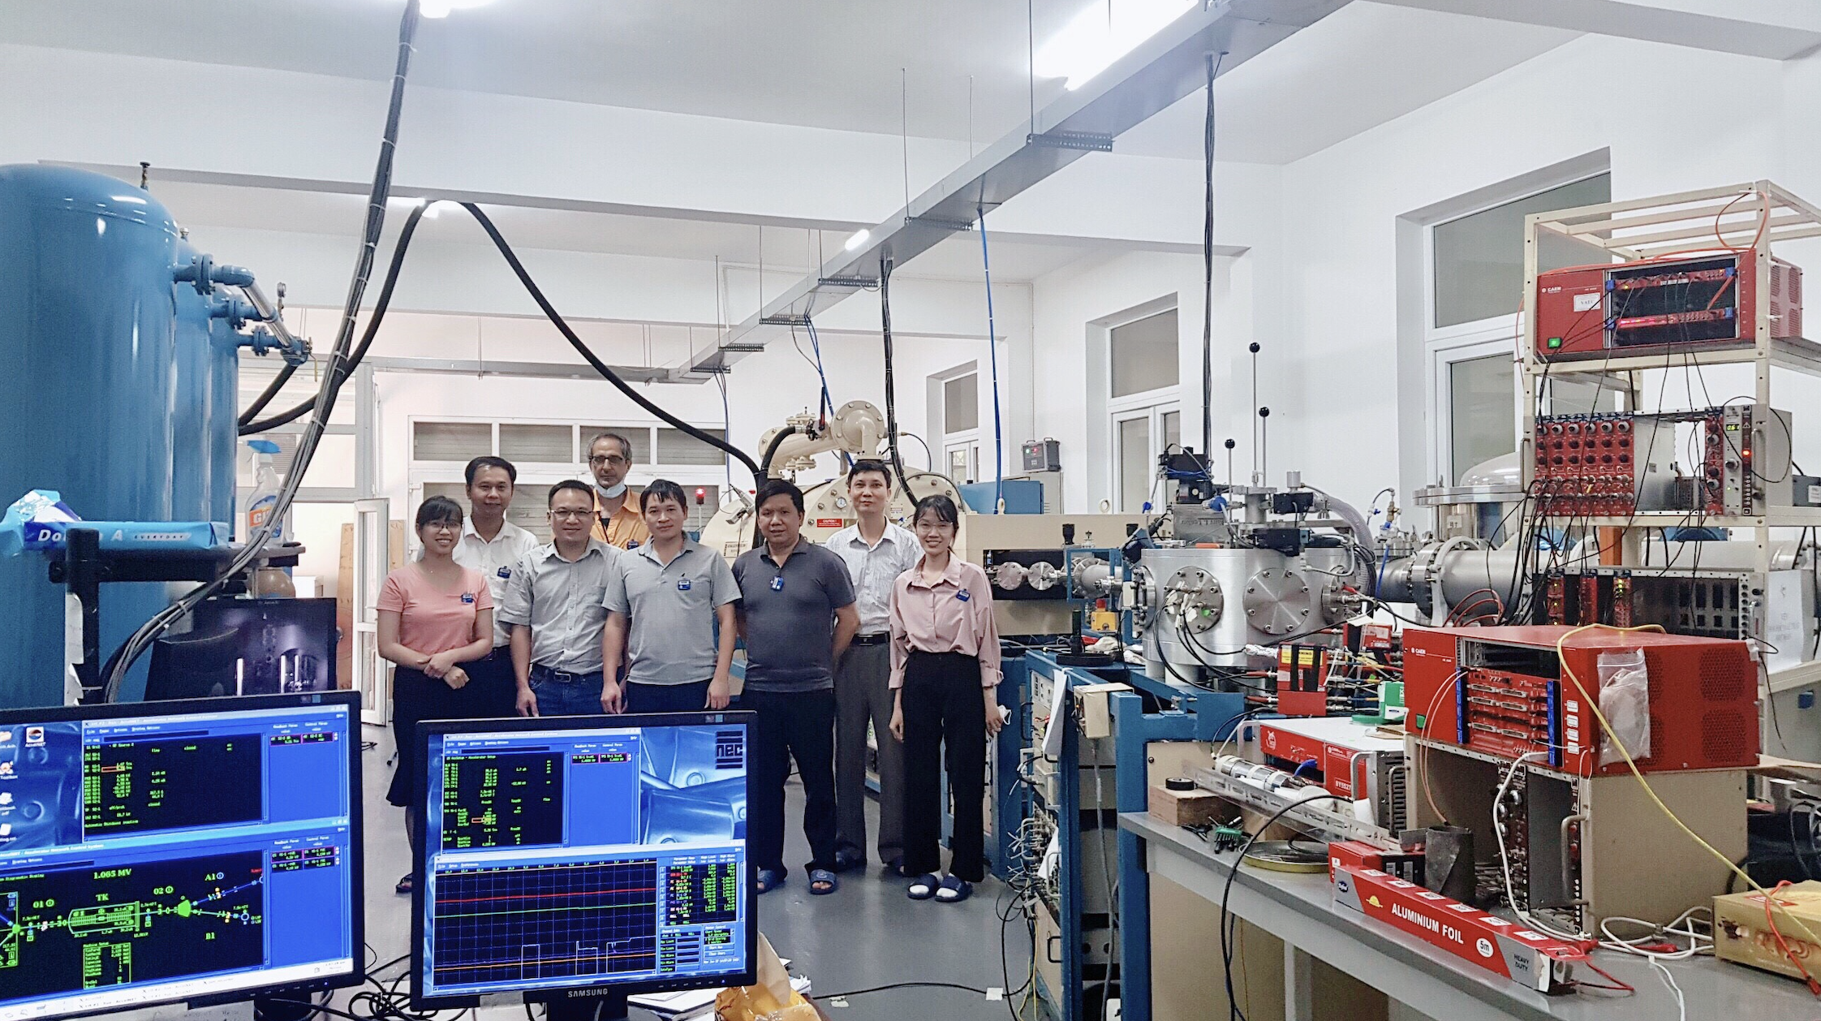
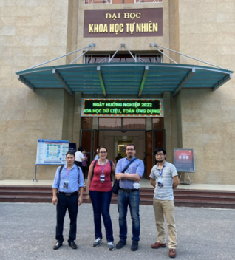
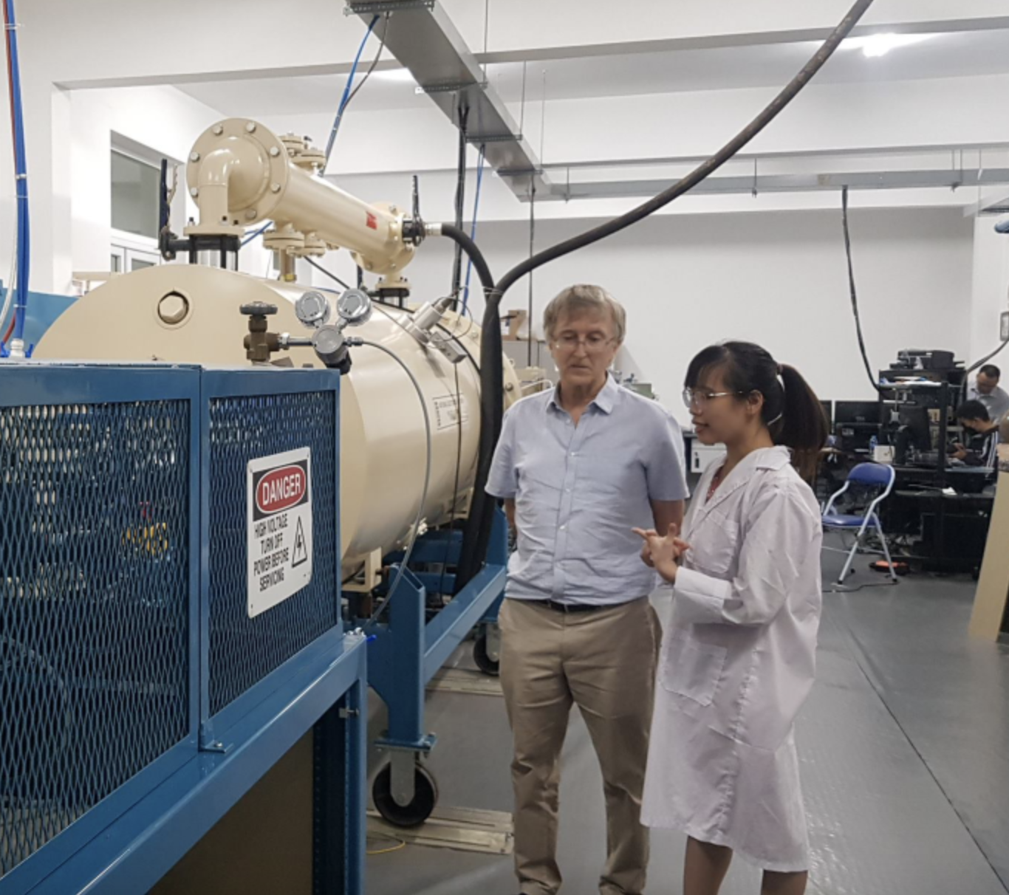
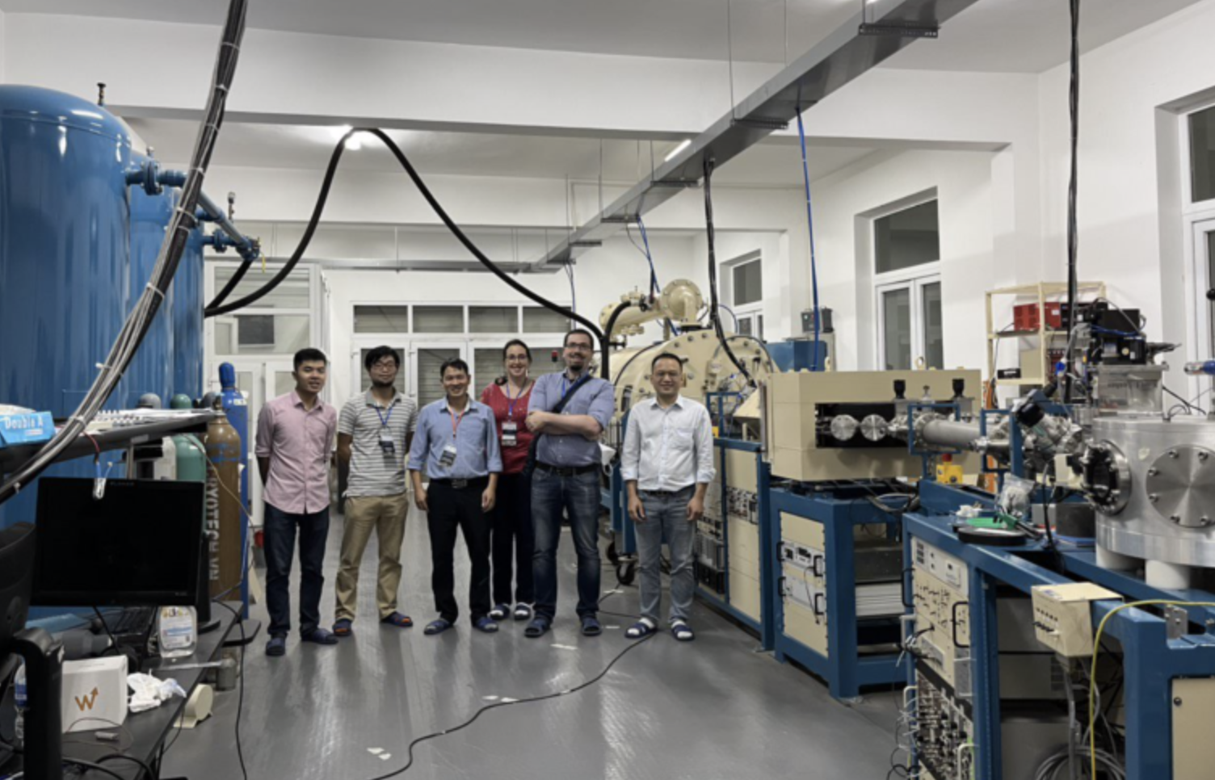









COLLABORATION

Slide 7
THANK YOU FOR YOUR ATTENTION!

