Slide 1

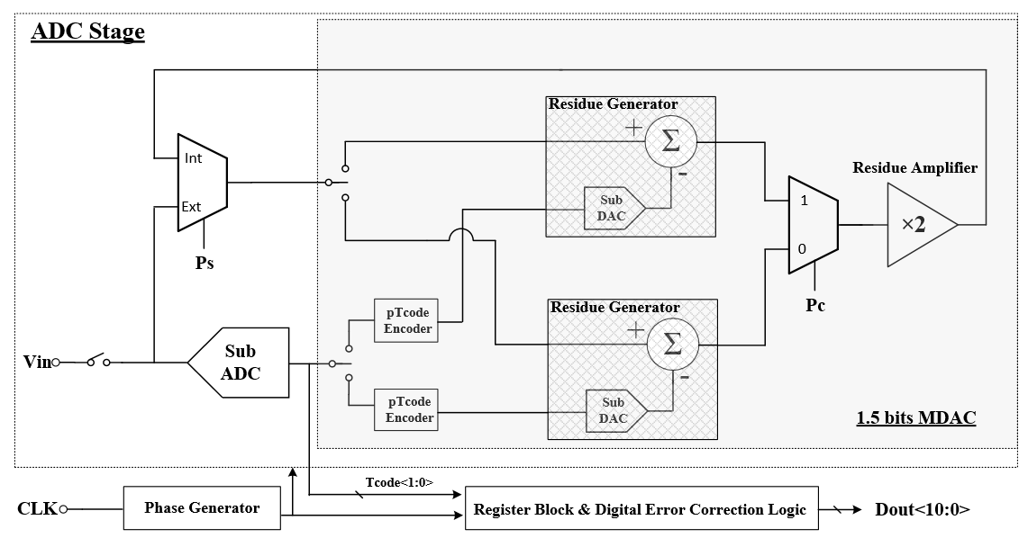
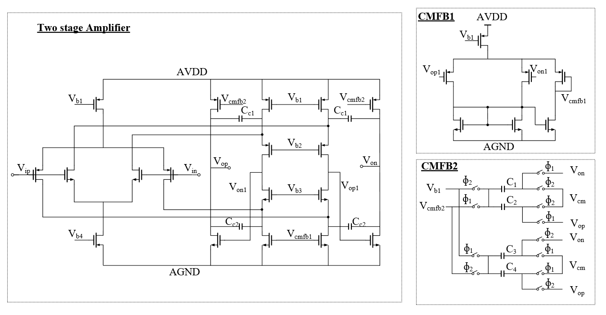
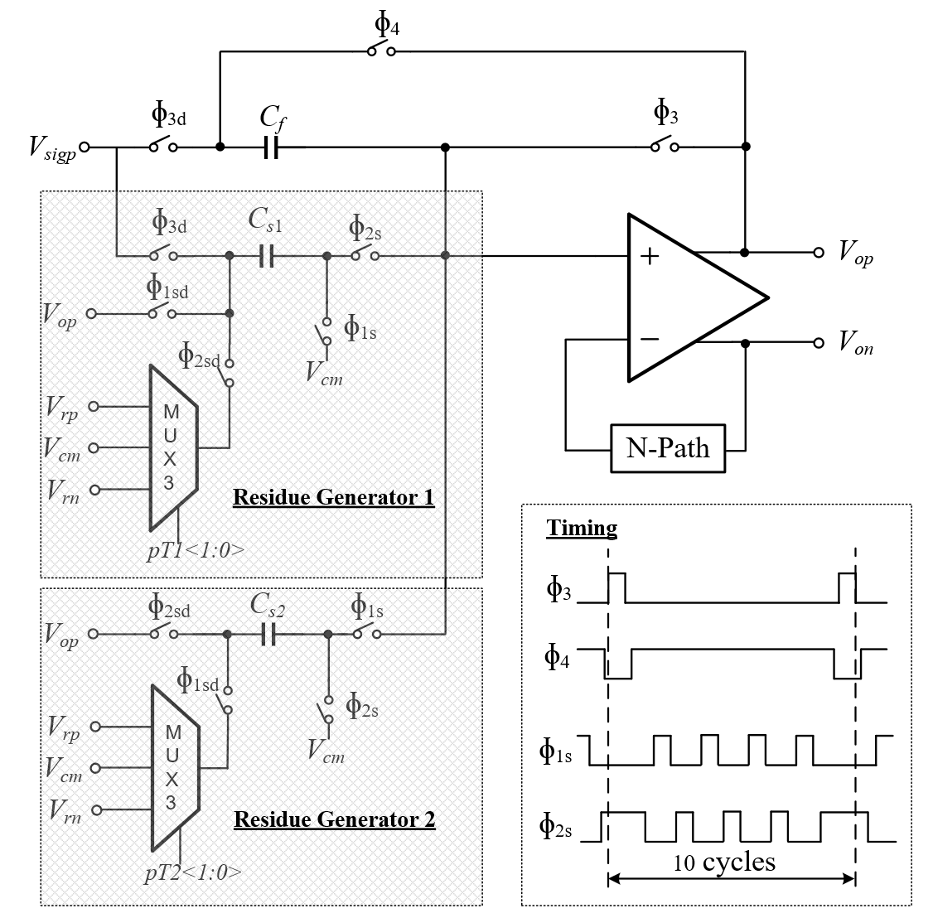

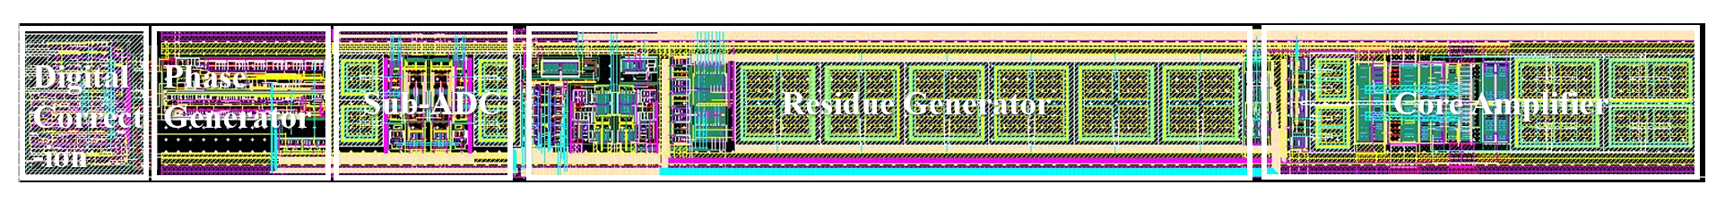

Design of a 11-bit column-parallel ADC for Monolithic Active Pixel Sensor
Weijia Han², Yongsheng Wang¹, Chengyou Xia¹, Weijia Han^{2,}, Yuhao Wen¹, Boxuan Li¹, Jiarui Wang¹, Fangfa Fu¹, Jinxiang Wang¹, Chengxin Zhao*,^{2,3}
Weijia Han
¹Department of Electronic Science and Technology, Harbin Institute of Technology, Harbin, China
²Institute of Modern Physics, Chinese Academy of Sciences, Lanzhou, China
³School of Nuclear Science and Technology, University of Chinese Academy of Sciences, Beijing, China
E-mail: chengxin.zhao@impcas.ac.cn
Introduction
The various physics and applications at the Heavy Ion Research Facility in Lanzhou (HIRFL) and the High-Intensity Heavy-ion Accelerator Facility (HIAF) require MAPS to measure particle hit's position, energy deposition, and arrival time.
An 11-bit column-parallel ADC has been designed to serve the pixels in every two adjacent columns.
This ADC uses cyclic architecture to meet the strict requirements of the area.
This ADC uses SHA-less architecture to reduce the power consumption.
A novel MDAC architecture with two residue generators is proposed to reduce the power consumption without additional area.
Overall architecture
Amplifier implementation
The simplified cyclic ADC architecture is shown in Figure 1, mainly consisting of a multiplying digital-to-analog converter (MDAC), a sub-ADC, and a digital correction circuit.
The core amplifier of the MDAC is shown in Figure 3.
This amplifier uses a two-stage structure to meet the requirements of high gain, high speed, and high output swing.
This amplifier uses two kinds of cascode compensation.
A PMOS input pair and an NMOS input pair are placed parallelly to achieve a wide input common mode range close to rail-to-rail.
Fig. 1. Architecture of proposed Cyclic ADC
MDAC implementation
As seen in Figure 2, two RG are used in the MDAC.
Allowing the amplification and sampling process to operate in the same time.
The area remains unchanged by reusing the Sampling cap as load cap.
Fig. 3. Schematic of the core amplifier
Measurement Results
The measured performance of the ADC is shown in Figure 5 and the Layout of the ADC is shown in Figure 6. The signal-to-noise and distortion ratio (SINAD) is 57.71 dB, and the effective number of bits (ENOB) is 9.3 bits. The area of the ADC is 60×670 μm².
Fig. 2. Schematic of the MDAC
Fig. 5. Spectrum for 113 kHz input sampled at 1 MS/s
Fig. 6. Layout of this column-parallel ADC

