Slide 1
Short oral ID #19:
Status and further development of the Trigger Time Event system for fusion experiment Wendelstein 7-X
J. Schacht, T. Brockmann, T. Schröder, and J. Recknagel
Max-Planck Institute for plasma physics
Greifswald, Germany

Slide 2
Outline
Introduction
Status of Wendelstein 7-X
TTE system

Slide 3
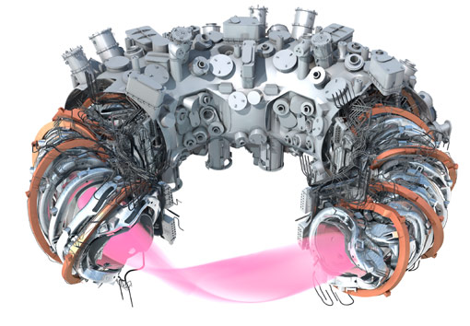
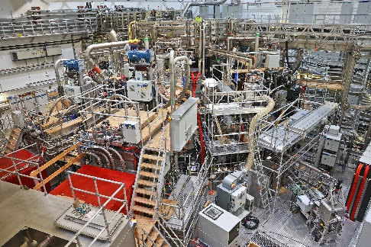
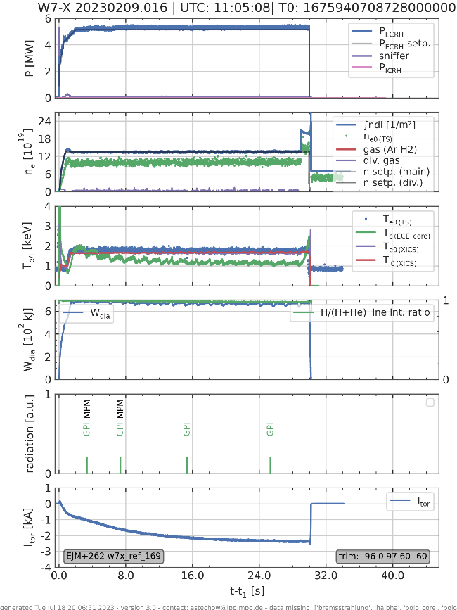
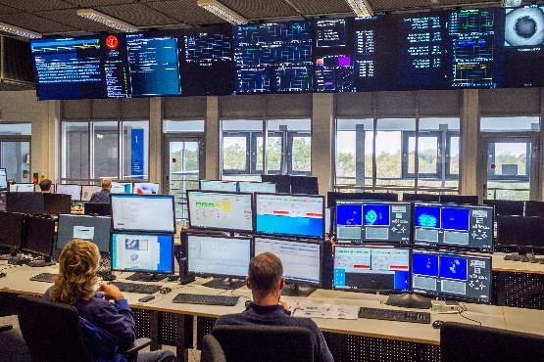
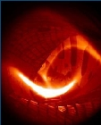
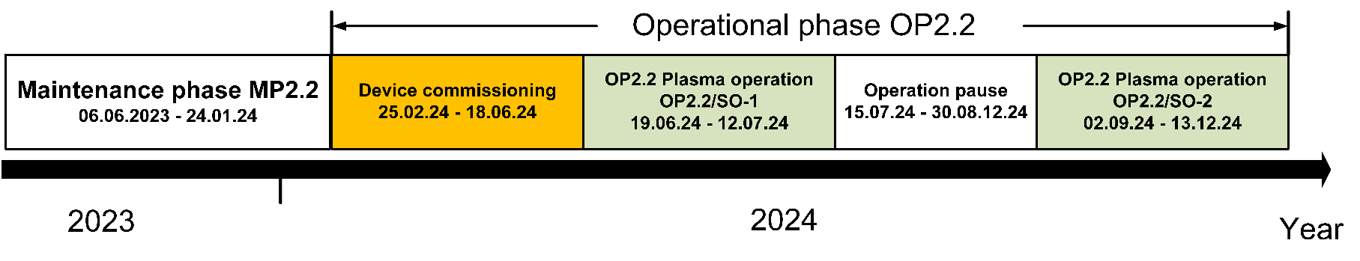
Introduction: W7-X operation status
Status of the superconducting stellarator experiment W7-X :
4 operational phases have been successfully completed, in which a total of 6,559 plasma discharges with a total plasma time of 473 min have been generated.
The next operational phase (OP2.2) will begin with scientific plasma operation in September 2024.
Commissioning of the Wendelstein 7-X facility has been underway since the beginning of 2024.
The first plasma discharge in OP2.2 will be in June 24.
The Trigger Time Event (TTE) system of W7-X as part of the CoDa system has functioned successfully during the operating phases to date.
CAD model of W7-X
View on W7-X in the torus hall
W7-X control room
Plasma discharge
High power plasma discharge in OP2.1:
(high power 5 MW / 30 s / 170 MJ)

Slide 4
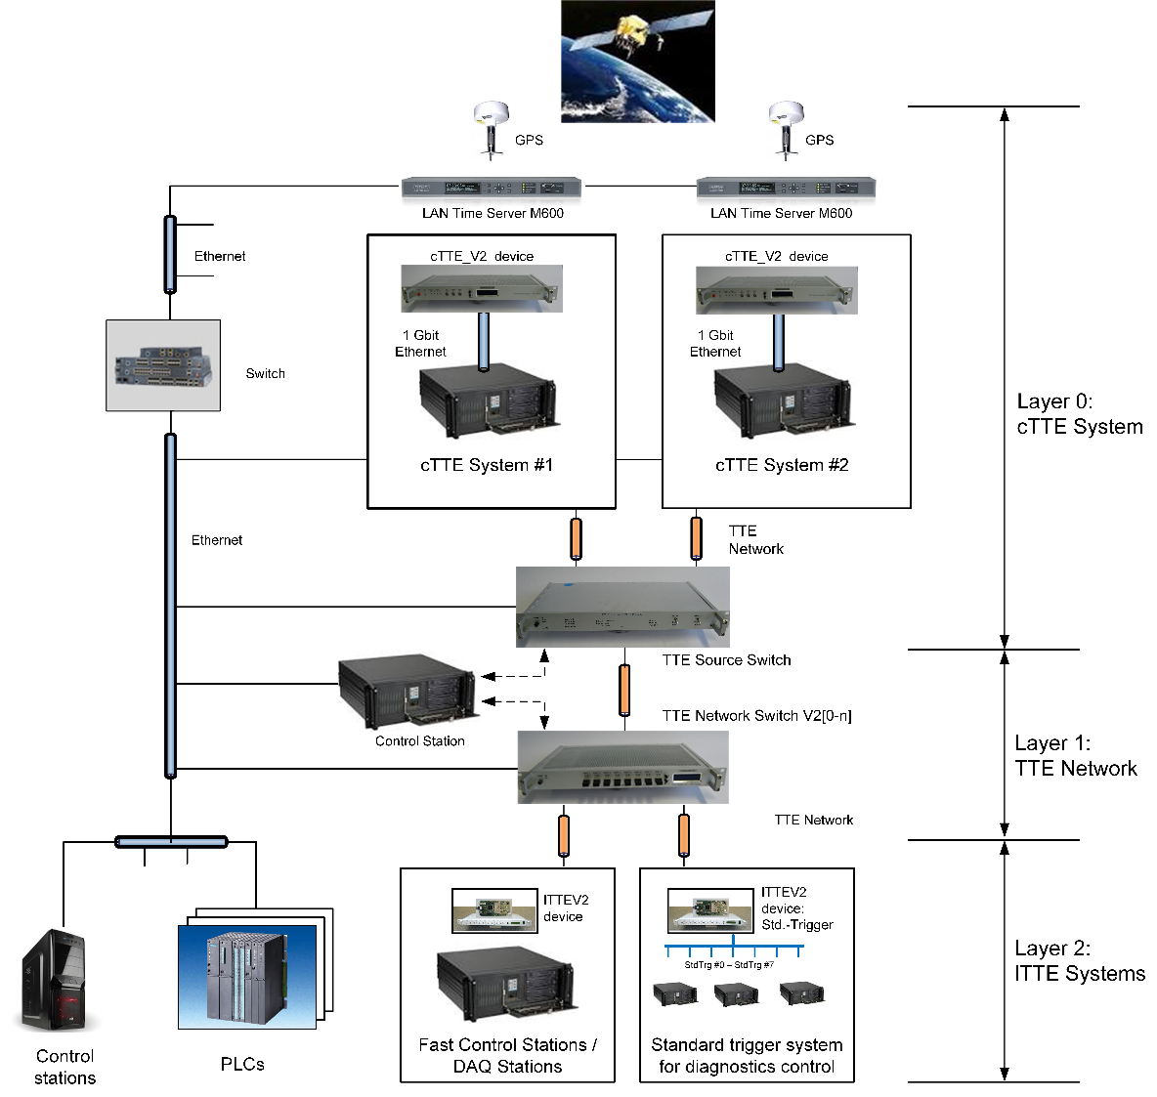
TTE system functions
Functions of the TTE system:
Generation of a global time for all CoDa components of W7-X,
Synchronization of all local time counters of the lTTE systems of the technical components and diagnostics,
Providing event messages processing and standard trigger signals,
Providing time and trigger related functions like:
  Time capturing,
  Pulse sequence generation,
  Time delays,
  Impulse counter,
  Event message / trigger signal processing.
TTE system architecture

Slide 5
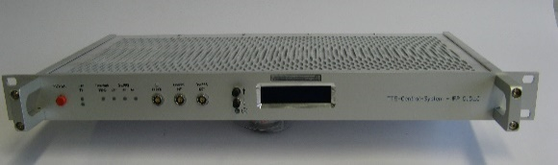
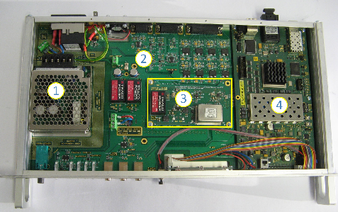
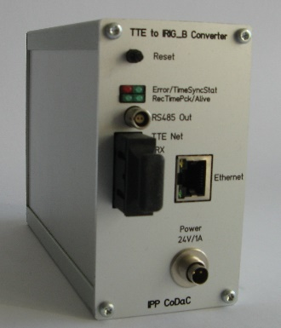
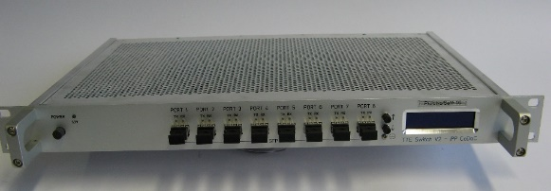
TTE system modifications / updates
Development of a new cTTE_V2 device:
  Based on lTTEV2 FPGA card,
  1 Gbit/s Ethernet interface,
  Oven stabilized controllable oscillator,
  Bidirectional optical network TTE network interface:
    Send synchronization and time information,
    Send / receive event messages,
  Transmission delay measurement mode,
Update FPGA configuration of lTTE_V2 device:
  Bug fixing,
  New pulse sequence generator device,
TTE network switch device:
  8 uplink ports,
  1 downlink port,
IRIG-B converter device:
  Conversion of cTTE time information into an IRIG-B signal for synchronization of DAQ electronics.
cTTEV2 device: front view.
cTTEV2 device: top view.
TTE network switch device.
IRIG-B converter device.

Slide 6
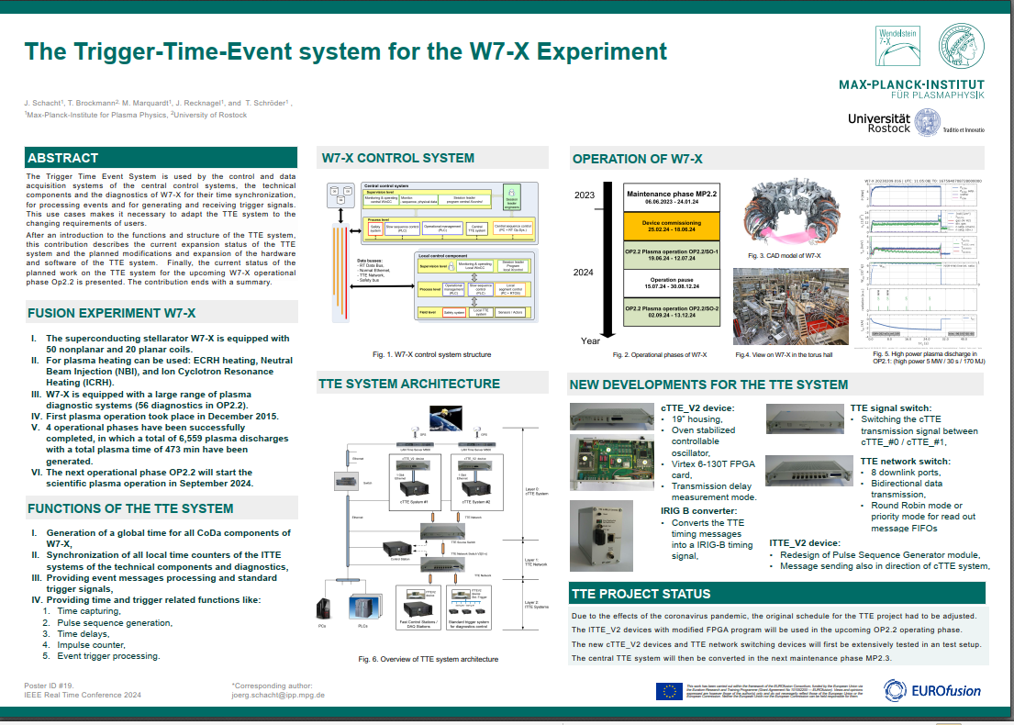
Business model for the control system of a fusion experiment
W7-X control system overview
Thanks for attention!
Please contact me during the poster session!
Poster session, Poster ID #19

