Slide 1


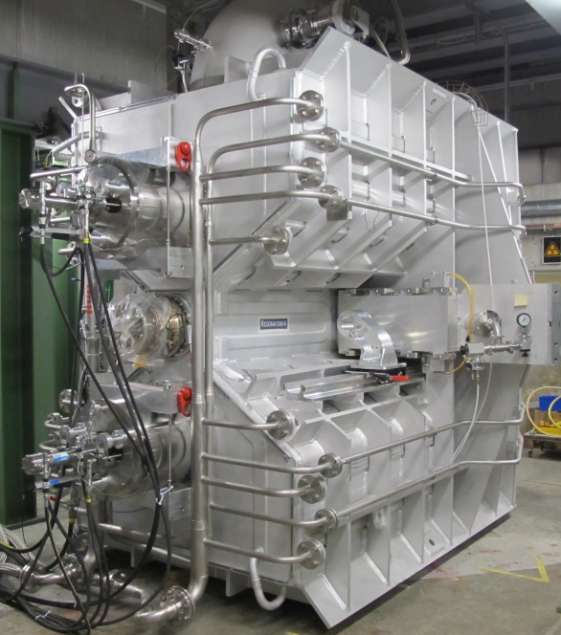
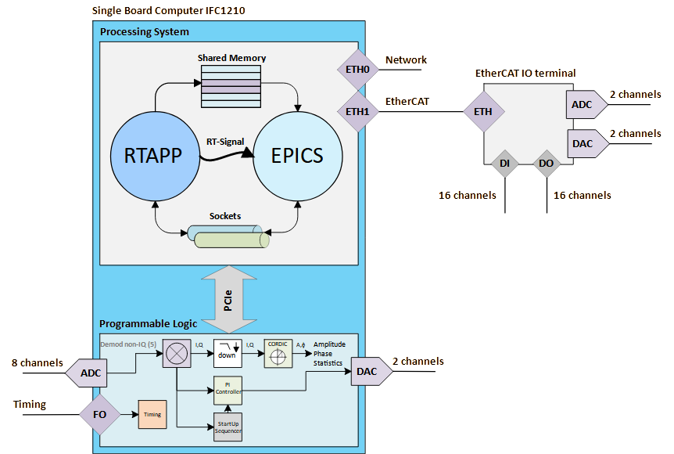
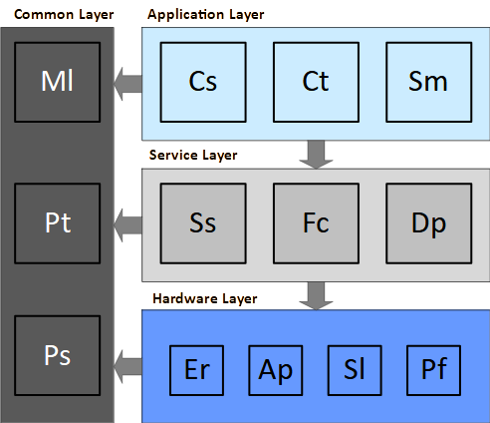
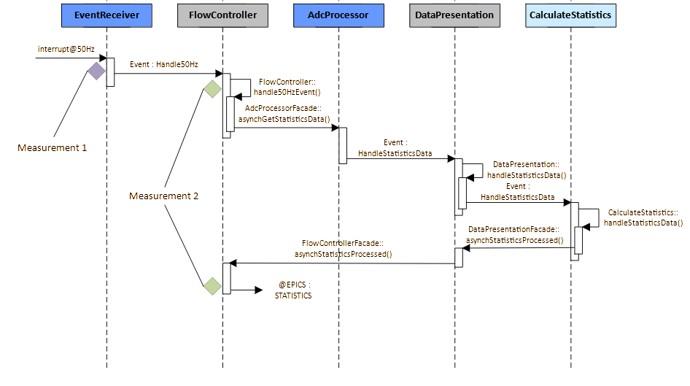
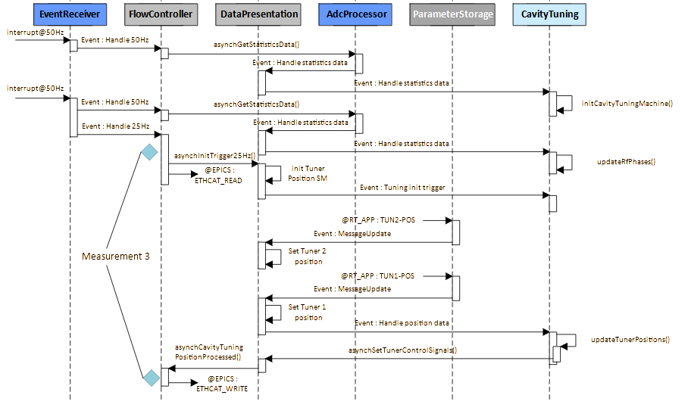
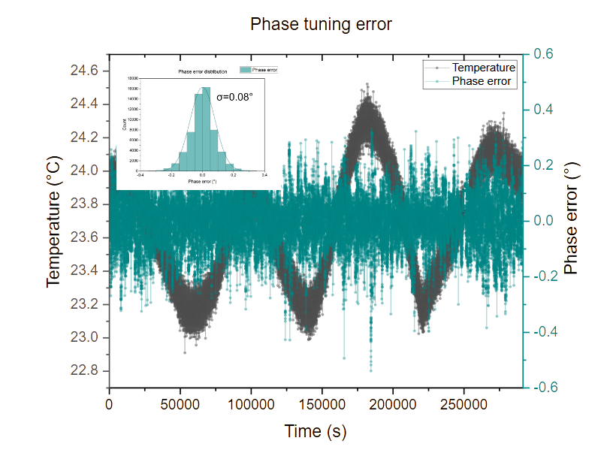
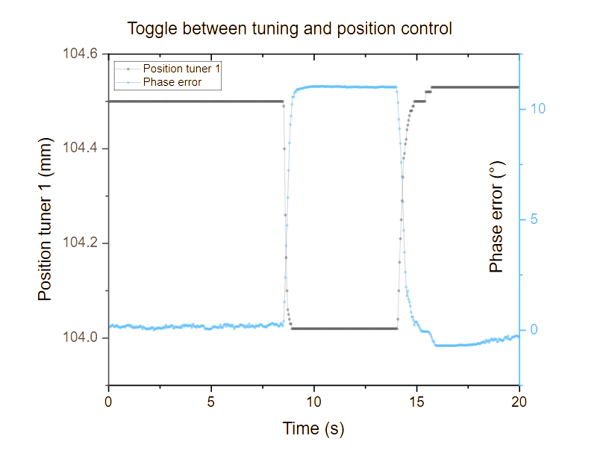
24th IEEE Real Time Conference – ICISE Quy Nhon, Vietnam
22-26 April 2024, Poster ID : 183
The HIPA radio frequency control system application
Mario Jurčević¹, Karina Ambrosch¹, Benoit Stef¹
¹ Paul-Scherrer-Institute (PSI), Center for Accelerator Science and Engineering (CAS), CH-5232 Villigen PSI, Switzerland
E-Mail: mario.jurcevic@psi.ch, karina.ambrosch@psi.ch, benoit.stef@psi.ch
Abstract
For the upgrade of the High Intensity Proton Accelerator at PSI of injector cavities 2 and 4, a new digital radio frequency control system was developed using the IFC 1210 VME board. This system comprises three components: A single-board computer running the control system software and the real- time application, both running on a dual core P2020 PowerPC, as well as the FPGA Design utilizing a Virtex 6. The real-time application (RTAPP) covers three use cases: "Cavity Tuning”, “Startup FSM”, and “Calculate Statistics”. “Cavity Tuning” implements the controller for the cavity’s tuning system, which consists of two controllers. One controls the physical position of the two tuners within the cavity, and the other one provides the setpoint for the tuner controller and controls on the phase error between forward power and cavity pickup, ensuring minimum reflected power during operation. The “Startup FSM” governs the radio frequency control system during the startup procedure. Here, the cavity must overcome the multipactoring zone while minimizing reflected power and without overstressing the amplifiers. Finally, “Calculate Statistics” performs computations on measurement data from high resolution ADC RAW values, reducing the data load before forwarding them to the control system. The software design is split into four layers: Common, hardware, service and application layer. These layers cover 13 different components which are each assigned a dedicated thread. The update frequency of the components varies between 25 and 50Hz, real-time behavior is given if a deadline of 20ms or 40ms respectively can be guaranteed.
Introduction and Requirements
Digital radio frequency control systems (also called Low Level Radio Frequency = LLRF systems) control the RF field in accelerating cavities. The objective of the present application is to operate a tuning feedback at 25Hz repetition rate and at the same time calculate signal statistics of down sampled data at 50 and 25Hz. In addition, an automated start-up procedure has been implemented to switch on the cavity.
Cavity characteristics:
Built from pure aluminum
Resonance : 50.6328MHz
Quality factor Q ~ 25’000
Dissipated power 45kW@ 400kV
Operation at 60kW
Vacuum pressure 1e-6mbar
Water flow 15m³/h
Tuning range ~ 200kHz
Weight 7.6t , Volume 55m³
Requirements briefly summarized:
Sample 8 ADC channels, demodulate, down sample signal and calculate signal statistics at 50 and 25Hz
Implement scope recorder functionality triggered by threshold value
Tuning feedback operation at 25Hz with exception and fault handling
Implement operation modes: valve, position and phase controlled (phase tuning)
Amplitude and Phase feedback operation at 8MHz (FPGA)
Start-Up procedure to bring up the high-power RF without too big reflections
Figure 1: Overview of the entire RF system consisting of accelerating cavity, amplifiers, couplers, analog pre-processing units, interlock unit, temperature measurement unit, hydraulic tuning system and the two tuners. Particularly noteworthy is the dark blue tuning controller, which is in the lower left-hand corner of the figure. Control signals are sent to the hydraulic tuning system via the EtherCAT bus. Currently the cavity tuning feedback runs at 25Hz. Because the bandwidth of the hydro-mechanical system is around 3Hz. A faster control loop would not improve the control quality. Rule of thumb is to sample with ten times the plant bandwidth. Measurements on the system also showed that it was sufficient.
Figure 2: As part of the HIPA upgrade the installed 150MHz 3rd harmonic cavity will be replaced with a 50 MHz cavity. In further steps all the remaining three cavities of injector 2 will be replaced. The picture shows the 50 MHz accelerating cavity with hydraulic tuners. The whole cavity was built entirely from aluminum. Ideally copper is used due to better conductivity. But the cost of producing such cavities is much higher.
Architecture and Implementation
RTAPP characteristics:
Layered architecture
Layer contains components
Every component is an actor, implementation of the actor model
Event-driven interaction
Client server principle
Component interfaces abstract event generation and reception
Every component can have reactive and proactive interfaces
Our approach was to divide the LLRF system into two parts: the processing system and a programmable logic. The main task of the processing system is to provide the control interface for the entire RF station and in particular for the cavity. It also provides measurement and control of cavity signals via EtherCAT bus and provides this data to clients via EPICS. The programmable logic (implemented in FPGA) has to perform signal pre-processing such as IQ-demodulation, down sampling and coordinate system transformation. It must also stabilize the amplitude and phase of the cavity signals using PI control.
Er : EventReceiver
Ap : AdcProcessor
Sl : StartUpLogic
Pf : ParameterForwarding
Ss : SystemService
Fc : FlowController
Dp : DataPresentation
Cs : CalculateStatistics
Ct : CavityTuning
Sm : StartUpFsm
Ml : MessageLogger
Ps : ParameterStorage
Pt : ParameterTransmission
Hardware/Software briefly summarized:
Single board computer from IOxOS IFC1210
FMC-ADC3110 and FMC-DAC3114 @253MHz
Linux with PREEMPT_RT patch running on PPC P2020
EPICS is the control interface and EtherCAT master
EtherCAT master stack from IgH
Beckhoff EtherCAT IO terminal
Application logic and time critical tasks in the RTAPP
Programmable Logic (FPGA) for signal processing
Figure 4: The RTAPP is a strictly layered architecture. Responsibilities were divided into four layers, hardware abstraction, service, common and application layer. Every layer includes components with specific responsibilities that are consistent with the layer's abstraction level. The component dependencies are organized so that they always point downwards. From higher to lower (or same) levels of abstraction. The common layer can be used by all other layers.
Figure 3: Shows the two relevant processes and the IPC mechanisms for event and data exchange. Three different mechanisms are in use: Shared Memory to move the big data blocks like waveforms, Unix domain sockets for application settings and data forwarded to the EtherCAT bus like the tuner control signal and RT-Signals to trigger shared memory access of EPICS.
Measurements and Results
Tuning
Position
Tuning
Figure 7: Long-term behavior of the phase tuning error over approximately three days.
Figure 8: Phase error when transitioning between two operating states. A smooth transition is crucial for operations.
Figure 5: Sequence diagram of use case: calculate statistics. Measurement 1 determines how periodically the interrupt is received. Measurement 2 records the execution time for statistical calculations across all channels.
Conclusion
Figure 6: Sequence diagram of use case: cavity tuning. Measurement 3 determines the time required to handle the tuner positions, feedback controller and set new control signals.
All requirements have been met with this design. The test run has shown stable and smooth operation over several days. The Measurement 2 shows that the statistics are calculated after 4.4ms. This is done every 20ms, so there is a large time margin. Measurement 3 shows that cavity tuning takes 0.79ms and this is performed every 40ms. There is also a significant time reserve. The communication overhead resulting from the implementation of the actor model can be ignored.
Measurement | Average [μs] | Standard Deviation [μs] | min [μs] | max [μs] | # of events
1 | 20013 | 37.15 | 5017 | 29888 | 50000
2 | 4441.8 | 627.41 | 3759 | 6354 | 200000
Measurement | Average [μs] | Standard Deviation [μs] | min [μs] | max [μs] | # of events
3 | 790.21 | 100.6 | 714 | 6219 | 160000

Slide 2
Grundfarben PSI
Wahlfarben Grafiken: 1. Wahl
Wahlfarben Grafiken: 2. Wahl

